Slide 1


Beyond Capacity – Let’s Go Global
Bram Peeters, Mian Usman
CNOO, Lead Network Evolution - GÉANT
TNC 2024, Rennes
11th of June 2024
Public

Slide 2
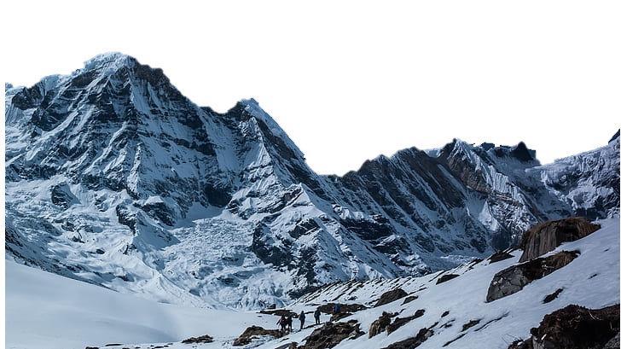
Networking – Capacity!
Now we’re really there!
Ehhh…
Now we’re there!
We’re there!

Slide 3
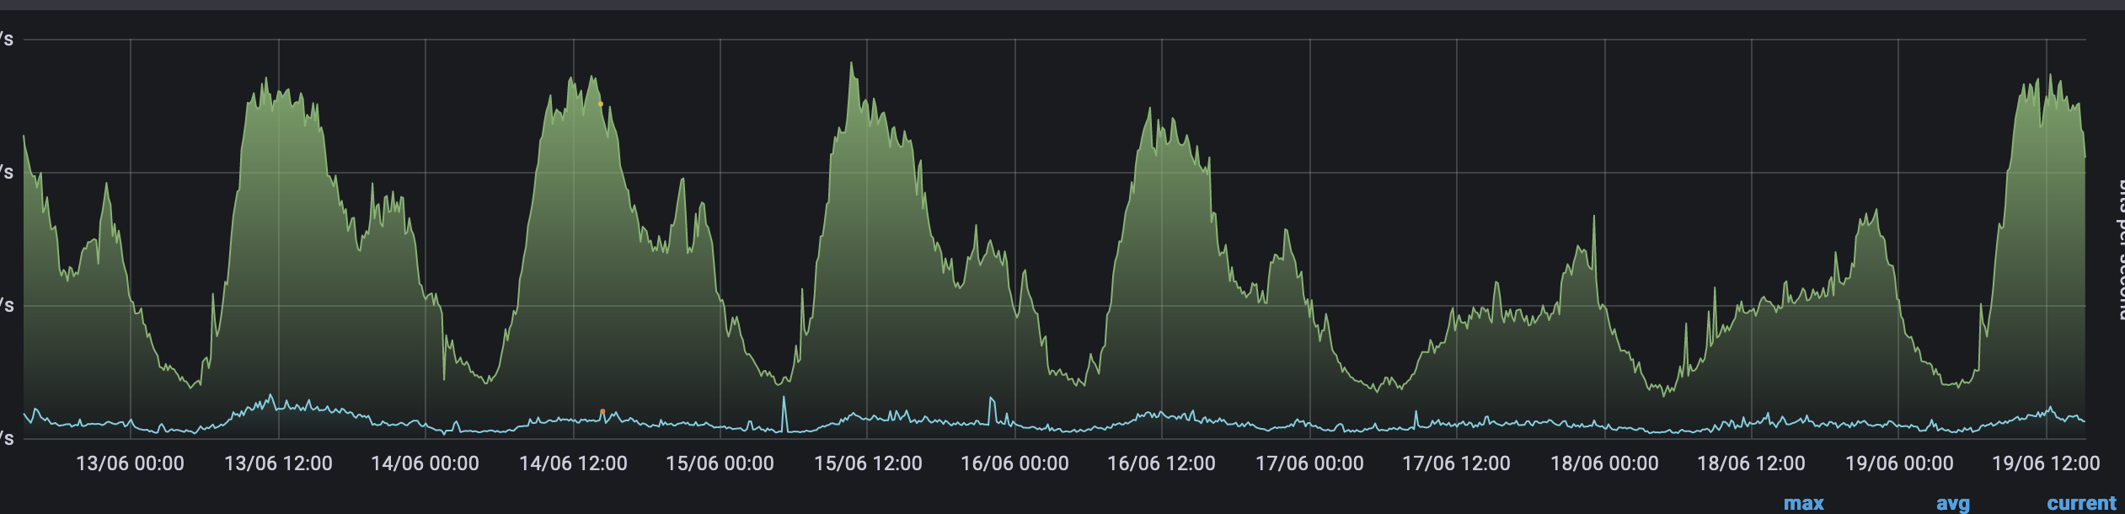
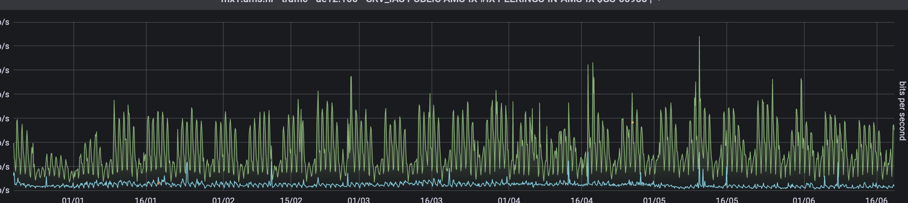
The Challenge:
Traffic
7 days of an LHC link
7 days of an Internet exchange link
6 month of an IX link
6 months of an LHC link
Notes:
Bursty and unpredictable, we want to overprovision and know there is quick and easy access to more capacity.

Slide 4
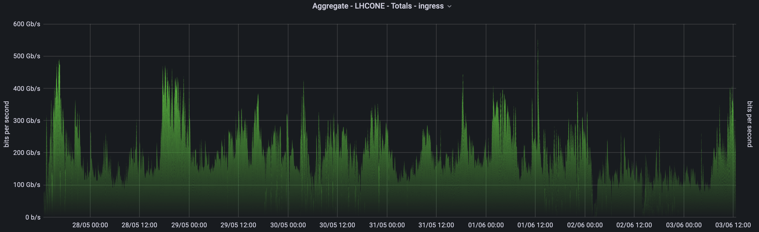
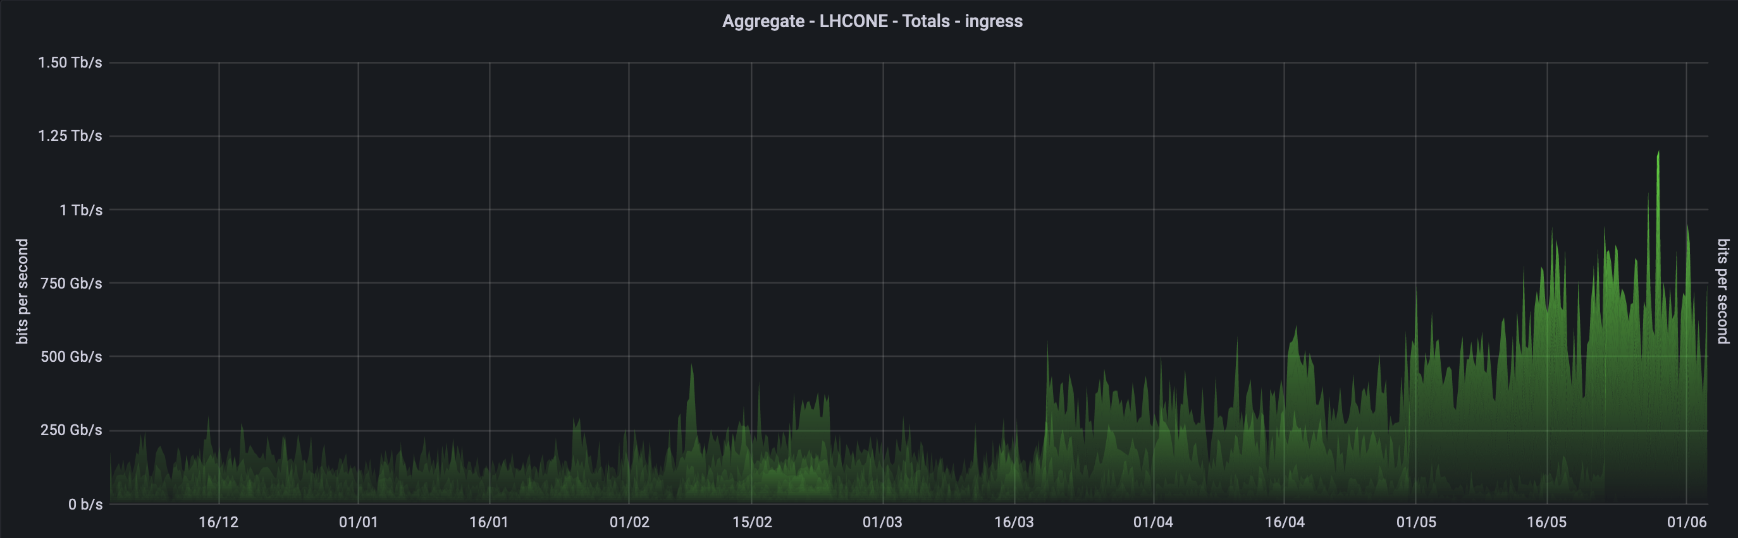
A Harder Challenge:
Science Traffic
7 days of LHC traffic
6 months of LHC traffic
Notes:
Bursty and unpredictable, we want to overprovision and know there is quick and easy access to more capacity.

Slide 5
The Standard Network Challenge: Traffic Growth
Total Backbone Trunk Capacity
Jan 2019 : 2.7 Tbps
Dec 2022 : 11.2 Tbps
Petabytes
YoY change in traffic in %
Long-term Growth: 30%
5
5
Notes:
In practice this is what it looks like – you need to look at 10 times growth over 10 years…
(on GÉANT largely driven by scientific instruments)
2015–2019: Traffic growth of 40% YoY
2015–2022: Traffic growth of 27% YoY

Slide 6
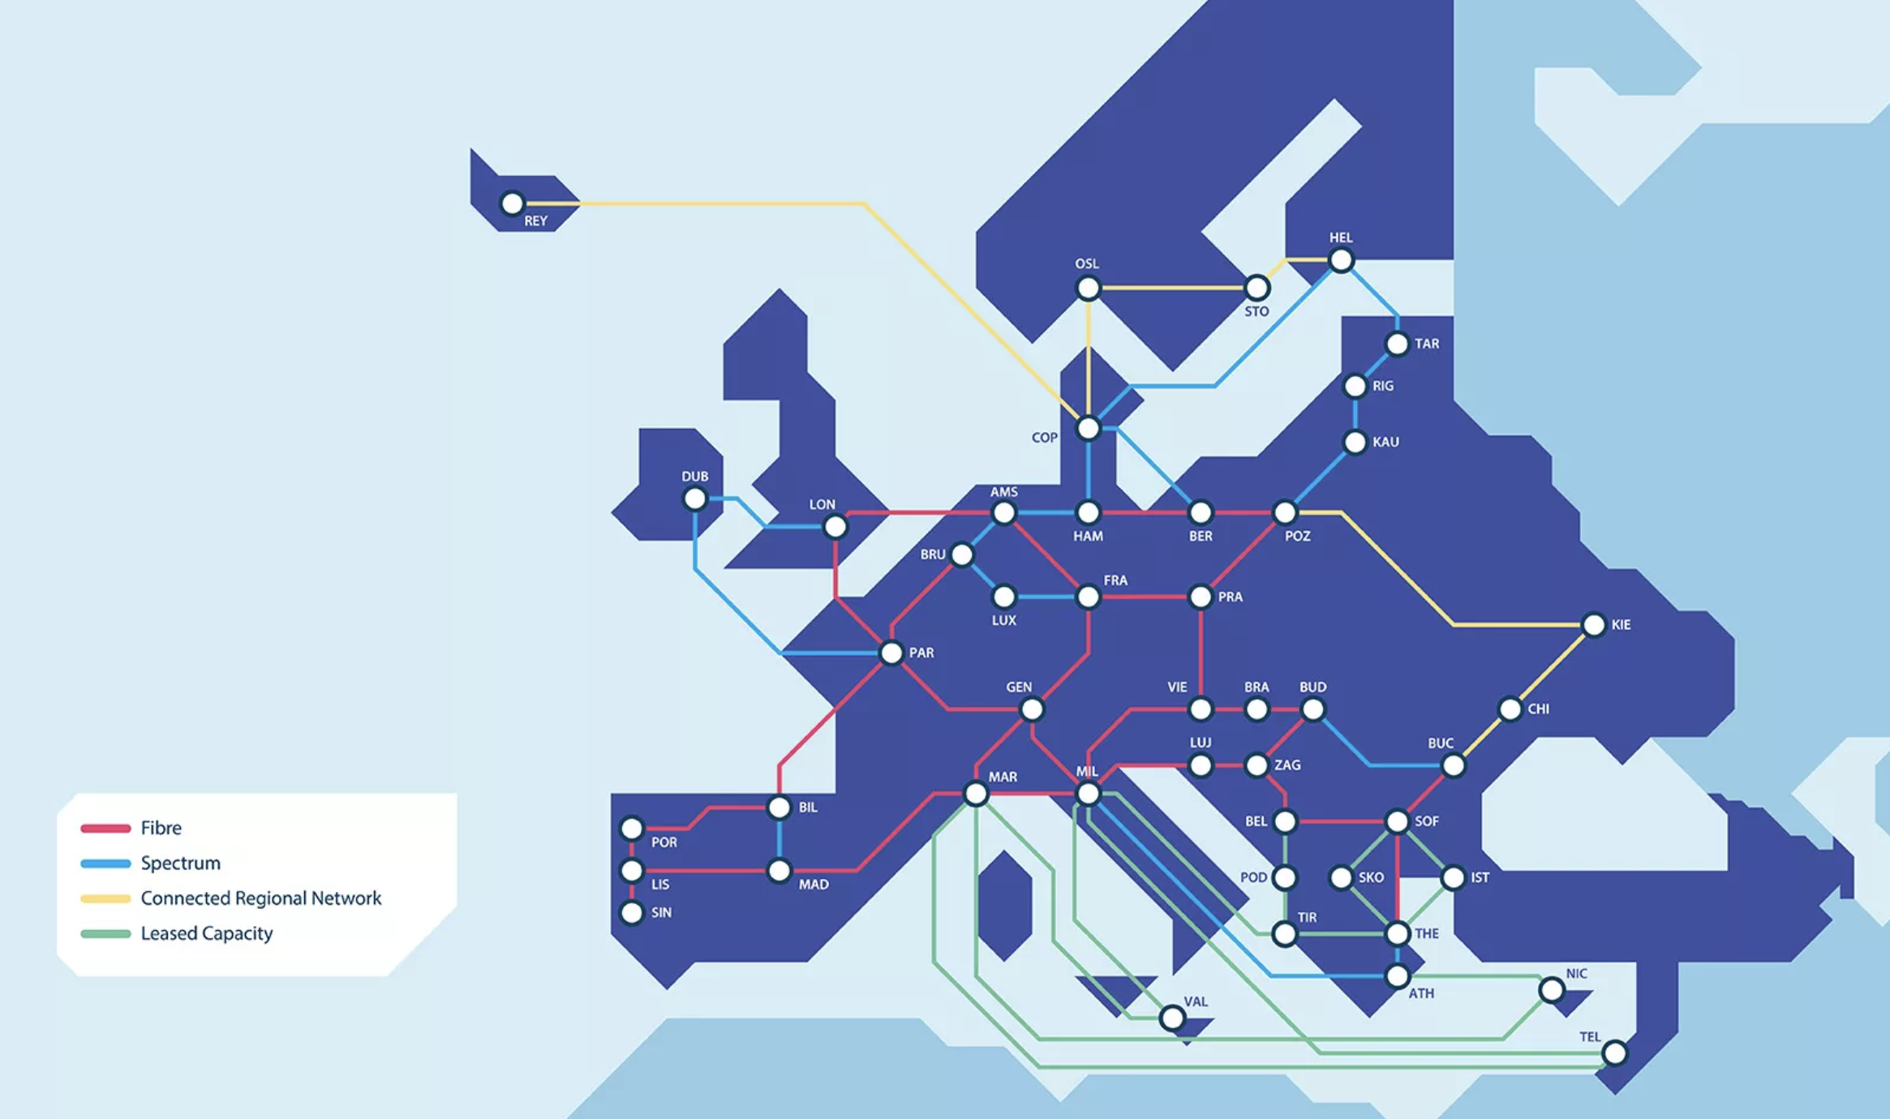
Long Term Approach:
Invest in Infrastructure
2019 – 2023 projects:
  European footprint
  EC-funded investment
  50 million project
Result: the new GÉANT network
  Fiber and spectrum
  32 + 5 countries
  Long term control
Notes:
So you do these kinds of projects
Control = technology
Control = cost

Slide 7
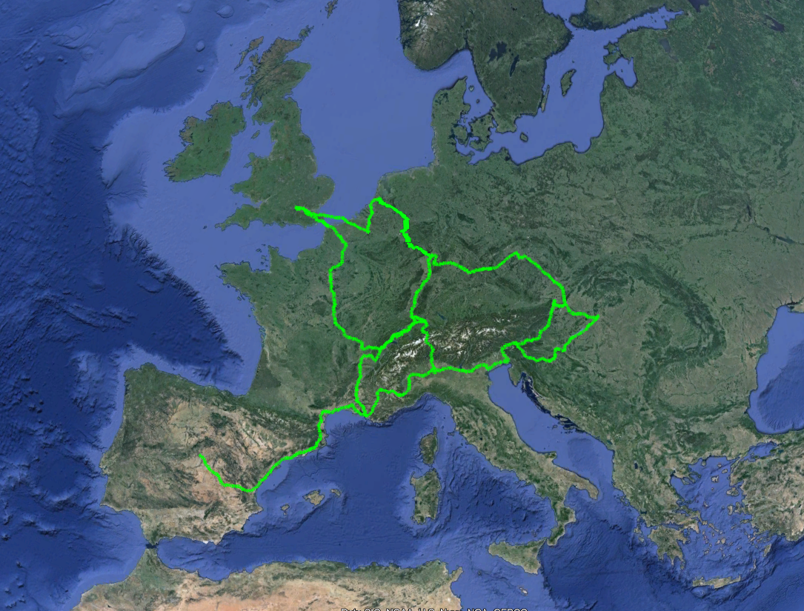
Before:
Fibre
Short Term Contracts

Slide 8
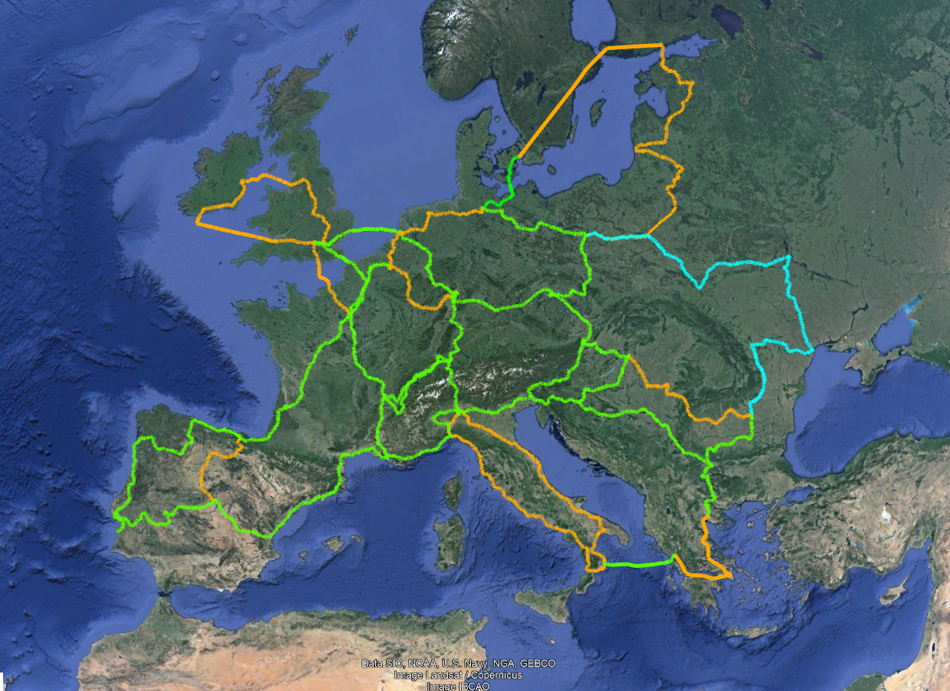
Now
Fibre and Spectrum
Short Term Contracts
Together with NRENs:
  A truly European-wide reach for services
  Capacity in Europe is no longer a real challenge
Notes:
AL, AT, BE, BG, HR, CY, CZ, DE, DK, EE => 10
FI, FR, DE, GR, HU, IE, IT, LV, LT, LU => 10
MT, ME, NL, MK, PL, PT, RO, SB, SK, SI => 10
ES, SE, CH, TK, UK => 35

Slide 9
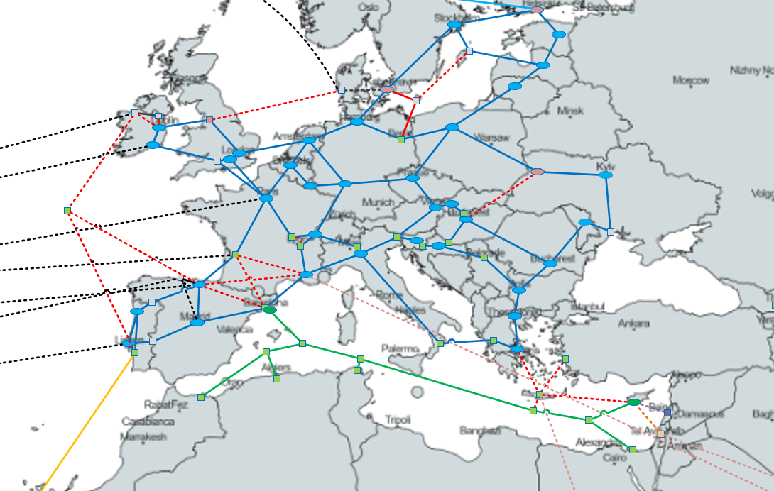
After the Project: Improvements and Opportunities
Connectivity Optimisations and Opportunities:
  Resiliency inside Europe
  Transatlantic links
  Mediterranean connections
  Eastward connections
  Gateways
9

Slide 10
An Opportunity: GN5-IC1 (International Connectivity) Project
3 years GÉANT project - €15M funding
Two Main Objectives:
Objective 1: Procure connectivity to at least 2 world regions
Objective 2: Create intercontinental connectivity investment plan
Notes:
1st dedicated EU-funded project for intercontinental connectivity
Part of 7-year GN5 FPA under Horizon Europe
€15M – 3 years (start 1 Dec 2022)

Slide 11
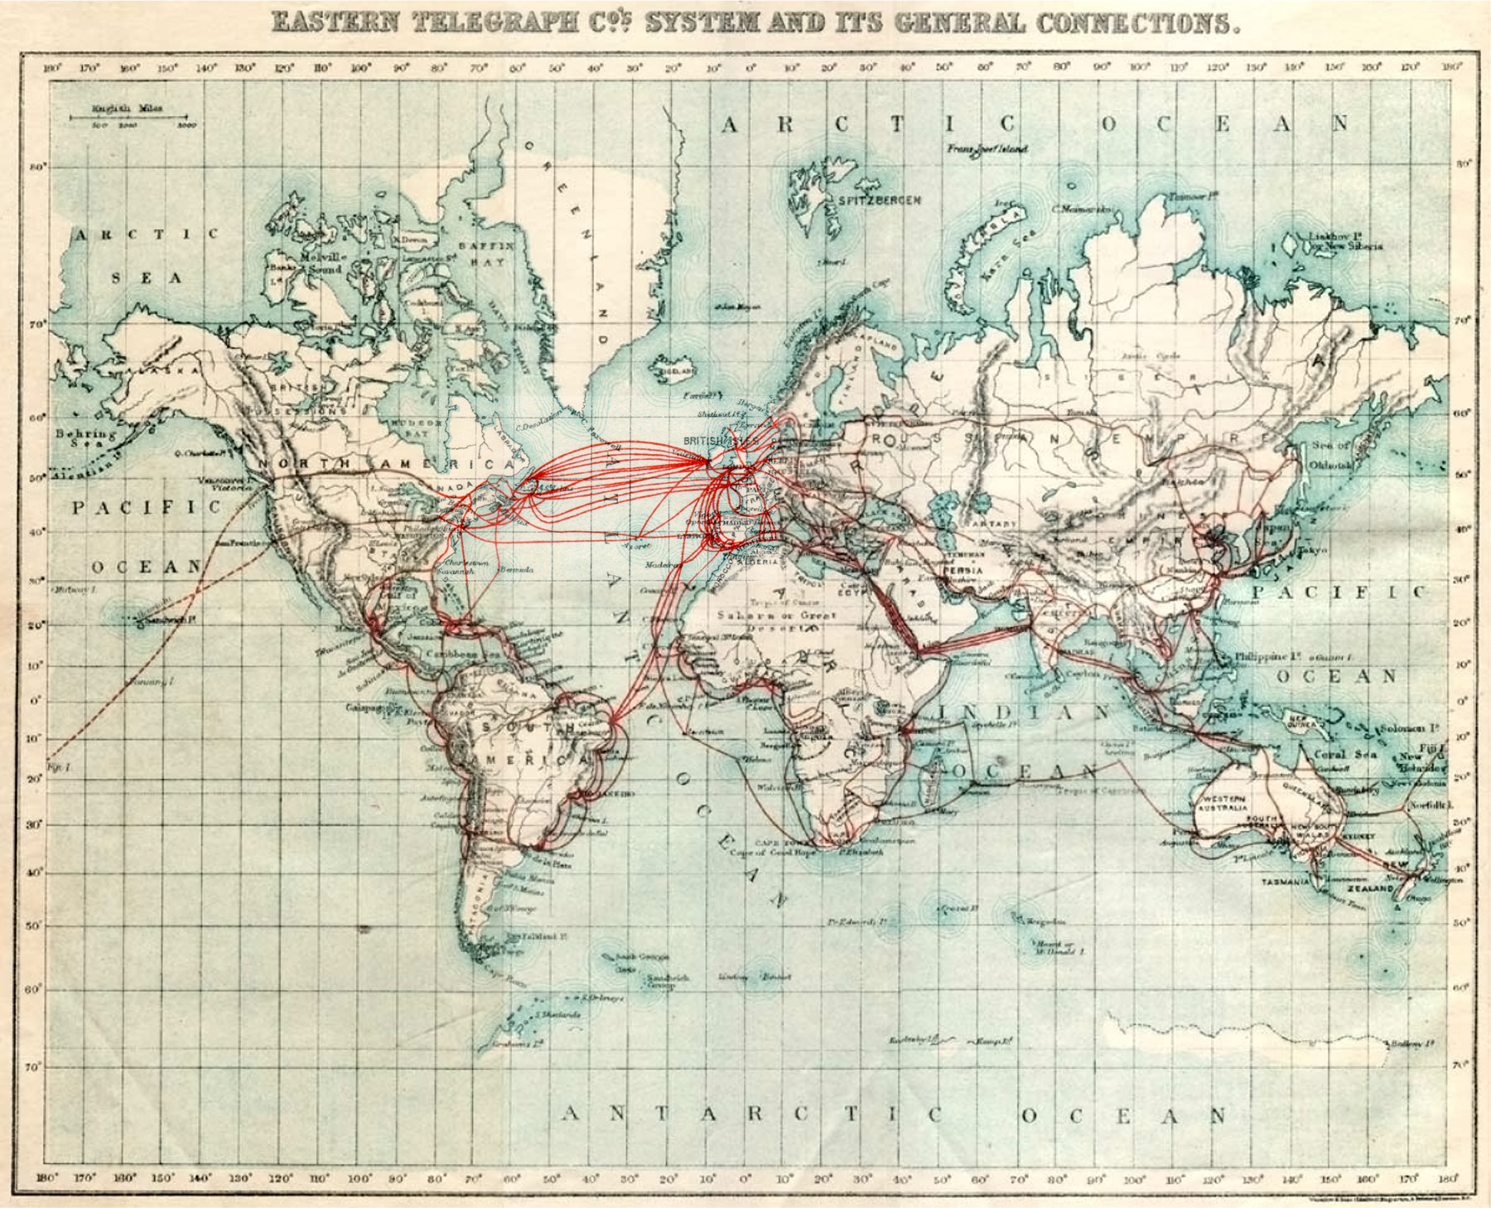
Connectivity Between world regions
About 120 years ago…
1901 network of
Eastern Telegraph Company

Slide 12
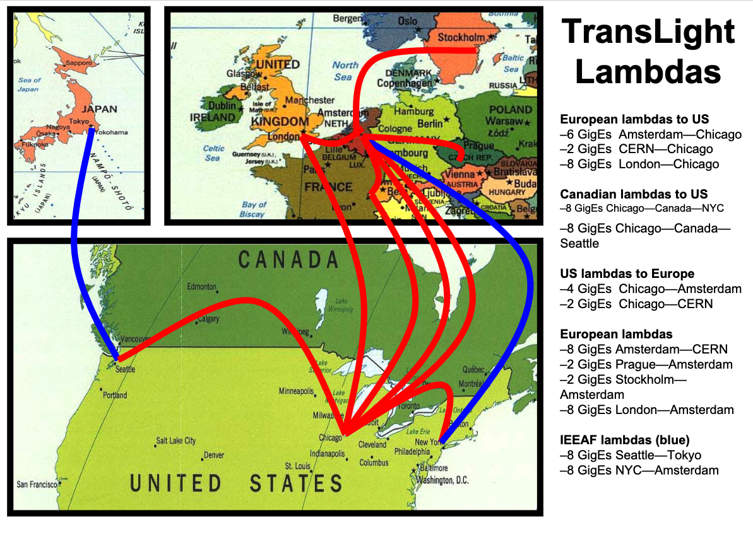
NRENs -
About 20 years ago…
https://www.glif.is/meetings/2003/delaat-overview.pdf

Slide 13
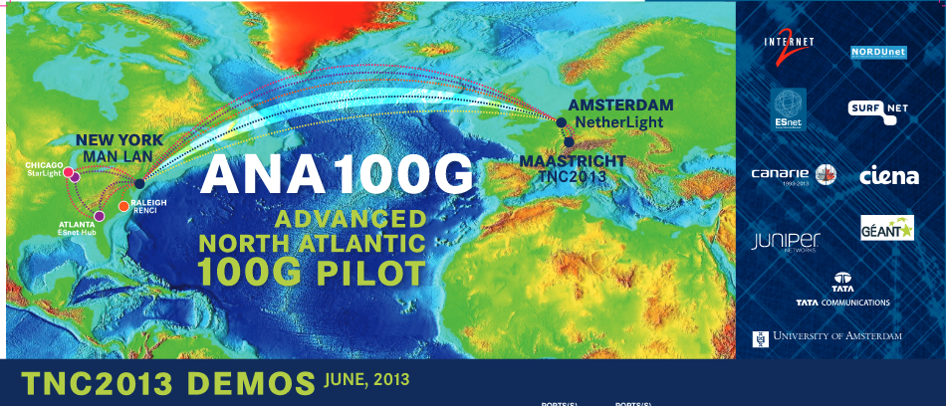
NRENs - about 10 years ago...

Slide 14
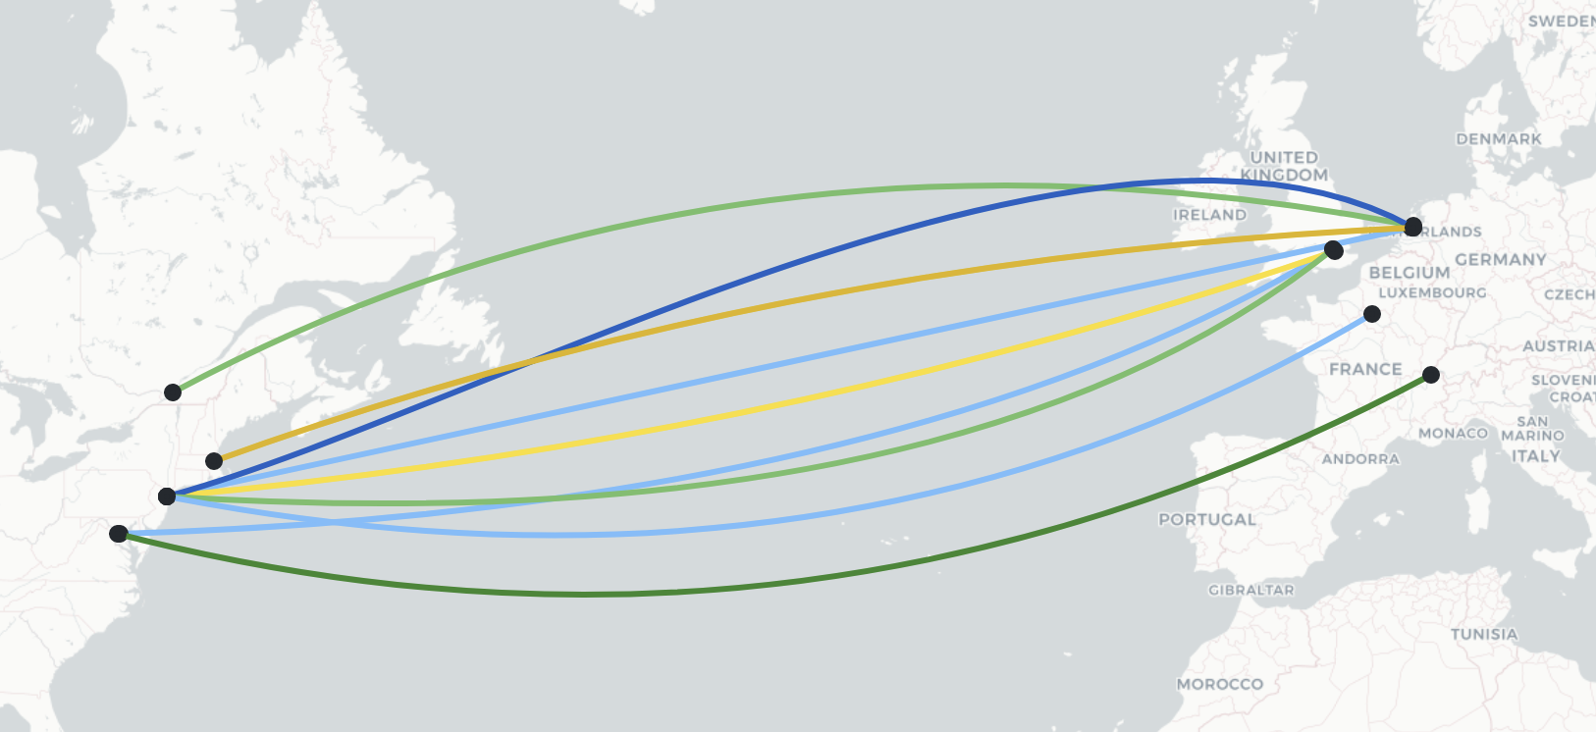
NRENs – a few months ago
9 x 100 Gbps connecting between the NA and EU networks

Slide 15
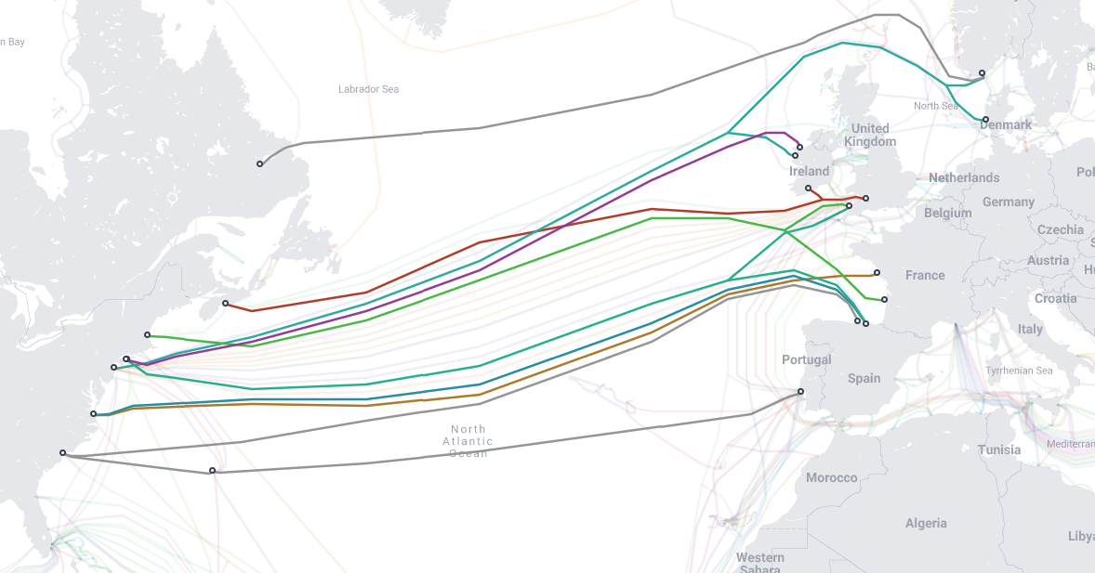
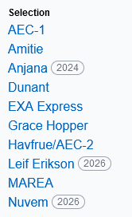
NRENs now – considering new Atlantic systems
11 Systems less than 10 years old available
3x Announced
7x Operational

Slide 16
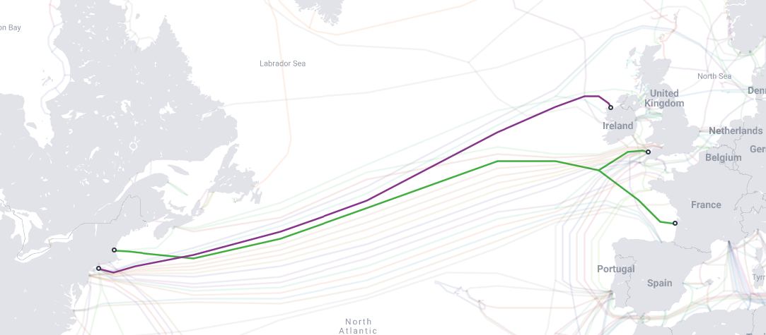
Already announced!
Amitié, AEC-1

Slide 17
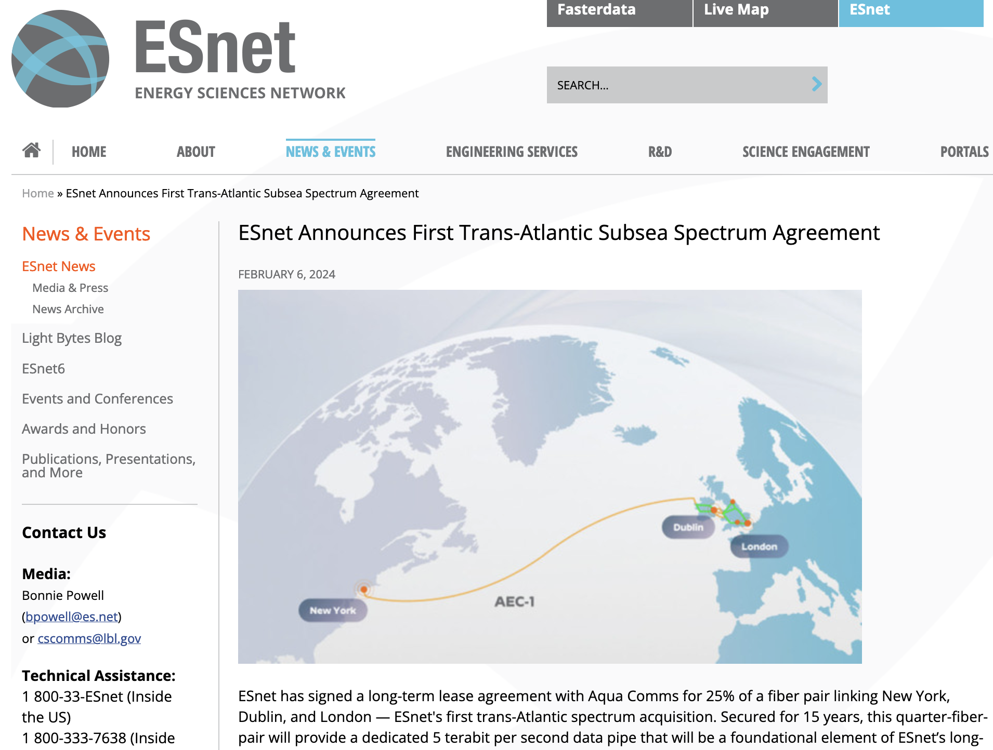
ESnet announcement
(Feb 6 2024)
https://www.es.net/news-and-publications/esnet-news/2024/esnet-announces-first-trans-atlantic-subsea-spectrum-agreement/

Slide 18
Spectrum changes the game
Capacity – Evolution:
  2003: 10 G
  2013: 100G
  2023: 1 Tbps
  2033: 10 Tbps

Slide 19
Spectrum changes the game
Capacity – Evolution:
  2003: 10 G
  2013: 100G
  2023: 1 Tbps
  2033: 10 Tbps

Slide 20
Spectrum changes the game
Capacity – Evolution:
  2003: 10 G
  2013: 100G
  2023: 1 Tbps
  2024: 10 Tbps

Slide 21
Spectrum changes the game
Longer term contracts
Investment up front
Maintenance cost “manageable”
Technological longevity - upgrading transponders / SLTs
There is now “Available capacity”
At marginal cost, largely
Considering opportunities to make available in the community

Slide 22
We have the capacity, so what now?

Slide 23


Let’s Go Global – Flatten the Earth
https://commons.wikimedia.org/wiki/File:Turtle_World.png

Slide 24
Why? Our users are global
Education is international
Science is international
Resources can attach to the network everywhere

Slide 25





Users: Education
Copyright: Lerato Mokhethi (CC BY-ND 4.0 Deed)

Slide 26
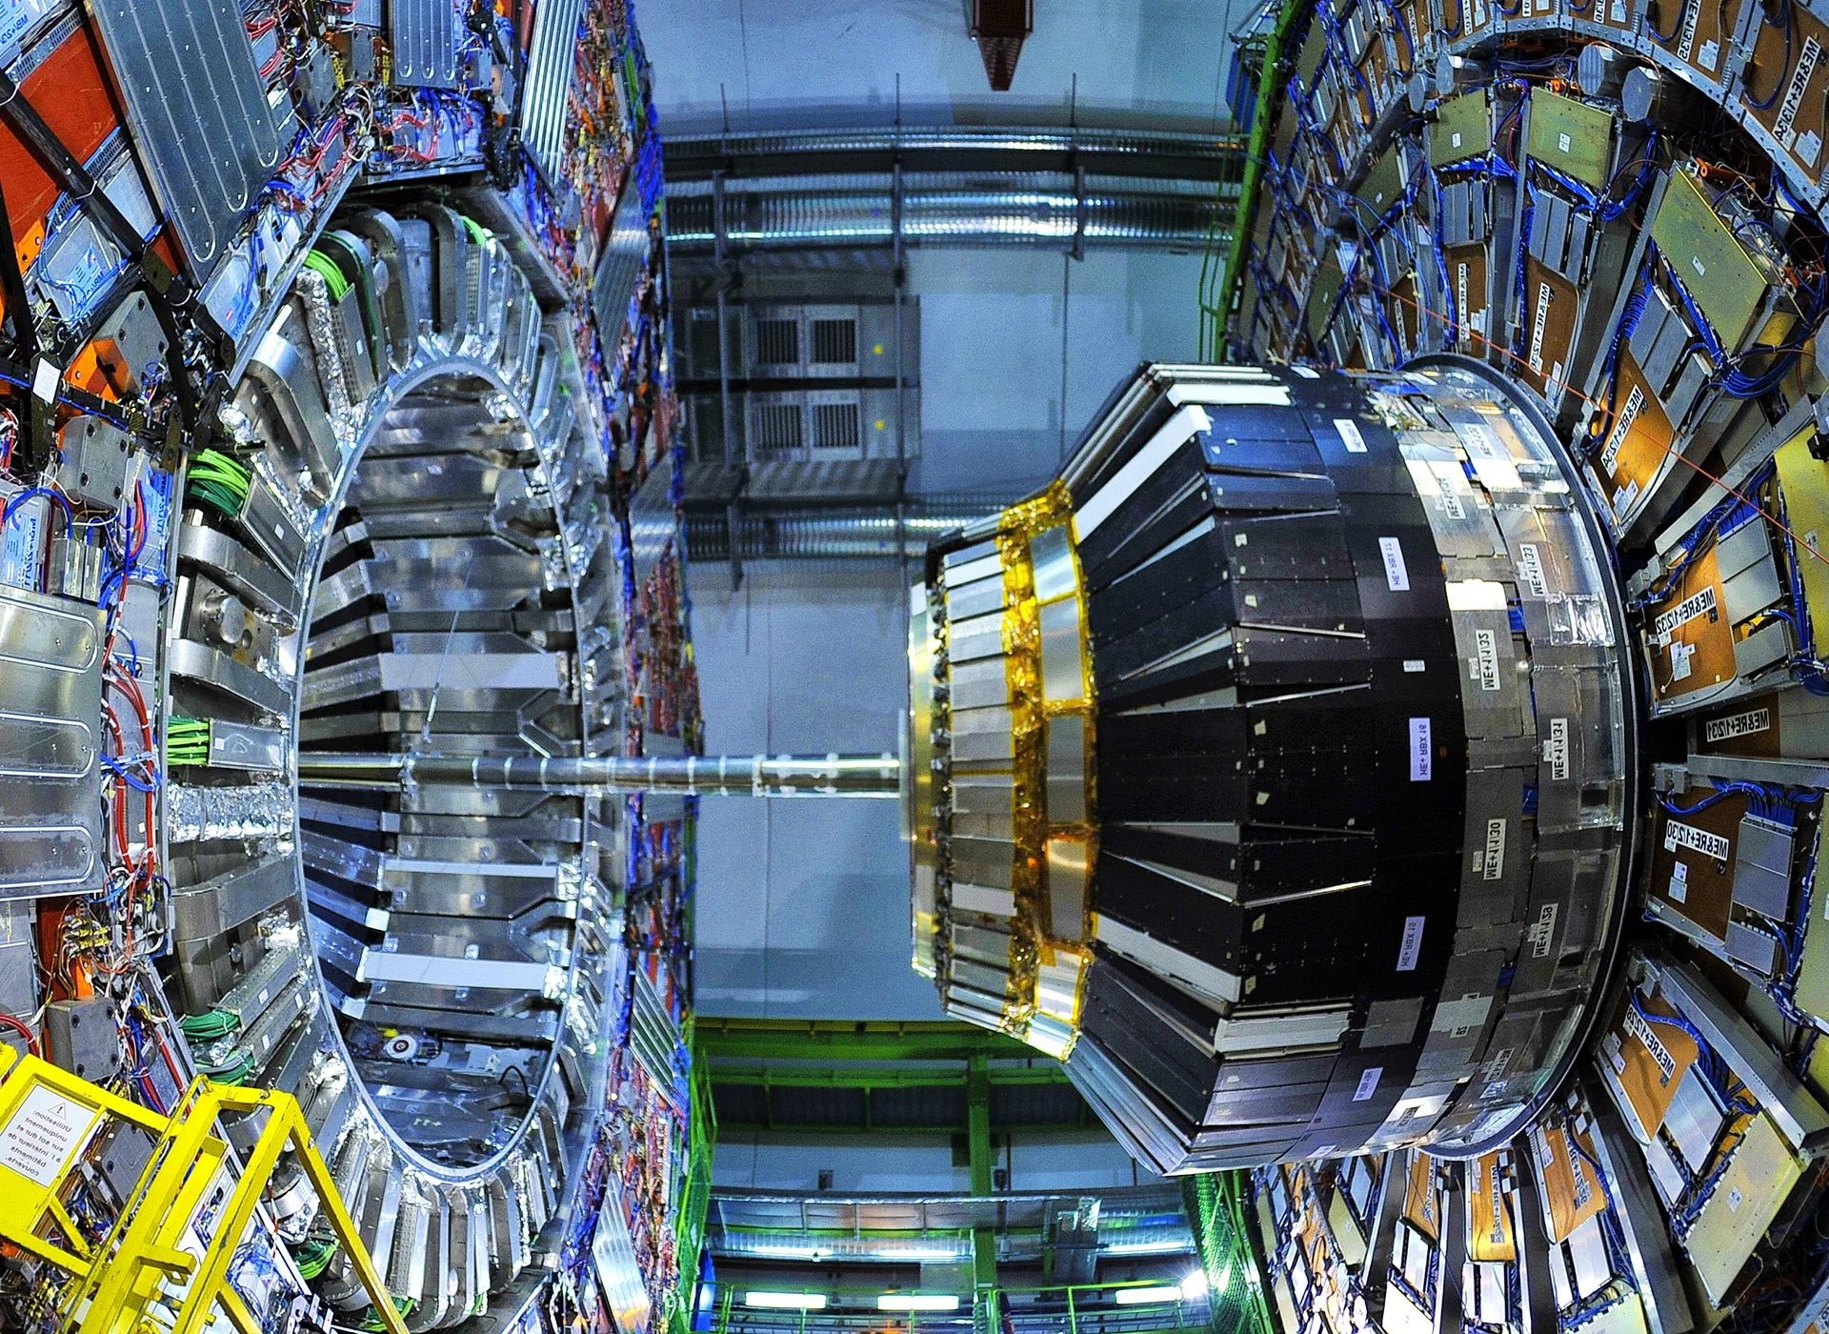
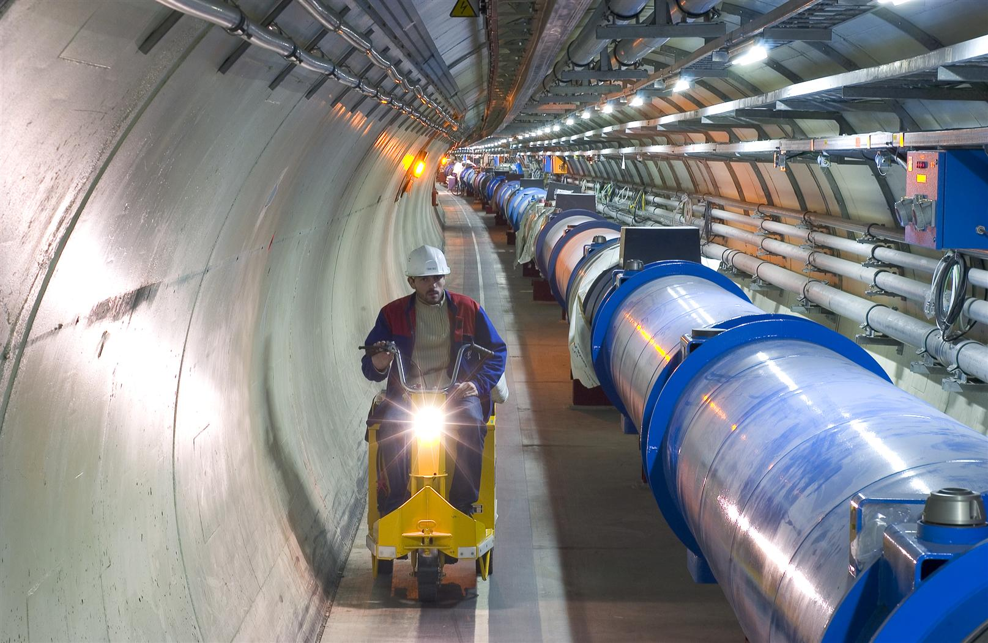
Users: Particle Physic - Large Hadron Collider

Slide 27
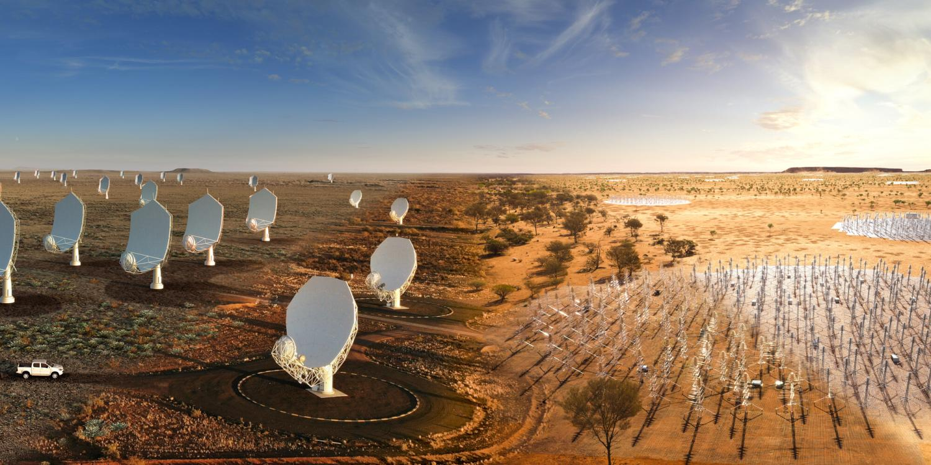
Users: Astronomy– Square Kilometre Array
South Africa
Australia
Notes:
Telescopes themselves produce 20 Tbps and 2 Pbps, but correlation happens locally
Up to 80Gbps continuous data products to 6 global sites (CA/UK/CN/ES/IT/SE - AU/SA)

Slide 28
Users: Astronomy– Square Kilometre Array
South Africa
Australia
Notes:
Telescopes themselves produce 20 Tbps and 2 Pbps, but correlation happens locally
Up to 80Gbps continuous data products to 6 global sites (CA/UK/CN/ES/IT/SE - AU/SA)

Slide 29
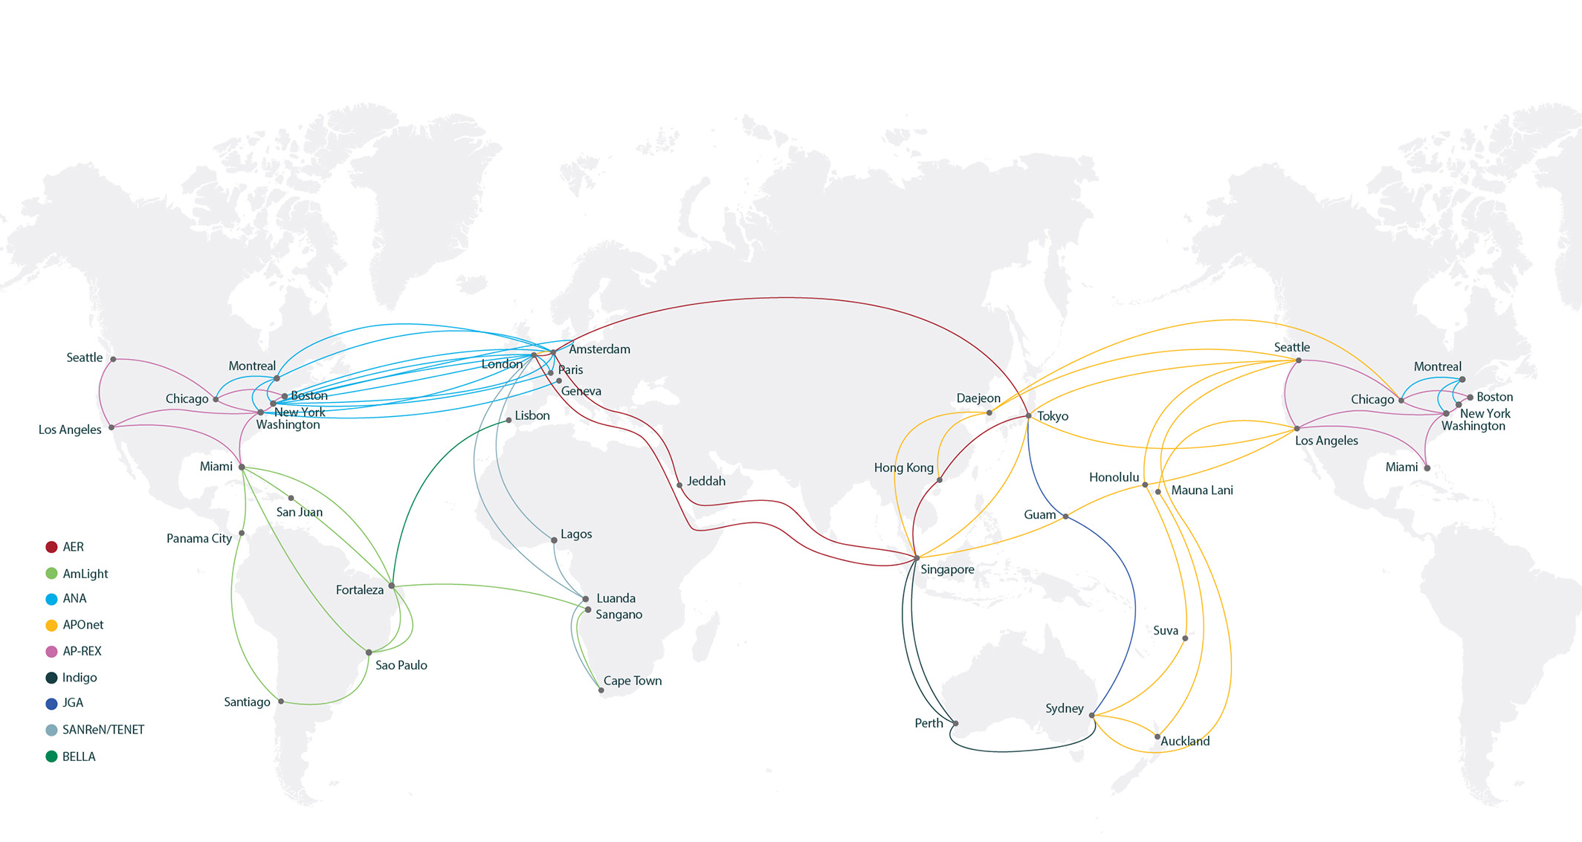
GLOBAL NETWORK RESOURCES EXIST (ADD THE TERRESTRIAL NETWORKS TO THIS MAP!)
Notes:
Operating at intercontintental scale needs partnerships
Investment pooling/coordination
Resiliency coordination
Technical – services on the links
Technical – driving global services
Operating at a global scale needs…
Coordination
Resilience
Technology/service coordination
Topology coordination

Slide 30


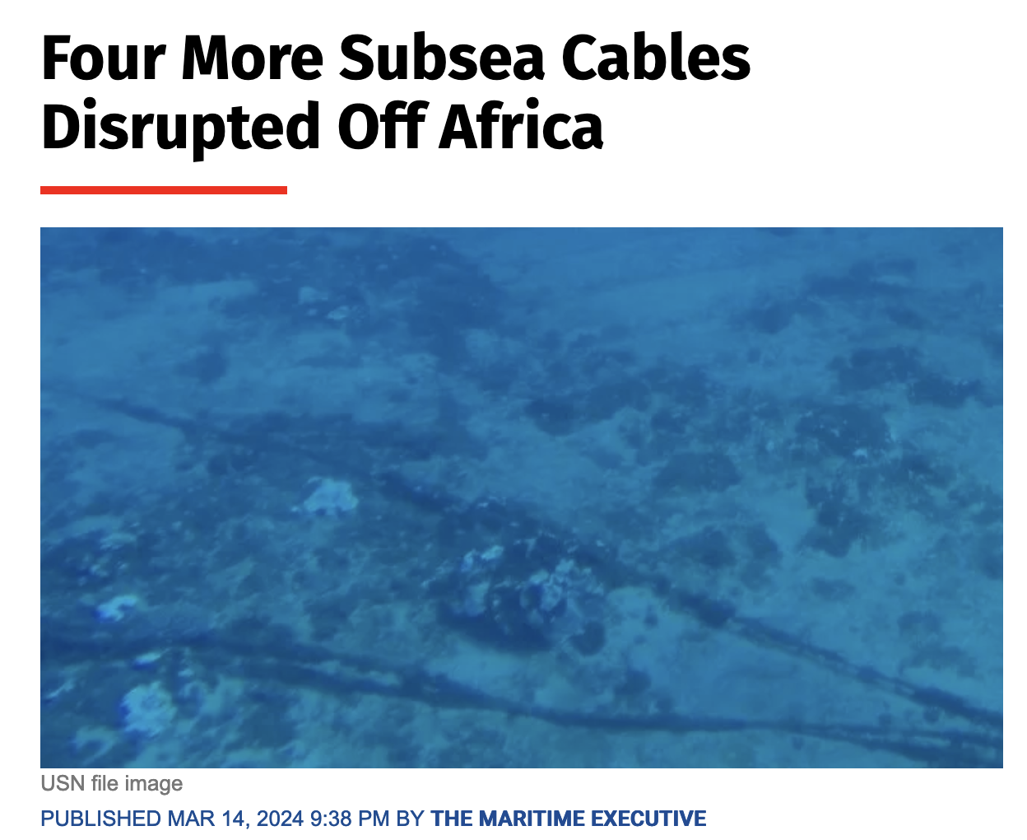
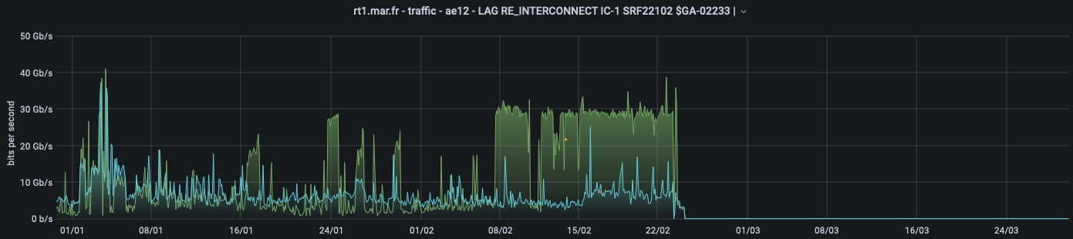
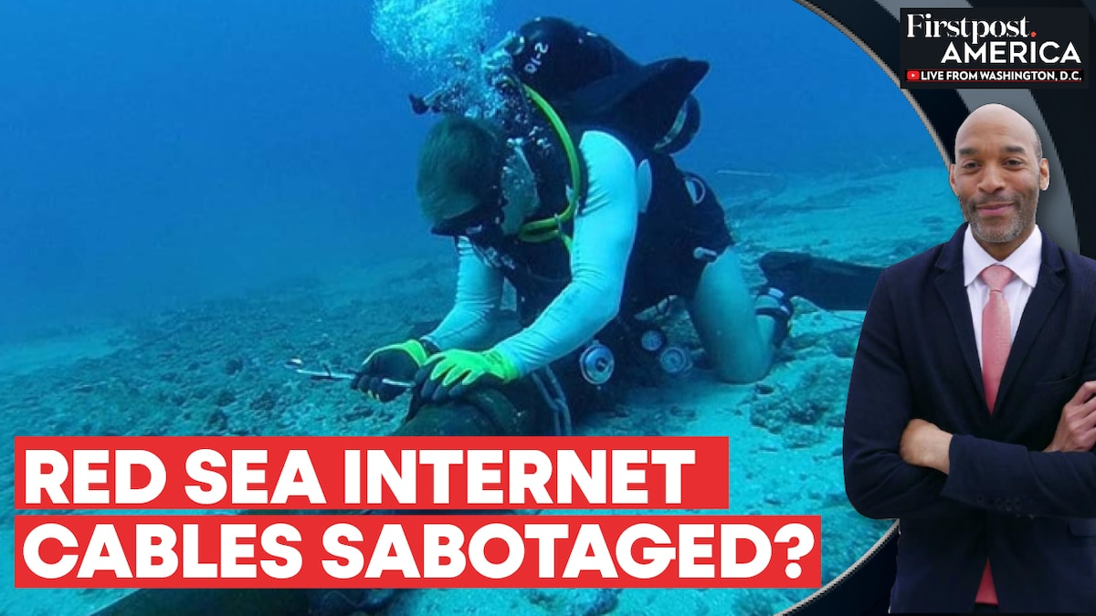
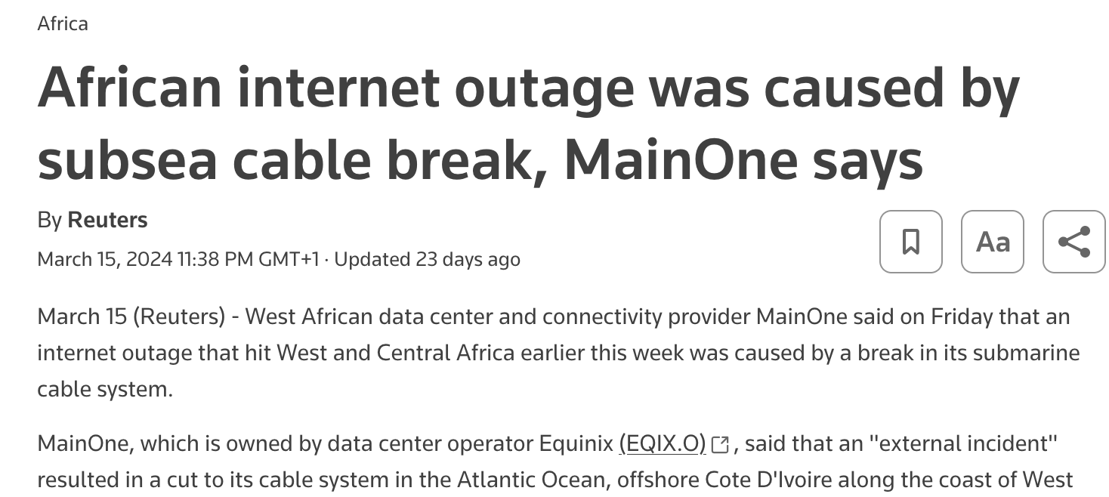
Considerations: Resiliency

Slide 31
Working towards global services requires
Organisation
Commitment to partnerships matters – get the best people to work on this
Investment pooling/coordination
Working with “the market” as a coordinated entity
We have a global community, but are we sufficiently “organised” globally?

Slide 32
Working towards global services requires
Operation
Design
Resilience, topology across the federated global topology
Technology/service coordination
Engineering
Driving global service delivery => uniform ‘base’ services
Can this build on maturing automation approaches?
Operations models: federated infrastructure with uniform services; joint design, joint operations?

Slide 33
To summarize
R&E traffic does keep growing
Capacity (will be) “solved” – infra, fibre and spectrum
Global R&E collaboration is essential
Move focus to global service delivery

Slide 34
Thank you!

Slide 35

Thank You
Any questions?
www.geant.org

