Slide 1
Patagonia
Forging a Digital Connection to Finis Terrae
Albert Astudillo
REUNA
June 11th

Slide 2
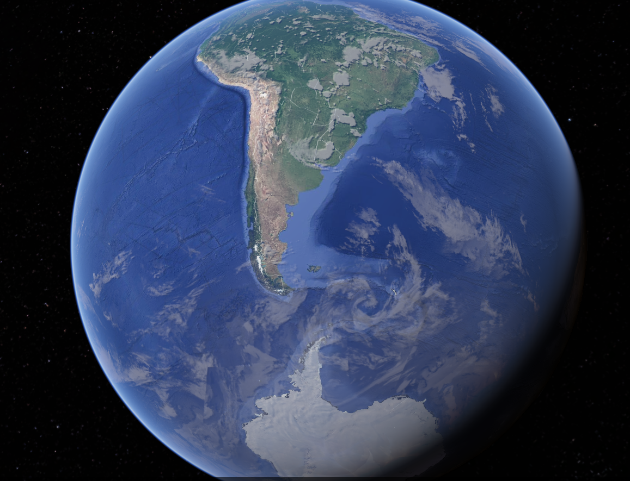
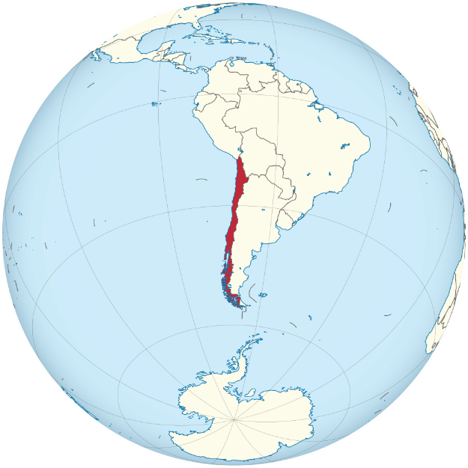
Chile is a wonderful country, which poses enormous challenges and great opportunities.
Population: ~19 million
Length: 4400 km (Continental)
Width: 445 km (max), 90 km (min), 177 km (average)
The population is highly concentrated towards the center of the country

Slide 3
Southern Macrozone
Southern Macrozone
It stands out for its vast geographical extension and its great scientific potential, recognized internationally. Its strategic location, covering Antarctic, sub-Antarctic and pristine areas, makes it a key place to address the climate crisis. Despite this, it is one of the few regions in the world that lacked, until now, a digital infrastructure dedicated to supporting scientific development and the generation of knowledge.
Fuente imagen: Presentación del Gobernador Flies en Charla Conectando los Polos

Slide 4

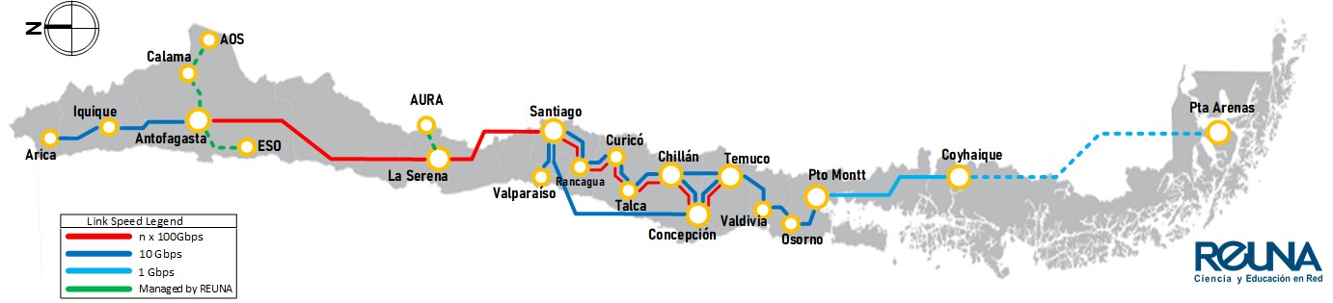
+ Community
50 Institutions
+80%
are part of REUNA and we work to integrate the entire R&E ecosystem.
+11.000 km
+30 years
of the research that is done in Chile goes through REUNA
REUNA promotes innovation projects and collaboration
network and a great digital platform
promoting the Digital Development of Chile

Slide 5
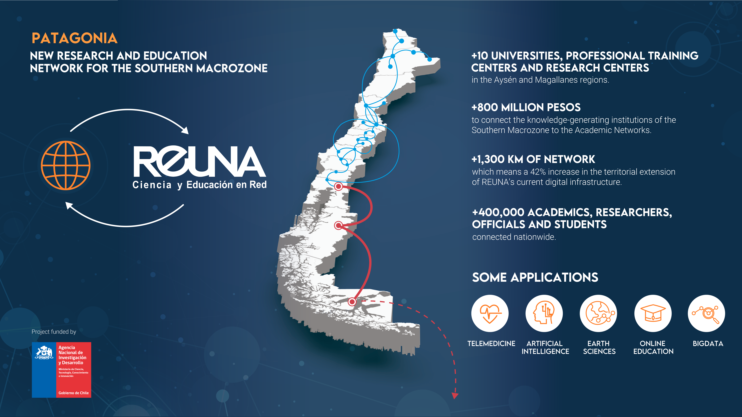

Slide 6
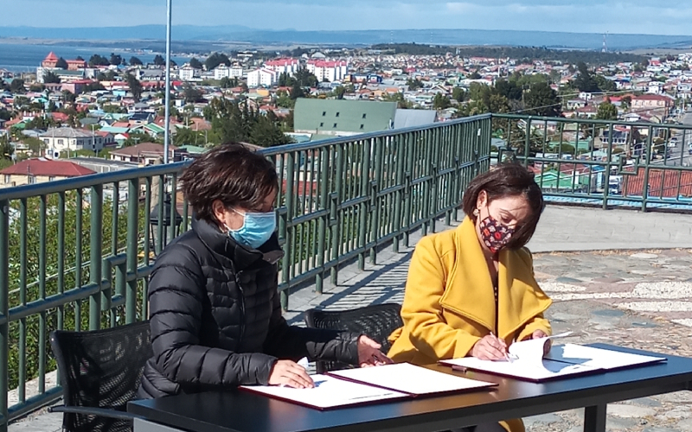
The Patagonia project was born in Punta Arenas in November 2021, and is founded on three pillars
Build the “Diital e Be a “bridge” that unites all the R&E institutions of the Southern Macrozone Macrozone
Strength the national Research and Education system
Join efforts to provide viability and sustainability
ANID-REUNA agreement signed on November 24, in Punta Arenas
ANID = Chilean National Research and Development Agency

Slide 7
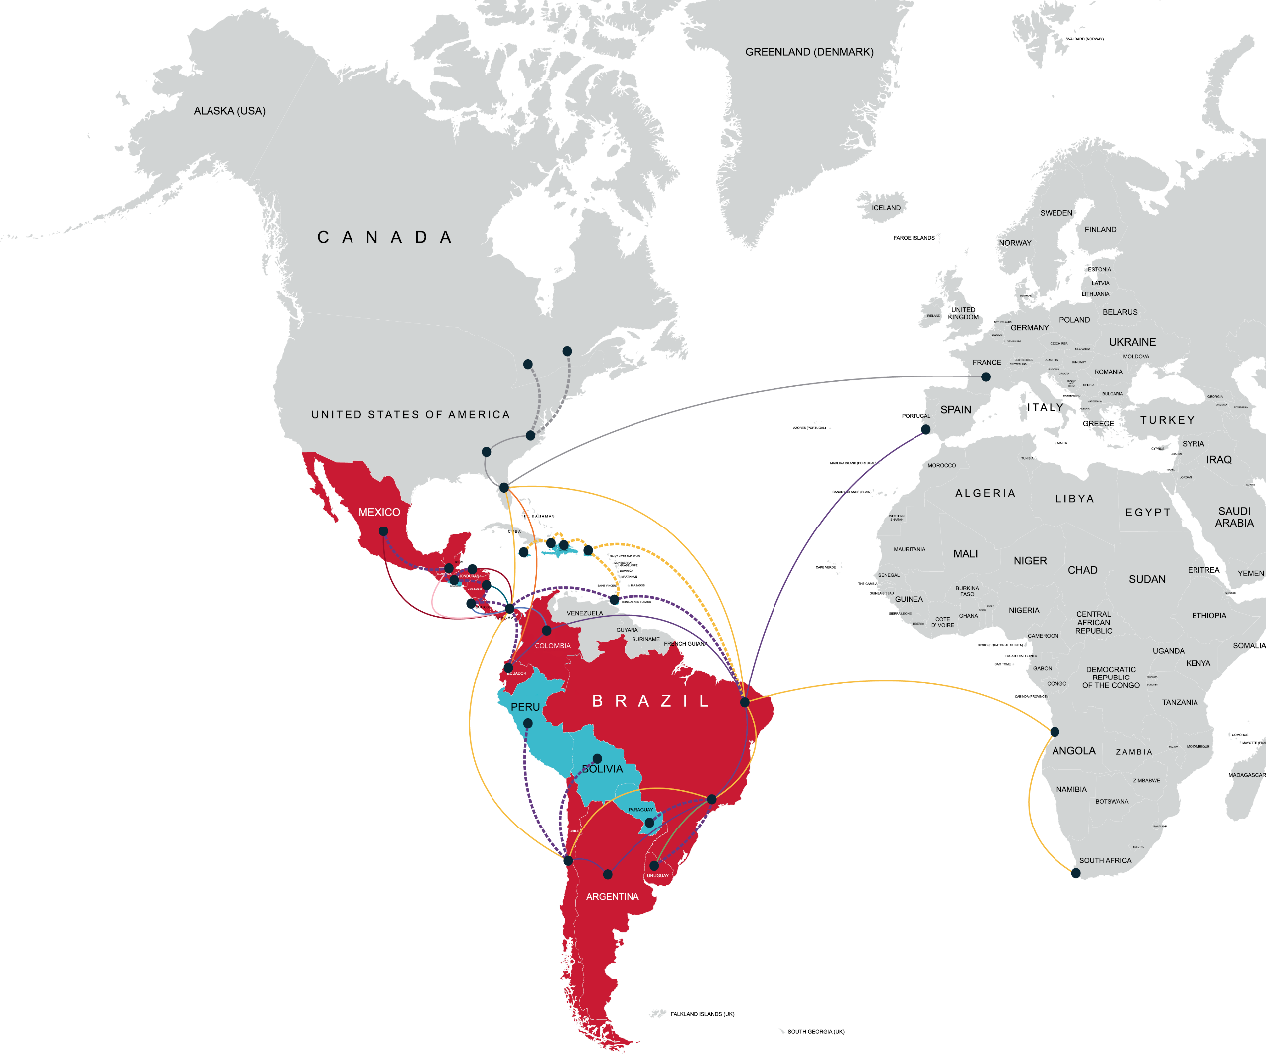
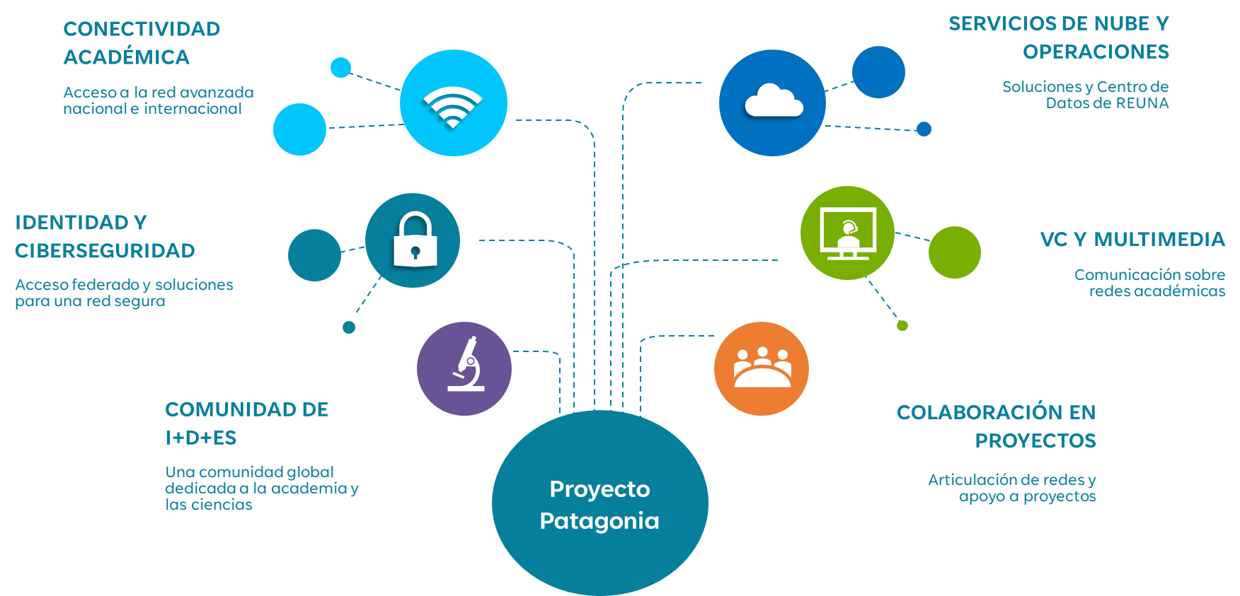

The project seeks to connect the southern macrozone both nationally and internationally
Internationally through RedCLARA
Integrating through REUNA with more than 130 countries connected to R&E networks
Patagonia is more than connectivity, it is global collaboration
Academic conectivity
National and internacional access
Cloud services and operations
REUNA Data Center and Solutions
Identity and cybersecurity
Federated access and solutions for a secure network
VC and multimedia
Communications on academic networks
R&D community
A global community dedicated to academia and science
Collaboration on projects
Network articulation and project support

Slide 8
Progress to date and next steps

Slide 9
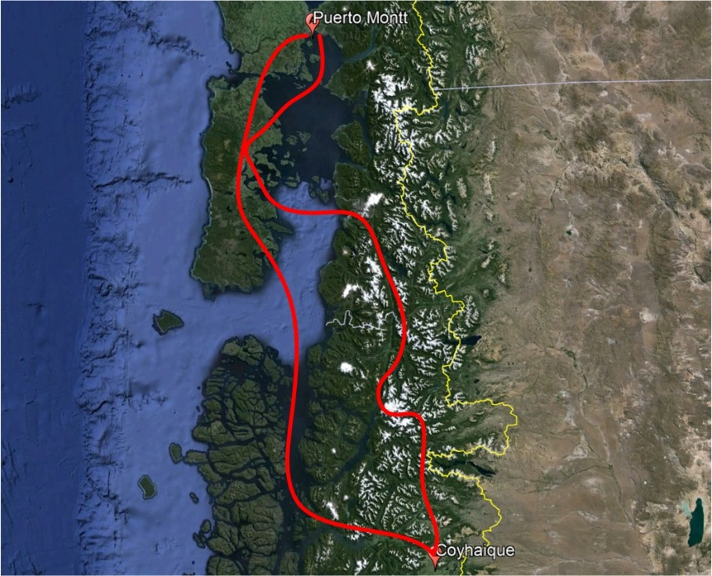
August 10, 2022: Coyhaique Node began operating
1 Gbps of capacity
Three organizations are connected today
Protected route over two different paths
Distance between Puerto Montt and Coyhaique 470 km

Slide 10
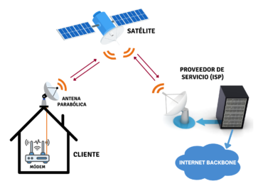
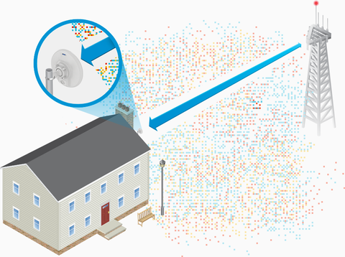
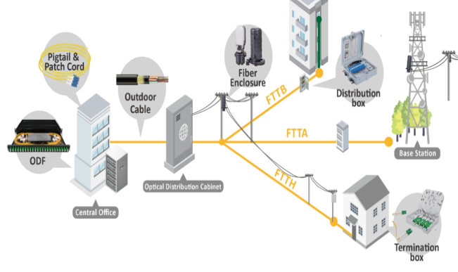



The region poses important challenges, which has led REUNA to integrate different solutions
Connection via Fiber, 2022
Satellite Connection, 2023
Wireless Connection, 2023

Slide 11
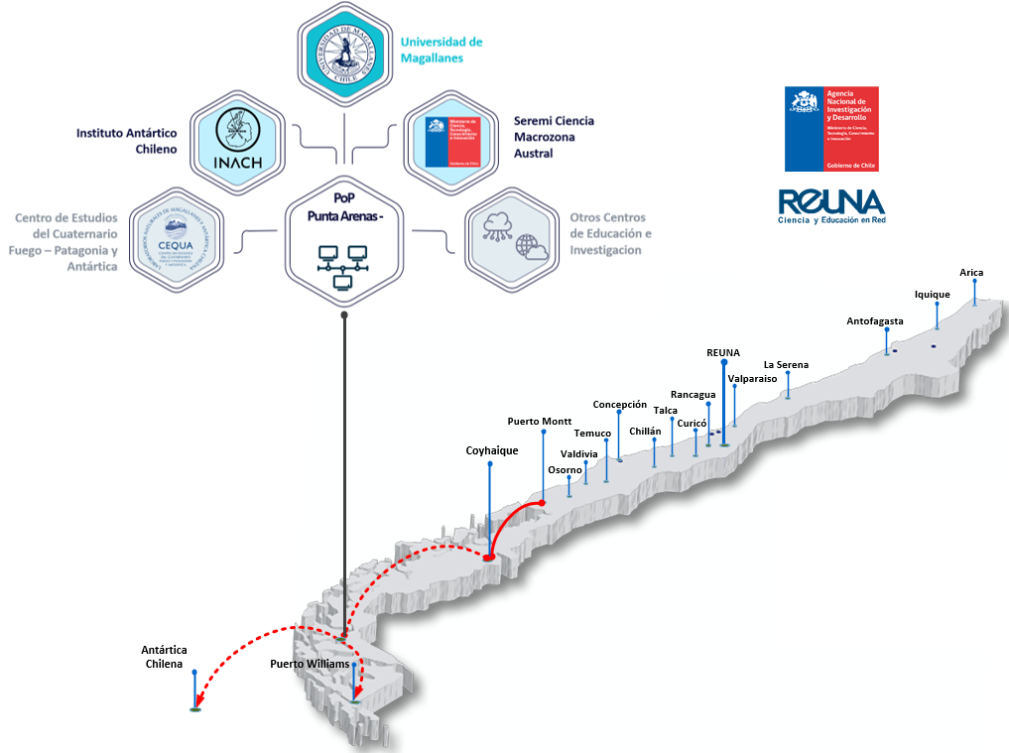

Punta Arenas connectivity is ready
REUNA and Regional Government signed the alliance for the installation and operation of the Magallanes and Chilean Antarctica Node.
Thanks to this alliance the node was installed in May 2024.
Demonstrating that collaboration is key to moving forward!

Slide 12
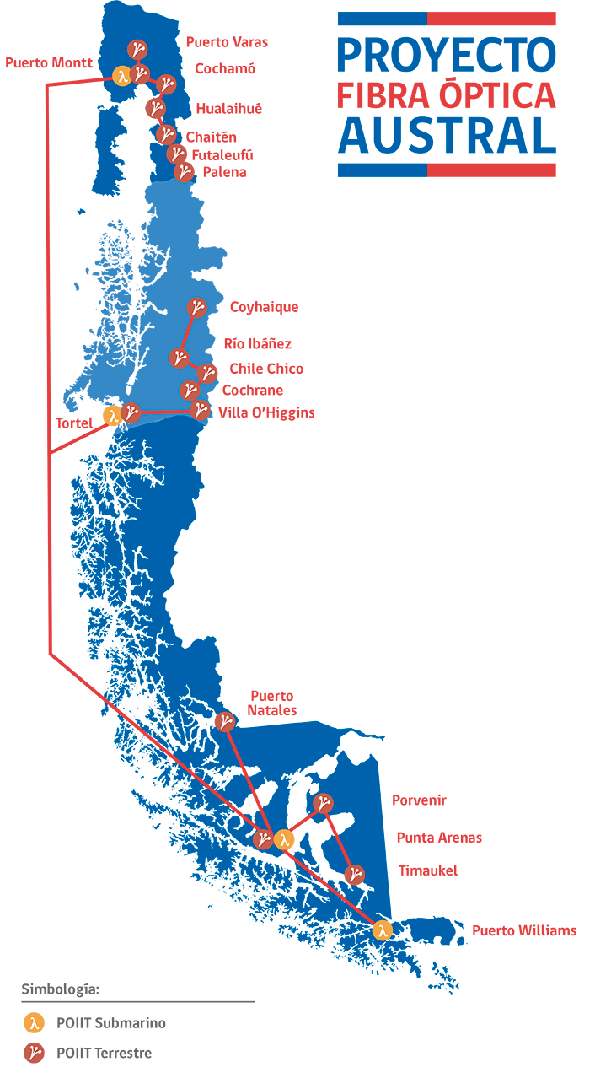
FOA cable to strength the connectivity
Project funded by the Chilean Government
One Submarine cable with three landings points and an extension of 2870 km
Three terrestrial cables to connect regions of Los Lagos, Aysen and Magallanes.
6 Terabits of capacity

Slide 13
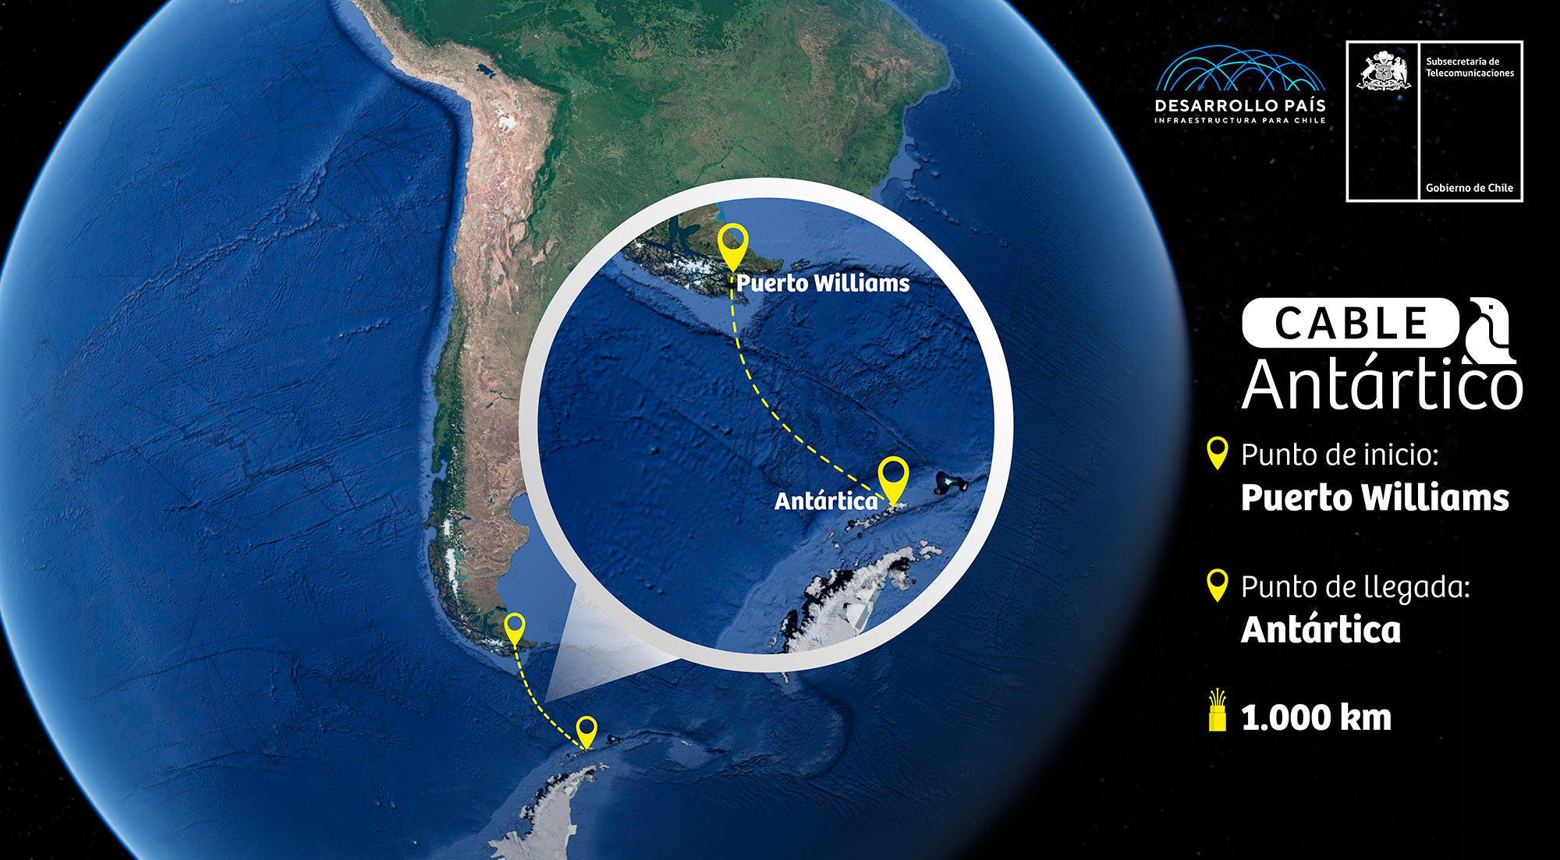
Next Challenge:
Connecting Antarctica
Proyecto Conexión Antartica.
More than 20 countries use Punta Arenas as a gateway city to Antarctica
Image Credits: Desarrollo País
Notes:
Important messages:
- Punta Arenas is a gateway city to Antarctica, being the main science route to the White Continent.
- It is Chilean State interest: it has been discussed with RedCLARA.
- It is envisioned not only the connection of the Chilean peninsula but also to enter other research bases on the peninsula.
- There is the commitment of Desarrollo País (Country Development), REUNA and RedCLARA to carry out the feasibility study.
- Punta Arenas is the main gateway to Antarctica.

Slide 14
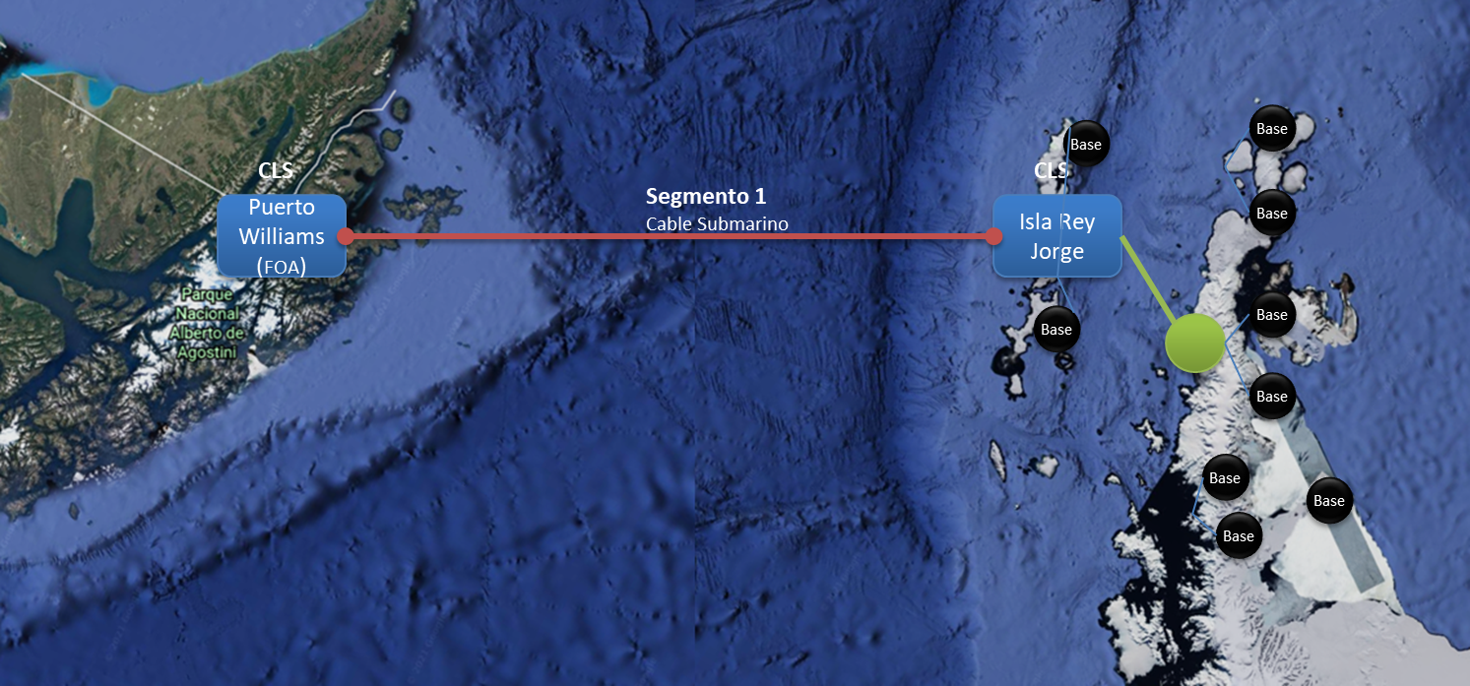
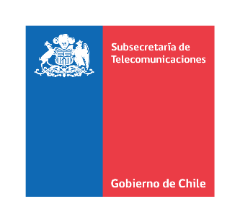
Antarctica: A WORLD POLE FOR SCIENCE
Antarctica holds important research centers and facilities given its unique characteristics for earth sciences and research.
Global phenomena are studied there, including climate change, evolutionary and ecological processes, pollution, fishing activity, among others.
Currently available digital connectivity is limited: limited number of satellites, reduced bandwidth and high costs.
~1,000 km
~120 km
Notes:
During March and April, Subtel will call on companies to carry out the technical and economic feasibility study of segment 1 of connection via optic fiber to Antarctica

Slide 15
REUNA wants to collaborate and promote new initiatives of regional and international importance
National Space System:
Address the challenges put by the Chilean Airforce (FACH) team for the interconnection of the Data and Processing Centers with the network of institutions of the ScTKI system.
  International Space System
  Punta Arenas is a strategic area for the installation of land bases for downloading satellite data.
Notes:
During March and April, Subtel will call on companies to carry out the technical and economic feasibility study of segment 1 of connection via optic fiber to Antarctica

Slide 16
Thank you
Any questions?
aastudillo@reuna.cl

