Slide 1
Driving IoT Innovations in Uganda
The Rise of LoRaWAN Technology
Claire Sharitah Nakakeeto
Daniel Kawuma
11th June 2024

Slide 2
About RENU
Introduction to IoT in Uganda
Challenges in IoT adoption
The Emergence of LoRaWAN
LoRaWAN Student Projects
LoRaWAN challenges
Future prospects
Outline

Slide 3
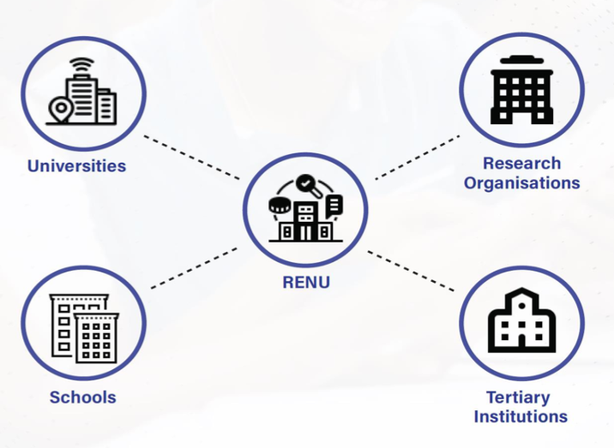
About Research and Education Network for Uganda (RENU)
Not-for-profit
Member based organization
Established in 2006
Goal is improve quality of education and research on the country

Slide 5
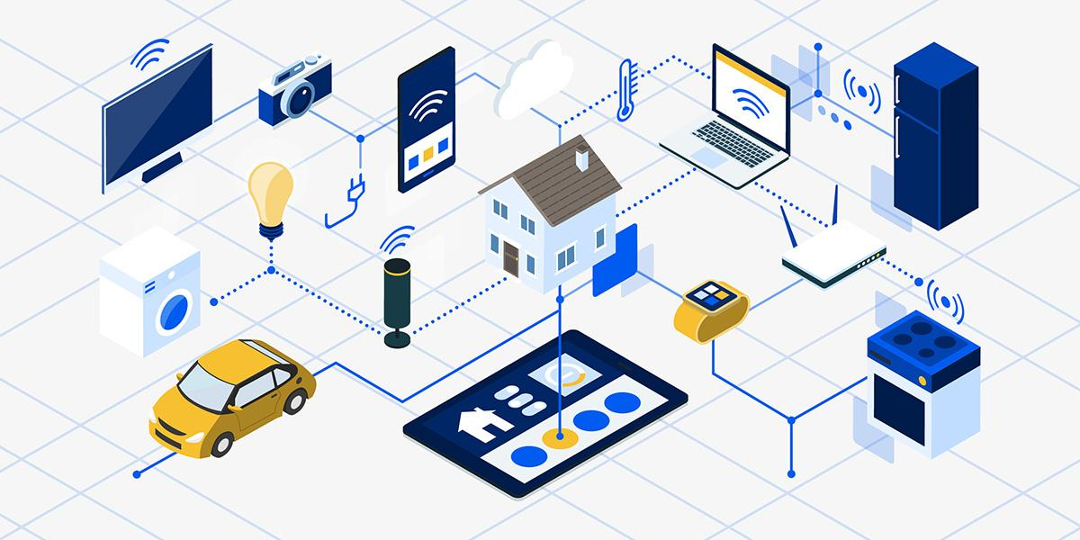
What is IoT?

Slide 6
IoT in Uganda
Remote sensing in Ebola Treatment Units - 2015
Integrated Sensors used to detect:
Heart rate
Blood oxygen saturation
Respiration rate
Body temperature
Other initial project: Jaguza

Slide 7
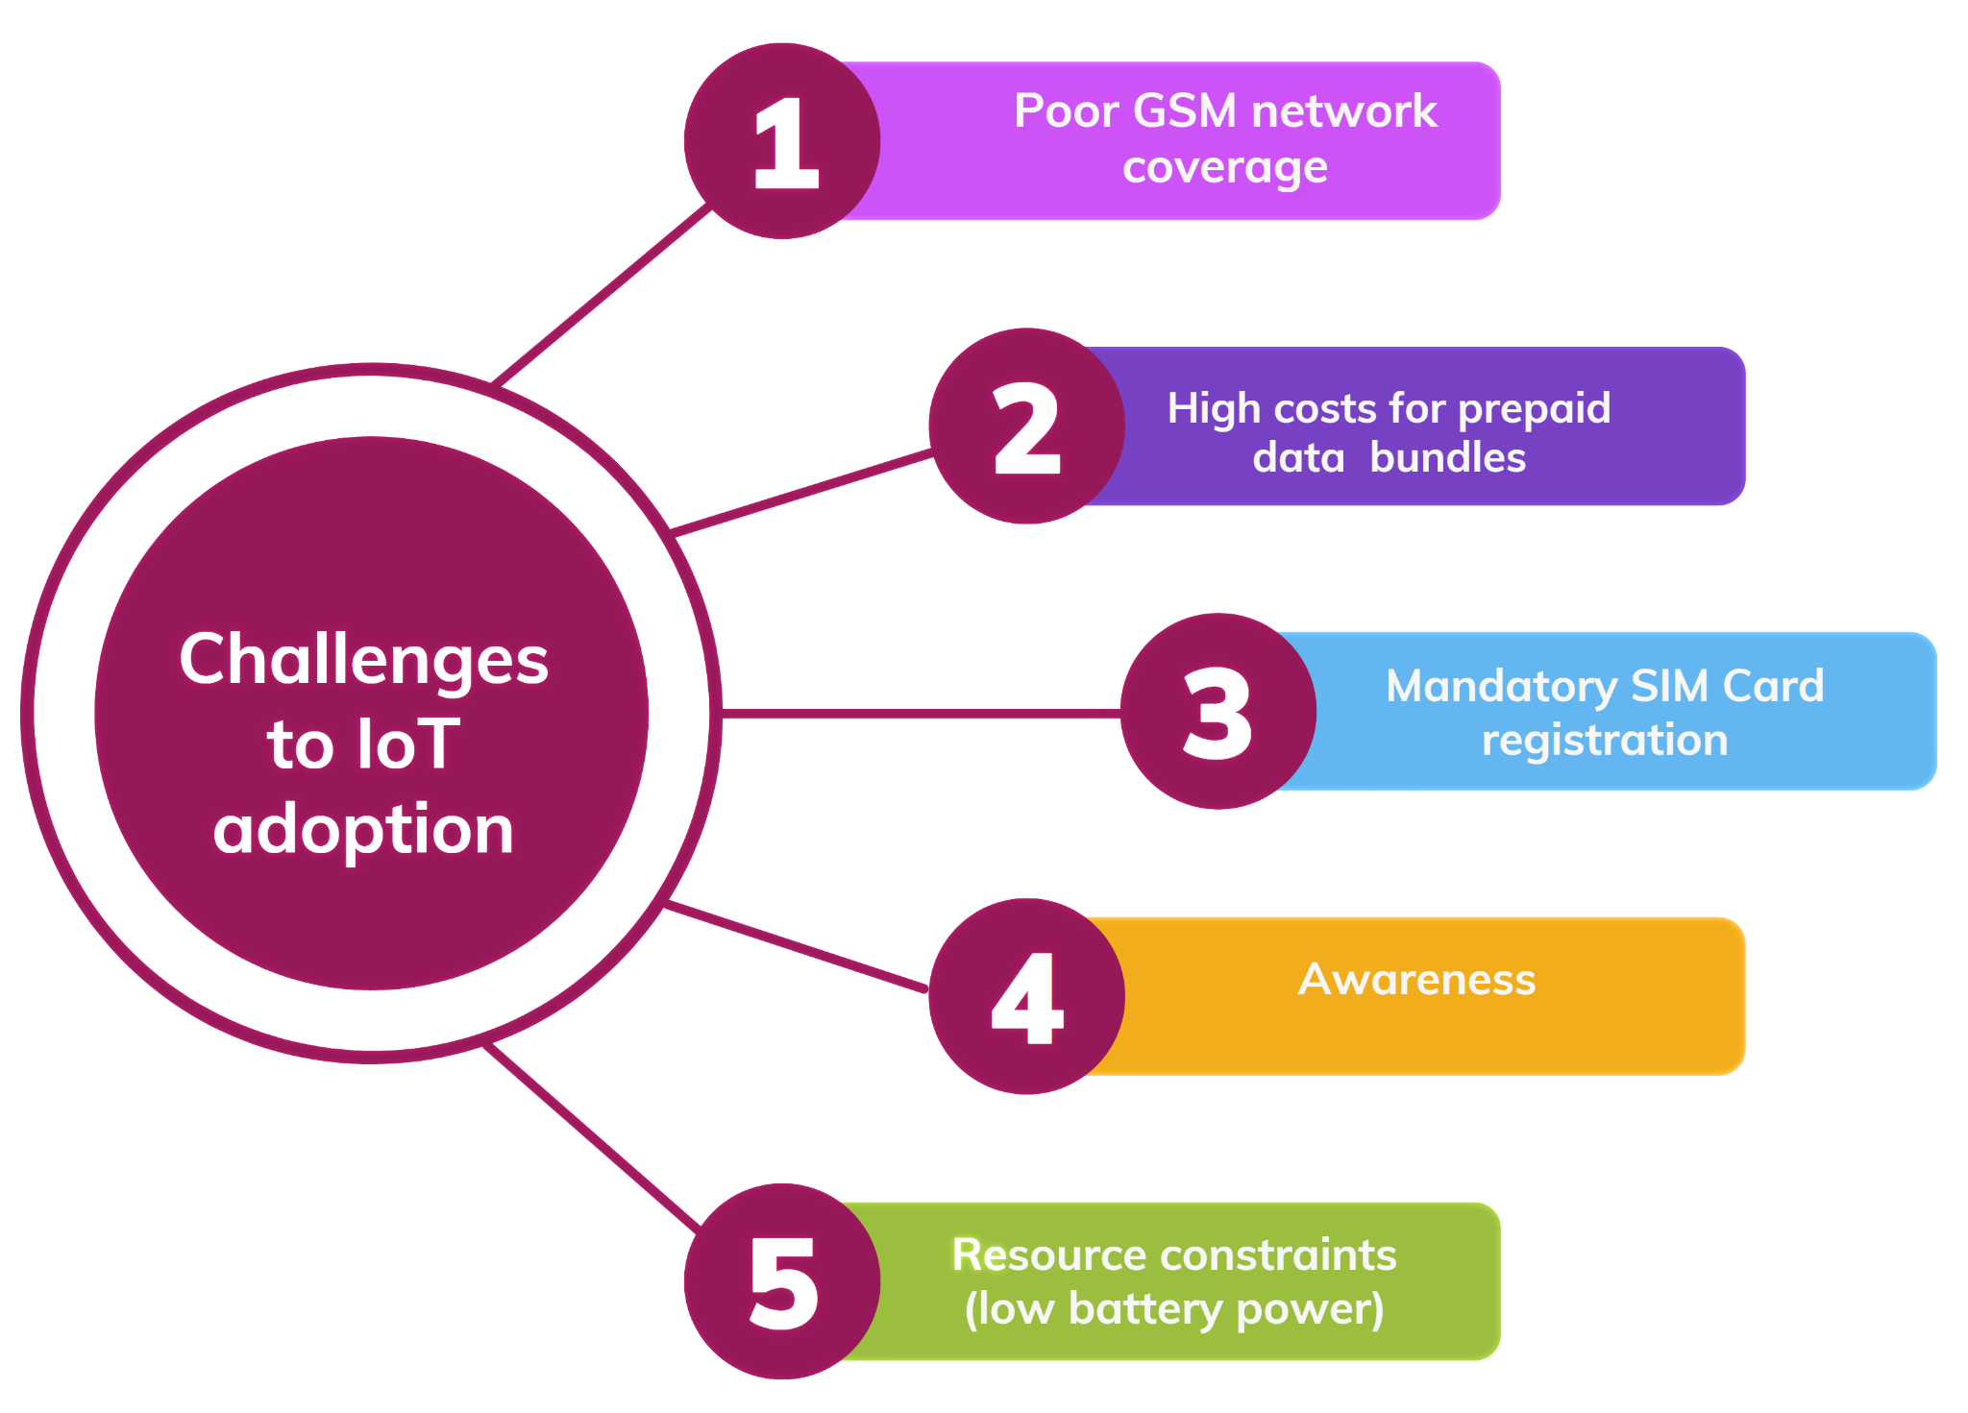
IoT Challenges

Slide 8
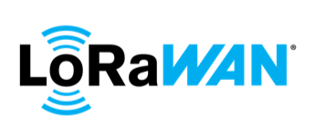
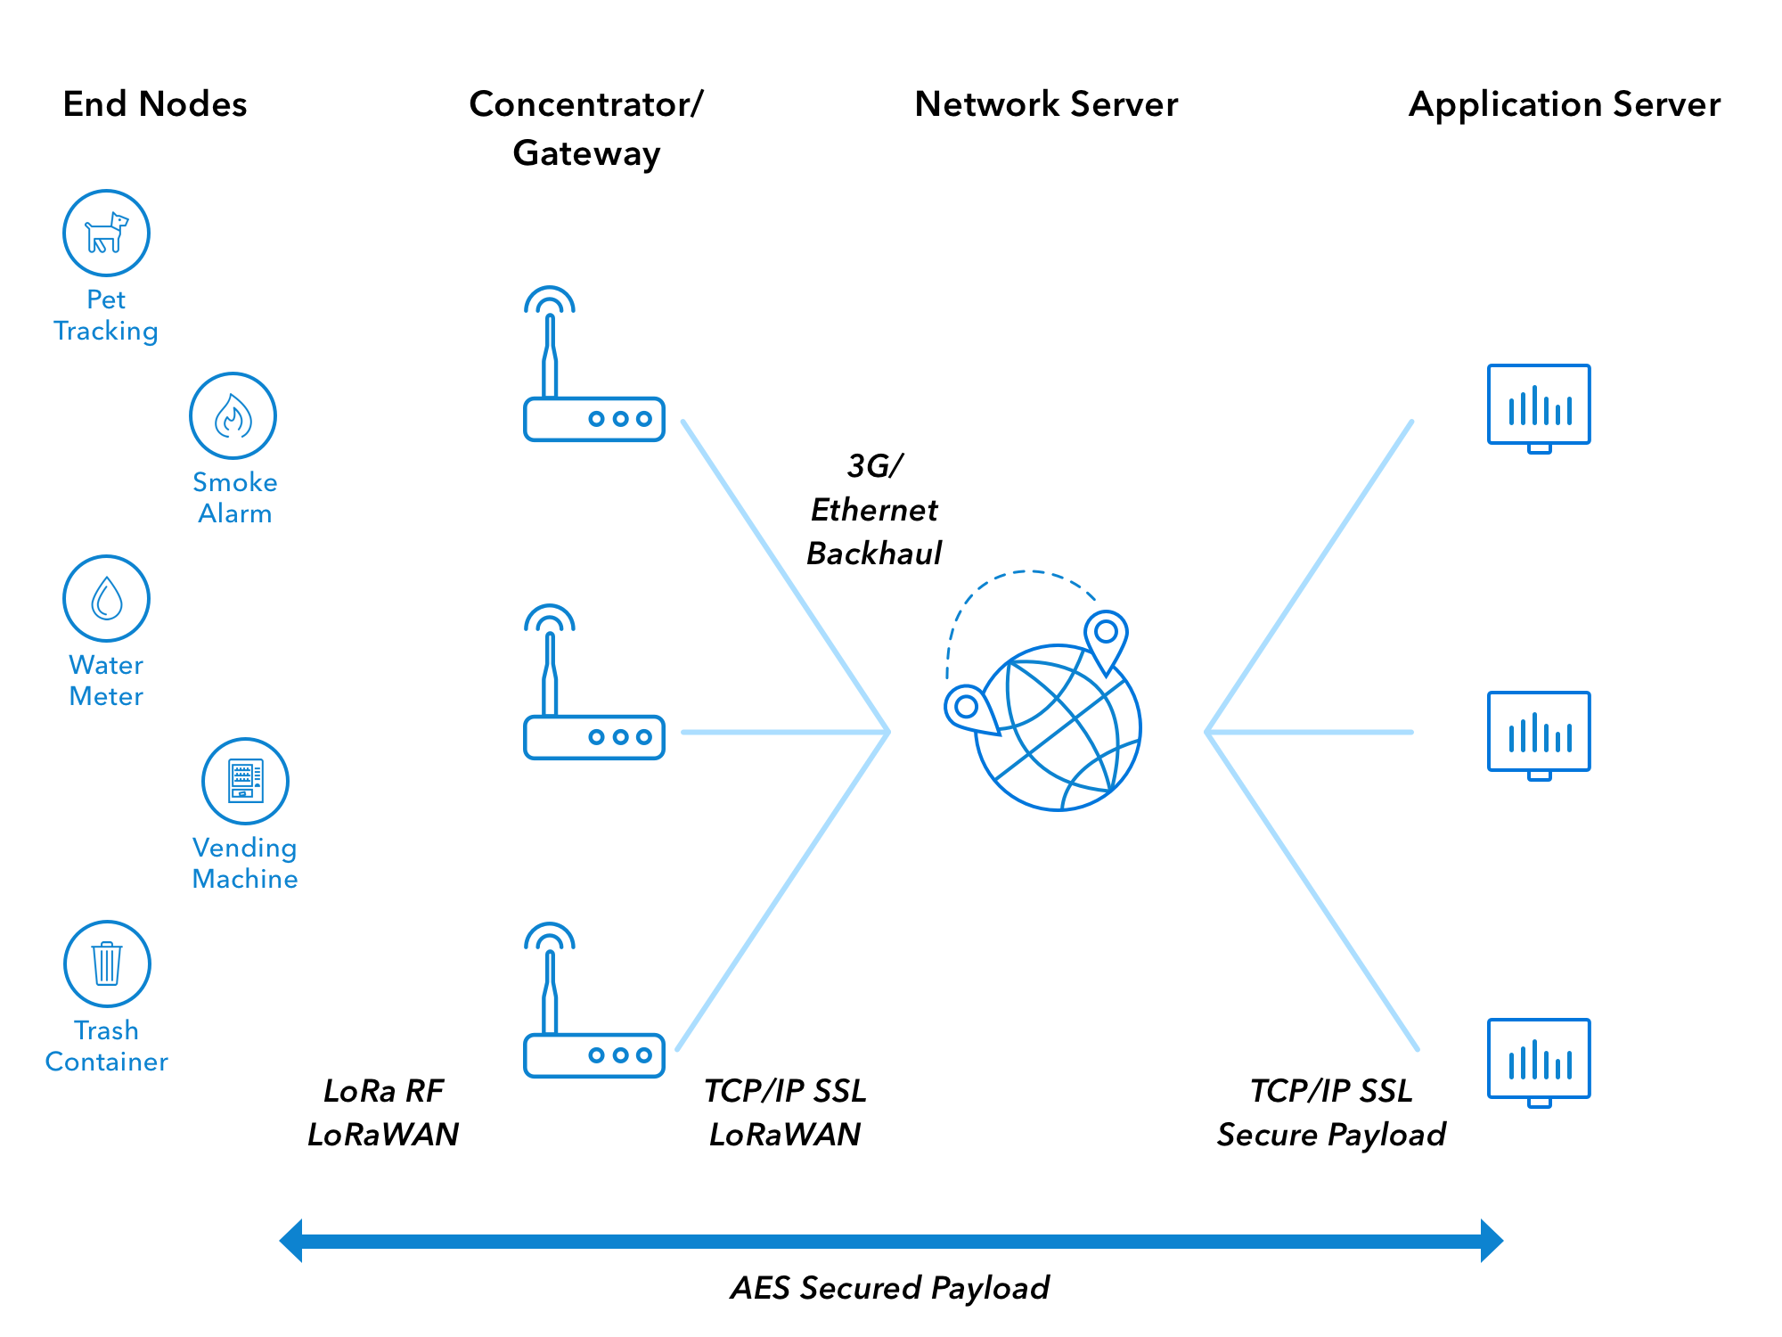
LoRa - long range, wireless radio frequency technology.
LoRa operates on unlicensed spectrum 1GHz.
LoRaWAN functions on LoRa
Communication protocol for IoT
Long Range, low power, low data rates.

Slide 9
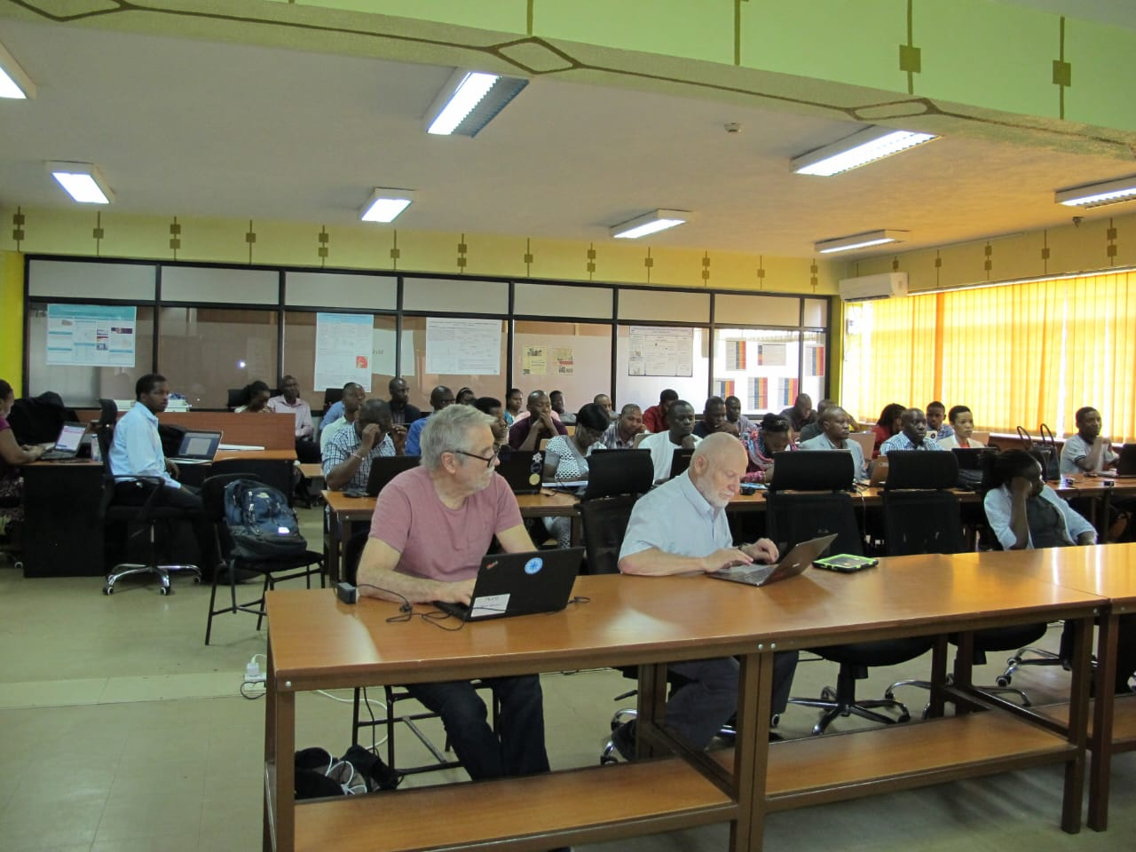
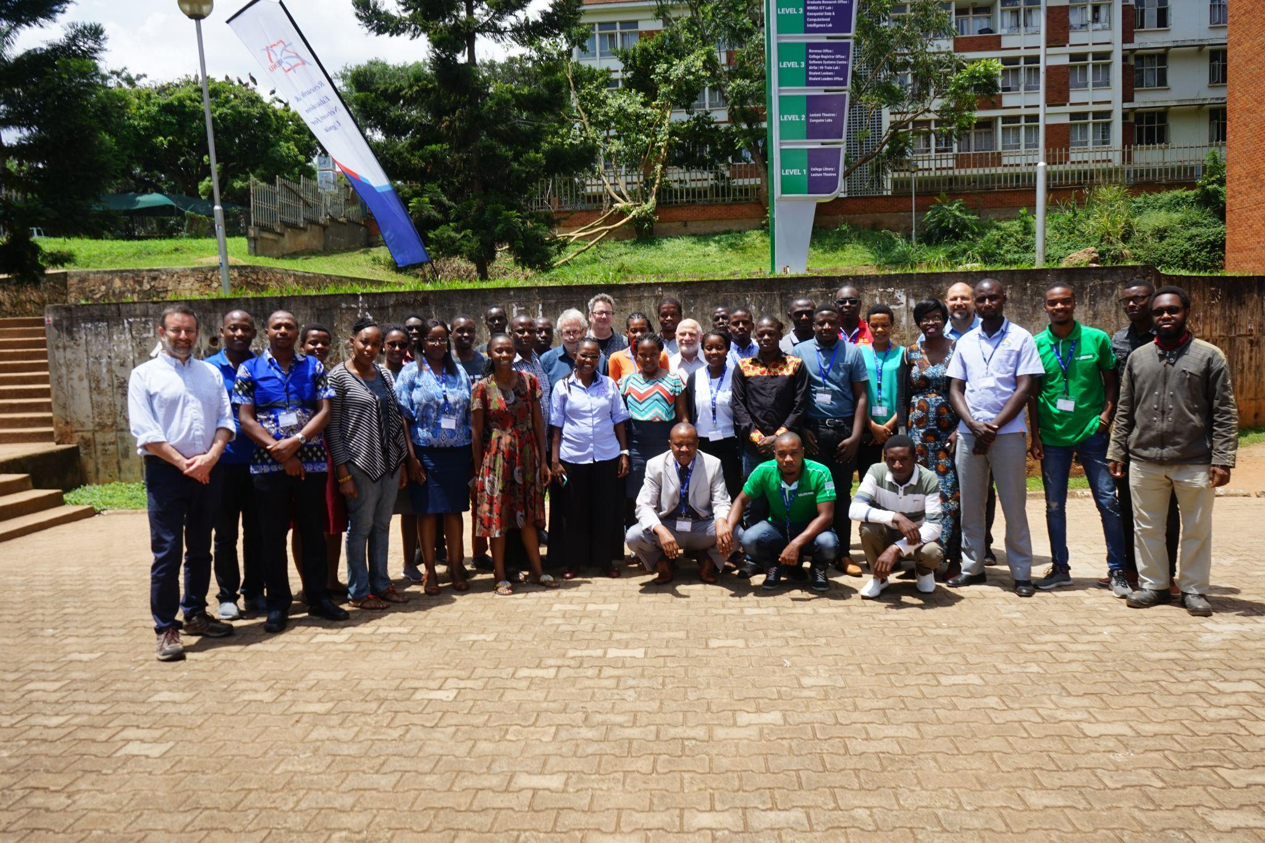
The Emergence of LoRaWAN in Uganda
NSRC LoRaWAN workshop - 2020

Slide 10
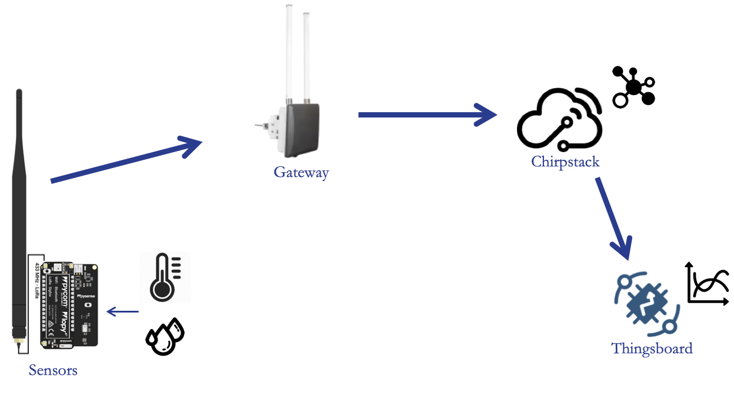
RENU LoRaWAN Architecture

Slide 11
2021

Slide 12
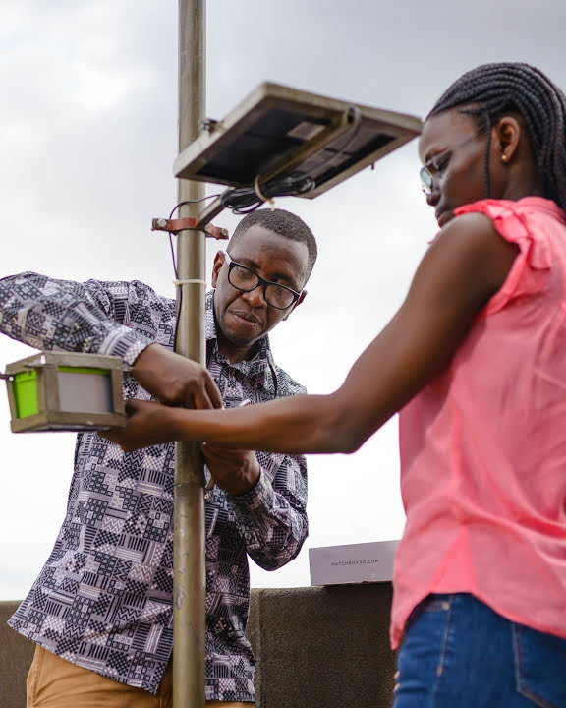
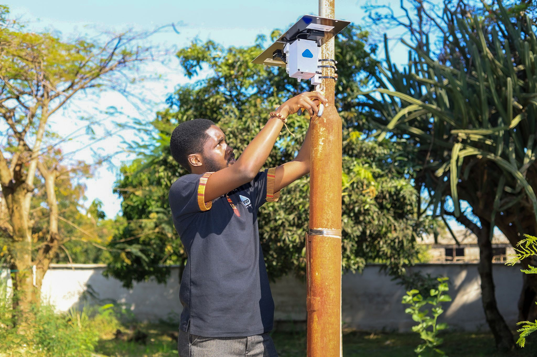
LoRaWAN Projects - AirQo
Air quality monitoring project
300 sensors using GSM
Shifting to LoRa
Providing LoRaWAN network and Support

Slide 13
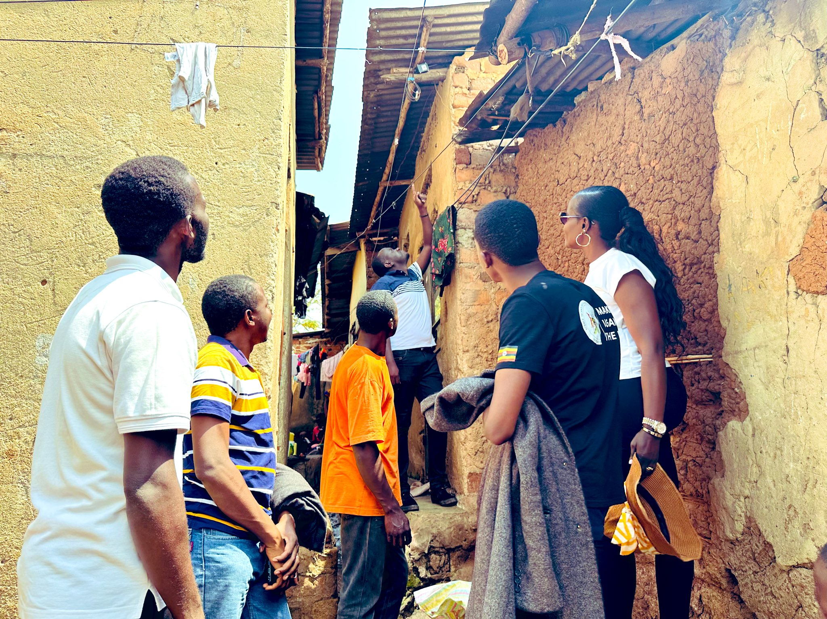
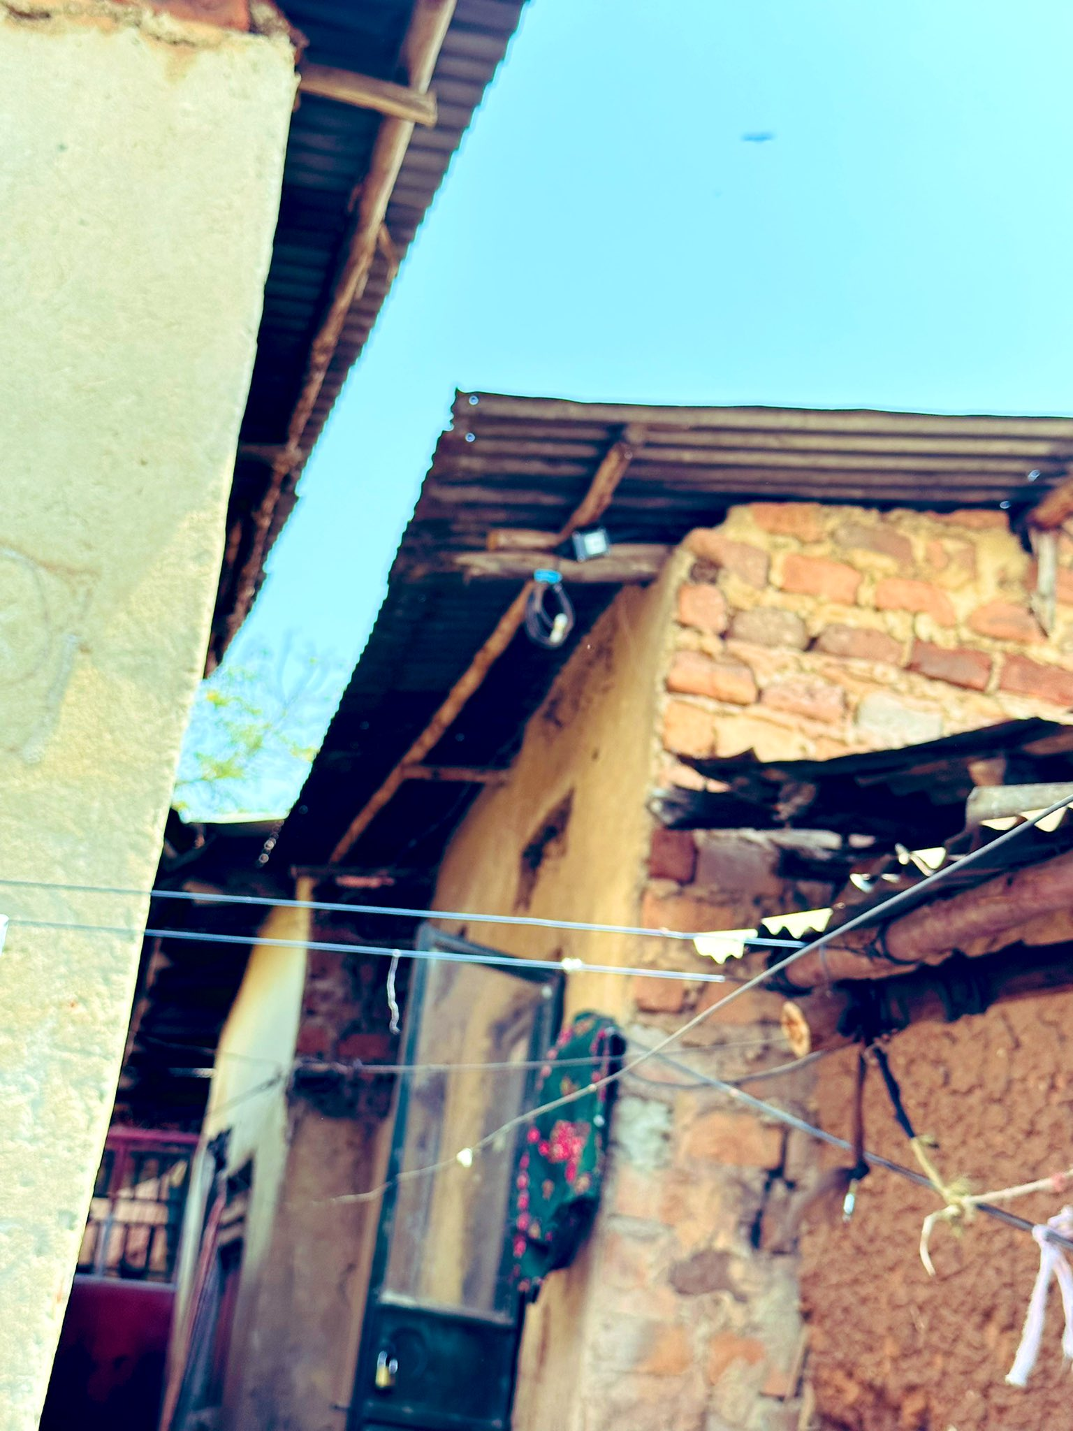

Slide 14
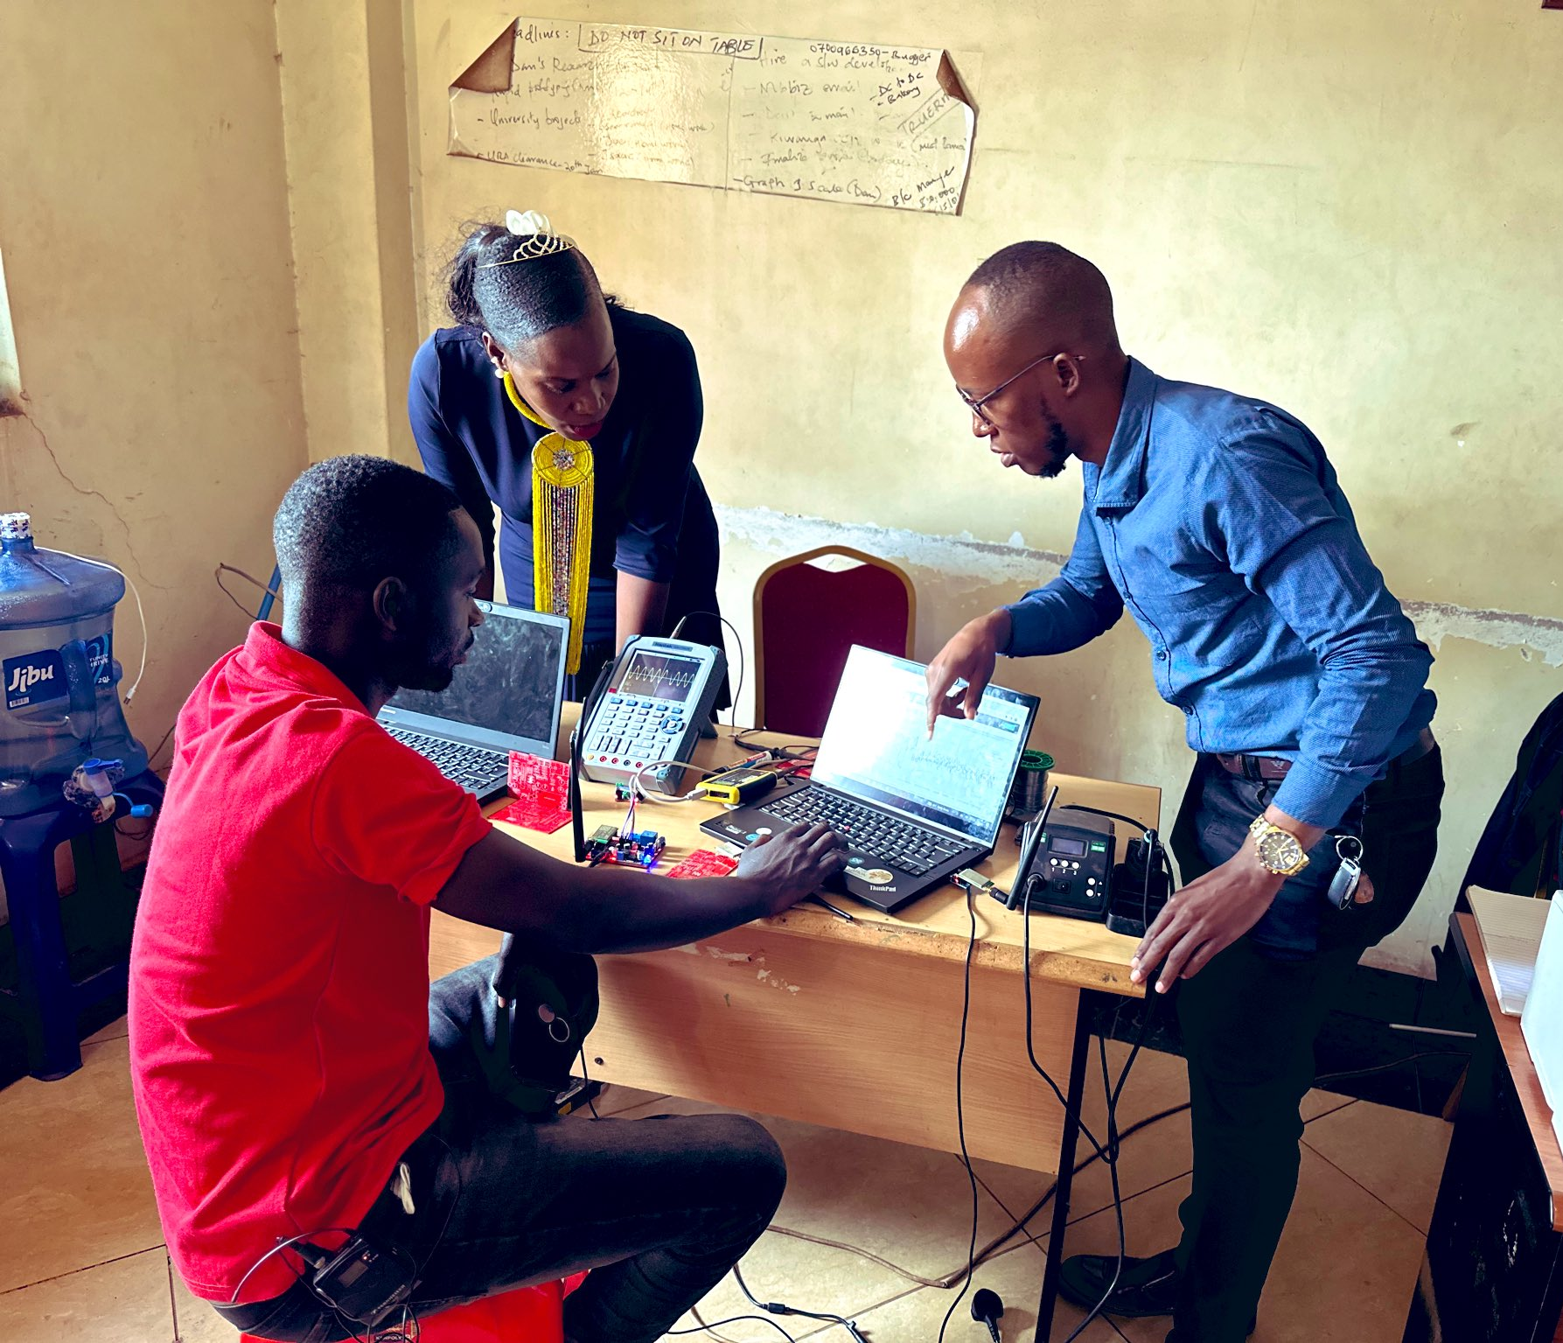
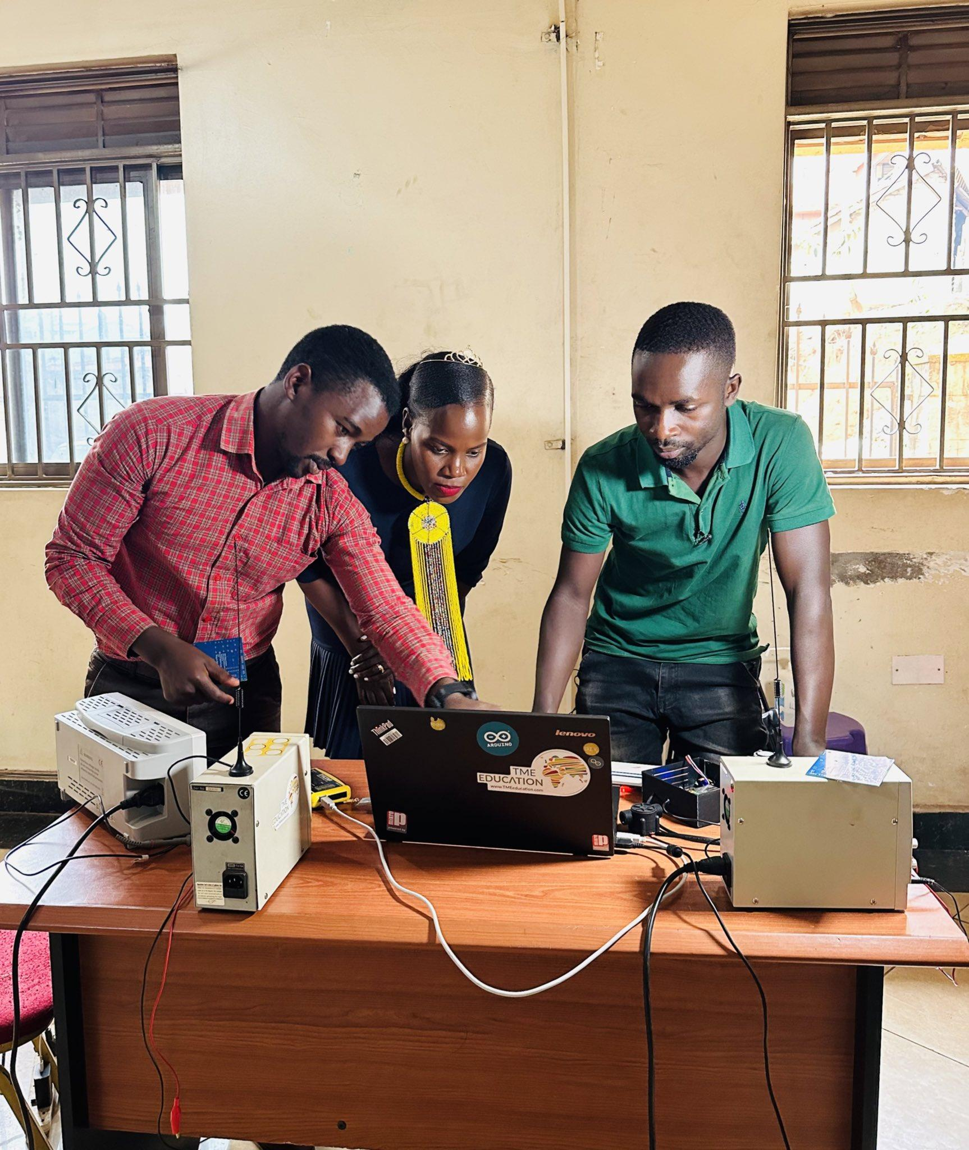
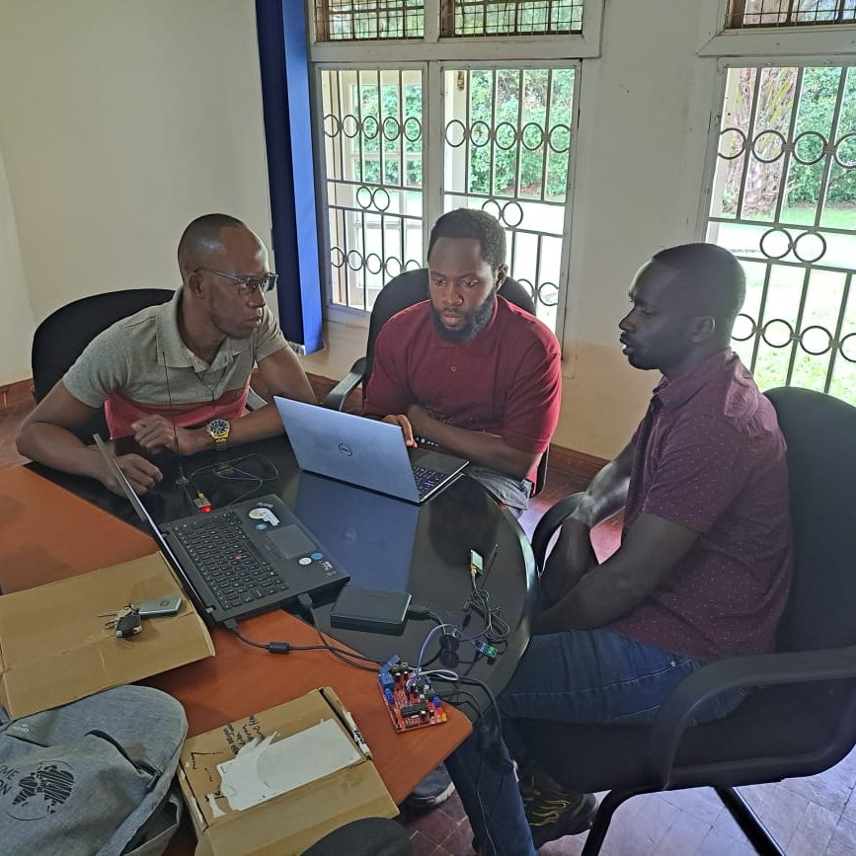

Slide 15
LoRaWAN Service Timeline

Slide 16
LoRaWAN Challenges

Slide 17
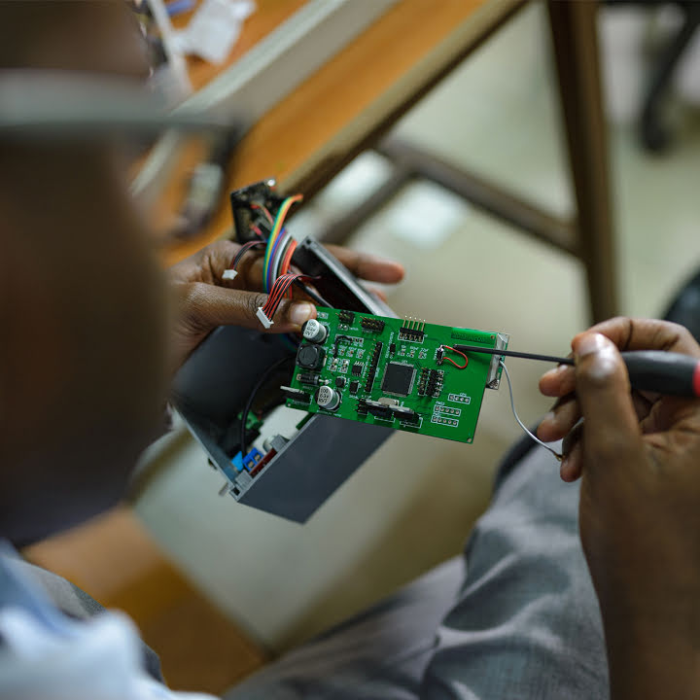
Future Prospects
Expanding more student projects - production
LoRaWAN antenna design - student project
Two gateways per region

Slide 18
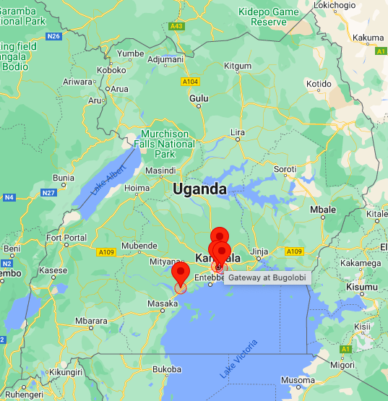

Slide 19
Special Thanks

Slide 20
Thank you
Any questions?

