Slide 1
How NRENs Can Help Create Digitally Mature Schools
Croatian e-Schools Programme
Goran Škvarč, Tihomir Markulin
Les Dortoirs
June 11, 2024.

Slide 2
02
Croatian Academic and Research Network
The impact of e-Schools programme
June2024

Slide 3
03
What is e-Schools programme?
2015. - 2023.
The impact of e-Schools programme
June2024

Slide 4
"
04
Comprehensive informatization of school operation processes and teaching processes aimed at the creation of digitally mature schools for the 21st century.
"
The impact of e-Schools programme
June2024

Slide 5
05
What we want to achieve?
Digitally mature schools
The impact of e-Schools programme
June2024

Slide 6
07
Project timeline
2012
2014
2015-2018
2018-2023
IDEA
PUBLIC CALL FOR PARTICIPATION
PHASE 1
PHASE 2
The impact of e-Schools programme
June2024

Slide 7
08
Key challenges
No system
No guidelines
No strategy
Low usage
Lack of a systematic approach to introducing ICT into education and other processes in schools.
Lack of guidelines or a system of development of digitally mature schools.
Lack of an officially accepted framework and strategy for the development of digitally mature schools. (Jugo et al, 2018).
Low level of use of the opportunities ICT offers in the education system.
The impact of e-Schools programme
June2024

Slide 8
09
Digitally equipped school with
a quality network
Benefits for principles
Equipped, educated, and digitally
competent teachers
Education
Guidelines on which aspects need further development in the school
Improvement of teaching and administrative processes of the school
The impact of e-Schools programme
June2024

Slide 9
10
Modern equipment and e-services for work
Benefits for teachers
Tools and resources for using ICT and applying modern teaching methods in education
Support in work
Education and training for the development of digital competencies
The impact of e-Schools programme
June2024

Slide 10
11
Benefits for students
Quality network in the school
Equipment for use in teaching
Digital content for learning
Development of digital competencies and skills for personal development and preparation for further studies and the job market
The impact of e-Schools programme
June2024

Slide 11
12
Phase 1
2015 - 2018
The impact of e-Schools programme
June2024

Slide 12
13
€40 mil
23,000
151
85% ESF+ERDF FUNDED
STUDENTS
ELEMENTARY & SECONDARY
SCHOOLS
Total budget for the Pilot project, where 15% of the total sum comes from the State budget, while 85% is financed by ESF + ERDF
Overall number of students included in the pilot project.
Number of schools that joined the program in the Pilot project
The impact of e-Schools programme
June2024

Slide 13
14
Faculty of Organization and Informatics
Partners
Education and Teacher Training Agency
Agency for Vocational and Adult Education
The impact of e-Schools programme
June2024

Slide 14
15
Results
Phase 1
The impact of e-Schools programme
June2024

Slide 15
16
RESULTS IN INFRASTRUCTURE
197
12,224
5
Interactive & presentation classrooms
school LANs
devices
regional training centres
The impact of e-Schools programme
June2024

Slide 16
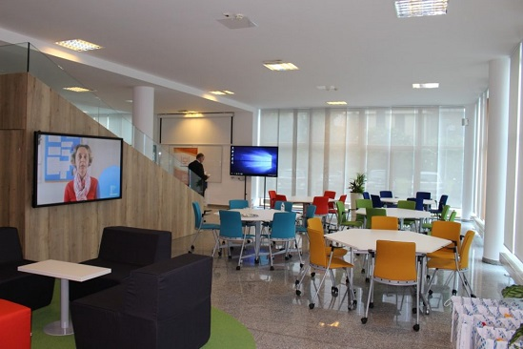
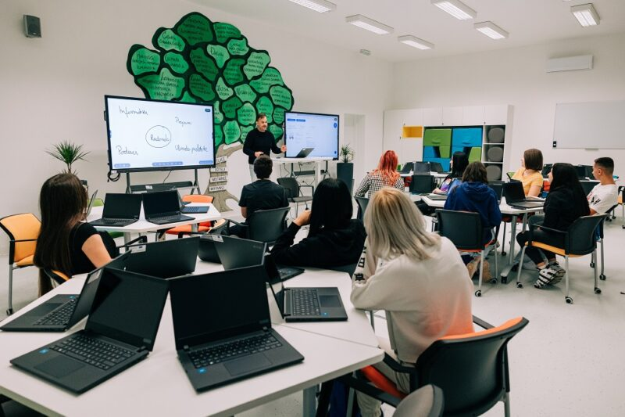
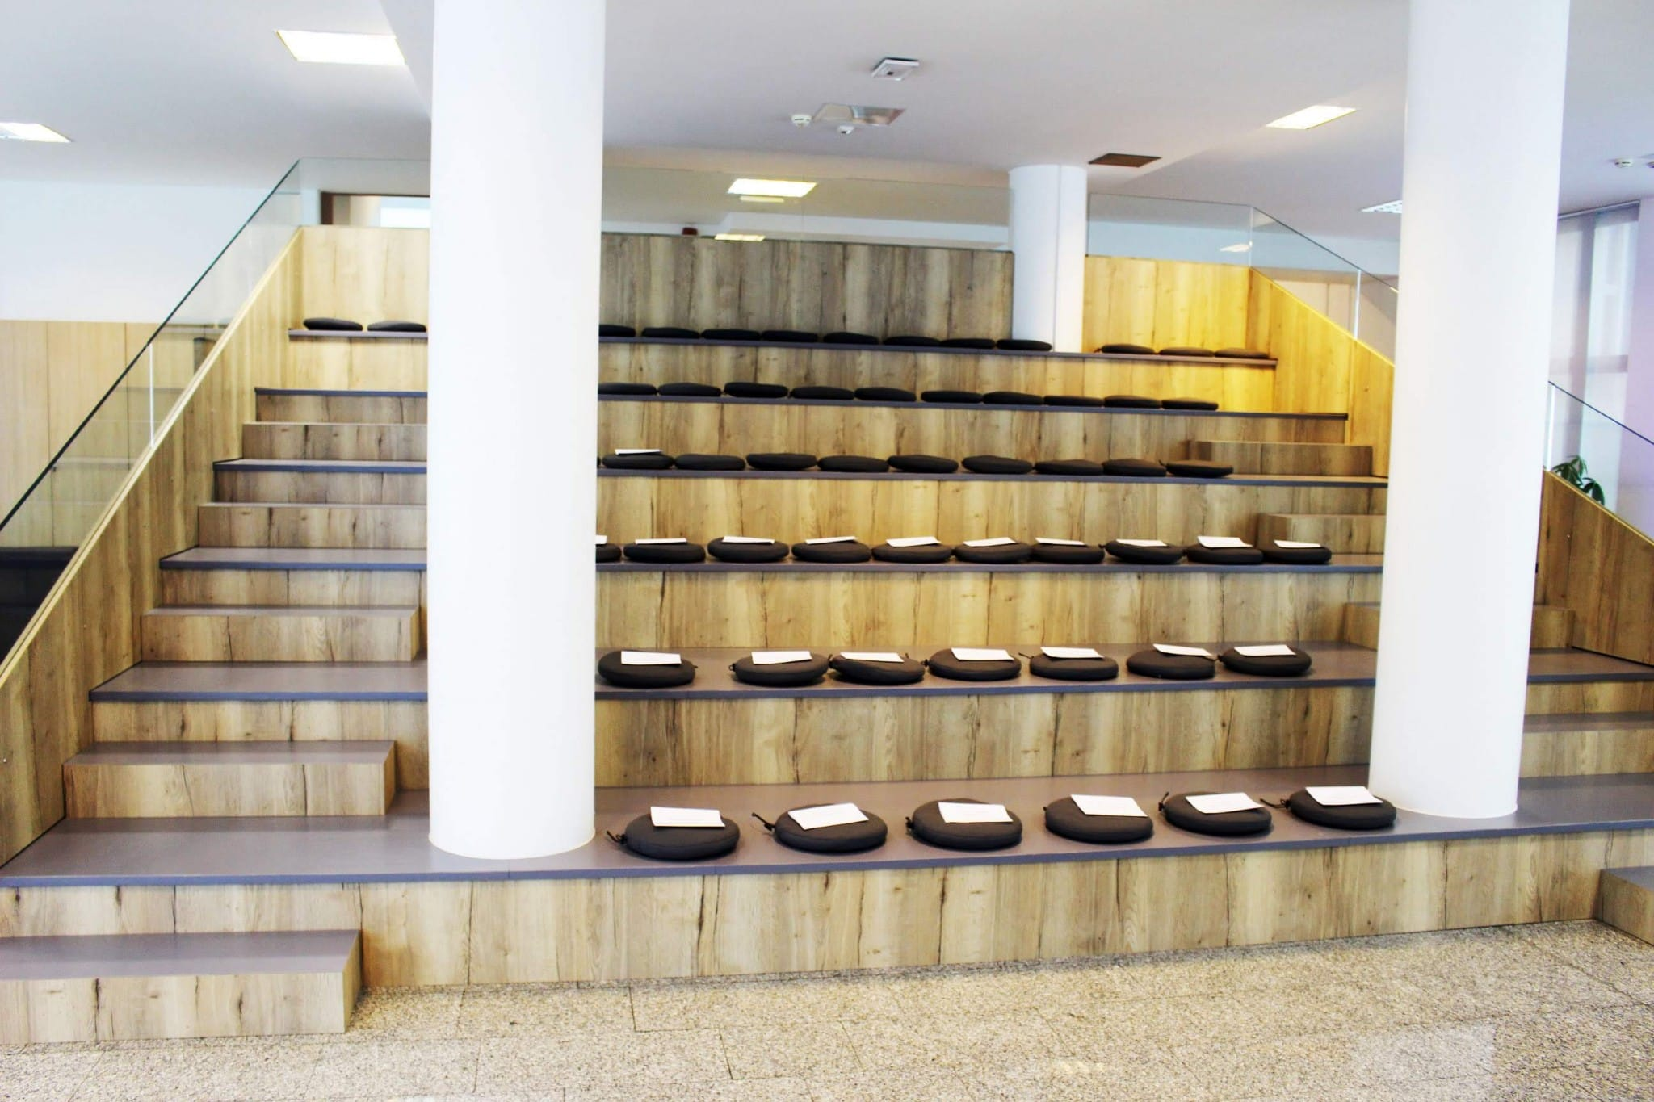
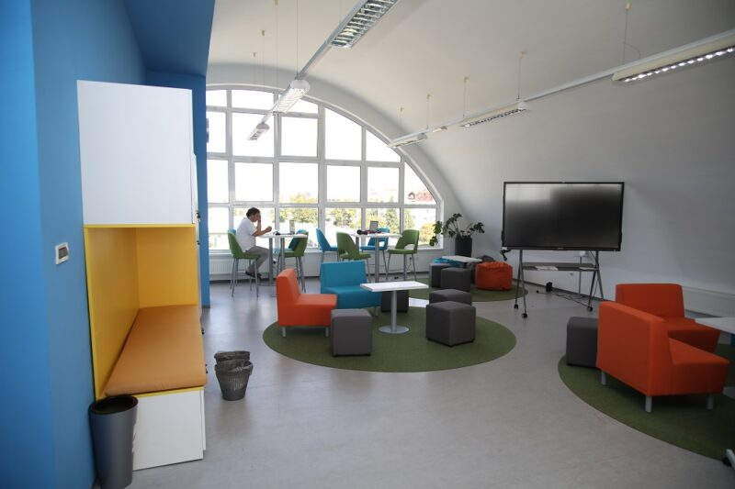
16
Regional training centres
The impact of e-Schools programme
June2024

Slide 17
17
RESULTS IN E-SERVICES
System for business informatization and monitoring of business processes in schools
Learning analytics system and educational data mining
Edutorij - Digital content repository
EMA - Application for organizing and monitoring education
The impact of e-Schools programme
June2024

Slide 18
18
RESULTS IN E-CONTENT
240
16
72
teaching scenarios
digital edu resources
e-Lektira (compulsory reading material)
The impact of e-Schools programme
June2024

Slide 19
19
RESULTS IN EDUCATION & SUPPORT
1.900+
7.000+
Framework for the Digital Maturity of Schools
Community of practitioners
various types of training
education program attendees
The impact of e-Schools programme
June2024

Slide 20
20
RESULTS IN RESEARCH
Scientific research on the impact of e-Schools pilot project (CPP)
Electromagnetic fields research
(IMI)
External evaluation of the digital maturity level
(FOI)
The impact of e-Schools programme
June2024

Slide 21
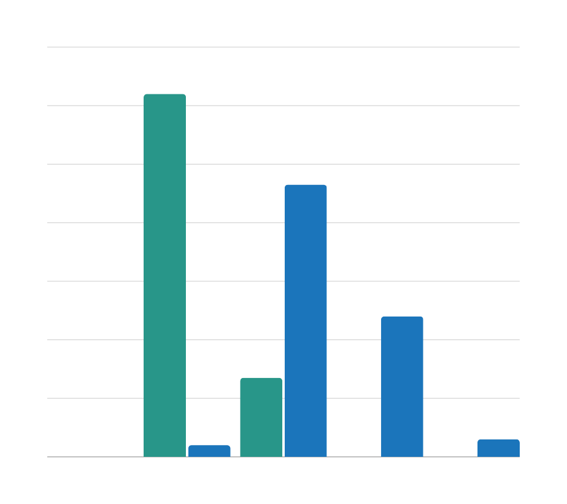
21
Level of digital maturity raised successfully
124
93
Framework for the Digital Maturity of Schools by CARNET & FOI
48
27
0
0
4
0
0
6
Digitally unaware
Digital beginners
Digitally competent
Digitally advanced
Digitally mature
2016
2018
The impact of e-Schools programme
June2024

Slide 22
22
Phase 2
2018 - 2023
The impact of e-Schools programme
June2024

Slide 23
23
€177 mil
600,000
1321
85% ESF+ERDF FUNDED
STUDENTS
SCHOOLS
Total budget for the Phase 2 of the project, where 15% of the total sum comes from the State budget, while 85% is financed by ESF + ERDF
Overall number of students included in the full-scale project
All schools in Croatia are included in the project. 907 elementary, 364 secondary, and 50 art schools and education centres
The impact of e-Schools programme
June2024

Slide 24
24
Faculty of Organization and Informatics
Education and Teacher Training Agency
Partners
Agency for Vocational and Adult Education
National Centre for External Evaluation of Education
Innovation Center Nikola Tesla
The impact of e-Schools programme
June2024

Slide 25
25
INFRASTRUCTURE
Allocation and management of institutional and user infrastructure resources
Centralized management of user devices in schools
Secure management of user master data
Management of the school's local computer network
User portal for personalized access to various data from different databases
E-CONTENT
RESEARCH
Education
Help Desk
Mobile teams for support
Community of practitioners
Framework for the Digital Maturity of Schools
Local computer network
Interactive and presentation classroom
Laptop computers
Digital educational resources
Teaching scenarios for curricular topics
Teaching scenarios and digital resources for interdisciplinary topics
Various research, measurements, and evaluations aimed at exploring the effects of using ICT in education
E-SERVICES
EDUCATION & SUPPORT

Slide 26
26
Results
Phase 2
The impact of e-Schools programme
June2024

Slide 27
27
RESULTS IN INFRASTRUCTURE
53,105
1510
Laptops delivered
LANs designed
10
2
new regional training centres
interactive & presentation classrooms per school
The impact of e-Schools programme
June2024

Slide 28
28
RESULTS IN E-SERVICES
Allocation and management of institutional and user infrastructure resources
Secure management of user master data
Management of the school's local computer network
MDM - Centralized management of user devices in schools
The impact of e-Schools programme
June2024

Slide 29
29
RESULTS IN E-CONTENT
240
350
47
teaching scenarios for curricular topics
Teaching scenarios for interdisciplinary topics
digital educational resources produced
The impact of e-Schools programme
June2024

Slide 30
30
RESULTS IN EDUCATION
23.000+
educational staff participating in workshops at schools
4.000+
attended online educations
Framework for the Digital Maturity of Schools
Community of practitioners
The impact of e-Schools programme
June2024

Slide 31
31
RESULTS IN SUPPORT
1.200+
mobile teams` visits to schools
Helpdesk for educational system support
Regional gatherings across the country
mobile teams' visits to schools
Community of practitioners
The impact of e-Schools programme
June2024

Slide 32
32
RESULTS IN RESEARCH
Scientific research on the impact of the project
Research of students’ digital competence and attitude
Experimental application of models for using ICT in learning and teaching
Evaluation of digital maturity of schools
The impact of e-Schools programme
June2024

Slide 33
34
Digital maturity by segments
Digitally mature
Digitally advanced
Digitally competent
Digital beginners
Digitally unaware
Planning, management & leadership
Digital tech in teaching
Development of digital competence
Digital culture
Infrastructure
The impact of e-Schools programme
June2024
Notes:
50% of schools (125 schools) at the middle 3rd level of digital maturity (e-enabled).
40%, (100 schools) are at the 4th level.
However, only three schools are at the highest, 5th level and can be defined as “digitally mature schools”.
Planning, managing and leadership continuously reporting lowest level of all domains (!) (2016, 2018, 2020)

Slide 34
06
Awards and acknowledgements
2017
UNESCO King Hamad bin Isa Al-Khalifa
2020
European Commission – Regiostars
2021
Cohesion Policy and Investments in Digital Education: The Experience of e-Schools in Croatia
e-Schools is one of the twelve best projects in the world in the field of ICT application in education.
The e-Schools pilot project won an award for the best project in the category of Skills and Education for Digital Europe, with the Republic of Croatia highlighted as an example of a country where continuity of education was successfully ensured during the crisis through distance learning.
The project was presented at the online conference of the MRRFEU and the European Commission as an example of best practice.
The impact of e-Schools programme
June2024

Slide 35
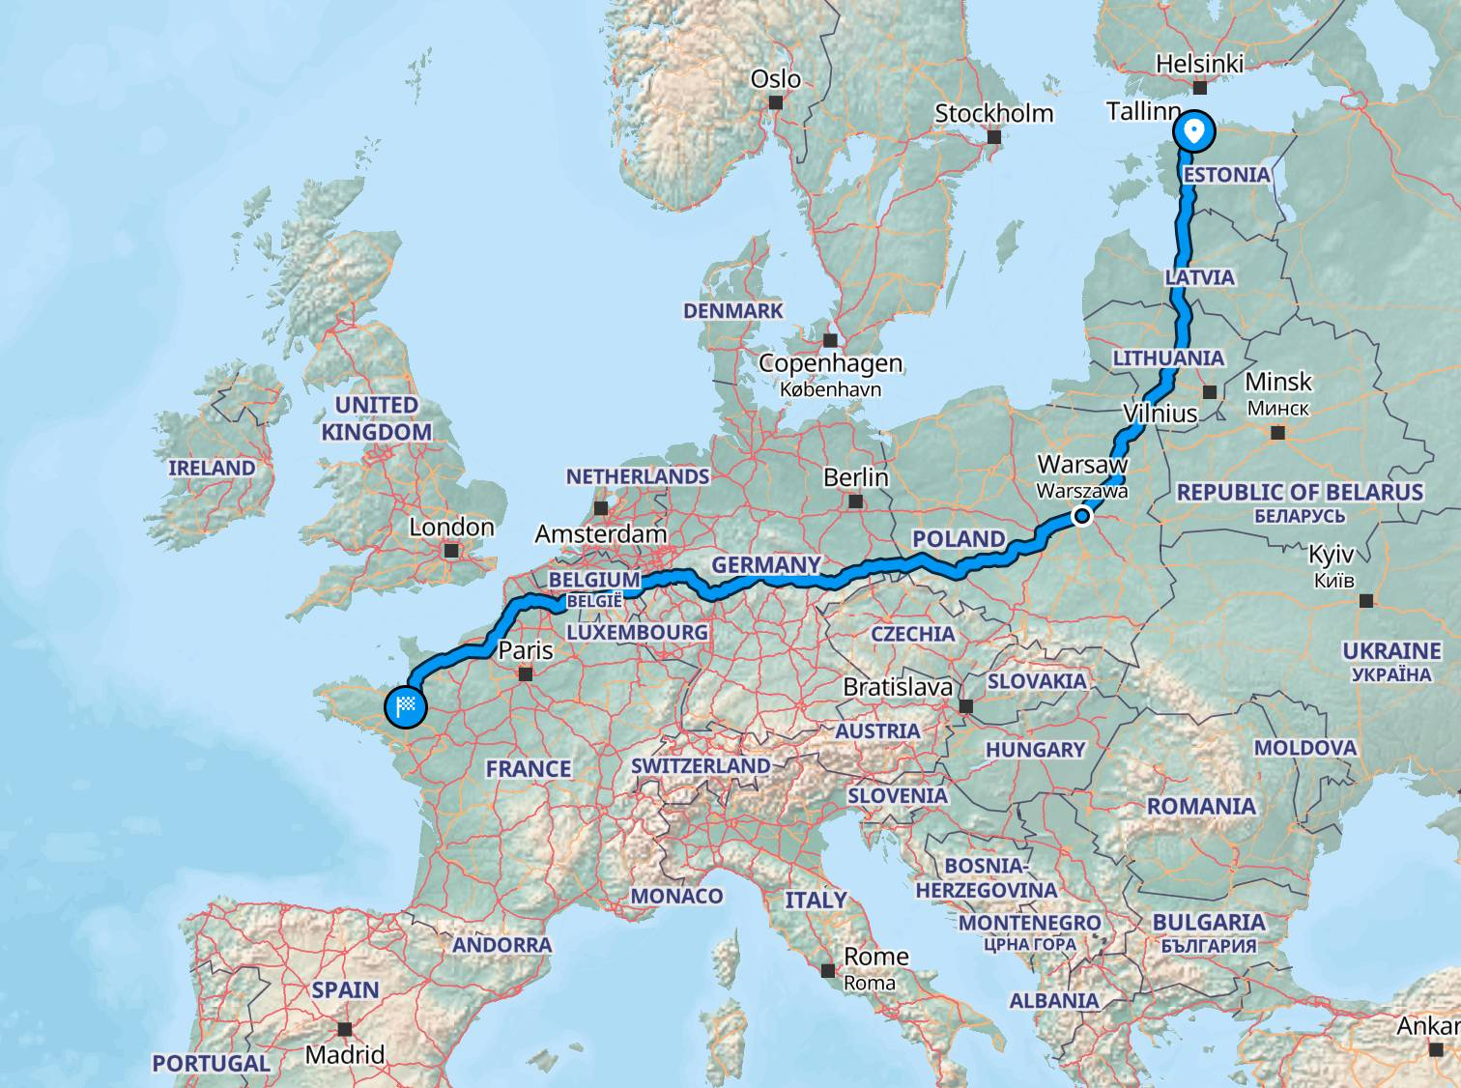
TRIVIA
4 380 racks
6175 meters high
19 Eiffel Towers
35
3 000 km – lenght of UTP cables used

Slide 36
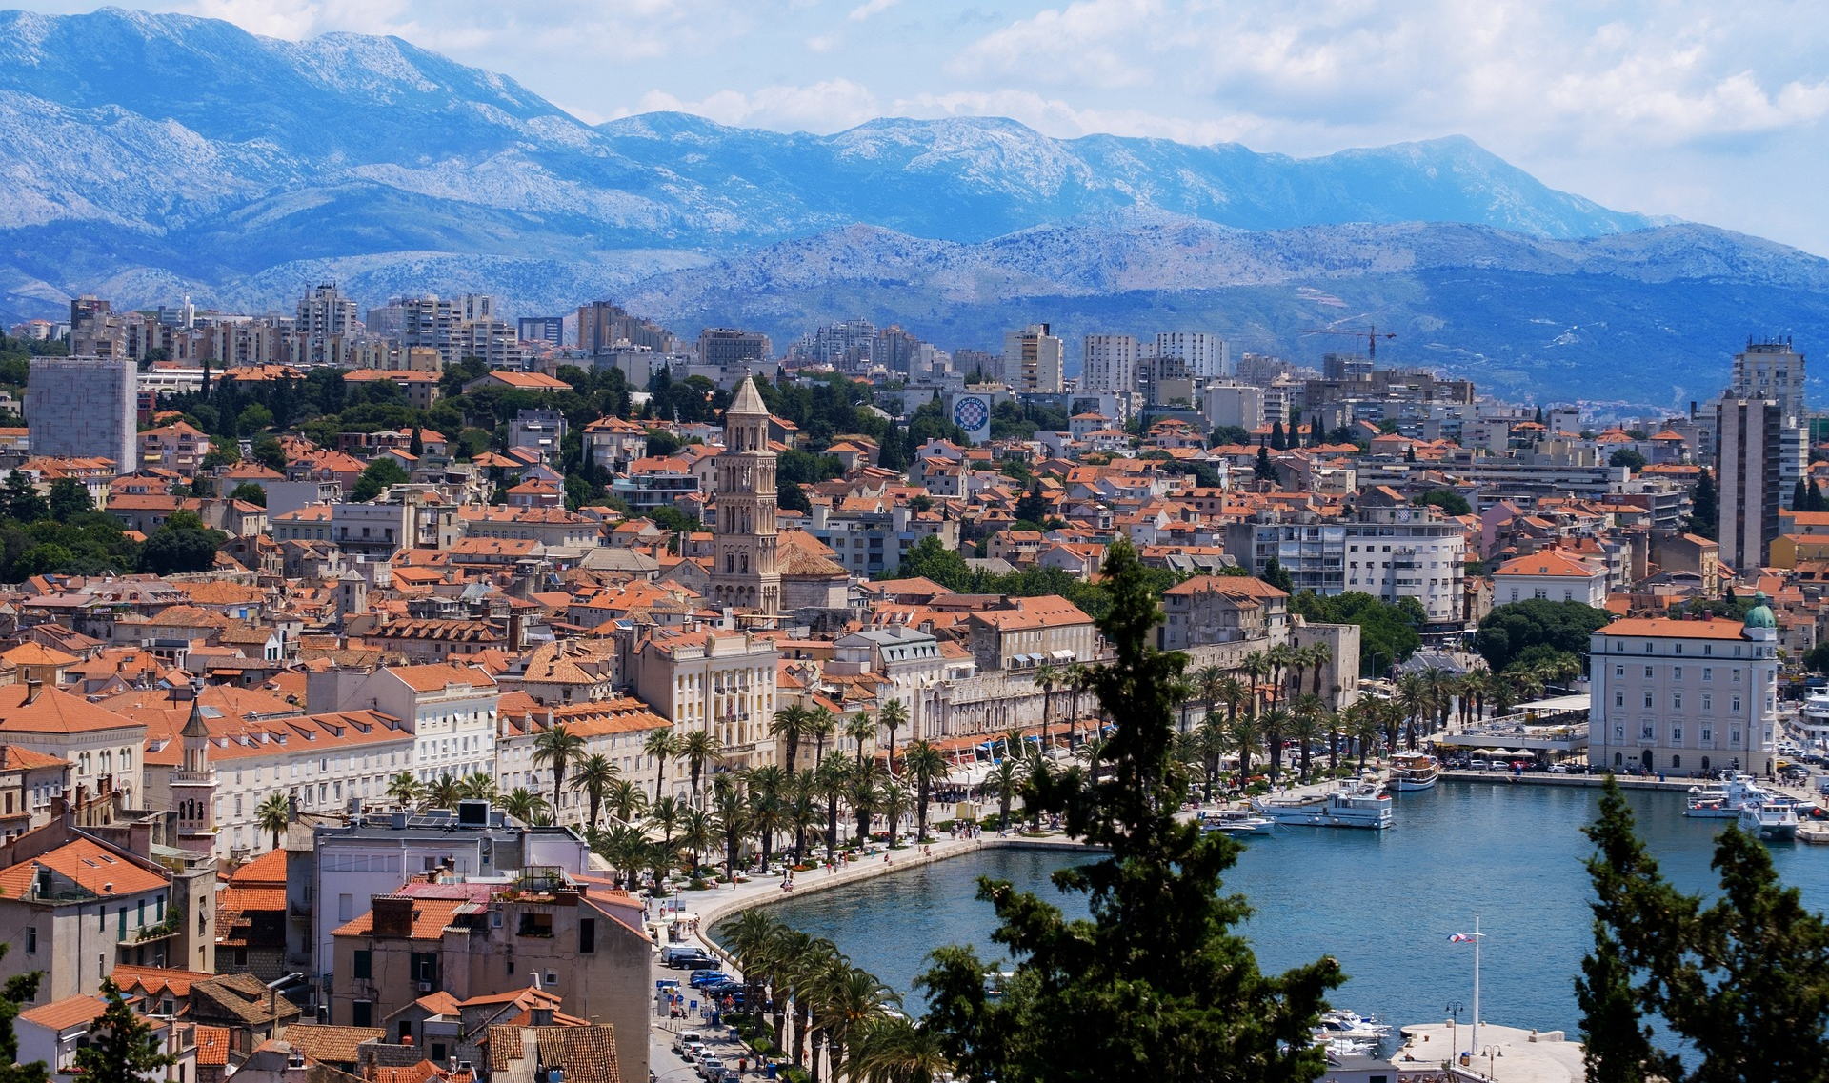
TRIVIA
35
400 000 kilometers
10 times around Equator
More than Earth to Moon
400 000 meters of fibre
Zagreb - Split
34 000 WiFi APs
1 400 meters high

Slide 37
The project was co-financed by the European Union through the European Structural and Investment Funds. More information about EU funds can be found on the website of the Ministry of Regional Development and European Union Funds: www.strukturnifondovi.hr
The content of this material is the sole responsibility of the Croatian Academic and Research Network - CARNET.
Contact: Hrvatska akademska i istraživačka mreža – CARNET | Josipa Marohnića 5, 10000 Zagreb
Tel.: +385 1 6661 616 | www.carnet.hr

Slide 38
Thank you
Any questions?
goran.skvarc@carnet.hr tihomir.markulin@carnet.hr

