Slide 1
Orchestrating Smooth Operations
The case of GP4L
Prof. Sonja Filiposka (UKIM), Roman Łapacz (PSNC)
TNC24, Rennes, France
10-14 June 2024

Slide 2
Paul can we have an agenda slide?
Agenda
The Global Platform for Lab (GP4L)
Automation and Orchestration in GP4L
Components
Pilot & Use Cases
Future work

Slide 3
The Global Platform for Lab (GP4L)
GP4L Experimental Testbed
A P4 distributed infrastructure that can be used by researchers to run network experiments.
01
GP4L Digital Transformation Use Cases
Network automation and orchestration solutions that will drive the digital transformation efforts.
02
GP4L Community Collaboration
Open for discussion and collaboration on digital transformation pilots:
Service Provisioning Pilot for PIONIER
03
https://geant-netdev.gitlab-pages.pcss.pl/gp4ldocs/

Slide 4
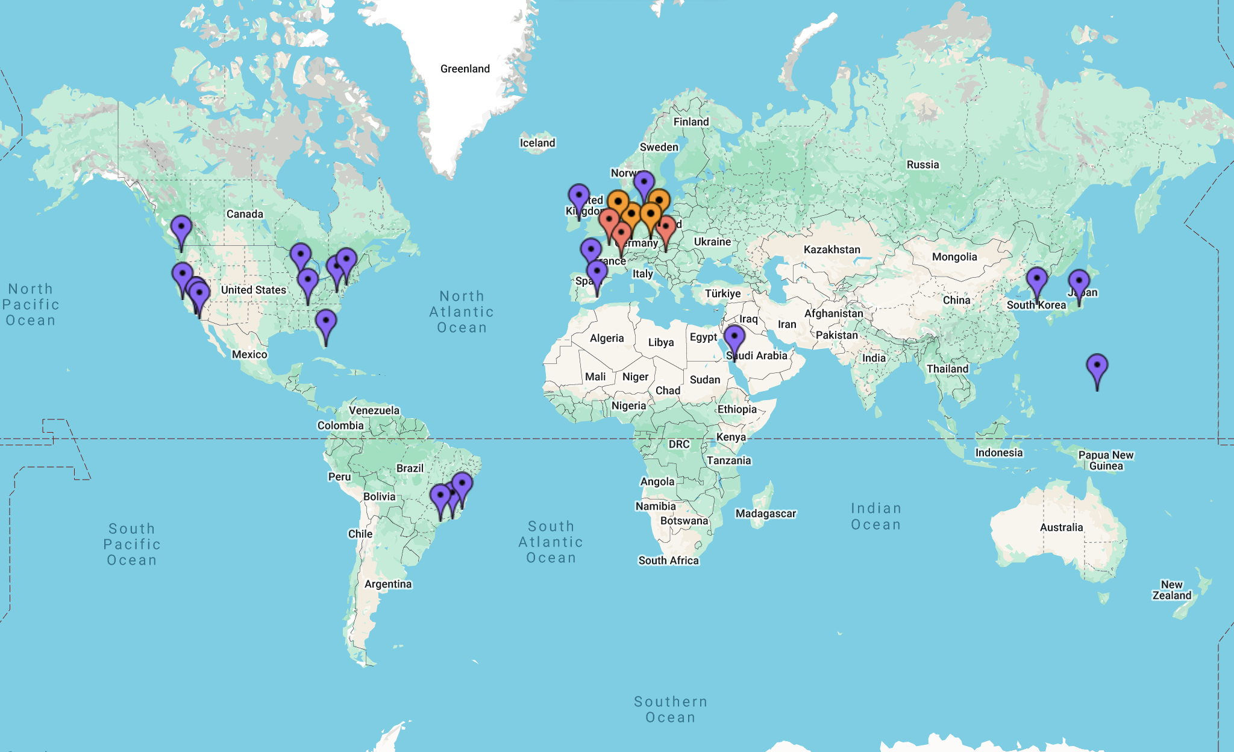
GP4L Experimental Testbed
A programmable network infrastructure that can be used to run cutting-edge network experiments.
id | Institution | Country
1 | GÉANT | NL
2 | GÉANT | DE
3 | GÉANT | HU
4 | GÉANT | PL
5 | MC36 | HU
6 | RENATER | FR
7 | SWITCH | CH
8 | STARLIGHT | US
9 | TCD | IR
10 | GÉANT | FR
11 | RNP | BR
12 | GÉANT | CZ
13 | CERN | CH
14 | CALTECH | US
15 | AM-Light | US
16 | RNP | BR
17 | UFES | BR
18 | HEANET | IR
19 | UM | US
20 | CALTECH | US
21 | CALTECH | US
22 | CALTECH | US
id | Institution | Country
23 | TT | US
24 | KISTI | KR
25 | KAUST | UAE
26 | KDDI | JP
27 | GÉANT | CH
28 | GÉANT | CH
29 | GÉANT | CH
30 | GÉANT | CH
31 | UM | ES
32 | UPB | ES
33 | UPB | ES
34 | KDDI | JP
35 | UMA | NL
36 | SDSC | US
37 | UG | US
38 | NYSERNet | US
39 | PW | US
40 | FIU | US
41 | TU | DK
42 | CENIC-LA | US
43 | CENIC-SV | US
44 | CENIC-SI | US
GÉANT Core + Partners => 44 devices

Slide 5
GP4L towards Digital Transformation
Orchestrated and automated operations
Source of Truth
Workflows
Components
APIs
GitOps
...
Use Cases & Solutions
Generalized, modular workflows and code
Education
Courses in Network Automation eAcademy
Digital Twin
virtual copy of the network
Network Visualization
Graphics as code
Cloud-based
All implementations are available in
Principles
Define intent
Model orchestration
Integrate tools
Automate all
Verify in pre-production
Reusable
Open-source code and documentation
GP4L Playground

Slide 6
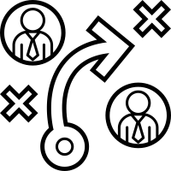
Want to automate? First decide on the Source of Truth (SoT)
Essential for Infrastructure as Code (IaC)
Facilitates the management and provisioning of infrastructure via code rather than manual procedures.
1
5
API & Data Model
Describe the network and services in sufficient detail. Manage all information via APIs.
Declarative approach
Defines the expected state / the correct state and expects the live infrastructure to follow it.
2
Service & Resource
Integrated or separated (w/o data duplication).
Single or not?
Single source per item type.
4
3

Slide 7
The Case of GP4L
NetBox
Maat
The SoT for GP4L network resources.
The SoT for GP4L network services

Slide 8
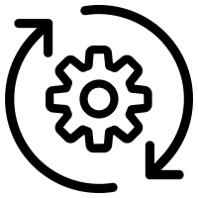
Maat as SoT
Maat is a microservice for open digital platforms that serves as a single source of truth for physical and logical resources and/or services.
Open Standard-based APIs
Full CRUD support for IaC out of the box
TMF638 Service management REST API
TMF639 Resource management REST API
Extensible Data Model
JSON-based data model
Validation based on data model schema file
Extensions do not require changes in code or database
Multiple data models can be defined in custom schemas
Events Hub
External applications can register and listen to selected events
Events are archived for historical purposes
TMF standard API
Technology stack
NoSQL database (MongoDB)
Spring Boot 3 library
Docker
Keycloak
OAuthN 2.0

Slide 9
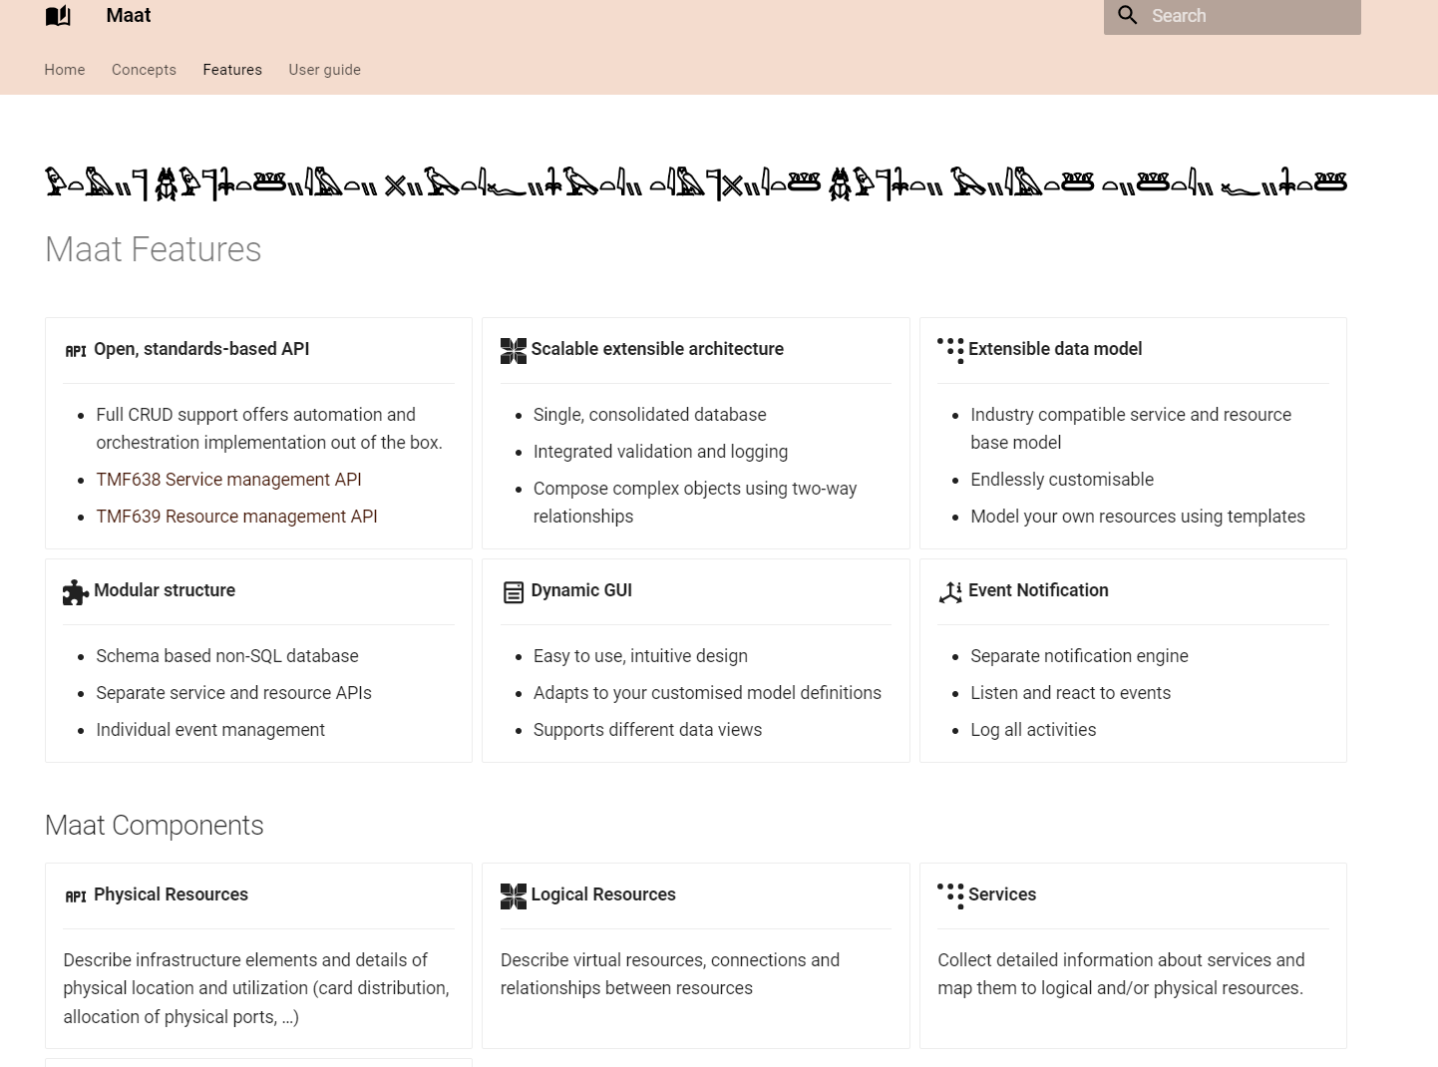
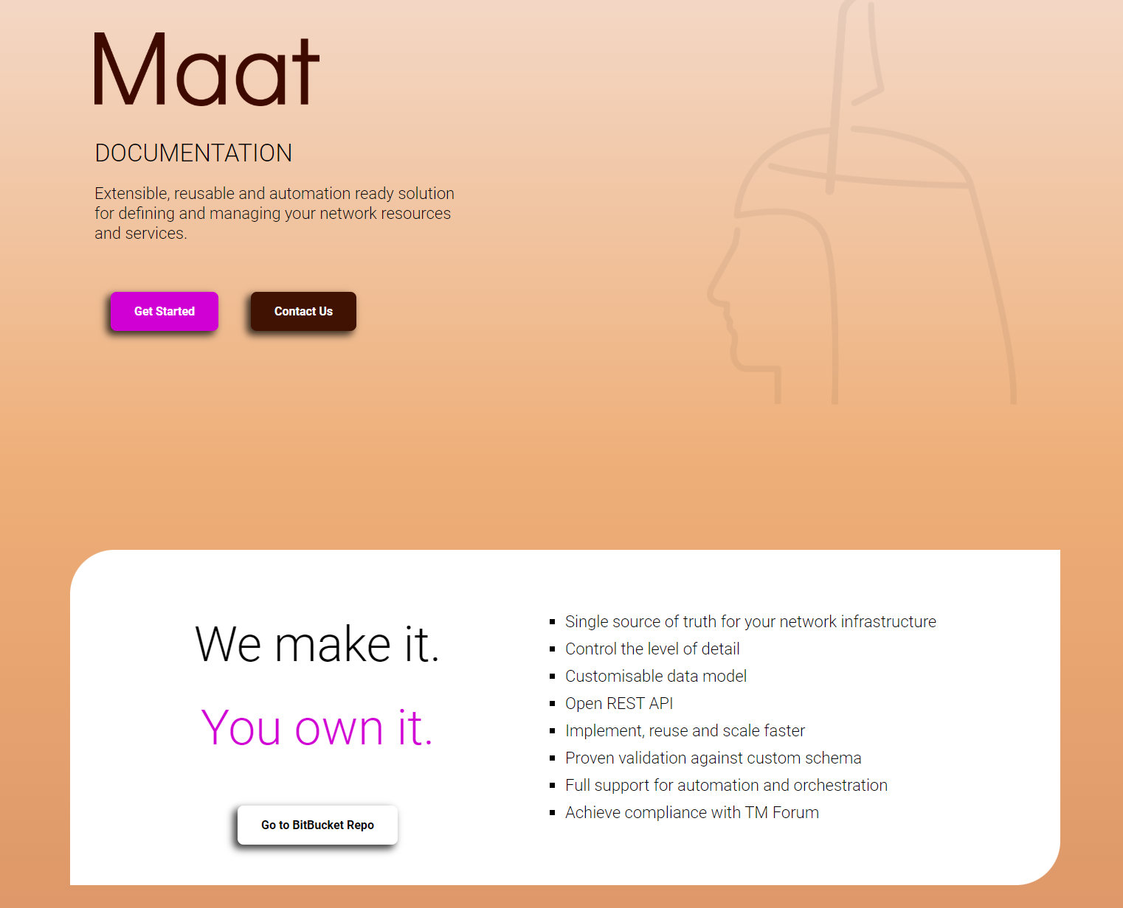
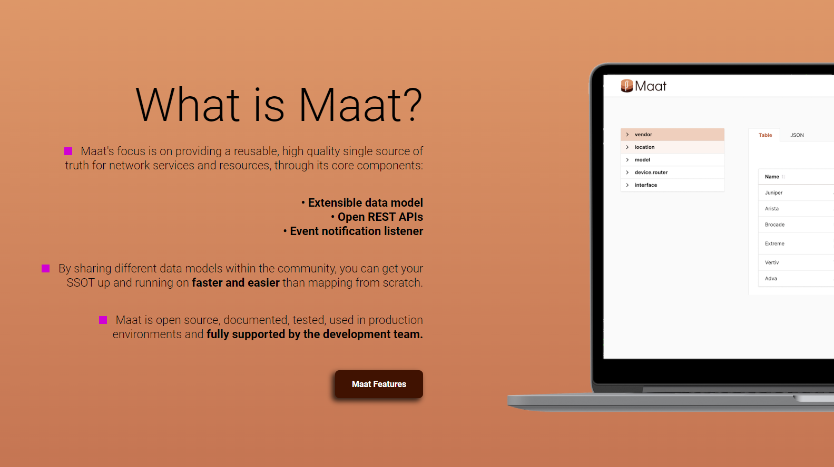
Maat as SoT
https://geant-netdev.gitlab-pages.pcss.pl/MaatDocs/

Slide 10
GP4L Automated Network Operations
1
2
1
Resource Management
2
Resource Reservation
GP4L testbed infrastructure devices
Inventory
Monitor
Configuration Backup
3
GP4L testbed infrastructure
Request an experiment
Approve experiment
Access reserved testbed devices
3
Service Provisioning
PIONIER network
Inventory
Model services
Prepare configuration
Verify then push

Slide 11
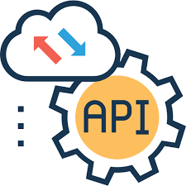
Resource management use case
A GP4L partner connects a new programmable switch to the GP4L infrastructure.
Probes in monitoring tool
User action in Source of Truth
Orchestration workflows
Configuration Backup
Oxidized

Slide 13
Experiment reservation use case
A researcher schedules an experiment in the GP4L testbed infrastructure.
Reservation system
User action in Source of Truth
Orchestration workflows
Access to the resources
Bastion
SSH Key Management application

Slide 14
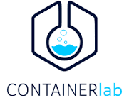
GP4L Joint Collaboration
Service Provisioning Pilot in PIONIER
01
Generalized workflow definition
05
Dry-run with digital twin
02
Data model for resources and services
04
Open-source modular approach reusable in different networks
Technology stack and integration with existing NOC tools
03
GÉANT LSO

Slide 15
Service Provisioning Workflow
check technical requirements for service provisioning
reserve service parameters
run test and analyse results
ensure all components are operating
validate against intent
prepare configuration for network devices
Determine service feasibility
Track service usage
Configure
Test service
setup performance data collection schedules
setup additional monitoring to track usage for billing purposes
Setup service health monitoring
Allocate service parameters
Activate service
allocate the appropriate specific service parameters to support service implementation
validate configuration changes (dry-run)
push configuration to network
based on service operational specification and quality requirements
setup monitoring for gathering any specific data according to SLA/OLA

Slide 16
Lessons Learned
Constant Headaches
Incomplete documentation
Libraries status
Bugs
Workflow Flexibility
Adding functionality
Changing components
Data Integrity
Matching data across components
Compatibility
The impact of upgrades

Slide 17
GP4L on the road of automation & orchestration…
Develop & Test
We’ll continue investigating new tools and technologies via use cases.
Share
Via open-source repos and documentation, courses on eAcademy.
Collaborate
Contact us and learn how we can collaborate on joint project and goals.

Slide 18
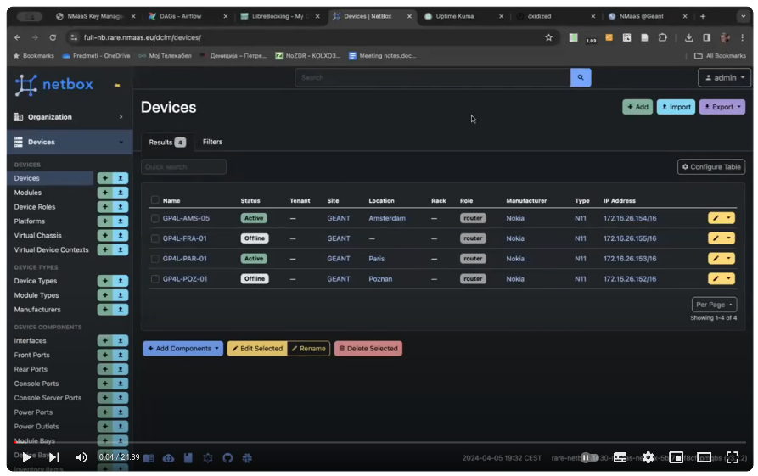
Thank You
Contact: gp4l-admin@lists.geant.org
Demo video:
https://www.youtube.com/watch?v=KYqpLPBDR3k
Some of the slides in this presentation were designed by www.slideegg.com
The scientific work is published for the realization of the international project co-financed by Polish Ministry of Science and Higher Education from financial resources of the programme entitled "PMW”.

