Slide 1


Part 02
Part 01
Empowering Optical Network Teams Through Digital Twins
Digital Twin
Optical Digital Twin
GNPy
Experiment
How-to GNPy
Conclusion
Renato Ambrosone
Matteo Colantonio
A Case Study on Implementing and Utilizing GNPy
Rennes, France
11 June 2024

Slide 2
Part 01
Part 02
Digital Twin
Optical Digital Twin
GNPy
Experiment
How-to GNPy
Conclusion

Slide 3



Digital twin concept
Digital Twin
System control interfaces
Environment
interfaces
Models
Needed actions for system function
Control
Interfaces

Slide 4



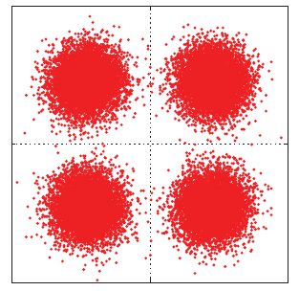
Physical layer in optical networks
Tx
Rx
+
+
+
+
+
_{XT}
_{ASE}
NLI
_{Tx noise}
_{Rx noise}

Slide 5

Physical layer in optical networks
D
GSNR_{DF}
F
GSNR_{BD}
GSNR_{ED}
GSNR_{EF}
GSNR_{FG}
GSNR_{EG}
G
B
GSNR_{BC}
E
GSNR_{AB}
C
GSNR_{CE}
GSNR_{HG}
GSNR_{GI}
A
GSNR_{AC}
GSNR_{CH}
H
I

Slide 6
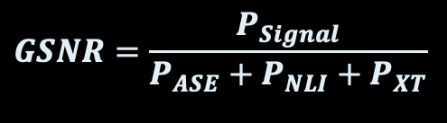



GSNR as metrics
Digital Twin ⇔ Real Network
$$SNR=\frac{P_{Signal}}{P_{Noise}}$$
$$BER=b2b\left(GSNR\right)$$
⇔ $GSNR={b2b}^{−1}(BER)$
Pre-FEC BER
$$GSNR=\frac{P_{Signal}}{P_{ASE}+P_{NLI}+P_{XT}}$$
OSNR

Slide 7
What is GNPy?
Python
Open Source
Quality of
Transmission
Estimator
Optical
Digital Twin
GN model
Design &
Planning

Slide 8
What do I need to use GNPy?
Deep topology
knowledge
Device
characterization
GNPy
Digital Model
Device
working points
Transceiver b2b
BER VS OSNR

Slide 9
GNPy limitation
Amplifier full
C-band spectral load
Data model
Live telemetry
interface

Slide 10
Experiment & Results
Matteo Colantonio

Slide 11
Objective
GNPy extensively validated.
Is it hard to use?

Slide 12
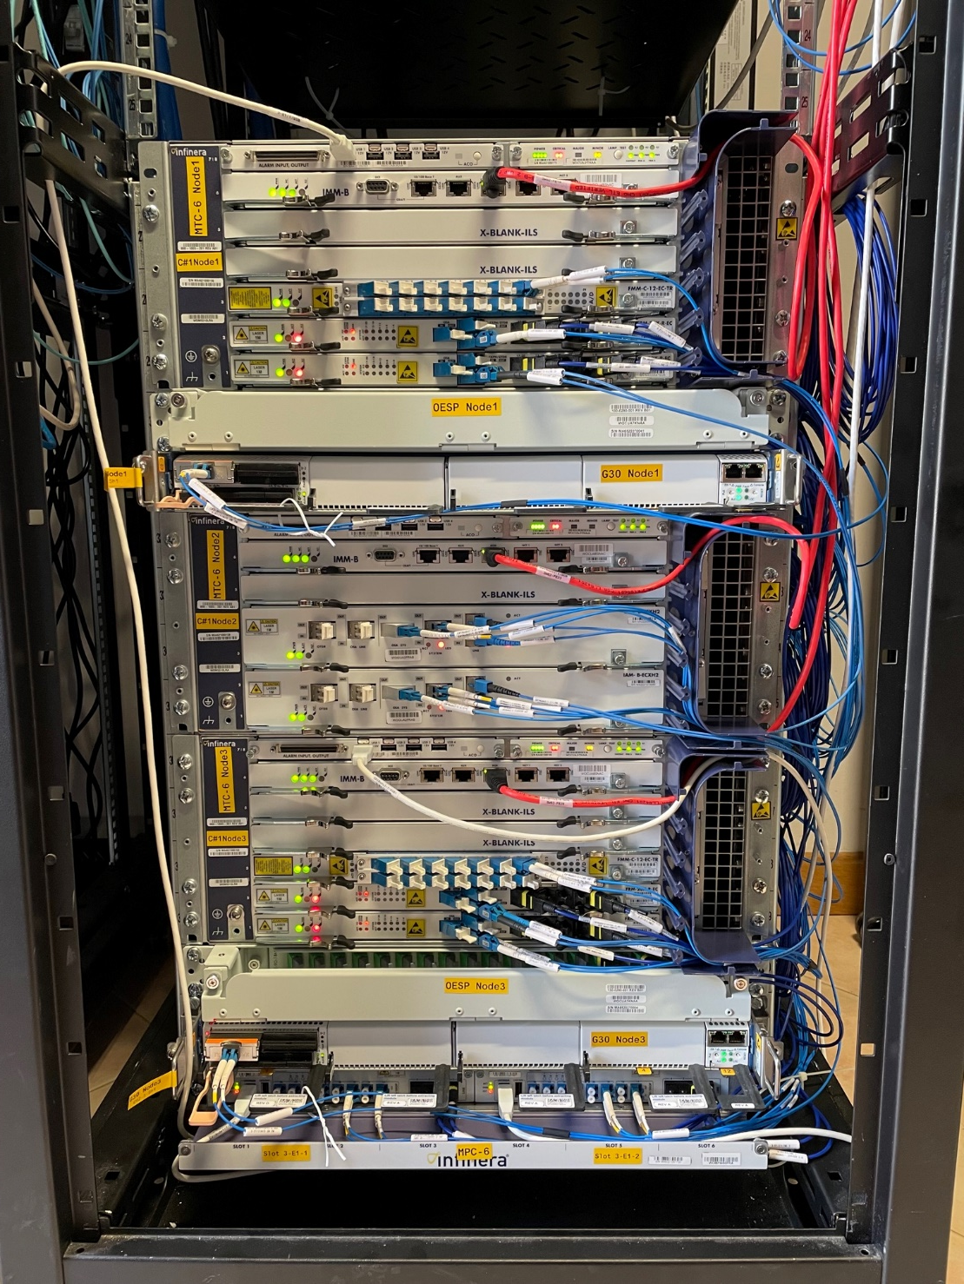

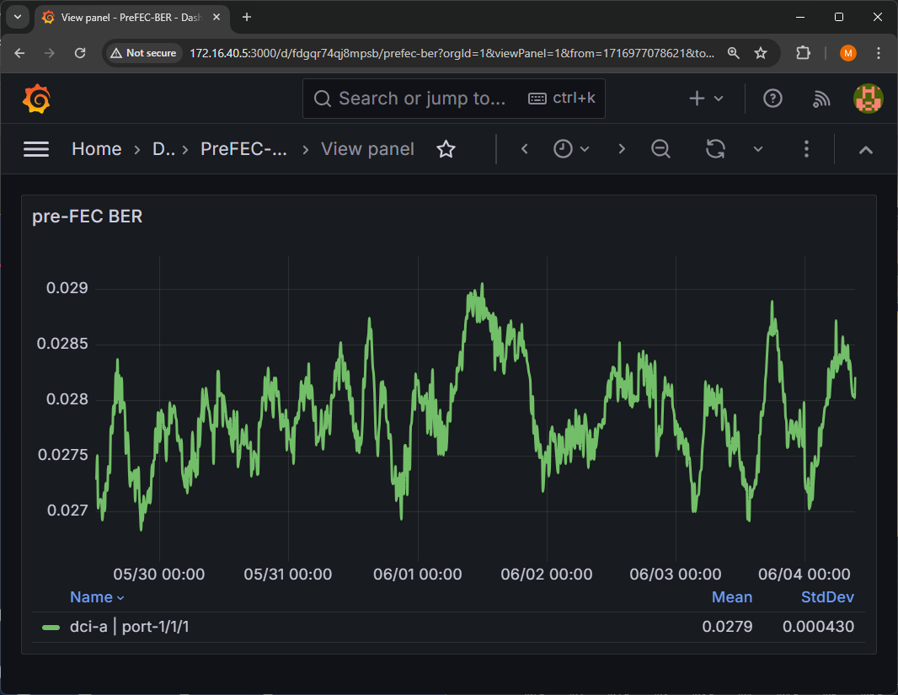
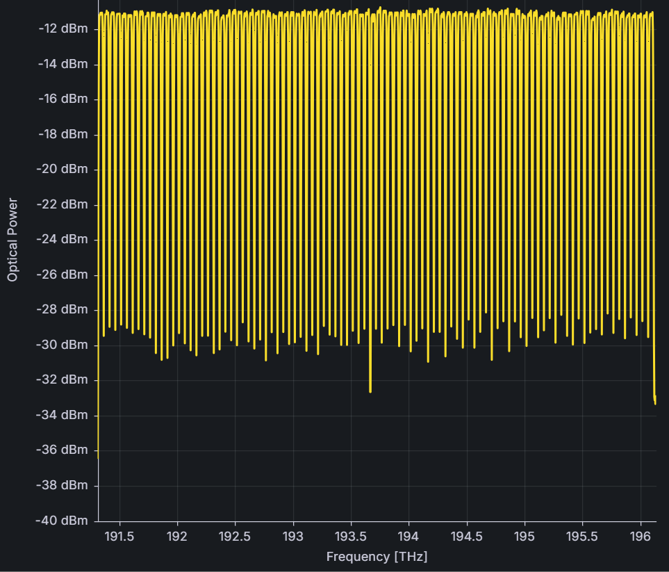
Hardware Setup
TRX
T01
125 km
ROADM
R01
ROADM
R02
100 km
ASE
A01
Loop w/
EDFA
E01

Slide 13
Ground truth
Pre-FEC BER
Power Spectral Distribution

Slide 14
GNPy Simulation
01
Topology
Signal Power
02
Models
for element in path:
compute noise and powers
ASE Power
GSNR
b2b
03
Op. Points
NLI
Power
BER

Slide 15
GNPy / Topology
Transceiver
WSS
Booster
Amp
100 km
fiber
Pre
Amp
WSS
Booster
Amp
125 km
fiber
Pre
Amp
WSS
EDFA
WSS
Booster
Amp
125 km
fiber
Pre
Amp
WSS
Booster
Amp
100 km
fiber
Pre
Amp
WSS
Transceiver

Slide 16
GNPy / Equipment Models
WSS
WSS
WSS
WSS
WSS
WSS
fiber
Pre
Amp
Pre
Amp
Pre
Amp
Pre
Amp
EDFA
Booster
Amp
Booster
Amp
Booster
Amp
Transceiver
100 km
fiber
Booster
Amp
125 km
fiber
125 km
fiber
Transceiver
100 km
fiber
From NDA or in-lab characterization

Slide 17
GNPy / Equipment Models
{
"type_variety": “myTrx",
"frequency": {
"min": 19$.*#e12,
"max": 19£.:^e12},
"mode": [
{"format": “myMode”,
"baud_rate": 🤐,
"OSNR":🤫,
"bit_rate": 1£$e9,
"roll_off":🙈,
"tx_osnr": 🙊,
"min_spacing": 🙉}
]
}
Transceiver
fiber
WSS
Pre
Amp
Booster
Amp
EDFA

Slide 18
GNPy / Equipment Models
Transceiver
{
"type_variety": “myFiber",
"loss_coef": 0.19,
"length_units": "km",
"att_in": 0,
"con_in": 0,
"con_out": 0,
"dispersion": 0.0000167,
"gamma": 0.00127,
"pmd_coef": 1.265e-15,
"effective_area": 83e-12
}
fiber
WSS
Pre
Amp
Booster
Amp
EDFA

Slide 19
GNPy / Equipment Models
Transceiver
fiber
{
"type_variety": “myRoadm",
"add_drop_osnr": 🙈,
"pmd": 🙉,
"pdl": 🙊,
"target_psd_out_mWperGHz": 🤐
}
WSS
Pre
Amp
Booster
Amp
EDFA

Slide 20
GNPy / Equipment Models
Transceiver
fiber
WSS
{
"type_variety": “myVarGainEDFA",
"type_def": "variable_gain",
"f_min": 🤐,
"f_max": 1£$e9,
"gain_flatmax": 🙊,
"gain_min": 🙉,
"p_max": 🙈,
"nf_min": 2$.*#,
"nf_max": 🤷
}
Pre
Amp
Booster
Amp
EDFA

Slide 21
GNPy / Equipment Models
Transceiver
fiber
WSS
Pre
Amp
{
"type_variety": “MyFixEdfa",
"type_def": "fixed_gain",
"f_min": £9$.*#,
"f_max": 😶,
"gain_flatmax":🙈,
"gain_min": 1£$e9,
"p_max": 🙊,
"nf0": 🤫
}
Booster
Amp
EDFA

Slide 22
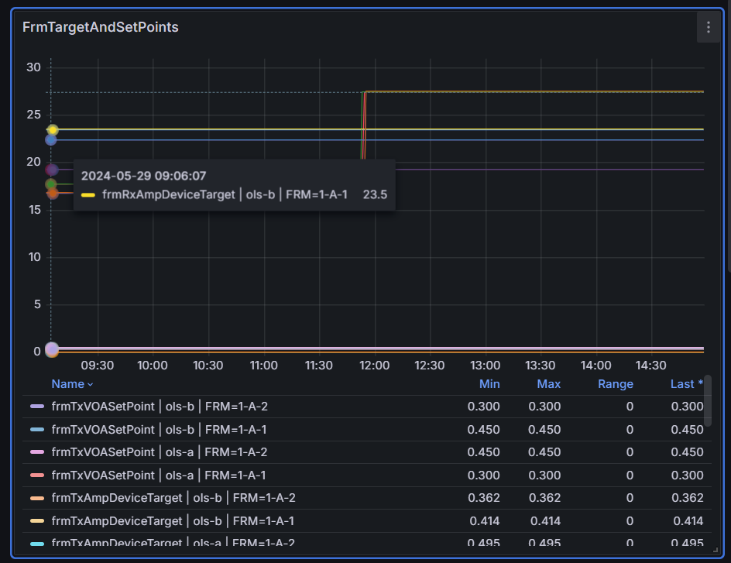
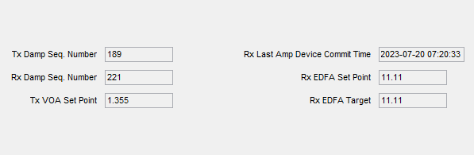
GNPy / Operating Points
Graphical Node Manager
Telemetry

Slide 23
Simulation vs Reality
Simulation
0.0266

Slide 24
Recap
😎 it works
🥰 GSNR
😵 Full C-band
🥲 Topology
🤐 Models
🤫 back-to-back curve
👀 Operating points
Notes:
GSNR Coherent
Full spectral load
Models and targets NDA or lab
Topology missing std intf

Slide 25
Call to action
GNPy developed mainly for design till now…
NREN should start contributing to influence the development.

Slide 26

Thank you!
Interested?
https://github.com/Telecominfraproject/oopt-gnpy
renato.ambrosone@polito.it
matteo.colantonio@garr.it

