Slide 1
INTELLIGENT TECHNOLOGIES FOR GLOBAL
IMPACT:​
COLLABORATIVE CARBON FOOTPRINT MEASUREMENT​
Notes:
​

Slide 2
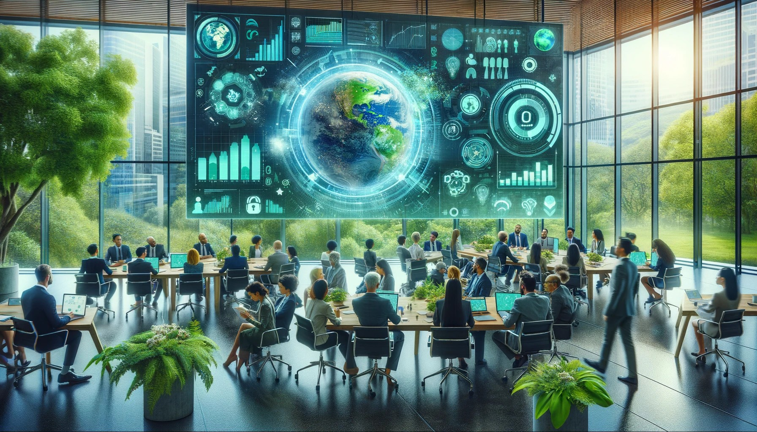
The role of NRENs as change agent trainers

Slide 3
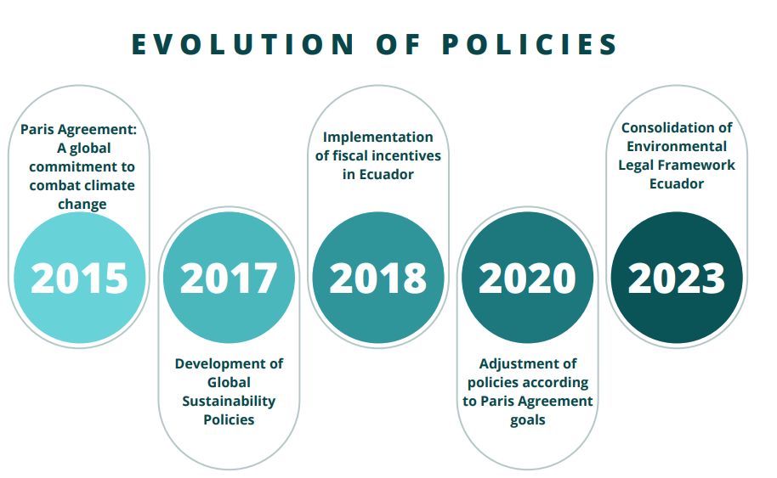
Background
Notes:
​

Slide 4
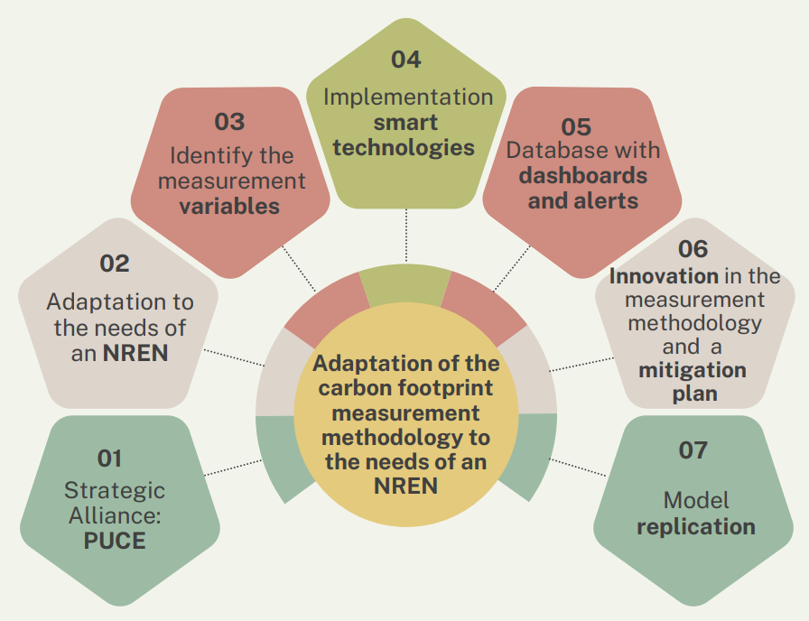
Measuring Carbon Footprint: A Strategic Tool for Impact

Slide 5
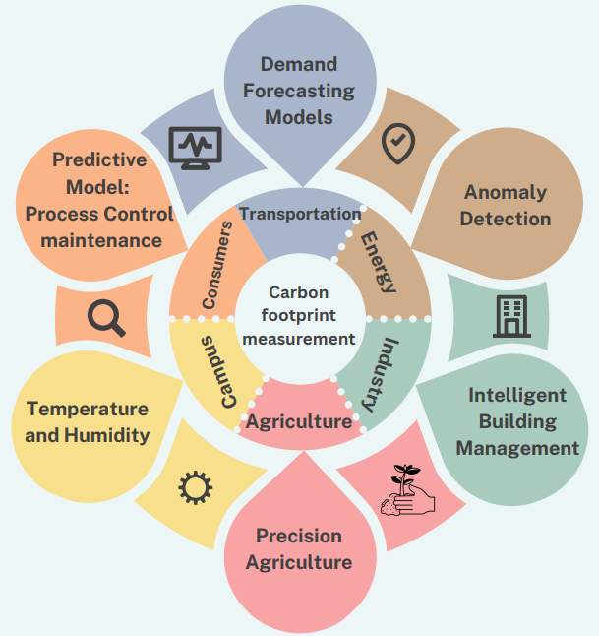
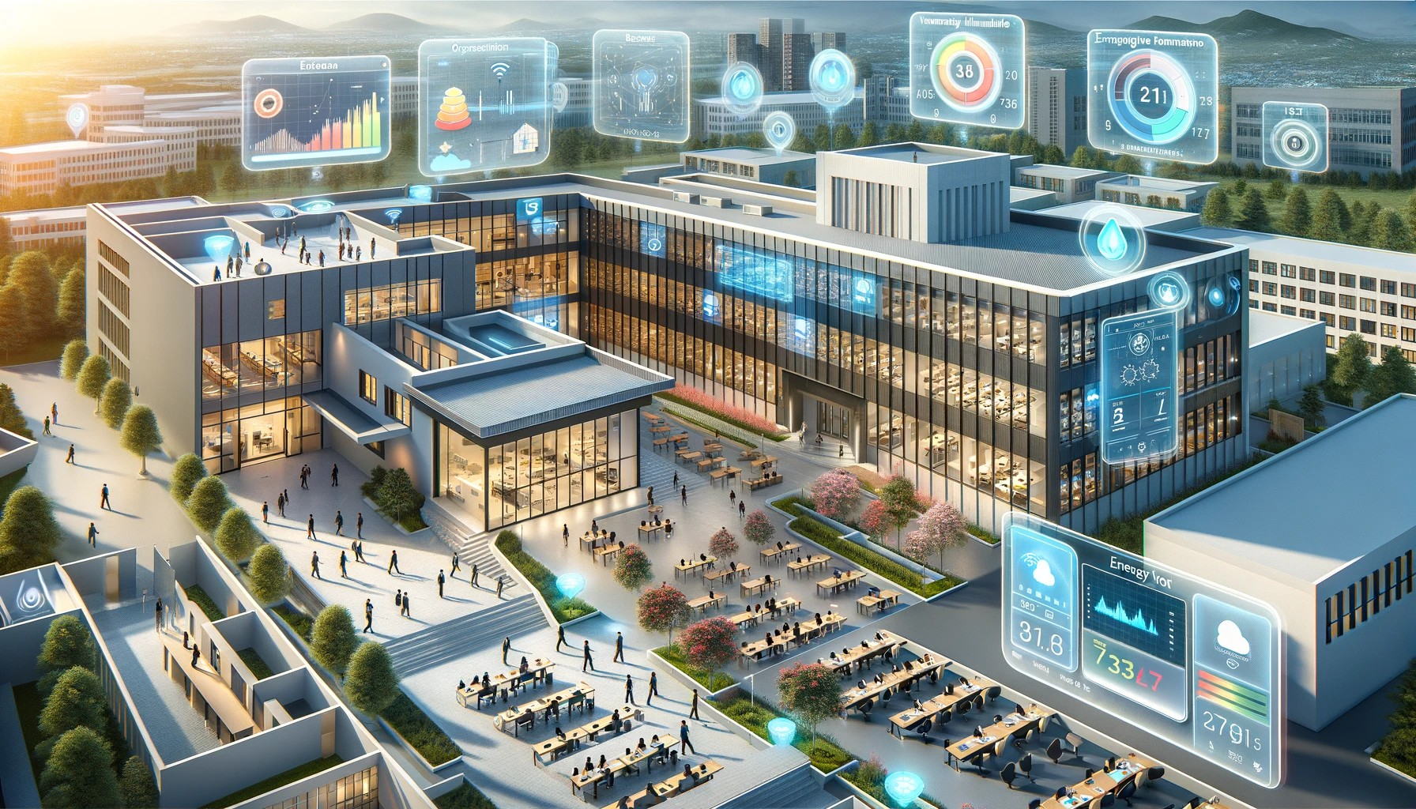
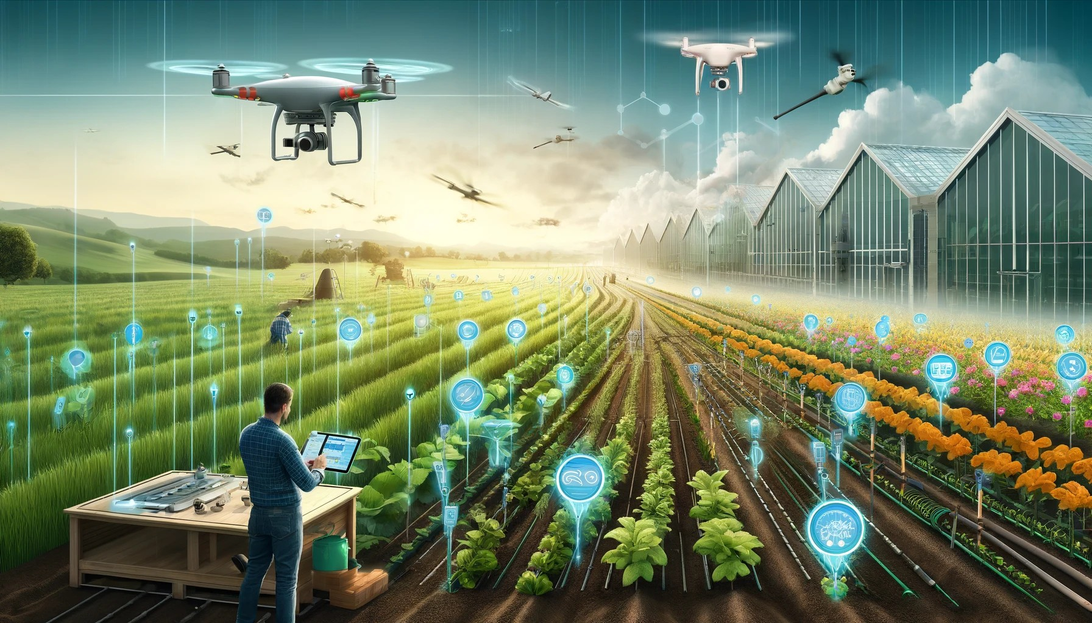
Integración de tecnologías inteligentes

Slide 6
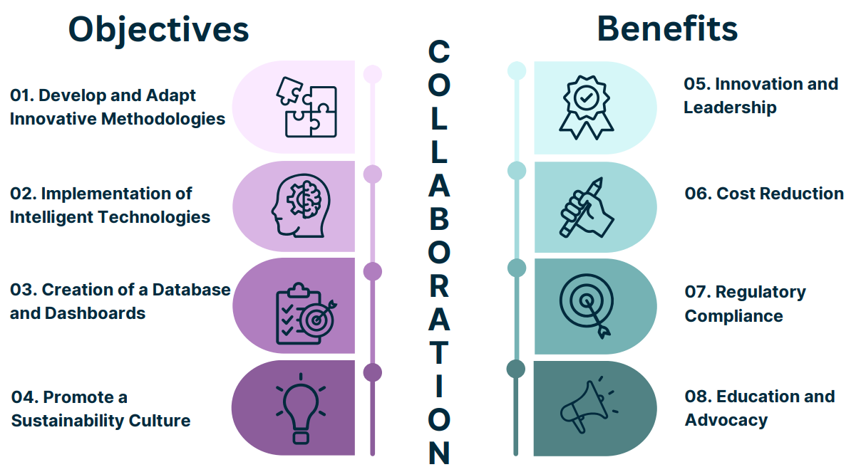
Proposal for collaboration

Slide 7
Call for action
Questions?

Slide 8
Thank you

