Slide 1
Innovation-For and By the GÉANT Community
Dawn Ng, GÉANT Community Programme Manager
Claudio Allocchio, GÉANT Community Committee Chair
TNC24 - Rennes
11th June 2024
Notes:
Dawn: Good afternoon everyone. My name is Dawn and I'm GEANT's Community Programme Manager. I'm here today with the current chair of the GEANT Community Committee, the "GCC", Claudio Allocchio from GARR. We’re here to represent the GEANT Community Programme, which is the place where things happen beyond all the good work we do in our projects, day to day grind- it's where the community comes together to share and learn from one another, to keep us stimulated and motivated, and remind us that we are not alone in what we pursue, but very much part of something greater. We house the longstanding Special interest groups, task forces, but also newer initiatives like the NREN principles on Gender Equality and the Community Hub, which I know you'll all be visiting while you're here at TNC. Today's session is about the Innovation Programme a feature of the Community Programme that's been around just long enough for us to draw some conclusions and evaluate. So let's start...

Slide 2
let's be honest...
Notes:
and (CLICK)- let's be honest – it's not exactly been what we had hoped- sparking innovation for and by the community. At least not yet! To be clear- we're certainly not the only ones attempting to innovate here- there are plenty of channels between incubators and all the other exciting initiatives in our community...but we’re meant to be a piece of the puzzle. So this is why we are here- to bring you, the community, into the fold. It's time to give new voice and meaning to the Innovation programme – we need your contribution to make it matter, which means perhaps reorienting, reshaping, and relaunching this thing- so we can start seeing some real impact. And so "innovation for and by the community" becomes not just a tagline, but actually true. You’re the community, and the request in this session is to hear us out and start holding us, collectively, accountable
Now let's step back and start from the beginning- Claudio, When did we launch the first Innovation Programme? What's the history behind it?
Claudio: we’ve been around since 2021. It was started to allow the community bring in new ideas without too many constraints. Developing projects for external funding is always big ordeal and sometimes people decided to forgo it because it was too complicated and time consuming. So we decided to invent something very light and very simple. Has anyone actually heard of us? Anyone Lucky enough to win one?
Dawn: Since 2021- so we're now in the 4th round, with an annual budget of 300K. That means by the end of this year, we'll have funded 36 projects and spent over a million euro.
Claudio: yes, remember this is our own money, NREN member contribution to support ourselves! And this is the reason why the funding is unrestricted and easy to access.
Dawn: Yes, and we keep the barrier low to participate. Parameters are pretty basic: Anyone can apply from any GÉANT member NREN or any institution connected to a member NREN on nearly any topic related to our sector. It's total blue sky. We also love joint proposals- NRENs coming together, or NRENs partnering with a research institute, university, it's all great! With such limited requirements, you'd think everyone in this room has applied for one. But this doesn't seem to be the case. Claudio, where exactly is this investment going? Who's being awarded? What’s been the spread…?

Slide 3
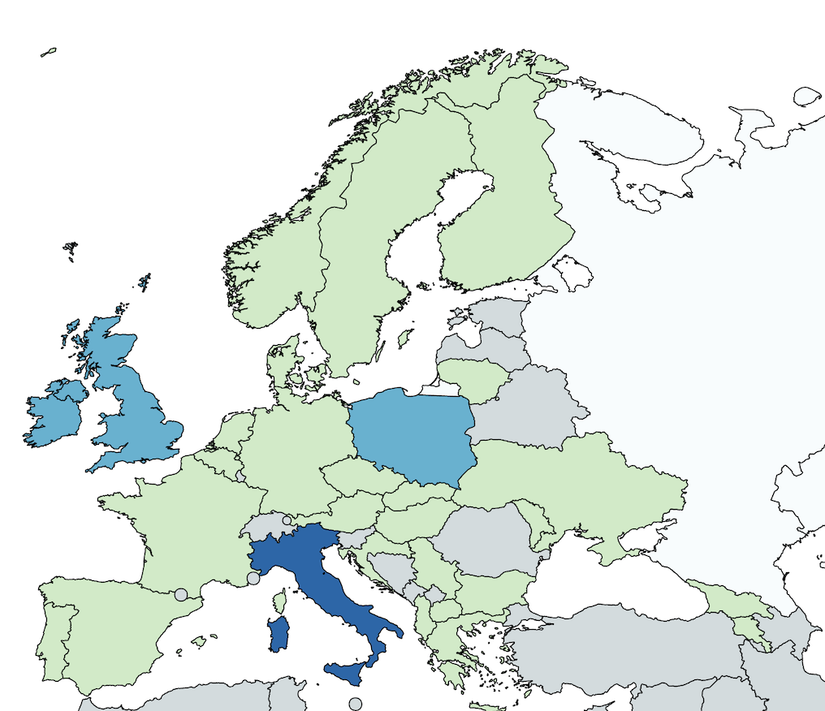
14
14
14
82
Notes:
Claudio: We’re being honest, right? Well, here's the spread- as you see, it hasn’t been great
Dawn: Indeed- let's see- this map is showing all the submissions from the last 4 years- Light green are countries with 1-5 applications. We have a small handful of countries with 14 applications..
And as you can see, one country blows it out of the water. Are we saying Italy is particularly prone to innovation?
Claudio: “country of inventors?” mmh,,, Or are others simply not doing enough? Or other factors which we should consider?
Dawn: This year was better, 66 applications from 20 countries. And by the way, we haven't been exclusively awarding Italian innovators... Just 1 out of 3. Projects have actually been selected from 17 countries in total.
Claudio: and a lot of good work for the ones who, behind the scenes, need to make the machine work!
Dawn: Well, regardless of where these applications are coming from…are any of the projects supported to date moving the dial on the purpose of this all? The Innovation bit? Have we had any ….

Slide 4
IoT Device Identification at the Edge
International login in TSD and Educloud
Digital Children Kidney Twin
SIEVA: SIEM Visibility Assessment
eCLAT: eBPF Chains Language And Toolset
ABEBox: Privacy Preserving File Sharing Service
Notes:
Dawn: Iight bulb moments? I mean light bulb moments as in Eduroam? eduVPN? Edumeet? Claudio?
Claudio: These have been our north stars, assuring us that our community-all of you- in collaboration, will keep us future proof. We cannot foresee when light bulb moments of this degree will be achieved. It is usally because we have a problem to solve and somebody needs to fix it. We have had some innovation- some highly specific for a small area which will help and support all of us without being so evident. Also some failures, which also count and are terribly useful: one of our projects totally failed to deliver what it promised, which was to bring the new IPv6 features into a real high performance computing center. Nothing worked because we discovered that all the technical features only worked on paper. But when we tried them in the field, it failed.
Innovation is tricky, sometimes you make progress also because of a failure, and we are here to give a chance to our community members to “give it a try”… the final result does not necessarily need to be on a massive scale.
Dawn: So, sounds like we have had some success but we haven't had a huge light bulb moment yet... Maybe some of you have taken part in one of our online showcases where each project shares their results. We've tried our best to award projects in all the main thematic areas of our community- from networks to cloud, security, trust and identity. Even several in digital health. Here are a few of the projects- anything stand out? (click 6x)
Claudio: let me see…for example in the e-health - you can see digital children kidney twin- and it worked. Of course it's limited to the medical field... Is this bad? no it isn't but it's not widespread throughout the community.
Dawn: What's getting in our way? Why haven't most of the projects we funded come back into the community more broadly to solve our issues, big or small? Why aren't the researchers connecting with their local NRENs and vice versa? Where is the "innovation for and by the community" part of the Innovation Programme?
Let’s be honest

Slide 5
Notes:
Dawn: We’re not quite there yet, are we? It hasn't come together in a nice neat light bulb moment. Rather, scattered and isolated from the community... What's going on Claudio, we're all at TNC, and I know there are plenty of innovators right here in our audience.
Claudio: well, innovation is a process, sometimes without discovering something while looking for something else… how about the post it as an example? that was a big failure by 3M, which then turned into a big success, used by everyone all over the world. And what about the Lola? It came before the Innovation Programme existed but it fixed a problem- latency issues in video conferencing. We invented the Innovation programme just because it is sometimes complicated to fit it inside projects where in the end you need to deliver “something which works”. But don’t mistake me.. I’m not stating that we do not pursue results, not at all!
Dawn: So we have created a great environment for blue sky innovation, free for people to access... Then why isn't this working better, creating the innovation and impact our community needs?
Claudio: aways the difficult questions to me!
Dawn: You are our GCC chair, after all! So tell us- where did we go wrong? What have we learned? And how can this wonderful audience point us in the right direction? (CLICK)

Slide 6
What went wrong
Isolated projects
Weak link to NRENs
Uneven promotion
Admin issues
Poor coordination
Notes:
CLAUDIO: What went wrong?
-it is not easy to focus a call, but often Random projects poorly aligned to community priorities and initiatives, including our GÉANT projects
-predicting innovation is impossible by definition, so we need to keep doors open. But maybe the Scope was too broad and undefined, we were often disqualifying proposals because they were simply out of scope. But of course is not easy at all to exactly define the boundaries.
-Not all NRENS are the same: Linking the projects to local NRENs was generally weak. Also in terms of information outreach and getting the word out to begin with..to begin with, do you believe we have the magic wand in Italy? no, we don't but by chance we have an efficient way to promote the programme to researchers across the country. What about in other countries?
-Uneven promotion, Italians can do it, why not the others?
Dawn: Yes, and I can definitely attest that we also had plenty of administration issues- ineffiiciencies, headaches. As my colleague Piotr knows all too well, cramming a grants management system into indico hasn't been pretty! Local institutions also had their own challenges, which are not easy to fix.
Claudio: not to mention lack of follow-up after implementation.
And poor coordination with our other activities, incubators, projects made it mess sometimes. We could not connect results of our innovation programme into follow up activities so they remained in stand by, and innovation cannot wait.
Dawn: at this rate, sounds like a total failure... But Claudio, we also have some things that went better, right? Some things we've learned after 4 rounds of this?

Slide 7
Increase to 50K
Record # applications
Expert reviewers
Select projects
What went better
Notes:
Claudio: if the minus were less than the plus we would not be here to talk to you!
This year we took some actions:
-Increased funding amount this year per proposal from 30 to 50K- was this our turning point? Was it a matter of money?
-Better promotion this year- record number of applications- thanks to our Marcomms team- well done!
-Strong support from thematic experts in our community to review proposals - thanks to you as well.
-And as I mentioned before we do have several projects that did achieve something for at least part of our community even it meant trying something and failing.
There is another one about Low orbit earth satellite network services, which evolved into a piece of GN5-2 project. So some things have worked well.
Dawn: Thank you Claudio. So all in all maybe not a total disaster...
Claudio: No! And we are also thinking about more improvements for the next round… stay tuned with developments in our future innovation news, which you will now be part of!
Dawn: Now, enough of what should and shouldn’t have happened. We've been honest and now it's time to move onward and upward...

Slide 8
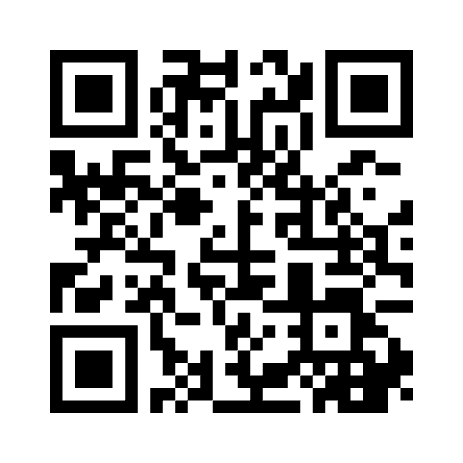
Innovation for and by YOU
Why haven’t you applied?
What kind of innovation is most needed?
How can you spread the word?
What needs fixing?
Notes:
Dawn: Let's talk about the FUTURE- this is the "Collaboration for the Future" session after all and as the community, you’re part of both the collaboration and the future.
You’re here because you care about the future of NRENs and our potential for innovation. That next light bulb moment is only possible because we work together.
It’s time to hear your ideas, your questions, your challenges on how we make the Innovation Programme for and by YOU!
The floor is now open...
For those who prefer, we also have a survey where you can share your input online (point to QR code)
Thank you! (open to Q&A)
(Audience questions)
Thank you for all your contributions both in this session and online. We hope we can continue talking at...

Slide 9
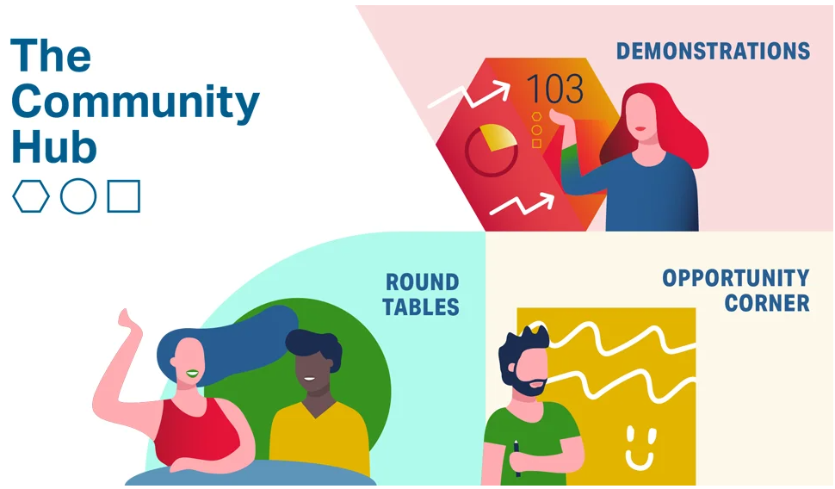
Notes:
Dawn: the Community Hub! We'll see you there!

Slide 10
Thank you
Dawn.ng@geant.org

