Slide 1


Submerged curiosity
Chris Atherton
Senior Research Engagement Manager
TNC24
11/6/24
Public

Slide 2
Did curiosity kill the cat?

Slide 3
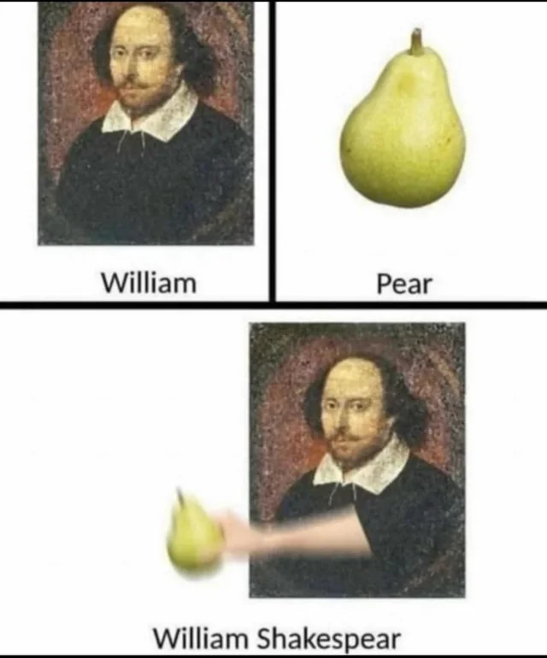
What, courage man! what though care killed a cat, thou hast mettle enough in thee to kill care.
- Some guy named Shakespeare
Much Ado About Nothing, 1599
Notes:
Did curiosity kill the cat?

Slide 4
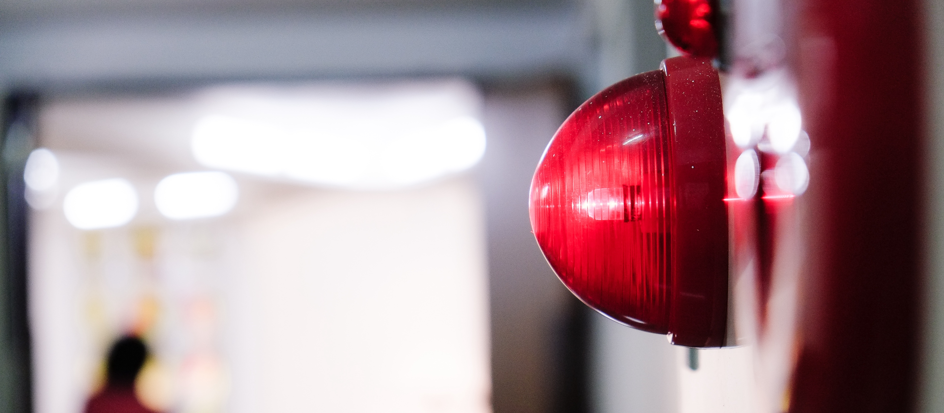
No: curiosity did not kill the cat
Notes:
Instead, the proverb became a warning for the dangers of unnecessary investigation or experimentation in the 1800’s.
The original form of the proverb, now rarely used, was "Care killed the cat".
Or more specifically, anxiety, worry, and self-doubt.

Slide 5
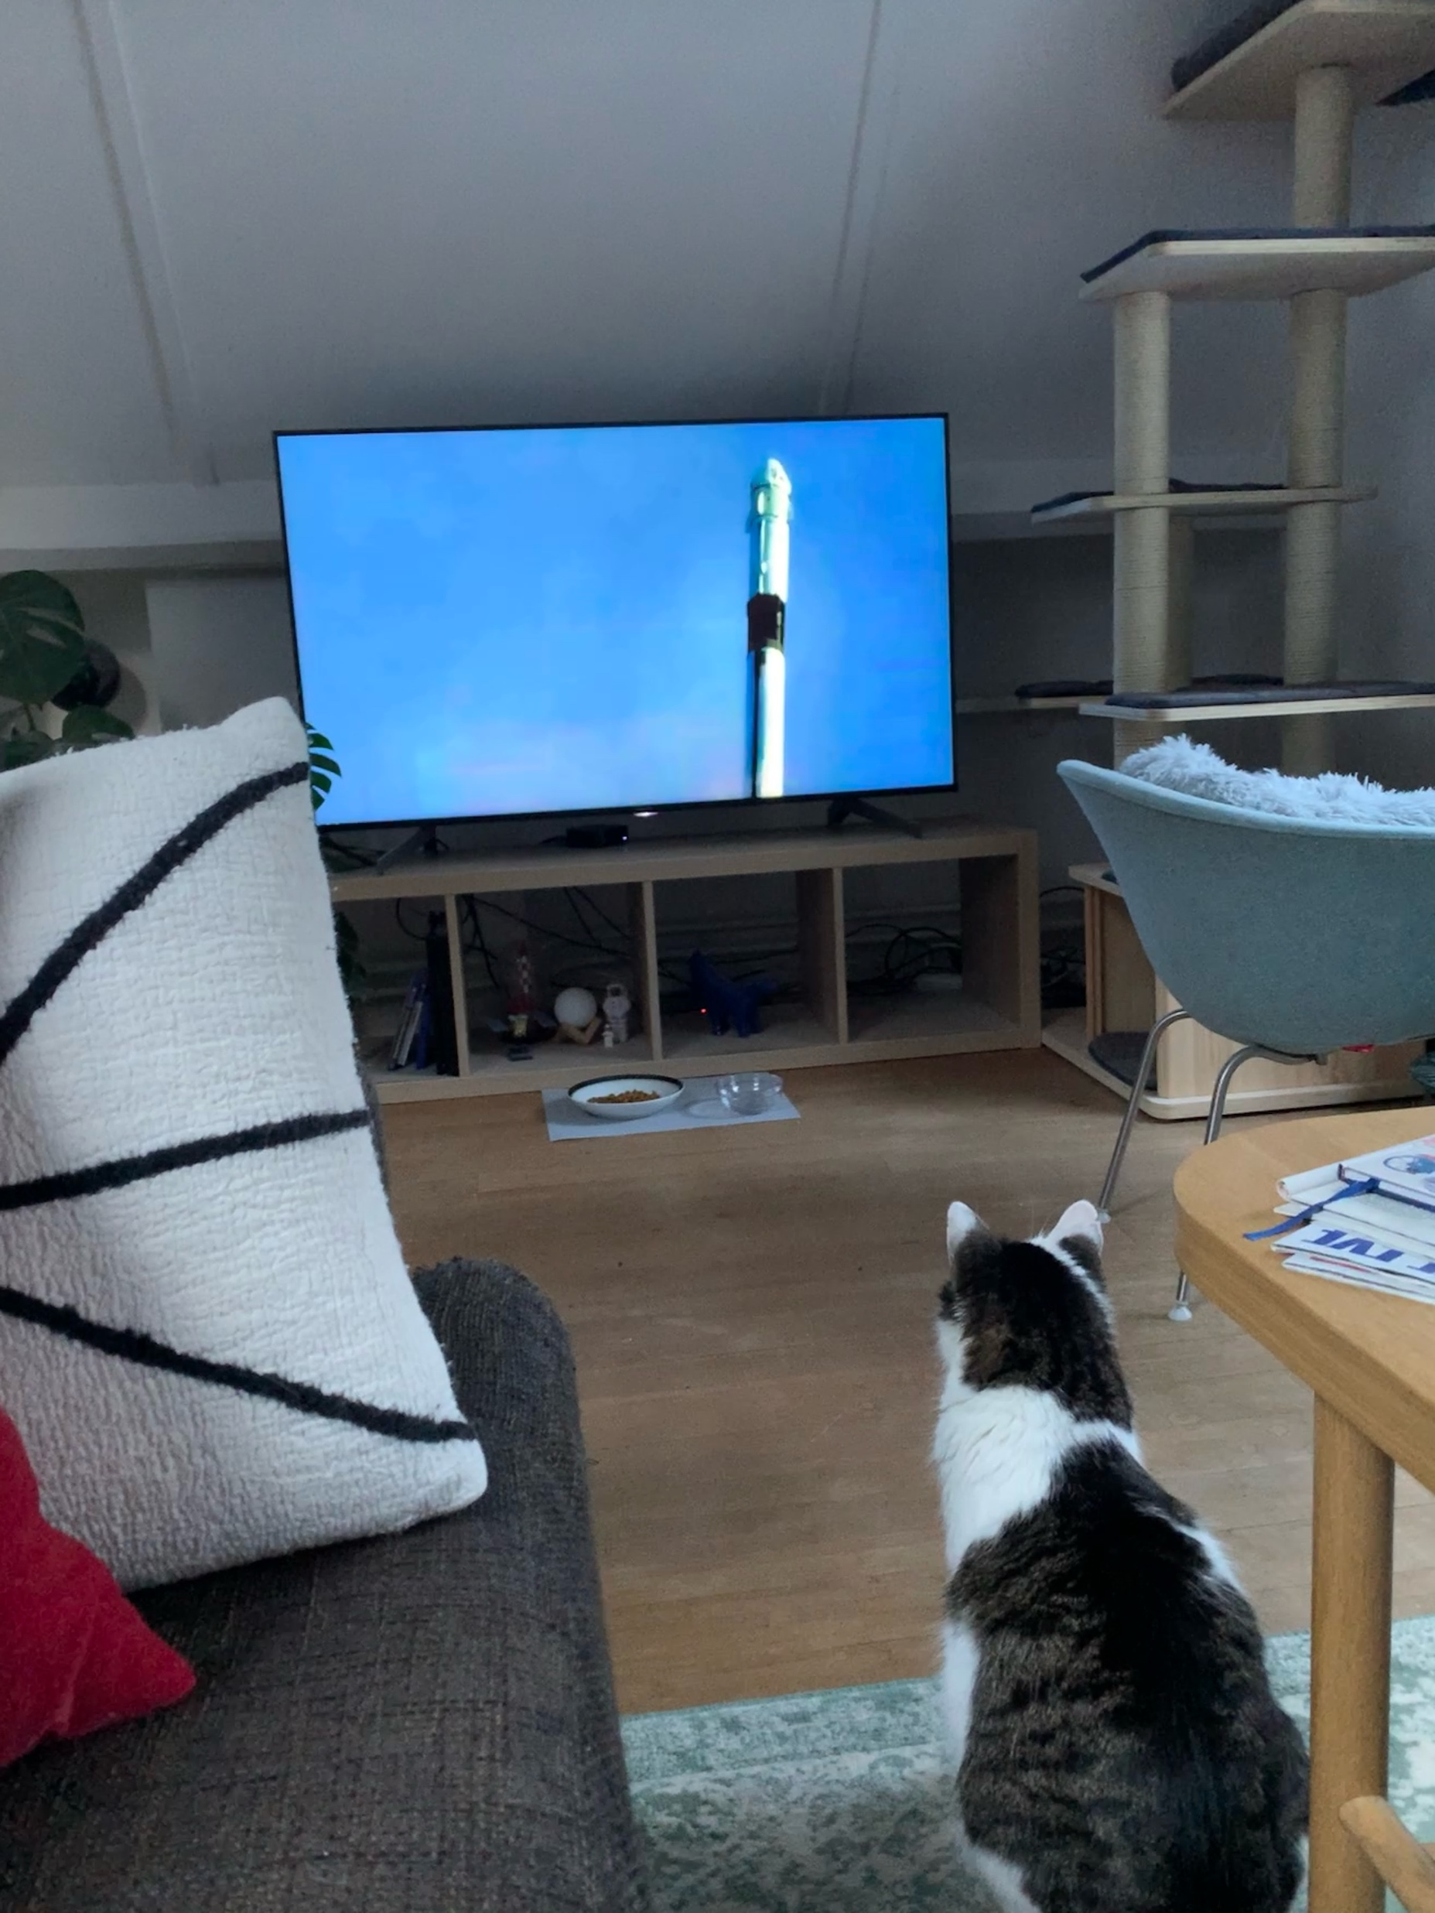
What is curiosity?

Slide 6
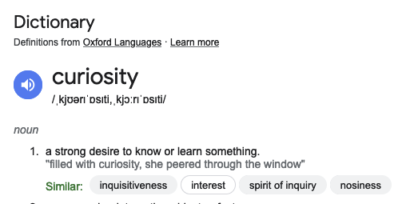
Thanks to google

Slide 7
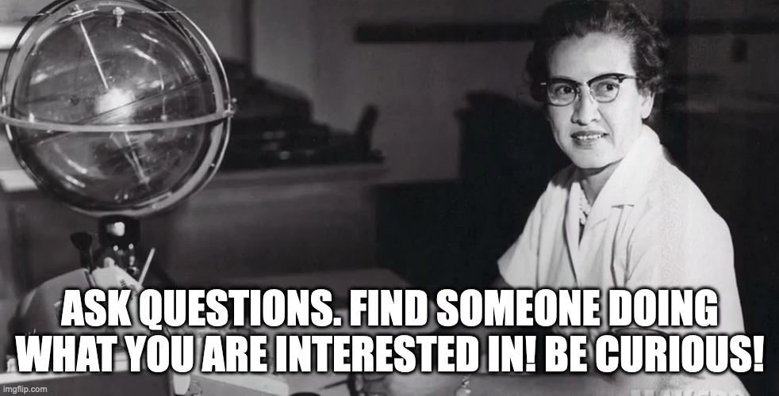


Famous people who say stuff about it

Slide 8
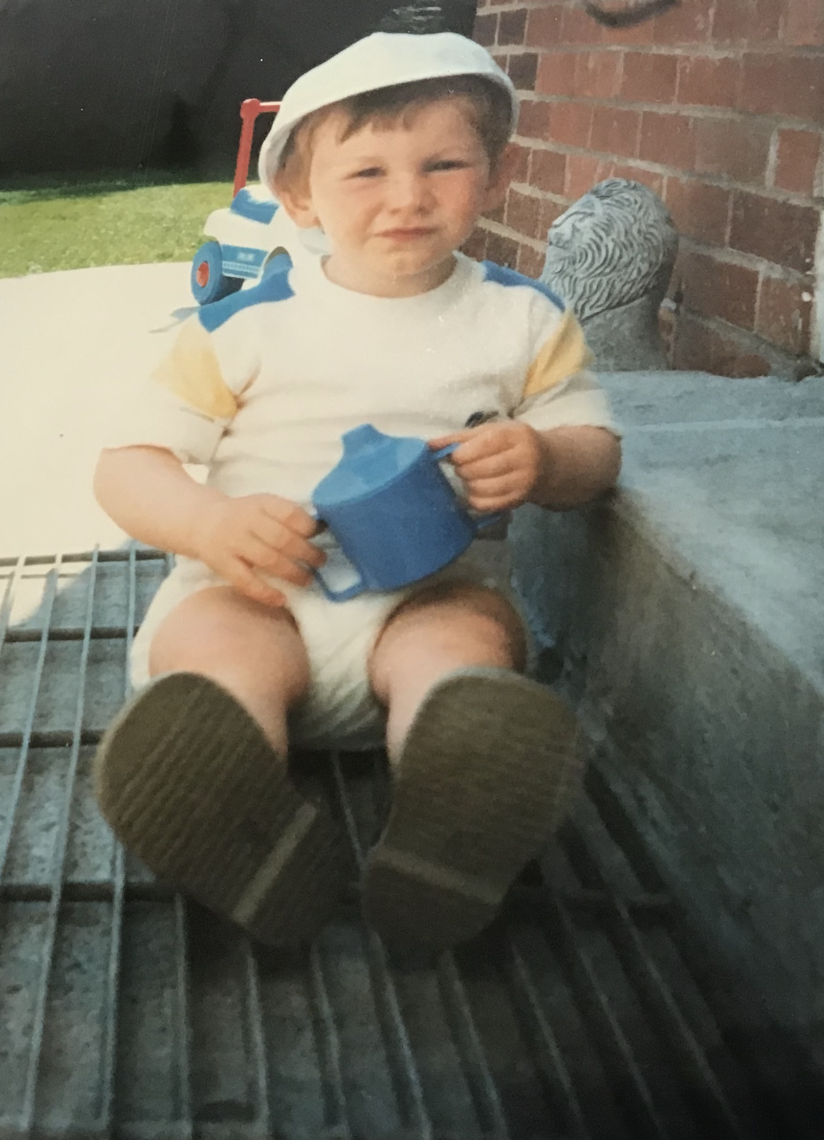
Around the time when I developed curiosity

Slide 9
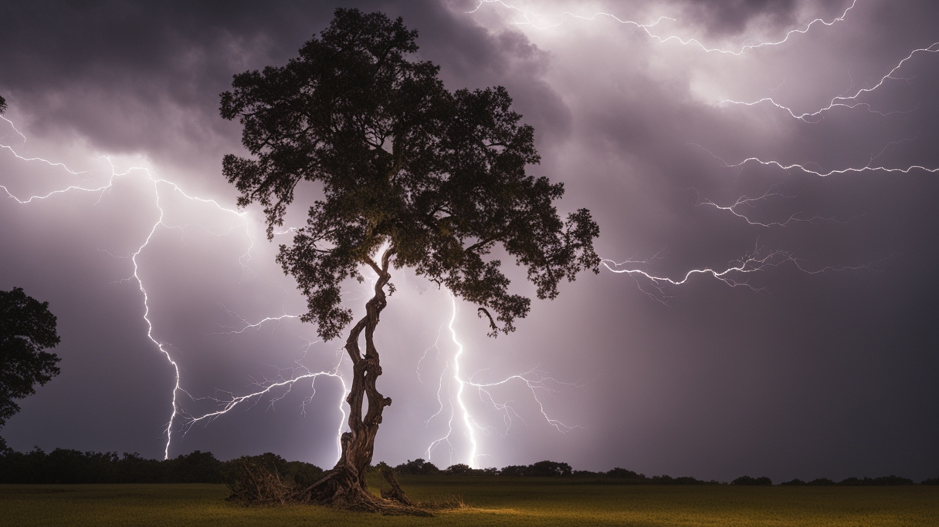

Slide 10
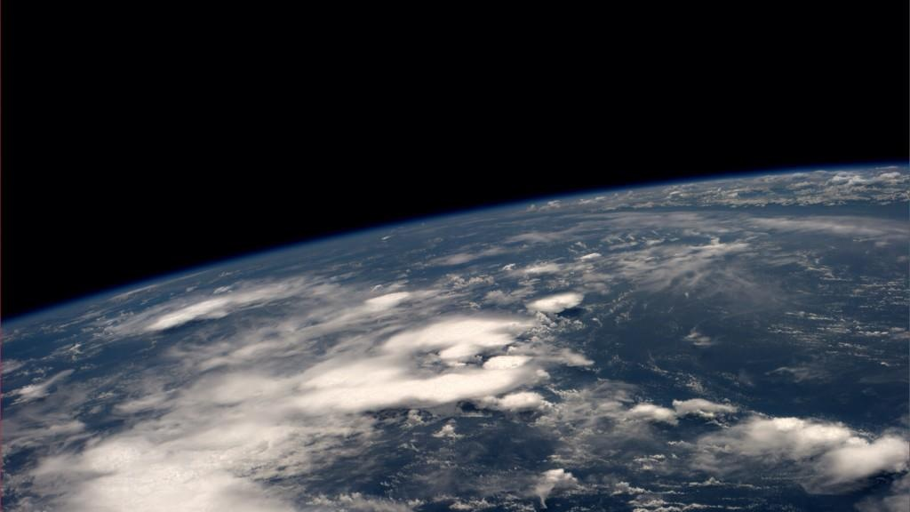

Slide 11
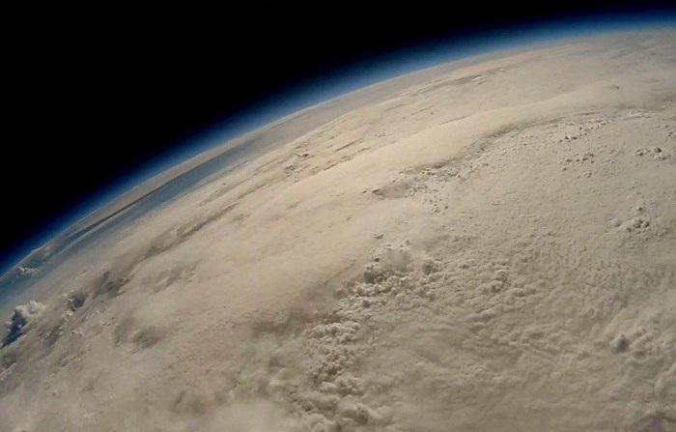
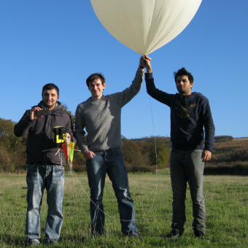
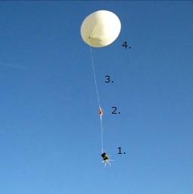
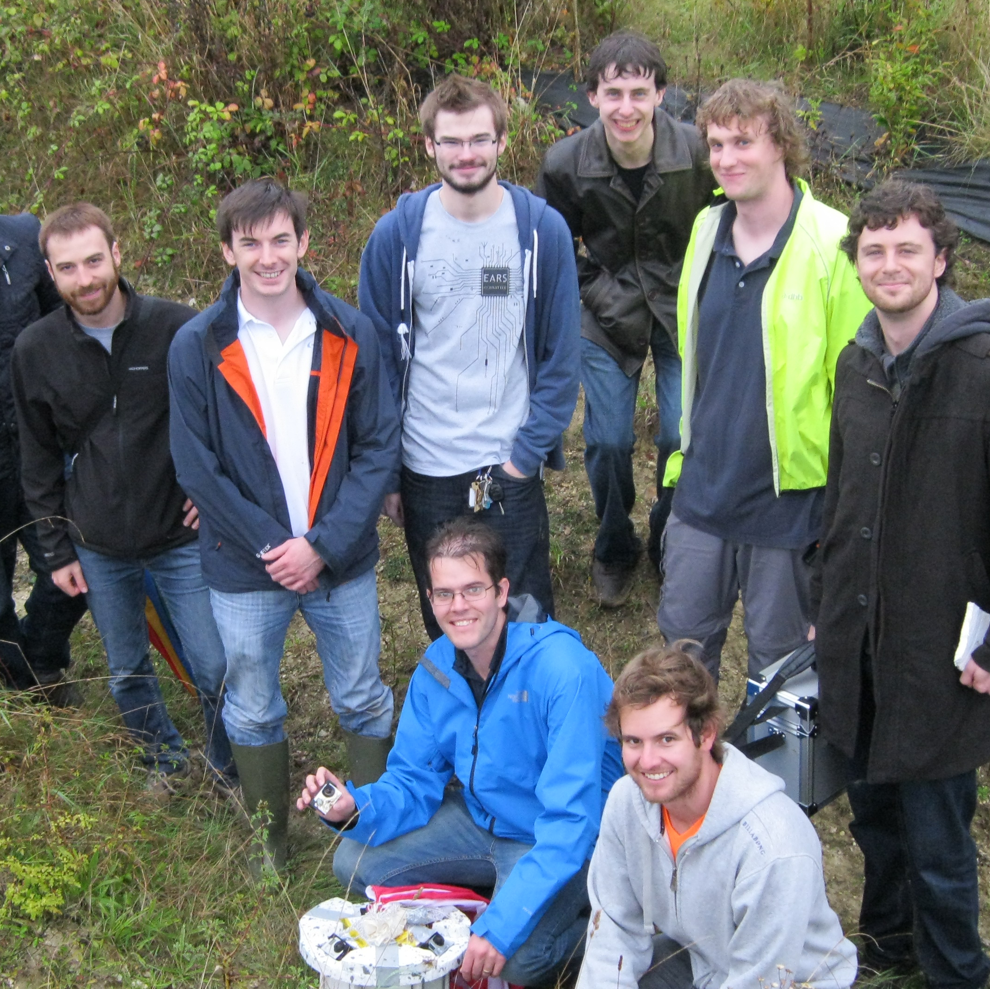
How I came to work at GÉANT

Slide 12

What I’m curious about today ?

Slide 13
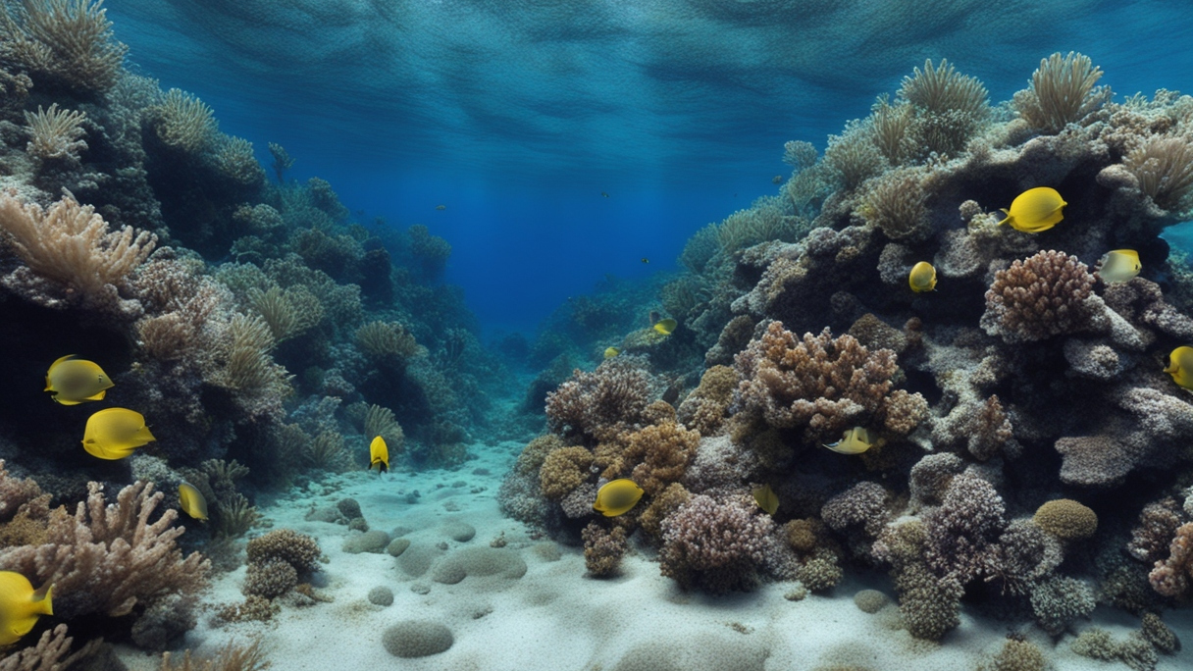
listening to things under the water
Notes:
How might we do that?

Slide 14
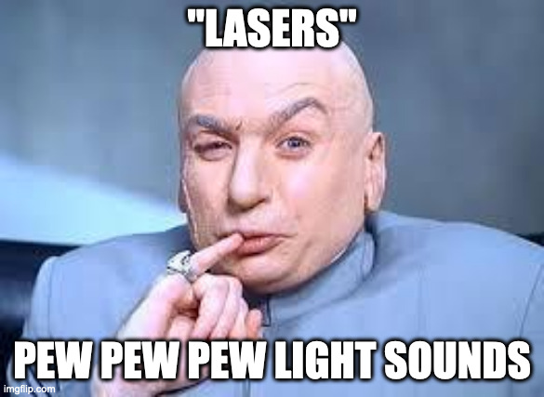

Slide 15
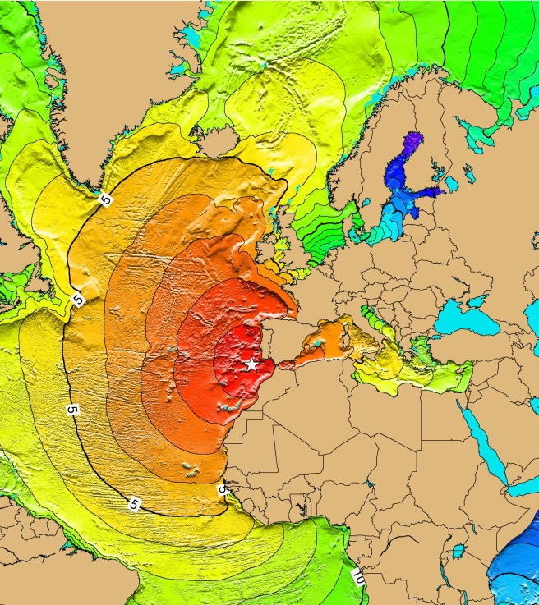
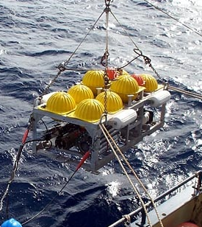
Why
Some of the many global challenges

Slide 16
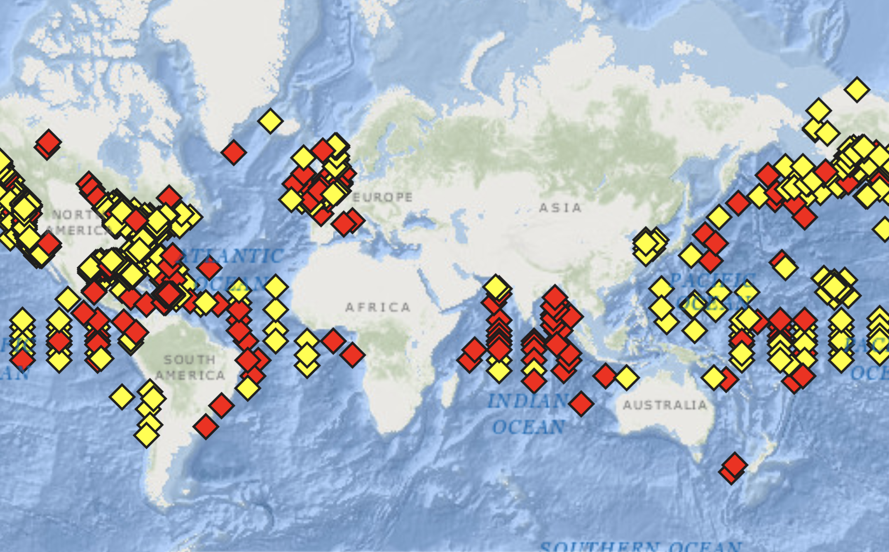

Slide 17
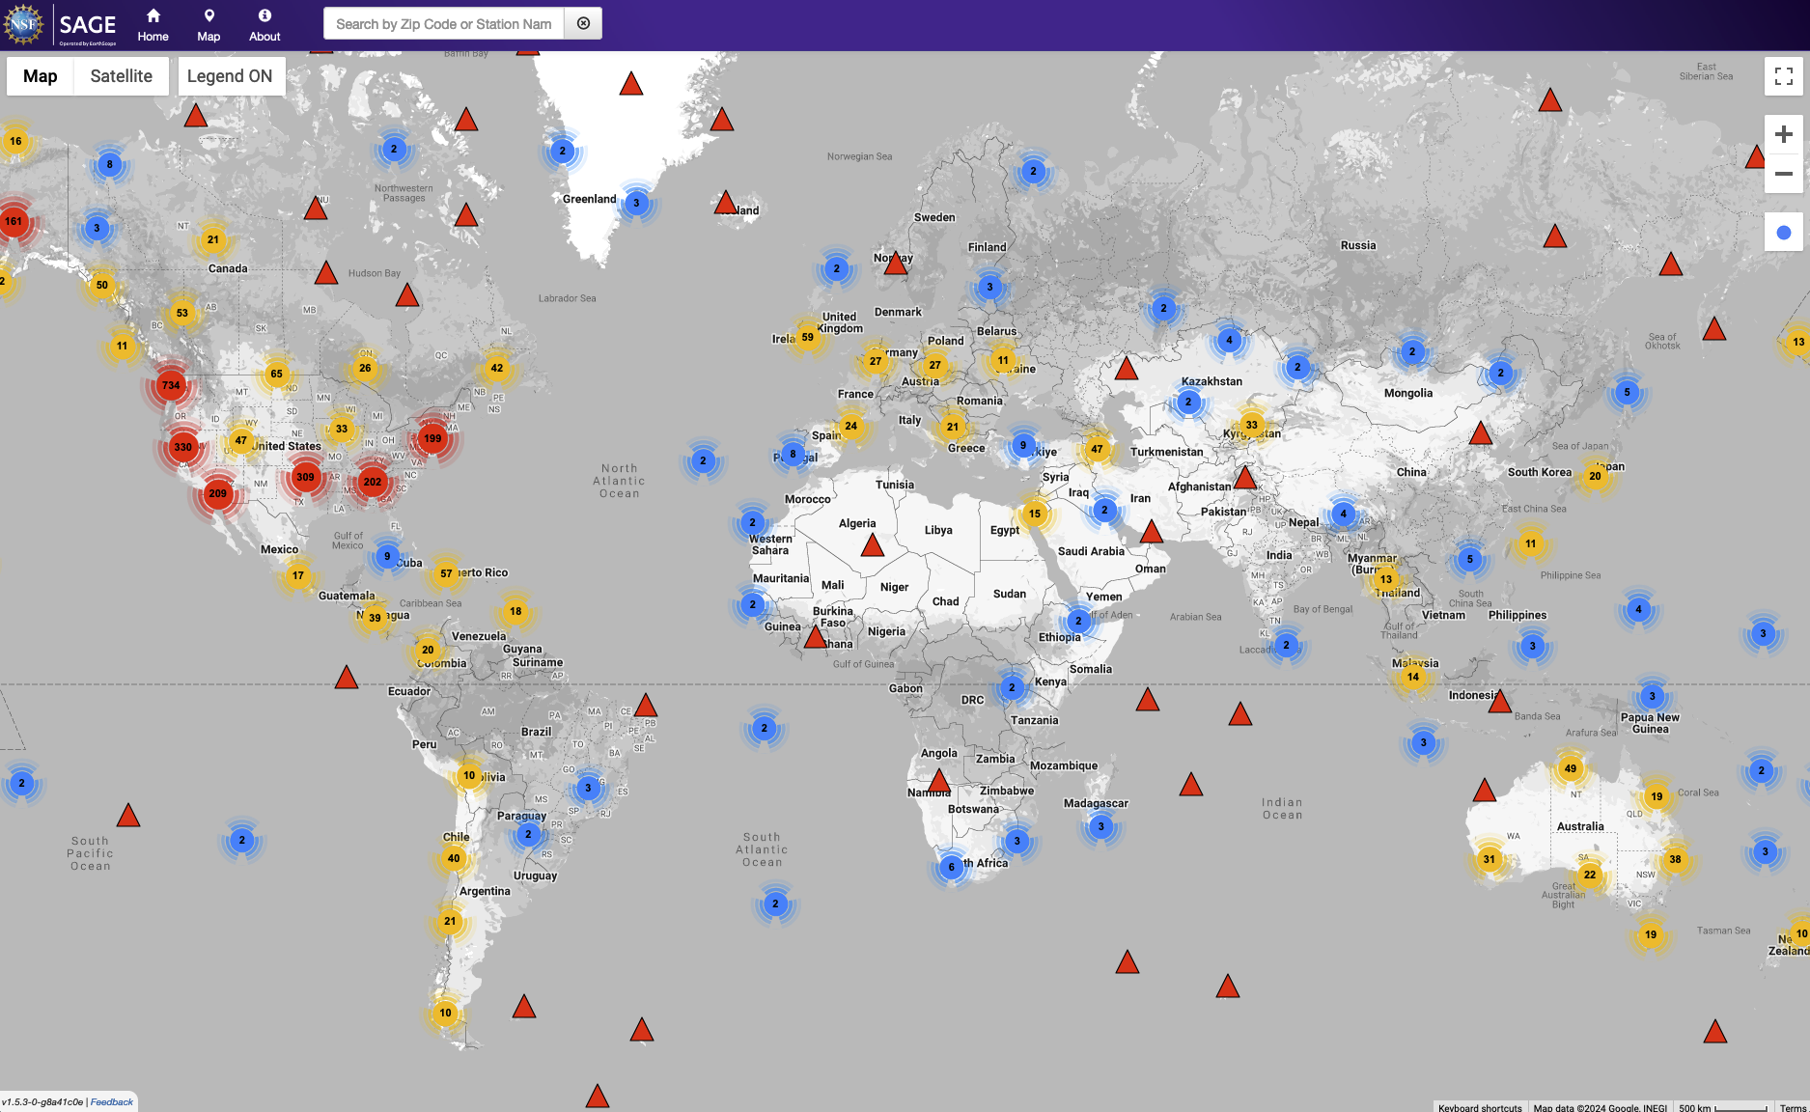

Slide 18
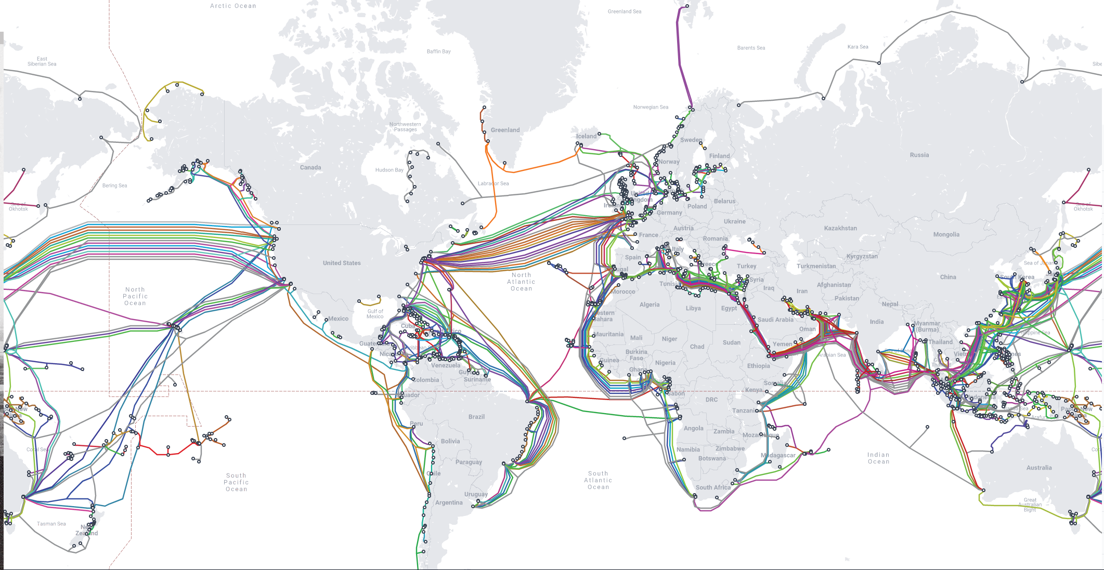
Credit: www.submarinecablemap.com
Notes:
What about submarine telecommunications cables?

Slide 19


Slide 20
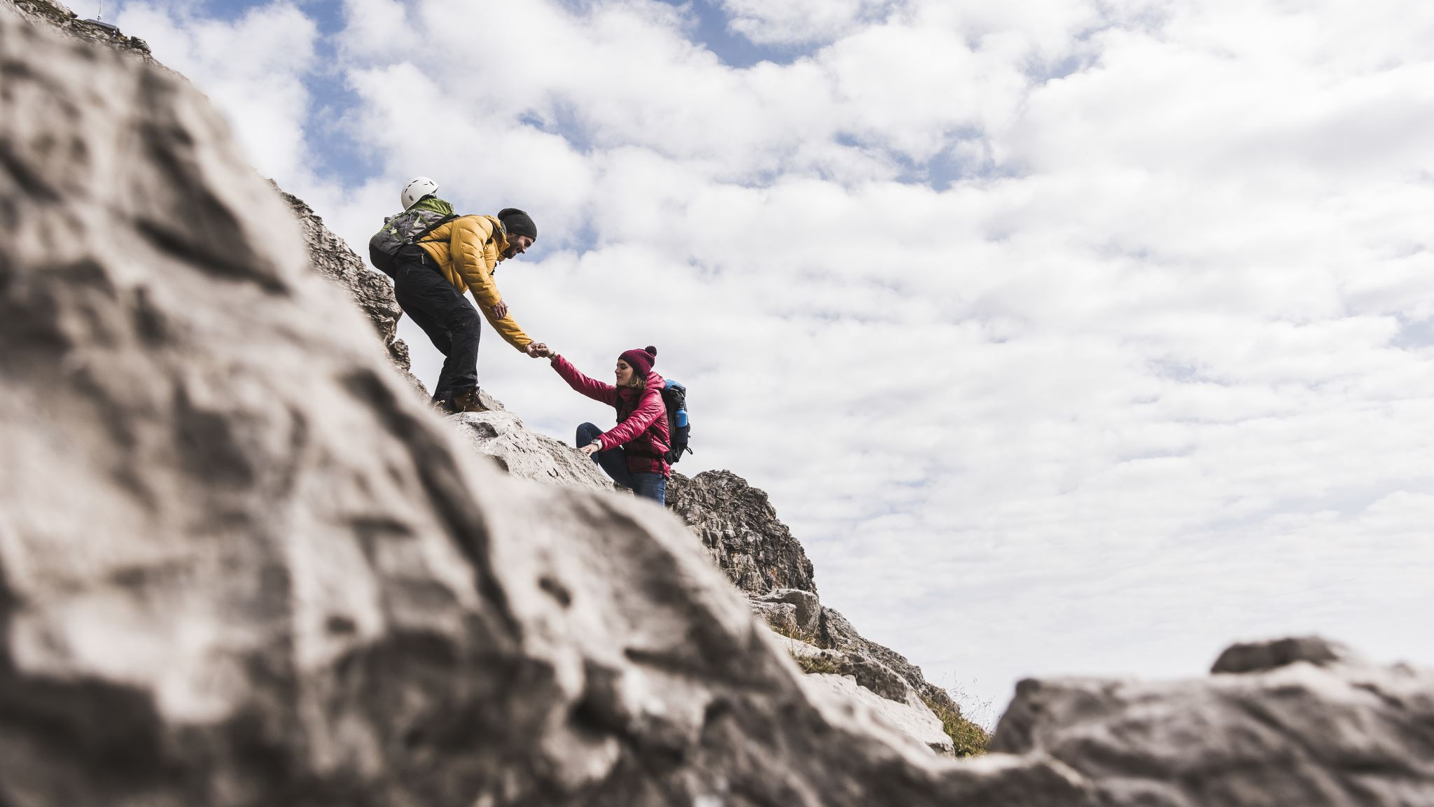
Aim
Investigate utilising existing telecom cables, rather than dedicated submarine fibre, for monitoring the earth and oceans, without disrupting the telecoms traffic.
Notes:
Fix this slide
See if we can simplify and increase the size of the letters.
"Standardised architecture" for example
"Roadmap and strategy for sustainable instrument"

Slide 21
Objectives
Standardised architecture
Research-Infra data dissemination
3 geographic locations
Produce open, machine readable, long-term datasets.
Develop in collaboration with research communities.
Defining training and capacity building
Roadmap and strategy for sustainable instrument
Scientifically validate deployments
Notes:
Fix this slide

Slide 22
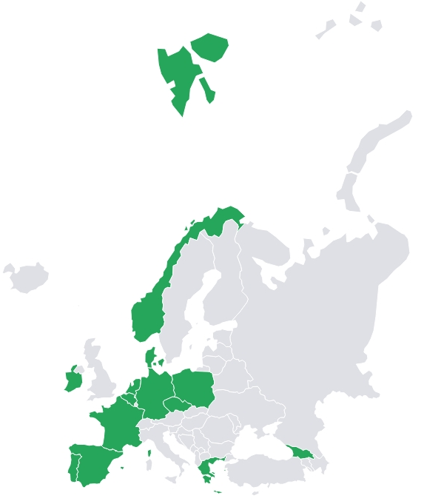













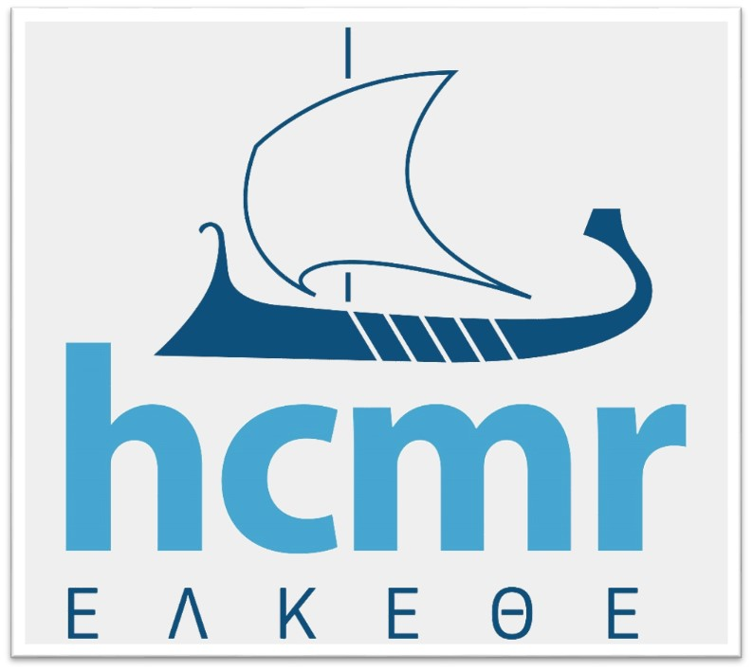







Consortium Members
36 Month Project
Research Organisations
NRENs
Commercial organisations
Notes:
8 NRENs

Slide 23


Wet vs Dry Sensing
Dry
Wet
SMART

Slide 24
DAS
SOP
IPD
Distributed Accoustic Sensing
State of Polarisation
Introformetric Phase Detection
Uses reflections from impurities in the fibre when a laser light hits the side, to measure stretch and strain.
Uses the changes in position of the laser light as it exits the fibre to detect changes made to the cable the laser light travels through.
Uses the changes in the time of arrival of the laser light when compared against a reference signal to detect changes to the cable

Slide 25
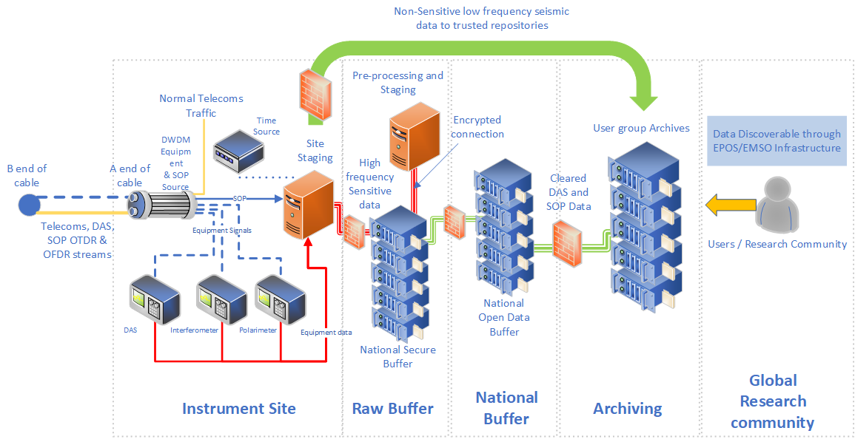


The high-level instrument architecture – per site
National Data Management policies
Open Science Data
Management policies (FAIR)
Notes:
The concept is to investigate integrating DAS, SOP, SOP OTDR and SOP OFDR techniques, then integrating the different infrastructures involved, maximising on each others strengths. The aim is not to create a new parallel research infrastructure but to integrate and compliment existing infrastructures together.
Not for the NRENs or GÉANT to do research into earthquakes, tsunami’s and the likes, but to provide the infrastructure and services necessary for researchers to do their work, in the most easy, scalable and streamlined way possible.

Slide 26
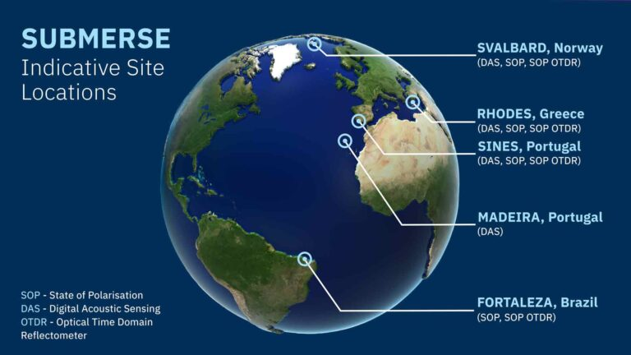
Preveza,

Slide 27
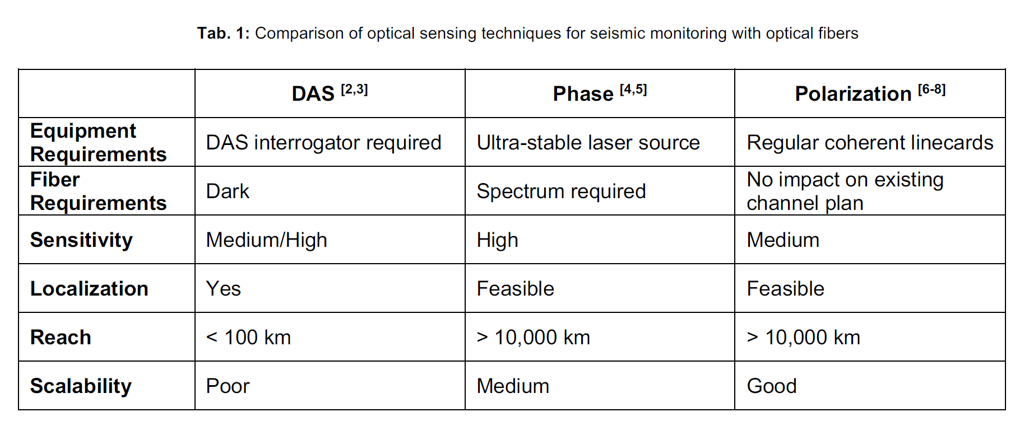
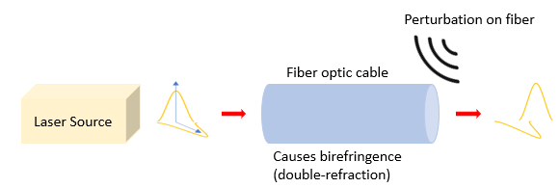
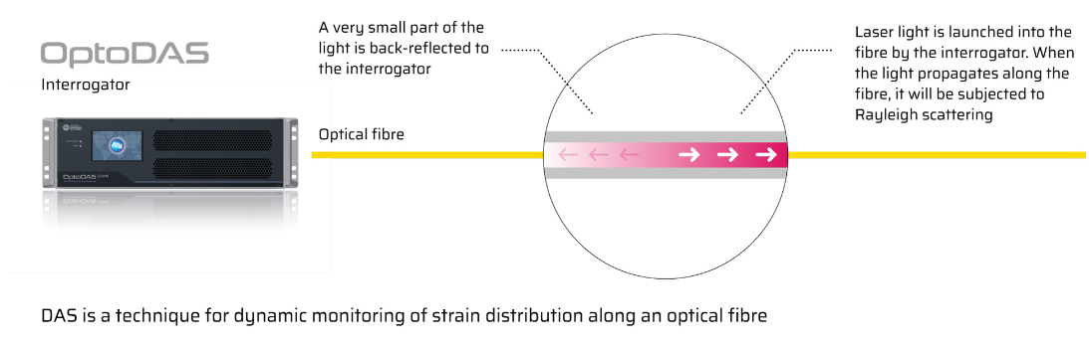
Dry Optical sensing techniques
L-band or 3 c-band channels
Source: Kristina Shizuka Yamase Skarvang
Adapted from Source: M. Cantono et al., Seismic Sensing in Submarine Fiber Cables,
Source: ASN website

Slide 28

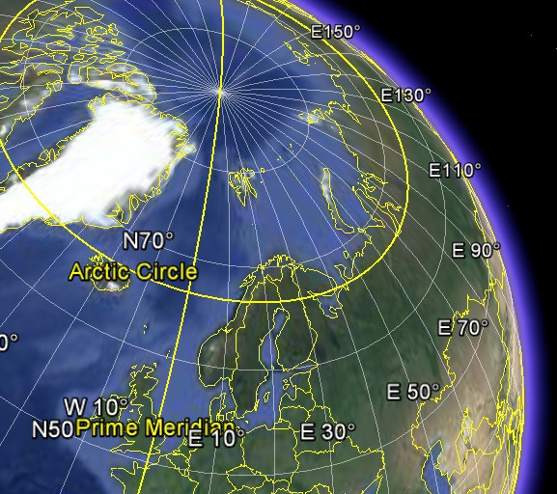
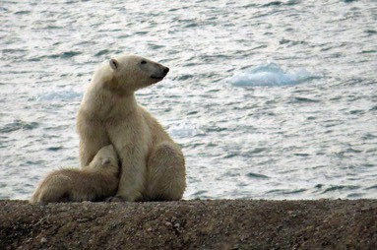
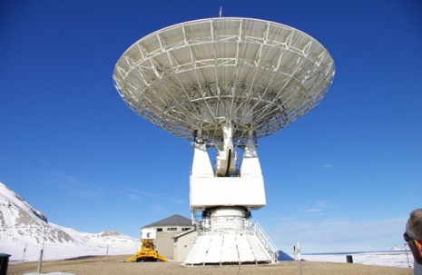
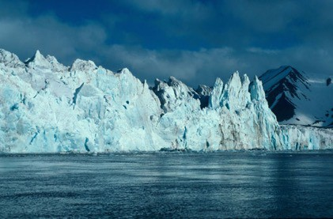
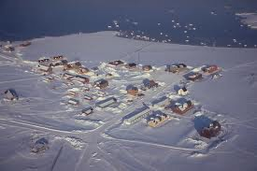
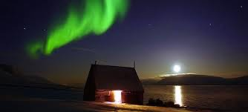
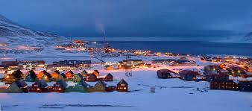
Svalbard – close to the North Pole

Slide 29
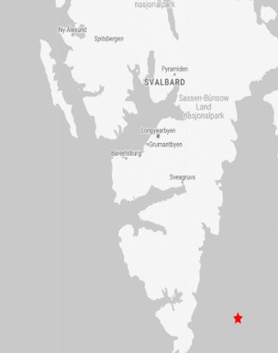
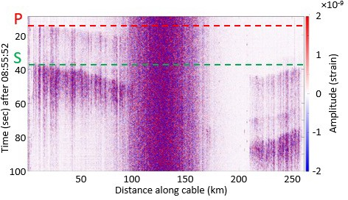
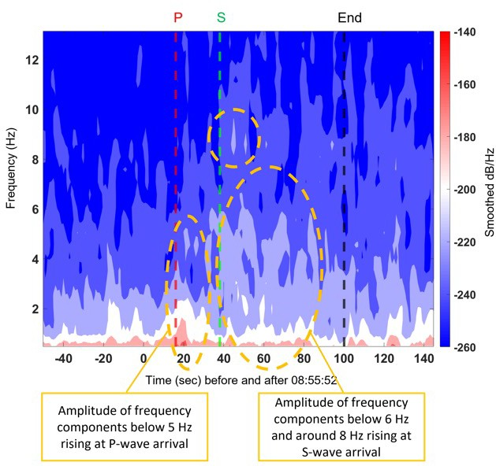





Detection of M2.7 Earthquake with DAS and SOP
-50
Earthquake: M2.70
NORSAR
seismometer
-60
-70
-80
Longyearbyen
Ny-Ålesund
Extract the timing the seismic waves hits the cable from DAS data
-90
Source: Kristina Shizuka Yamase Skarvang et al., Observation of Local Small Magnitude Earthquakes using State Of Polarization Monitoring in a 250km Passive Arctic Submarine Communication Cable, OFC 2023
SOP variation corresponds with the timing of the Earthquake hitting the cable

Slide 30
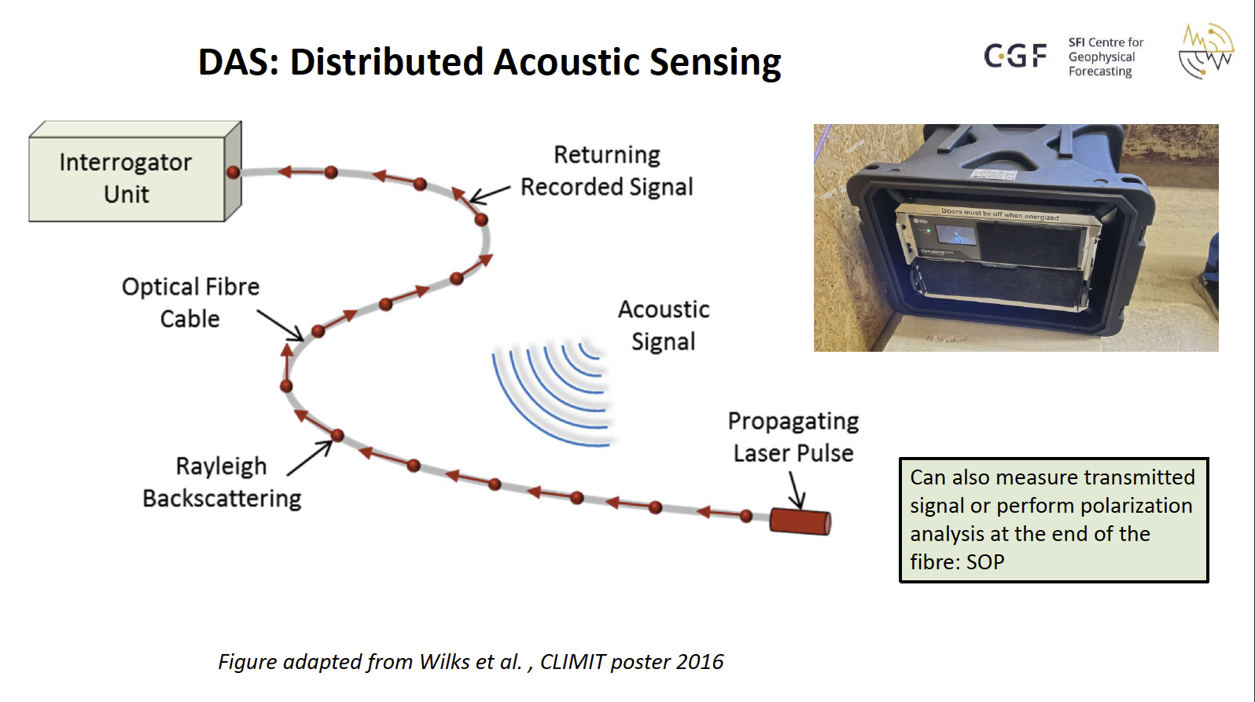
With thanks to Prof Martin Landrø, NTNU
Notes:
Interrogator sends a “laser” down a fibre optic cable. The reflections of the laser against the fibre, a concept called Rayleigh backscattering (the same concept which explains why the sky is blue and turns red at sub set) get sent back to the interrogator unit, turning each point the light wave hits the fibre into a sensing point. Collectively it turns the cable into effectively a giant microphone.
DAS works to the first junction box but due to the way the interrogator works, the usable distance is limited to about 200kmm. After that there is too much noise to properly discern what it is that is making the signal.

Slide 31
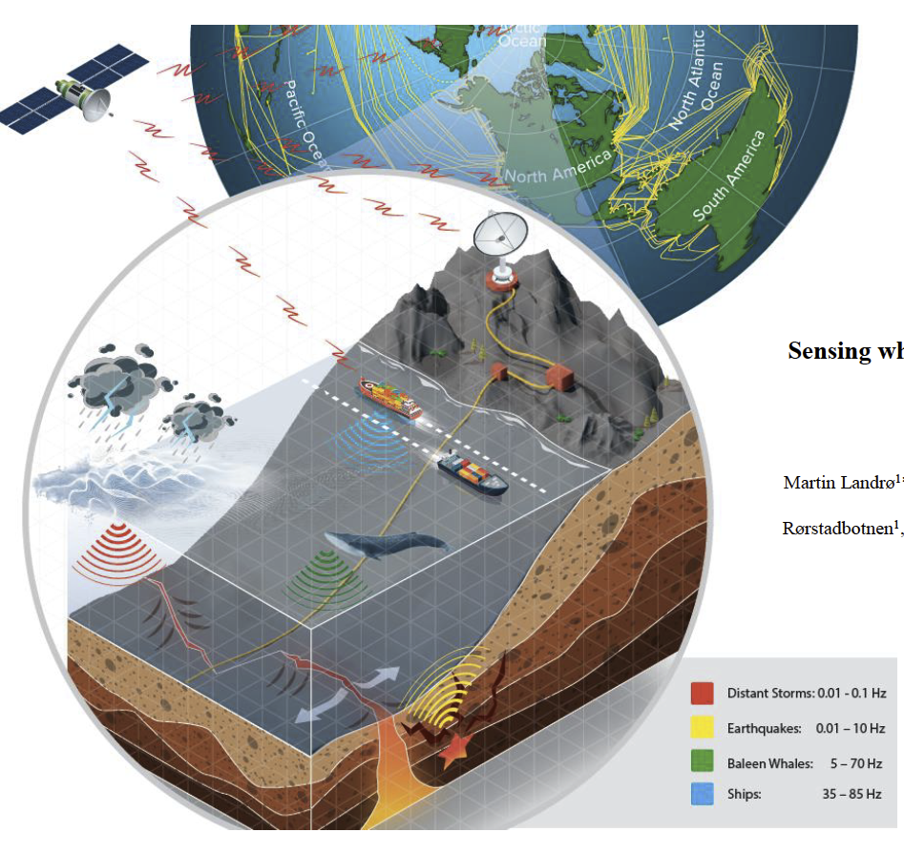
What can DAS detect?
Wales
Storms
Ships
Earthquakes
And more
With thanks to Prof Martin Landrø, NTNU
Notes:
Das can be used to detect many things
Wales and other sea life
Earthquakes
Vessels
Storms
Suspensions in the cable
Some research suggests that you can also detect ocean bottom temperature

Slide 32
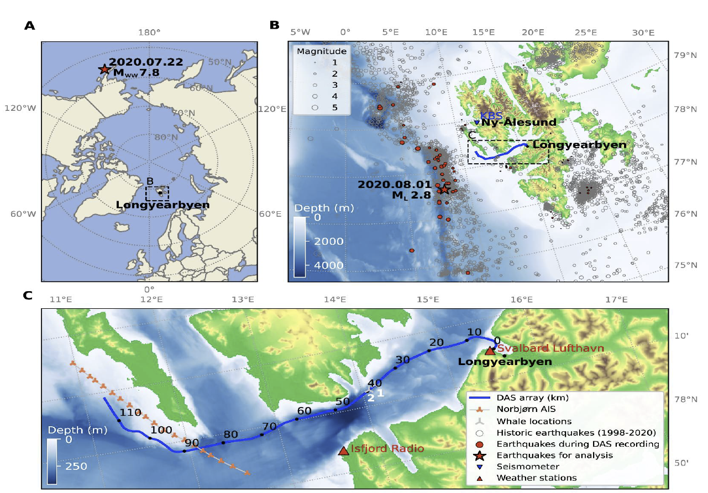
With thanks to Prof Martin Landrø, NTNU

Slide 33
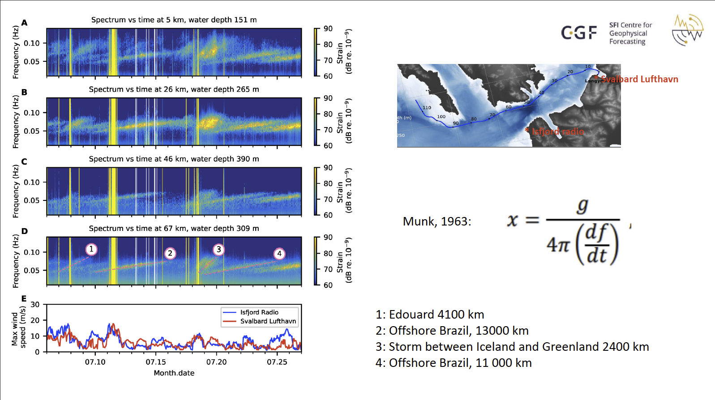
With thanks to Prof Martin Landrø, NTNU

Slide 34
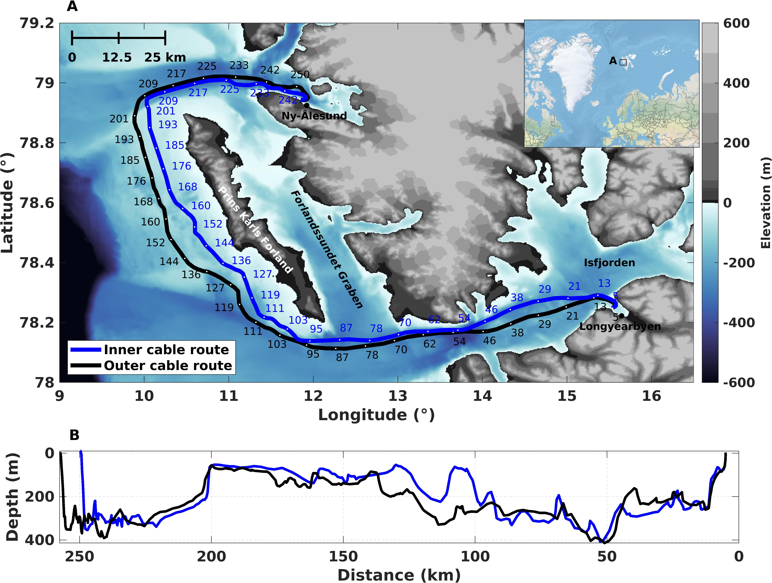







2nd Field Campaign: Svalbard
Polarimeter (PM1000, Novoptel) connected to a live DWDM link
2 x CESNET PolBox (Polarimeters) connected to a live DWDM link
White rabbit protocol running between the two end sites
2 x DAS (OptoDAS, ASN) interrogators connected to DWDM system in L band
DAS (OptoDAS, ASN) interrogators connected to two dedicated fibres in each cable
White
rabbit
White
rabbit
Ny-Ålesund
125 km
125 km
Longyearbyen
DAS signal injected on Rx fibre
DAS
Tx
$$λ_{1}$$
$$λ_{1}$$
Rx
Tx
$$λ_{2}$$
DWDM
EDFA
C/L Filter
EDFA
DWDM
$$λ_{2}$$
Rx
…
100 Gbps per 𝜆
…
SFP
1542.94 nm
Signal multiplexed with other communication traffic
Raman Pump
Polarimeter
250 km
DAS
Dedicated Fibre
DAS

Slide 35
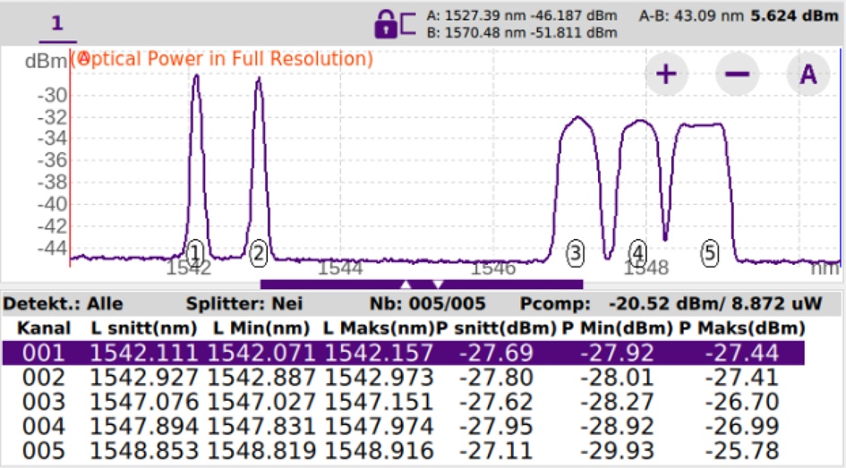
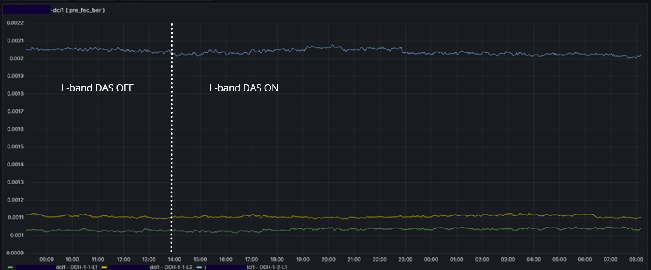
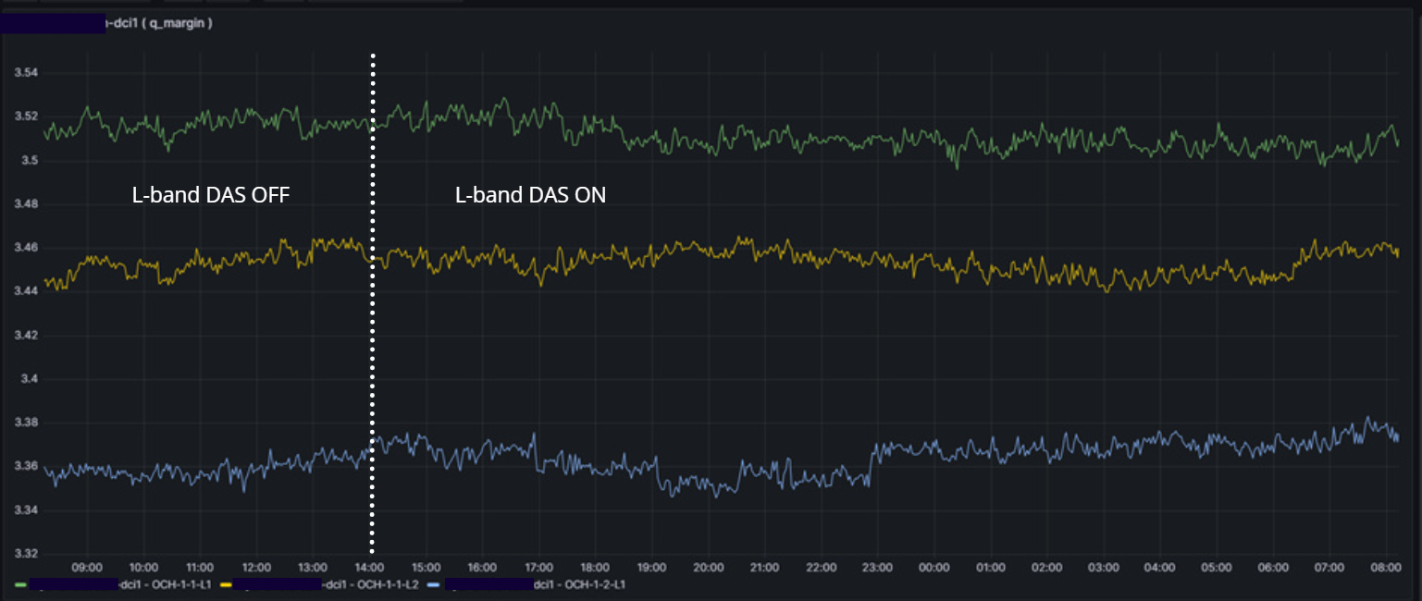
DAS coexistance with DWDM
pre-FEC bit error rate (BER)
24 hour of operation
5 Active wavelengths monitored
1G
1G
200 G
200 G
300 Gbps (Production traffic)
200G (62Gbaud QPSK with SDFEC-G2), 300G (84.23Gbaud 16SQAM with SDFEC-V. Monitored for 14 days in total with no degradation in signal
Q-margin
Credit: K. Bozorgebrahimi and R. Veisllari, SIKT

Slide 36
Preveza,

Slide 37
Credit: www.submarinecablemap.com
Notes:
What about submarine telecommunications cables?

Slide 38
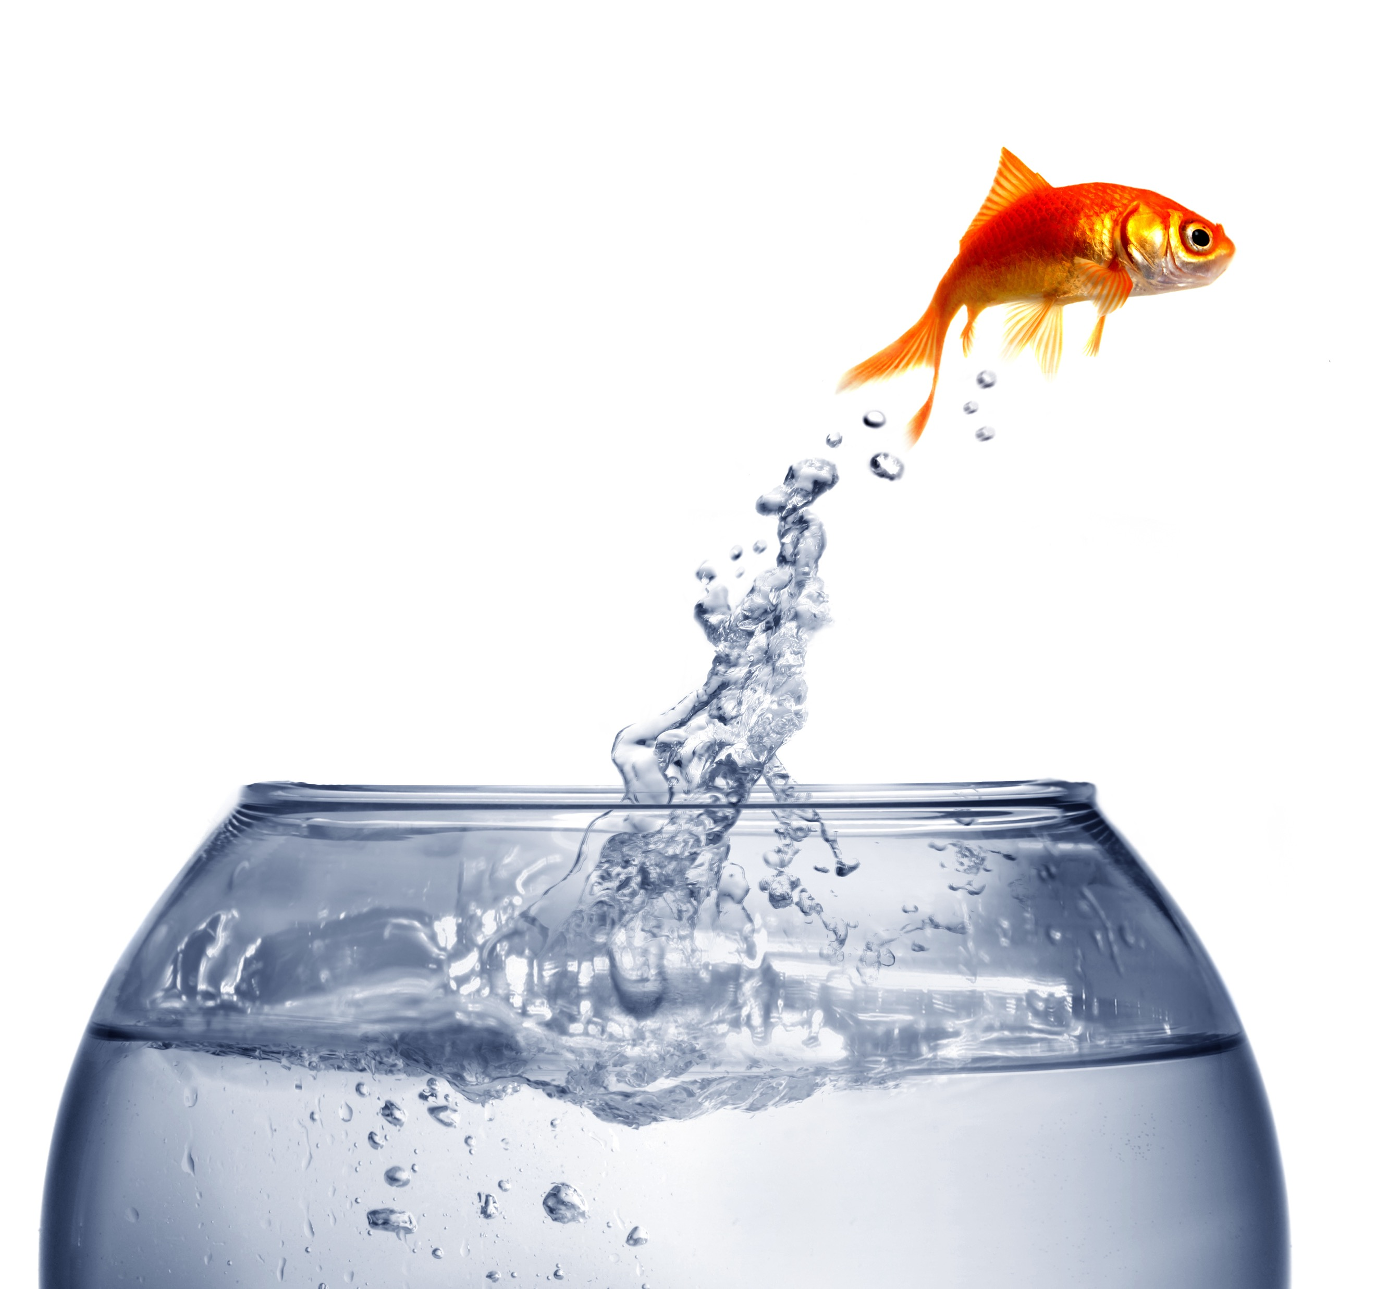
You don’t have to feel like a fish out of water.
  How can the tech benefit wider European NREN group?
  Identification of potential terrestrial cable sensing locations?
  Identify how will fibre sensing affect our other plans? QKD and T&F, network footprint expansion.
  Propose ways to allow cooperative use of the network resources.
Fibre sensing incubator in GÉANT project
  How tech can benefit NRENs
  Investigate terrestrial cable sensing
  Identify how sensing can complement our other plans.
  (QKD, T&F, network footprint expansion.)
Notes:
How can the tech benefit wider European NREN group?
Identification of potential terrestrial cable sensing locations?
Identify how will fibre sensing affect our other plans? QKD and T&F, network footprint expansion.
Propose ways to allow cooperative use of the network resources.

Slide 39
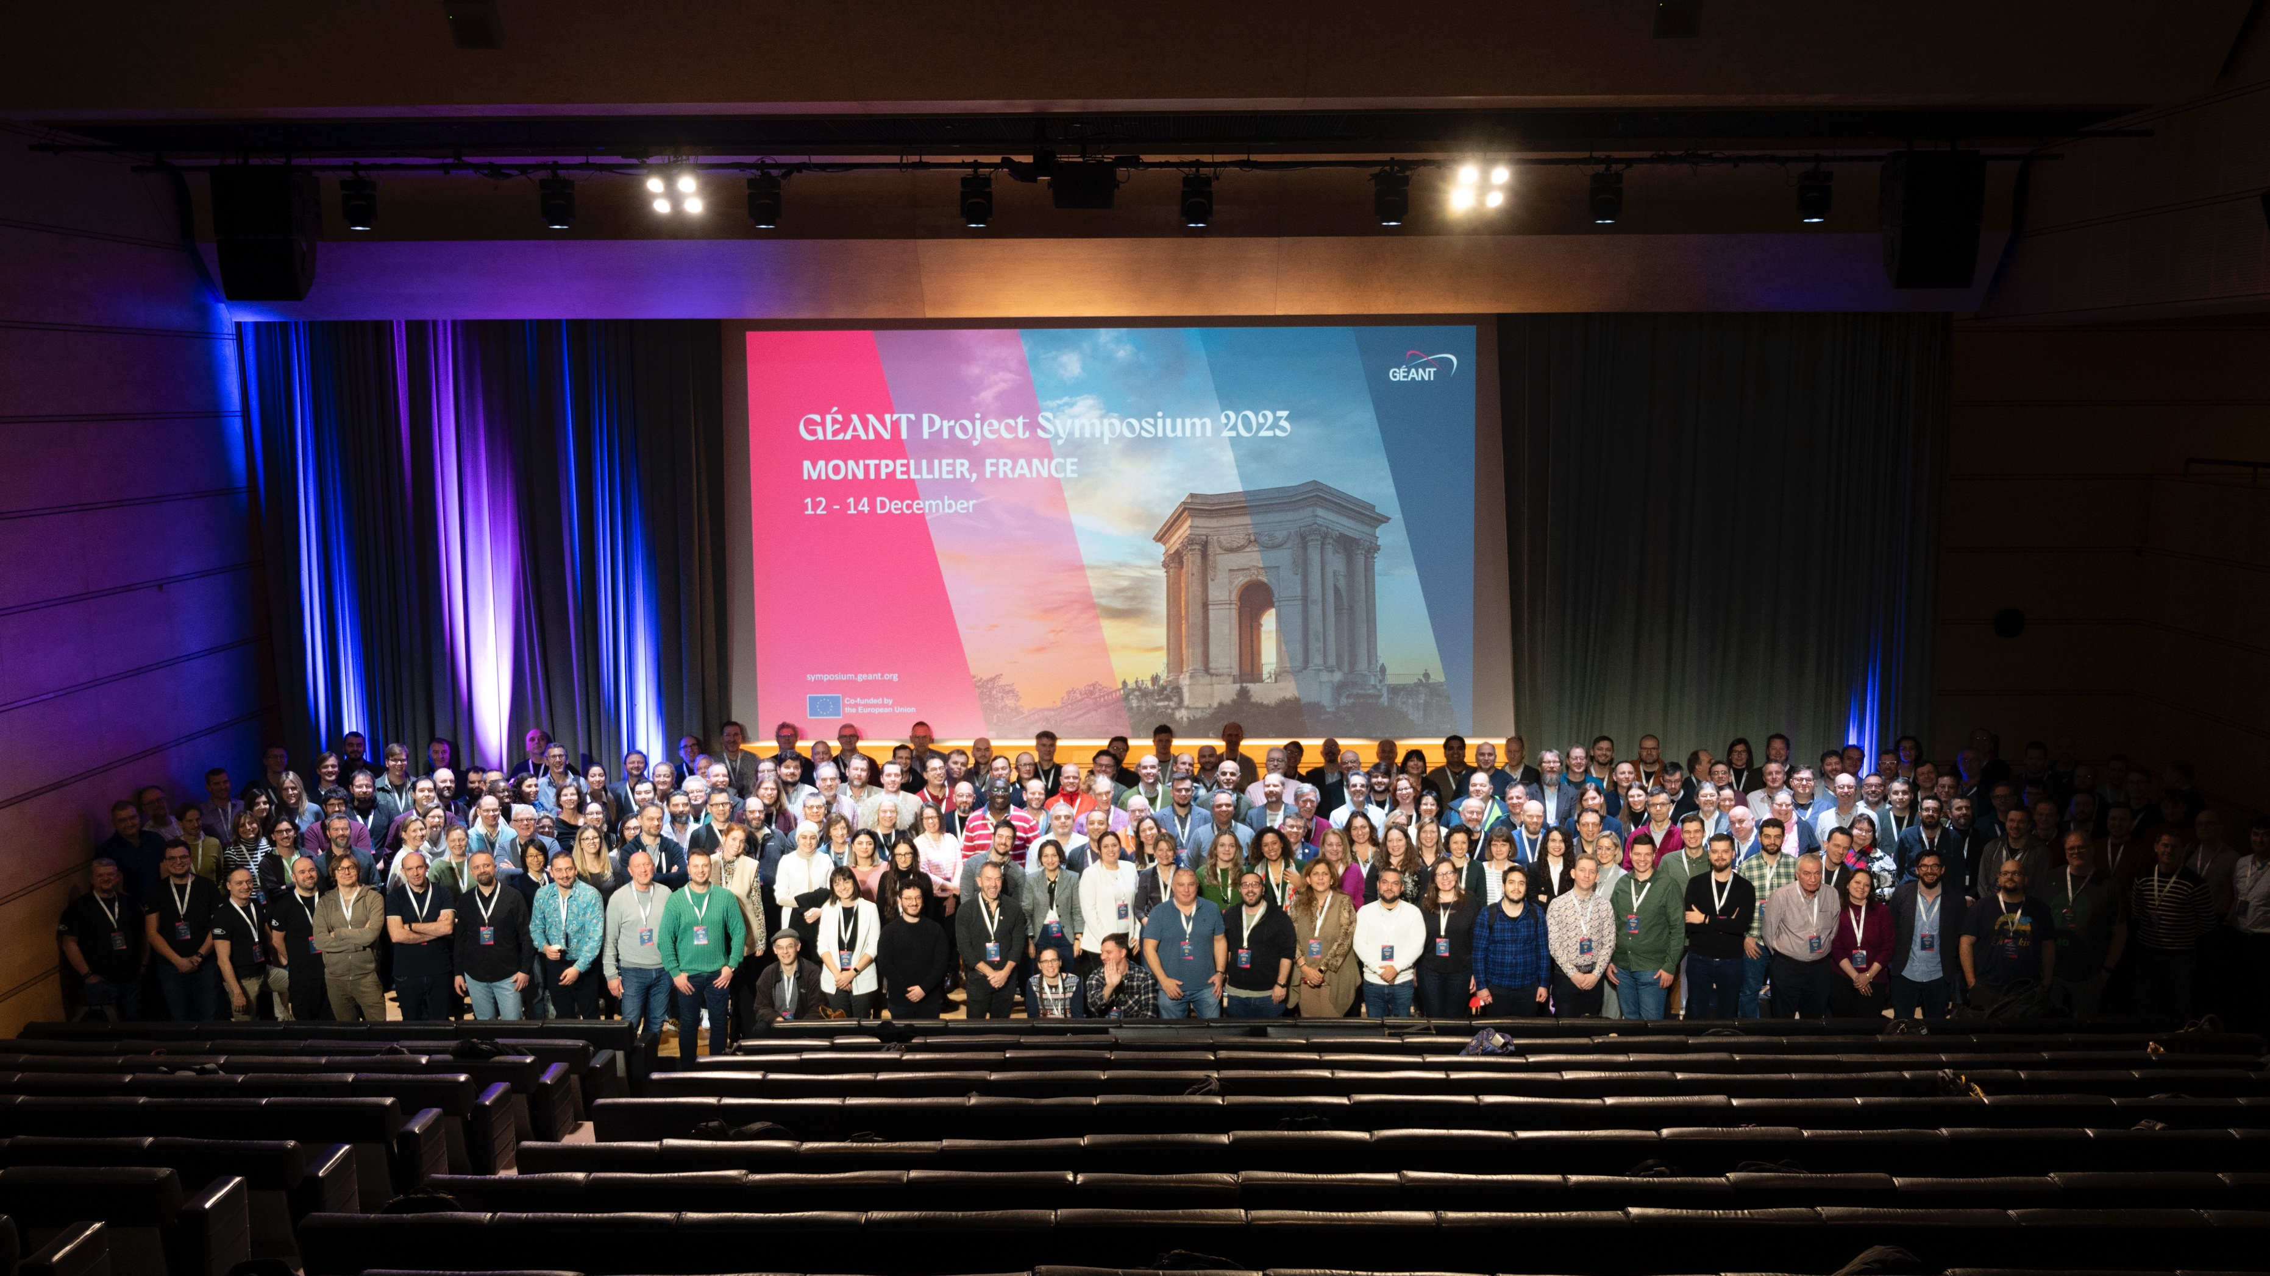
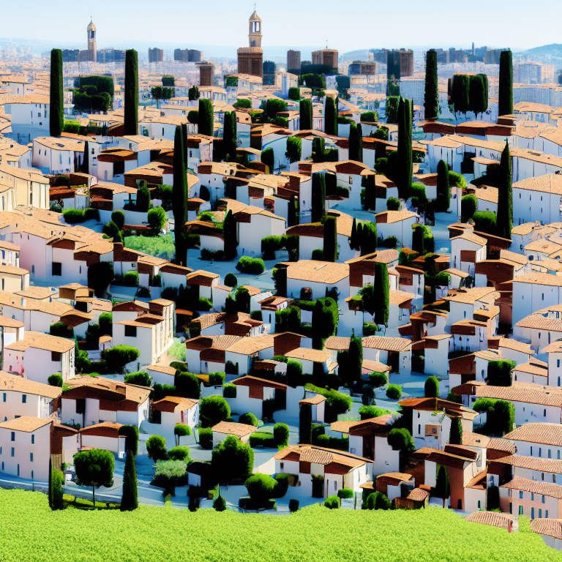
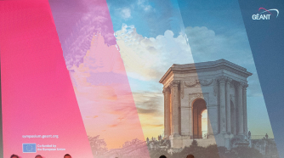
GN5-1 Fibre Sensing focus group report
Get the report here

Slide 40
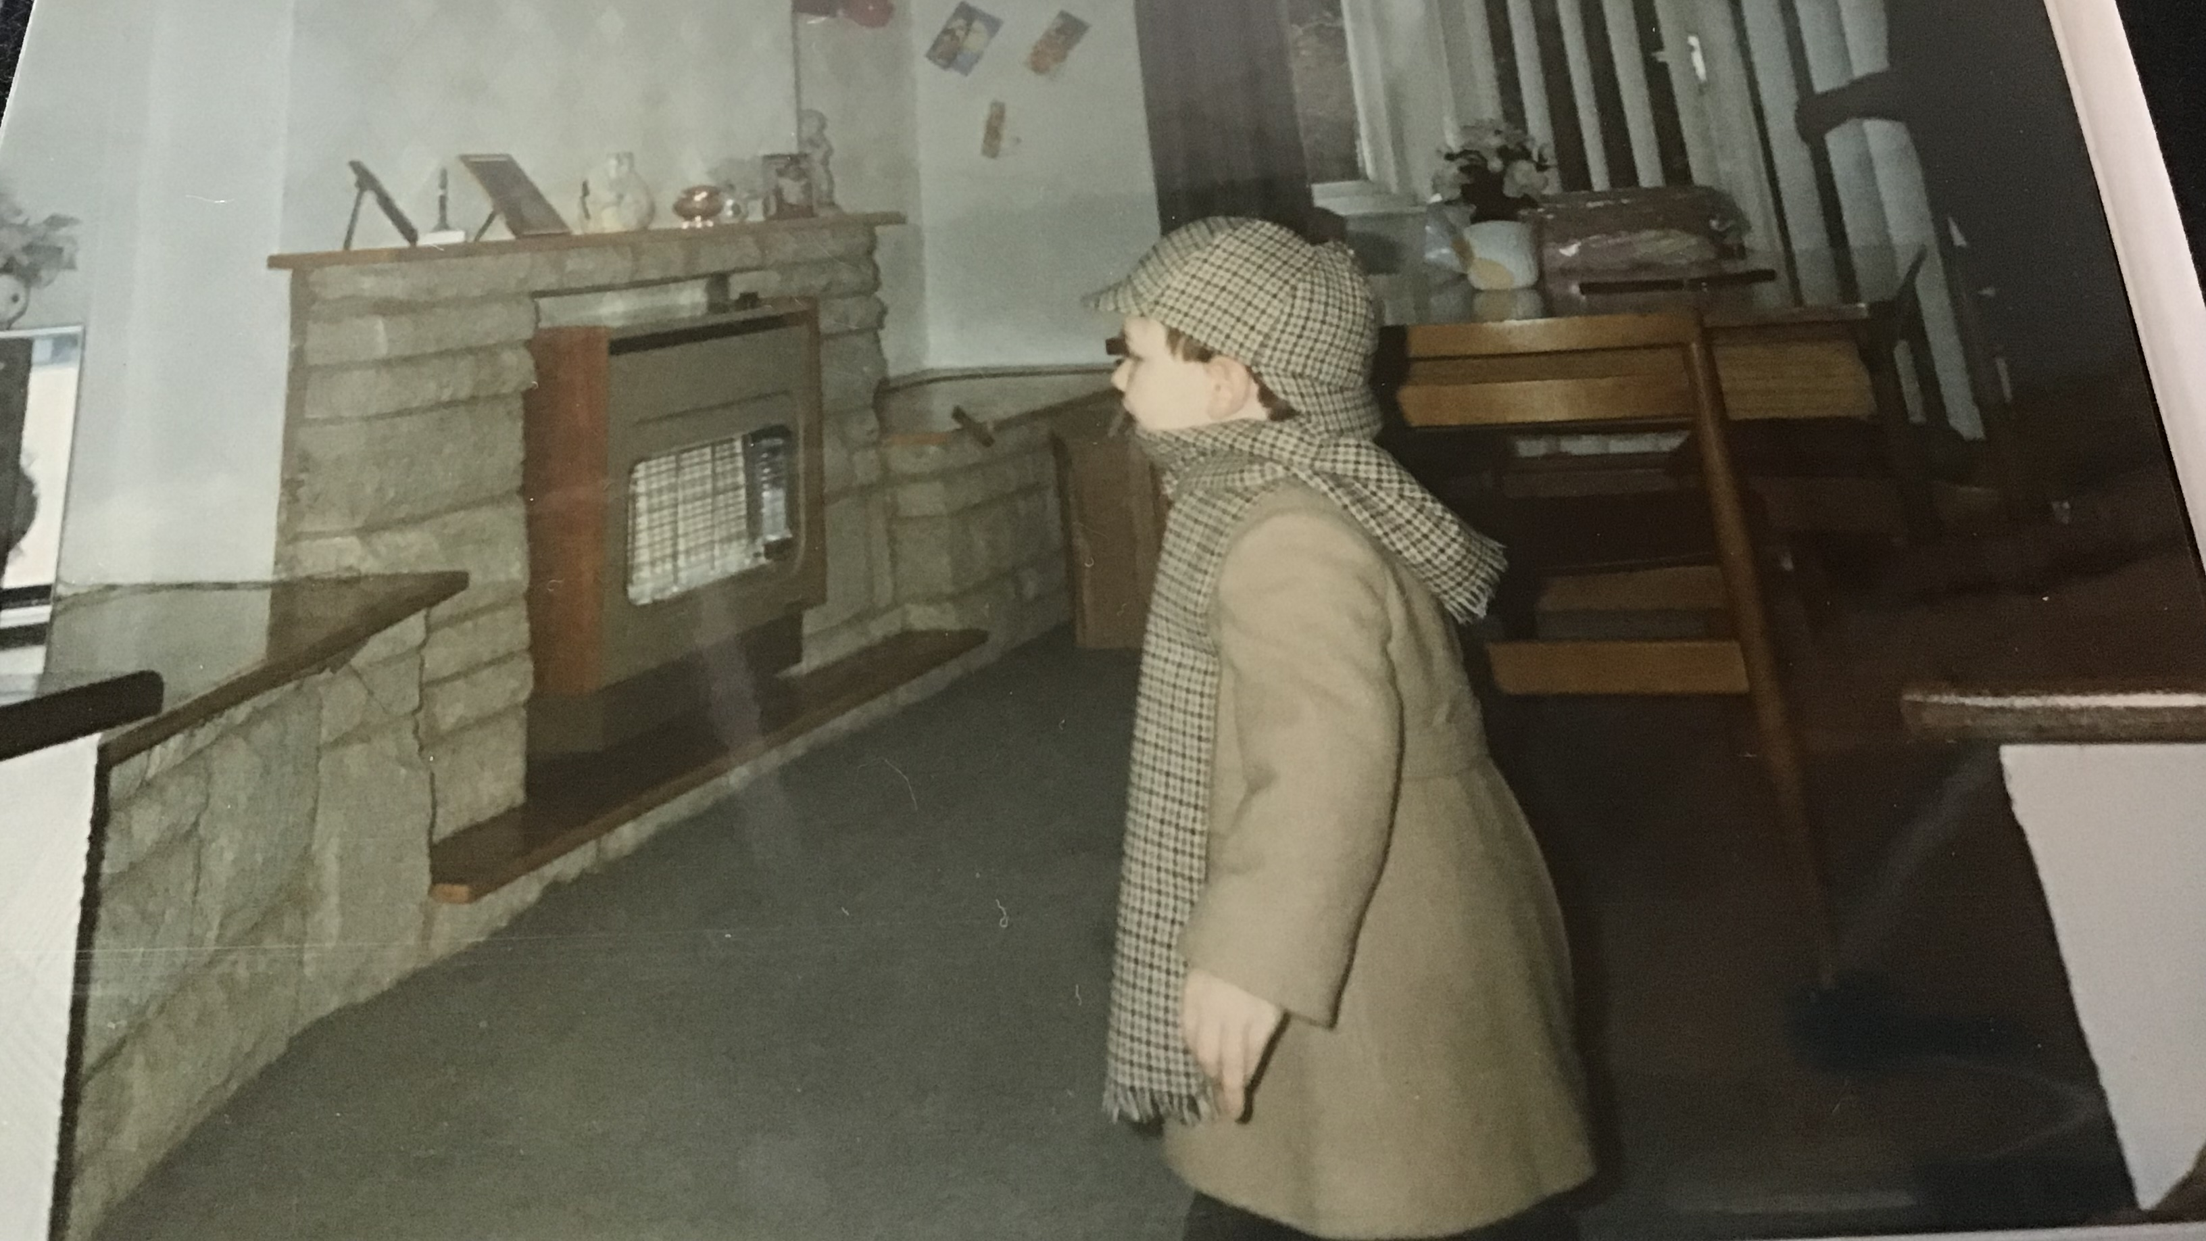
Picture of me as a kid with a ball
My Sherlock Holmes phase
Invitation to come and play.

Slide 41

Thank You
Any questions?
chris.atherton@geant.org – SUBMERSE
gn5-1-wp6-fs-fg@lists.geant.org – GN5-1 Incubator
www.geant.org

