Slide 1
"Strengthening competencies in Ecuador's Higher Education Institutions".
Based on the DigCompEdu Framework
June 2024

Slide 2
Background:
Traditional Classes
The traditional classroom uses the transmission of information by the teacher as the center of learning.
Notes:
"This class took place a few days before the pandemic began.“
"Look at the teacher in the following image."
Maps, Chalkboards, Posters.

Slide 3
What happens when the classroom becomes a virtual space?
Teachers ?
Materials / resources ?
Communication ?
Evaluation / Follow-up ?
Student ?
Notes:
When the pandemic began, it was necessary to adapt face-to-face classes to the virtual modality.
What about
Teachers, Resources, Comunication,Evaluation, Students?
There are two types the evaluations: Formative Assessment (Evaluación Formativa) and Summative Assessment.

Slide 4
Expectation
vs
Reality
Adaptation online express
Students:
¿ Motivated, Solitary, Self-regulated ?
Notes:
The expectation was to be like her, motivated, relaxed.
the reality was different, very unmotivated, lonely

Slide 5
Before, we could only appreciate and analyze
these interactions with our senses.
Educational researchers had to observe, record and analyze.
Notes:
By Nature, teachers are researchers.
In this class we can identify 3 research professors
this is in the ideal world

Slide 6
Notes:
In this class, only the first row of students is paying attention to the teacher. In the middle of the class, they are probably drawing the teacher. In the back rows, they are probably planning their weekends.”

Slide 7
LL³
^{Learning Analytics,}
^{Self-Regulation of Learning,}
^{Active Learning}
Ecosystem
based on:
Notes:
The virtual platform register all activities performed by the student.

Slide 8
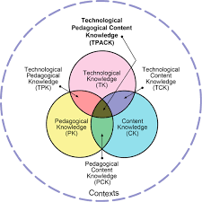
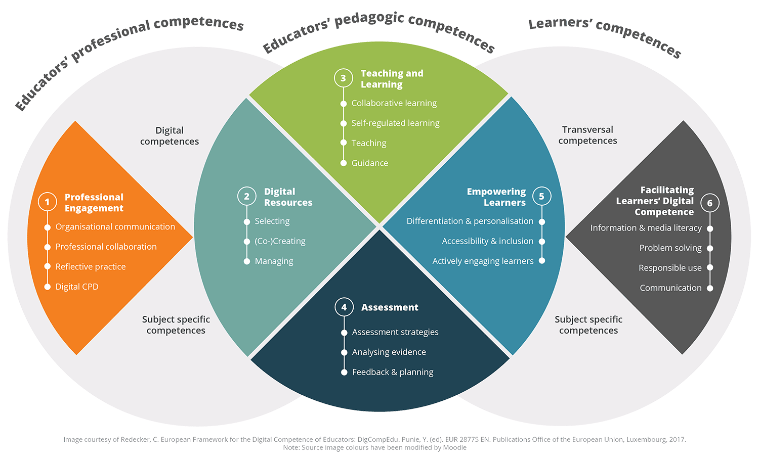
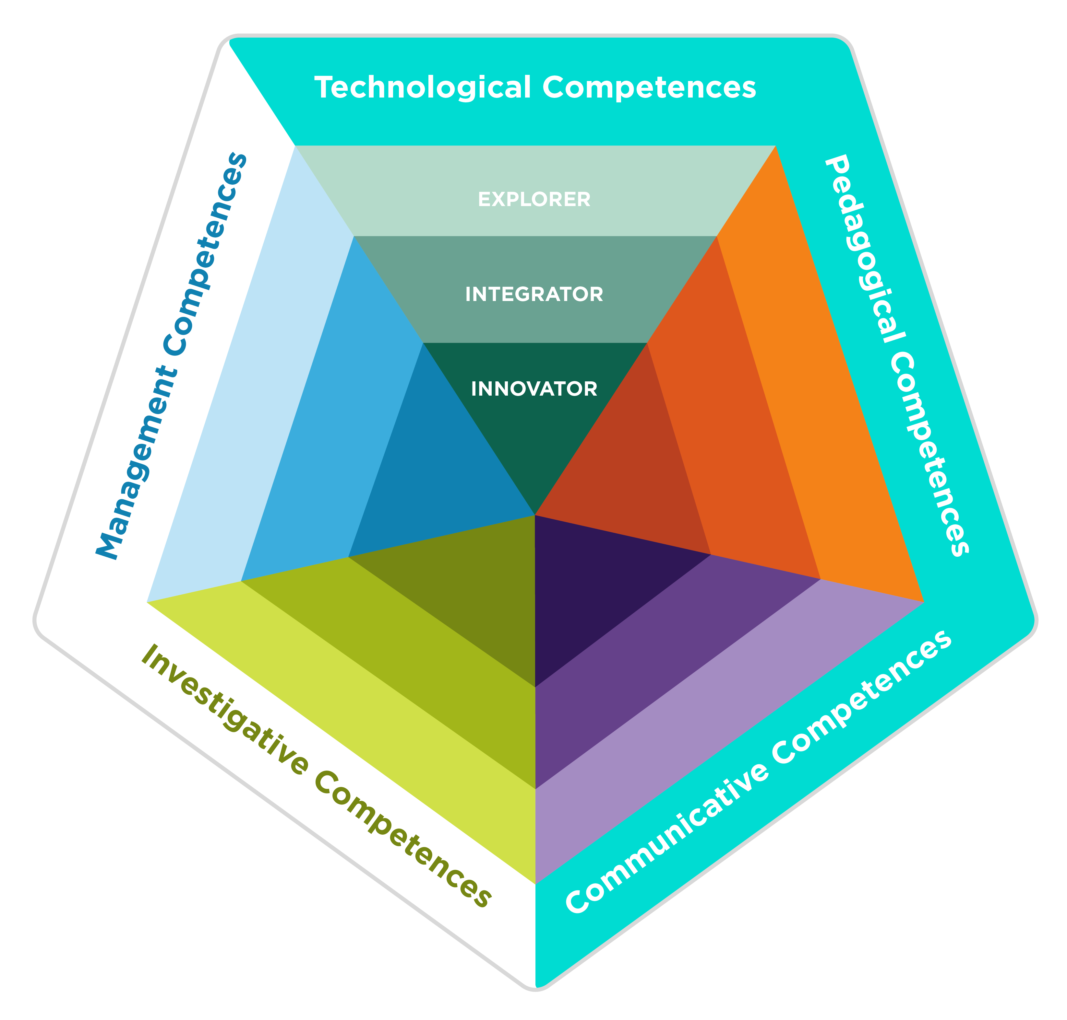
Proposal based on: Frameworks.
ELSA Plataform.
TPACK Framework, 2012
DigCompEdu, Unión Europea, 2017
Competence Pentagon TIC, Min Edu Colombia, 2016
Notes:
While the ICT Skills Pentagon and DigCompEdu focus more on the development of digital skills and the integration of technology in the educational process, the TPACK provides a theoretical basis on how technology, pedagogy and content interact. All these frameworks are complementary and can be used together to form a comprehensive vision on the integration of ICT in education.

Slide 9
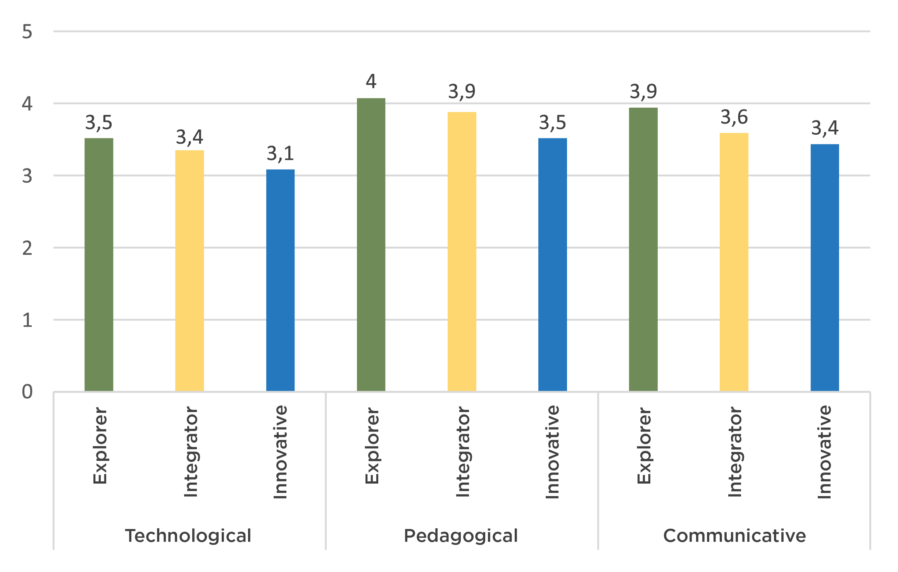
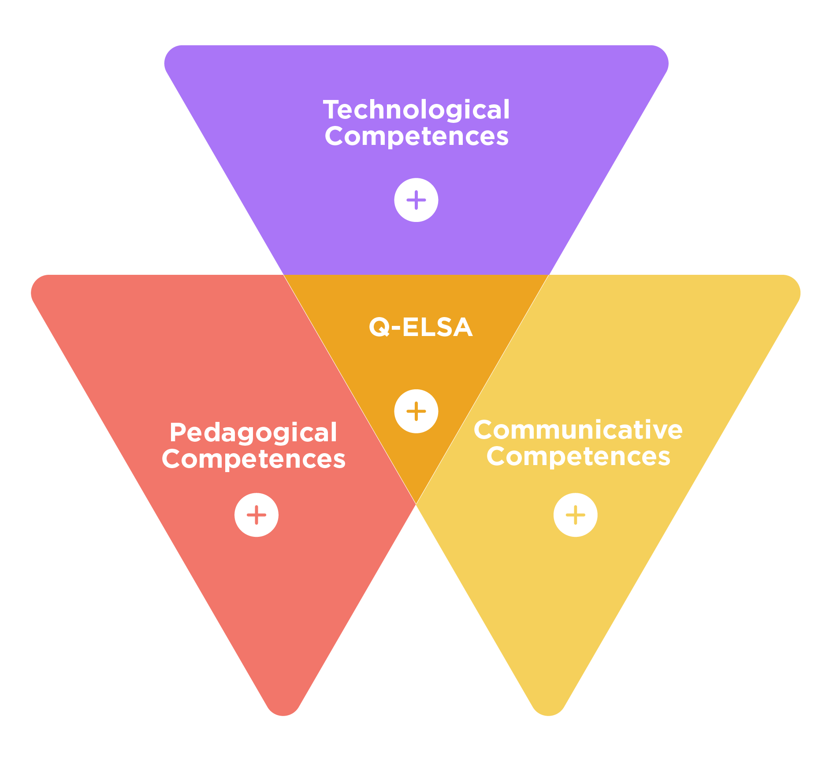
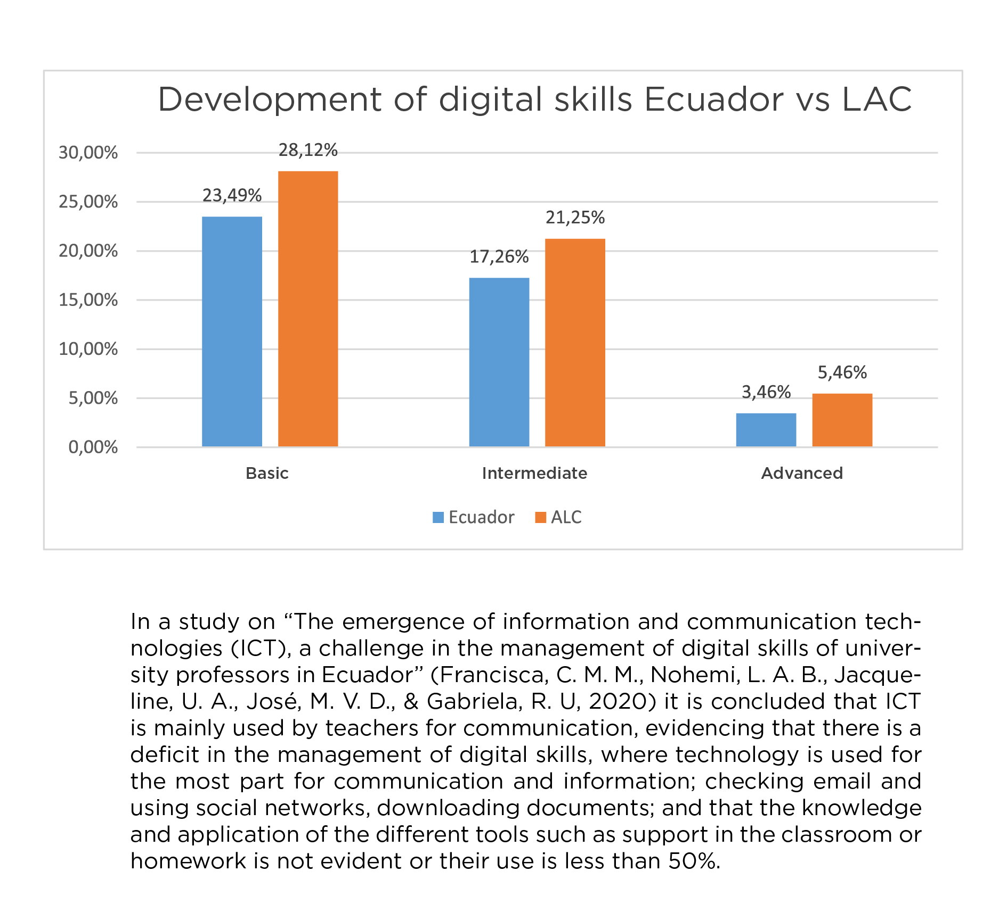
Assessment Using the Pentagon's: Three Pillars
Assessment of competences CEDIA, 2021.
More tan 245 Teachers.
BID (Banco Interamericano de Desarrollo, 2022)
Q-ELSA. Triangle of Competences. 2021.
Explorer: They begin to introduce ICT in some of their teaching and learning tasks and processes.
Integrator: They integrate ICT into curricular design and institutional management in a pertinent manner.
Innovator: They adapt and combine a diversity of technological tools to design learning environments.
Diagnosis of the current capacities of teachers in Ecuadorian Higher Education Institutions (HEI) in relation to active teaching-learning methodologies and the use of the LMS Moodle.
Notes:
"An assessment was conducted in 2021.“
The teachers obtained the following results

Slide 10
Learning Analytics for Monitoring and Tracking
62%
82%
They do not know
Learning Analytics
Institutions do not have a policy
or AL initiatives
COMPETENCESS
24%
Believe to use some AL tool
Evaluation and Academic Integrity
88%
Use a tool to
detect plagiarism
85%
No tool used
Proctoring

Slide 11
The majority have only basic digital skills, with significant variability among faculty members.
WEAKNESSES
Variable Digital Competencies
Limited ICT Integration
Training Challenges
THREATS
Resistance to Change
Rapid Technological Advancement.
Inequalities in Technology Access
Regional Competition.
Lack of Funding
Inadequate Technological Infrastructure
High Expectations for Digital Transformation
Limited use of ICT, especially in active learning methodologies.
Existing training processes are insufficient or misaligned with the real needs of faculty and students.
Some teachers show resistance to adopting new technologies.
Lack of incentives for innovation and research for teachers
Difficulty in keeping up with new tools and methodologies.
Impacts the quality and reputation of higher education.
Lack of infrastructure, limited training.

Slide 12
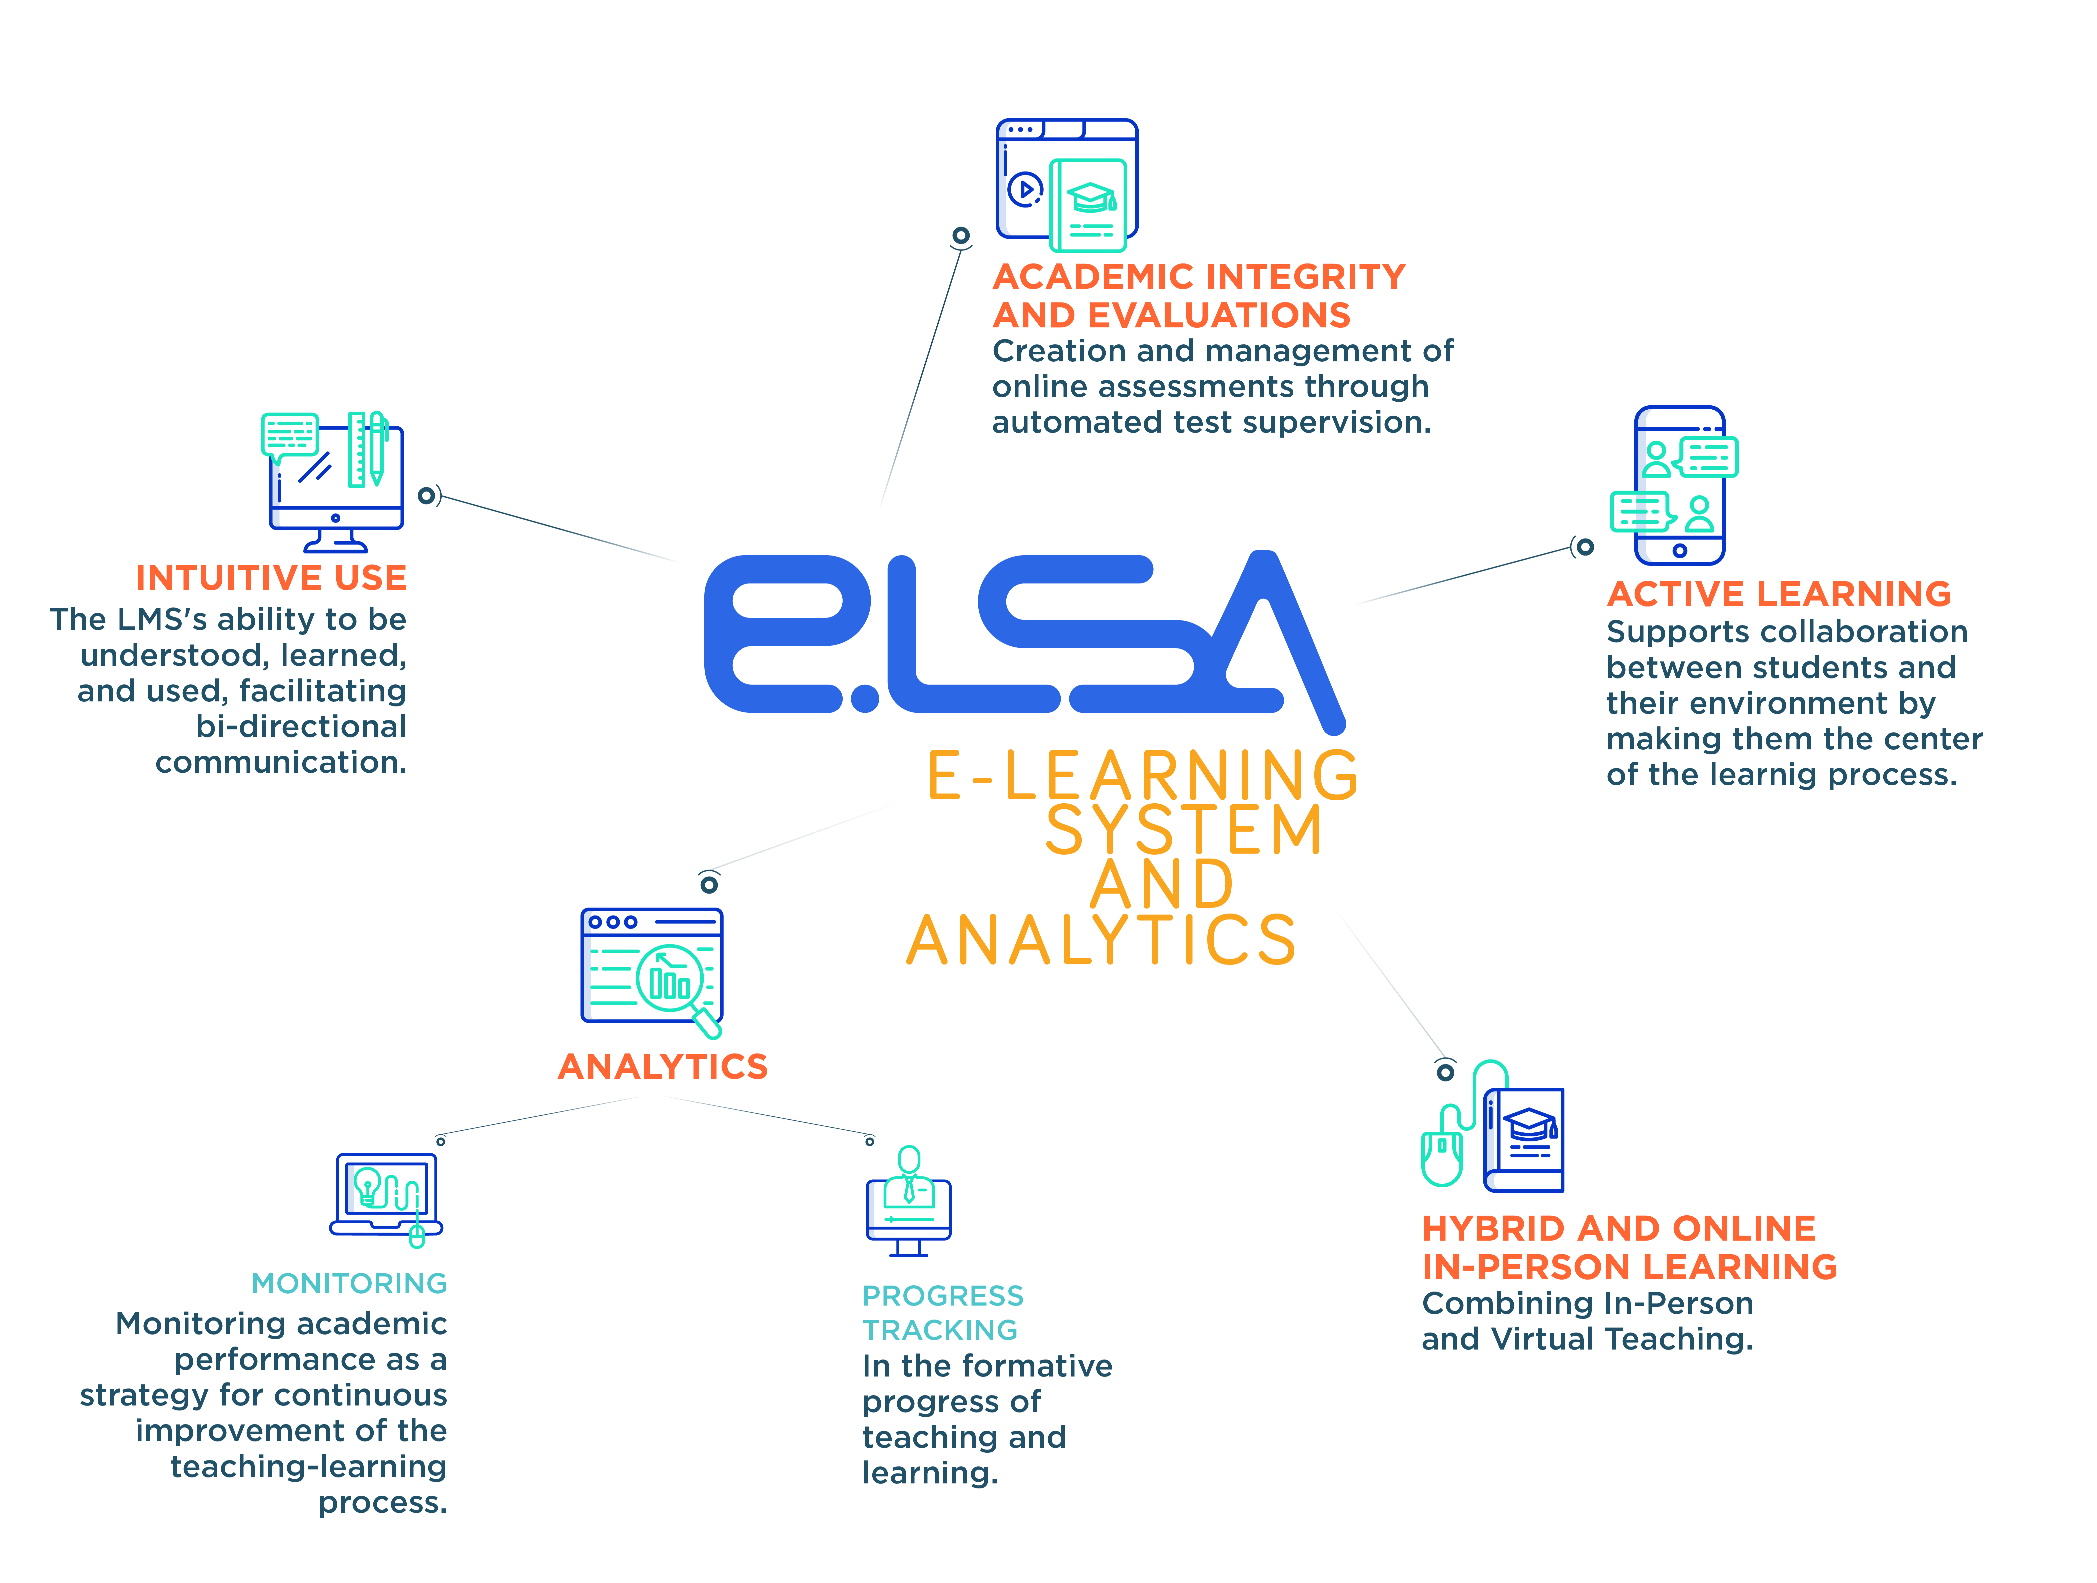
ELSA Plataform.
Implemented in more than 35 universities and 350.000 students.
Notes:
Implemented in more than 35 universities and 350.000 students

Slide 13
ELSA (E-Learning System and Analytics)
TEACHER PROFILE
Course design
Visualization by Week
Visualization by resource type.
Visualization by type of activity
Generals Indicators
Follow-up and Monitoring
Study sessions
Tasks
Grades
Evaluations
Inverted session
Gamification
Performance Alerts
Reports
Student Group
Student Profile
Resources per week
Sessions and Time
Grades
Course Design
Academic Load Report
LMS usage report (Teacher)
Moodle Records
Students report
Course Resources
STUDENT PROFILE
General indicators
Study sessions
Access to resources
Homework tracking
Gamification
Learning logs

Slide 14
Challenge 1:
How to support students' self-regulation strategies to successfully achieve the course objectives?

Slide 15
Challenge 2:
How to track and monitor the development of student activities through learning analytics in an LMS?

Slide 16
https://guidelearning.netlify.app/

Slide 17
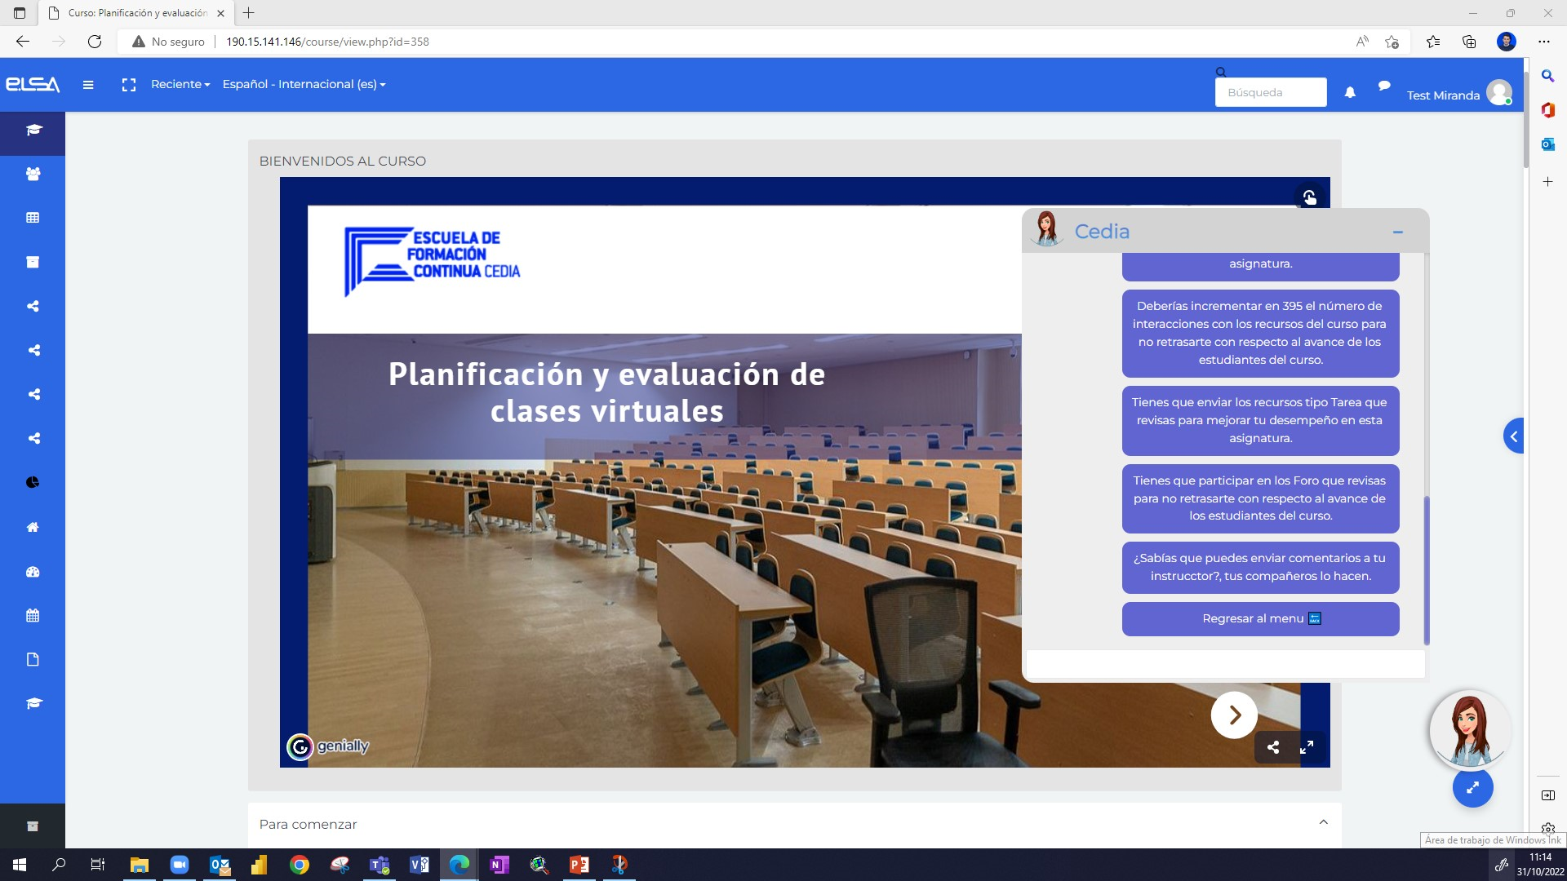
https://guidelearning.netlify.app/

Slide 18
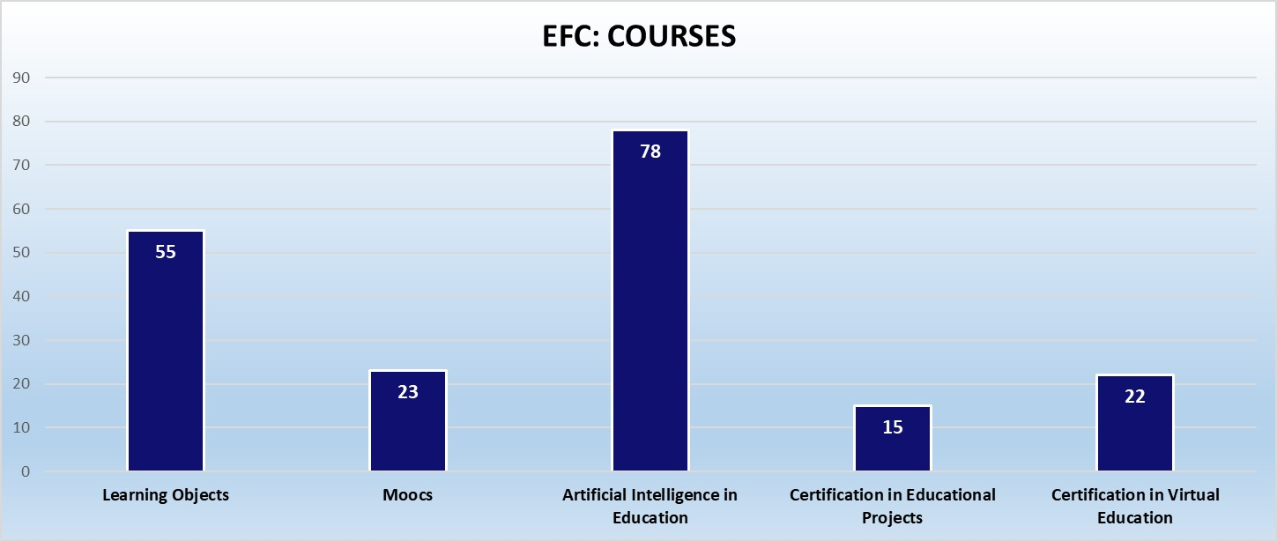
Training Fill the Gap
More than 200 teachers trainers of trainers

Slide 19
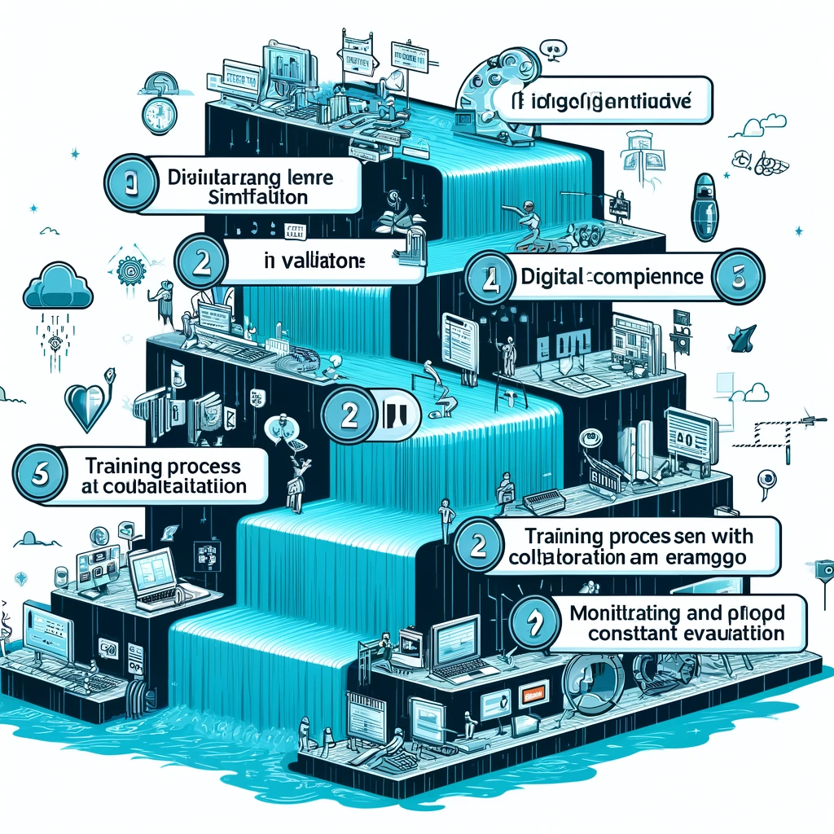
Training Process
cascade based
training model
Phase 1: Validation of training levels.
1
Phase 2: Content creation.
2
Phase 3: Training of trainers.
3
1 month
2 months
2 months
Phase 4: Intermediate-level training (regional).
4
2 months
Phase 5: Local training.
5
4 months
Phase 6: Certification and recognition.
6
2 months.

Slide 20
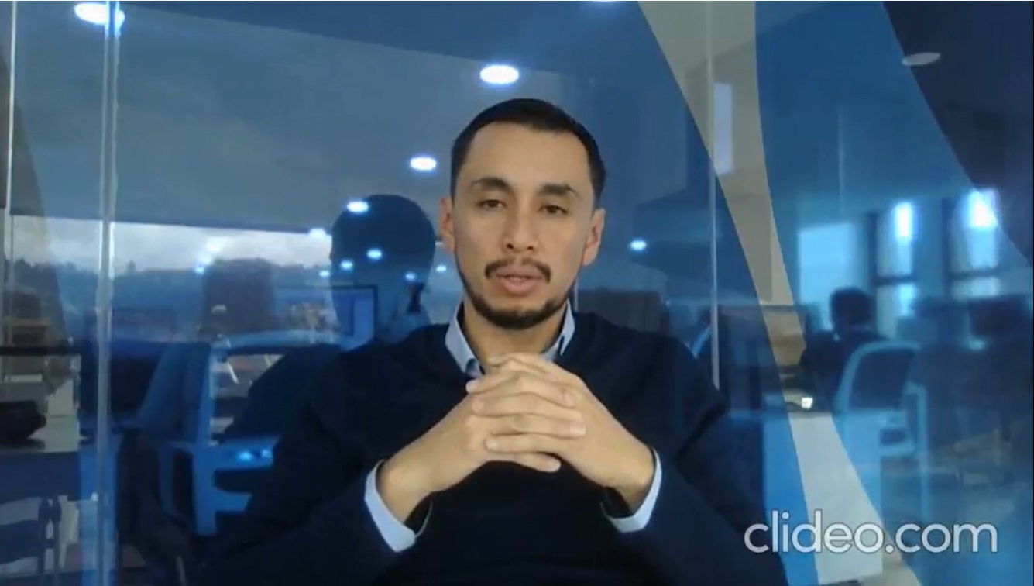
Generative AI based content generation
project-translated-video_k6b9NRQ1.mp4
2. Introduccion 2.0.mp4

Slide 21
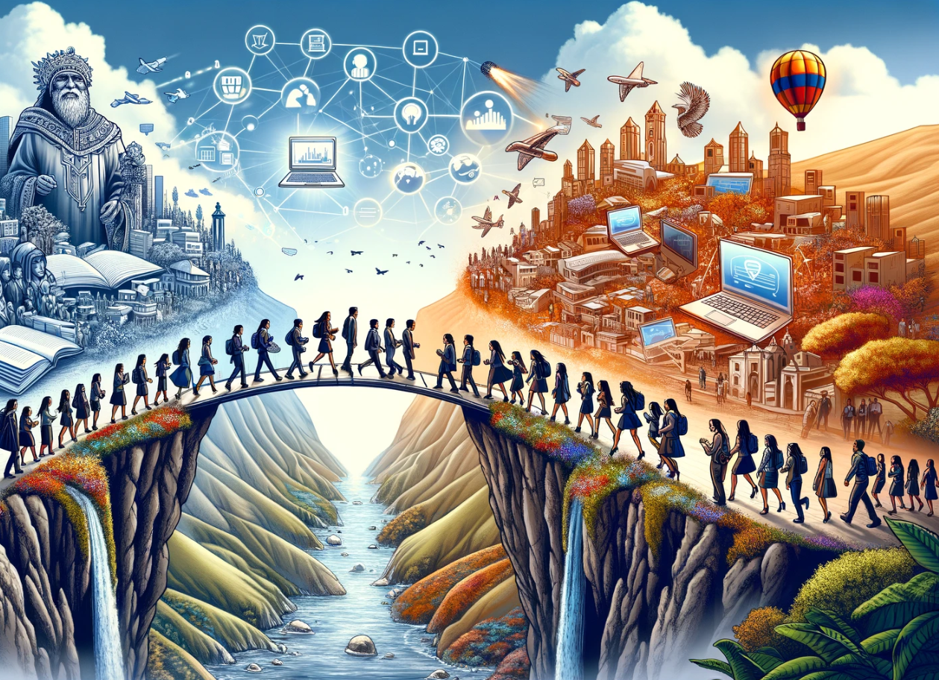
Expected Outcomes
The project aims to bridge the digital skill gap, enhance the quality of higher education in Ecuador, and facilitate ongoing professional development and collaboration among educational institutions.

Slide 22
Thanks

