Slide 1
Orchestrating Change
Automating GÉANT Network Migration
Simone Spinelli <simone.spinelli@geant.org>
TNC24
Rennes, France | 10-14 June 2024

Slide 2
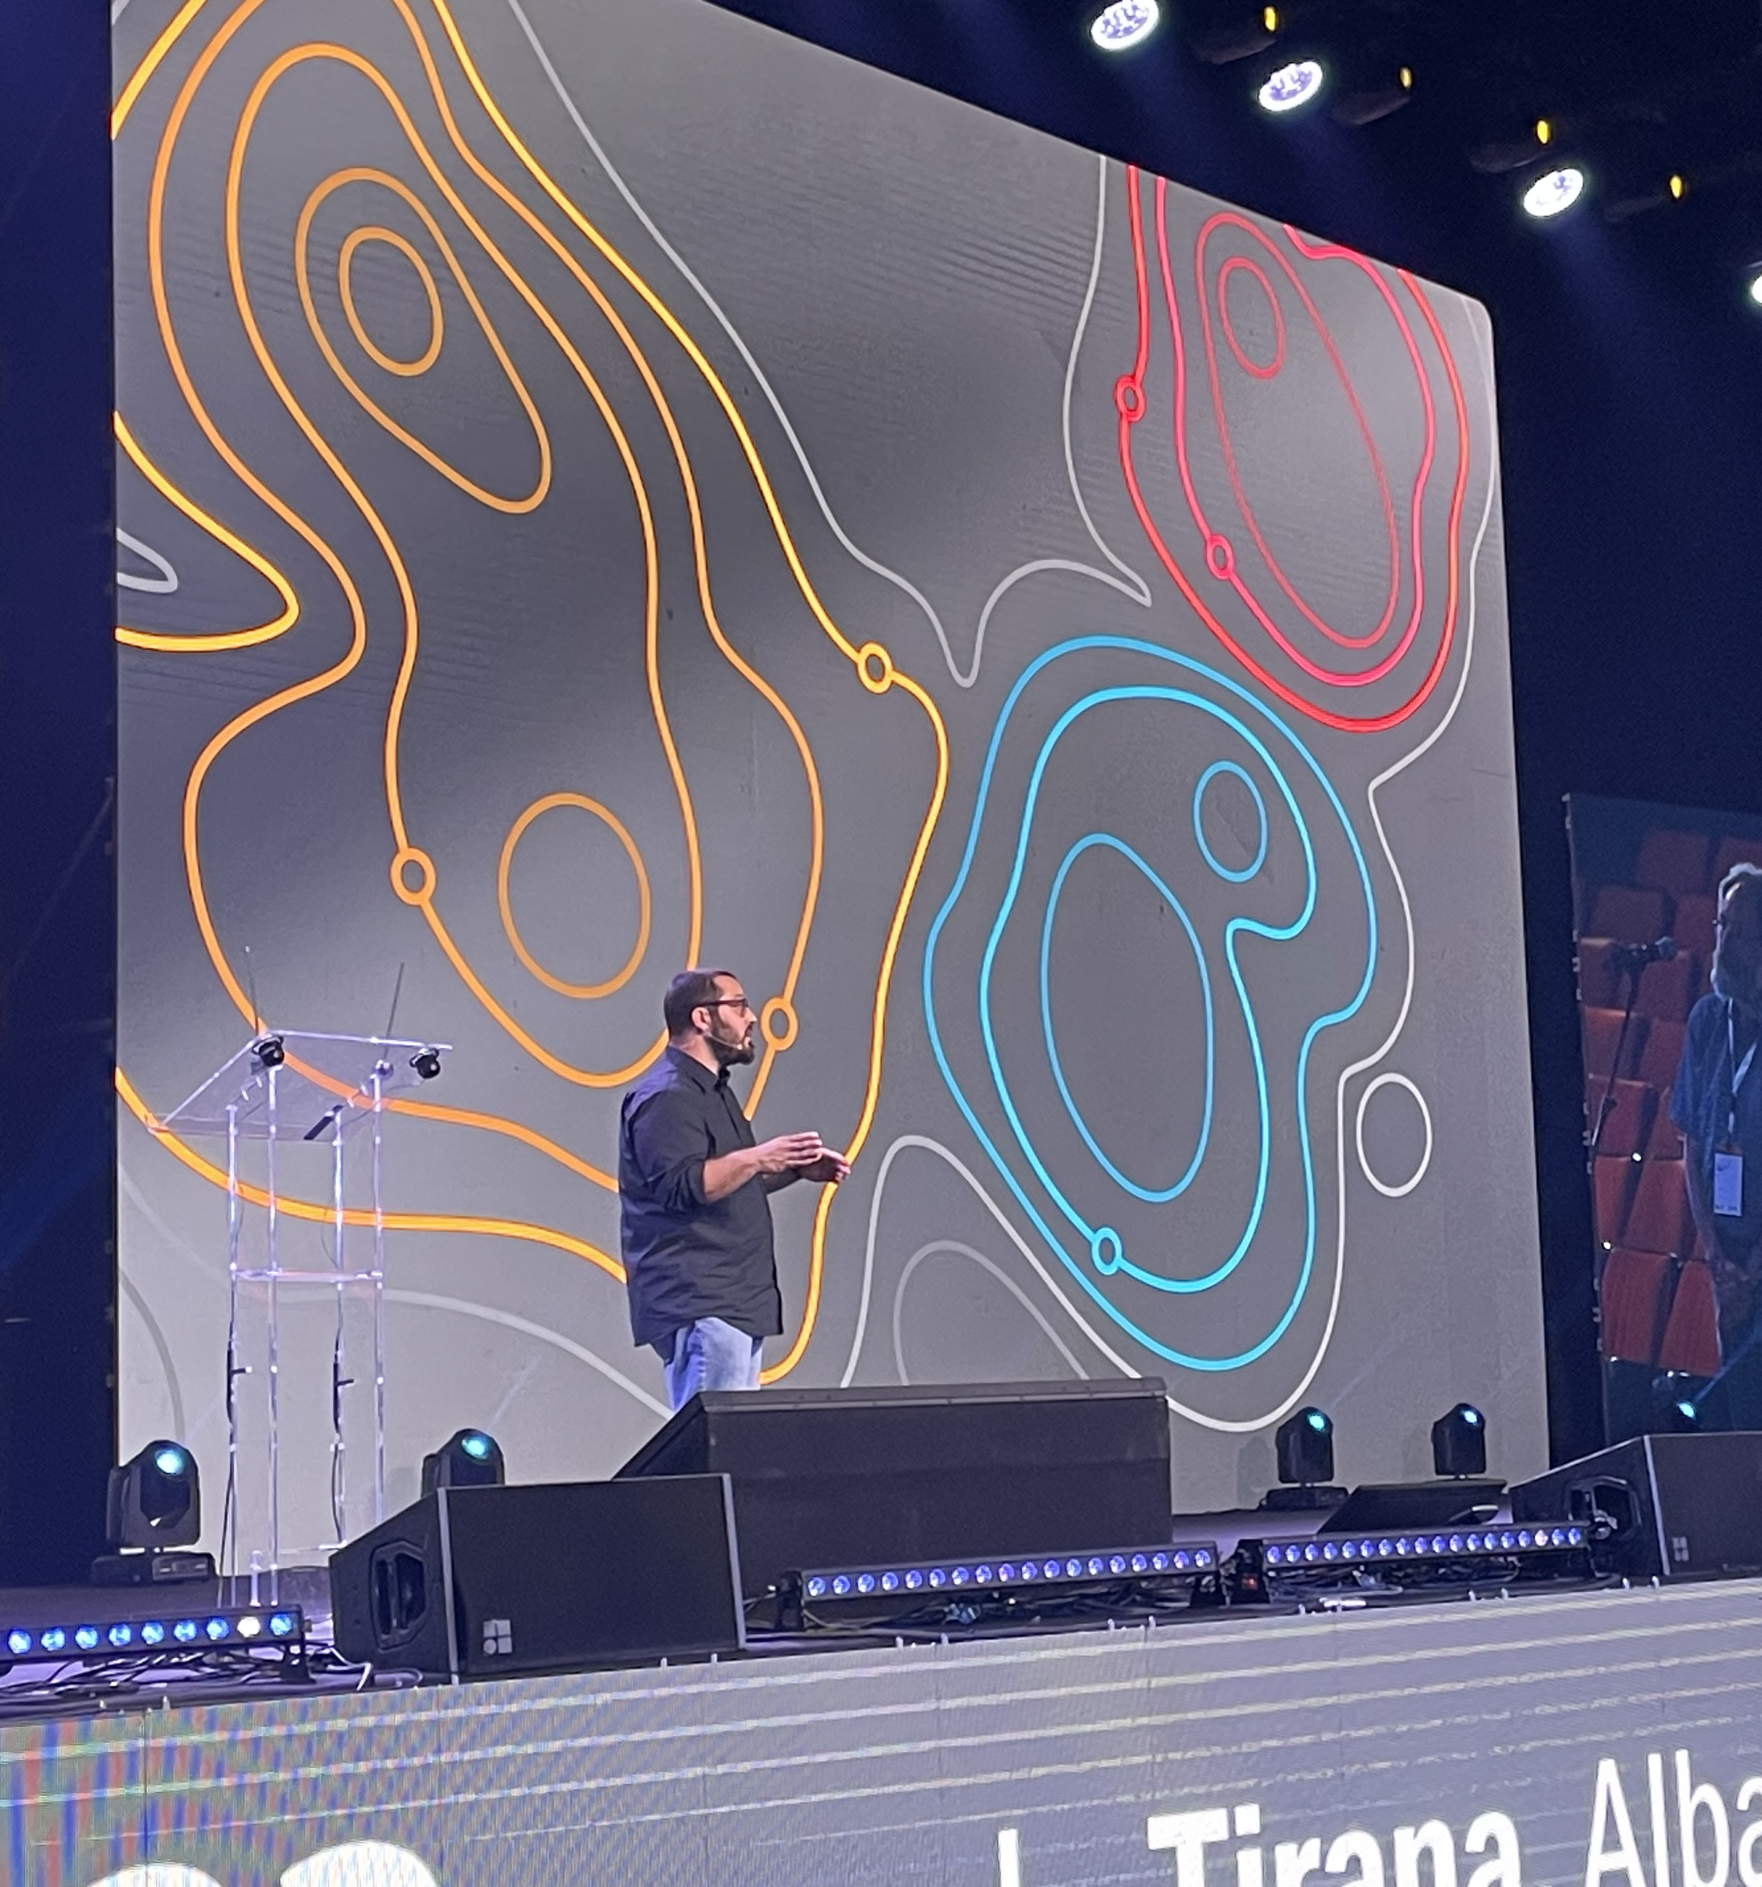
Here I am… after one year.
Again on:
GAP: GÉANT AUTOMATION PLATFORM:
What is the approach
What is it doing for us
GÉANT IP/MPLS migration:
What’s the status
What is our strategy
Why I hope you will do the same
…and I did not loose weight ☹

Slide 3
TNC23: what happened
IP/MPLS layer is re-procured and NOKIA + NOMIOS wins the tender.
New platform is 7750SR-S based on SR-OS (Not SR-Linux)
800G everywhere becomes actually possible
The migration should be completely automated

Slide 4
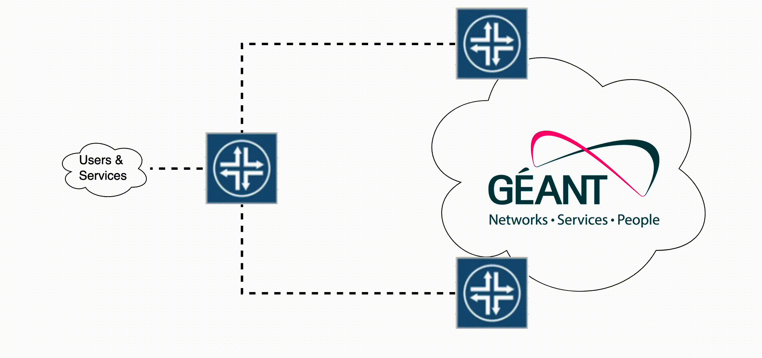
Migration strategy
Phase1:
Nokia router is added as P router
Migrate the first trunk
Migrate all the others
Phase 2:
Users are migrated to Nokia
Remove old Juniper

Slide 5
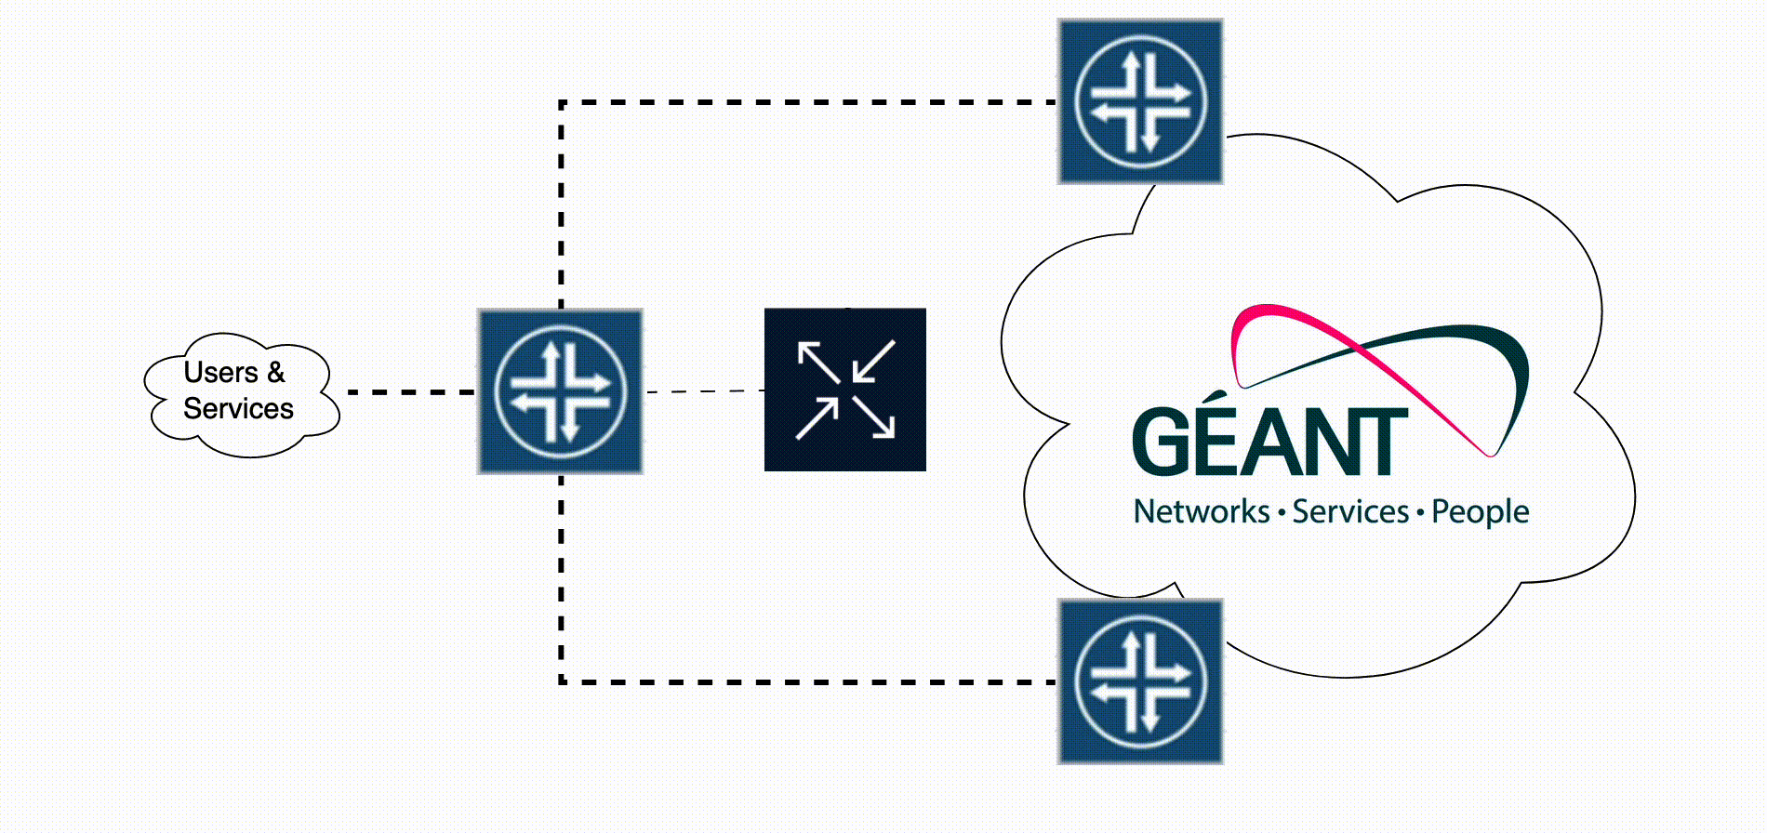
Migration strategy
Phase1:
Nokia router is added as P router
Migrate the first trunk
Migrate all the others
Phase 2:
Users are migrated to Nokia
Remove old Juniper

Slide 6
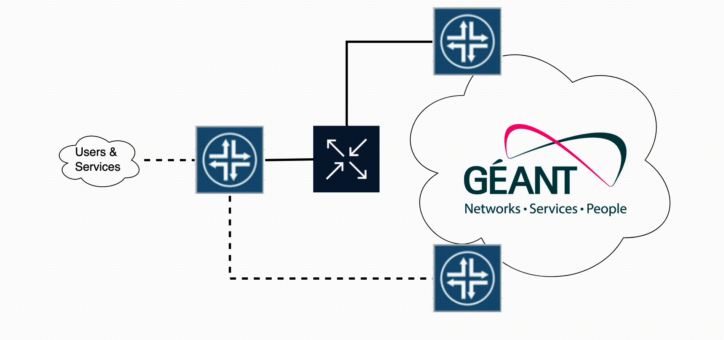
Migration strategy
Phase1:
Nokia router is added as P router
Migrate the first trunk
Migrate all the others
Phase 2:
Users are migrated to Nokia
Remove old Juniper

Slide 7
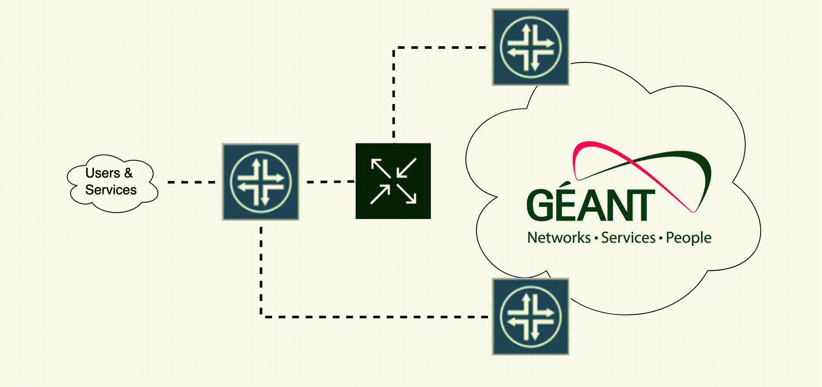
Migration strategy
Phase1:
Nokia router is added as P router
Migrate the first trunk
Migrate all the others
Phase 2:
Users are migrated to Nokia
Remove old Juniper

Slide 8
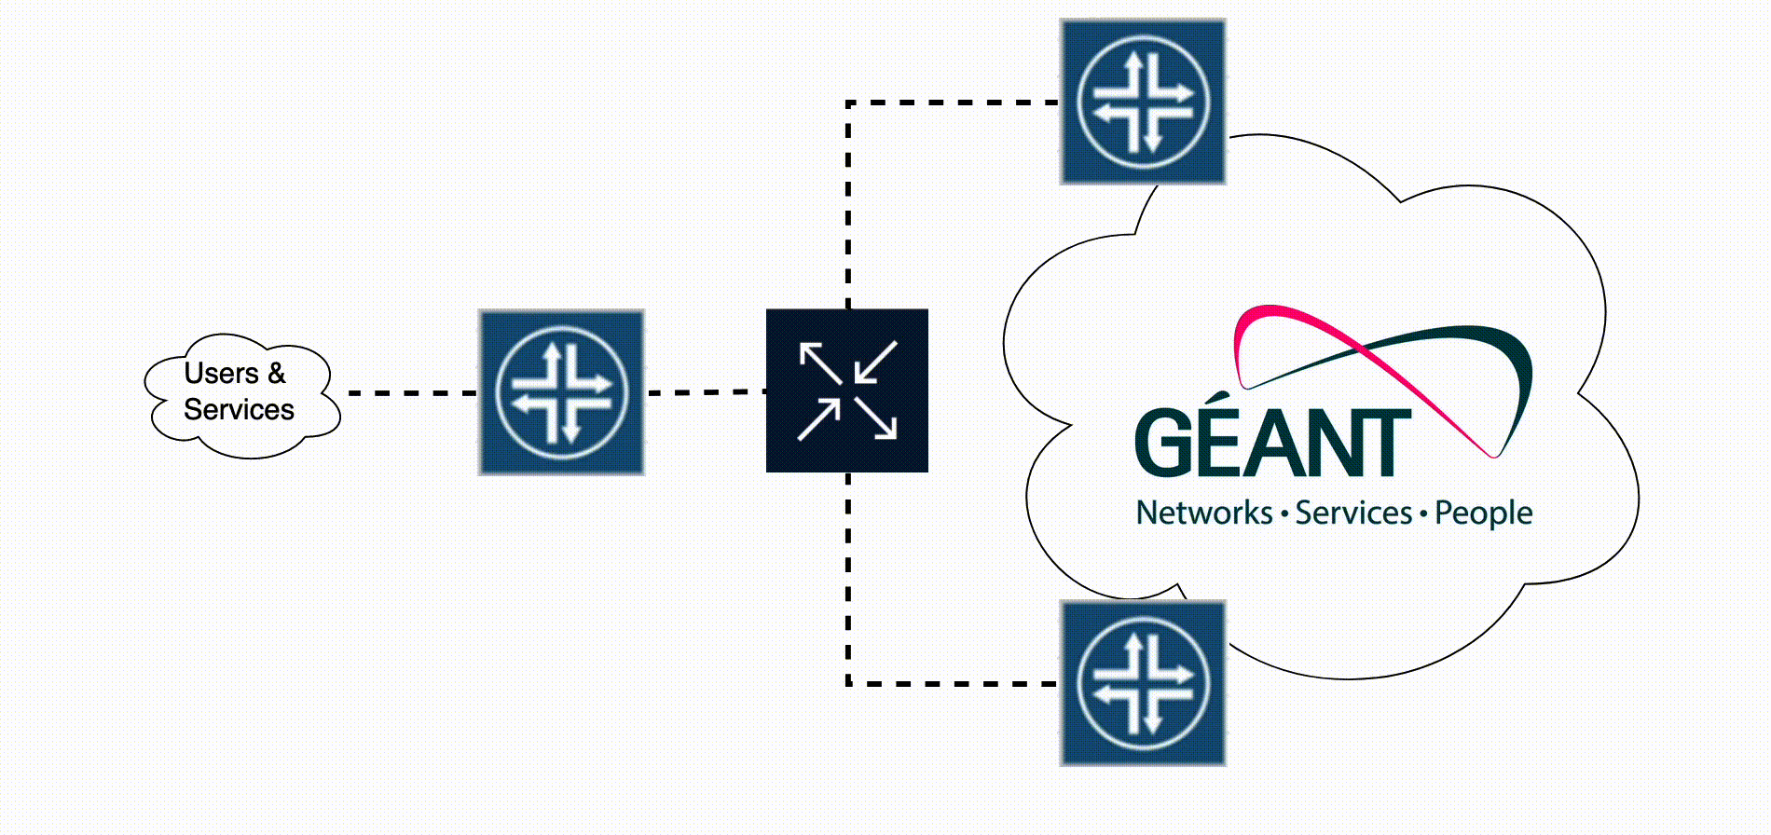
Migration strategy
Phase1:
Nokia router is added as P router
Migrate the first trunk
Migrate all the others
Phase 2:
Users are migrated to Nokia
Remove old Juniper

Slide 9
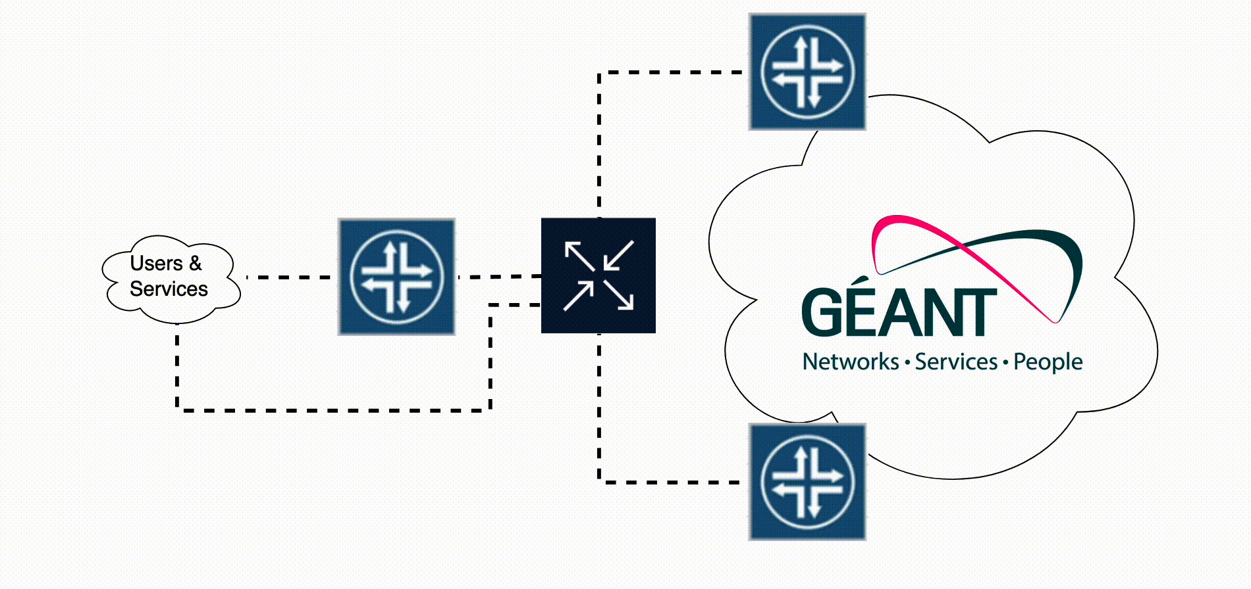
Migration strategy
Phase1:
Nokia router is added as P router
Migrate the first trunk
Migrate all the others
Phase 2:
Users are migrated to Nokia
Remove old Juniper

Slide 10
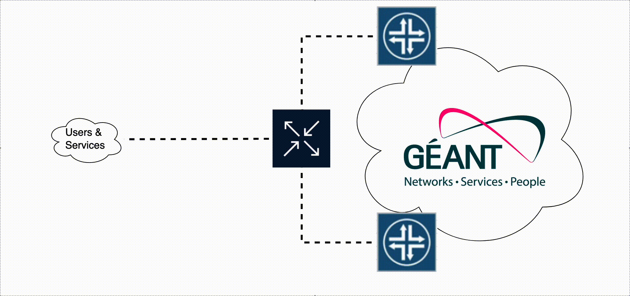
Migration strategy
Phase1:
Nokia router is added as P router
Migrate the first trunk
Migrate all the others
Phase 2:
Users are migrated to Nokia
Remove old Juniper

Slide 11
Challenges & Opportunities
SROS introduces new concepts and different constraints
Many services multiplexed on the same physical layer
For some time, we are going to run a hybrid network:
Abstract modeling of our services
Lots of interoperability testing
Changes will be done as quick as possible: smoke test should be embedded
Managing firewall filters for hosts on routers is not really sustainable: SNM
Decoupling functions
Rationalize/simplify model

Slide 12
What do we want
Minimize problems
Be fast
Be predictable
Be scalable
Embed config generation and change validation
OSS/BSS finally in sync

Slide 13
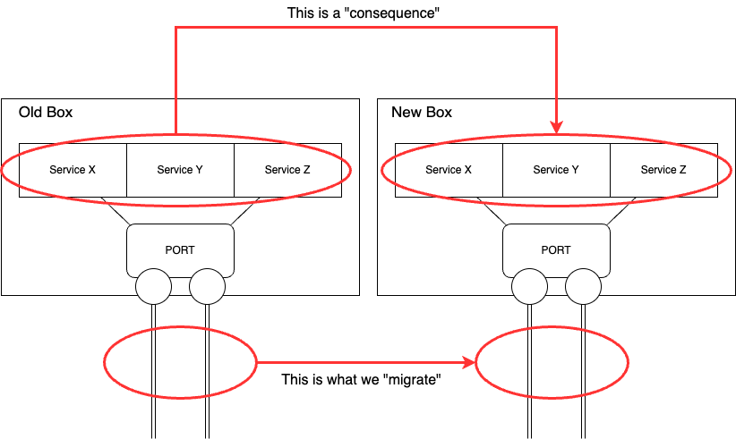
What do we want
Minimize problems
Be fast
Be predictable
Be scalable
Embed config generation and change validation
OSS/BSS finally in sync

Slide 14
What do we need to do this?
A model of our network that represents the dependencies between services
Functionally equivalent configuration on Nokia
Programmatic access all our routers (Nokia & Juniper)
API access all our OSS/BSS systems
Clear procedures and MOPs for managing nodes and services lifecycle
An engine to coordinate “all the things”

Slide 15
Two interconnected worlds
Processes
What is the service and how do you deliver it?
Who decides? And how?
What is the authoritative system for a specific data?
Anything else that must happen because of your action?
Artifacts
Is it config?
What is static/design?
What depends from the single instance?
Where is the data coming from?
What are the possible variants?

Slide 16
Two interconnected worlds
Processes
What is the service and how do you deliver it?
Who decides? And how?
What is the authoritative system for a specific data?
Anything else that must happen because of your action?
Artifacts
Is it config?
What is static/design?
What depends from the single instance?
Where is the data coming from?
What are the possible variants?
Orchestration
Represent the business logic
Interacts with multiple systems
Agnostic to the context
Generally, end-to-end
Automation
Executes atomic actions:
Highly specialized, dependent from the context (Cisco/Juniper/Nokia/Linux/*)
The focus is the artifact itself

Slide 17
Our approach
Approaching top to bottom (Orchestration) is a winning choice for us.
“Shift our thinking from lines of config to abstract models”
Analyze & rethink our design & processes
Node decomposition
Service decomposition
Config decomposition

Slide 18
Understanding the lifecycle of our services

Slide 19
Understanding the lifecycle of our services

Slide 20
Understanding the lifecycle of our services

Slide 21
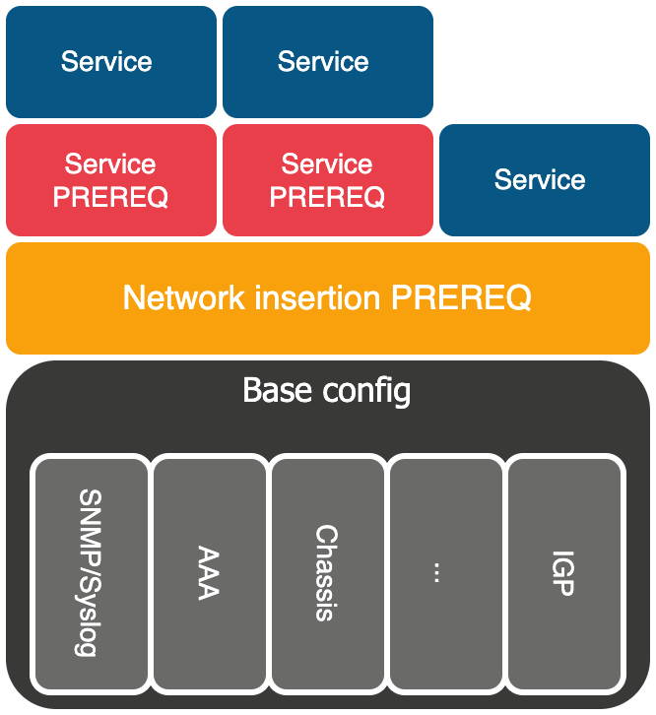
Decomposition

Slide 22
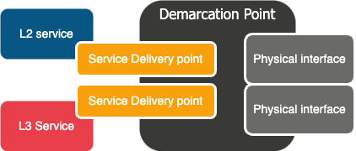
Decomposition

Slide 23
Decomposition

Slide 24
Config decomposition
neighbor 1.2.3.4 {
description "-- Peering with RENATER --";
accept-remote-nexthop;
out-delay 10;
import [ ps-BOGONS ps-RPKI-RE-PEER ps-from-RENATER-nren ];
authentication-key "$@$%DGKND#$%^#^%$"; ## SECRET-DATA
export [ ps-BOGONS ps-to-RENATER-nren ];
peer-as 2200;
bfd-liveness-detection {
minimum-interval 3000;
multiplier 3;
}
}

Slide 25
This is design
neighbor 1.2.3.4 {
description "-- Peering with SURF --";
accept-remote-nexthop;
out-delay 10;
import [ ps-BOGONS ps-RPKI-RE-PEER ps-from-SURF1-nren ];
authentication-key "$@$%DGKND#$%^#^%$"; ## SECRET-DATA
export [ ps-BOGONS ps-to-SURF1-nren ];
peer-as 2200;
bfd-liveness-detection {
minimum-interval 3000;
multiplier 3;
}
}

Slide 26
This is specific for that Organization/Partner
neighbor 1.2.3.4 {
description "-- Peering with RENATER --";
accept-remote-nexthop;
out-delay 10;
import [ ps-BOGONS ps-RPKI-RE-PEER ps-from-RENATER-nren ];
authentication-key "$@$%DGKND#$%^#^%$"; ## SECRET-DATA
export [ ps-BOGONS ps-to-RENATER-nren ];
peer-as 2200;
bfd-liveness-detection {
minimum-interval 3000;
multiplier 3;
}
}

Slide 27
This is specific for that instance
neighbor 1.2.3.4 {
description "-- Peering with RENATER --";
accept-remote-nexthop;
out-delay 10;
import [ ps-BOGONS ps-RPKI-RE-PEER ps-from-RENATER-nren ];
authentication-key "$@$%DGKND#$%^#^%$"; ## SECRET-DATA
export [ ps-BOGONS ps-to-RENATER-nren ];
peer-as 2200;
bfd-liveness-detection {
minimum-interval 3000;
multiplier 3;
}
}

Slide 28
This is an additional feature
neighbor 1.2.3.4 {
description "-- Peering with RENATER --";
accept-remote-nexthop;
out-delay 10;
import [ ps-BOGONS ps-RPKI-RE-PEER ps-from-RENATER-nren ];
authentication-key "$@$%DGKND#$%^#^%$"; ## SECRET-DATA
export [ ps-BOGONS ps-to-RENATER-nren ];
peer-as 2200;
bfd-liveness-detection {
minimum-interval 3000;
multiplier 3;
}
}

Slide 29
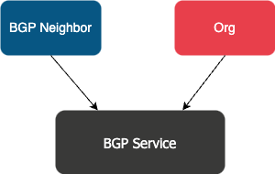
From config to models
neighbor {{ neighbor.ipv4_address }} {
description "-- Peering with {{org.name}} --";
accept-remote-nexthop;
out-delay 10;
import [ ps-BOGONS ps-RPKI-RE-PEER {{ org.import_policy }} ];
authentication-key ”{{ neighbor.auth_key }}"; ## SECRET-DATA
export [ ps-BOGONS {{ org.export_policy} } ];
peer-as {{ org.as_number }};
{% if neighbor.features.bfd_enable == True %}
bfd-liveness-detection {
minimum-interval {{ bfd.minimum_interval }};
multiplier {{ bfd.multiplier }};
}
{% endif %}
}
So, in the end we have 2 constructs:
Neighbor: Represent a BGP peering session
Address: ipv4 address
Authentication_key: string
Features:
BFD: boolean
Org: Represent the other side of the cable
Name: string
AS_number: int
Import_policy: list(dicts)
Export_policy: list(dicts)

Slide 30
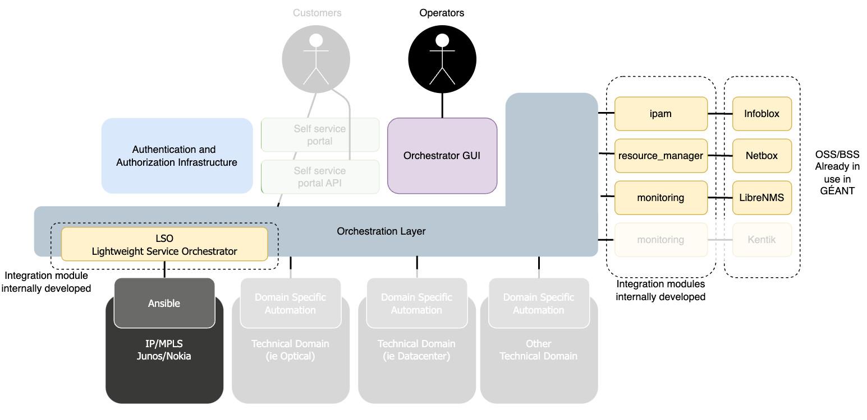
GAP architecture

Slide 31
Lessons learned until now
The main source of truth is design. Tools themselves only provide data
The network is definitely not SoT (as it is)
Design is everywhere:
In models
In templates
In workflows
Good design takes time but gives you a foundation to build on.
Compiling config, executing action is ”easy” and does not matter which tool you use
Understanding processes, clarifying procedures is hard:
Needs consensus
Needs expertise from all the parts involved

Slide 32
Exploring our design

Slide 33
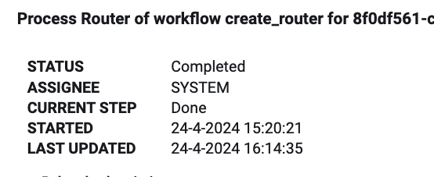
TNC24: where are we now?
First 3 routers deployed: AMS/LON/LON2
An average of 1 hour is needed to:
configure the router
configure the first core link
update iBGP mesh
all the necessary updates in OSS/BSS
Verification is included and stored forever ☺
Core link migration:
Testing is done
First migration scheduled for the end of June 2024
Modeling of services currently in progress
06/4/24|2:35:33➜ ~ fping < targets
rt0.ams.nl.geant.net is alive
rt0.lon.uk.geant.net is alive
rt0.lon2.uk.geant.net is alive
06/4/24|2:35:40➜ ~

Slide 34
Workflow Orchestrator Community
Setup under the commons conservancy
All code is licensed under Apache 2.0
All Intellectual Property remains at each member company
Membership levels:
Partner
Graduate
Sandbox
Mainly NREN’s and networking use case but other use-cases as well
https://workfloworchestrator.org/

Slide 35
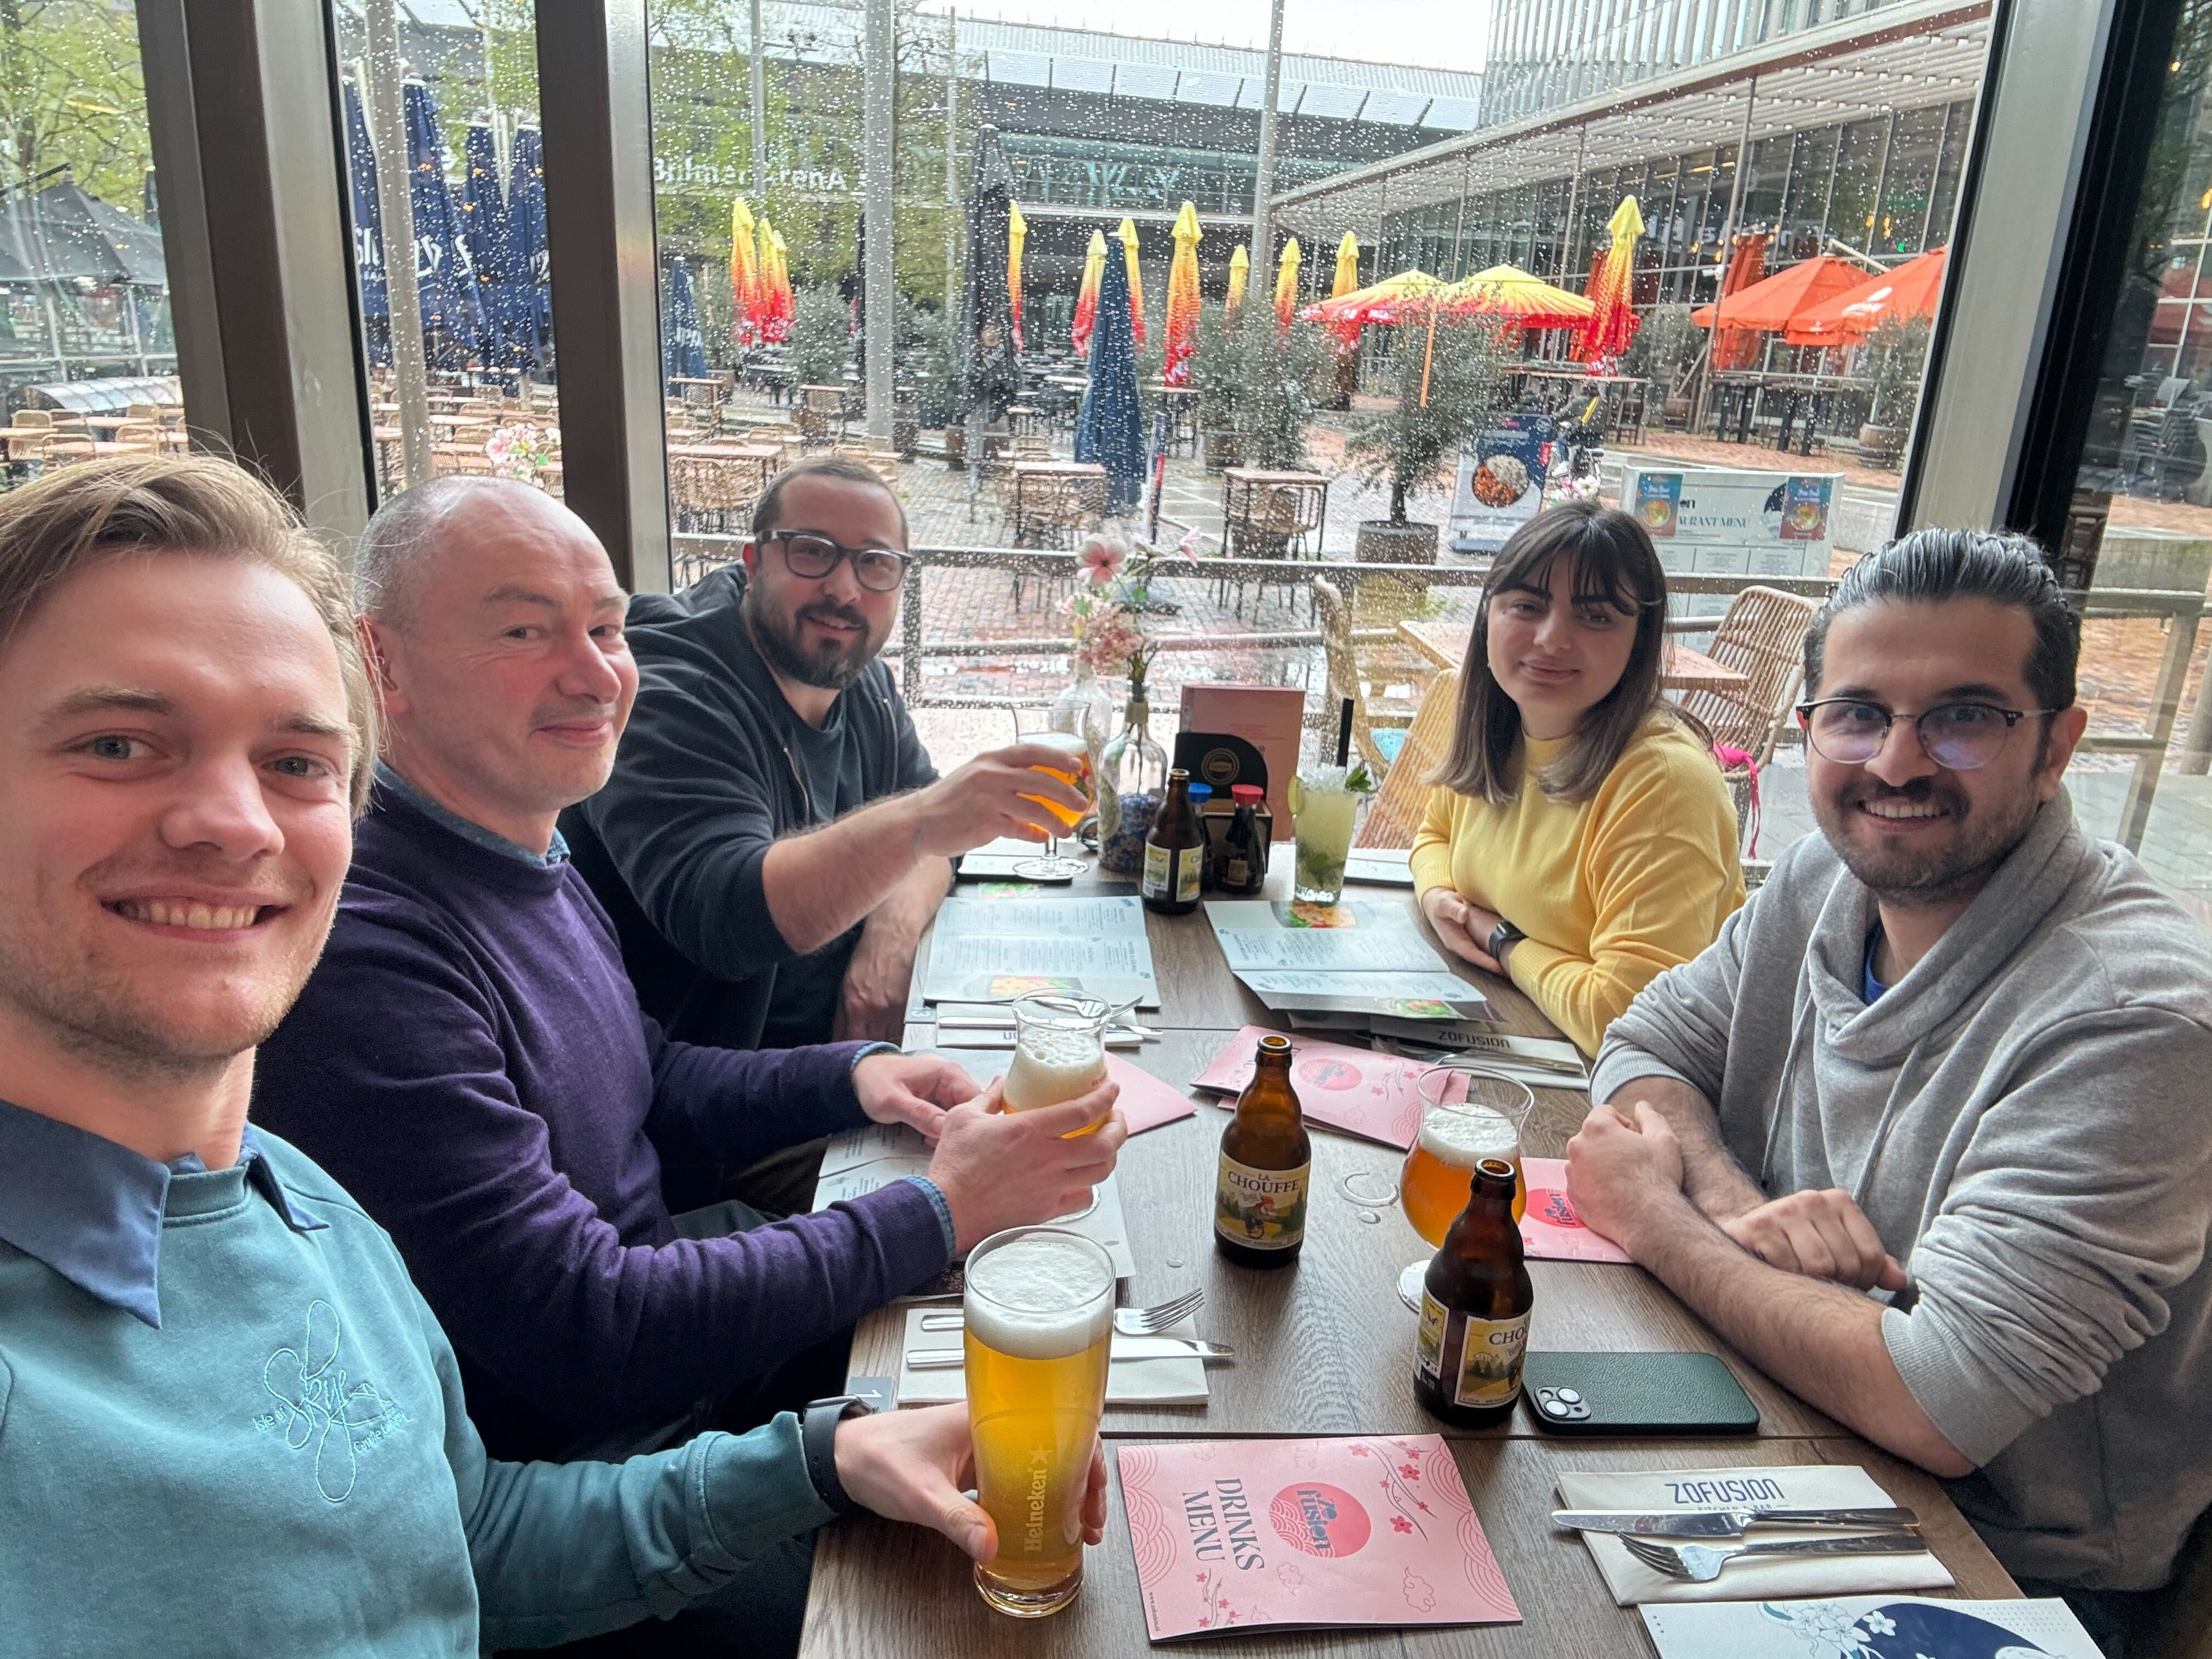
TNC25: what are we working on
Migration should be finished in mid 2025:
100% coverage – nothing is left to manual
We will be in a better place than now
GAP (GÉANT AUTOMATION PLATFORM) is going to be an enabler:
Availability
Monitoring / ST
Self service
If you are curious, you want to ask questions, rebut… find us around!

Slide 36
Thank you
Any questions?
simone.spinelli@geant.org

