Slide 1
SOC-RNP
A holistic approach to evolve cybersecurity capabilities
Humberto Forsan
Information Security Manager – RNP Brazil
humberto.forsan@rnp.br

Slide 2
About RNP

Slide 3
RNP
Brazilian National Research and Education Network (RNP).
Created in 1989.
1768 institutions connected (RedeIpê)
27 Points of Presence (PoPs)
Source: https://www.rnp.br/sistema-rnp/rede-ipe

Slide 4
CAIS – Intelligence in Cyber Security from RNP
Created in 1997 for coordination CSIRT of Brazilian research and education network in Rede Ipê.
Capabilities:
Security Vulnerability Handling
Governance, Risk and Complaince
Information Security Awareness
Privacy Handling
Red Team
CSIRT
Coordination
Information Security Architecture
SOC

Slide 5
Motivation to create a national SOC?

Slide 6
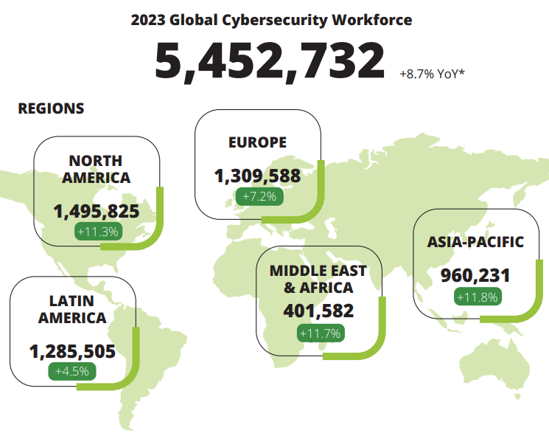
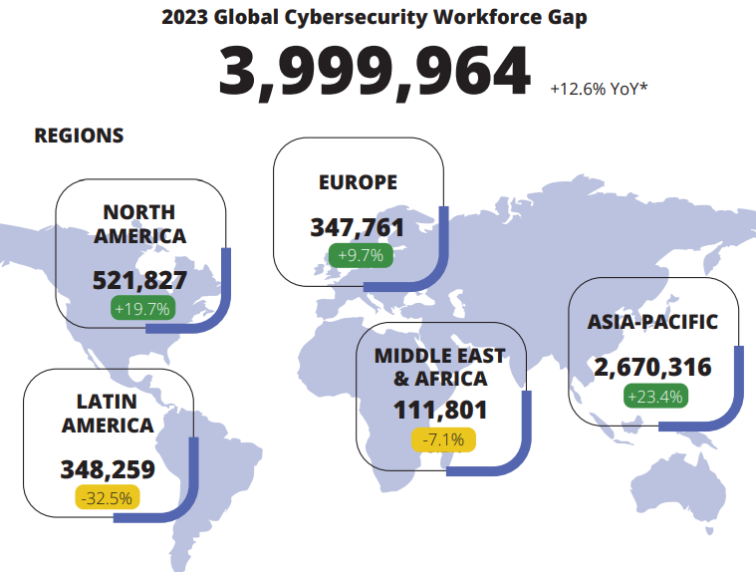
What´s the motivation to create a national SOC?
https://media.isc2.org/-/media/Project/ISC2/Main/Media/documents/research/ISC2_Cybersecurity_Workforce_Study_2023.pdf

Slide 7
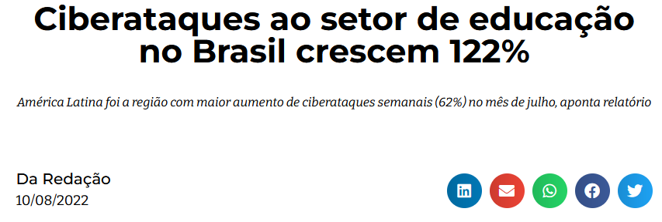
What´s the motivation to create a nacional SOC?

Slide 8
What´s the motivation to create a nacional SOC?
https://www.weforum.org/communities/gfc-on-cybersecurity/

Slide 9
SOC Evolution

Slide 10
Security Operation Center (SOC) Evolution
SOC v1
SOC v2
SOC v3
Next Gen SOC
Antivírus
IDS
Firewall
Vulnerability Management
IPS
DLP
Advanced Persistent Threats
SIEM
SecOps
CASB
Cloud Security
UEBA
Threat Intelligence
Sandboxing
CSIRT
BYOD
Cyber Defense Center
Big Data/Data Lake
WAAP
SOAR
Deception
XDR
Cloud Native SIEM
NOC
Network alerts
Proactive Monitoring + Automation
Availability Monitoring
Reactive Monitoring
Proactive Monitoring
Before 1995
1996 - 2000
2001 - 2006
2007 - 2013
2013 - 2015
Since 2015
NOC
Internal SOC
SOC
SOC/MSS
Hybrid/Remote SOC
NDR
Network device management
Virus alerts
Intrusion detection and response
Compliance
Incident response
Regulatory compliance
Log monitoring
Malware analysis
Reverse engineering
AI models
Threat intelligence
Threat hunting
Automation
Playbooks
Analytics
External risk scoring
https://www.isaca.org/resources/isaca-journal/issues/2021/volume-5/the-evolution-of-security-operations-and-strategies-for-building-an-effective-soc

Slide 11
Holistic Approach

Slide 12
Holistic Approach of SOC in RNP
Mission
Security Visibility
Advanced Detection and Response
Security Operations
Security Intelligence
XDR
Vulnerability Management
SOC
Platform
Location / Coverage
Brasília
27 states
Security Sensors
Threat Intelligence
WAF
SIEM
Anti-DDOS
Corporate RNP
Rede Ipê
Security Rating
Standards
Guidelines
Workflows
Process
Team
24x7
Awareness
Integrations
Level 1: Triage
Level 2: Investigation
Level 3: Threat Hunting

Slide 13
The RNP SOC bring to community follow benefits
No increase in headcount
Lower costs compared to a Market SOC
24x7 performance
Lower costs compared to na internal SOC
Use of the latest technologies
Increasing maturity in InfoSEC
Don´t worry about renewing licences and equipaments
Specialized team

Slide 14
Implementation Steps
Step 1
Anti-DDOS
Vulnerability Management
Security Sensors
Web Application Scaning
Threat Monitor
Step 2
XDR
Security Rating
WAF
Threat Intelligence
SIEM
I
N
P
R
O
G
R
E
S
S
Exposure Management Platform
Web application and API protection (WAAP)
Step 3
Vulnerability Management
Risk Analysis
API Security
Bot Manager
DDOS Protection
IP Reputation
Web Application Security
Inventory
Next Generation SIEM
OT Security
LOGS
SOAR
UEBA
Threat Intelligence
AI

Slide 15
Technology partnership model
We work with open source and proprietary solutions
For proprietary solutions, we seek shared costs and sponsors
Example:
SOC by Partners
… And we looking for a new partners

Slide 16
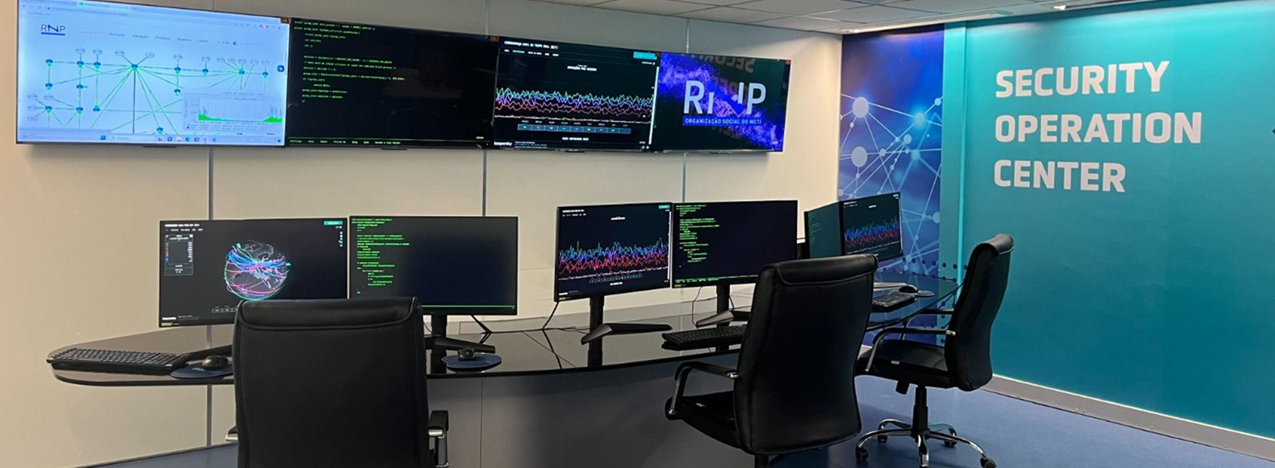
SOC RNP

Slide 17
Thanks! Merci! Obrigado!

Slide 18
The National SOC: Brasília
Cordinates all activities
Create standards, guidelines and playbooks
24x7
Analysts: Level 1, 2 and 3
Responsable for licences and contracts
27 State SOCs
In partnership with states
Monitoring
Detection
Mitigation
Threat hunting
Local Operation in each state

