Slide 1
Interoperable DTN Testing Facility
A GEANT and ESnet collaboration to support international science projects
Dr Domenico Vicinanza
TNC24, Rennes, France
13/06/2024

Slide 2
Why effective data transfer matters
International research projects often involve collaboration across borders.
Researchers across the globe need on timely and reliable data exchange.
Examples:
Genomics, earth observation, particle physics
European scientists working on climate modeling need access to real-time weather data from US-based observatories.
American physicists need access to data generated at CERN and stored in EU
Research and Education (R&E) networks play a fundamental role

Slide 3
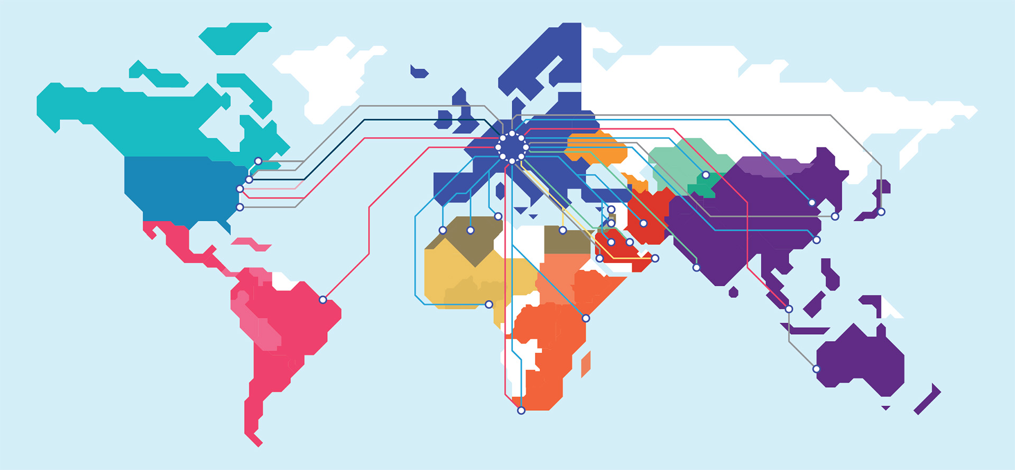
GÉANT at the heart of Research and Education
Notes:
GÉANT collaborates with global research and education network partners to ensure high performance connectivity is in place, and also to make a range of services available to user groups across the world, enhancing their ability to work together.
GÉANT manages research and education networking projects serving Europe, the Eastern Mediterranean, Africa and transatlantic connectivity to Latin America. In addition, it supports research and education networking organisations in Asia-Pacific, coordinates Europe-China collaboration and nurtures relationships with counterparts in North America.
Service collaborations cover areas such as network performance monitoring, connectivity roaming (eduroam) and federated access (eduGAIN), and real-time communications.

Slide 4
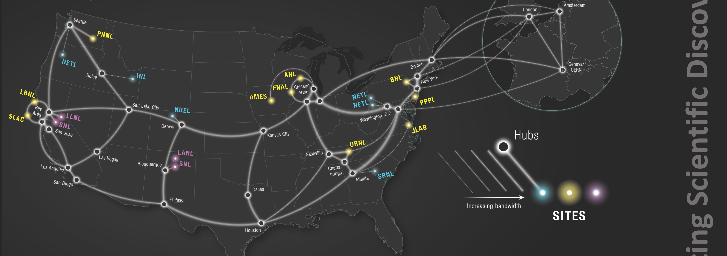
ESnet
Notes:
ESnet is the Department of Energy's dedicated science network, helping researchers meet their goals from experiment to discovery.
ESnet is a high-performance national network built and engineered specifically for the purpose of science data transport. ESnet connects more than 40 Department of Energy research sites, including the entire National Laboratory system, its supercomputing facilities, and its major scientific instruments. ESnet also connects to 140 research and commercial networks, permitting tens of thousands of DOE-funded scientists around the world to collaborate productively.

Slide 5
Collaboration between GÉANT and ESnet
Towards a world-wide research community
We serve the same users, just across an increasingly large geographical area
Aligning services
Interoperability will play an increasingly crucial role

Slide 6
The need for a testing facility close to the users
perfSONAR and other specialized tools have been crucial in improving network monitoring
However often the bottleneck is in the lab
Computers and data transfer applications not optimised for high-speed communication across globe
Researchers need to try, evaluate, test and verify the performances of transferring research data within Europe and across the globe.

Slide 7
The proposed service: a GÉANT DTN Testing Facility
Dedicated hardware for wide-area transfers
Three nodes: London, Prague and Hamburg (10 Gb/s)
Security implementations: Host-based firewalls
Careful tuning
Using protocols optimised for bulk data transfers
For example: FDT, WebDAV, RDMA
Multiple streams of data sent using multiple sockets possible

Slide 8
A service built on a strong test case
Based on the DTN testing tool used by GEANT Research Engagement
Two 100 Gb/s servers, one in London and another one in Paris
Offered to network experts from supported projects
Use cases included: protocol/application validation, data transfer performances, troubleshooting
Users included: CERN, LRZ, LHCONE, Belle-II/KAK
The DTN Testing Facility is created to offer to NRENs, projects and researchers the provision of data transfer testing capabilities

Slide 9
Use cases from NRENs (from formal requirement gathering)
Validate new data transfer techniques
Transfers from national supercomputing facilities to sites off-island
Enable end sites (like universities) to test impact of firewalls on data transfre
Enable users to test their systems with hosts further away
Throughput validation for R&E project
Input for network design
Storage transfer capability validation including the network
For example, reproducing/emulating the far end user behaviour
In future: a network of DTNs spread everywhere geographically for relevant data transfer tests between NRENs and projects
Notes:
In March 2023 we run a survey across GEANT NRENs and gathered their requirements and needs

Slide 10
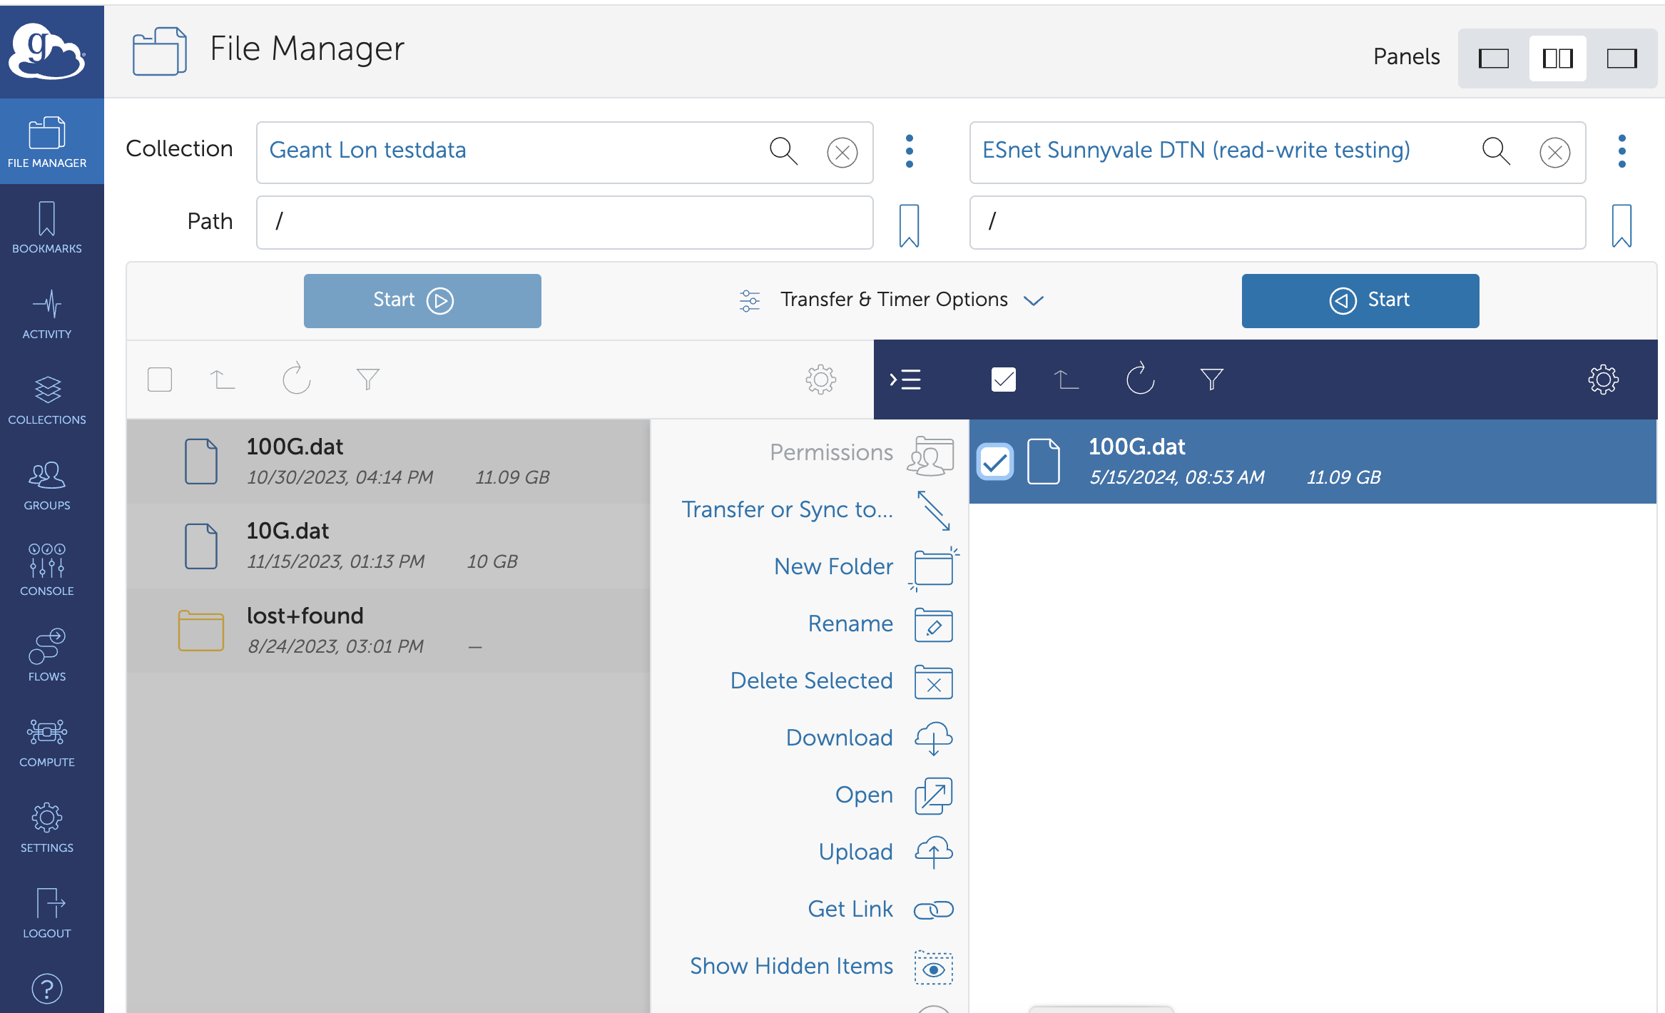
Web interface

Slide 11
GEANT → ESnet

Slide 12
ESnet → GEANT

Slide 13
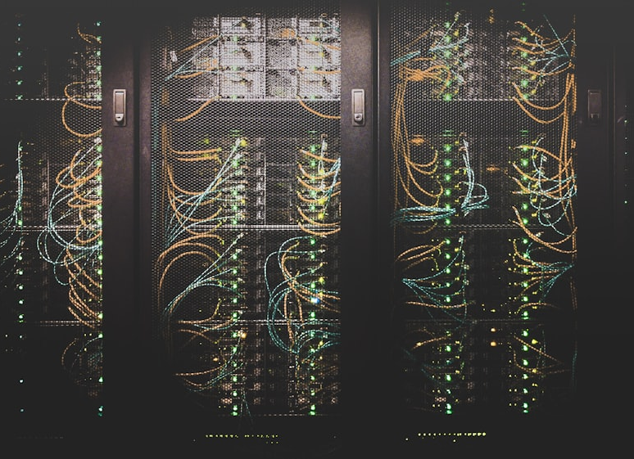
Live demo on demand
Just come to see us after the presentation

Slide 14
Thank you
A huge thank-you to:
GEANT DevOps and Network team, in particular Pete Pedersen, Massimiliano Adamo, Cristian Cicu, Patrick Unthank
ESnet Research Engagement and DTN Team, in particular Eli Dart and Kenneth Miller
(images: unsplash)

Slide 15
Thank you
Any questions?

