Slide 1
Towards an Interoperable EOSC Core
How ARGO Services were used for the implementation of EOSC Monitoring, Messaging and Accounting and their corresponding Integration Options.

Slide 2
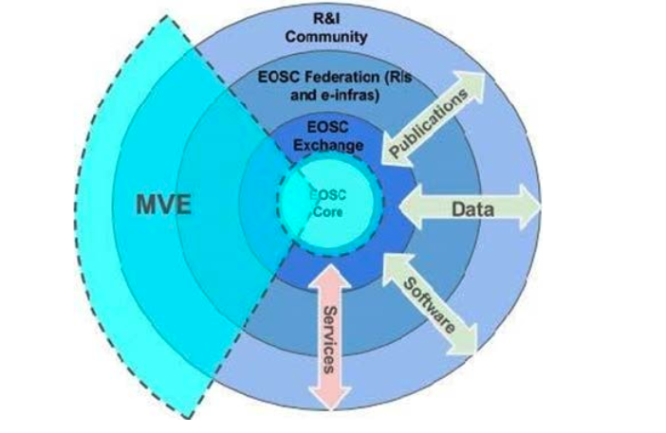
EOSC 101
EOSC-Core : The basic component of EOSC which provides the key internal capabilities - the 'glue' - to support the basic operations of EOSC. This predominantly consist of services and resources which face service providers and the people coordinating EOSC.
EOSC-Exchange: The basic component of EOSC containing the researcher-facing resources from the EOSC community.
Horizontal Service: A generic service that may be used by multiple communities, rather than one that is focussed on one particular community
EOSC Platform: The EOSC-Core and EOSC-Exchange will form the technological backbone of the EOSC Platform
EOSC Profile: A set of linked metadata formats to describe service providers, resources of various types and within the EOSC catalogues.
EOSC-Interoperability Framework: Provides guidelines and technical components using which interoperability may be achieved.
MVE: Minimum Viable EOSC

Slide 3
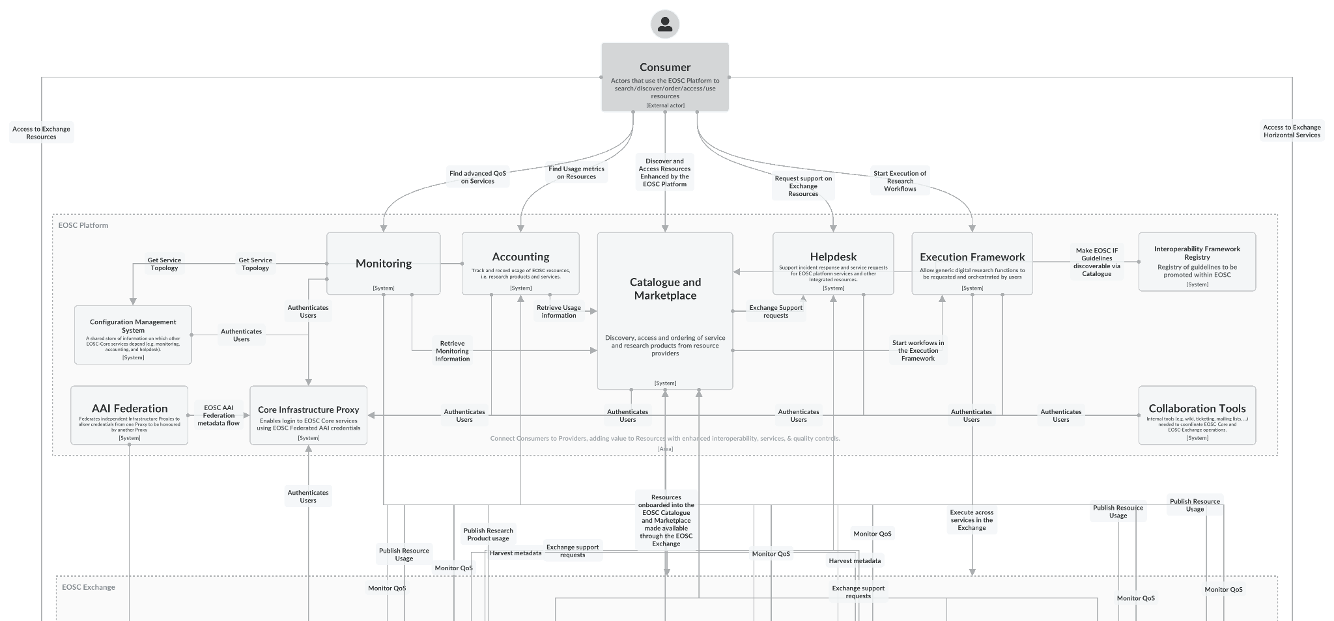
EOSC Architecture / Platform
Notes:
EOSC Future is the project that is responsible to improve and enhance the entry point to EOSC and the capabilities behind it. A dedicated workpackage has been created to describe the entry point, the different types of consumers (users, researchers, providers,) and how they can interact with EOSC.
The scope of this workpackage is to enhance the EOSC architecture, as well as the interoperability guidelines and frameworks needed for the EOSC-Core and EOSC MVE capabilities to offer an integration layer for Research Infrastructures (RIs), providers (operating in the research sector as well as commercial) and researchers. The architecture also refers to the integration of core services. With all these in mind they have currently resulted in a clear and accepted EOSC Architecture that can be used as a solid foundation to build upon. This architecture highlights functionalities and components, and we can have a look to build upon it.

Slide 4
EOSC Monitoring
Helping EOSC to be more reliable

Slide 5
WHAT IS EOSC MONITORING
EOSC Monitoring is the key service needed to gain insights into an infrastructure. It is continuous and on-demand to quickly detect, correlate, and analyze data for a fast reaction to anomalous behavior.
The key functional features are:
Monitoring of services
Real Time Reporting availability and reliability,
Real Time Visualization of the services' status,
Provide dashboard interfaces,
Sending real-time alerts.
Part of EOSC Core

Slide 6
WHAT IS EOSC MONITORING / ADDED VALUE
PROVIDER
RESEARCHER
Added value of the EOSC Monitoring
EOSC Monitoring is the key service needed to gain insights into the Resources Onboarded in EOSC. It is continuous and on-demand to quickly detect, correlate, and analyse data for a fast reaction to anomalous behaviour.

Slide 7
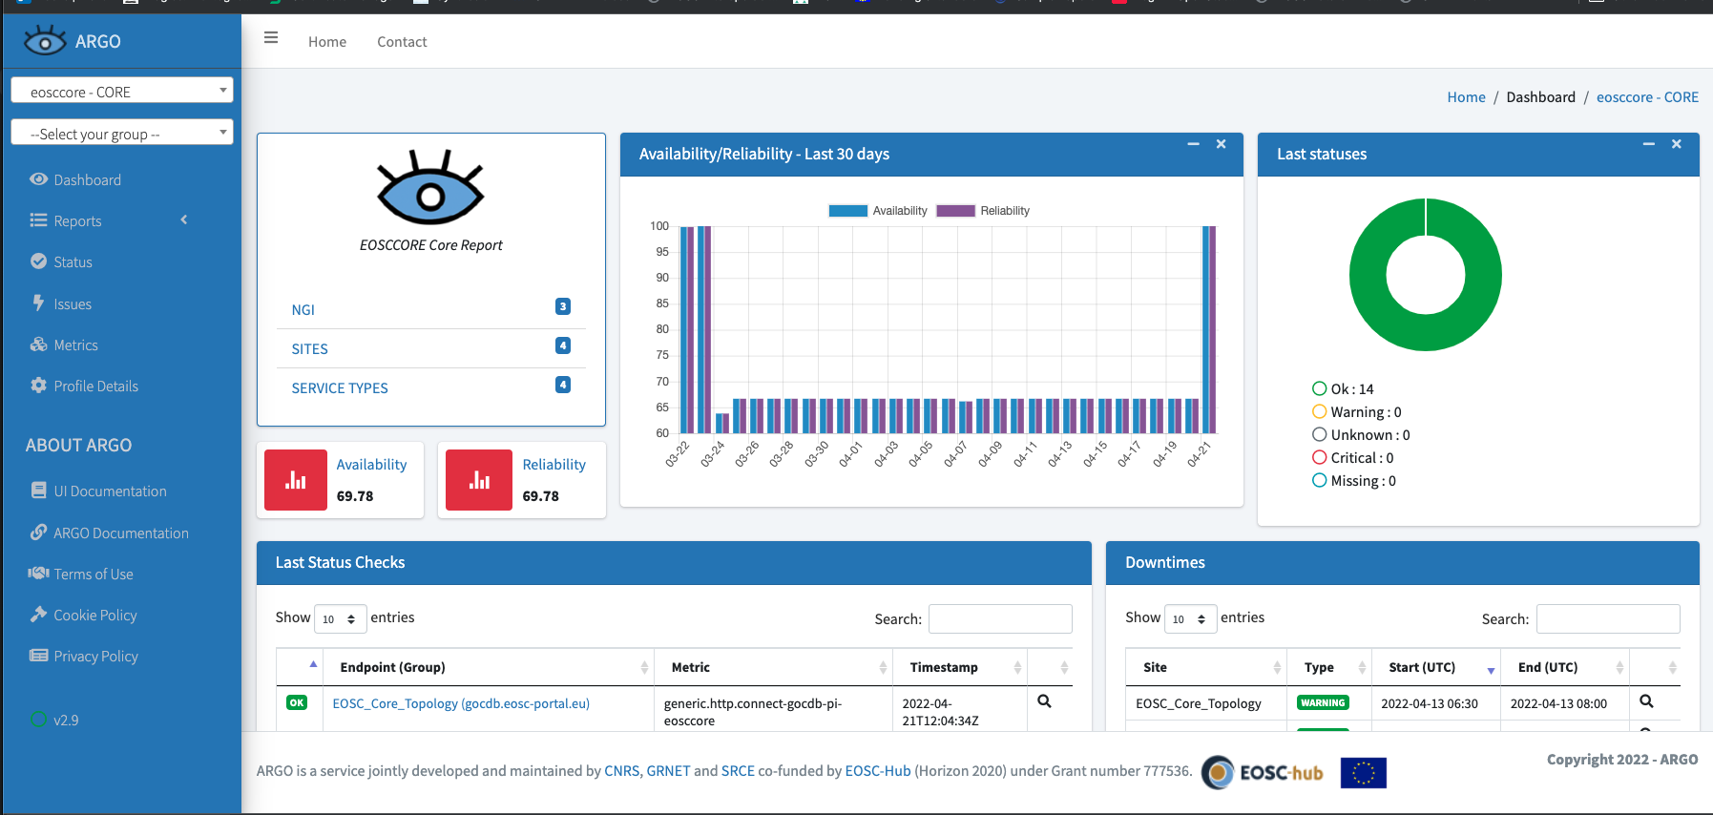
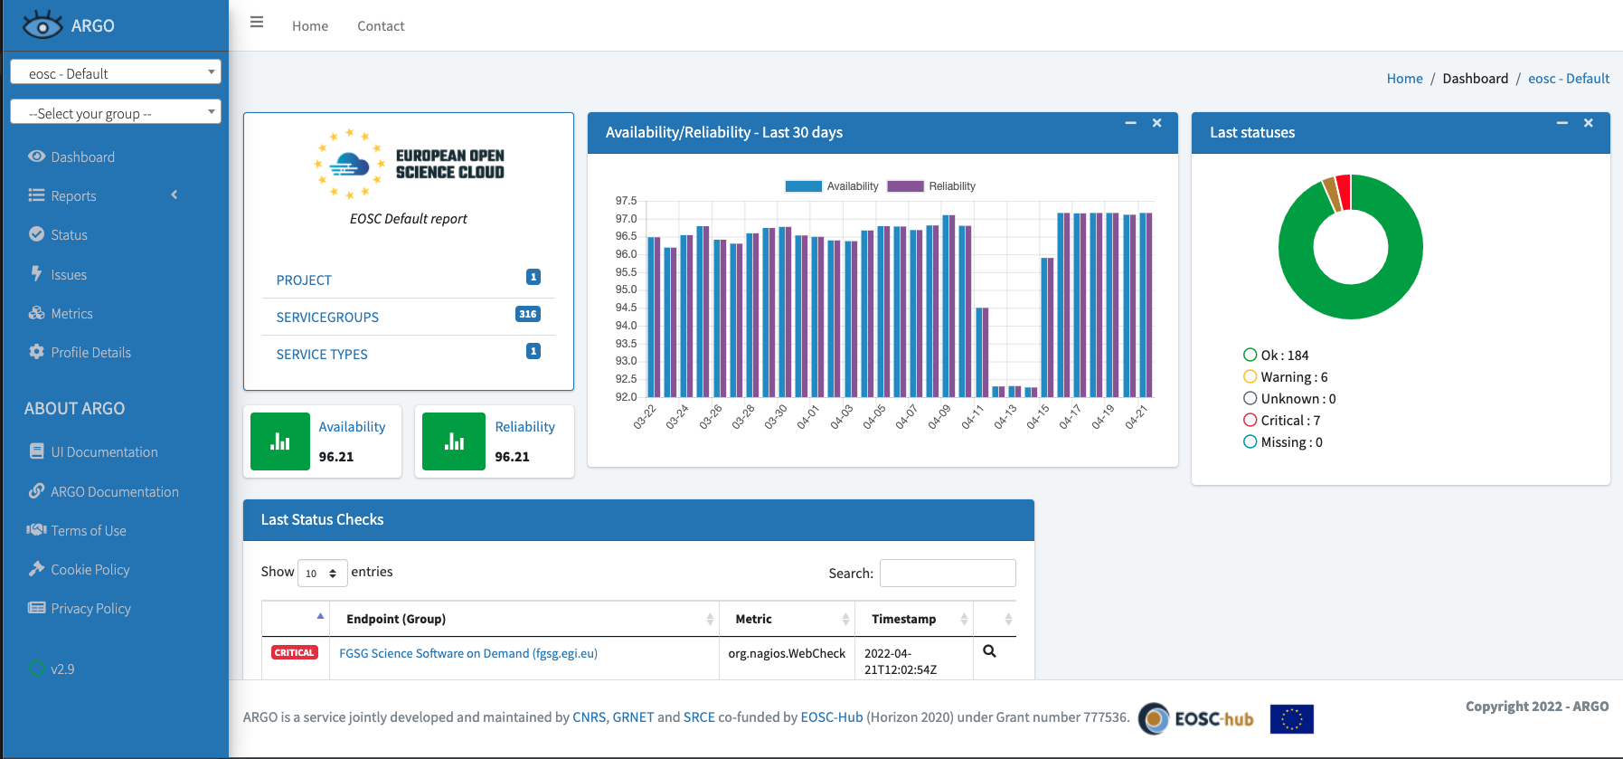
WHAT IS EOSC MONITORING / CORE + EXCHANGE
EOSC Core Monitoring
EOSC Exchange Monitoring:

Slide 8
EOSC EXCHANGE / INTEROPERABILITY OPTIONS
Integration Option 1
Integration Option 2
Integration Option 3
Monitor an Onboarded
Service (central one)
Monitor an Infrastructure (community)
Integrate External Monitoring service
EOSC Monitoring: Architecture and Interoperability Guidelines
https://doi.org/10.5281/zenodo.7118590
Waiting for the updated ones

Slide 9
WHY SHOULD WE CARE
PROVIDER
RESEARCHER
COMMUNITY
A way to build trust between providers and users
A way to identify problems and unreliable services
A way to present trends and performance of the communities service portfolio
Improve the overall efficiency and productivity of your community.
Promote advertise the reliability of your services
Increase customer satisfaction
Diagnose and prevent internal , or user related issues
A way to build trust with your users or potential new customer
A way to find trustworthy and reliable services
A way to identify issues with the underlying providers/services
A way to identify trends and winds

Slide 10
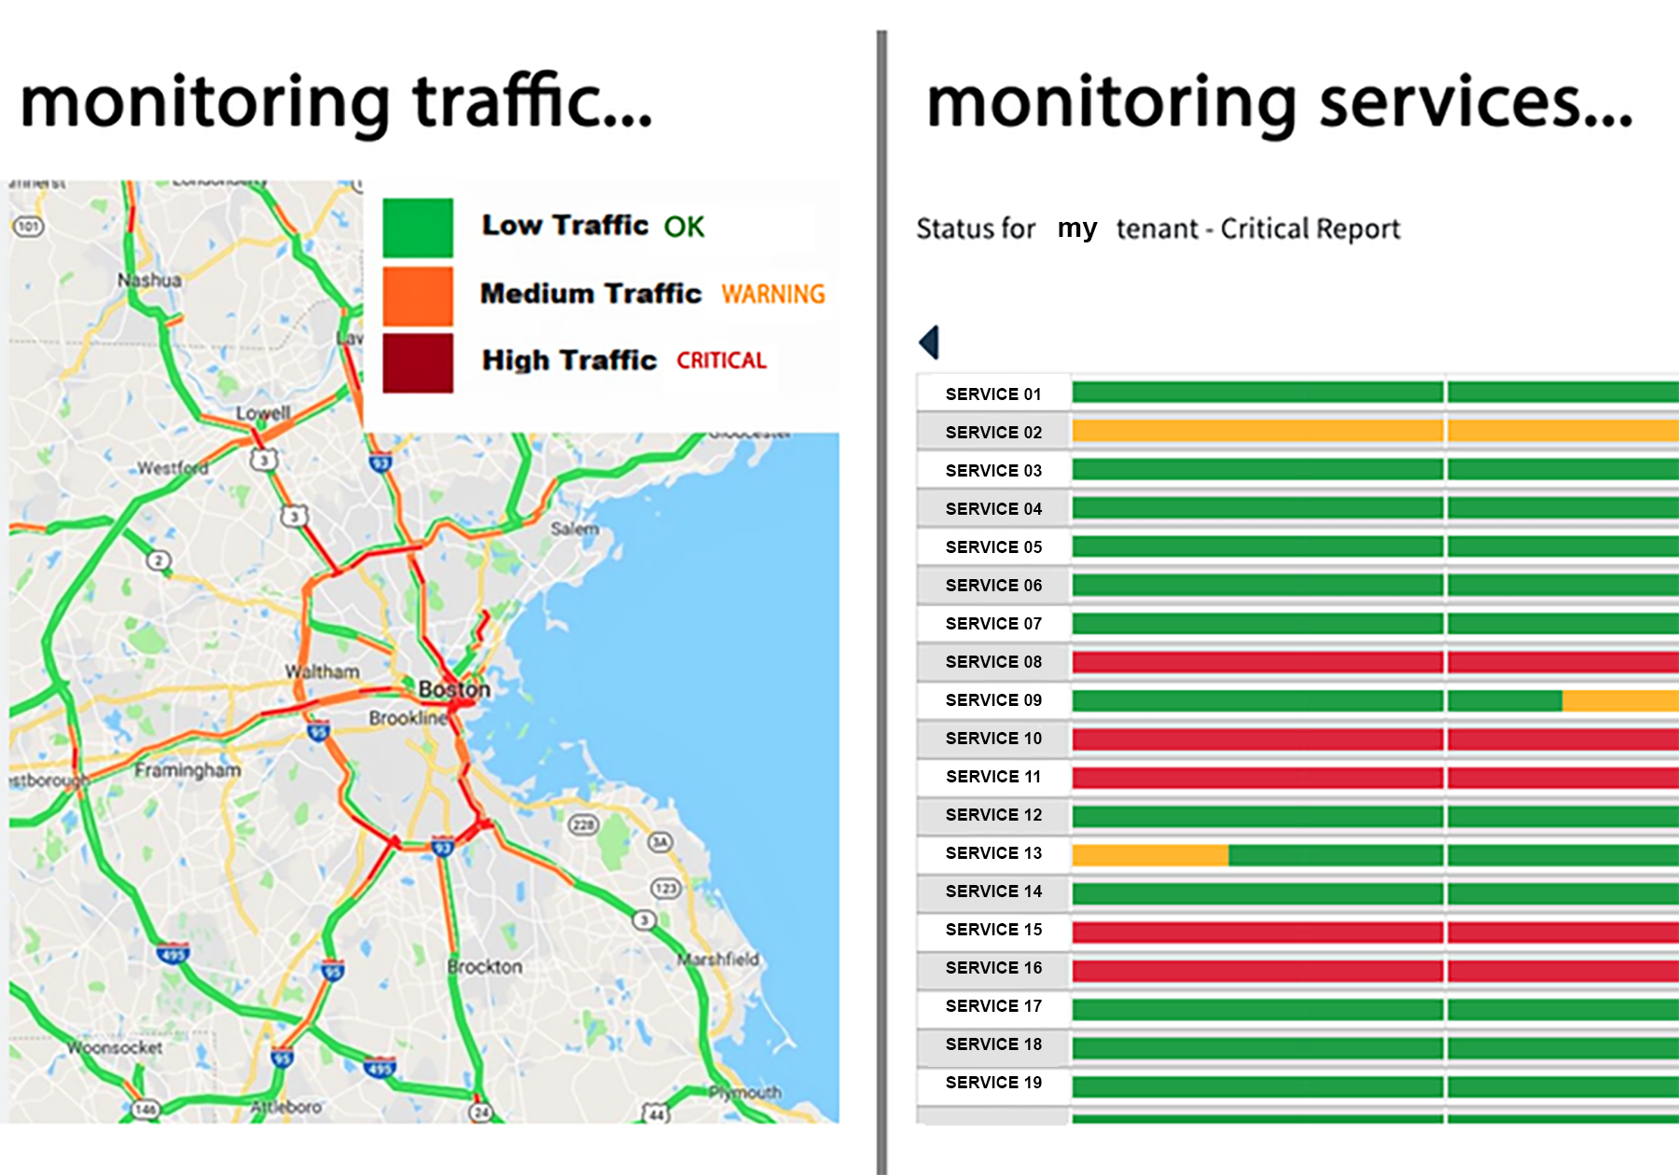
WHY SHOULD WE CARE FOR MONITORING

Slide 11
EOSC MONITORING / Part 1: Base Monitoring
Base Monitoring
Base monitoring involves the process of checking your service. The first checks. Check if your service is up and running
Notes:
Basic monitoring experience for a service involves the knowledge that
it is actually in action. That is up and running, that users can interact with the service.

Slide 12
EOSC MONITORING / Part 1: Base Monitoring
Is your service on or off?
Checks set by default
generic.http.check: Does the service responds when someone is visiting
generic.certificate.check: Is the certificate of your service valid
These 2 basic checks can give us the basic information about the status of the service.
OK
WARNING
CRITICAL
Notes:
Is your service turned on? Monitoring whether your service is working as seen from the outside.
Each organization has its own monitoring but this is a free monitoring tool from another country / region / datacenter that can also check is everything is working smoothly and as expected.
Everything might look fine at your backend servers from inside your network, but a broken load balancer or misconfigured internet routing could stop users from getting that far. Thus, it’s wise to have some basic monitoring from outside your network confirming that traffic can get in. It’s also useful to look for sudden dips in traffic to detect issues with users getting to your services, although this tends to be difficult to tune for a good signal-to-noise ratio.

Slide 13
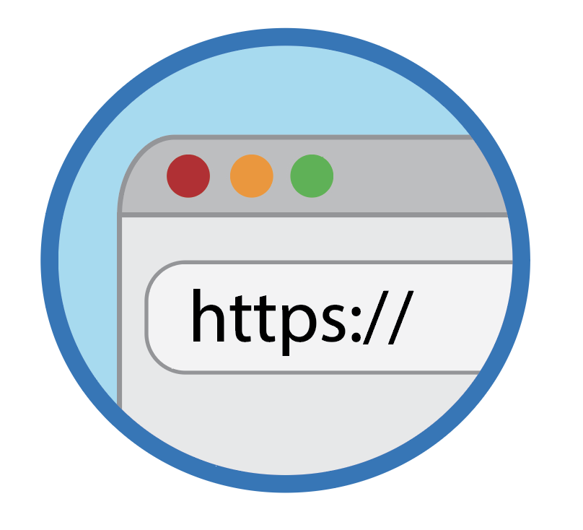
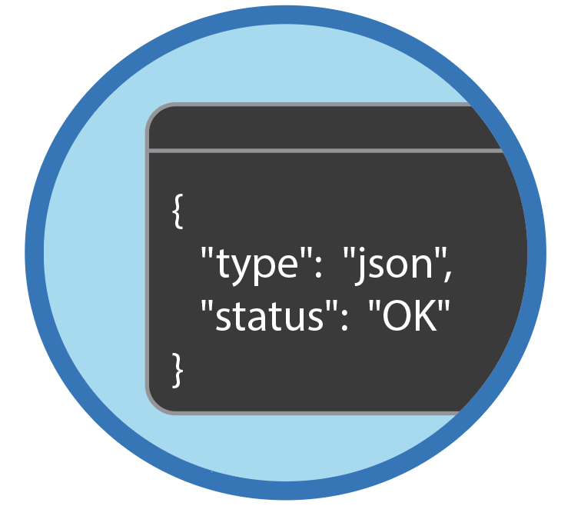
EOSC MONITORING / Part 1: Base Monitoring / What checks you get from the get go
Host
Http/s
Certificates
Port
API (JSON)
ideal for checking if your host is up/down
ideal for checking your websites & web service frontends
ideal for checking your host certificates
ideal for backend services running on specific ports
e.g. db server
ideal for web services backends and apis
Notes:
Depending on the type of the service , different basic check results , processed by the EOSC Monitoring Service,
will decide it’s status
The checks can be like:
host checks to decide if the host is up
http checks to decide if the service frontend are reachable
certificate checks to decide upon expired or missing certificates
port checks to decide that the ports are available @themis check here if correct please
api checks to decide that the service apis operate @themis check here if correct please

Slide 14
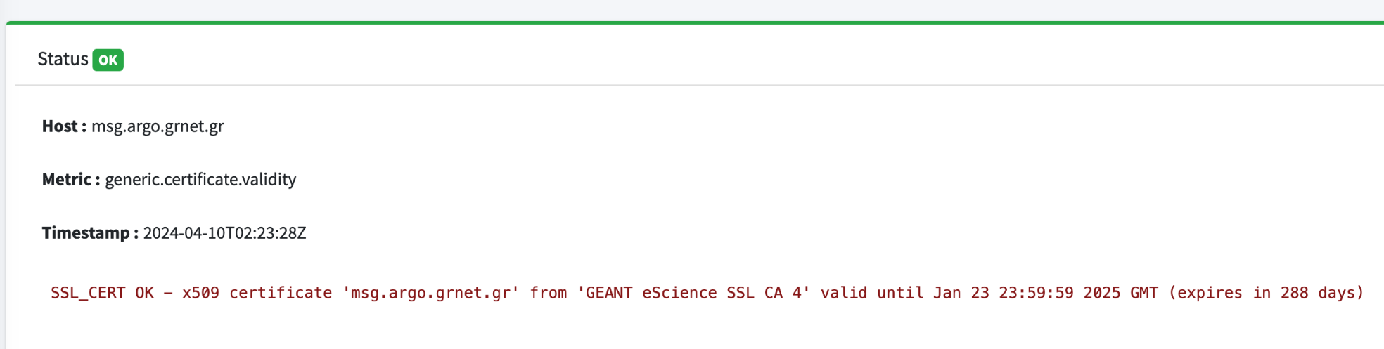
EOSC MONITORING / Part 1: Base Monitoring / EOSC Messaging
The EOSC Messaging Service API Allows users to Publish and Consume Messages
https://msg.argo.grnet.gr/api/projects/METHOD
All methods are called using HTTPS.
generic.certificate.validity check certificate validity
generic.http.connect-messaging
This metric checks the HTTP service on the messaging host. It can test normal (http) and secure (https) servers, follow redirects.
Notes:
For example, a service such us EOSC Messaging Service API ,
that allows publish -consume of messages, operates well if valid certificates exist, to permit secure message exchange
and the http connection on the messaging host succeeds and is secure.
So, we need to check that these requirements are satisfied and checks should run to decide so.
The results of these checks are computed to result in the general status of the messaging service

Slide 15
EOSC MONITORING / Part 2: USER PERSPECTIVE MONITORING
User Perspective Monitoring is the process of monitoring the performance and effectiveness of the service operations from the end user’s perspective.
User Perspective Monitoring provides the data and insight service teams need to improve it and quickly solve user issues, making applications more reliable and efficient and providing a better user experience.
Notes:
EOSC Monitoring Service extends the monitoring experience beyond of monitoring the basic operation of the
service but also to the user’s actions on the service.
The user would like to know if he can rely on all the operation the service is supposed to provide.
Checks can simulate use’s actions and when monitored, user issues can be spotted to be solved efficiently.

Slide 16
EOSC MONITORING / Part 2: USER PERSPECTIVE MONITORING
User perspective monitoring: Simulate User interactions with the service
login
upload a file
SERVICE
run job
delete file
retrieve results
Notes:
For example a user in life can login in a service, upload or delete a file, run a job and ask for results.
These user interactions with the service can be simulated by the checks and be monitored for
malfunctions.

Slide 17
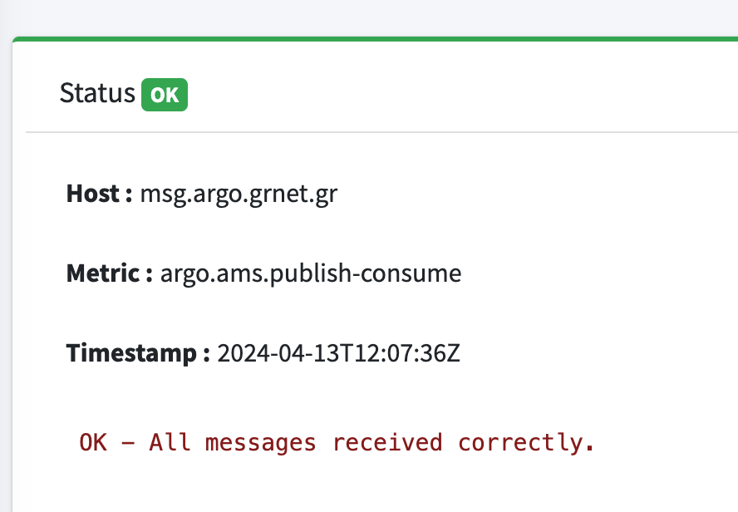
EOSC MONITORING / Part 2: USER PERSPECTIVE MONITORING / EOSC MESSAGING
The EOSC Messaging Service API Allows users to Publish and Consume Messages
https://msg.argo.grnet.gr/api/projects/METHOD
All methods are called using HTTPS.
argo.ams.publish-consume
It checks the main functionalities of the messaging service (publish, subscribe, send, delete, acknowledge)
dedicated checks developed by the messaging service developers using the api
the client can send messages to the service
the client can consume messages from the service
Notes:
In our former example of EOSC Messaging Service API
a user would interact with the service by publishing or consuming messages.
The messaging service developers developed checks to simulate this action
and the results of this check are collected and calculated to
add information , along with the previous base checks , about the service status

Slide 18
EOSC MONITORING / Part 3: PERFORMANCE MONITORING
Performance Monitoring provides insights on the performance of the services it monitors. It tracks resource consumption, response times, and other performance metrics as well as predict potential issues
In Performance Monitoring, graphs and time series are used to provide observability and data visualization on the performance data
Notes:
Monitoring experience can be extended to conclude how services perform.
This is a very useful information, as users can now have knowledge, not only
about the general behavior of the service but also more specific behaviour
regarding it’s performance.
EOSC Monitoring service can enrich the experience with this insight.
It can retrieve information about how fast a service responds or how many resources it consumes
or how much memory or disk it uses or any other metrics that indicates performance and
conclude if the service performs satisfactorily.
EOSC Monitoring , provides graphs on performance data so users can observe the service performance easily and instantly.

Slide 19
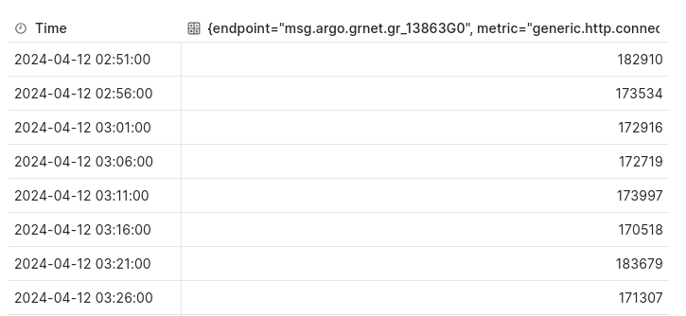
EOSC MONITORING / Part 3: PERFORMANCE MONITORING
When referring to Performance data we are referring to service behaviour, such as network connection time response, on CPU load, memory, processes and disk usage.
Notes:
Collection information about how much CPU does a service use, or how much memory or how much time
does it take to connect , can help us conclude if the service performs well.
In the example we present the collected time response performance data for messaging service

Slide 20
EOSC MONITORING / Part 3: PERFORMANCE MONITORING / EOSC Messaging
The EOSC Messaging Service API Allows users to Publish and Consume Messages
https://msg.argo.grnet.gr/api/projects/METHOD
All methods are called using HTTPS.
generic.http.connect-messaging
It checks the ability to connect to the service
dedicated checks developed by the messaging service developers .
added performance data of service behaviour based on time response.
Notes:
In the example we can view how the EOSC Messaging Service, is monitored for it’s performance.
One of the checks that decides if the messaging service is operating well, is the argo.ams.publish-consume. It provides
the status of main functionalities of the service such as publish, subscribe, send, delete, acknowledge.
Beyond status information, the check can offer insight on the time response of these operations, as part of the performance data
added to the check results. The check carries information about concluding
both the status of the service as well as it’s performance.

Slide 21
How it works?
Notes:
So how does the magic work?

Slide 22
EOSC MONITORING / HOW DOES IT WORK
Simple & Complex topologies
EOSC Monitoring is configured to support simple (flat) and complex topologies of service endpoints:
Topology items are easily imported from external sources
Hierarchies and Groupings of topology items are easily defined inside argo platform (web-api / poemUI)
external topology source
argo topology connector
define profiles
external topology source
external topology source
Notes:
User needs to define information about the monitored infrastructure. Which items in the infrastructure need to be monitored, which checks decide the status of the service, etc.
User can use various sources to define the topology information and , such as GOCDB or others .
This information, necessary for the EOSC Monitoring Service calculations, can reach the service, through the topology connector .
The connector reaches the external sources and serves the information in the argo platform in a structured format.
Then the information will be used by the compute engine of the EOSC Monitoring Service, to conclude to calculations.

Slide 23
EOSC MONITORING / HOW DOES IT WORK
EOSC Monitoring Service monitors service endpoints and collects results as independent messages in self-contained schema-based format.
Results are easily shipped through EOSC Messaging service to
EOSC analytics engine (based on Apache Flink) where big data computations take place
reports
alerts
EOSC Monitoring
EOSC Messaging
Apache flink
Analytics Engine Big Data Platform
Notes:
As the monitoring starts , the EOSC Monitoring Service monitors the service endpoints.
The compute engine , collects the results of the checks, that decide the status of the service endpoints and analyze them.
The results comes as messages to the compute engine, structured into a schema-based format.
In order for EOSC Monitoring Service, to provide reliable and accurate reports and alerts, the service -endpoints are monitored in regular timestamps.
producing real-time massive result datasets, that need EOSC Monitoring Service compute engine to apply big data analysis calculation, on them.

Slide 24
EOSC MONITORING / HOW DOES IT WORK
Declare your service and it's type
Appropriate checks are employed
The system runs the checks against your service repeatedly for various intervals
Collects the results in real time (messaging)
Generates Notifications when needed
Displays them (ui/api)
Aggregates the results over periods of time and produces reports with availability results, trends, etc (big data analytics)
Notes:
So how does the EOSC Monitoring Service works in a glance.
The services to be monitored are defined and checks run on them to decide their operation status.
These checks run repeatedly and collect real-time results.
These results are processed and generate alerts, to notify for problematic cases.
Also the results are processed to produce reports about status and calculate statistics,
that help the user have a thorough knowledge for the service behaviour through time.

Slide 25
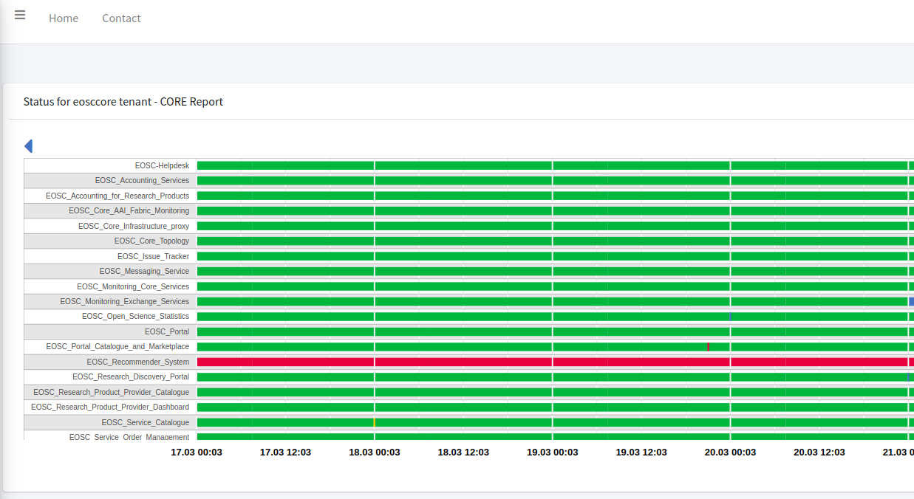
EOSC MONITORING / FEATURES / STATUS REPORT
Status is a report of the status of the monitored item/group of items, during the monitoring time.
Knowing the timeline
provides information about the condition of the monitored item
helps to spot the most problematic metrics
and decide about the problematic metrics.
Notes:
EOSC Monitoring Service provides user with the ability to export through reports, information about the monitored services, in the timelines of interest.
Reports are an optical, quick and visualized way to receive this information.
Through status reports, the user can check the condition of each service’s functionality, in a specific chosen timeline.
What is reported is the status of each check on the various service functionalities or operations, on the timestamp it is monitored
and In this way the user can be informed about services that do not function or malfunction. The report helps the user to acknowledge the
problematic cases and take actions.

Slide 26
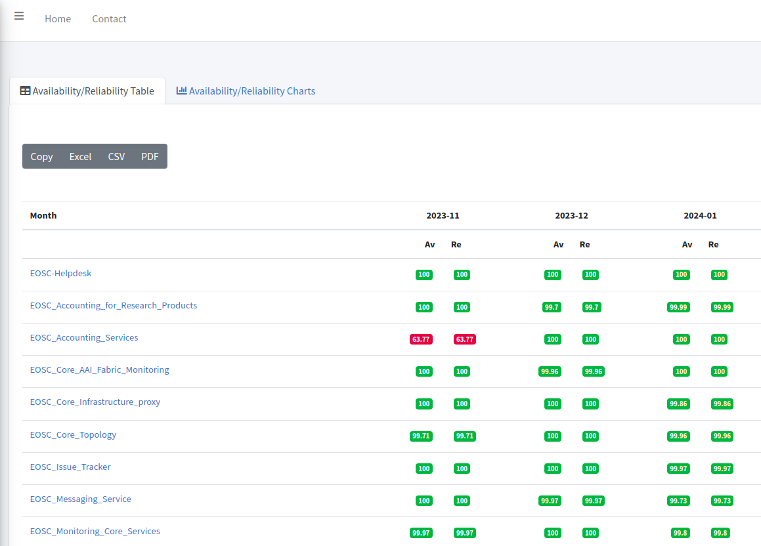
EOSC MONITORING / FEATURES / Availability - Reliability reports
Availability/Reliability percentages can be calculated on the timelines.
Decide if the item is available for usage and if it is considered as reliable.
Notes:
Availability/Reliability reports provide information whether a service is available and reliable.
Availability indicates whether users can even access the service. The report provides a percentage that calculates how much of the monitored time the service is accessible to the users.
Reliability indicated whether users can operate well with the service. The report provides a percentage that calculates how much of the time that is the service is defined to operate well it actually does so.
In other words, if the service operates as expected.

Slide 27
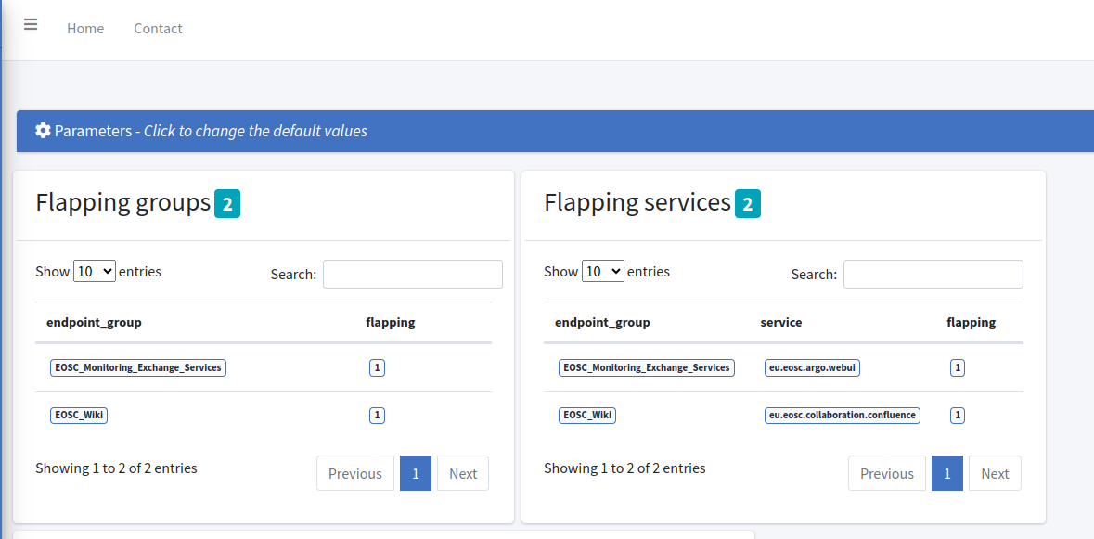
EOSC MONITORING / FEATURES / Status Trends - Flapping
Flapping : a service changes state too frequently, resulting in a storm of problems and recovery notifications.
Indicative of:
configuration problems,
troublesome services,
or real network problems.
Notes:
EOSC Monitoring offers more information through reports, such as statistics of the service, the so called trends.
One example is the flapping trend. This statistic provides insights about the services which status switch too often. This can indicate problems during the
service initialisation, problems of network connection or any other problems that need to be spotted and solved.
Also EOSC Monitoring Service, provides the ability this trend to be categorized based on the categories of the spotted problem. For example the user can easily be informed about services switching status , caused by network problems

Slide 28
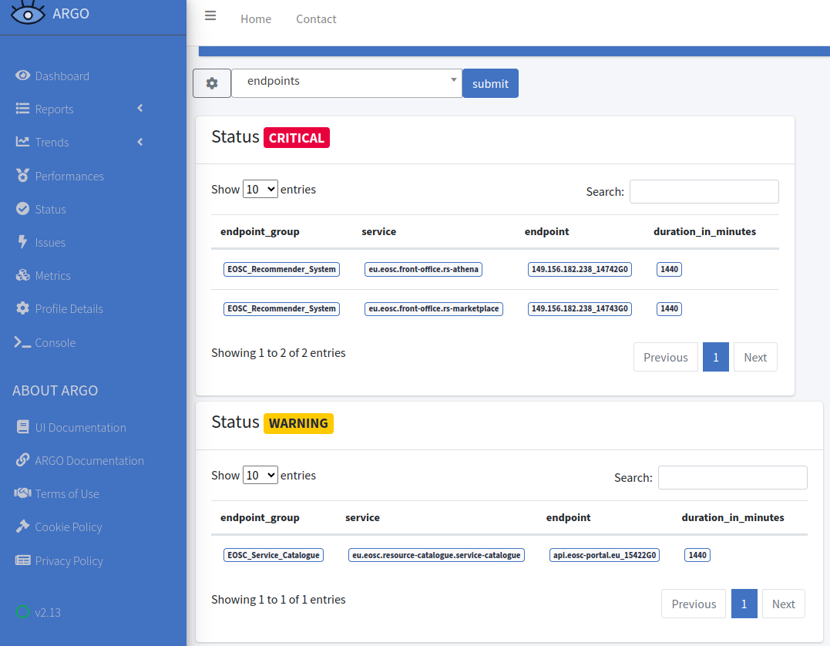
EOSC MONITORING / FEATURES / Status Trends - Critical, Warning,Unknown
Problematic states (critical, warning or unknown state) occurring for a time period are monitored in order to conclude on configuration problems, troublesome services, or other service internal problems
Notes:
Another trend reported is the one providing the user with the ability to acknowledge the services that presents problematic behaviour more often.
This trend can be categorised , based on the level of the malfunction. For example a service can not function at all while another one can function but with delays
User can easily spot the services that are in these states, the longest.
This trend also can be categorized based on the categories of the spotted problem.

Slide 29
EOSC Messaging Service
The Transport Layer for EOSC Core

Slide 30
EOSC Messaging Service
EOSC Messaging Service is a real-time messaging service that allows the user to send and receive messages between independent applications. It is implemented as a Publish/Subscribe Service. A scalable HTTP Messaging Service With:
an HTTP API for client access
Transparent scalability & high availability
Access controls implemented at the API layer
Multi-tenant support
Instrumentation at the API layer

Slide 31
EOSC Messaging Service: Fundamentals
Fundamentals
Project
a basis of organizing and isolating groups of users & resources
Resource Types
Users & Roles
Topic
A named resource to which messages are sent by publishers.
Roles
A list of service-wide roles. Can be extended. (action is a permission)
Subscription
A named resource representing the stream of messages from a single, specific topic
Publisher
Message
Client that publishes msgs to a topic.
The combination of data and attributes
Schemas
Subscriber
A mechanism that support schema validation
Client that consumes msgs from a topic.
Metrics
activity of the resources
Notes:
its internal hierarchy is based on projects, which intern have Topics that may have on or more subscription to it.
You can see here additional information for each resource type.

Slide 32
EOSC Messaging Service: Main Features
Main Features
At-Least-Once delivery: delivers each published message at least once for every subscription
Support of message attribute: key/value pair
Support of multiple subscriptions per topic: topics and subscriptions provide a one-to-many form of communication, in a publish/subscribe pattern.
Replay messages: that have been acknowledged by seeking to a timestamp.
Replicate messages on multiple topics: Republisher script that consumes and publishes messages for specific topics
Schema Support:
Metrics to help us understand the activity of our resources (publishing-rate, consumption-rate)
Always Follow the Google PUB/SUB features
Monitoring/logging
Internal optimizations
Notes:
At-Least-Once delivery: delivers each published message at least once for every subscription
Support of message attribute: A key-value pair that a publisher can define for a message.
Support of multiple subscriptions per topic: topics and subscriptions provide a one-to-many form of communication, in a publish/subscribe pattern. Useful for scaling to very large numbers of recipients, each published message is made available to each subscription registered with the topic. Messages are sent to a topic and delivered to one or more associated subscriptions.
Replay messages: replay messages that have been acknowledged by seeking to a timestamp.
Replicate messages on multiple topics: Republisher script that consumes and publishes messages for specific topics (ex. SITES)
Schema Support: on demand mechanism that enables the definition of the expected payload schema

Slide 33
EOSC Messaging Service: Integration Options
Integration Options
It is used by
EOSC Accounting for Services
EOSC Monitoring
It can be extended to be the Gateway to the EOSC platform for Exchange services.
Notes:
EOSC Messaging is currently in Use
By EOSC monitoring as a transport layer between its internal components
And offered as an Integration Option to EOSC accounting for EOSC Exchange services.

Slide 34
EOSC Accounting for Services

Slide 35
Accounting for Services: What is it
The Accounting System is a platform that is responsible for collecting, aggregating, and exchanging the metrics between different infrastructures, providers, and projects.
of the service
Functionalities of the service
Accepting input from several different resources, define and support metrics
Store metrics into a data store.
Search, filter, offer data for a specific time period via API, UI
Associate Resource (services) with Metrics.

Slide 36
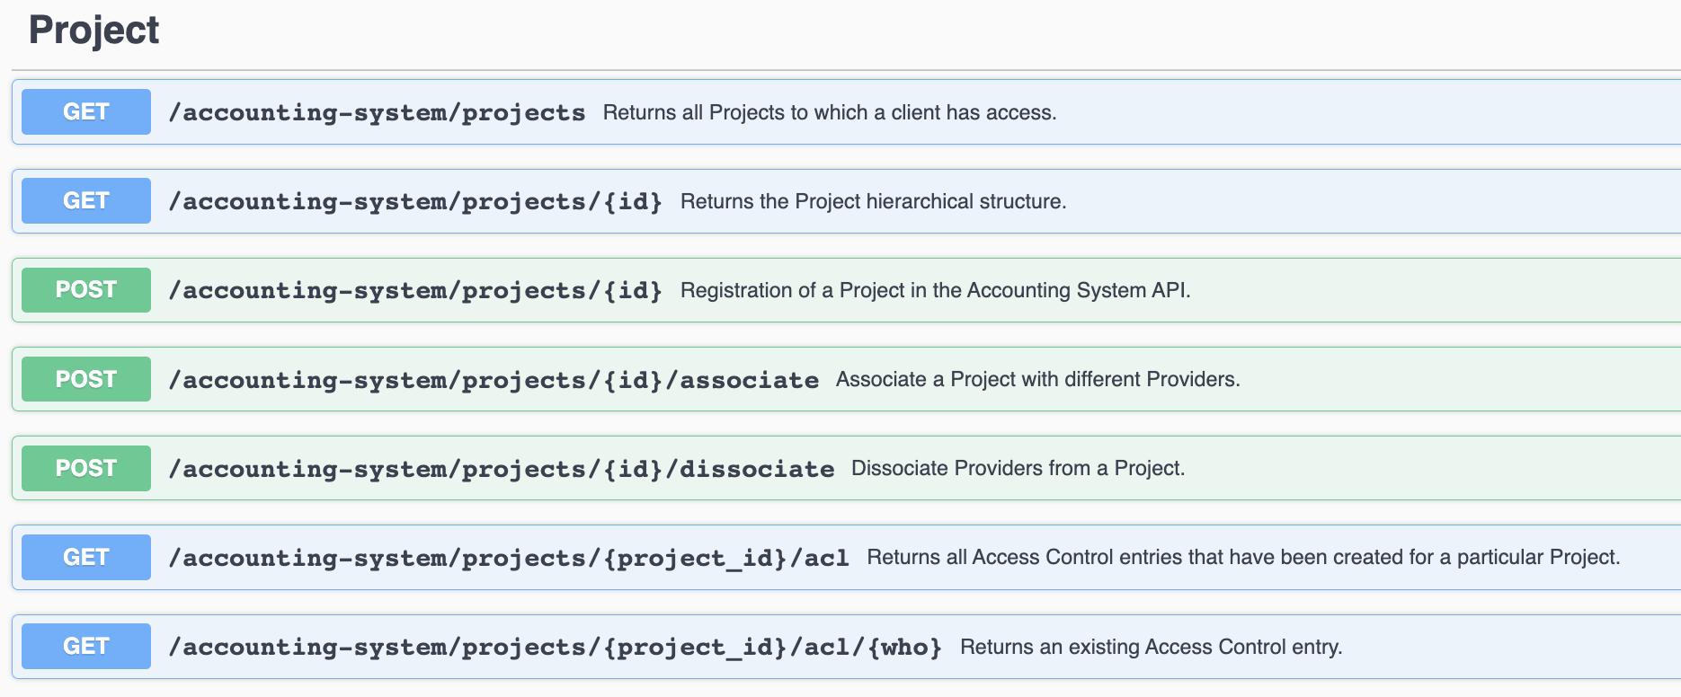
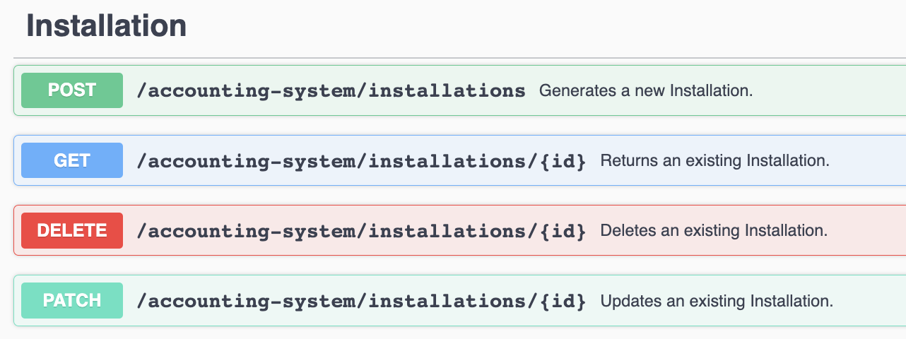
Accounting for Services: API Perspective
https://argoeu.github.io/argo-accounting/

Slide 37
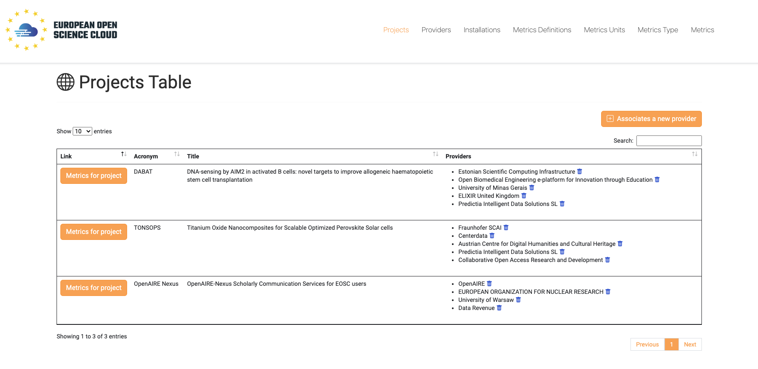
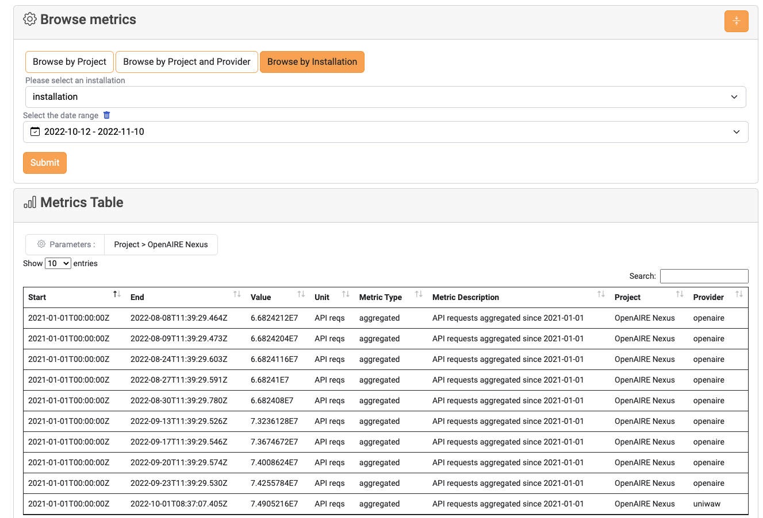
Accounting for Services: UI
Apart from the API , it also supports an easy to use UI.
Manage
View
FIlter
Browse

Slide 38
Accounting for Services: What is it? - UI
Apart from the API , it also supports an easy to use UI.
Manage
View
FIlter
Browse

Slide 39
DOCUMENTATION
Monitoring documentation
https://argoeu.github.io/argo-monitoring/docs/intro
https://zenodo.org/doi/10.5281/zenodo.7118590
https://argoeu.github.io/argo-monitoring/docs/monitoring/SP_guide
Messaging Documentation:
https://argoeu.github.io/argo-messaging/
Accounting Documentation:
https://argoeu.github.io/argo-accounting/
Accounting: https://zenodo.org/doi/10.5281/zenodo.10843158

Slide 40
Questions ?

