Slide 1
From Regional to Global
What is GÉANT doing and how can we improve the interregional connectivity model
Sebastiano Buscaglione
Rennes
12/06/2024

Slide 2
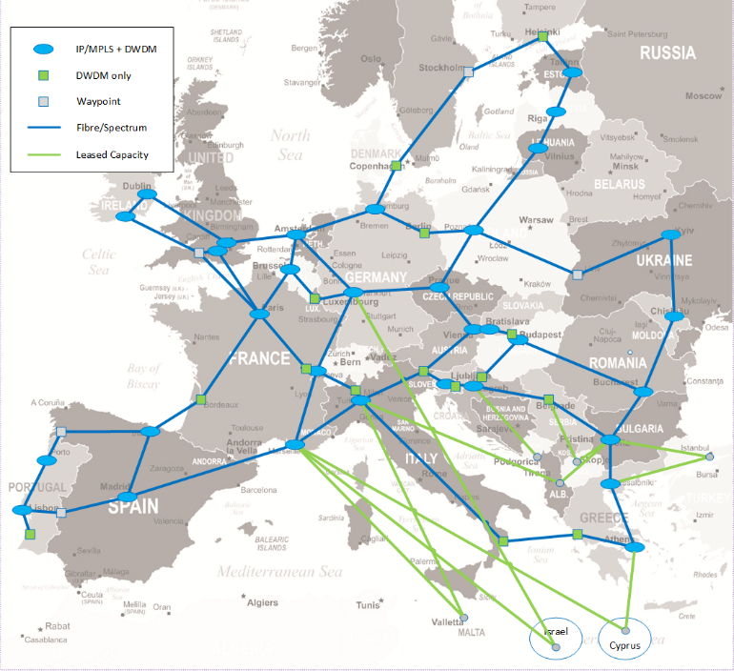
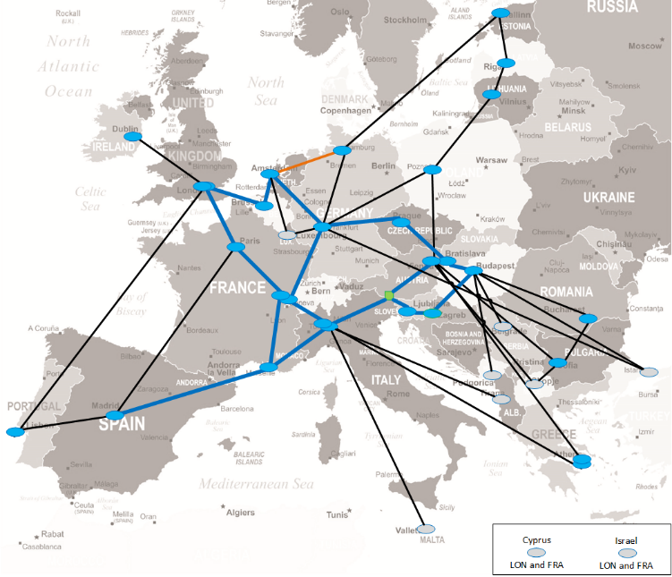
What we have done at “Regional” level
In Europe with GN4-3N we moved from a “pay as you grow” to an “infrastructure ownership” model.
In this model GÉANT self-provisions capacity as required over its own infrastructure.
This is from TNC2018!

Slide 3
The benefits of infrastructure ownership
A game changer at regional scale
Guarantees resources availability
Reduces dependencies from market
Reduces the digital divide
Increases visibility and control
Speeds up delivering
Offers options to provide new services
Encourages growth
You know you will find others there allowing to maximise the value of the investment

Slide 4
Can we use this model at a Global scale?
There are challenges…
Many of us do not operate outside of our region
Investments required are much higher
Security and stability are pre-requisites
Regulatory environment is very complex
System functioning is dependent on many parties
You know you will find others there allowing to maximise the value of the investment
What about Funding?

Slide 5
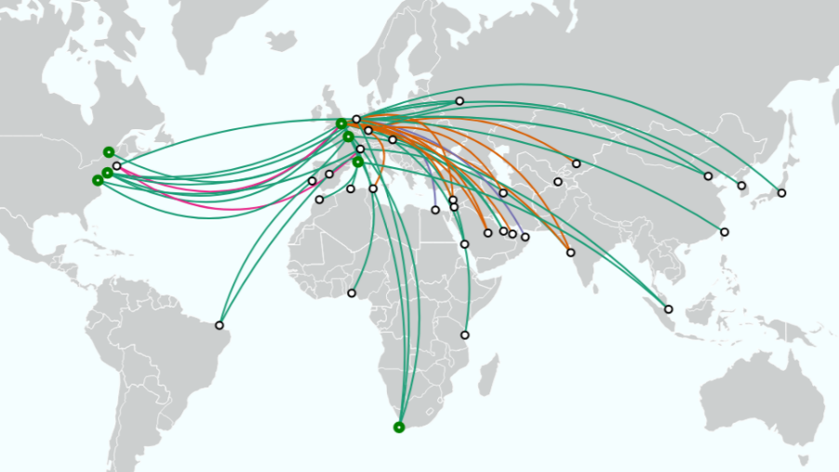
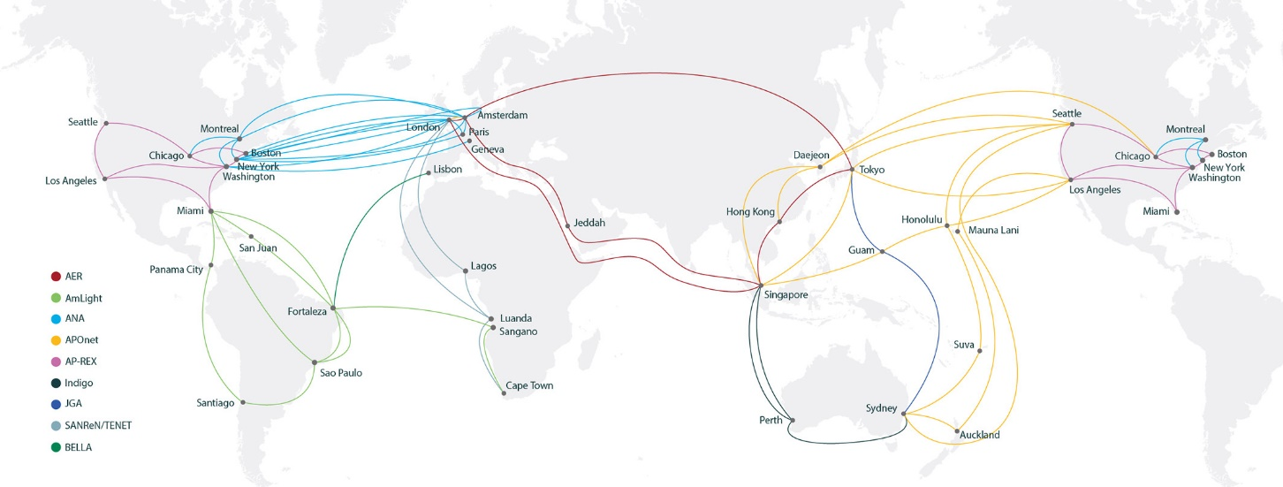
…but also strong collaborations we can build upon.
← I see this…
Global collaborations are working and coordinating the establishment of systems that benefits all members in ways that would otherwise not be possible.
You know you will find others there allowing to maximise the value of the investment
…but also this →

Slide 6
Still room for improvement
Leasing of capacity remains the main mechanism
Every collaboration is governed by its separate set of rules
Collaborations tends to be superregional, but not yet Global
Logical connections are frequently based on 1-to-1 relationships
You know you will find others there allowing to maximise the value of the investment
Is now a good time to look at this?

Slide 7
Let’s take a step back and look at the Geography
More than 70% of our planet is covered in Water

Slide 8
In between water “continents”
Continents "are understood to be large, continuous, discrete masses of land, ideally separated by expanses of water"

Slide 9
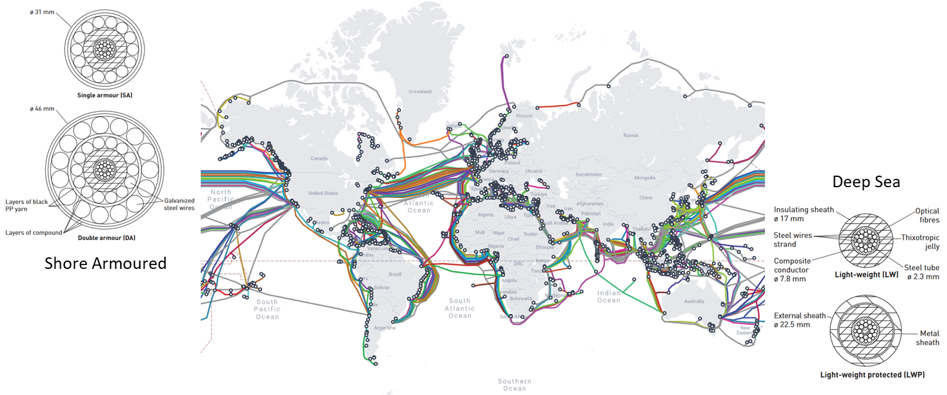
Looking at Global or Intercontinental connectivity…
…means looking at communication across these large bodies of water.
We do this today primarily with Submarine Telecommunication Cables.
More than 70% of our planet is covered in Water

Slide 10
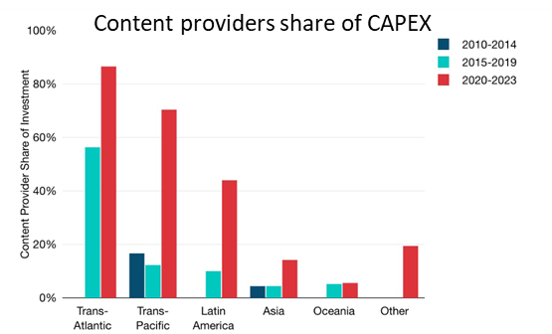
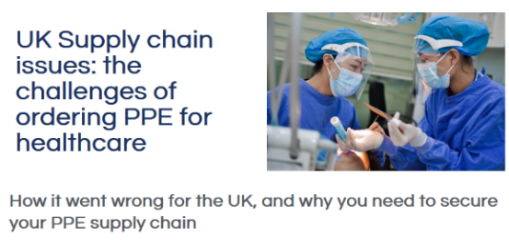
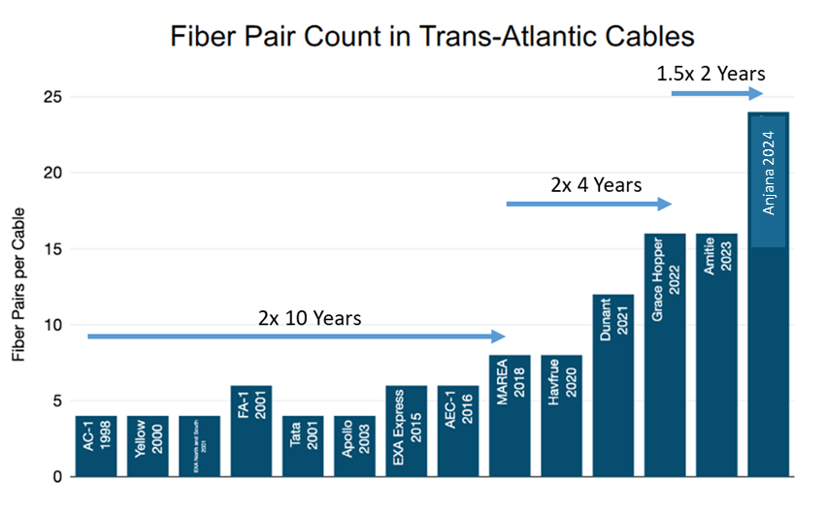
The Submarine industry is enjoying a period of change and growth
Change of ownership (and demand)
New Technologies
Geopolitical instabilities
Post COVID effect
Timing

Slide 11
What does this mean for us (R&E)
Change of ownership is squeezing the TELCO market
As change is happening this is the time to put our interests on the table
Funding bodies are ready to invest more
Collectively we do have experience in this area
So yes – this is a good time!

Slide 12
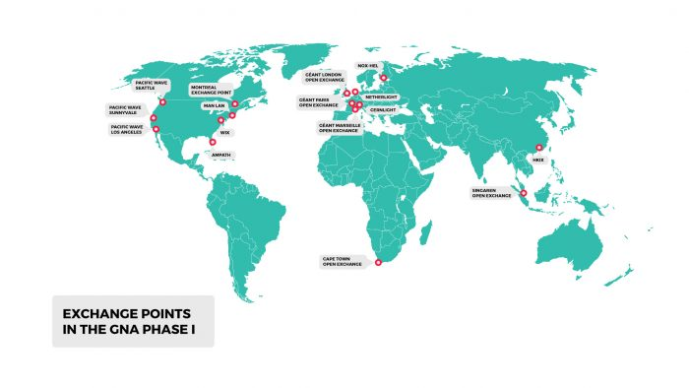
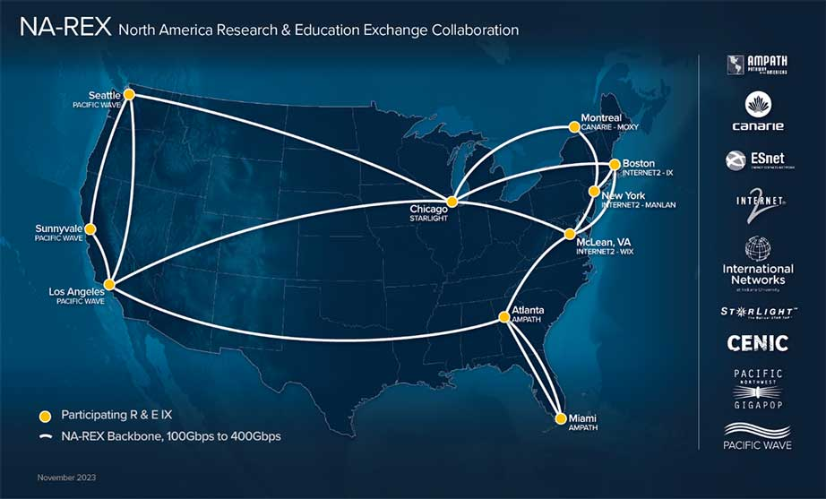
If submarine cables are the links - what about the nodes?
Nodes in “global” terms are represented by “Open Exchanges”
Lightweight policy environments allowing clients to establish connections with each other
However…
Geographical coverage is limited
Information is also limited!
Location of Exchanges should be reviewed to ensure optimal positioning

Slide 13
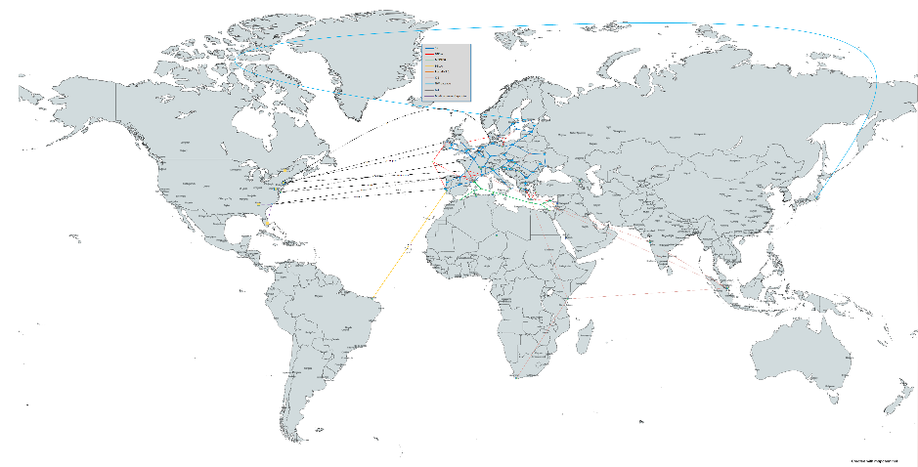
What is GÉANT doing?
GN4-3N
GN5-IC1
~50M EUR
~15M EUR
2017 – 2023
Refresh the GÉANT European Network Infrastructure
move to long term IRU and Fibre/Spectrum where possible
2023 – 2025
Provide a long-term intercontinental capacity and investment plan
Connect to two regions

Slide 14
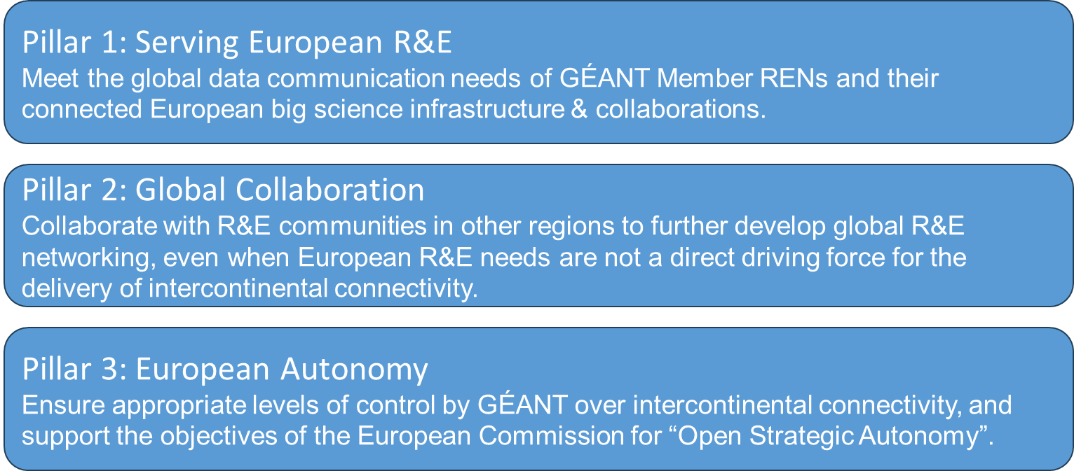
GN5-IC1 as an opportunity to be more involved
The project is the answer to the need for increasing the strategic direction and coordination when it comes to interconnecting globally.
Three pillars have been defined to guide intercontinental connectivity investment planning:

Slide 15
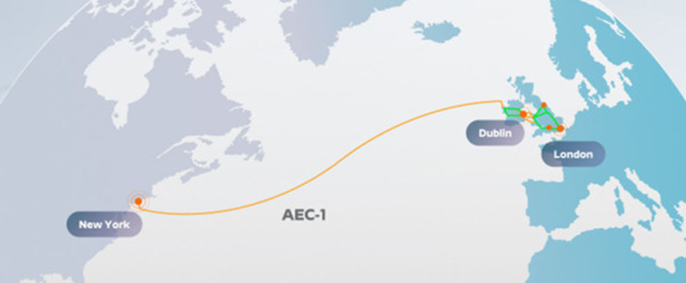
GN5-IC1 in practice - Infrastructure to North America
In coordination with ESnet, GÉANT is looking at acquiring ~25% Spectrum over 4 links transatlantic.
The total capacity of the combined system (with ESnet) will be at ~20Tbps with GÉANT owning half of it.
Based on Spectrum IRUs with GÉANT capacity delivered at Open Exchanges
ESnet successfully acquired the first link

Slide 16
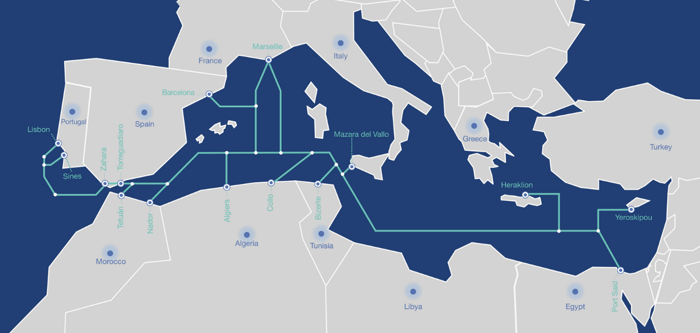
Working with funding bodies – the case of MEDUSA
In partnership with DG-NEAR (EC), EIB, ASREN and AFR-IX, GÉANT is working on co-building the MEDUSA submarine system.
A 40M investment to provide Terabits capacity to North African countries.
https://medusascs.com/

Slide 17
What can we do?
Getting involved at lower layer requires more resources – we need to work together to overcome challenges - Groups like GNA-G will be important to coordinate
We need to prepare our regional and national networks to connect to these systems R&E Exchanges are key
https://www.gna-g.net/
Get in touch!

Slide 18
Thank you
Any questions?
sebastiano.buscaglione@geant.org

