Slide 1
Developing a Collaborative BGP Routing Analyzing and Diagnosing Platform
Changqing An, Jilong Wang
Rennes, France
12 JUNE, 2024

Slide 2
Outline
Background
BGP Hijacking Detection Algorithm
Functionality of the BGPWatch Platform
BGP Route Sharing and Looking Glass Platform
Future Work
2
Notes:
First, I will provide some background information.,
then I will present the hijacking detection algorithm and functions of the platform.
two supporting platforms providing data and measurement

Slide 3
Collaborative Community
Work of 19 organizations (listed alphabetically)
AARNET (AU)
APAN-JP (JP)
BdREN (BD)
CERNET (CN)
DOST-ASTI (PREGINET, PH)
ERNET (IN)
Gottingen University (DE)
HARNET (JUCC, HK)
ITB (ID)
KREONET (KR)
LEARN (LK)
MYREN (MY)
NREN (NP)
PERN (PK)
REANNZ (NZ)
SingAREN (SG)
Surrey University (UK)
ThaiREN (TH)
TransPAC (US, APAN/GNA-G Routing WG)
3
Notes:
This work was funded by the APNIC Foundation. And there are 19 organizations taking part in this work, and Most of them are NRENs from the Asia-Pacific region. This group is expanding,

Slide 4
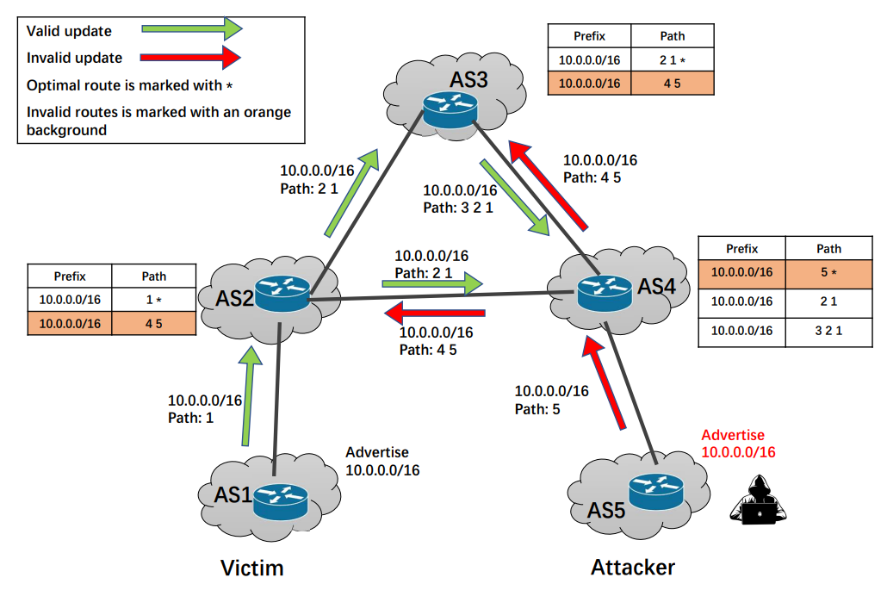
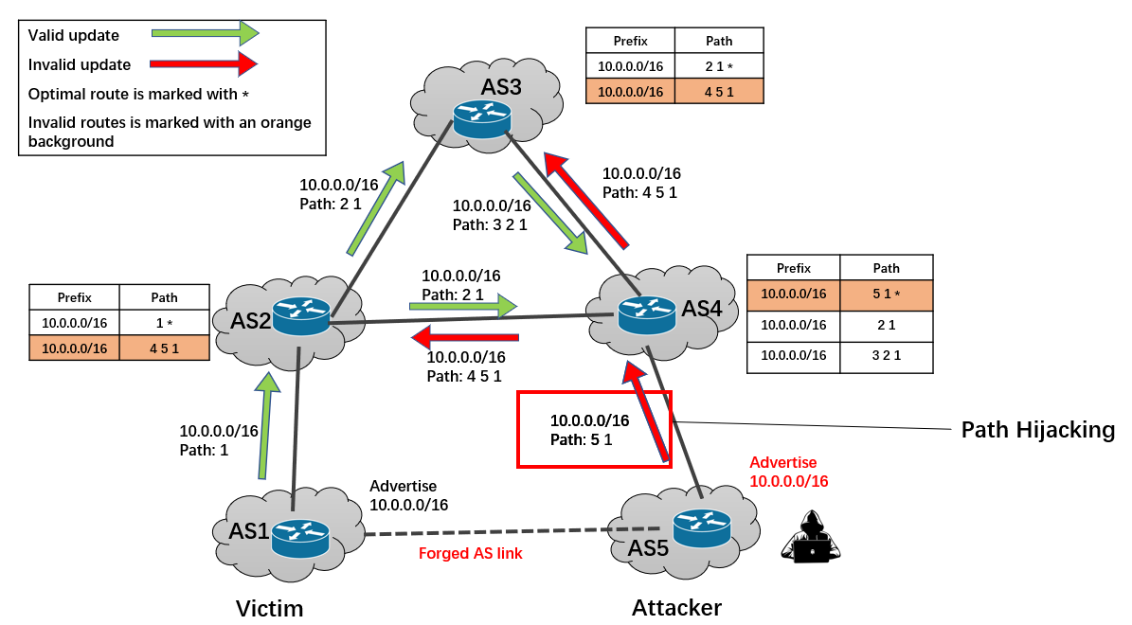
BGP Hijacking
BGP hijacking often leads to catastrophic consequences
Prefix Hijacking
Path Hijacking
4
Notes:
BGP hijacking often leads to catastrophic consequences.
Left is a prefix hijack scenario, the attacker AS5 announces IP prefix belongs to AS1.
Right is a path hijack scenario, when announcing the prefix…, attacker AS5 appends AS1 to the end of the AS-PATH, pretending there is an AS link between AS5 and AS1
/ˌkadəˈsträfik/ /ˈkänsəkwəns

Slide 5
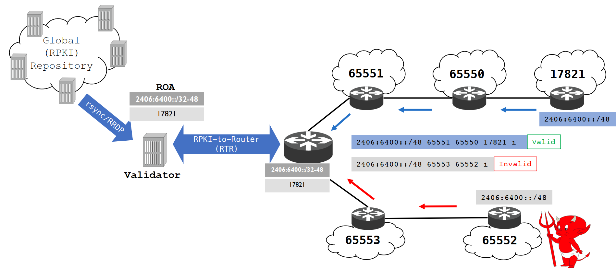
Solutions to BGP Hijacking
Preventing the hijacking before it happens
RPKI (Resource Public Key Infrastructure)
ASPA(Autonomous System Provider Authorization)
Monitoring to detect the hijacking
Route Views
RIPE RIS
BGPstream
GRIP
Mitigating the hijacking
Announcing a more specific prefix
Contact other networks to filter routes
RPKI is very useful, but it's still in the process of deployment
5
Notes:
Many solutions have been proposed.
I think most of you know RPKI and ASPA, which lets the AS announce it’s prefixes and provider relationships.
RPKI is very useful, but it is still in the process of deployment, while ASPA is still in the early stages of research.
Here, we focus on monitoring BGP routing information from multiple vantage points to detect hijackings
And after the detection, Mitigating methods are carried out, such as.

Slide 6
MOAS and BGP Prefix Hijacking
MOAS (Multiple Origin AS) : multiple ASes originate the same prefix
MOAS is a critical characteristic of source hijacking
MOAS is not solely caused by hijacking
Multihoming
Traffic Engineering
DDOS Mitigating
Anycast Address
Determining the legitimacy of MOAS is a major challenge
6
Notes:
When a prefix hijacking event occurs, multiple ASes originate the same prefix, which is referred to as MOAS (Multiple Origin AS).
MOAS is a critical characteristic of prefix hijacking
But not all MOAS are caused by hijacking
There are multihoming, …, they will also l cause moas
So,

Slide 7
A Rules and Machine Learning Combined Method
ROA, IRR, AS
Relationships
Extract
Features
Ground Truth Data Features
Ground Truth
Training
BGP Route Feeds
Rule-Based MOAS Filter
Potential Source Hijack
MOAS
Machine-Learning (ML) Classifier
Potential Hijack
Initially, train the machine learning classifier.
During operation, the platform fetches BGP ROUTE feeds, extracts MOAS.
Rule-based filters are used to sift through a large volume of legitimate MOAS.
Then, the machine learning classifier is utilized to categorize the remaining MOAS.
7
Notes:
The platform uses a rules and machine learning combined method.
Initially, the algorithm extracts features from domain knowledge and ground truth data. These features are used to train the machine learning classifier.
During operation, the platform fetches BGP ROUTE feeds, extracts MOAS.
FOR those moas, rule-based filters are used to sift through a large volume of legitimate MOAS. Then, the machine learning classifier is utilized to categorize the remaining MOAS. And finally get the potential …
The system collect BGP route feeds from RRC00,

Slide 8
Rule based Filtering
ROA Filter: Sync with public repository using Routinator, every minute
IRR Filter: use Internet Routing Registries to assist in filtering, sync every day
Provider-Customer Filter: CAIDA as relationship database
TOPO Filter: Hijacker and Victim in the same AS-PATH
Admin Filter: Same administrator etc., sync with WHOIS every day
Frequency/Duration Filter: Frequency/Duration longer than a threshold
ROA, IRR, AS
Relationships
Filter
MOAS
ROA Filter
IRR Filter
P-C Filter
TOPO Filter
Frequency Filter
Duration Filter
Potential Source Hijack
Legal Moas
8
Notes:
These are the rule based filters
For ROA FILTER, prefixes announcement will be compared with ROA, to check if they are valid. The filter will
IRR Filter use Internet Routing Registries to assist in filtering.
… information are also used to assist in filtering

Slide 9
Machine Learning based Filtering
Features
MOAS TYPE, AS Rank Difference, Business Relationship, Geographical Relationship,
Announcement Activity, Hijacking Activity,
Edit Distance of AS name, org, desc,
AS type, Degree and Coreness of AS,
Prefix type
Classifier
Extreme Randomized Trees
ROA, IRR, AS
Relationships
Extract
Features
Ground Truth Data
Features
Ground Truth
Training
MOAS
Machine-Learning (ML) Classifier
Potential Source Hijack
Result:
Precision | Recall | Accuracy
0.9410 | 0.9570 | 0.9622
9
Notes:
For machine learning filtering,
The features we used include MOAS TYPE, ( SUBMOAS, MOAS)
And experiment shows that it can get high precision and accuracy

Slide 10
Path Hijacking Detection
Path hijacking can evade MOAS, but usually cause unseen AS link
State of the art detection technique
Treat all unseen links appearing in the control plane as suspicious event
Then validate the event through the data-plane probing
Limitation
Unseen links are very common
Intense data-plane workload
Inefficient and difficult to guarantee real-time
10
Notes:
….
However, unseen links are very common,
new peering establishment, Backup links. Route policy changes, etc. , all these will cause unseen links
and only a few of them are due to path hijacking. So existing methods will cause intense data-plane overhead, making them Inefficient and difficult to guarantee real-time.

Slide 11
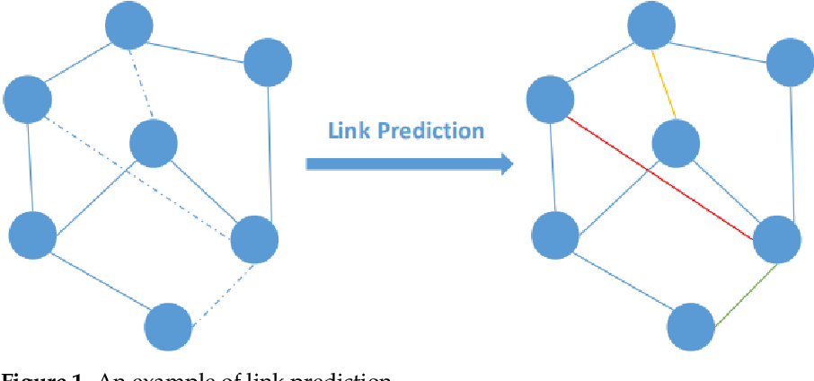
Detecting Fake AS-PATHs based on Link Prediction
Evaluate the authenticity of unseen links with link prediction and filter the benign unseen links
Link prediction: a technique for inferring whether a link is likely to exist between two nodes from an existing observable portion of the network
Is AS link predictable? Graph characteristics of AS-level topology
Power-law distribution
Negative degree-degree correlation
Hierarchical structure
AS links usually connect two ASes
with the same properties.
11
Notes:
To solve the problem, our idea is to evaluate the authenticity of unseen links with link prediction and then filter the benign unseen links.
So here comes the question: Is AS link predictable?
Fortunately,
makes it is predictable

Slide 12
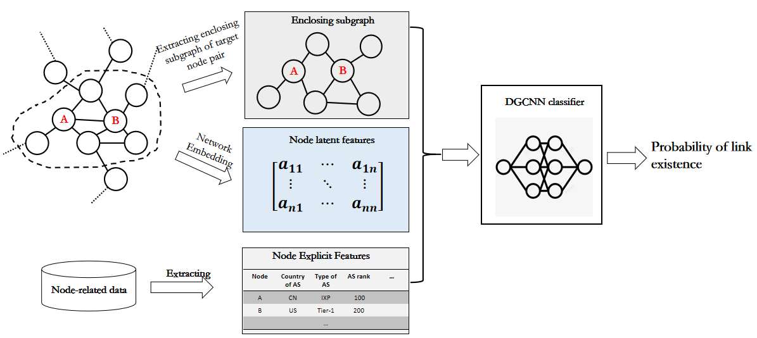
Unseen Link Prediction
Select Deep Graph Convolutional Neural Network (DGCNN) as the link prediction algorithm
CAIDA AS relationship & AS location、 type and rank
Training with positive and negative samples
The accuracy reached 0.95 and the AUC reached 0.98
12
Notes:
Here , we try to evaluate the possibility of a link between A and B
First, we get the subgraph including A and B
The graph is embedded into a matrix to obtain latent features.,
Also, AS related data, SUCH AS,… are extracted get the node explicit features
All these are used to train the classifier,
We use ….
We train the classifier use both positive and negative samples. The positive samples are
the links that exist in the AS topology, and the negative samples are the links that do not exist. we randomly sample some invisible links as negative samples.
The results of the experiment show that the predictor performs well.

Slide 13
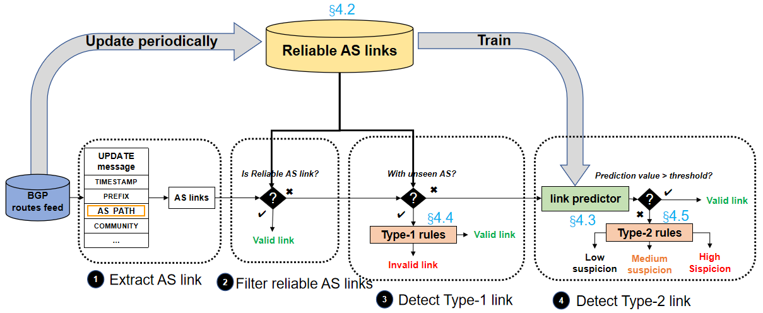
Framework: Combining Link Prediction and Rules
Link prediction is used to find suspicious unseen links, and rules are used to improve the confidence level
The accuracy of positive AS-PATHs is about 99.5%
The accuracy of Type-1 path hijacking is 87.5%
13
Notes:
This is the fake AS-PATHs detection framework.
It combines link prediction and rules.
Link prediction is used to find suspicious unseen links and the rules are used to improve the confidence level.
This is the workflow
First it gets BGP feed and extracts the AS links
Then it filters seen reliable AS links and evaluate unseen links with link prediction and get a prediction value.
If the value larger than threshold, then It’s good , else it will be evaluated with rules
For links from the positive sample, 50% of the predicted values are close to 1, and more than 75% of the predicted value is greater than 0.8.
Threshold value = 0.8
For 𝑡 = 0.8, Metis can obtain about 80% precision and 80% recall

Slide 14
Rules
If any rules are successfully matched, the suspicious score is increased by 1.
The number of unique ASes in AS-PATH is greater than the pre-set threshold.
The suspicious link with a single-digit ASN at the end of the AS-PATH.
The editing distance between two ASN digits of a suspect link is not more than 1.
The AS-PATH has AS loop, and the link is in the loop.
The AS-PATH violates the valley-free rule.
The AS-PATH causes traffic detour.
When a path score reaches a threshold, it is judged as hijacking.
14
Notes:
In path hijacking, the attacker needs to insert ASNs into the AS-PATH, which may result in a larger number of unique ASes in the ASPATH than in the regular AS-PATH, We suggest the threshold is set as 1.5 ∼ 2 average AS-PATH length (approximately 4.5 hops in November 2021) in the global BGP routing table.
This rule takes into account the fact that operators can accidentally introduce single-digit ASNs at the end of the AS-PATH when performing AS-PATH Prepending (ASPP) operations.
Same as the previous one, misconfiguration may cause such AS links.
AS loops are often caused by BGP poisoning, and the links in the loop are usually fake. •
The AS-PATH violates the valley-free rule [22]. Some Malicious BGP hijackings may insert ASNs into ASPATH to make it violate the valley-free rule.
• The AS-PATH causes traffic detour, i.e., traffic goes out of a country and then comes back to that country. Traffic detour is rarely seen (6% of AS-PATHs have detour in the global BGP routing table), and path hijacking usually causes detour

Slide 15
Further Data Plane Probing
AS2
Looking Glass vantage point
166.111.0.0/16
166.111.0.0/16
AS6
Representative services
AS3
AS1
Possible Hijacking?
Multi Home, Proxy
Prefix Migration
Hijacking
Hijacker
Victim
AS4
AS5
When a hijacking occurs, it will affect the service reachability
Approach: Test representative service from Looking Glass VPs
15
Notes:
Over 2000 thousand Looking Glass vantage point will be used to detect the hijacking from data plane
And will improve the detection accuracy

Slide 16
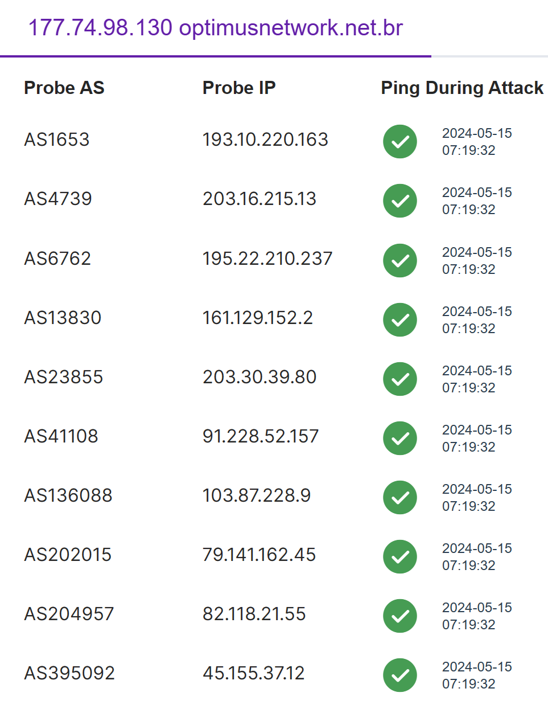
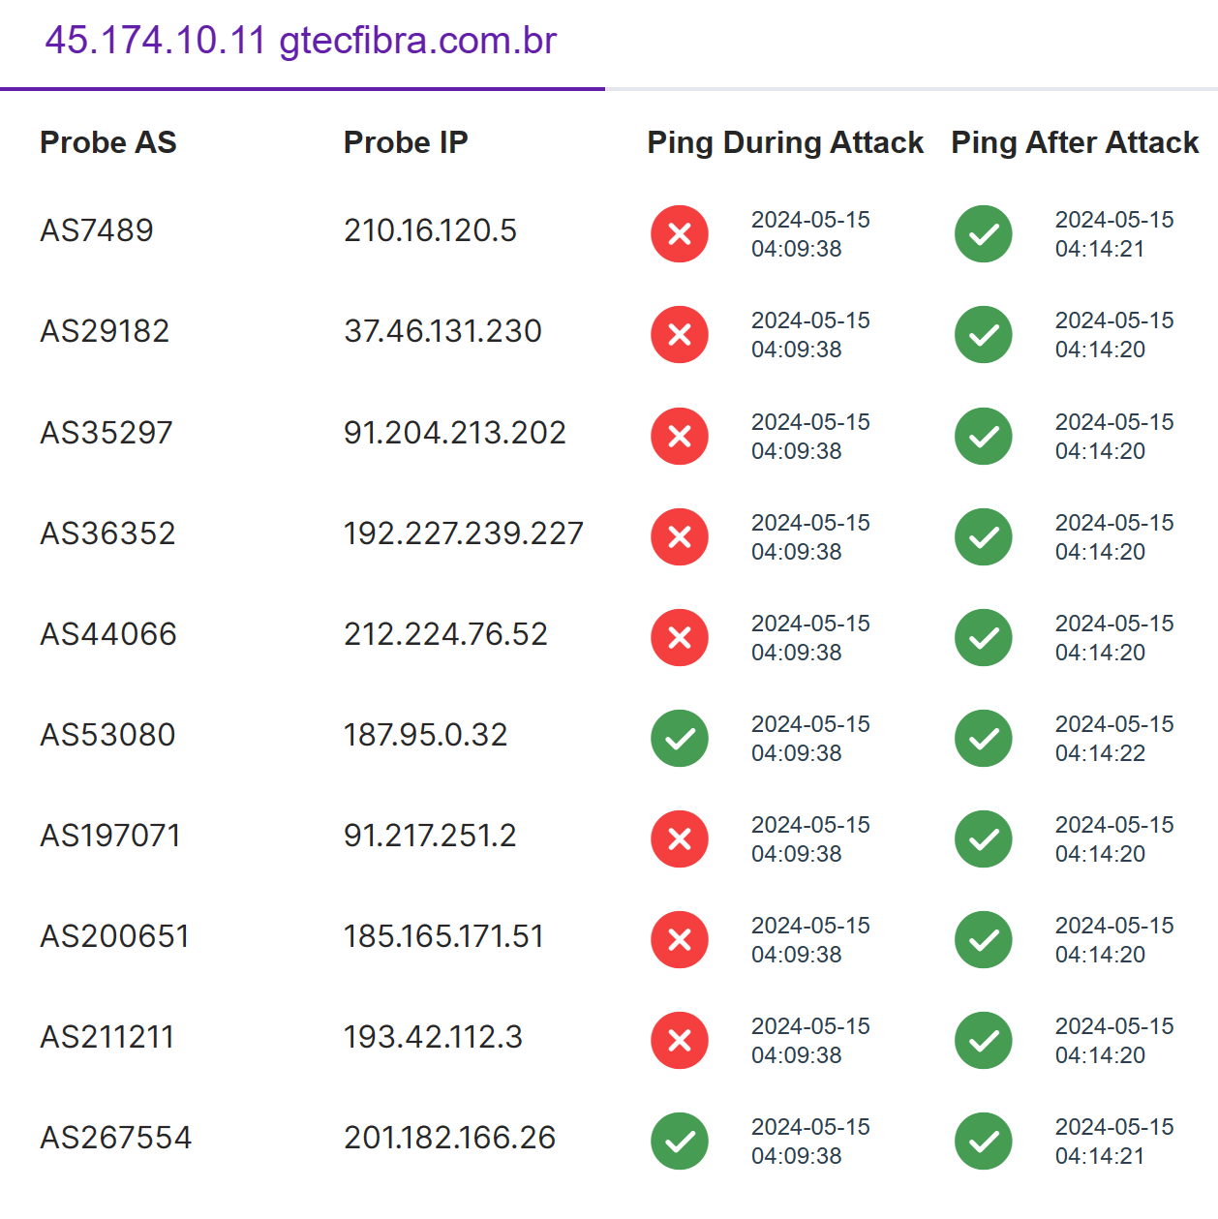
Further Data Plane Probing
Select anchor server for the prefix/subprefix from TOP 1M domain name.
Select looking glass vantage point from affected ASes and unaffected ASes.
Check reachability during attack and after attack. Ping? Tracert?
Evaluate the possibility of Hijacking.
16

Slide 17
Example of a Hijacking Event
17

Slide 18
Example of a Non-hijacking Event
18

Slide 19
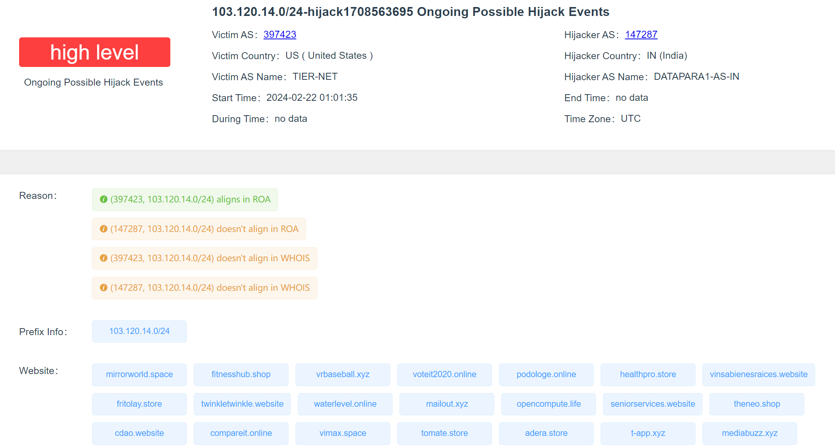
Evaluate Harm Level
Whether the prefix and AS provide critical services?
19
Notes:
High level: The number of websites contained in the hijacked prefix is greater than 5.
Middle level: The number of websites contained in the hijacked prefix is greater than 1 but less than 5; The victim AS is Hosting and Cloud Provider.
Hosting and Cloud Provider

Slide 20
Domains in Prefix and AS TYPE
TOP 1M domain:
Tranco: https://tranco-list.eu/
Cloudflare: https://radar.cloudflare.com/domains
Convert domain name to IP Prefix
Get AS type from ASdb:
https://asdb.stanford.edu/
ASdb is a research dataset that maps ASN to organizations and industry types using data from business intelligence databases, website classifiers, and a machine learning algorithm.
Hosting and Cloud Provider
20
Notes:
maps ASN to organizations and industry types

Slide 21
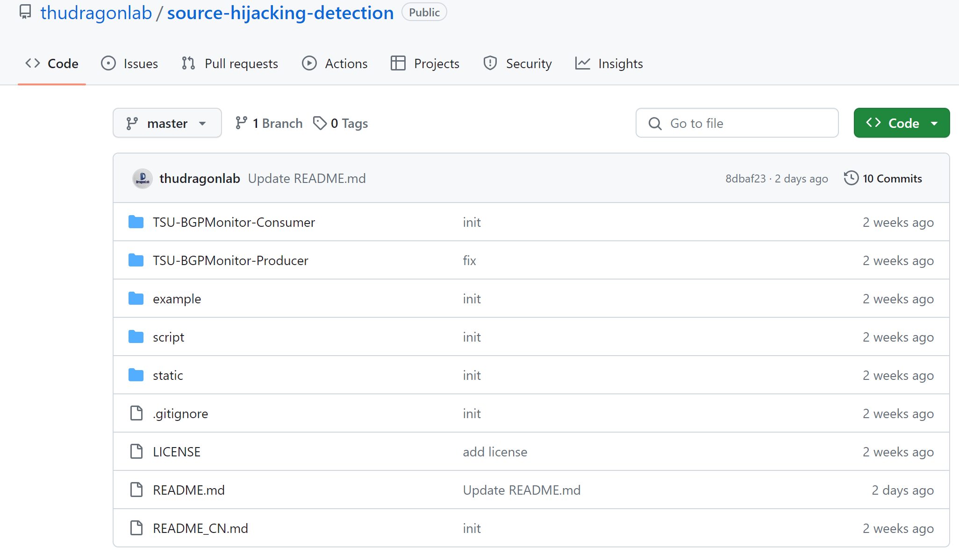
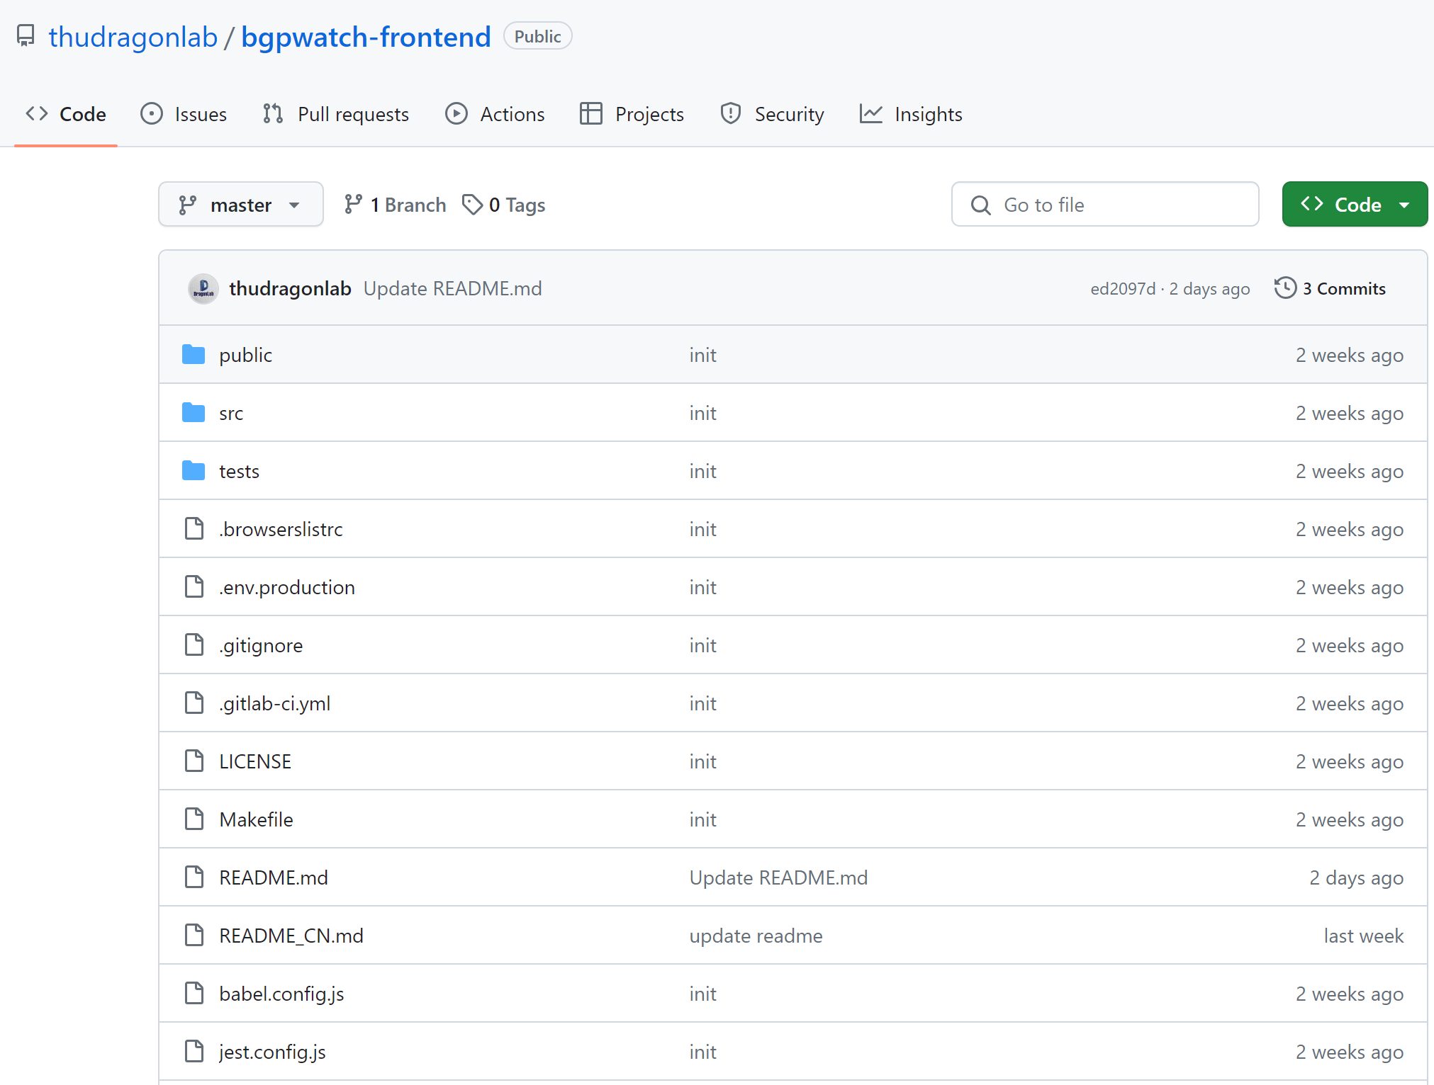
Open Source
https://github.com/thudragonlab/source-hijacking-detection
https://github.com/thudragonlab/bgpwatch-frontend
https://github.com/thudragonlab/bgpwatch-backend
https://github.com/thudragonlab/bgp-analysis
21

Slide 22
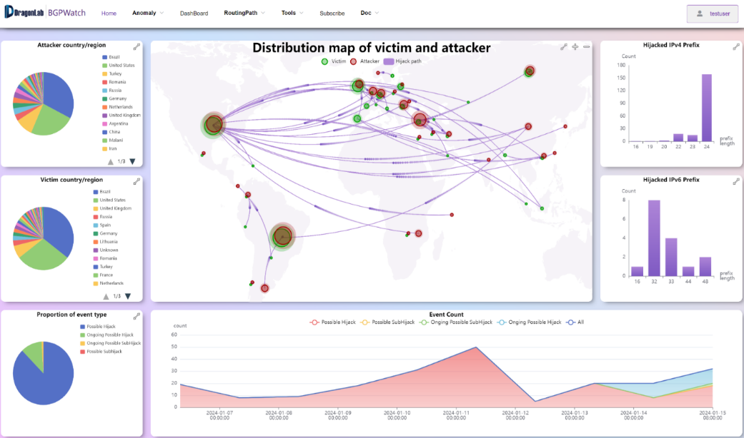
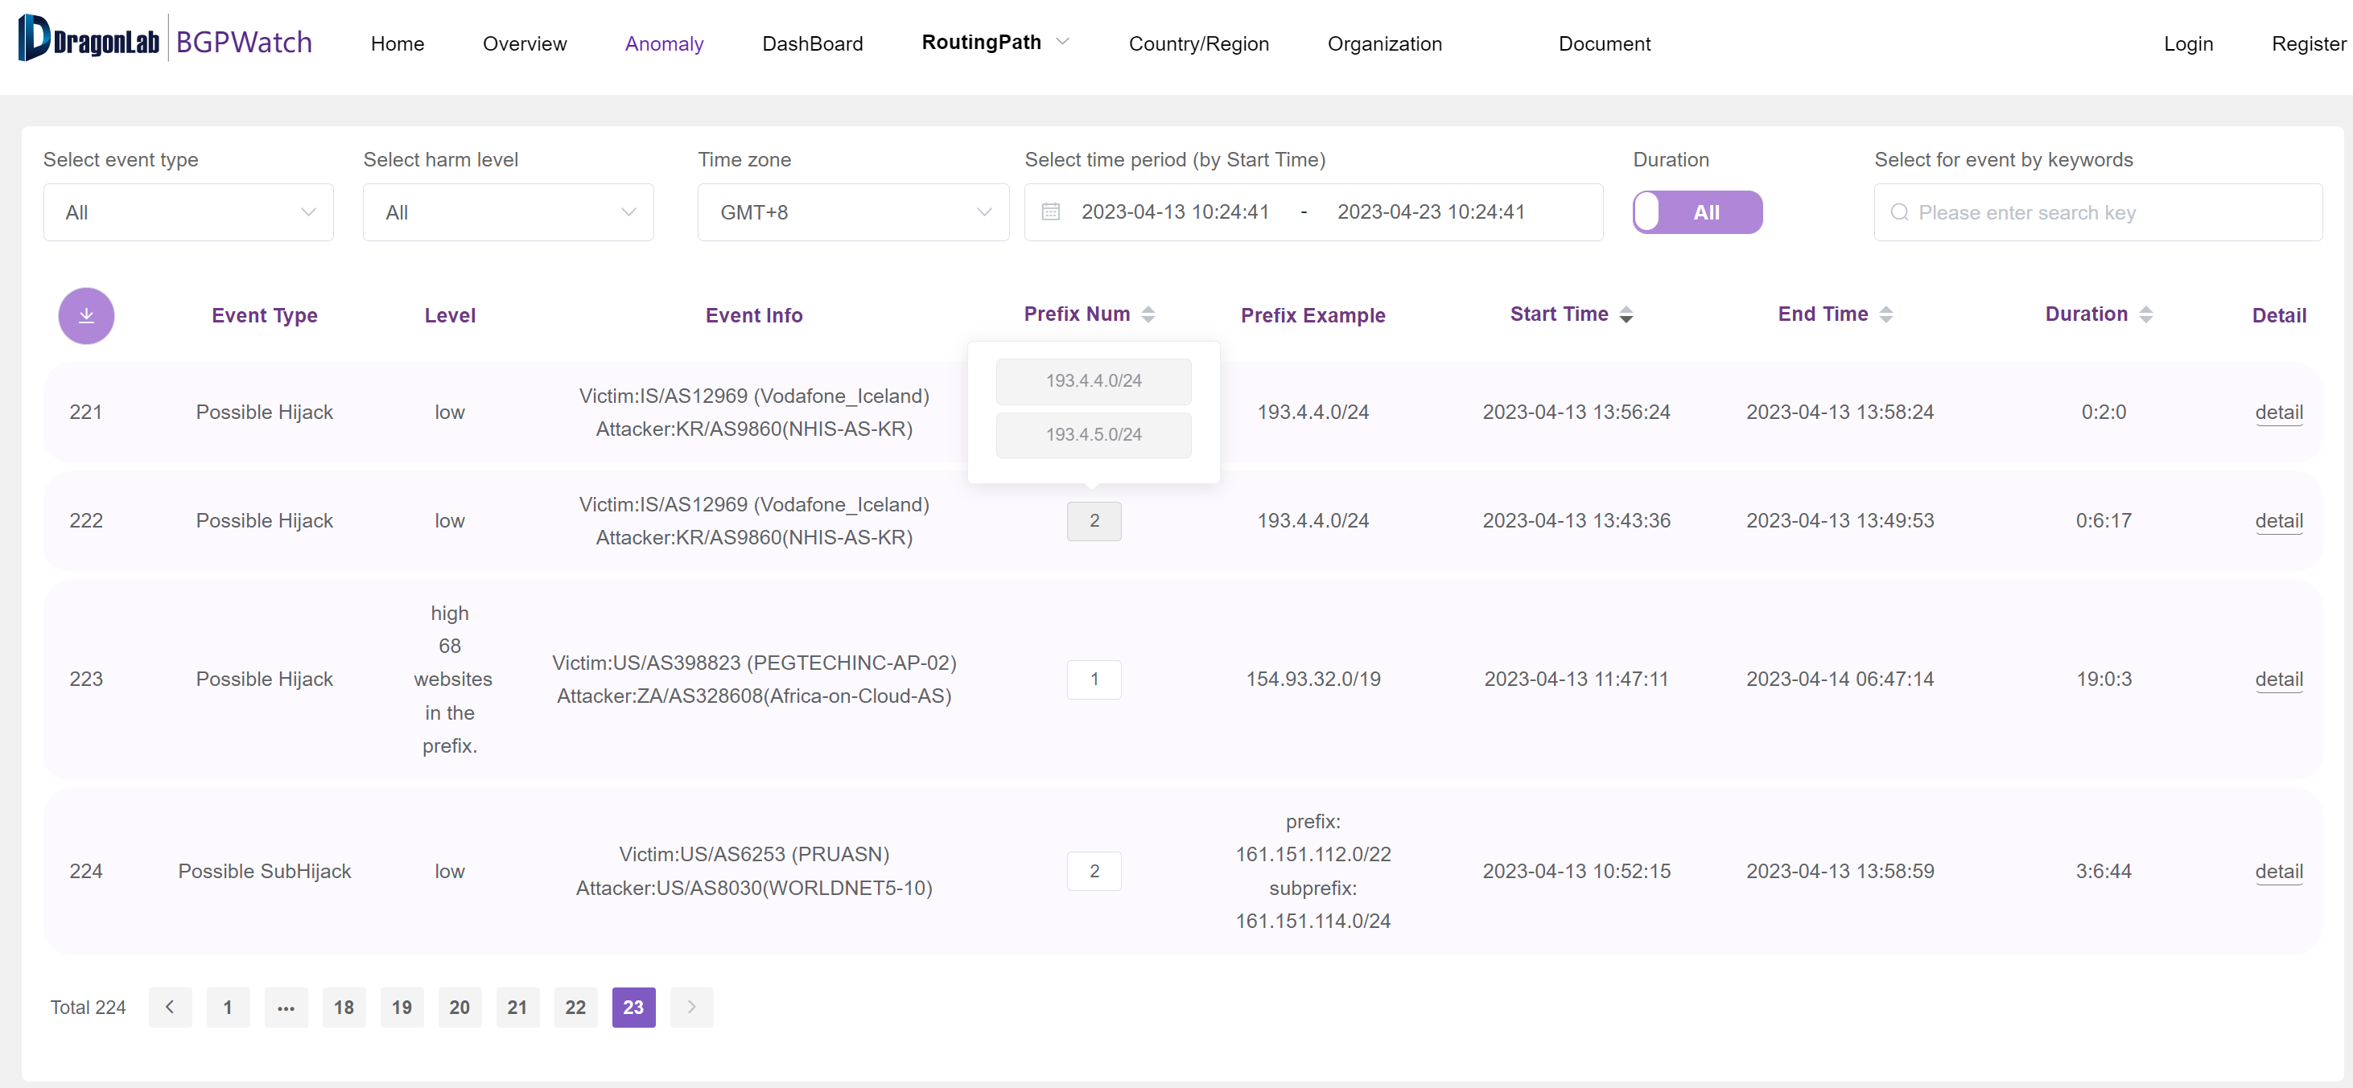
BGPWatch: Prefix Hijacking Detection Platform
Knowledge-based real-time BGP hijacking Detection System
Public BGP event reporting service
Based on MOAS/subMOAS
Rely on Domain Knowledge (ROA, IRR, AS relationship, routing path, accumulated information, etc.)
https://bgpwatch.cgtf.net
22
Notes:
Now I will move to the functions of the platform
Left is the homepage, it shows statistics hijacking information
Righ is the real time monitoring page shows information of the hijacking events
In order to detect if there is any BGP hijacking happening on the Internet, we have been developing a Knowledge-based real-time bgp hijacking detecting system
BGPwatch is a public BGP events reporting platform, it mainly besed on MOAS and subMOAS events, and relay on domain knowledge, such as ROA, IRR, AS relationship, AS topology etc.
You can visit BPGwatch at bgpwatch.cgtf.net.
Here are the home page of bgpwatch.

Slide 23
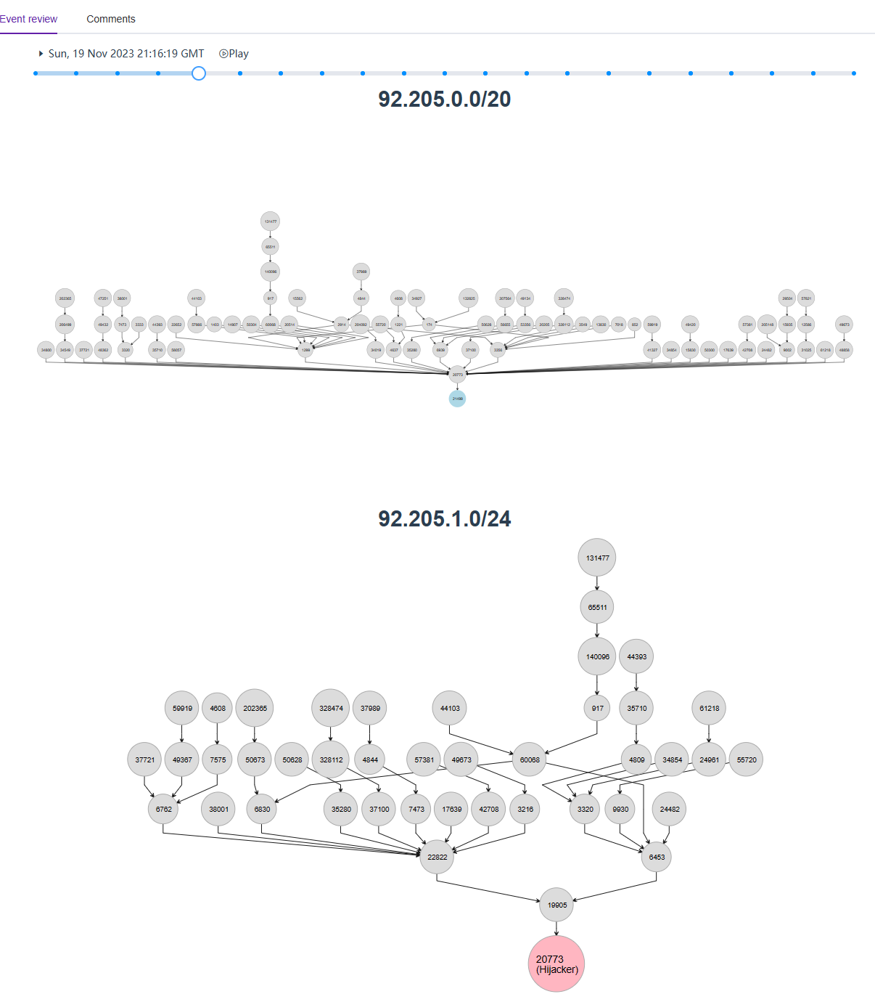
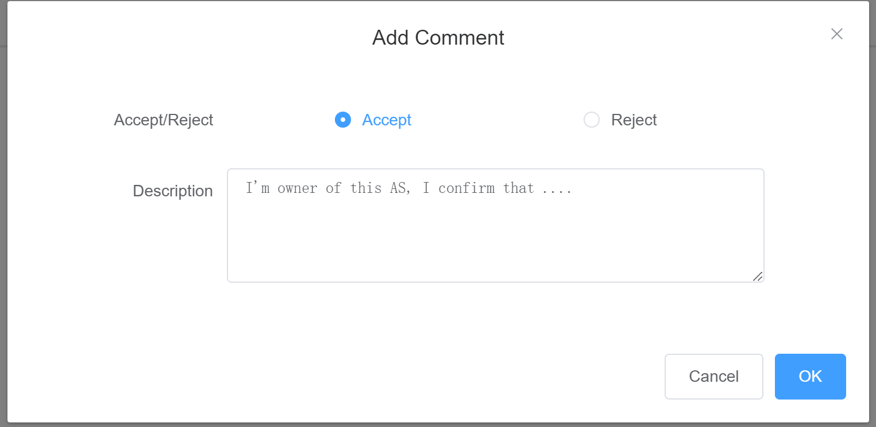
Quick Response, Event replay, Comments
Use RIS LIVE data
Notify users immediately when an event is detected, minimizing damage from hijackings
Event replay can help users understand the procedure, and analyze the extent of the impact of the event
Comments from users can help improve the platform
23
Notes:
The platform can response quickly, use RIS LIVE data, 2 minutes delay.
Bgpwatch will alarm when an event is detected, minimizing damage from hijackings.
When an event happened, people always want to figure out how the event happened. To help network operators understand a BGP hijacking event, we implemented event replay functionality.
To be specific, we can view the routing trees from the vantage points to hijacked prefix throughout the event.
Through event replay, it is easy to understand how the BGP routing changes and analyze the impact range of the event.

Slide 24
Parallel Computing and Clusters to Handle Big Routing Data
There is a huge amount of routing data from RouteViews, RIS, CGTF.
We improved the system by Parallel Computing and Clusters.
RouteViews
Process Data
Kafka
Cousumer
Result
Cousumer
Process Data
Cousumer
RIS
Cousumer
Process Data
Cousumer
Cousumer
CGTF
Process Data
Cousumer
Cousumer
24

Slide 25
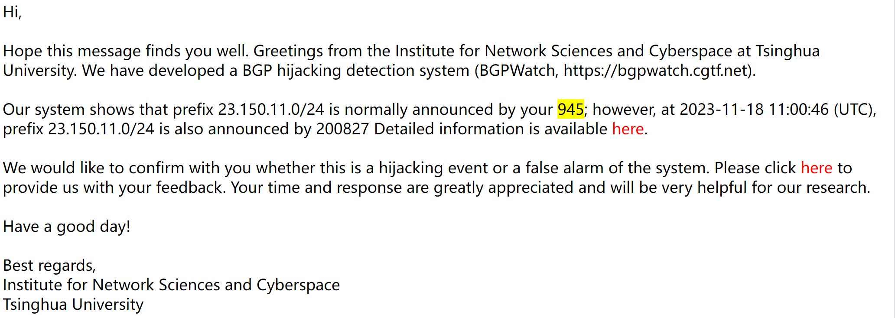
Subscribe Hijacking Events for AS and Send Alarm
25

Slide 26
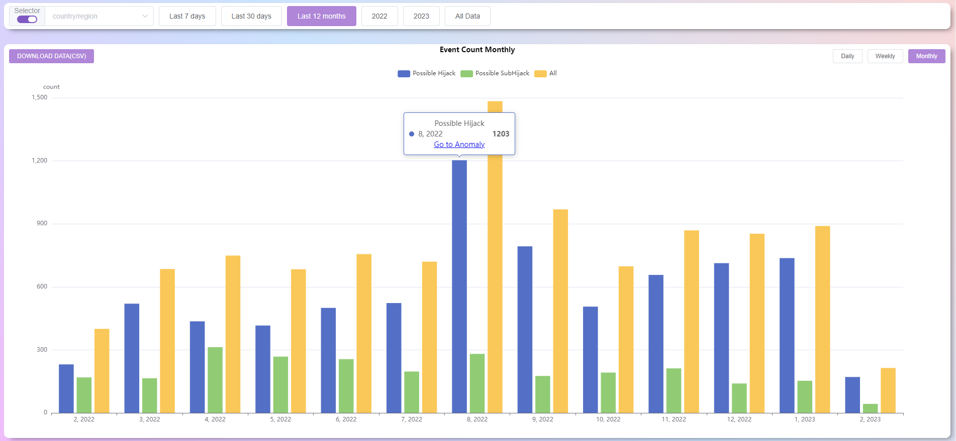
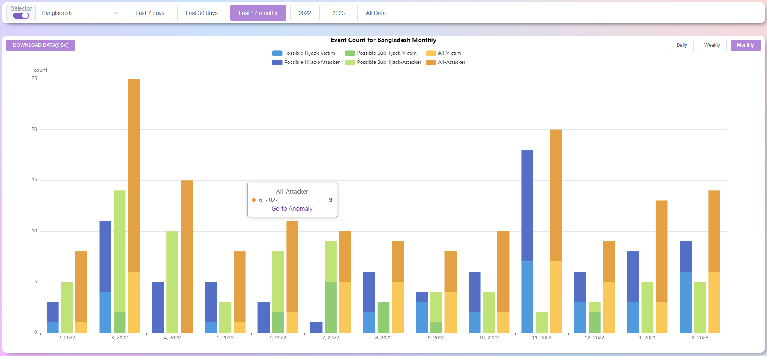
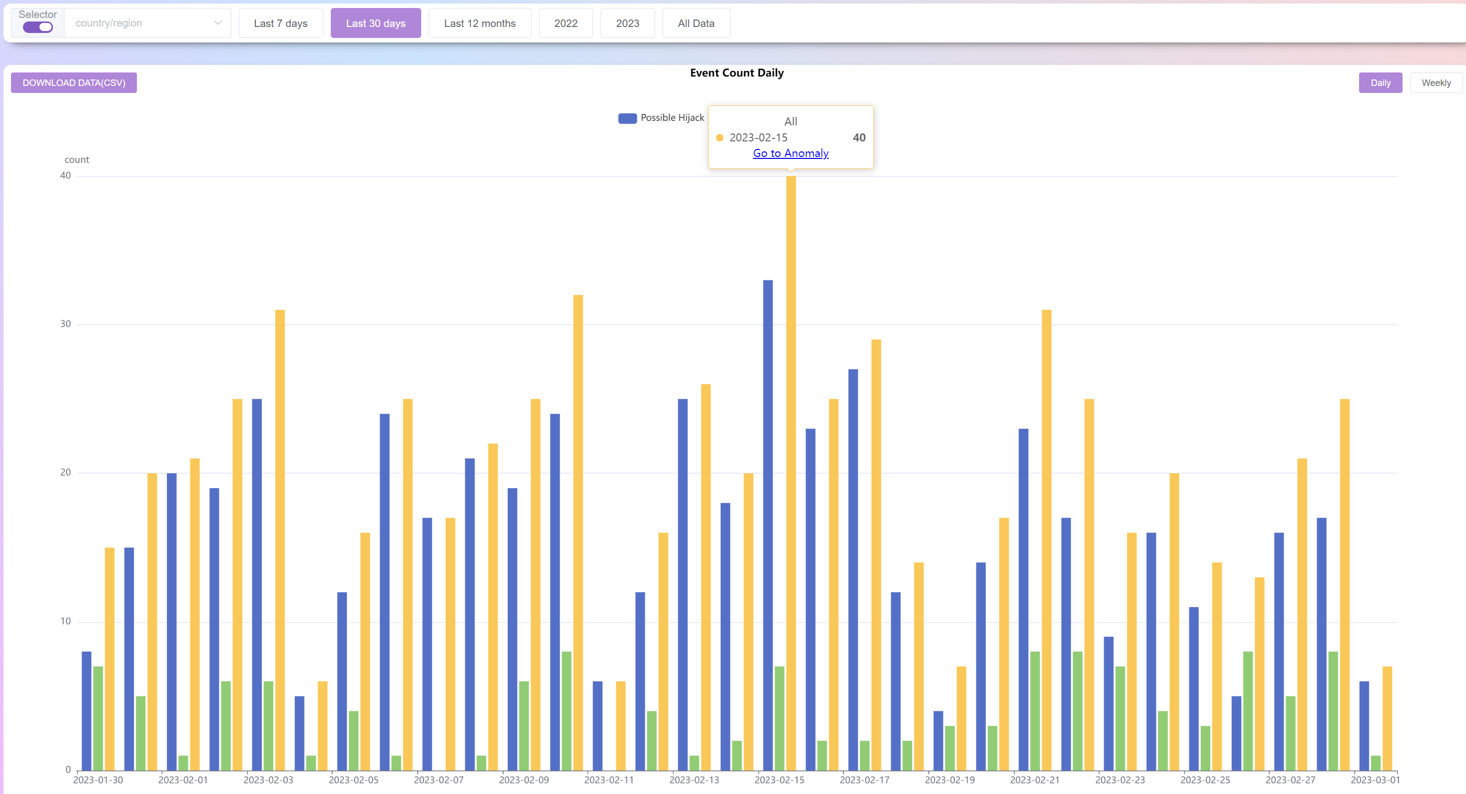
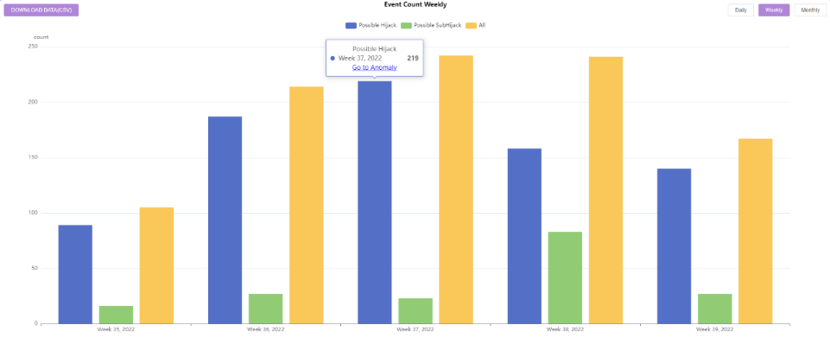
Overview--Statistics for Anomaly Events
Do statistics by economy, AS,
and by yearly, monthly, weekly, and daily
26

Slide 27
Compare with other Platforms
 | BGPWatch | GRIP | BGPStream
Delay | 2 mins delay | 5 mins delay | More than 2 hours
Event replay | √ | × | √
Event statistical analysis | √ | × | ×
Event level evaluation | √ | × | ×
Benign MOAS report | √ | √ | ×
Email Alarm | √ | × | ×
Accuracy | High | Medium to High | Low
27

Slide 28
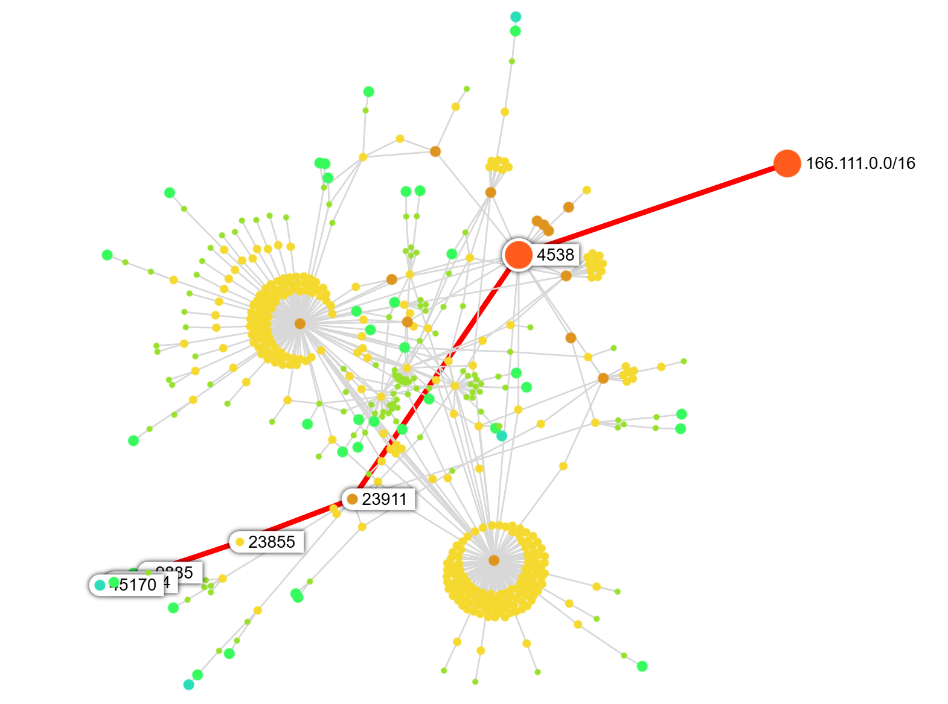
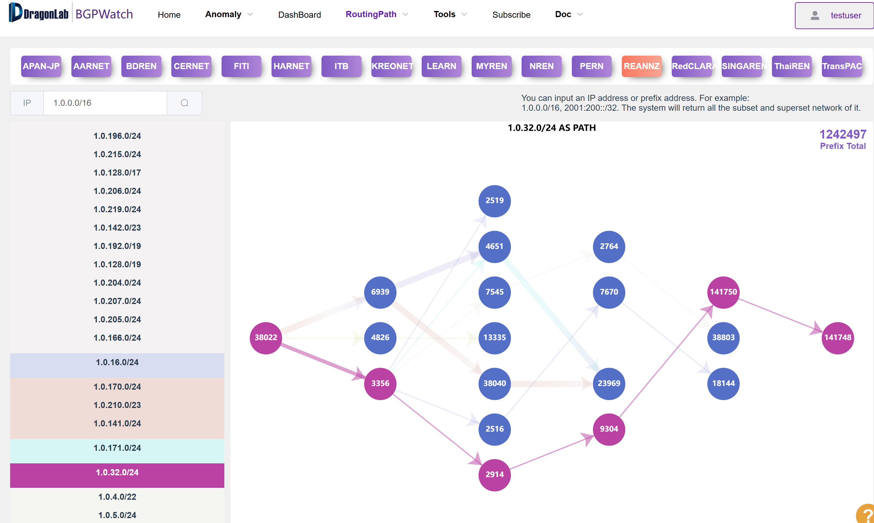
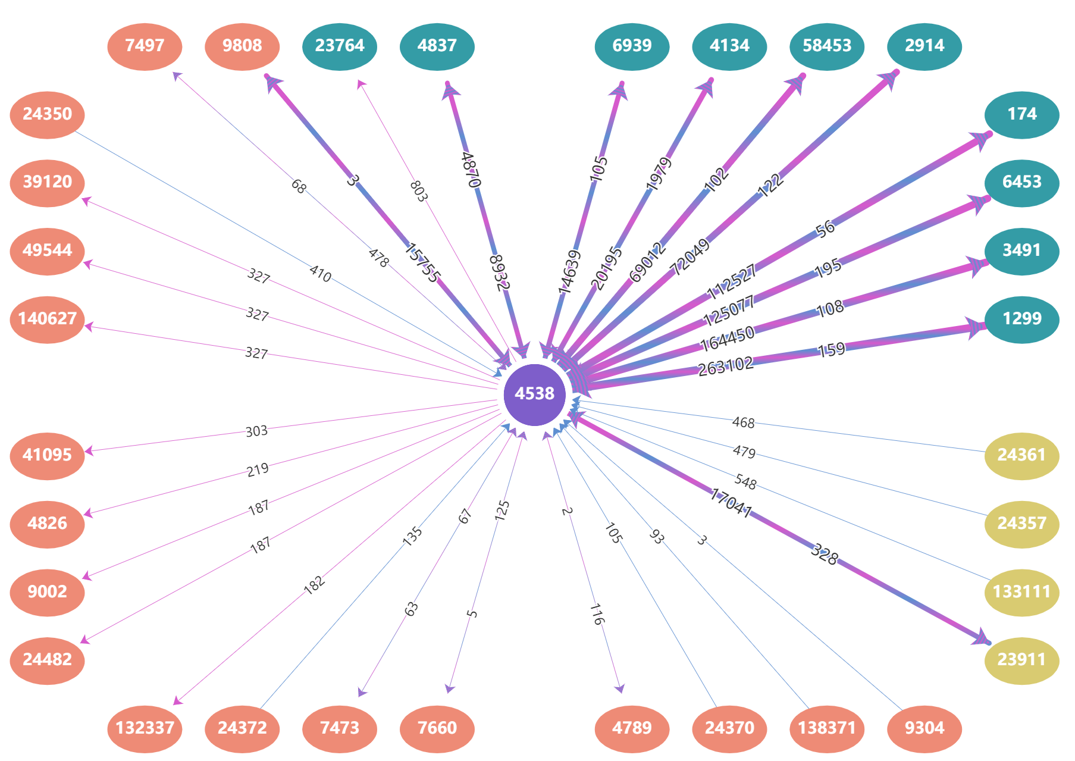
Tools for Network Operator
Dashboard: AS info, prefix, peers
Routing Search:
Aggregated forward routing path
Reverse routing path
Bi-direction routing path
Subscribing, Alarming
https://bgpwatch.cgtf.net
28

Slide 29
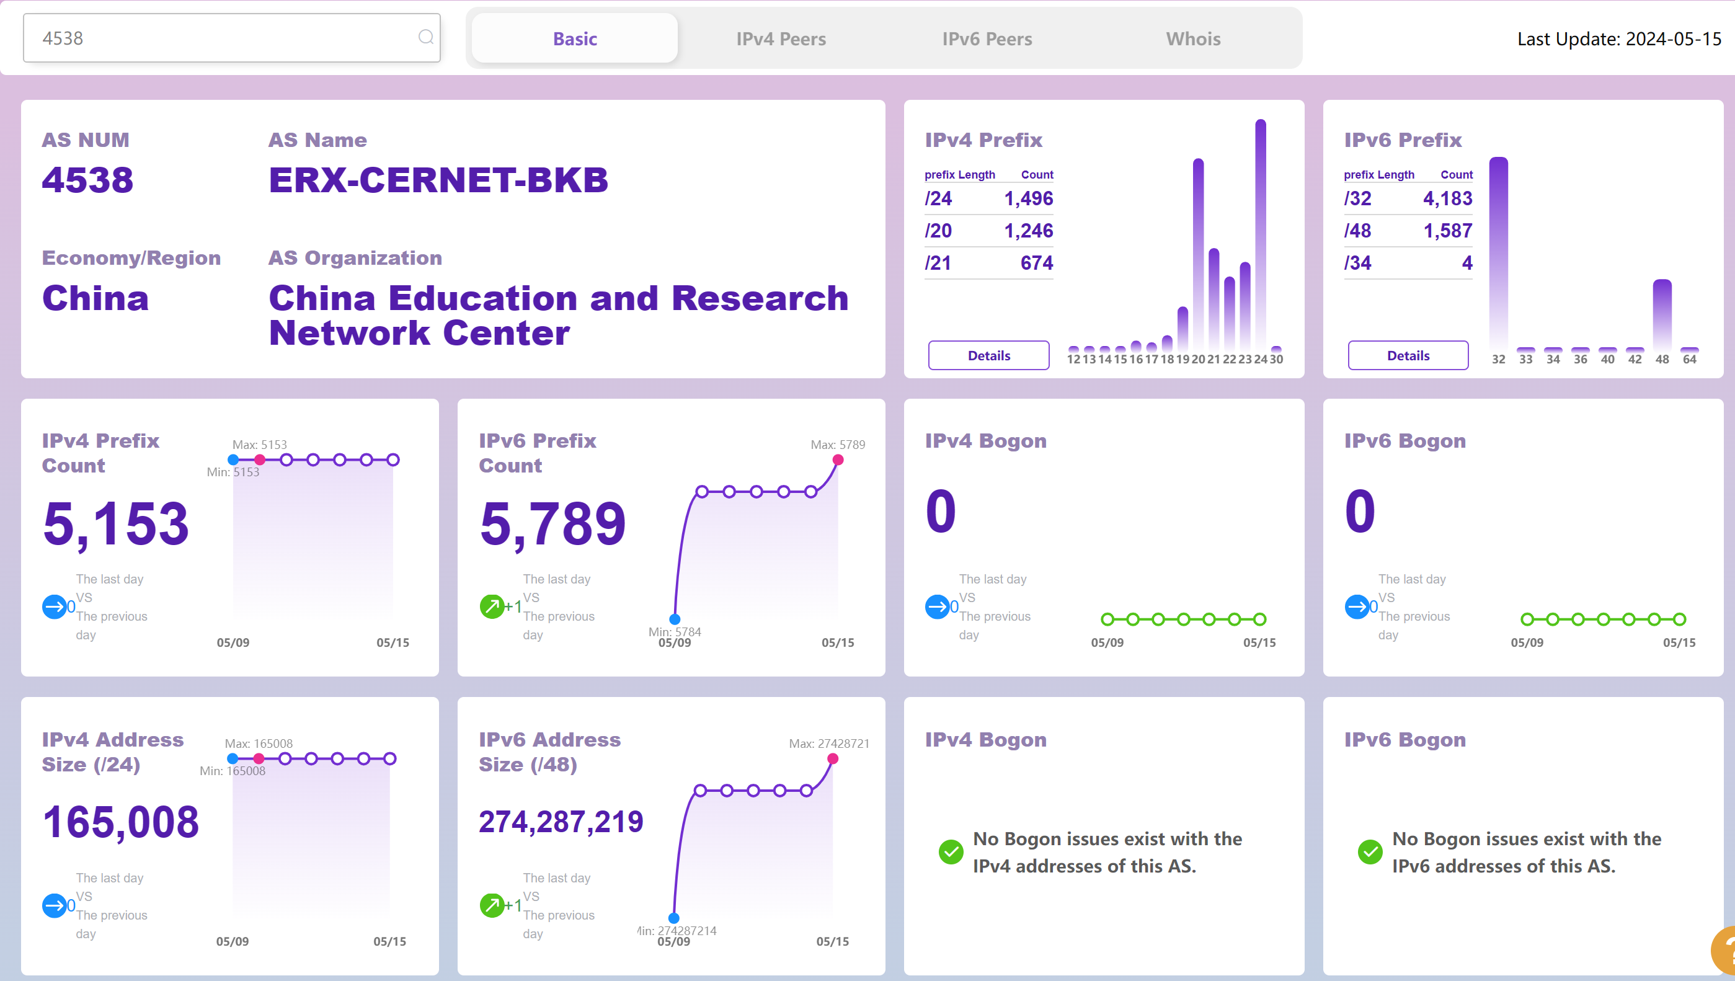
Dashboard
Search by
AS number, Organization name
29

Slide 30
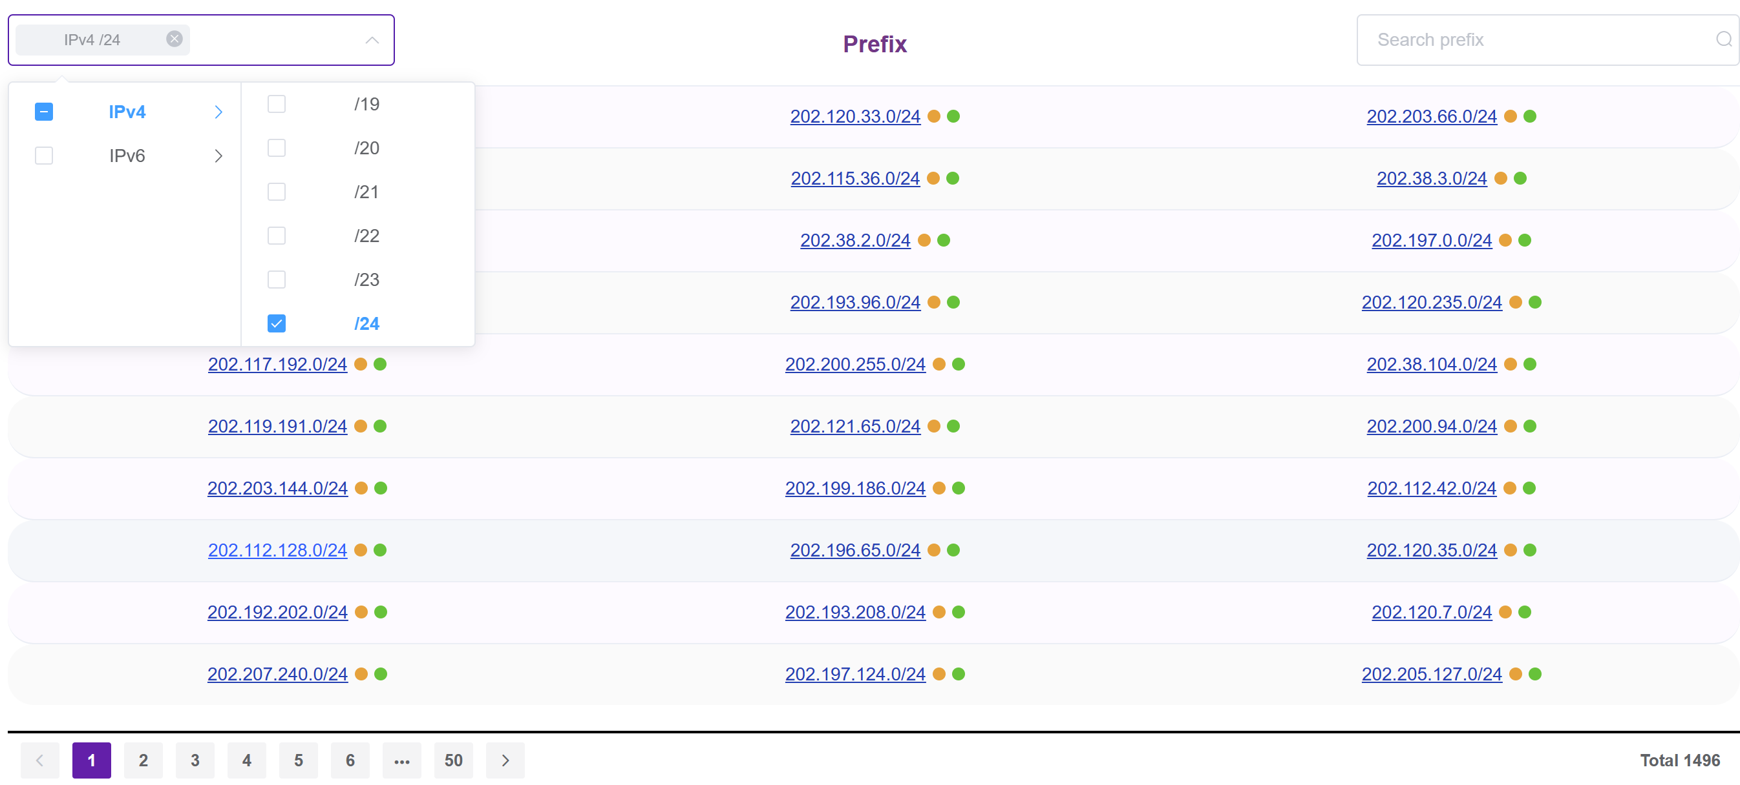
Prefixes Originated from the AS
Search
Select
ROA,
RIR status
30

Slide 31
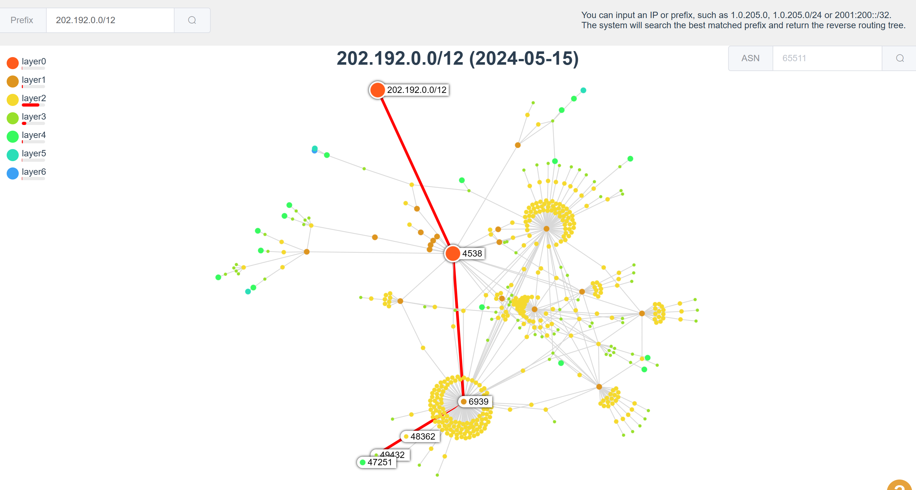
Reverse Routing Path
Support Prefix / IP, IPv4 / IPv6
The system will search the best matched prefix and return the reverse routing tree
With better interactivity
Click an AS or input AS number, the system will highlight the path to the AS
The number of layers to display can be selected
31
Notes:
How traffic is routed to your network, or how your traffic is routed to a destination from your network

Slide 32
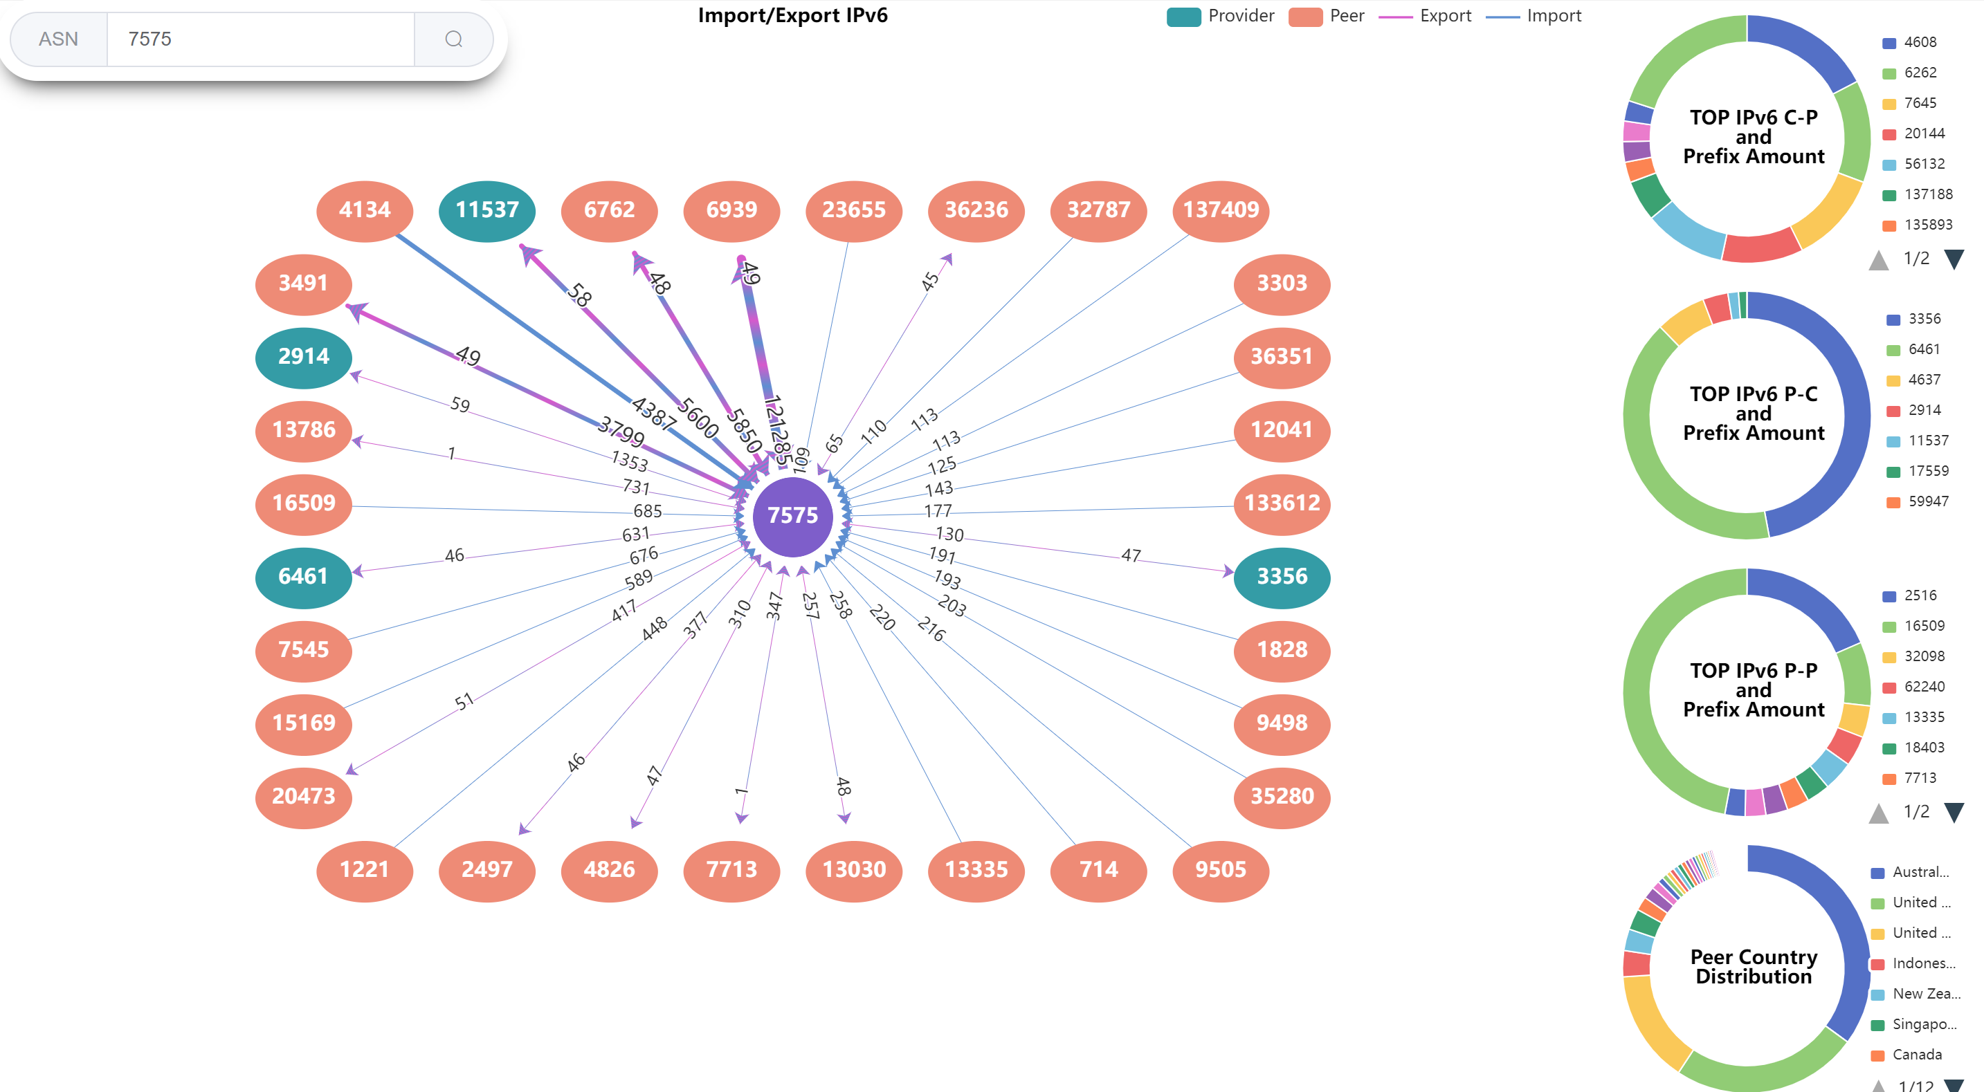
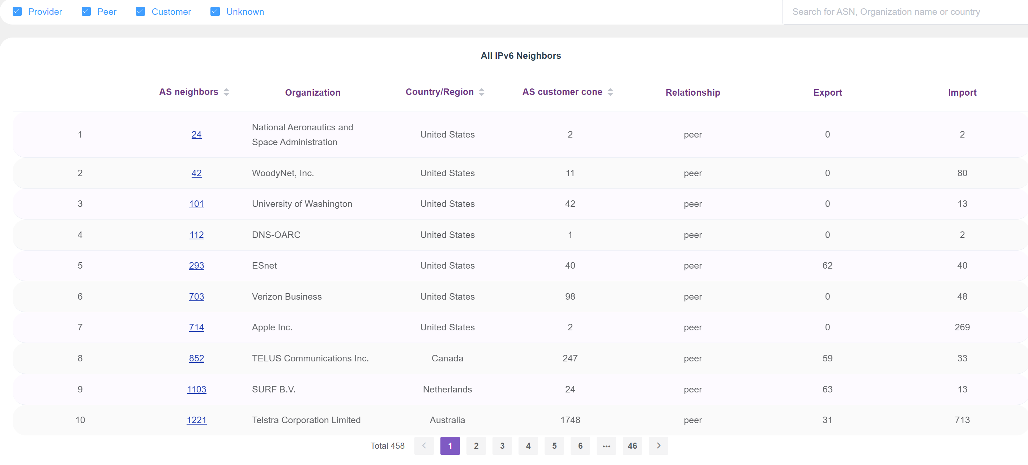
Dashboard: IPv4/IPv6 Key Peers and All Neighbors Information
Key Neighbors
All Neighbors
32
Notes:
INTUITIVE
PREFIX EXPORT/INPORT

Slide 33
Multiple Routing Path Search
Support Prefix / IP, IPv4 / IPv6
Return paths of all sub networks and super networks of the input prefix
Group prefixes with the same routing path
33
Notes:
Usually operator will search for the path of a prefix
For a routing query of a prefix, the system will only search the exact matched prefix, search and return routing paths of its sub networks and super networks, which is valuable for operators.
Also, it will group prefixes with the same routing path. So operators can see well organized information.
In the graph, when user search this prefix, there isn’t a exactly matched prefix, and the system returned some sub networks of it.
And prefixes with the same routing path are shown within a color block. When we click the color block, the corresponding path will be highlighted.

Slide 34
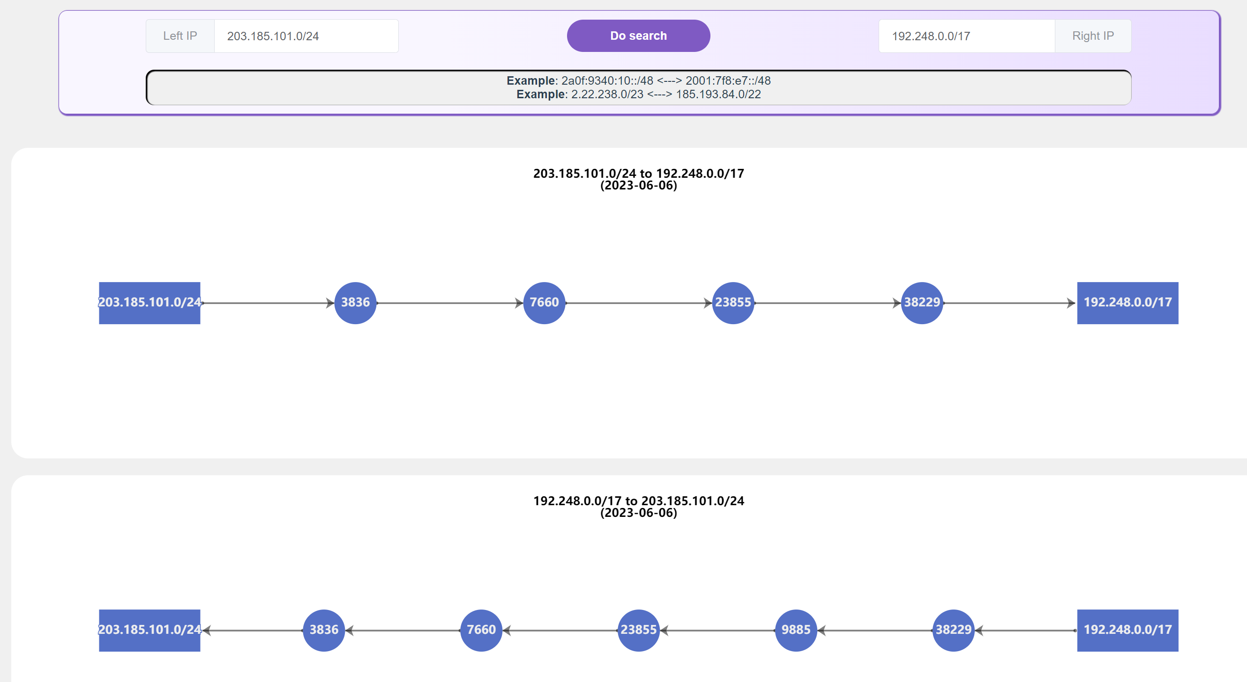
Bi-Routing Path
Left : 203.185.101.0/24, from ThaiREN
Right: 192.248.0.0/17, from LEARN
Support Prefix / IP, IPv4 / IPv6
Search the best matched prefix
34
Notes:
Not asymmetrical

Slide 35
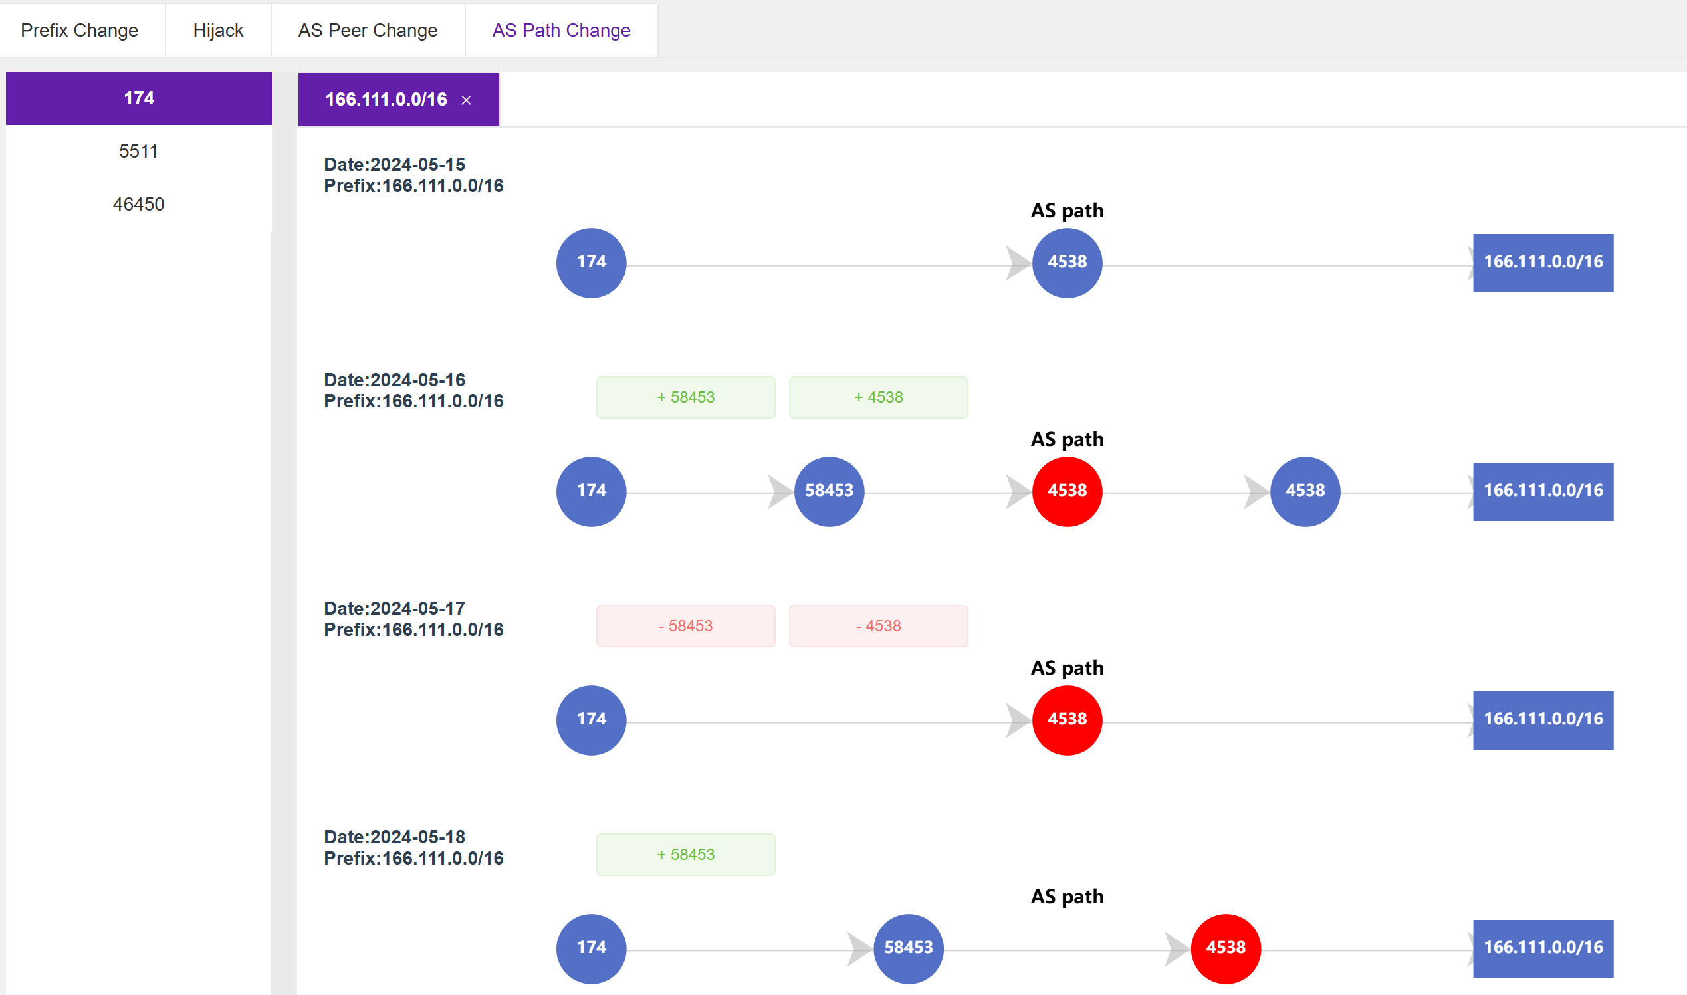
Path Change
35

Slide 36
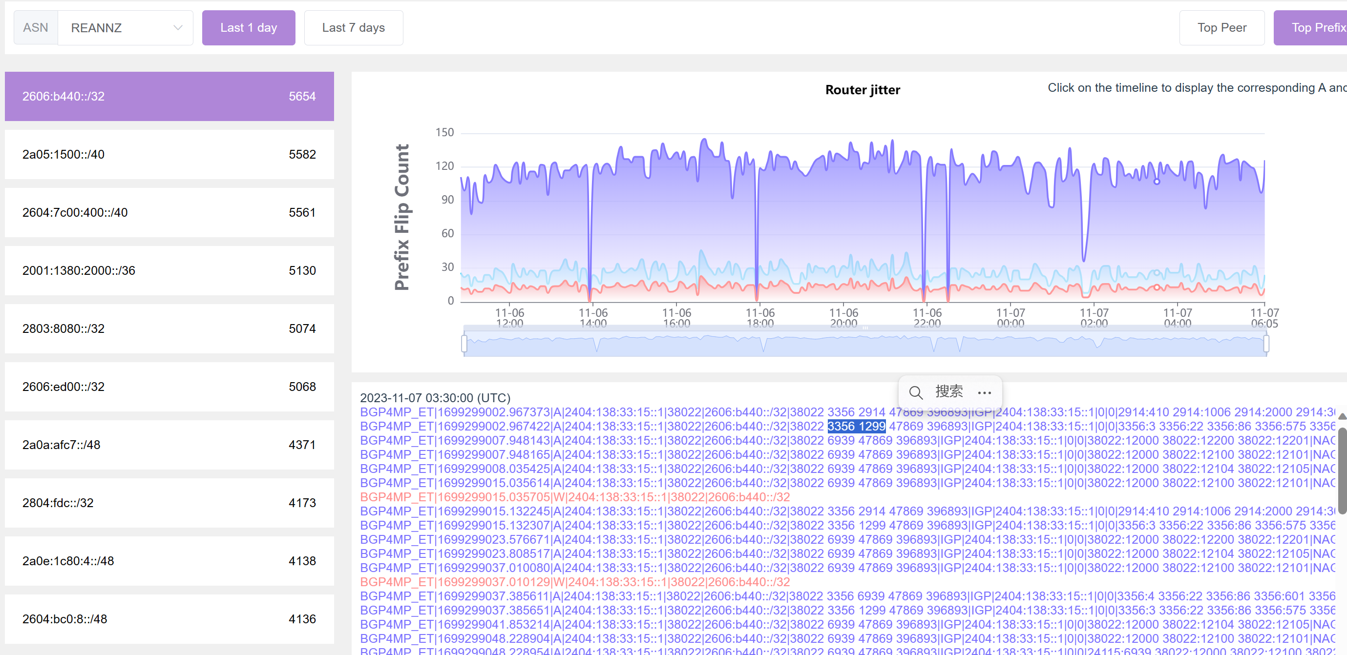
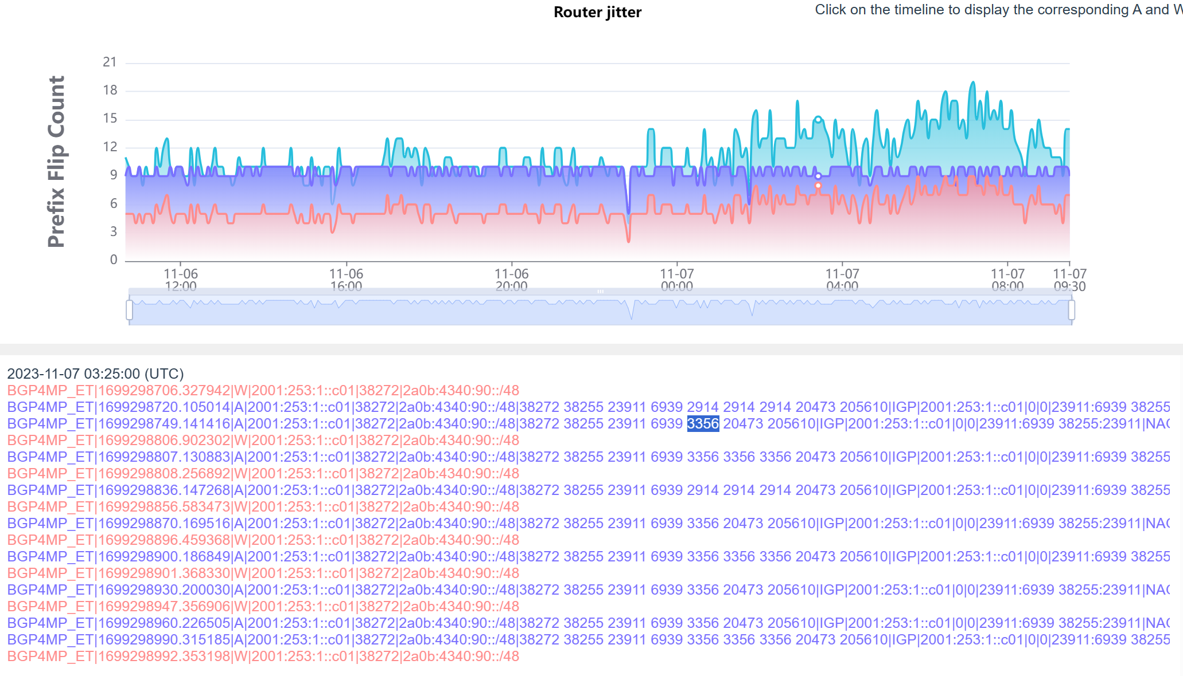
Router Jitter
The advertisement and withdraw messages are received frequently.
If this will harm internet performance?
We may conduct some data plane testing in the future.
36
Notes:
Investing the reasons

Slide 37
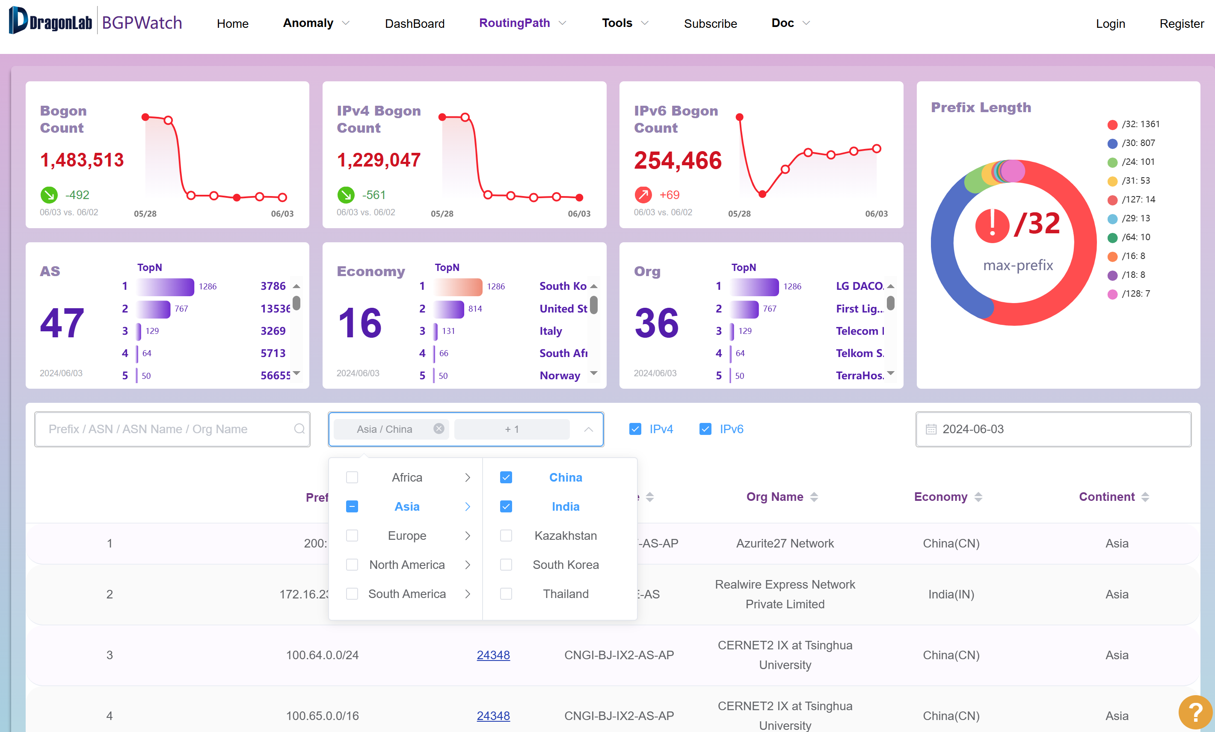
Bogon IP Address Detection
Support searching by continent, economy, AS
37

Slide 38
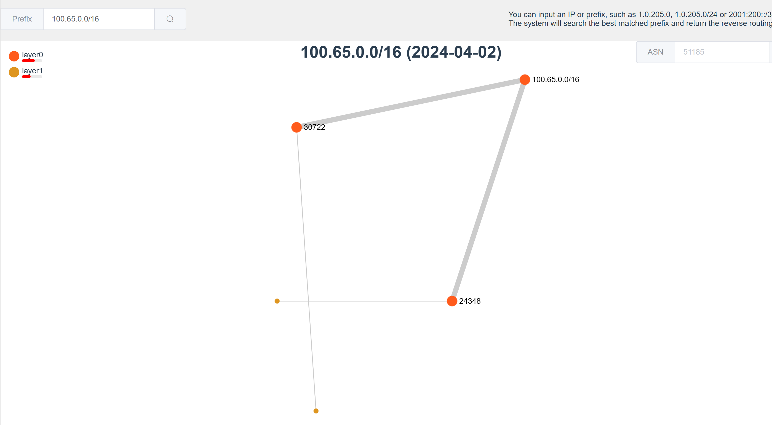
Propagation of the Bogon IP Address
38

Slide 39
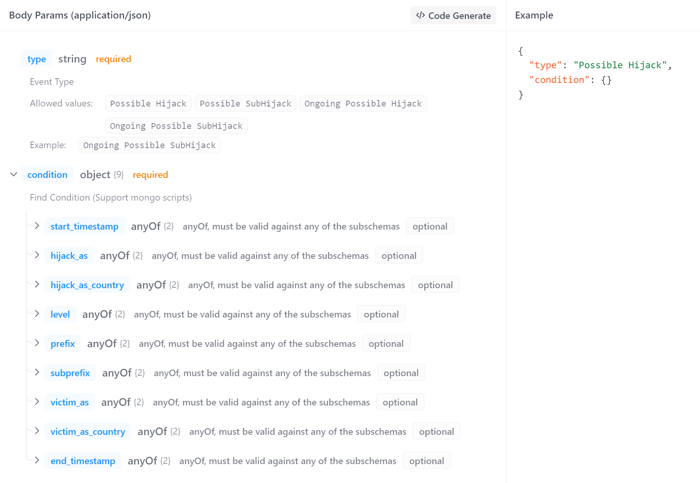
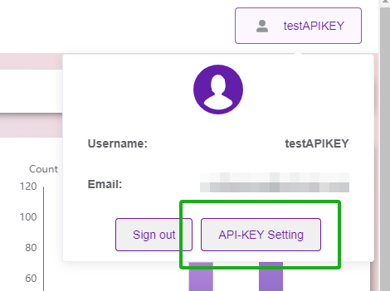
OPEN API
/get_event_by_condition
/get_event_detail
39
Notes:
Now we have developed 2 open API, one is get_event_by_condition, and one is …
For the first, there are the param you can specify.
For using the API, you need to first acquire the API KEY

Slide 40
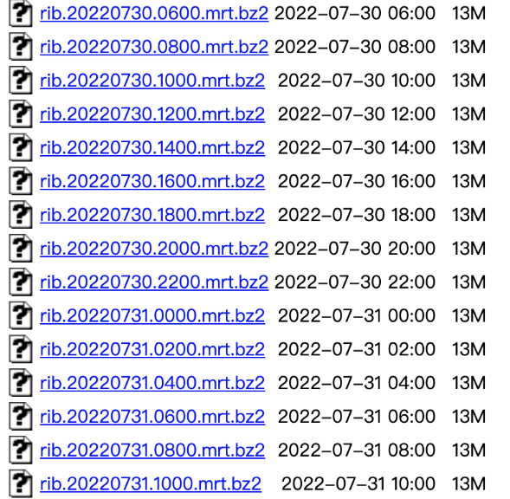
CGTF RIS
We have established BGP session with 16 partners.
Configuration manual can be accessed at
https://www.bgper.net/index.php/document/
https://bgp.cgtf.net
No. | Partner | No. | Partner
1 | APAN-JP | 9 | MYREN
2 | AARNET | 10 | PERN
3 | BDREN | 11 | REANNZ
4 | CERNET | 12 | SINGAREN
5 | HARNET | 13 | ThaiSARN
6 | ITB | 14 | TransPAC
7 | KREONET | 15 | NREN
8 | LEARN | 16 | RedCLARA
40
Notes:
CGTF RIS provide routing information sharing, it mainly focus on Asian pacific region .
Now CGTF RIS has established BGP peering with 16 ASes.
And the data and configuration manual can be accessed at the url

Slide 41
CGTF RIS Collector
Just have your border router establish an eBGP session with one of our collectors:
Our Collector ASN: 65534
Our Collector1 IPv4 address: 47.241.43.108
Our Collector1 IPv6 address: 240b:4000:b:db00:8106:7413:738f:e9ed
Our Collector2 IPv4 address: 203.91.121.227
Our Collector2 IPv6 address: 2001:da8:217:1213::227
Notes:
Partners can gain a better understanding of their network.
Help to identify problems in partners’ network.
Prompt research in Asia-Pacific Area.

Slide 42
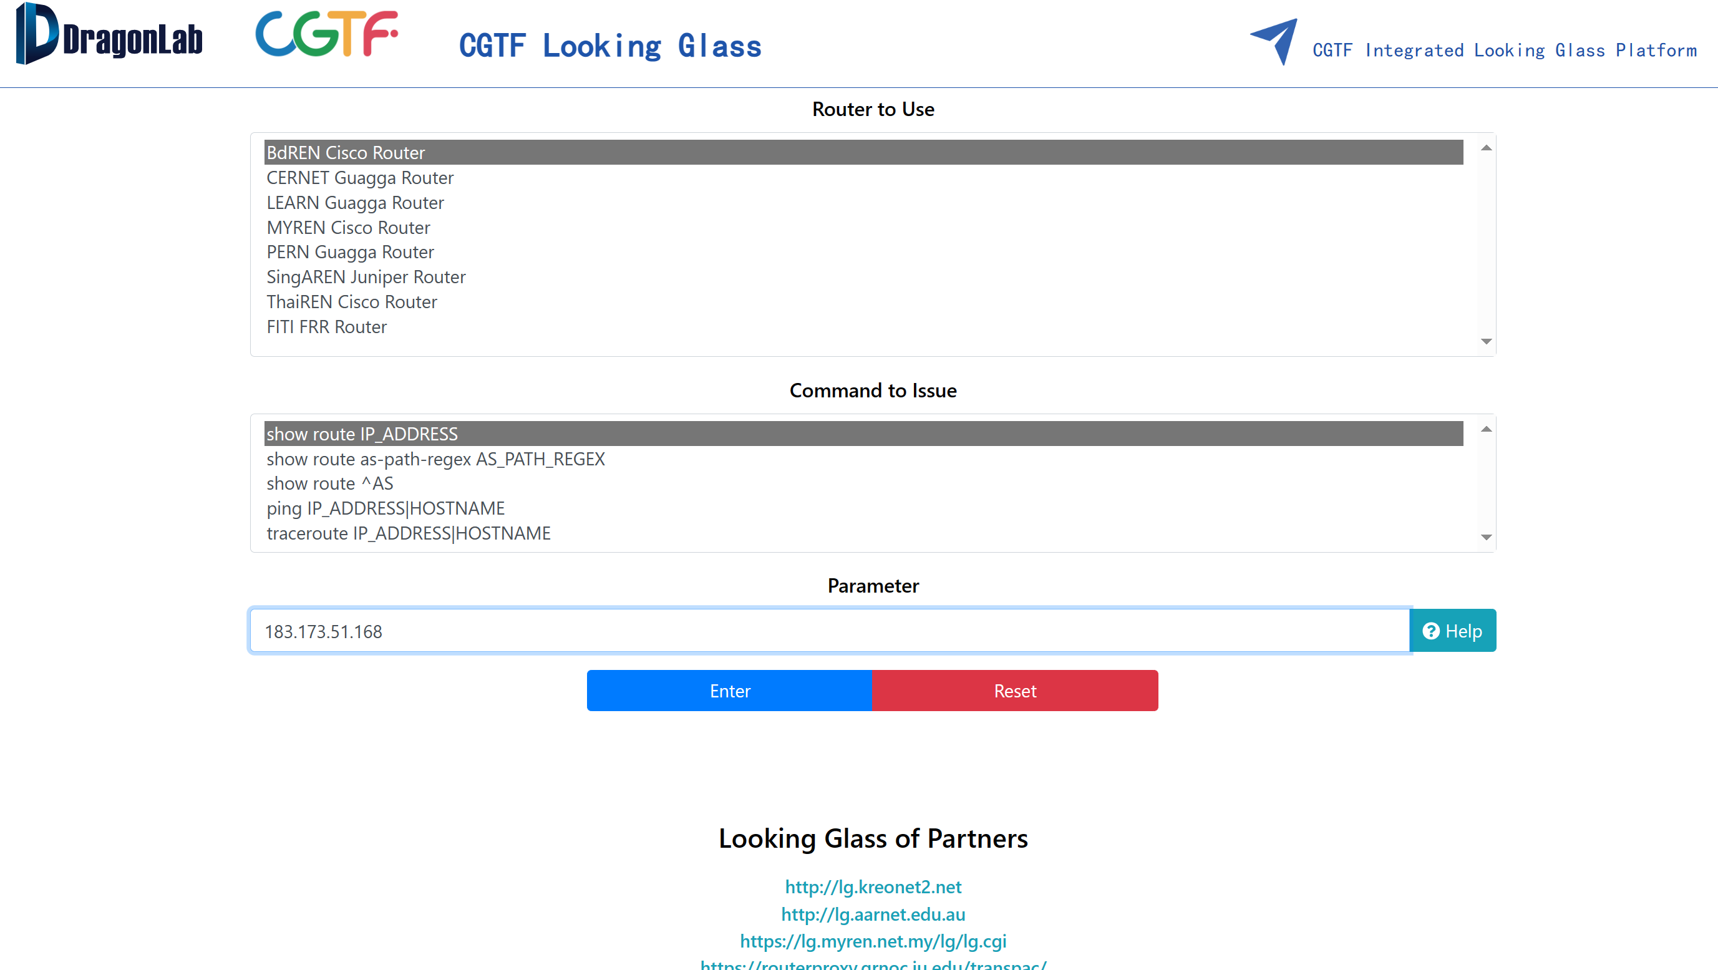
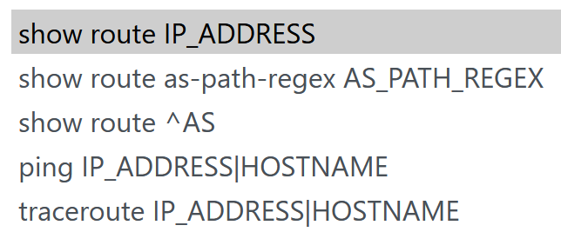
CGTF Looking Glass
Open Source:
https://github.com/gmazoyer/looking-glass
5 commands
Query speed limit for security
More partners is welcomed
https://lg.cgtf.net
Links to partners’ looking glass
7 Education & Research network joined
Links to Integrated Looking Glass Platform
42
Notes:
This is the web site of our looking glass platform
Now we have connected with 6 partners
And we also do query speed limit for security

Slide 43
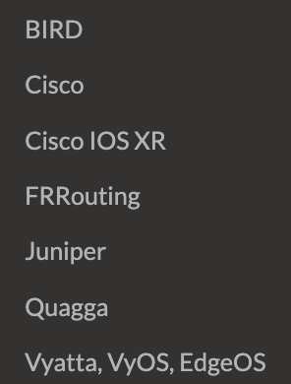
Configuration on Router Side
Create a router account only for LG, and this account only has privileges of executing the above command.
Use IP filtering mechanism. Add the web server IP to the whitelist.
Juniper JUNOS:
Define the login class with permissions:
set system login class lookinglass permissions network
set system login class lookinglass permissions routing
set system login class lookinglass permissions view
Define the login user:
set system login user lookinglass class lookinglass
set system login user lookinglass authentication encrypted-password "encrypted-text"
set system login user lookinglass authentication ssh-rsa "ssh-rsa rsa-pub-key-text"
https://www.bgper.net/index.php/document/
https://looking-glass.readthedocs.io/en/latest/
43
Notes:
We know that logging into the router is an operation that requires great caution. So we need do something to secure the router login. Following are some solutions:
We have currently tested it on the Jnuiper、FRRouting router. Here is our configuration for LG router account permissions and SSH key login：

Slide 44
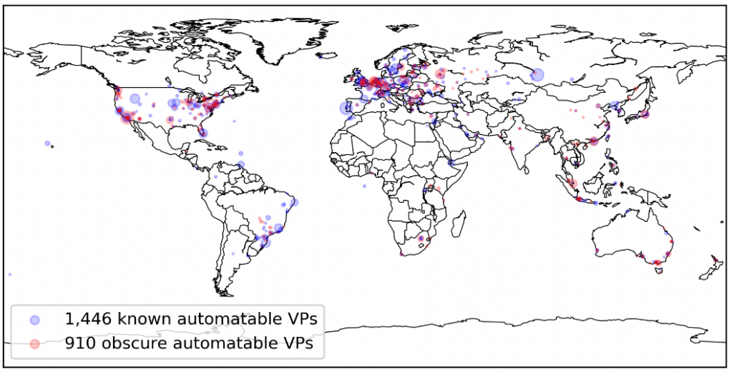
Open Looking Glass Vantage Point
Paper: “Discovering obscure looking glass sites on the web to facilitate internet measurement research”——CoNEXT’21
The 910 obscure VPs cover 8 exclusive countries and 160 exclusive cities, where no known LG VPs have been found before
The 8 countries are mainly distributed in East Africa and South Asia
https://github.com/zhuangshuying18/discover_obscure_LG
1,446 known LG VPs in 386 cities of 75 countries
910 obscure LG VPs in 282 cities in 55 countries
Periscope has found several hundred VPs (364)
44

Slide 45
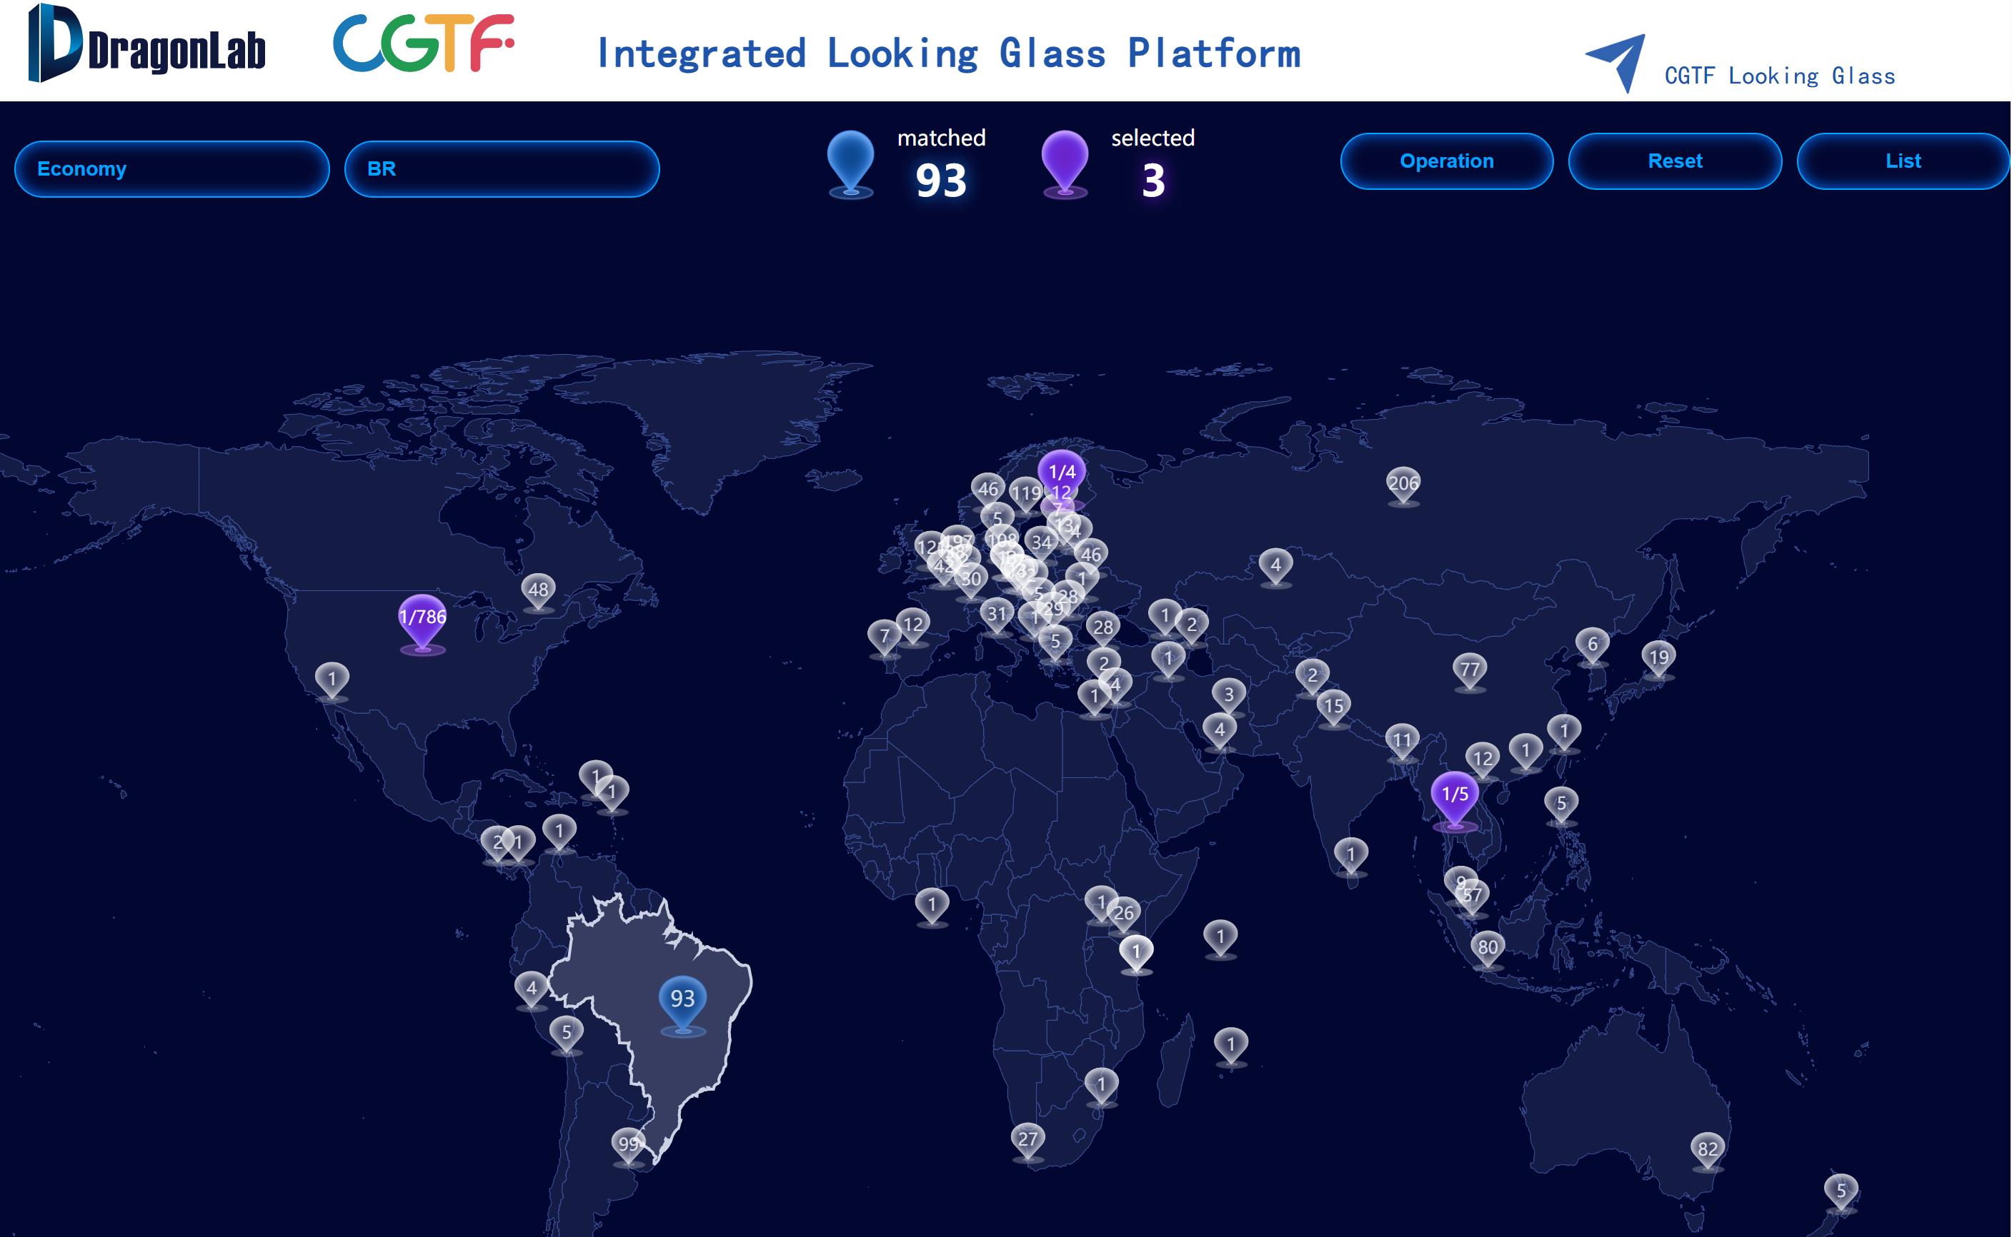
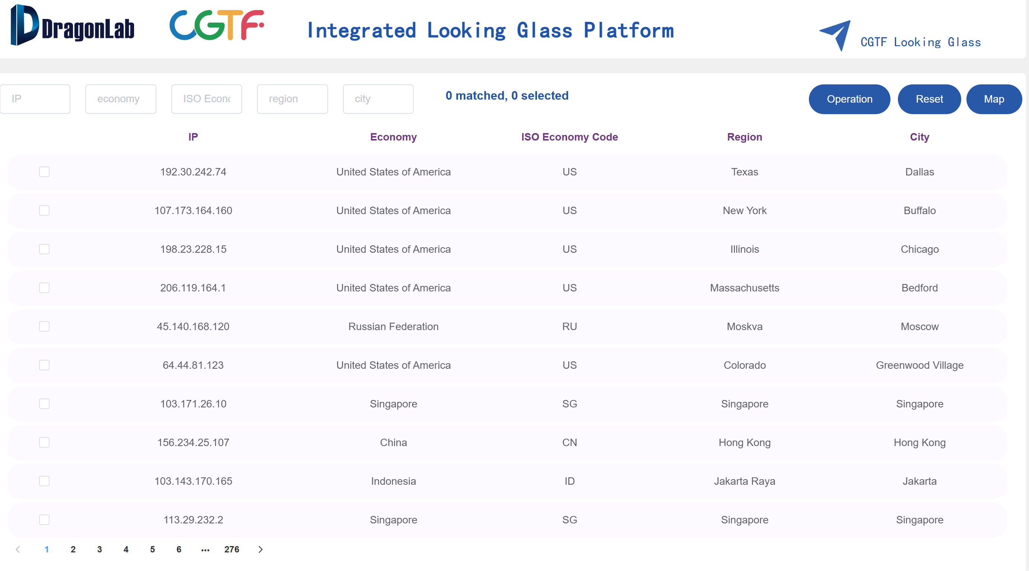
An Integrated Looking Glass Platform
45
https://gperf.cgtf.net/#/integrated

Slide 46
Security Concerns
Where are the data stored?
BGP sharing platform: Cloud server in Singapore
BGPWatch: Cloud server in Hongkong
Looking Glass: Cloud server in Hongkong
Will peering harm my network?
We use routing FRR[2] to simulate a real BGP router and it won’t send routing anouncement.
Will sharing routing information harm my network?
No, it’s common and useful. Routeviews and RIPE RIS are two most famous RIS sharing platform.
Our security policy doesn’t permit ssh/telnet access from other network
Such as SingAREN, they use a VM to simulate a router, and peer with their real router. Then our looking glass access to the VM.
46
Notes:
Ibgp is better

Slide 47
Future Work Plan
Objectives | Work Plan | Tentative Timeline
Develop an integrated Looking Glass platform | Find obscure Looking Glass VP regularly | Dec. 2023 Done
 | Develop integrated Looking Glass platform | Feb. 2024 Done
 | Develop Looking Glass API | Mar. 2024 Done
Use Looking Glass to further check routing hijacking at the data plan | Develop data plan detection method and decision algorithm | June 2024 Ongoing
 | Integrate the algorithm to the system | Aug. 2024 Ongoing
Implement path hijacking detection and routing leak detection methods | Develop path hijacking detection method | Nov. 2024
 | Develop routing leak detection method | Jan. 2025
Continue to maintain and fix bugs in the BGPWatch platform | Continually test and get suggestions from user | Throughout the entire project duration
Continue community development and engagement, and international collaboration | The second phase of the project (Dec.06, 2023 – June 06, 2025 (18 months)) Welcome new partners to join! | Throughout the entire project duration
47
Notes:
Ahead of schedule
Multipath
Best Path
Second best path
Routing integrity

Slide 48
Thank you
Any questions?
Contact us at: sec@cgtf.net
48

