Slide 1
Towards affordable high-performance 5G networks
A production-ready UPF based on RARE
David Franco
Asier Atutxa
Rennes, France
12 June 2024

Slide 2
Content
5G
RARE router
UPF implementation
Scenario under consideration
Conclusions

Slide 3
5G: vision
5G mobile subscriptions worldwide
Mobile broadband is the fundamental technology for interconnecting communities and individuals
5G will continue growing with more that 4.4 billion subscribers predicted by 2027*
The impact of mMTC
Notes: *Forecast
Source: Ericsson (2022), statista

Slide 4
5G: vision
Five tier one vendors
High CAPEX/OPEX
The market share is growing for "Other" vendors
Open-source solutions
Startups
More customizable and affordable products

Slide 5
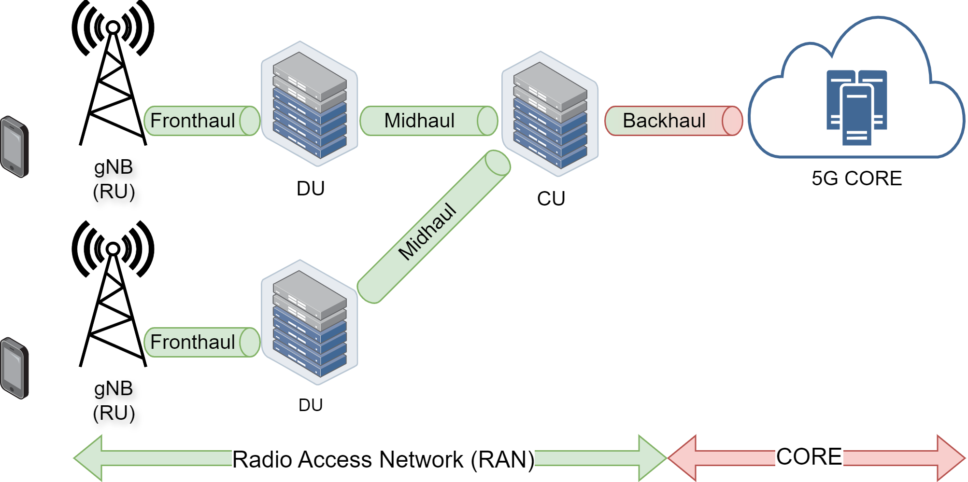
5G: architecture
Radio Access Network
Base station (gNB)
Function split (DU-CU)
Fronthaul/Midhaul links
Standard 5G RAN deployment

Slide 6
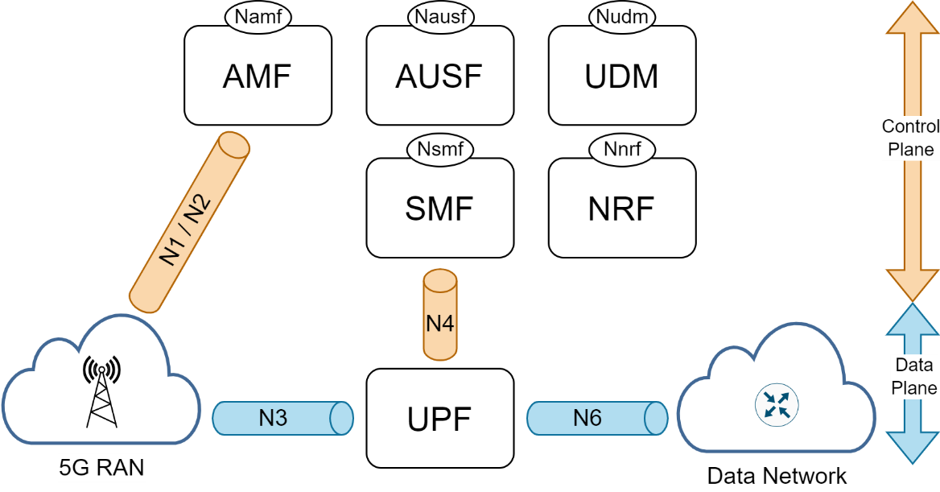
5G: architecture
5G core
Service Based Architecture (SBA) framework
A set of interconnected Network Functions (NFs) to provide:
the control plane functionality
common data repositories
NFs
Self-contained, independent and reusable
Expose services through well-defined interfaces: REST, QUIC
Standard 5G Core deployment

Slide 7
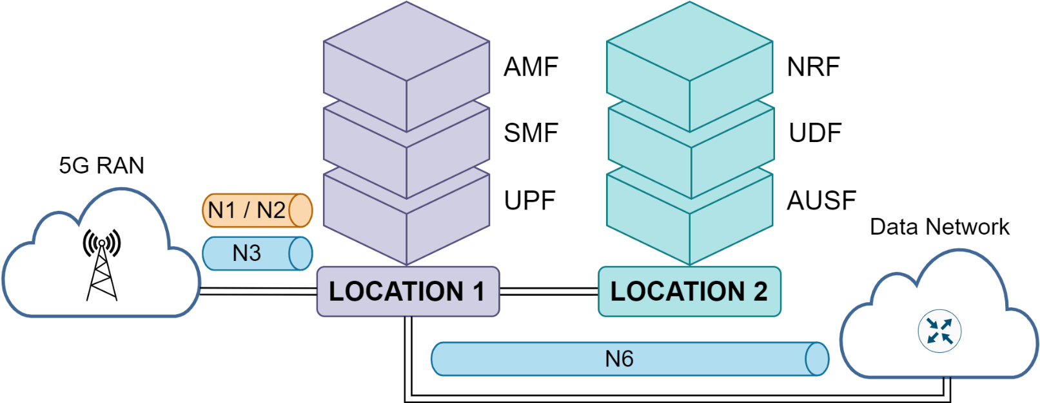
5G: deployment
Example of 5G deployments
5G containerization
NFs at different locations
Not all the configurations are possible

Slide 8
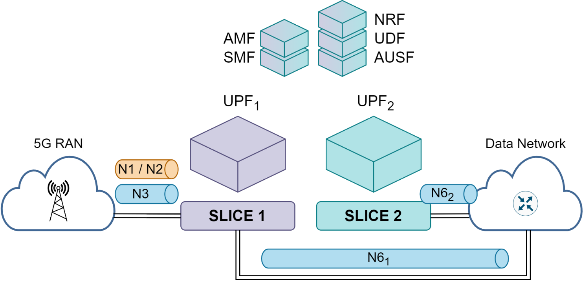
5G: deployment
Example of 5G deployments
5G slicing
Duplication of NFs
Each slice for a type of traffic (URLLCc, eMBB, mMTC)

Slide 9
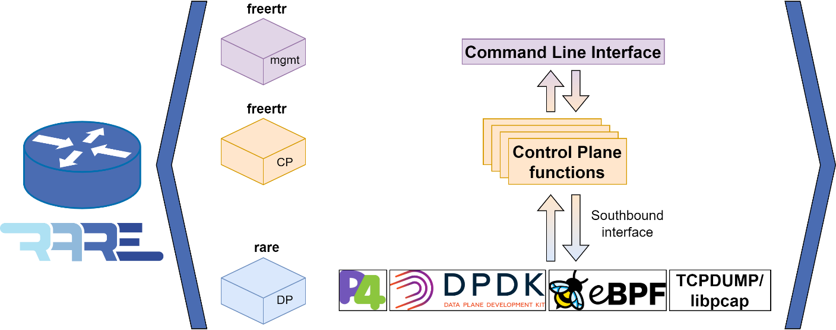
RARE router
Router for Academia, Research & Education (RARE)
Production ready routing and switching functionalities
GEANT 5th programme
Control and data plane separation
Control plane: freertr
Data plane: rare
Programmable data plane
P4, DPDK, XDP, libpcap

Slide 10
RARE router
Functionality
Routing & forwarding
IP, LLDP, VLAN, MPLS, BGP, OSPF, BFD
Tunneling
GRE, L2TP, VXLAN, GTPv1, IPsec, MACsec, wireguard, openvpn
Management
Telnet, SSH
Performance
Tested at 100 Gbps (Tofino ASIC)
Tested at 400 Gbps (Tofino2 ASIC)

Slide 11
UPF implementation in RARE
Target
Provide a standalone UPF
Motivation
Affordable UPF solution
Enhance the performance between the RAN and the Data Network (DN)
More users
Higher data rate
Lower delay/jitter

Slide 12
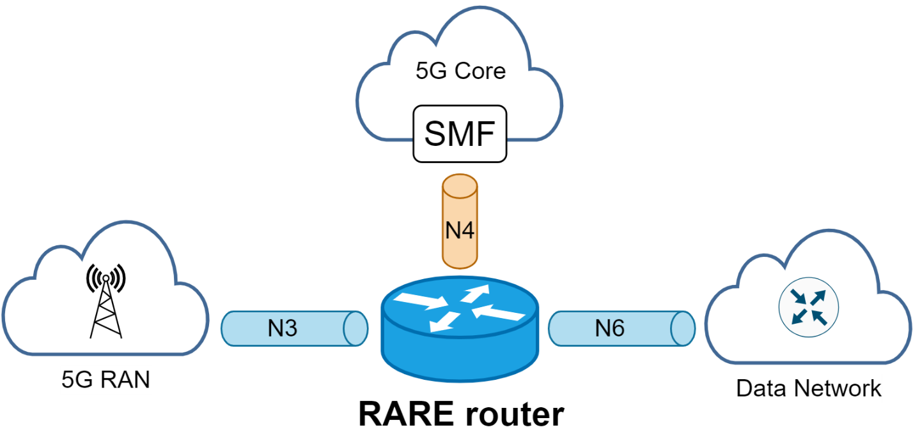
UPF implementation in RARE
Implementation
N5 interface: PFCP protocol (tested)
N3 interface: GTPv2 protocol (ongoing)
N6 interface: IP protocol (already available)

Slide 13
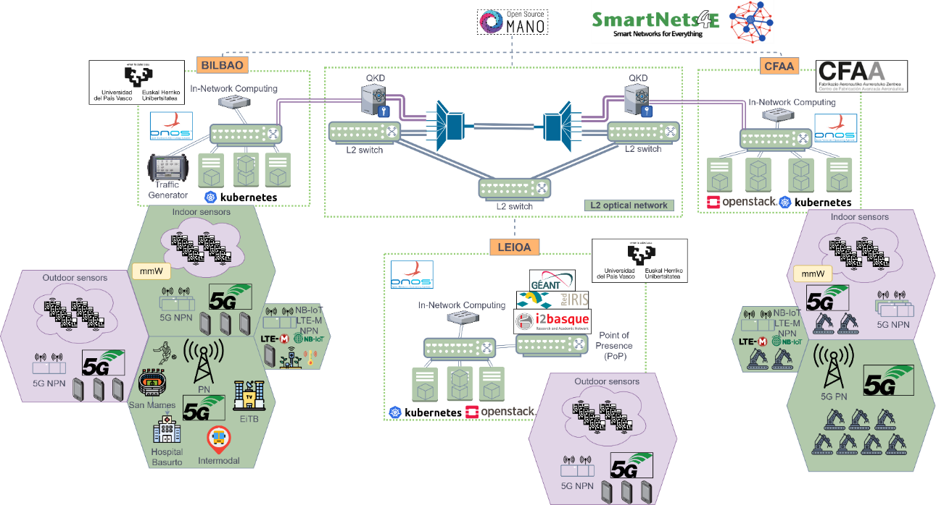
Scenario under consideration
Smart Networks for Everything (SmartNets4E¹)
An infrastructure for network research
Three nodes interconnected at 100G
Research resources for 5G/6G in different verticals
Advanced manufacturing (CFAA node)
Health, education, transportation and mobility (BILBAO node)
Integrated into the ESFRI SLICES-RI
Collocated with GEANT’s PoP (LEIOA node)
¹ https://i2t.ehu.eus/en/resources/smartnets4e

Slide 14
Scenario under consideration
SmartNets4E: BILBAO location
Computing nodes
Commercial and experimental 5G NPN
Quantum Key Distribution (QKD) equipment
Secure communication between CFAA and BILBAO
Network analysis and testing equipment:
Traffic generator
Impairment generator
Experimental P4 network

Slide 15
Scenario under consideration
SmartNets4E: CFAA location
Advanced manufacturing R&D
Indoor commercial 5G NPN (mmWave)
Experimental 5G NPN
LTE-M and NB-IoT support
IIoT sensor network
Quantum Key Distribution (QKD) equipment
Secure communication between CFAA and BILBAO

Slide 16
Scenario under consideration
SmartNets4E: LEIOA location
Interconnection site
GEANT PoP
RedIRIS PoP
Computing nodes
Outdoor commercial 5G NPN
Campus network

Slide 17
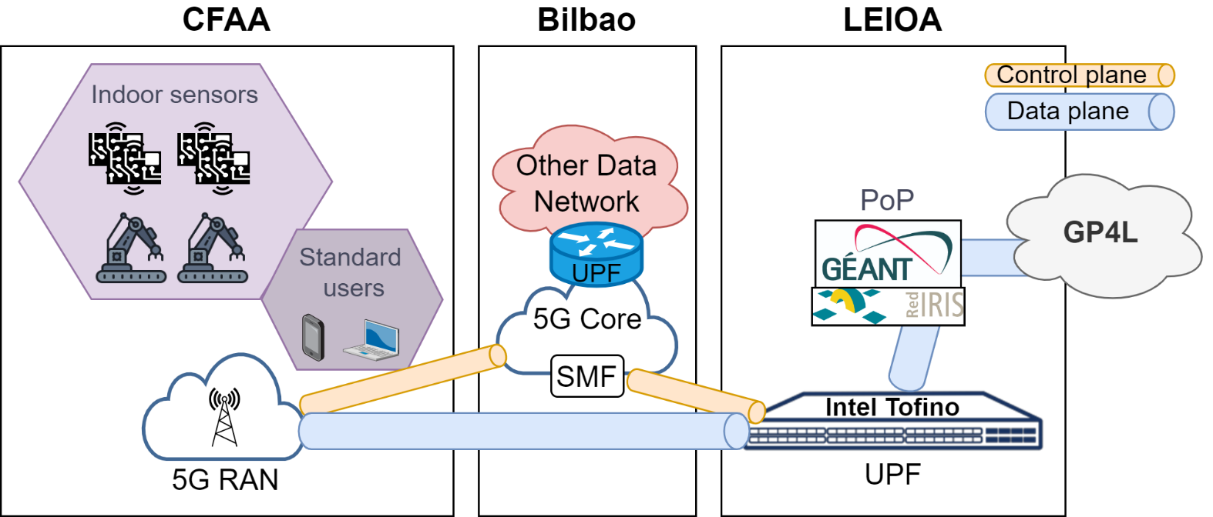
Use case
The role of RARE-UPF
The scenario in our research infrastructure

Slide 18
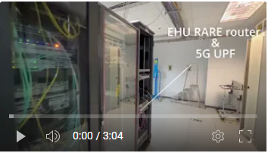
Use case
Video:
SmartNets4E : the 3 locations of the experimentation facility
5G and RARE infrastructure
PFCP implementation in RARE

Slide 19
Conclusions and next steps
Conclusions
High-performance user plane for 5G core network
Multi-UPF scenario
Next steps
Performance tests
Implementation of other 5G entities: SMF, N3IWF, etc.
Remote access and management tools

Slide 20
Thank you
Any questions?
david.franco@ehu.eus
asier.atutxa@ehu.eus

