Slide 1
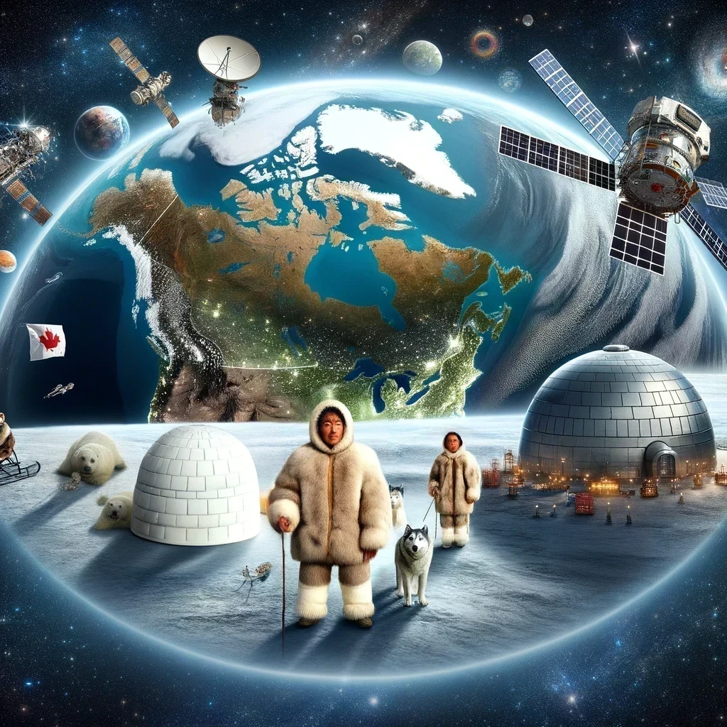
RENDEZ-VOUS AT THE EDGE OF THE EARTH. Harnessing LEO technology for Inuit knowledge sovereignty & resilience.

Slide 2
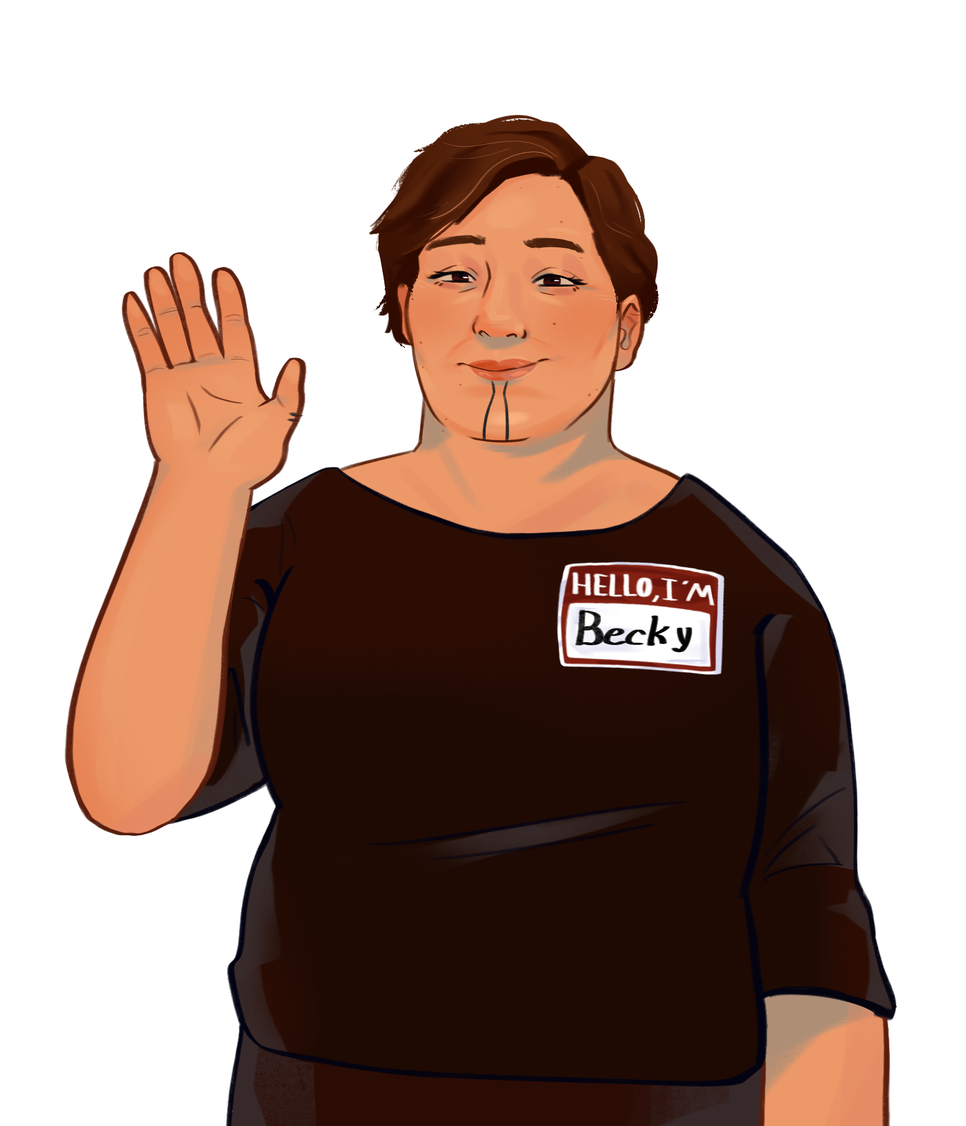
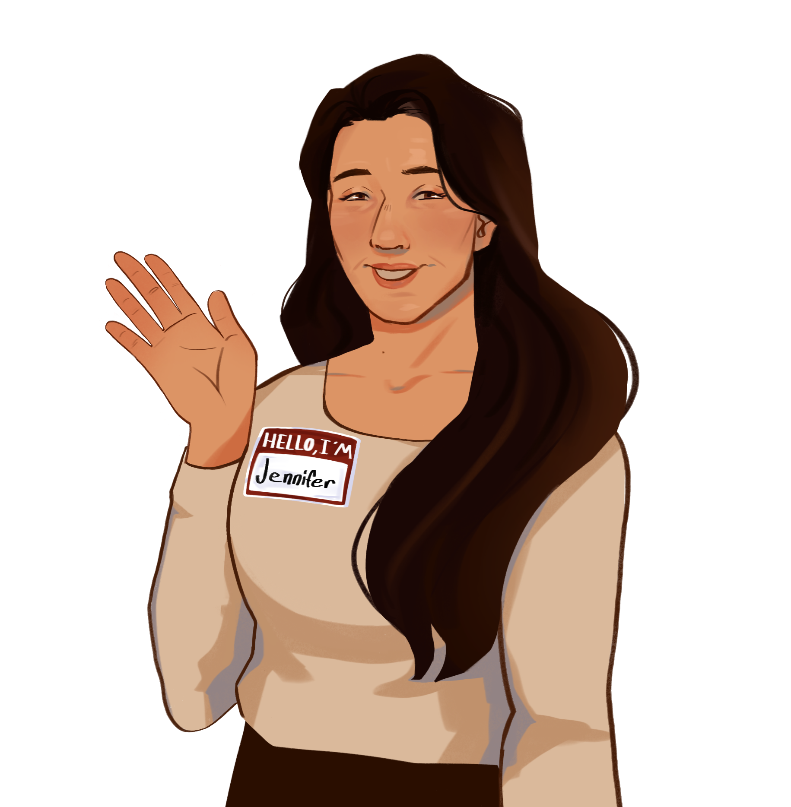
ᐅᓖᐱᑲ ᒨᓐᔅ
ᔭᓂᕗ ᓚᐃᓐ
Notes:
Rebecca: Ullukkut, Rebecca Mearns-ngujunga, Inuujunga .Panniqtuuq Nunavummi Scotlandmillu pirurnikuujunga. Maannali Iqalummiutauliqtunga, taikani iqanaijaaqarama, Nunavut Silattuqsarvingani Angijuqaarijaujunga. Good day, everyone. I’m Rebecca Mearns, I am Inuk, I grew up both in Panniqtuuq, Nunavut and in Scotland. I now live and work in Iqaluit, Nunavut, where I am the President of the Nunavut Arctic College.
Jennifer: And I’m Jennifer Lane and I am Metis Canadian and Barbadian. I moved to Nunavut 8 years ago where I now works as the Chief Information Officer at Nunavut Arctic College and Governance Committee Member on the National Research and Education Network of Canada We both mention this, because where we live, where you come from and your lived experience, it matters, and it has the potential for both positive and negative lasting impacts.
We’re here to share a story with you on our Journey of connecting researchers, students and educators in Nunavut to the National research and education network of Canada. A network which has been in operations for over 20 years, and Nunavut was the last member to join.
Click slide

Slide 3
Notes:
Jennifer: Often when people think of the Arctic, they tend to think of this. But what they do not realize is this is just a small part of a much bigger, beautiful and more resilient picture. So to give context to this talk we are about to have, let us show you Nunavut, Canada.
Click

Slide 5
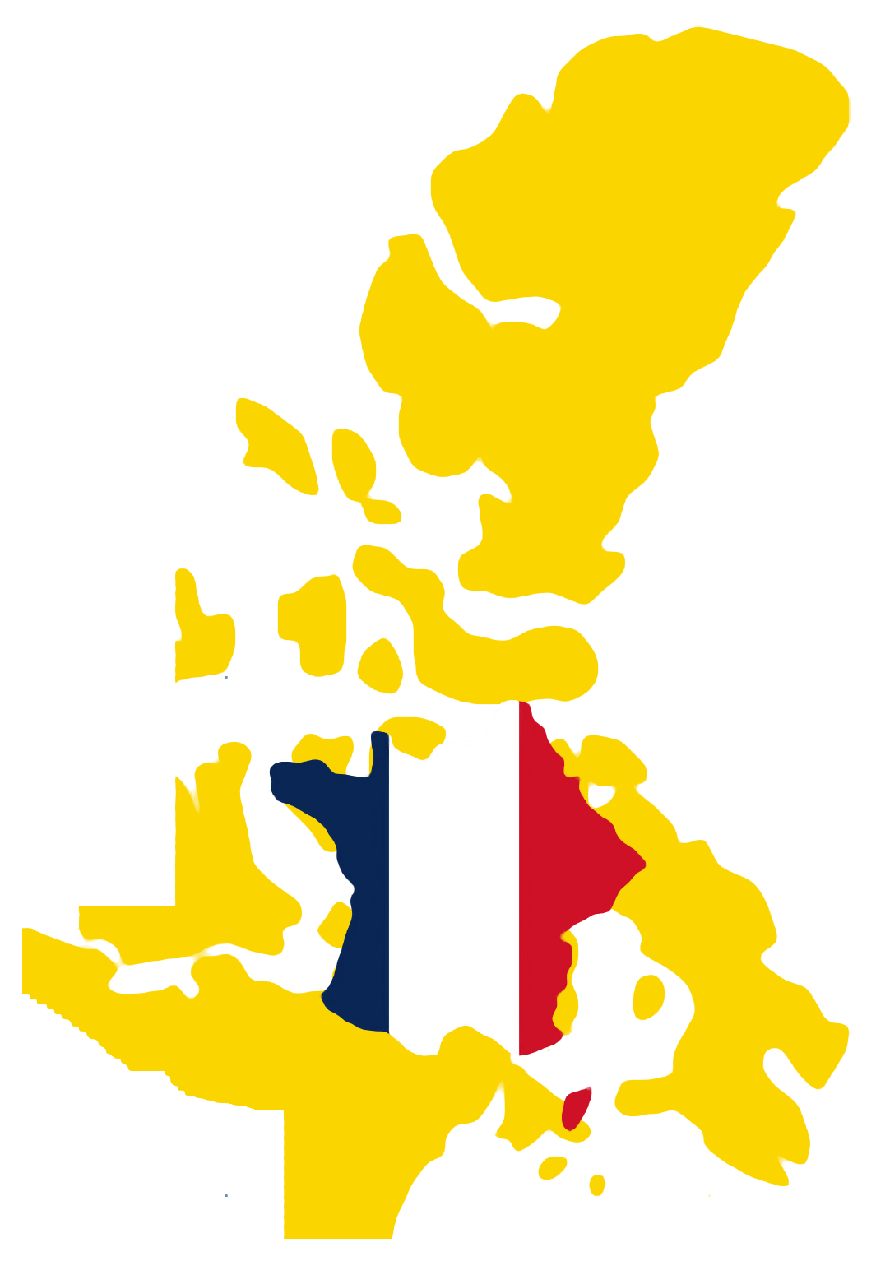
NUNAVUT
2,093,190 square kilometers
FRANCE
551,695 square kilometers
Notes:
Becky: As you could see in the Video, Nunavut is one of the most remote regions on Earth, with a vast land area of over 2 million square kilometers that is 3.8 times bigger than france. We have 48,000 residents, 89% of which are Inuit. Once a traditionally nomadic society is now settled across 25 Communities, our ability to be connected and pass on traditions is pivotal in ensuring we do not lose sight of who we are as a people.
Click

Slide 6
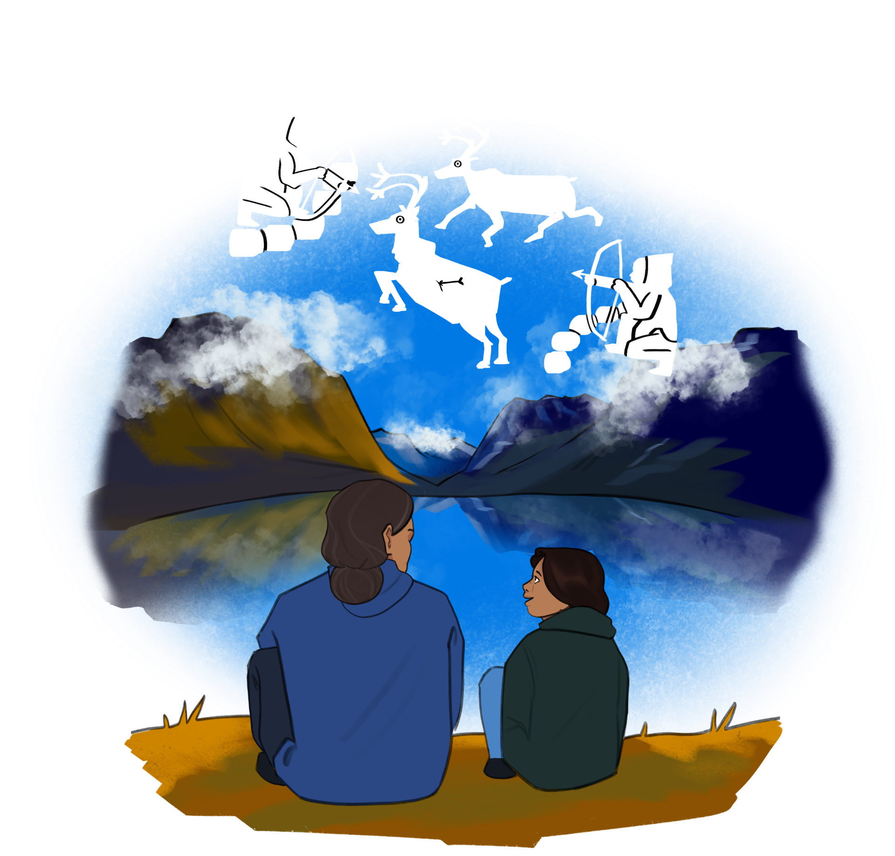
Notes:
Becky: Storytelling is the lifeblood of Indigenous cultures, particularly Inuit culture. It’s how we pass down wisdom, values, and traditions from one generation to the next. Today, we’re going to tell you a story about how technology has been used as a form of decolonization through knowledge ownership and preservation in Nunavut. Our stories are often circular and abstract. So know that we will always get to the heart of the lesson as we go on this journey together.
But first, let me introduce you to Sailua and Uliipika. Grandmother and Granddaughter.
Click Slide

Slide 7
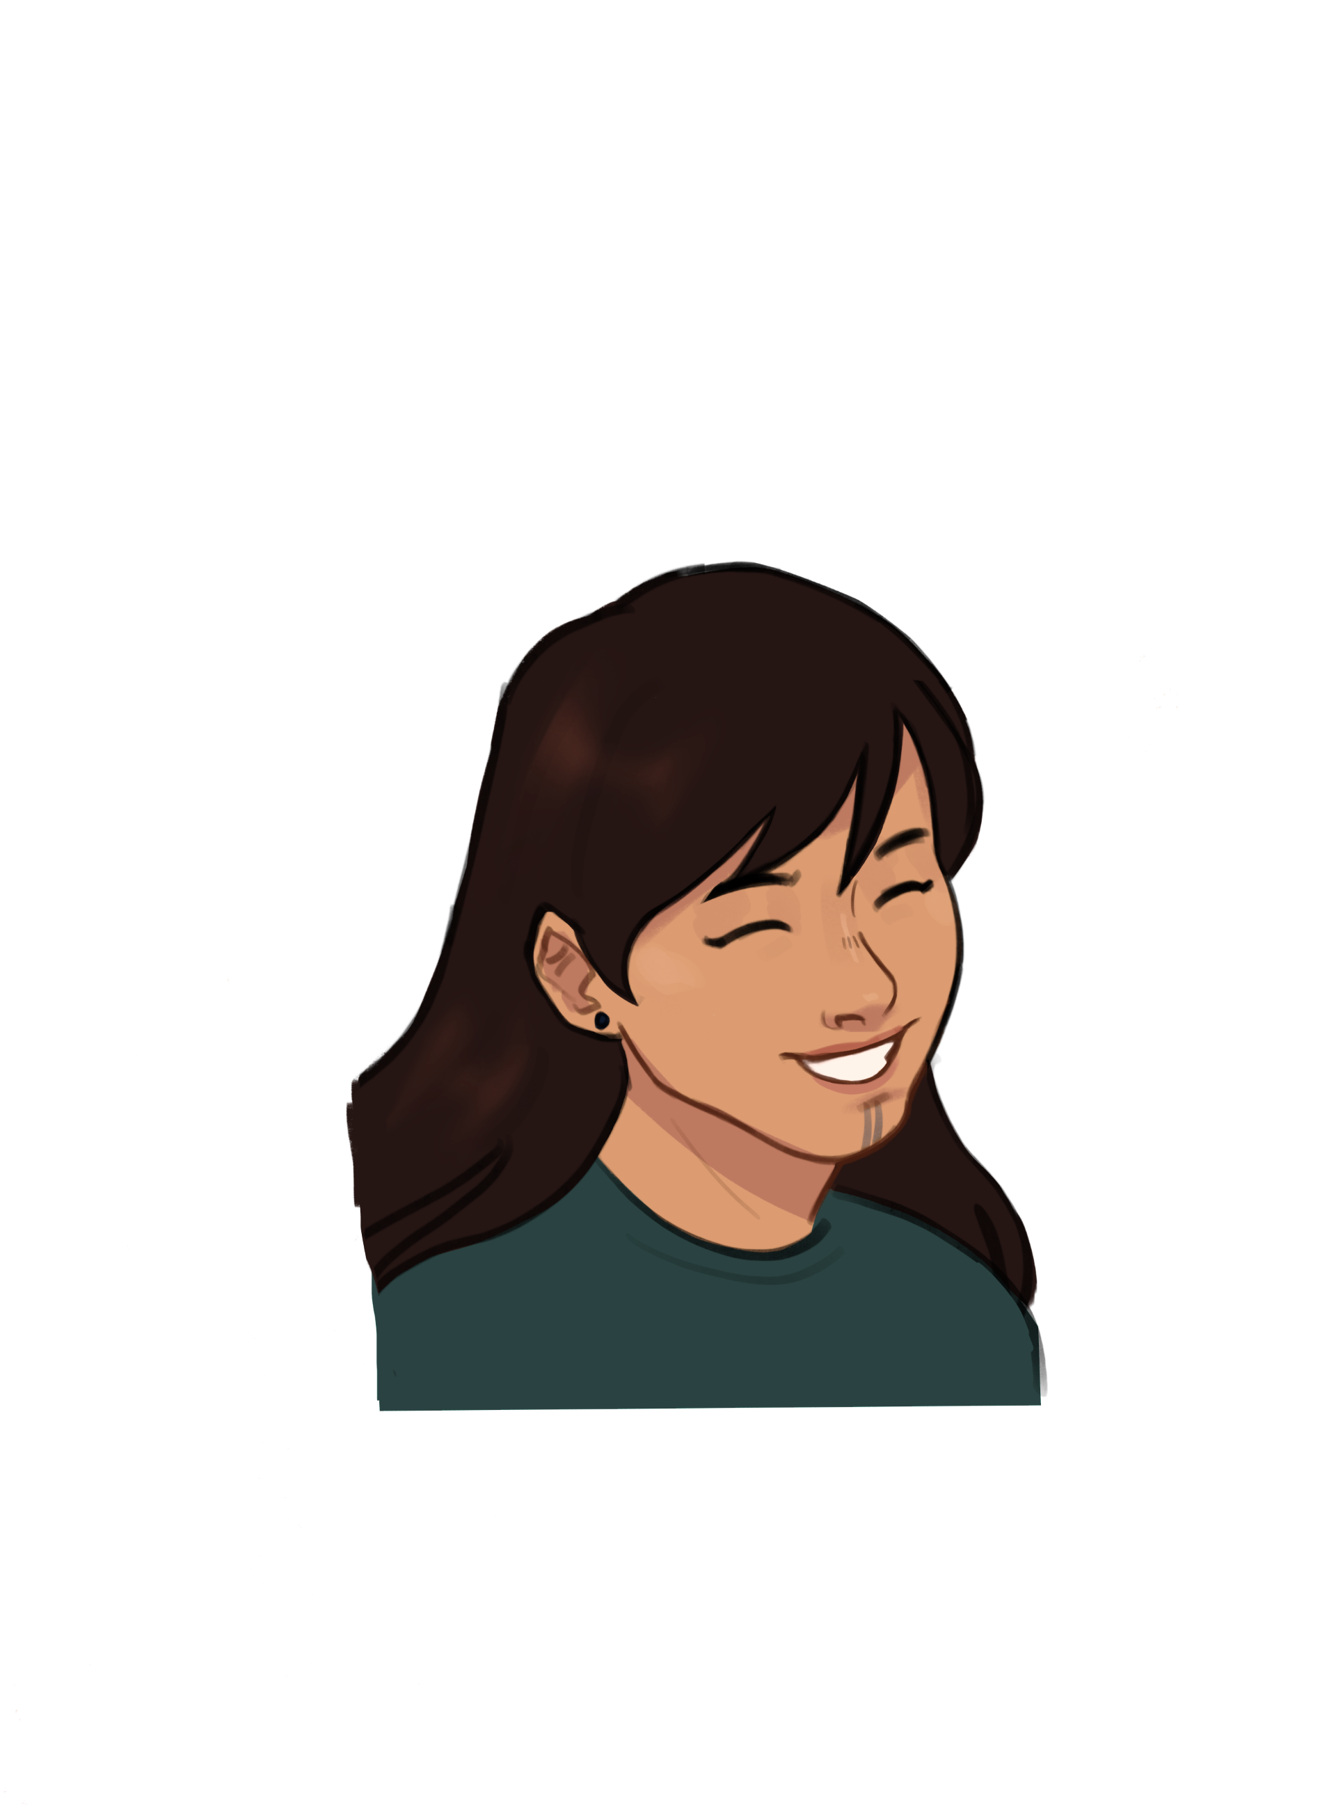
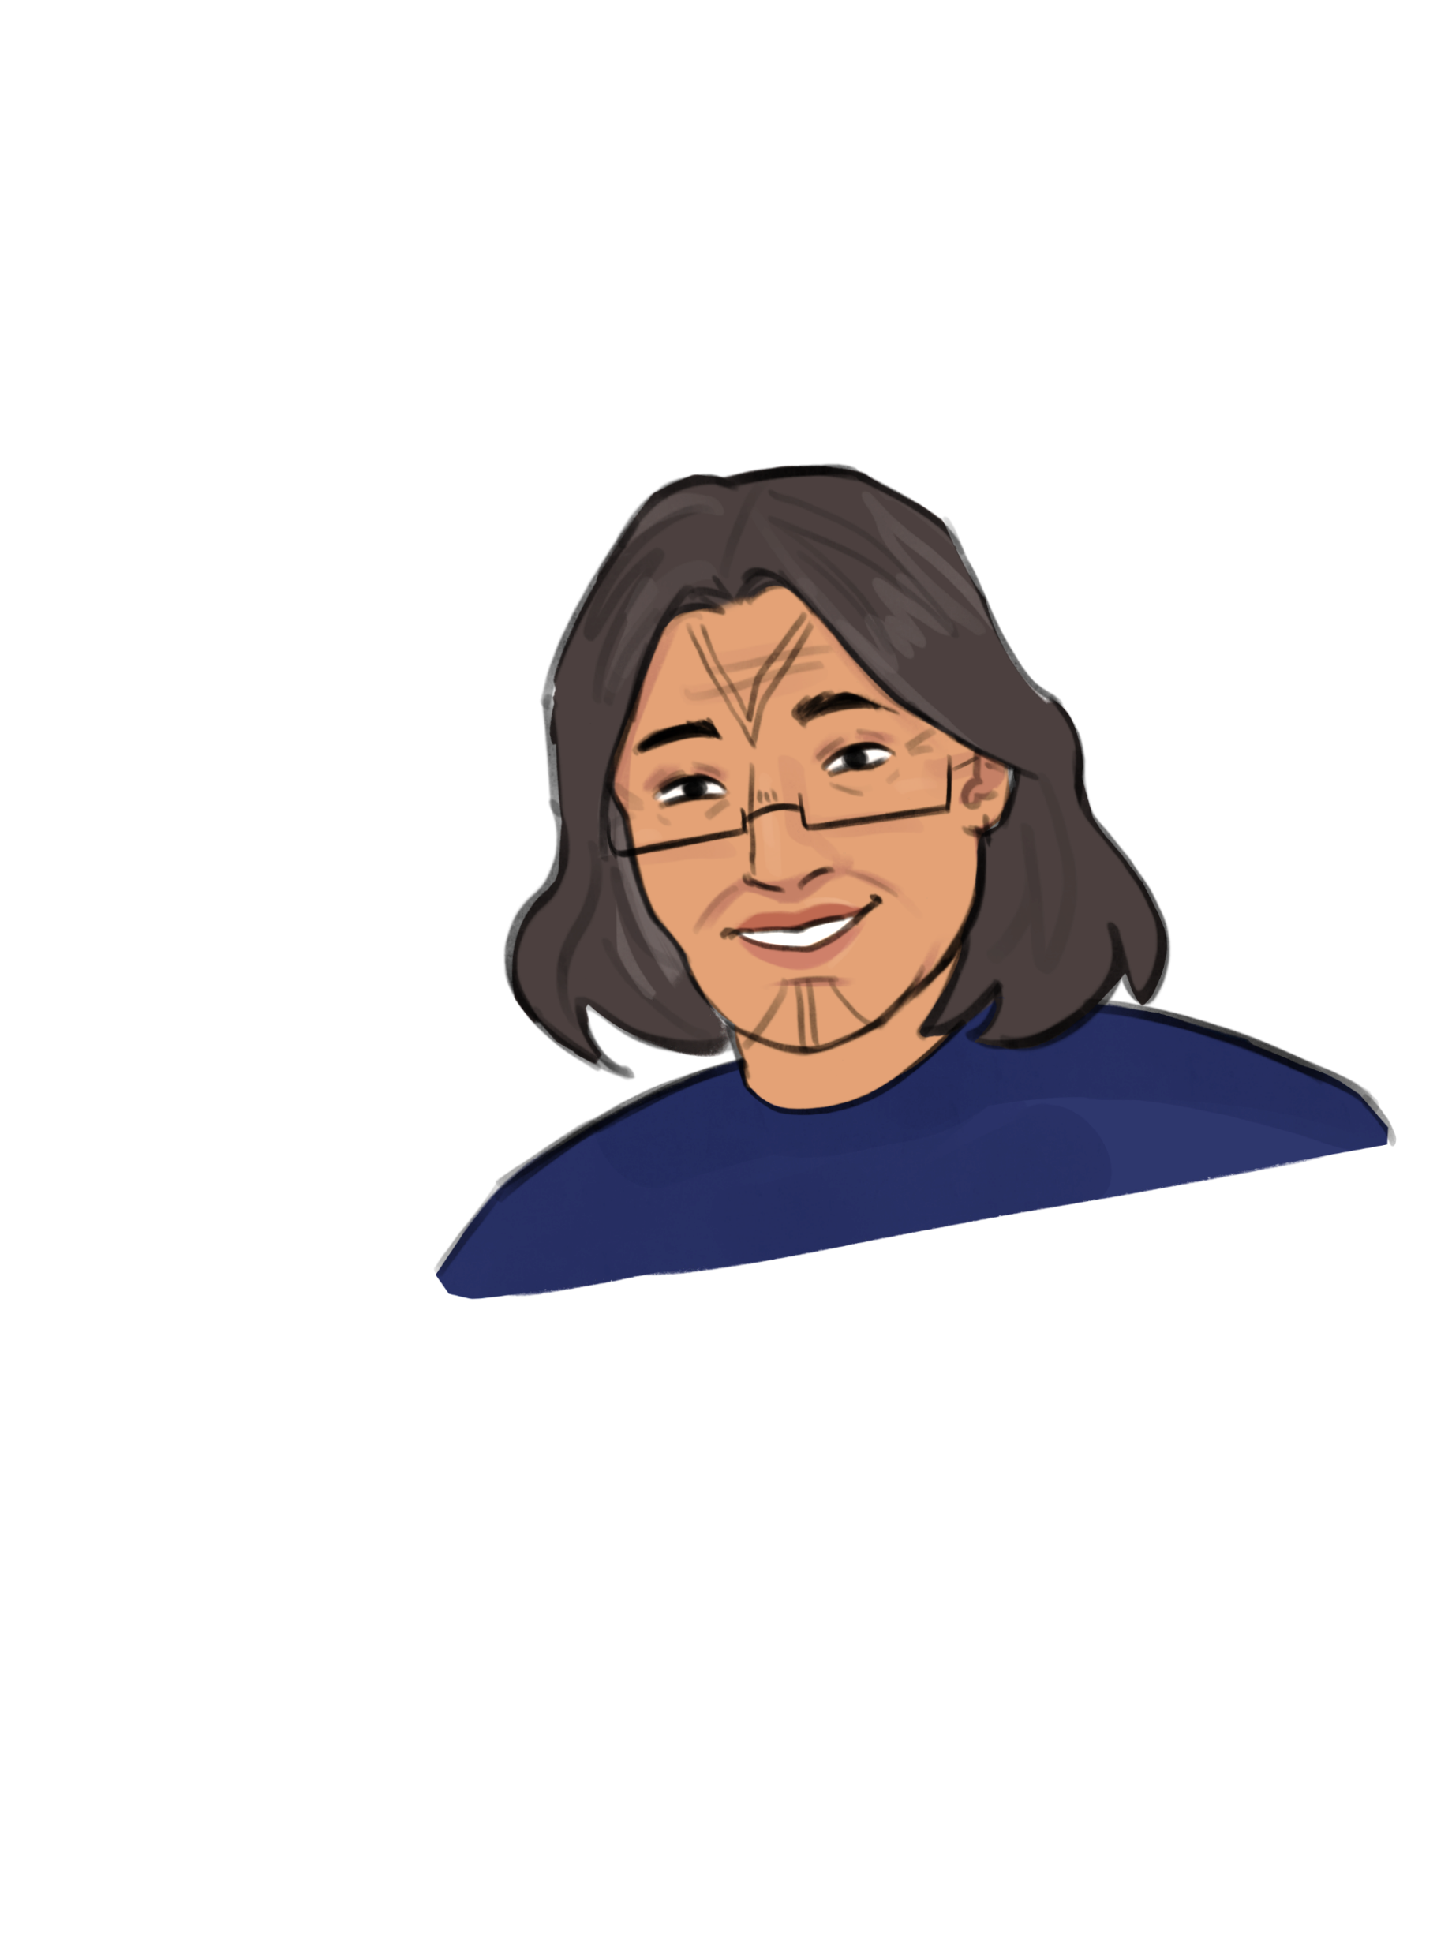
Uliipika | ᐅᓕᐱᑲ
Sailua | ᓴᐃᓗᐊ
Notes:
Becky: Sailua, an Elder and unilingual Inuktitut speaker, was born on the land, during the early days of colonization in Inuit Nunangat, Inuit homelands. A time before towns were built, before the introduction of western education, before the introduction of technology. She has lived long enough to see an immense shift in the way of life, coming off the land and into communities. Sending her children to school, and watching her grandchildren born into a very different way of life.
Uliipika, just two generations later, born in a hospital, and has grown up in a house in their community and is bilingual in both Inuktitut and English. Although she grew up in community life, she spent much of her childhood on the land with her family. She completed her secondary school education in her community but had limited options for further post-secondary education after that.
Jennifer : Like any good story, it requires some background to really transport you to the reality I remember coming up to Nunavut in 2016, and being presented with this idea of implementing the National Research and education network in Nunavut, the last remaining province or territory to be connected in Canada. A network which had been proposed multiple times prior and failed to gain the approval of the Government for implementation.
I like many southerners came north with the mentality most southerners have that … I am going to help “these people” innovate I am going to pave the way for a digital future. How hard can it be?
We can implement this no problem, EASY, lets just run fibre. Well… It probably would have helped if I had context, you know, like the important piece of information that there are only 32 kilometers of paved roads in the ENTIRE territory. Which mean’t you could only fly between communities, or boat, or snowmobile in winter.. it truly felt like my dream of the possible, was quickly becoming impossible.
Click Slide

Slide 8
Notes:
Jen:
What I hadn’t realized was Unlike many parts of the world, Nunavut did not have robust telecommunications infrastructure, as a territory Laying fiber-optic cables across the vast, icy, and rugged terrain of Nunavut was virtually impossible due to the extreme weather conditions, permafrost, and immense distances involved. For instance, in Southern Canada, laying fiber-optic cables or upgrading cellular infrastructure is relatively straightforward because you have roads and industry readily available to provide services.
But in Nunavut, the same process would involve traversing over 2 million square kilometers, often only accessible by air or sea. We have spent significant funds and planning to attempt undersea fibre projects, above see infrastructure projects, and often if not always the project will fail, or be met with significant costs and ongoing issues such as satellite disruptions due to weather, visibility, inaccessibility.
Click slide

Slide 9
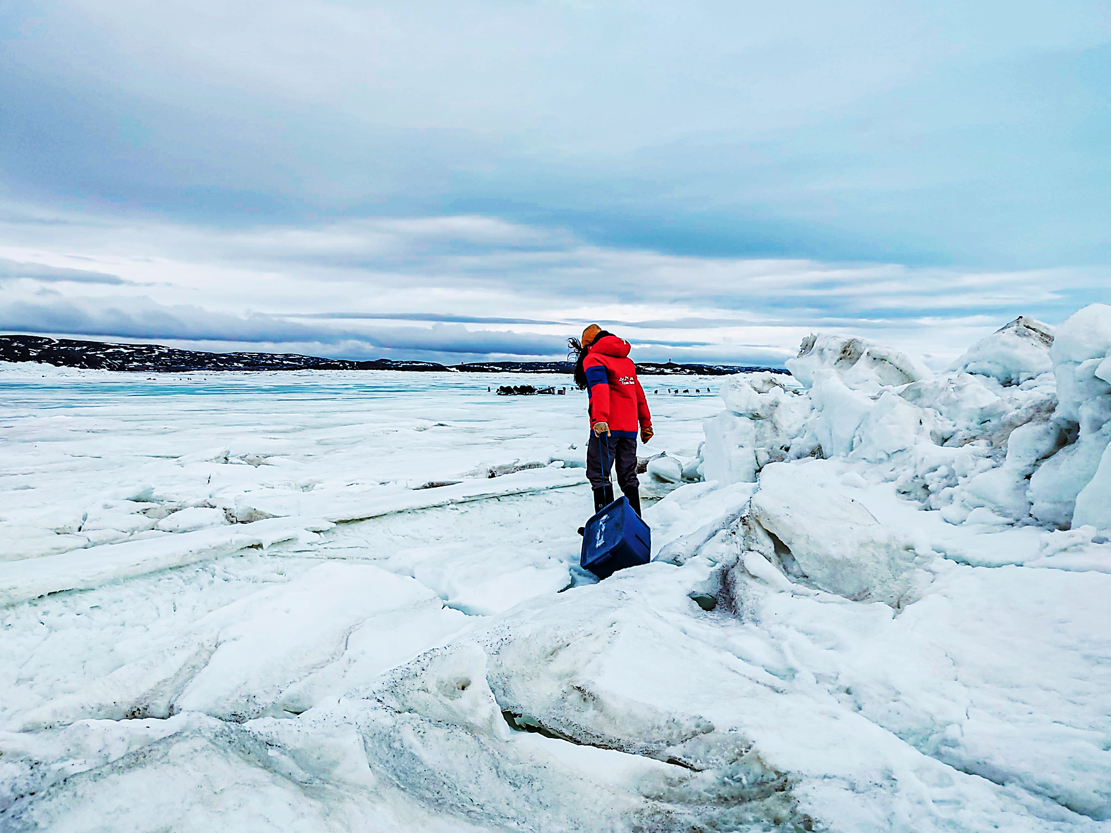
Notes:
Jennifer: Most notably in Nunavut , specifically Iqaluit the capital we experience tidal heights between eight and twelve meters, the tides in this bay are the second highest in the world which causes chunks of ice that had been crushed and crunched by the tides, causing them to jam together and push high into the air
(As you can see here. This is my dragging a bin of heavy steaks across the ice break to feed sled dogs on the ice) These ice shifts pack a lot of pressure, weight and instability in anything coming out of, or underneath the first few feet of ice which inevitably causes issues for undersea projects that need to have landing sites on land for infrastructure.
Prior to working for the College, I used to consult with the Government of Nunavut, and I recall when 50 Million was spent on an undersea study for fibre, that determined it would cost us 1.64-2 Billion to connect all 25 Nunavut communities to Fibre with a project time line of 5-10 years. For obvious reason this project did not go forward.
So, for much of the last 20 years this lack of infrastructure resulted in a significant digital divide between Nunavut and the rest of Canada
Click slide

Slide 10
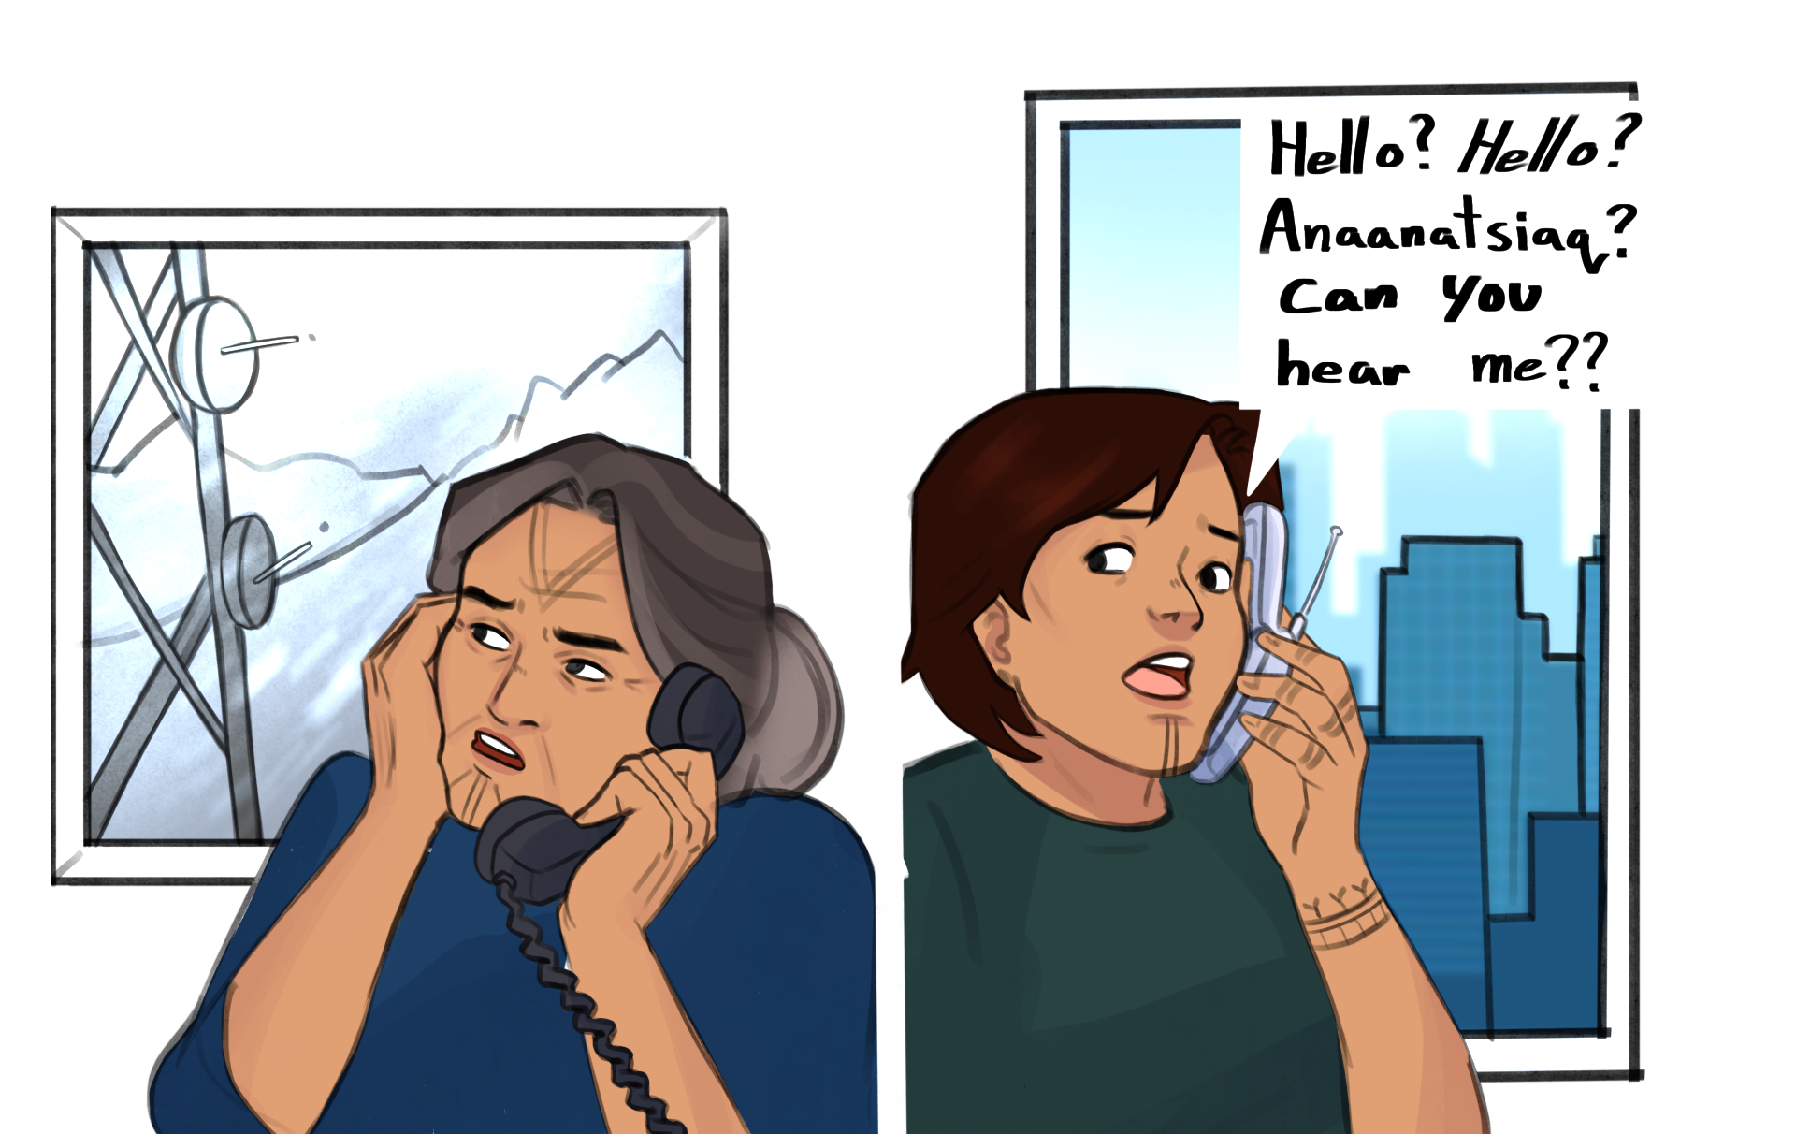
Notes:
Becky: For people like Uliipika, the desire for internet access and basic digital capabilities was for more than just convenience—it’s about equality and opportunity and a feeling of connectedness. Like Many Inuit youth, Uliipika had dreams of pursuing a University degree. This ambition meant she had to leave her home in Pangnirtung, travel to Iqaluit, and eventually move south to a big university. But before the year 2000, she didn't have a cell phone or internet connection to stay in touch with her community while studying. This lack of connectivity is especially hard on Inuit, as our cultural understanding and identity are deeply rooted in community, not individuality. When Uliipika first went away to school in southern Canada, she purchased her first cellphone. Once her program was complete and she returned home, her cellphone was then useless. There was no cell service in Pangnirtung.

Slide 11
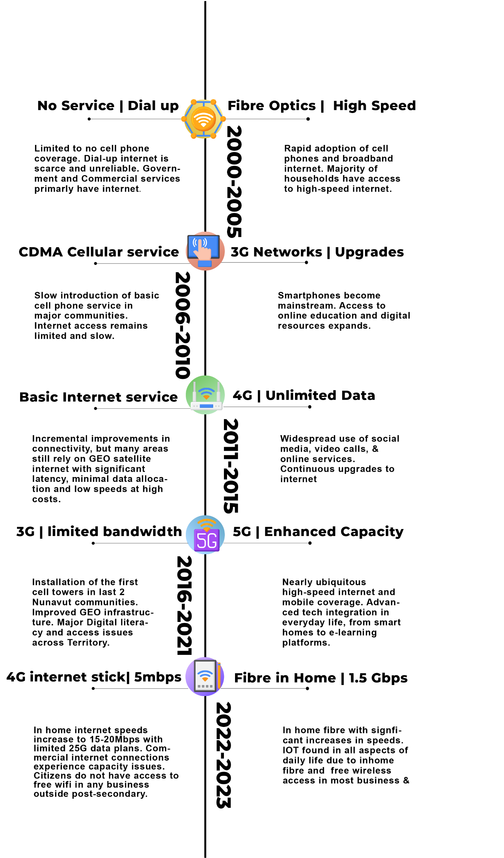
SOUTH
Notes:
Jennifer – Key Points on slide
2000-2005 No Service and dial up commercially when the south had fibre and high speed
2006-2010 – CDMA (2G) Cellular – south had 3G and upgraded infrastructure
2011-2015 – Basic Internet service – GEO, minimal data, high cost and only DSL– South had 4G and unlimited data
2016-2021 – We finally got 3G, but what good is 3G and in home dial up internet if they cap your data at 10 or 15G and the data you do get is slow due to saturation, meanwhile in the south they are now on 5G with Enhanced capacity.
2022-2023 – Post Covid- North significant improvements with 4G internet Sticks that received 5MBPS down and 1 up. Which is what all students and researches had to rely on from our Nunavut lockdown in 2021 up until this past year to do online or remote schooling. Whereas in the south there was in home fibre and 1.5Gbps speeds
Click

Slide 12
"Remote isolation cannot be used as a justification for governments, businesses nor individuals being unable to access a service that is vital in today’s digital economy and that in turn provides access to other services, such as health care, education, government, and public safety,” – Government of Nunavut
Notes:
Jennifer : internet and cell service was delivered to most communities via wireless communication , in fact the last cell tower was installed in 2018 (Gjoa Haven was the last community in Nunavut to get cell service)
At that time, many communities still did not have in home internet services and relied on mobile wireless internet via wingle sticks or cell service for internet access.
A key technological problem that impacts the North is the reliance on singular GEO stationary satellite technology. The Canadian radio telecommunications corporation of Canada has a service Objective per household in Nunavut or 60Gbps. To support education , governmental needs and commercial capacity adds an estimated 20 Gbps for a total need of 80Gbps. The entire capacity of the few satellites that are aimed at the North may be 15Gbps hence the severe shortage of accessible bandwidth in the Arctic.
This reliance can prove detrimental should anything happen to that satellite.
In 2011 A software glitch put Telesat’s Anik F2 satellite out of commission for 16 hours,this was the ONLY satellite the Government and most businesses utilized in Nunavut for network connectivity. The result of this glitch was a complete knock out of long-distance telephone, cellular, internet and automated banking services.
I remember trying to explain to my spouse who came to Nunavut 6 months later than me in 2016 that her inability to connect with me on my cell phone was truly because of the infrastructure and slow speeds, and not because I was avoiding her. In 2010 mobile speeds were between 1-2MBPS down and 1 Mbps or less Up with significantly saturated networks.
How many people had a cell phone that could make video calls that worked in your home community in 2005? 2010? 2015? 2018?
Becky raises hand
Jen: Wait, you didn’t have a cell phone until 2018 in your home that you could actually video call people with?
Becky “ Gives knowing facial expression”
Jen “ Uh, you didn’t, or?
Becky : Smiles turning to audience “In Inuit culture, we often communicate volumes with our facial expressions. This was because as a nomadic people, in harsh weather environments we couldn’t only depend on verbal communication, communicating with your face or body was necessary for survival.
Click Slide

Slide 13
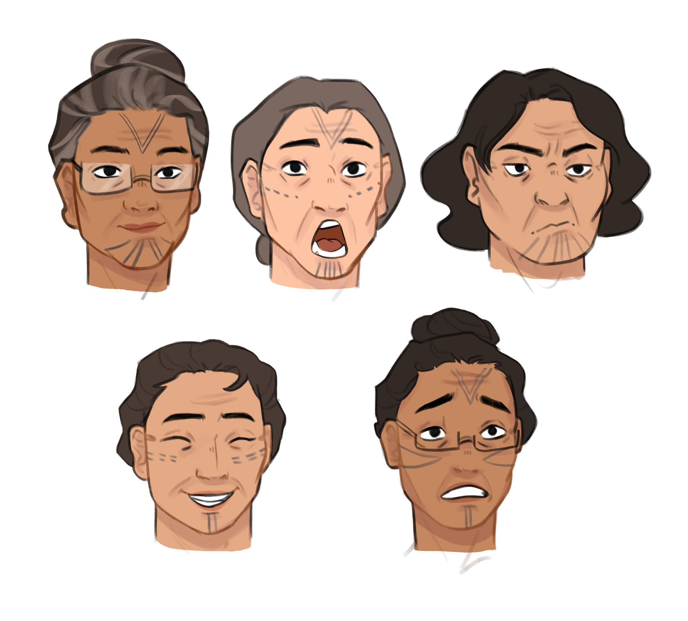
Notes:
Becky: So, you can image, things can get lost in translation and facial expression. When it came to Implementing technology in Inuit communities it meant we had to approach it from a different perspective. For 5 years Jennifer, like others before her, attempted to lobby government to bring this network to Nunavut. But she kept failing to get the support of our Ministers, the regional Inuit orgs and funders.
As I stated earlier, Inuit make up about 89% of the population of Nunavut, and Inuit organizations oversee the implementation of the Nunavut Agreement. The Inuit land claim agreement that created the Nunavut Territory.
Jennifer: This lack of ability to do something as simple as call your family member and talk over a video chat, or even a normal call can prove detrimental for Inuit. Inuit face significant challenges due to a lack of connectedness (suicide, substance abuse, displacement). This “disconnectedness” was as a result of colonization. These issues Underscore the need for culturally sensitive technology solutions that resolve this disconnection in a way that allow Inuit to weave their own story, and build resilience as a people.
Click slide

Slide 14
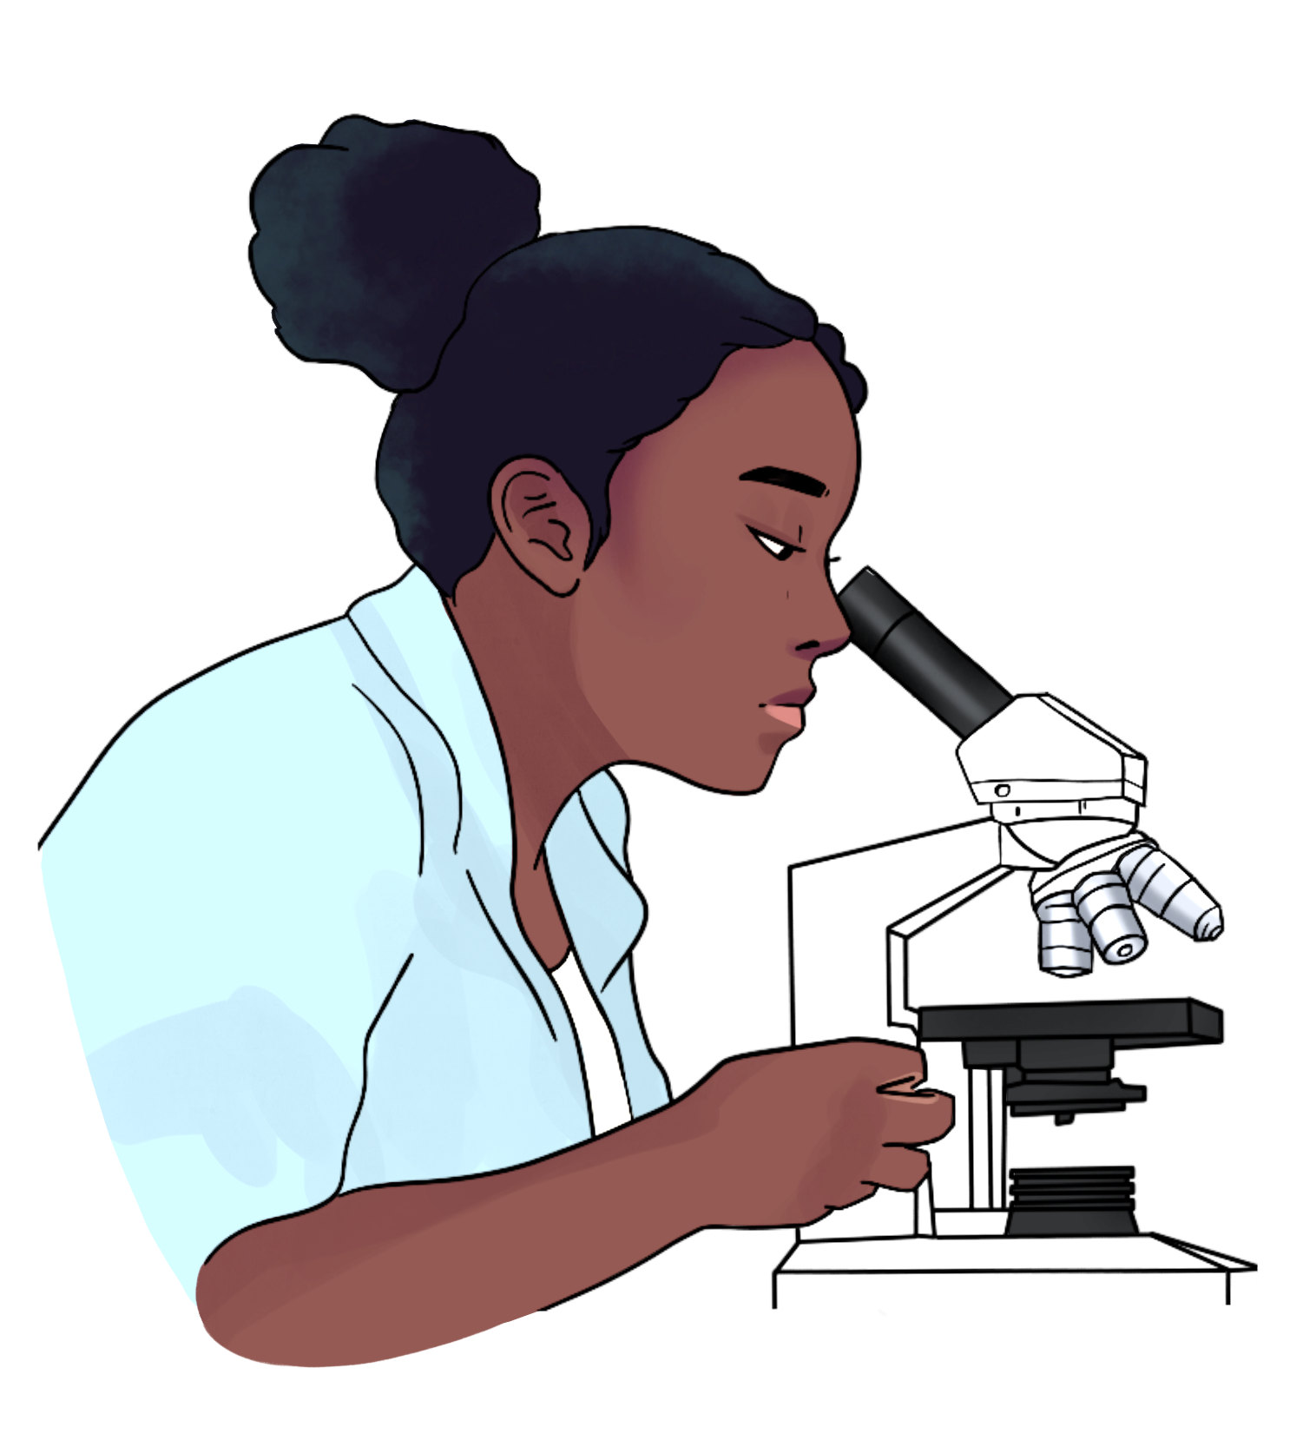
“Nothing about us, without us.”
Notes:
Becky: In many communities across Nunavut, we are still reconciling our relationships with research. For decades, extractive research approaches have had detrimental impacts on our communities. Far too many of our communities have stories of unethical research experiences, being excluded from research development or never hearing of the research outcomes. Its for this reason that you will often hear the saying “nothing about us, without us”
Traditionally, researchers would visit our communities, record knowledge from elders like Silua, and leave with that information. This has often been the case with Indigenous communities globally. Over-researched and under-consulted, our narratives have frequently been taken without proper respect or reciprocity. This disconnection from our cultural narratives was a road block on our path to build a high speed, research and education network in Nunavut. This was a problem we sought to solve with technology, the goal being a way forward for Inuit that saw us be the gatekeepers of research and knowledge on our lands, where we owned the data and the infrastructure that it transports on.

Slide 15
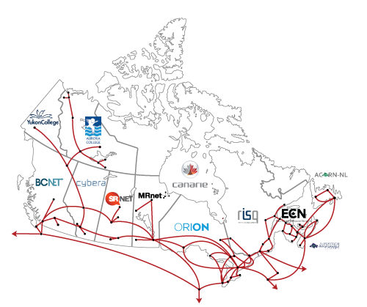
But what does this mean for the National Research and Education Network, in Nunavut?
Notes:
Jennifer:, As you can imagine, Not everyone wasn’t excited as I was about the idea that “Hey with this amazing new network researches can come into the territory and do their research more easily, with higher speeds and can easily take that data away and access it from anywhere in Canada, or my other key benefit which was, This will be amazing, now people can leave there communities to go to school elsewhere and still talk with people back home….” clearly I lacked understanding on the sensitive realities of Inuit and Indigenous peoples in general around research, or the fact that the actual benefit would be doing remote school from your community and not actually having to leave it.
It wasn’t until we stepped back, listened and understood the sensitive history of this land and its people, the traditional communication methods and values approaching it from an indigenous lense that we were able to really deliver benefits that mattered.. Imagine if your way of being and knowing is so rooted so deeply in visual and verbal connectedness and you have to travel like Uliipika far away to go to school.
Jennifer Our ability to lobby and gain support in Government and with Inuit Organizations and federal funders had to focus on this cornerstone benefit to Inuit. That we could create a form of digital connectedness that would traverse communities and large distances.
Jennifer: We didn't just ride in on our white horse bring in technology like “Qallunaq” saviours from the south.. That means white people in Inuktitut by the way.
Rebecca “ Like many often do”
Jennifer: Instead we supported the creation of a network initiative where knowledge is preserved and controlled by Inuit, for Inuit and delivered in a way the builds resiliency, connectedness and data sovereignty.
Click

Slide 16
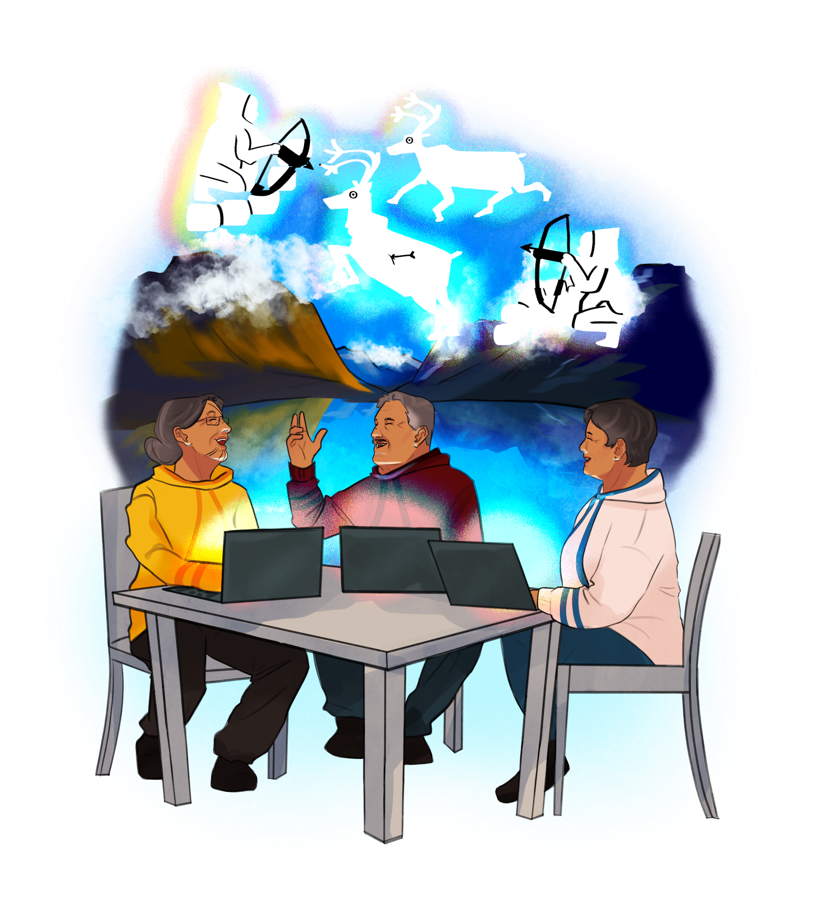
Decolonizing technology through these networking projects “exemplify how communities long regarded as objects of study have instead increasingly become leaders in the study and stewardship of their own languages”
(Henke & Berez-Kroeker, 2016, p. 425).
Notes:
Rebecca: What was approved by Cabinet after 5 long years of learning, was a network that WE as Inuit would OWN, OPERATE and support. We would Fund it, hold the knowledge that crossed it, and train local Inuit to operate it. Our collaboration with regional Inuit organizations and partnerships with CANARIE and Galaxy Broadband ensured the network would foster digital communities, support knowledge sharing, and maintain knowledge sovereignty.
Jennifer: You might wonder how we managed to deploy high-speed internet in such a large and remote region with minimal infrastructure. deploying internet services across Nunavut, fundamentally was near impossible in terms of high speed connectivity.
Click

Slide 17
Notes:
Jen: Before 2021, providing reliable internet access in Nunavut was not only a logistical nightmare This was the year our territory was locked down and moved remote from Covid.
We had to scale quickly for Students and provide mobile wingles, managing 600+ devices 5mbps down, 1 Mbps up. Unusable for shift to home learning during Covid
Cost was staggering. Click slide

Slide 18
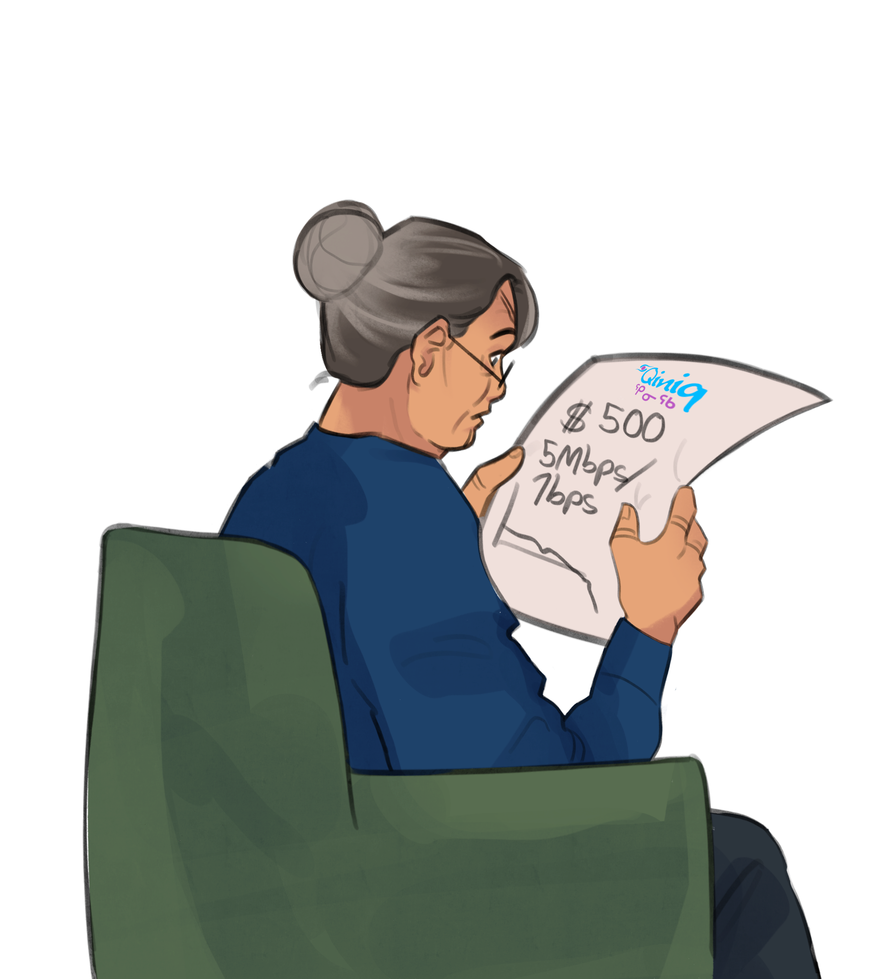
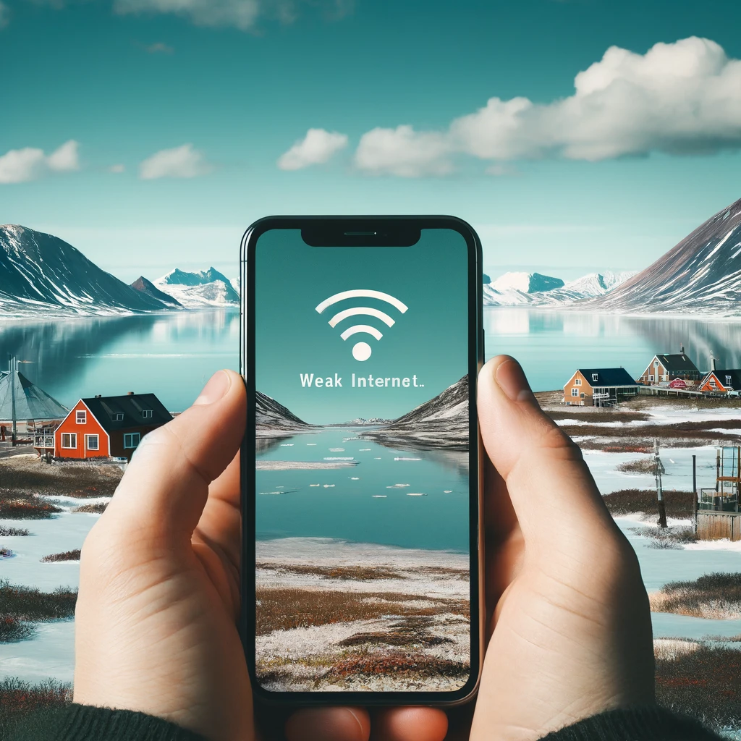
1MB
5Mbps/1Mbps
5MB
Notes:
Jen: In 2021 a 15G plan with one of our only 2 local Internet service providers would cost around 84 dollars a month, with significant overage fees. So most researchers and educators would go over their allotment upwards of 500/user each month.
The costs to try to run research and educations services was staggering for a post secondary institution in the north, managing hundreds of these internet devices, that we could not cap, secure or further connect to the greater National research and education network of Canada. There was no way we could have an integrated network. So despite having approvals to proceed with bringing the NREN to Nunavut, we were left with little options that could produce the speeds required to deliver this service or the integrate network capabilities to sit the CANARIE provided National Research and Education Network on it.
Then something MAJOR happened. Skys opened up, and Enters this guy
Click.

Slide 19
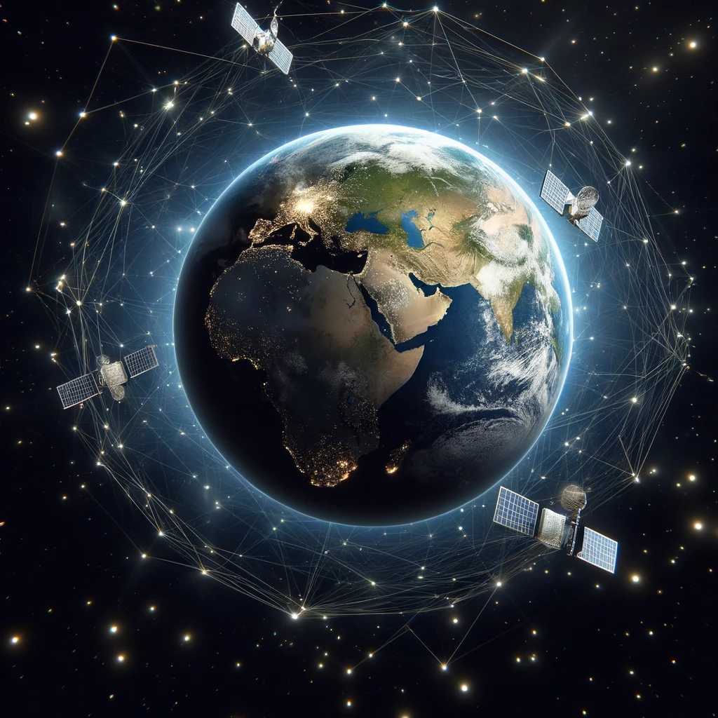
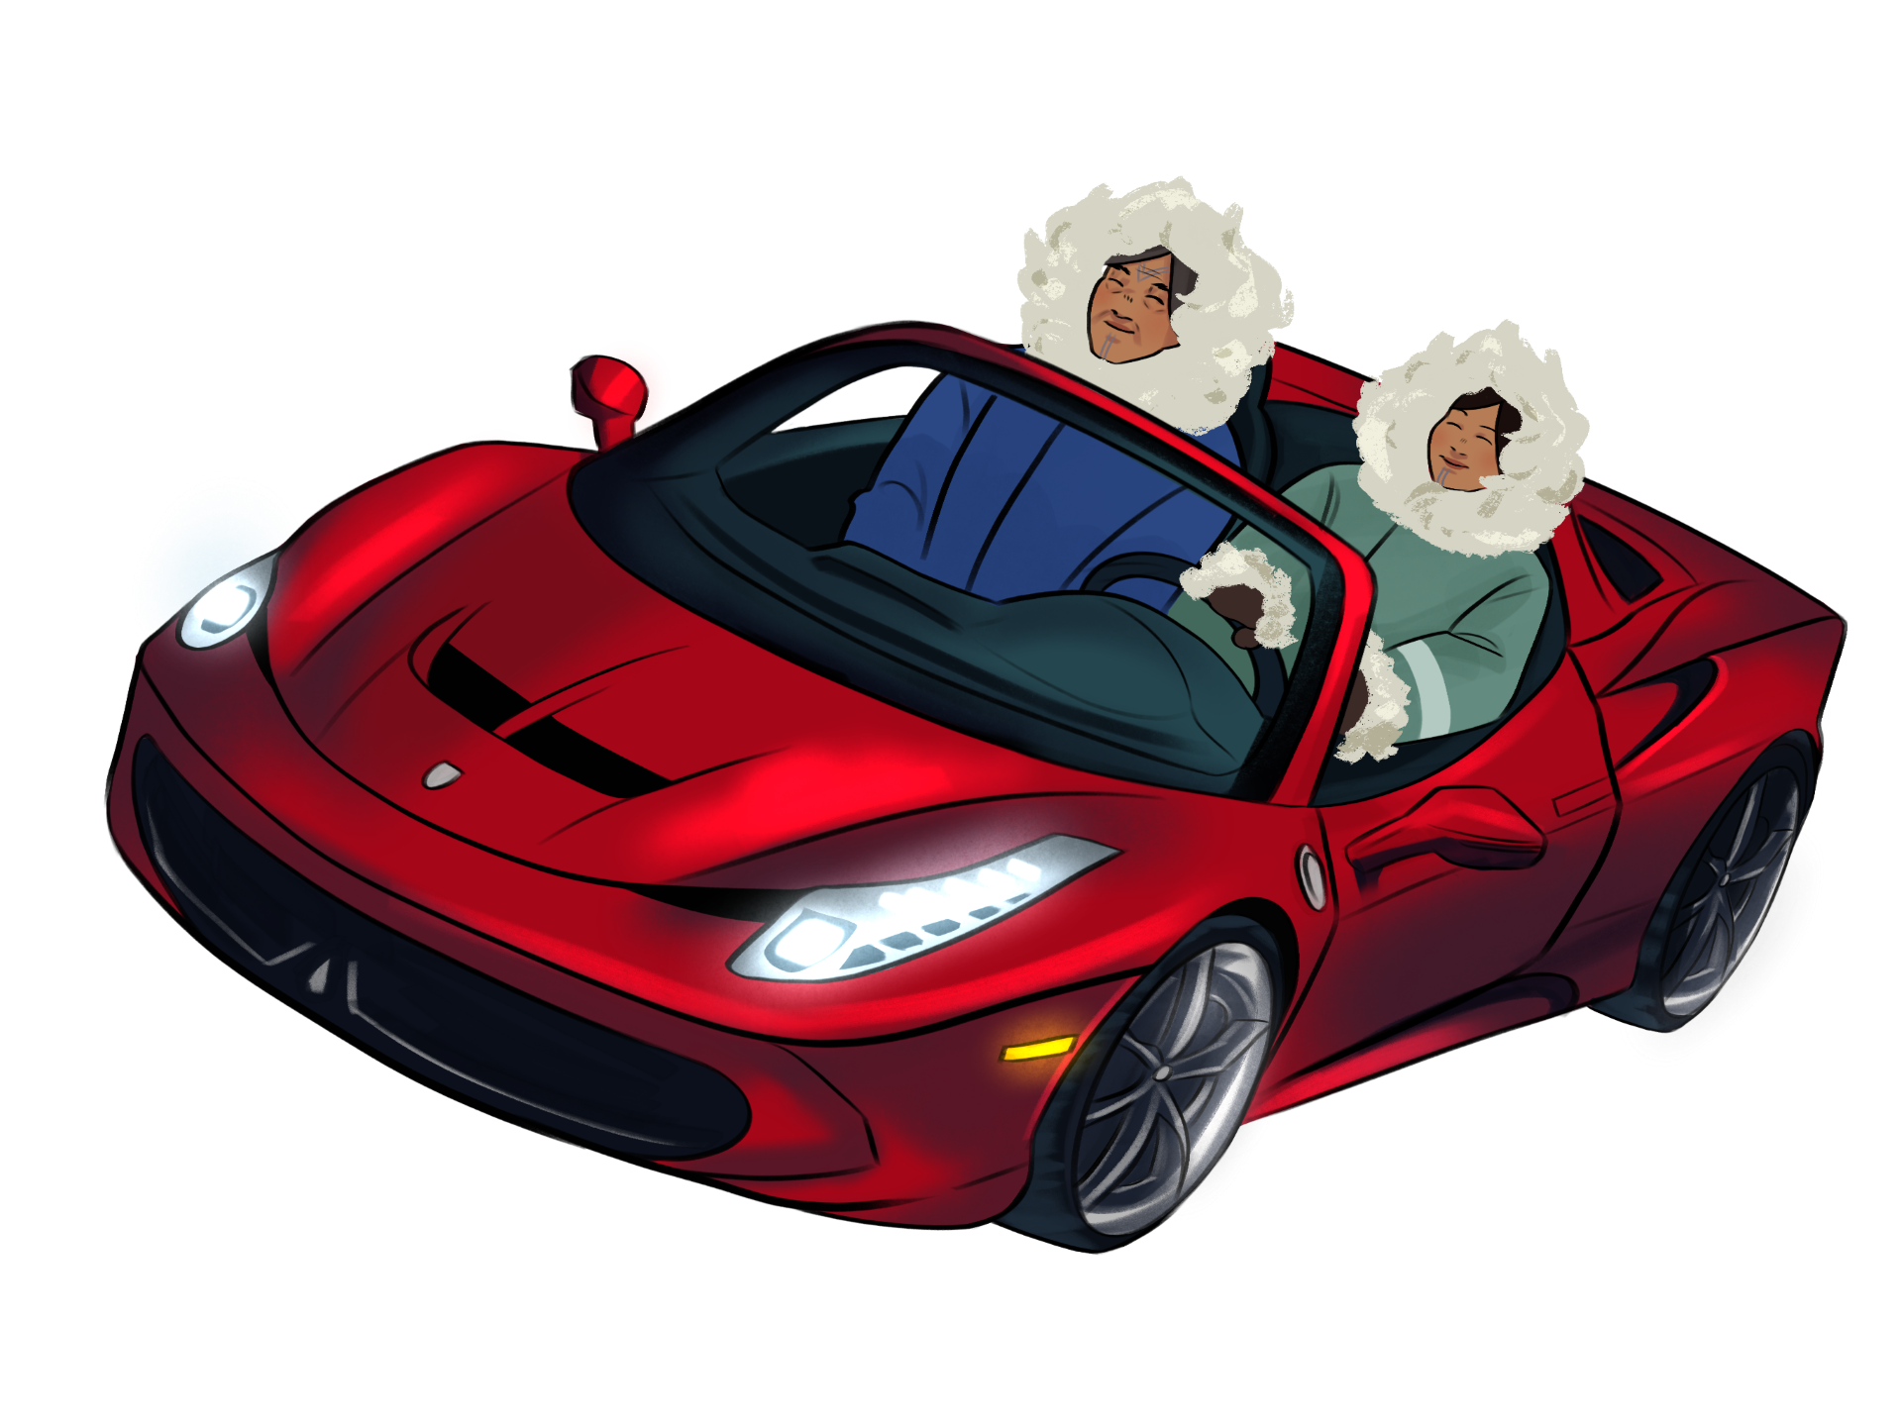
Notes:
Jen: Space X followed by OneWeb were game changes in Nunavut to what was now possible, not only for commercial services like our Research and Education Network, but also for residential customers.
Click

Slide 20
Notes:
Jennifer: Low Earth Orbiting (LEO) Satellite Technology was a game changer for northern, and remote indigenous communities world wide who had limited access to connectivity. Unlike traditional geostationary satellites that orbit much farther from earth, LEO operates much lower altitudes, significantly reducing the amount of latency and improving bandwidth, providing faster more reliable internet. With reduced infrastructure requirements, and reduced costs for both residential and commercial users, this new technology was a major disruptor to the telecommunications industry.
Rebecca : For Inuit, and Nunavut this meant the ability to deploy high speed services, without data caps, with minimal ground infrastructure. Lower cost and higher efficiency. LEO opened up new possibilities for the future of research and education in the North.
According to a study by the Canadian Radio-television and Telecommunications Commission (CRTC), only 27% of households in Nunavut had access to high-speed internet before the introduction of LEO technology.
Click Slide

Slide 21
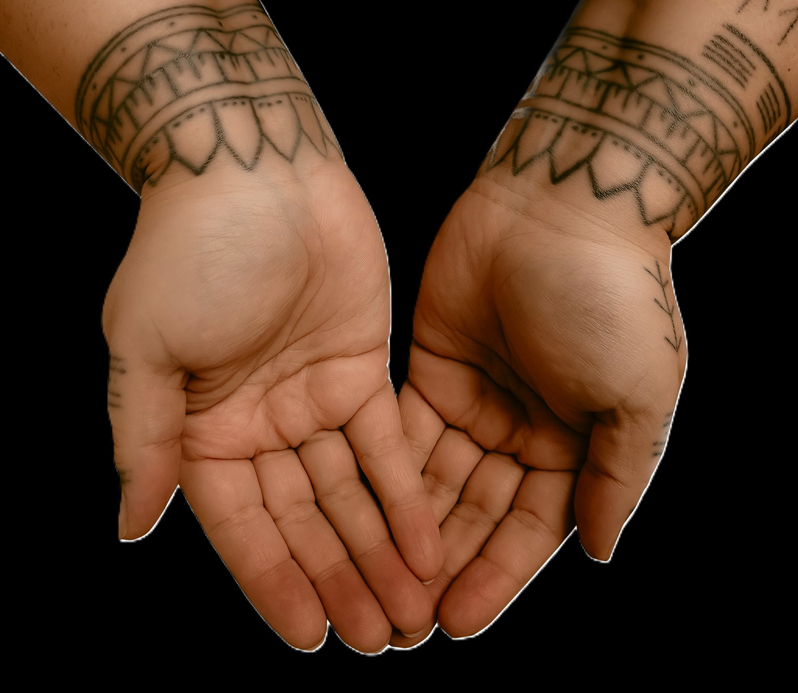
The GiiG Solution
Notes:
Jen: NAC with the help of our Partner ISP - Galaxy Broadband harnessed the power of LEO to connect us, to the rest of the Canadian NREN. Galaxy is a service provider with extensive experience in the most remote sites in Canada. They are Primarily focused in the satellite space and, they were one of the very first in the world to combine new Low Earth Orbit (LEO) satellites with SD-WAN routing software, developing solutions that squeeze the most performance out of limited bandwidth.
By working with leading technology developers, they have leveraged the power of SD- WAN to smartly route traffic to the best performing links. Space is a difficult environment so having multiple LEO satellites and GEO backhauls managed by SD -WAN software offers the most resilient service possible. In addition, Galaxy has bonded the two LEO operators (Starlink and One Web) to increase speeds. Since upload speed are he most difficult and expensive, bonding two 20Mbps links together to get 40Mbps performance enabled us to prioritize certain applications that needed to perform better.
The added GEO link in our service although having greater latency does provide a much larger bandwidth pipe sizes and better average jitter performance. This makes it a good candidate for specific use cases such as software Updates, and other large bandwidth hogs. These applications are typically buffered by not requiring the lower latency that real-time applications require. Off-loading these applications frees up more bandwidth on the LEO links for real-time data needs.
We now have access to Speeds 220/25 at its slowest 400/40 at highest
Expansion of the network to other buildings is another interesting challenge that we had to overcome in the North as we cannot always rely on fibre to fibre building connections .Fun fact about Nunavut is we do not have trees, so no line of sight issues existed for us in extending the network from building to building using point to point canopy radio technology. As a result we have been able to expand to our facilities and member facilities in an efficient, cost effective and scalable way.
This innovative new technology is allowing us to implement this high-speed network across all Nunavuts 25 communities for roughly 1.3Milliion dollars, this is pennies in comparison to the almost 2 Billion that fibre would have cost.

Slide 22
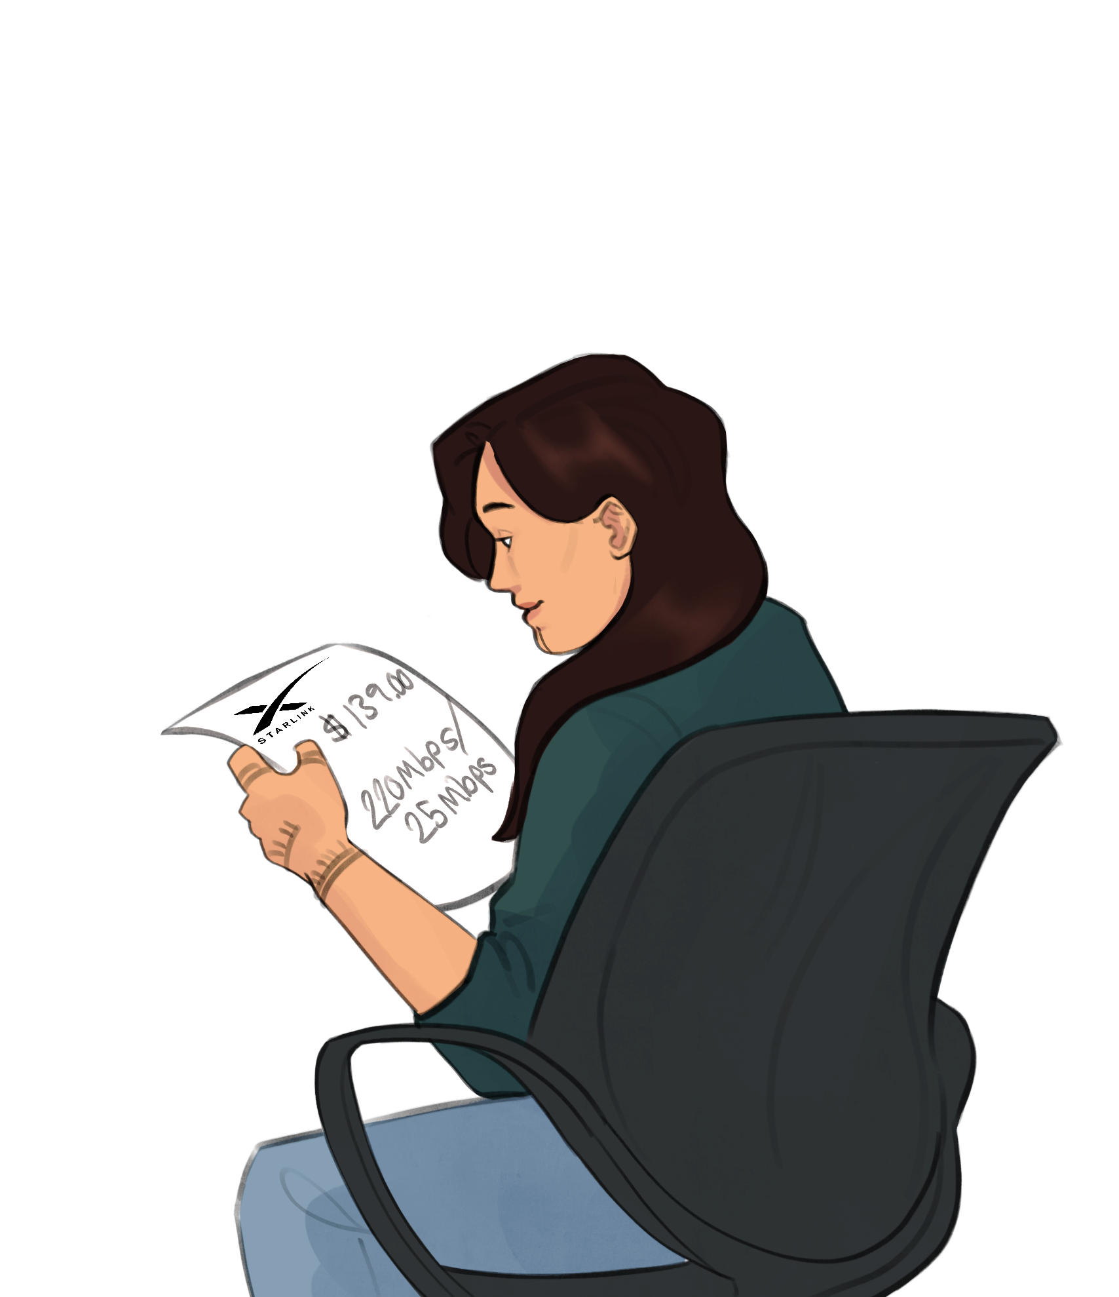
220MB/25MB
Notes:
Becky: With LEO technology, we saw a future that could provide the same quality of internet service available in major urban centers, thus narrowing the digital divide. This has profound implications not just for individual users but also for educational institutions, It supports the creation of a connected, informed, and empowered community, paving the way for socio-economic development and cultural preservation. Prior to building this network we ensured our plan took into account key Inuit values.
Click Slide

Slide 23
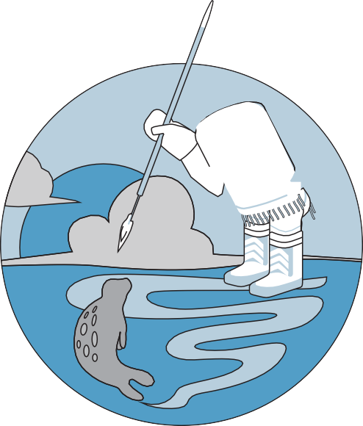
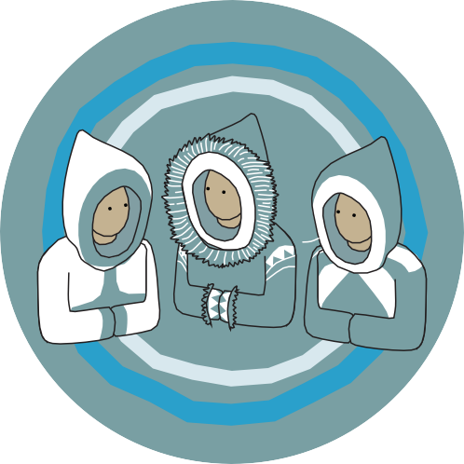
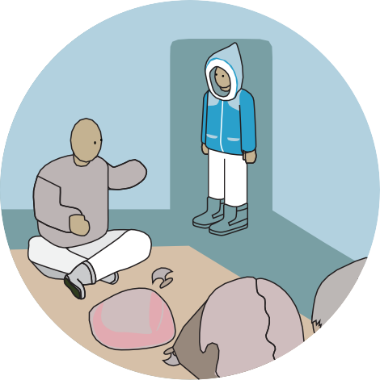
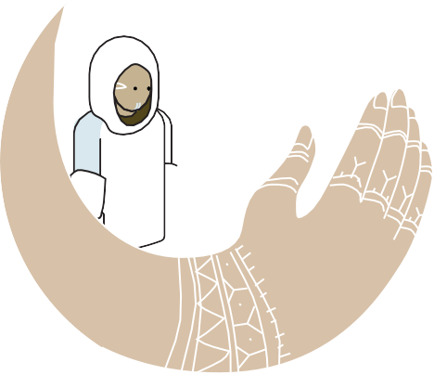
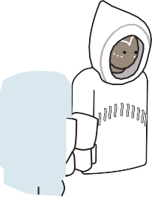
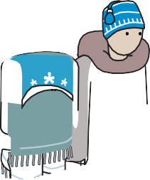
INUIT IQ VALUES
ᐃᓅᖃᑎᒌᑦᓯᐊᕐᓂᖅ: ᐅᐱᒋᔭᖃᑦᓯᐊᕐᓂᖅ, ᐃᓚᒌᑦᓯᐊᕐᓂᖅ ᐊᓯᒥᓂᓪᓗ ᐃᑉᐱᒋᔭᖃᑦᓯᐊᕐᓂᖅ.
Inuuqatigiitsiarniq:
Respecting others, relationships and caring for people.
ᐱᔨᑦᓯᕐᓂᖅ: ᐃᓚᑦᑎᓐᓂᒃ, ᐃᓅᖃᑎᑦᑎᓐᓄᓪᓗ ᐊᒻᒪᓗ ᓄᓇᖅᑲᑎᑦᑎᓐᓂᒃ ᐱᔨᑦᓯᕈᑎᖃᕐᓗᓂ.
Pijitsirniq:
Serving and providing for family and/or community.
ᐋᔩᖃᑎᒌᓐᓂᖅ: ᐃᓱᒪᓕᐅᖃᑎᒌᓪᓗᓂ, ᐅᖃᖃᑎᒌᓐᓂᒃᑯᑦ ᐊᒻᒪᓗ ᐊᖏᖃᑎᒌᓐᓂᒃᑯᑦ.
Aajiiqatigiinniq:
Decision making through discussion and consensus.
ᑐᙵᓇᕐᓂᖅ: ᒪᑐᐃᖓᓂᖅ ᐱᑦᓯᐊᓂᒃᑯᑦ, ᐃᓚᕋᓇᙱᓐᓂᖅ ᐊᑕᖏᖅᑎᑦᓯᓂᕐᓗ.
Tunnganarniq:
Fostering good spirits by being open, welcoming and inclusive.
Notes:
Becky: Touch on incorporation of inuit values in all things we do in the North.
Inuuqatigiitsiarniq: Respecting others, relationships and caring for people
Pijitsirniq: Serving and providing for family and/or community
Aajiiqatigiinniq: Decision making through discussion and consensus
Tunnganarniq: Fostering good spirits by being open, welcoming and inclusive.
How to truly decolonize your approach to any project whether it be technology, or business processes you need to take into account the value systems, beliefs, and ways of being of the indigenous people you are supporting. If the things we do, do not align with our values, it is a strong key indicator that we should not be doing them.
Jennifer: These values we took and incorporated into our implementation plan for this network.
Click

Slide 24
A decolonized approach to Implementation
Partnership | Ownership
Community Planning
Collaboration | Inuit Orgs
Benefits | Values Alignment
Notes:
Jen: We did this in a few key ways
We entered a 10 year partnership with Galaxy Broadband which in our territory was a disruptor to the monopoly on services that was previously experienced. The benefits of this partnership for us, included:
Our ability as an Inuit Post-Secondary we were able to co-own this network locally and drive forward some key requirements of delivery of service.
We Ensured that data must be accessed, controlled and monitored by Inuit via our post secondary
Training programs must be put in place to train an all Nunavummiut Tech Workforce to support and maintain the network
Costs must be at wholesale prices as a benefit for facility use, reducing the cost burden on research and education in the territory.
We centered the Inuit Orgs and Government in our planning and consultation processes honouring decision making through discussion and consensus and being open and inclusive
We worked with our funding partners CANARIE, NAC programs, CIRA and our Inuit Organizations to come up with a plan that met community needs, focused on caring for people, building relationships and respecting traditions
Changed our approach to centralize on Inuit Benefits and drove firmly towards those
Rebecca: Returning to our story, how did this benefit Saliua and Ulipiika
Click Slide

Slide 25
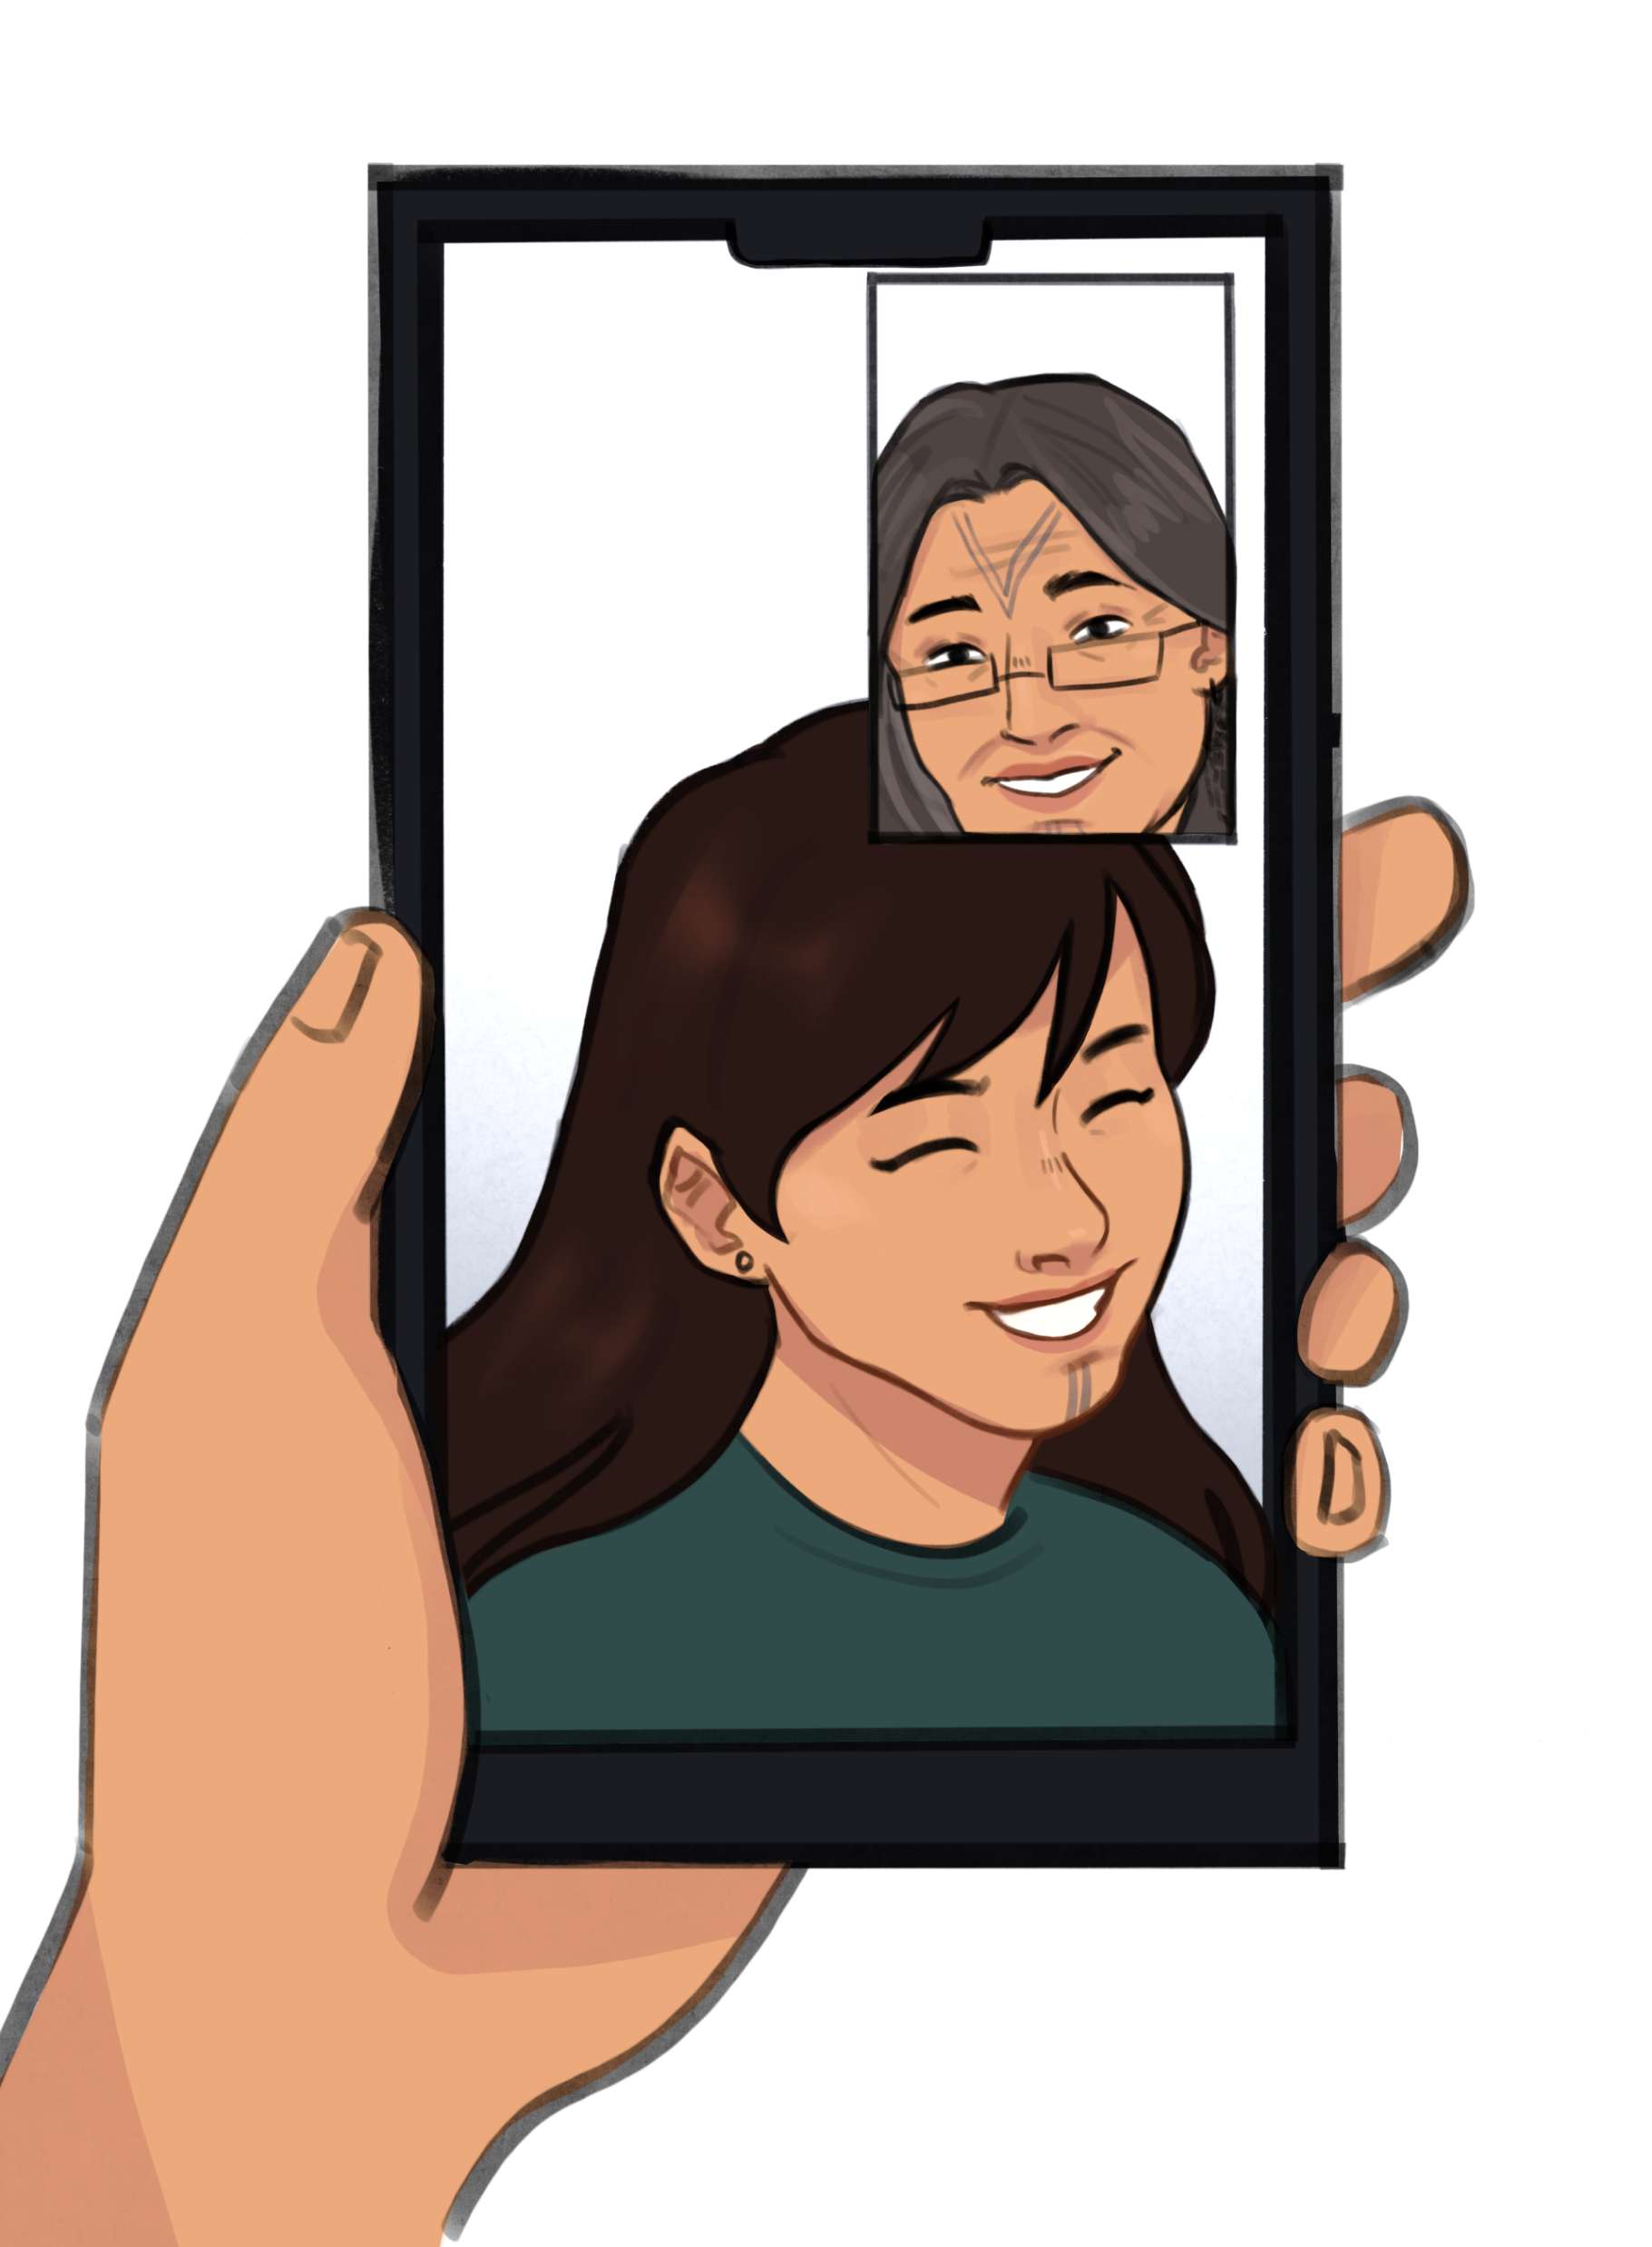
Notes:
Becky: High-speed internet allowed Ulipiika to attend school in a different community while staying connected to her grandmother through video calls. This technology supports our traditional ways of being by enabling visual communication and maintaining important familial and social ties.
Click slide

Slide 26
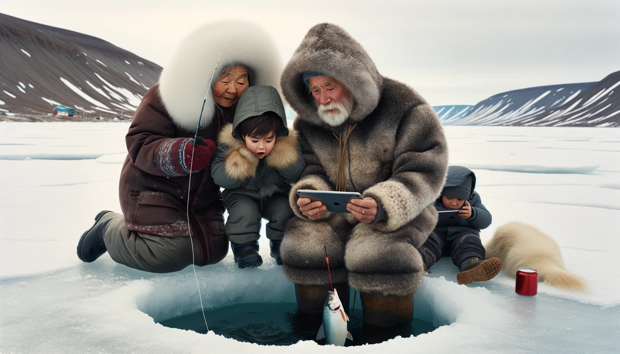
Access to digital tools and platforms can facilitate the revitalization of Indigenous languages and support the intergenerational transfer of knowledge
-First Nations Technology Council
Notes:
Jen: Research by the First Nations Technology Council highlights that digital equity is crucial for preserving Indigenous languages and cultures stating “Access to digital tools and platforms can facilitate the revitalization of Indigenous languages and support the intergenerational transfer of knowledge”​
Through this initiative the integration of LEO tech and the Canadian NREN has been a catalyst for change in Inuit communities.​
It has Empowered citizens to reclaim their narratives​
Conduct and control their research​
Strengthen their cultural and educational frameworks​
This Transformation is a testament to the power of technology not just to connect but to empower, protect and enrich indigenous communities. ​

Slide 27
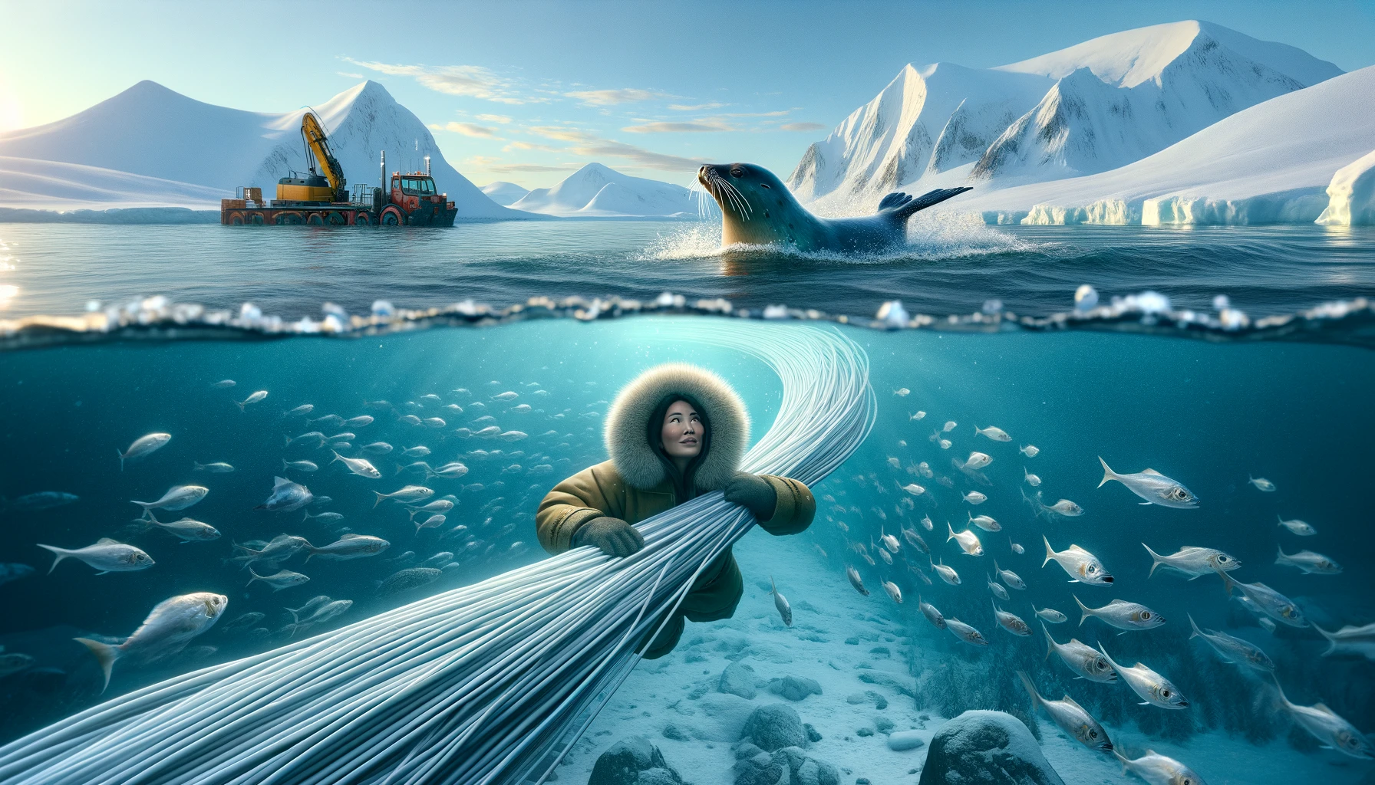
IKIAQQIVIK
Notes:
Rebecca: With new technology comes the need to be able to explain it in the Inuit language, Inuktitut. The word we use for internet, ikiaqqivik, is not a new word but refers to the concept within Inuit beliefs of travelling through layers of time and space.
Elisapee and Angnakuluk are not completely fictional characters. Their story is based off my own experience of the introduction (and the lack) of technology in the Nunavut Territory.
This is a shared story of how digital technology was introduced to our lives, in our way, at the edge of the world.
Jen : We invite you to look in towards your own countries, to the furthest most remote parts of them, we invite you to rendezvous at the edge of our earth and create a lasting digital impact
Becky: One that seeks to connect, and not disconnect our original people to each other, and the rest of the world.
Jen: Thank you
Becky: Nakurmik

Slide 28
Becky Mearns | President, Nunavut Arctic College
Rebecca.mearns@arcticcollege.ca
linkedin.com/in/rebecca-mearns-67b760a2
Jennifer Lane | CIO, Nunavut Arctic College
Jennifer.lane@arcticcollege.ca
linkedin.com/in/jennifer-lane-15605712

Slide 29
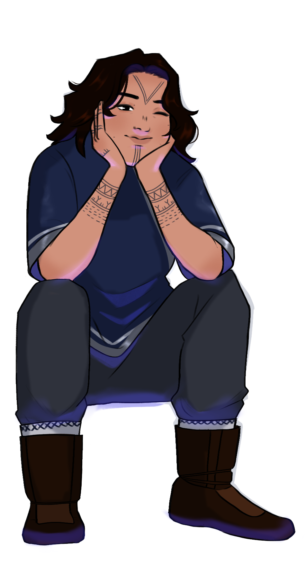
ILLUSTRATIONS BY

