Slide 1
What Breaks a Network?
An Analysis of EPOC Consultations
Nathaniel Mendoza
CISO TACC
National Science Foundation Award # 2328479
https://epoc.global

Slide 2
EPOC Core Mission
Understanding and supporting science use cases
“Smallest difference for the biggest change”
Campus, regional, national, and int’l support
Debugging any and all network complications via established measurement and monitoring infrastructure
Data movement at all layers of the CI ecosystem
Software, hardware, network, people

Slide 3
Current Regional Partners (14)
EDGE
Front Range GigaPop (FRGP)
Great Plains Network (GPN)
iLight
KINBER
Lonestar Education and Research Network (LEARN)
NOAA N-wave
NYSERNet
Ohio Academic Resources Network (OARnet)
Pacific Northwest GigaPop (PNWGP)
Southern Crossroads (SoX)
Sun Corridor Network (SCN)
Texas Advanced Computing Center (TACC)
University of Hawaii / PIREN

Slide 4
Current Infrastructure Partners (6)
Trusted CI
The Quilt
Internet2
ACCESS
CARCC
Gateways

Slide 5
EPOC Five Focus Areas
Roadside Assistance and Consulting
Application Deep Dives
Network Analysis (NetSage)
Baseline Testing / Faster Data Mobility Framework
Training

Slide 6
Roadside Assistance
“This file transfer worked last week, but it doesn’t anymore?”
Think of this like a flat tire, crash repair
Anyone can submit
Contact epoc@tacc.utexas.edu
Within 24 hours, gets triaged
Some initial investigation to verify issues
A Case Manager and Lead Engineer are assigned
Shareable infrastructure set up
Centralization of Researcher Assistance
Notes:
RAs are the most popular thing we do, and usually require some back-and-forth via email/zoom to get sorted out (i.e. not a single response type of issue)

Slide 7
Roadside Assistance - Consulting
EPOC is an “Ask Me Anything” help desk
Often simpler questions:
Suggestions for data architecture choices
DTNs, DMZs, firewalls
Data projections for science fields
Expected (real) performance between two sites
Advice on how to conduct a performance assessment
Or others!
Same operations center approach, aim for 1 business day turnaround for first response
Notes:
RA Consults are usually shorter than full RAs (previous slide), usually just people who need specific info.

Slide 8
Deep Dives
Think of this as regular maintenance,
oil change, or planning to buy a car
Based on ESnet facility req’ts reviews
Walk through science workflow with the
actual scientists
Way to understand needs and planning
Often identifies issues that have nothing to do with networks, and everything to do with sociology
Notes:
Deep Dives are the most intensive thing we do - they take a lot of time and planning, but the result is a holistic understanding of a Researcher’s scientific workflow and the pain points caused by either technology or policy.

Slide 9
Deep Dive Overview
Formal mechanism via structured conversations to determine shared understanding of CI needs
Bring together a cross section of campus
Network users (researchers)
Administrators
Technology providers
Try to find common problems and paths forward
In-person component a significant value add

Slide 10
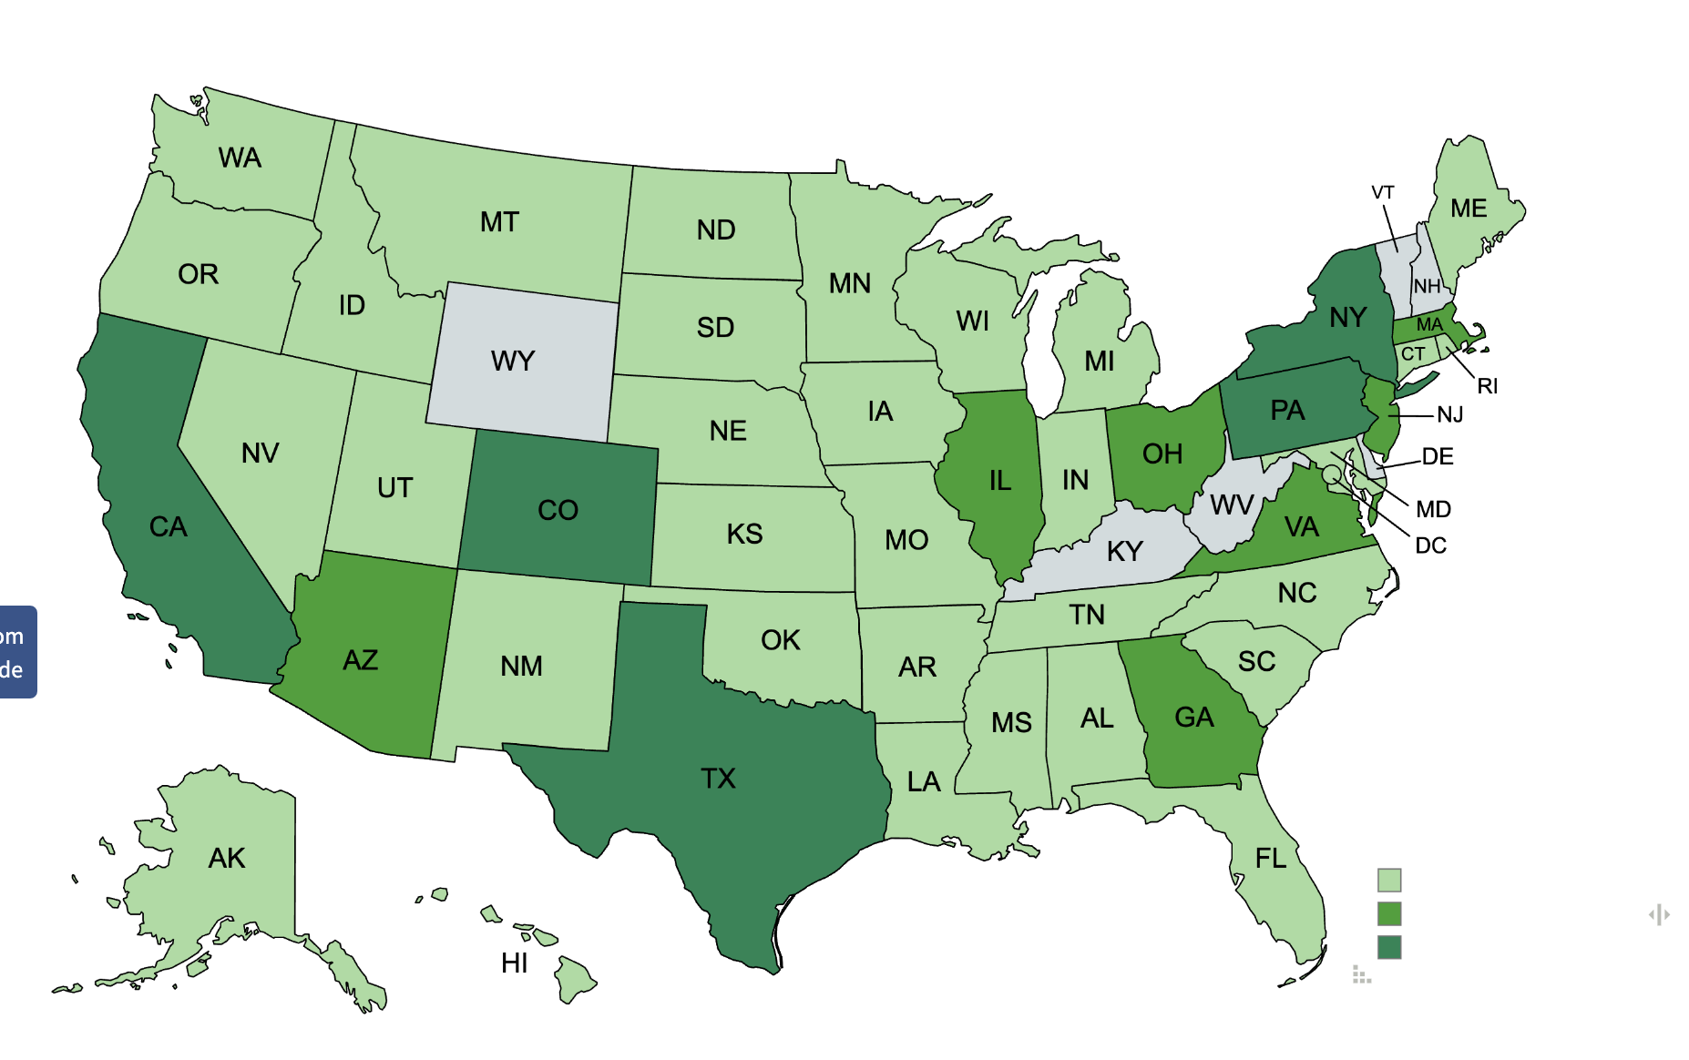
350 Cases over 6 years
Plus 22 Countries
Notes:
Dark green - over 20 - CA, CO, NY, PA, Texas. Middle green 10–19; light green 1-9

Slide 11
Analysis Basics for 350 Cases (cont)
221 cases were with Partners
Slightly skewed as we added Partners to EPOC often based as who we had done a lot of work with
LEARN - 31, GPN and FRGP - 25
57 with outside associates
IRNC, perfSONAR, Globus

Slide 12
Analysis Basics for 350 Cases (cont)
Participants
~280 Cases has only 1 institution
~35 Cases had 2, rest had 3-8
216 unique institutions
About half only involved in one case, half in more than one
We did have some “Frequent Flyers”
Kent State, TAMU, University Central Florida, ASU among others
Notes:
XX I don’t think I should mention “frequent flyers” by name

Slide 13
Topic Tags for Cases
Data Architecture 93
Transfer Performance 70
perfSONAR 63
Grants 62
DTN 52
DMZ 50
Security 32
Routing 25
Deep Dives 23
Globus 21
Network Engineering 21
Science Drivers 21
Training 16
DME 15
NetSage 15
EPOC Info 12
Capacity/Baseline 10
HPC 7
IPv6 3

Slide 14
What have we gotten asked
93 Cases tagged data architecture assistance
Can you comment on this design
What do we need to think about to expand in this way
We’re looking at router X versus Y
70 Cases tagged for help with a data transfer problem
Trying to move data and its not going well
Often cases with these tags have secondary tags for help with DMZ, data transfer node, or perfSONAR

Slide 15
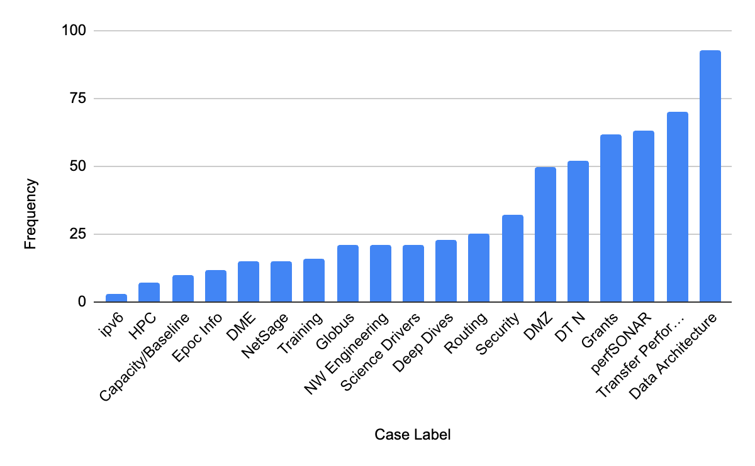

Slide 16
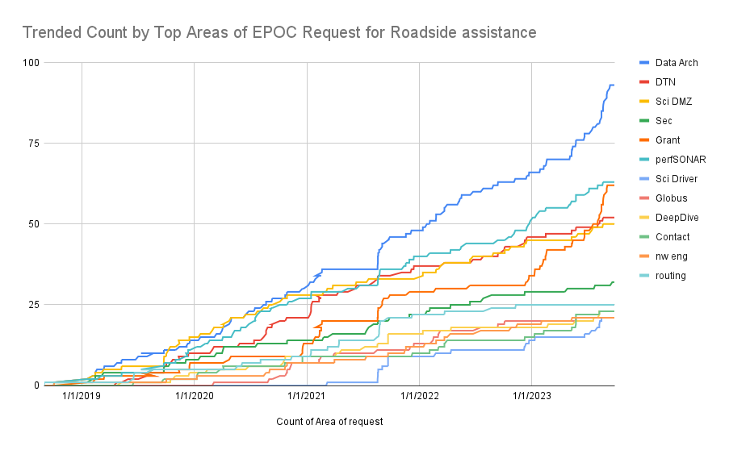
XX Line graph of tags over time

Slide 17
Changes we saw over time
Pandemic question shifts
March-April 2020 very quiet
By May, things picked up again
But time to closure on cases grew - some extended for over 12 months
Some question changes - use shift from solely R&E Networks to mixture with commodity
When CC* expanded to include HPC, we started getting HPC questions
When we tried to push something out, for instance:
RouteViews, MANRS
Notes:
The landscape is always changing, and the questions we get asked often coming in cycles

Slide 18
Changes we saw over time (cont)
6 weeks leading up to CC* deadlines
Increase in data architecture reviews
Increase in requests for Letters of Collaboration
After we do a Deep Dive
Institutions often open several cases for DD actions
Example - University Central Florida Deep Dive, led to numerous questions on campus, and our ongoing involvement with Arecibo

Slide 19
What Questions Didn’t We See
Condor/PATH
ACCESS
FABRIC
SDN/Automation/Orchestration
OSN
They have their own support communities
Which highlights the most important piece of our shared R&E infrastructure: community!

Slide 20
What’s Broken in the Network?
MTU mismatch over the path
Routing over commodity not R&E
Routing over small vs large pipes
Endpoint behind firewall(s) (or bad firewall policies)
Edge routers to building- last mile problem
Datacenter TOR vs DTN class equipment (mismatch for large flows)
Lack of comms between communities, missing science drivers - Data architecture built for wrong use case
Design, plan, and build to build vs for science
Vendors may sell you gear that doesn’t match your needs
Just because you’ve always done it that way, doesn’t mean you should keep doing it that way

Slide 21
What all of this looks
like in the real world
Real solutions for real problems, and what we learned along the way
National Science Foundation Award # 2328479
https://epoc.global

Slide 22
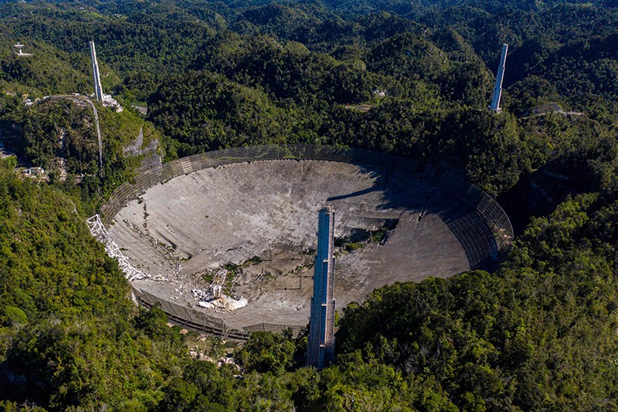
Facilities Break and need a Community to fix them
Arecibo Observatory: Tuesday,December 1st, 2020
Data Center Building 1.
Notes:
10 meters away from primary data center building 1
Tower 8 when it fell made a hole into the road (5m deep)

Slide 23
The ask: Get the DATA to a safe, stable place
3 Petabytes of Golden Copy, nowhere-else-data…
Fiber from Arecibo to the coast is cut
Network Attached Storage (NAS) “Appliances” being used via sneakernet
~100+ Terabytes at a time. (Full capacity of NAS device in RAID-0).

Slide 24
MISSION: Get the DATA to a safe stable place
Onsite team hand carries this priceless data to the closest 10GbE link
Transfers on 10GbE link only performing at MB/s with PB to go!
Data movement calculated at a scale of years
Initially, things don’t look good…
Operations teams working harder than ever, hand carrying copies of priceless scientific data to safety.

Slide 25
Call for assistance - EPOC
The challenges:
We can’t just ship hardware as the site is shutting down and not accepting ANY new installations
There’s a Global PANDEMIC
Closest 10GbE link an hour drive away
But, we have human resources!

Slide 26
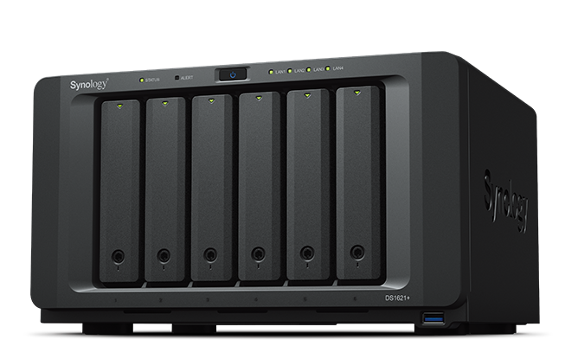
Hope… Call for Backup helps! “Hey, EPOC.”
Commodity Network Attached Storage devices are small but, mighty solutions that can be tuned
EPOC drop ships a NAS device to one of our engineers to see what performance gains are possible
Considerable experience with Data Transfer Node tuning
Has seen what good looks like, knows too well what bad feels like.
Backup crews: EPOC, TACC, folks at the site itself!

Slide 27
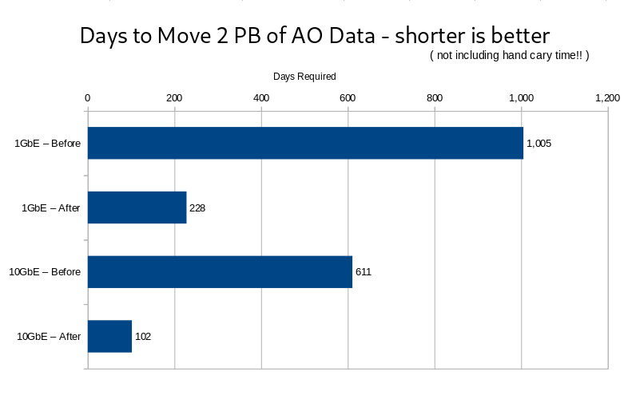
Real World Results: Just under a 6x boost…

Slide 28
Move that data! Just under a 6x boost…
Before tune applied:
1005 days on a 1GigE path 611 days on a 10GigE path
After tune applied:
228 Days on a 1GigE path
102 Days on a 10Gige path
Out of a commodity NAS device (Amazon)… SPOILER: The primary Golden Copy data is SAFE!!!

Slide 29
Lessons learned…
The network is part of the instrument!
NSF’s 2011 Data Management Plan requirement:
https://www.nsf.gov/bfa/dias/policy/dmp.jsp
Reminder to Facilities, both large and small - Make SWOT analysis a regular part of your infrastructure plan:
The data management plan
Replica site(s)
Backups
Fiber paths

Slide 30
AO Part 2
Closed August 2023
Team from TACC Deployed May 2023 to save the Data
Approx 60 years of data history was condensed down to 4 pallets
Data Currently at TACC
3 PB Online
Approx 3000 tapes curing

Slide 31
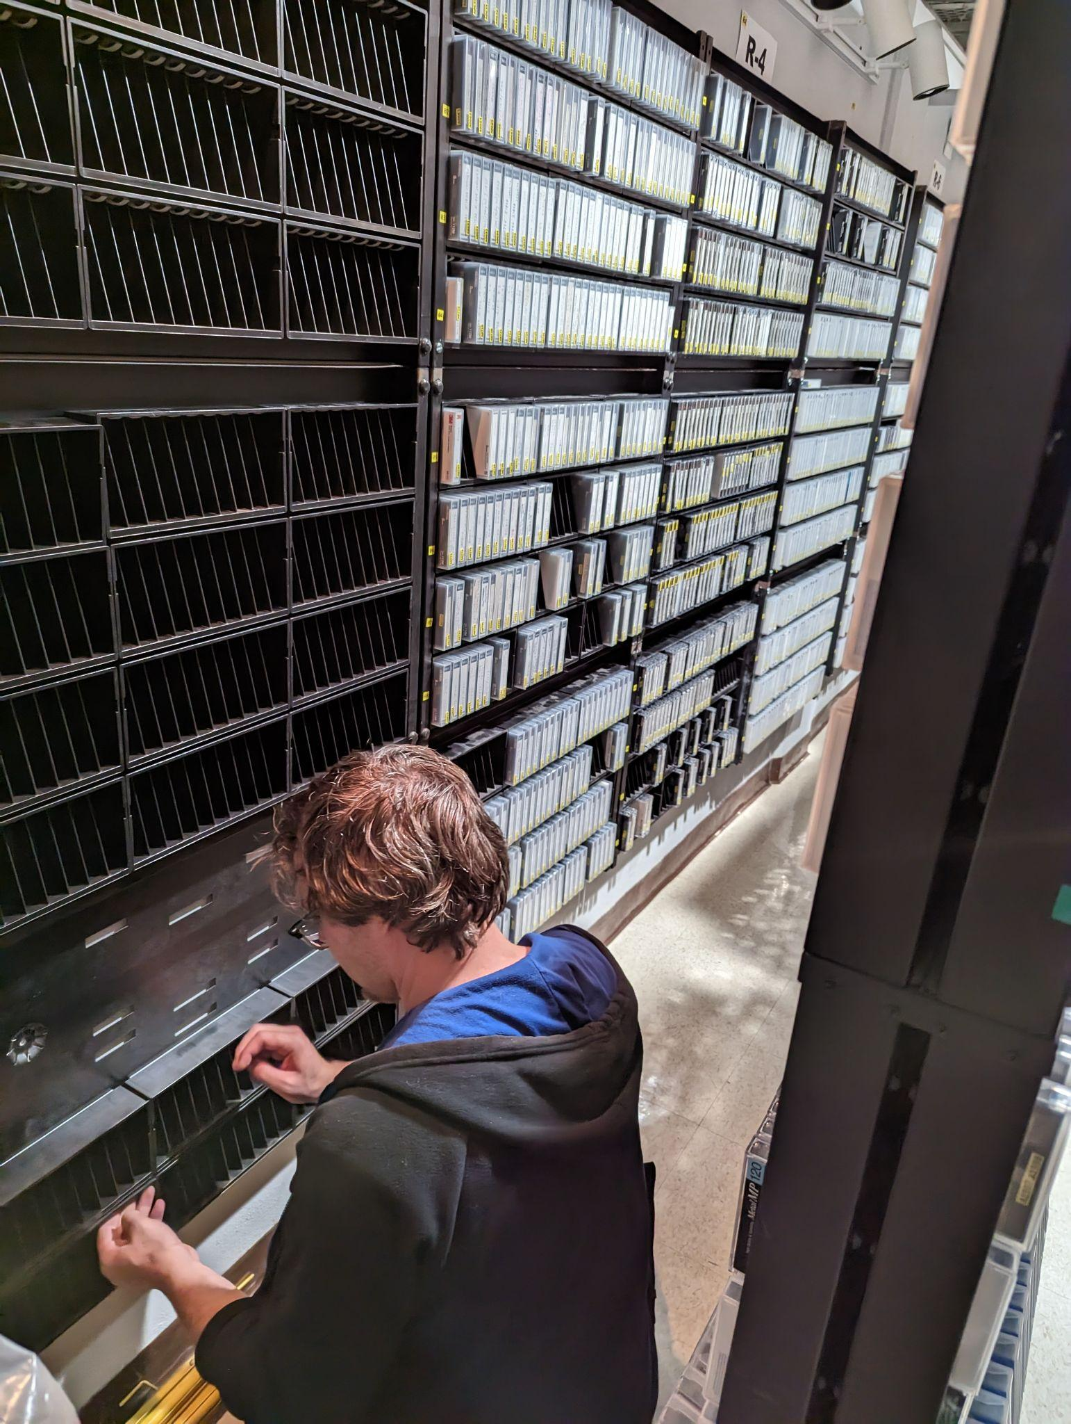
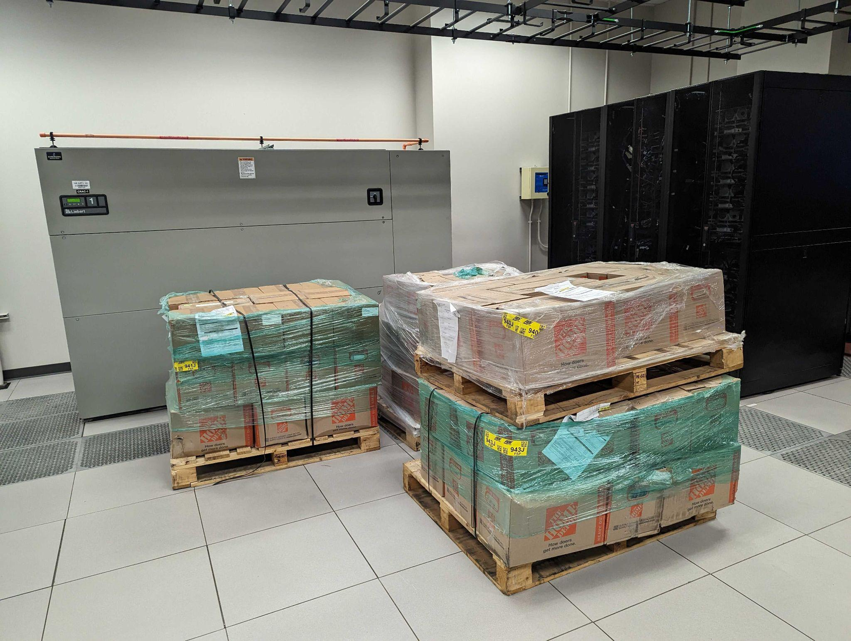

Slide 32
Networks Break and need a Community to fix them
The case: COSMOS (www.cosmos-lab.org)
an advanced city-scale testbed supporting experimentation on next-gen wireless technologies
collaboration between researchers at the City College of New York and Kyutech Institute in Japan
The challenge: Networking
…it’s always the network

Slide 33
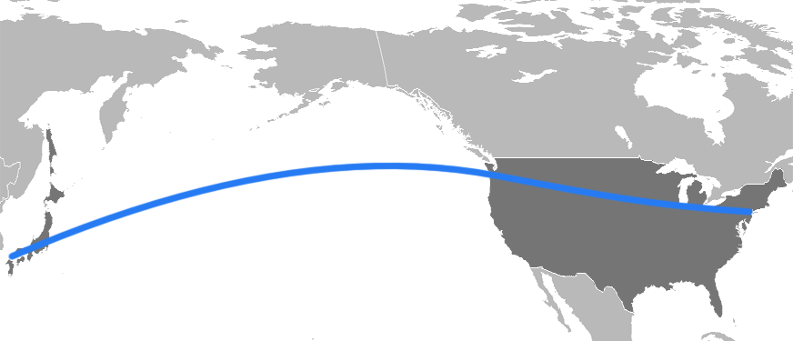
Initial troubleshooting
Used perfSONAR nodes along the path to test to closest open node available-at ManLan.
Nodes located at
APAN/Tokyo
TransPAC/Seattle
Internet2/Chicago
NEAAR/ManLan
TransPAC
Internet2
NEAAR
APAN
Testing to NYC showed good performance and no packet loss- indicating problem was likely within CCNY
Notes:
These tests were conducted outside of CCNY from four publicly available perfSONAR nodes that were situated along the same network path as the CCNY GRE tunnel. At the time of this testing there were no perfSONAR nodes on the CCNY campus.

Slide 34
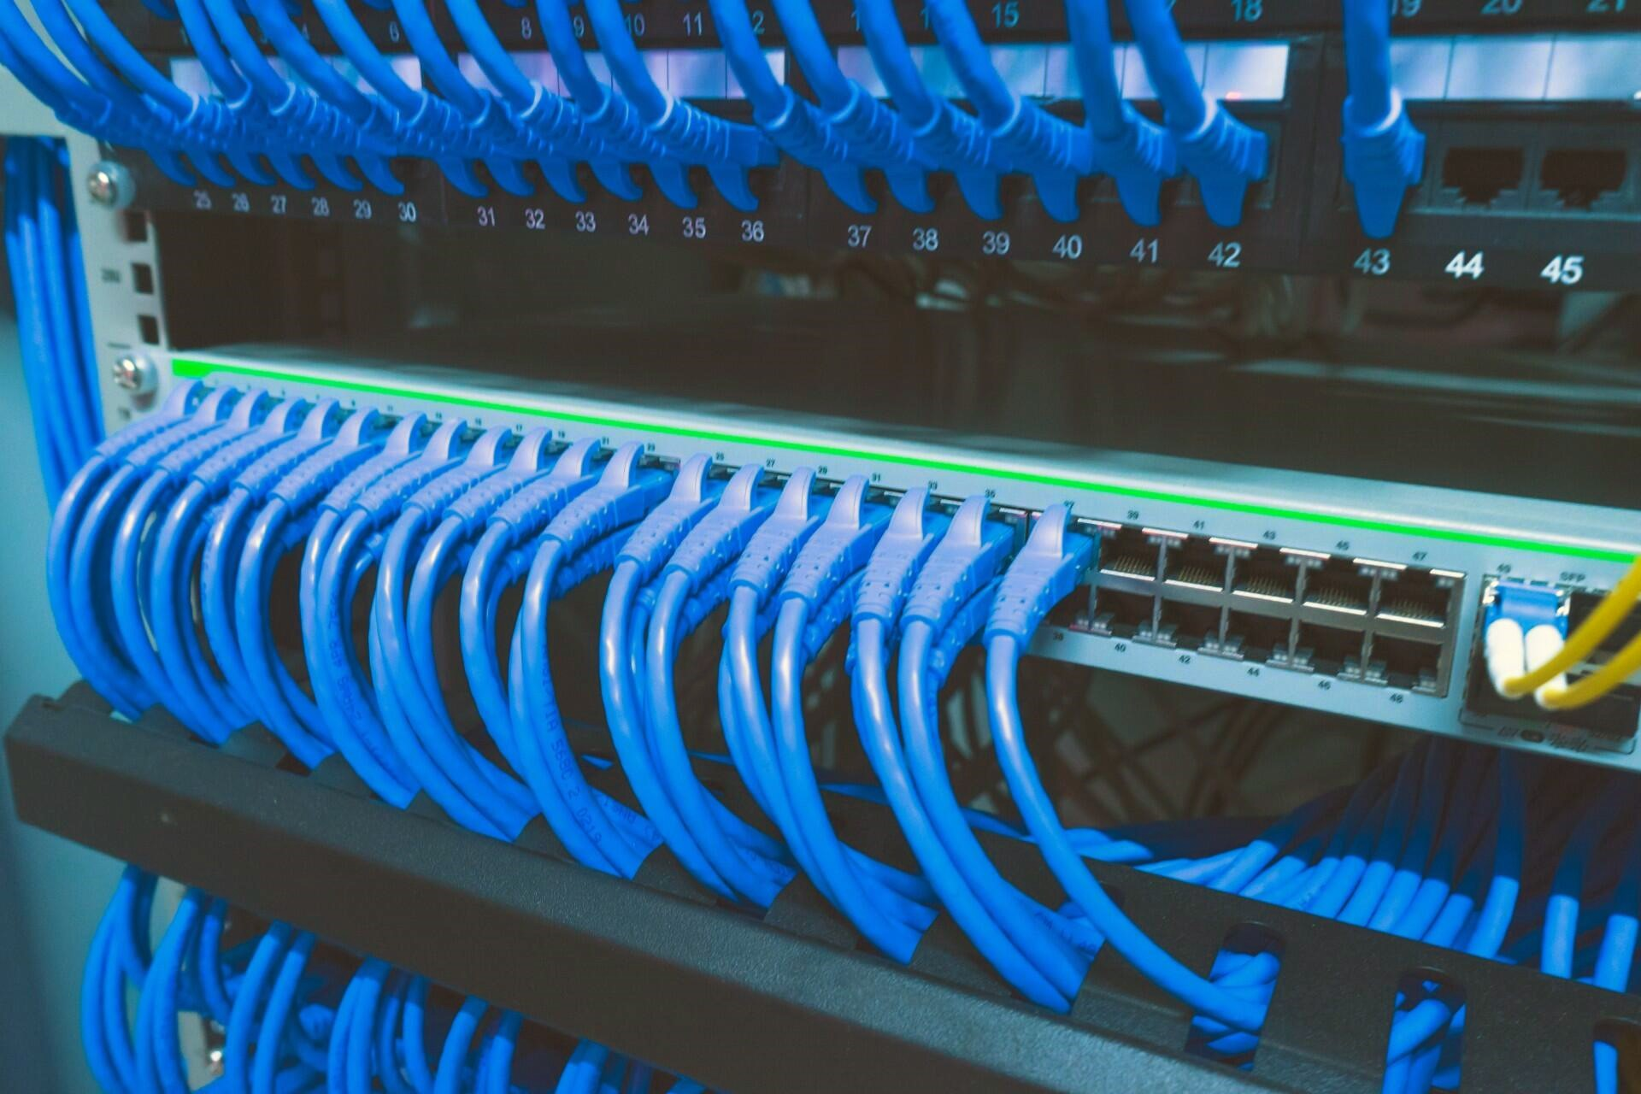
Internal troubleshooting
CCNY and EPOC engineers installed perfSONAR node in researcher’s lab
Tests from prior locations to lab showed same packet loss as original problem
Verified issue within campus
Notes:
Testing was completed from the newly installed perfSONAR node in the researcher’s lab on the CCNY campus. This testing did not involve the GRE tunnel.

Slide 35
Regional troubleshooting
NYSERNet
Regional network for NY
Provides R&E connectivity for CCNY
Engineers installed a new CCNY pS node at campus edge
Testing edge to lab
Packet fragmentation and MTU issues on the ingress path to CCNY
Packet loss isolated to specific segment of the CCNY campus network
Notes:
NYSERNet perfSONAR node located at the same point in the network where CCNY’s connectivity originated.

Slide 36
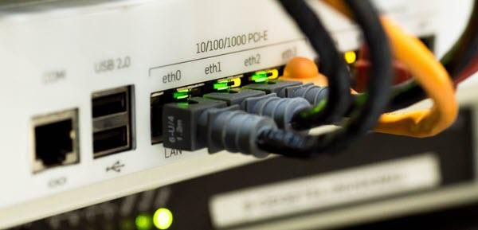
Problem located
With this data
CCNY engineers did additional local troubleshooting
Cause identified as outdated network security device
Replacement had been scheduled, expedited due to results
After replacement
pS tests verified performance was greatly improved
Notes:
Specifics about the updated equipment are unknown, with CCNY citing “security concerns”.

Slide 37
Final Results
CCNY/JGN GRE tunnel shows consistent, symmetric performance
JGN 🡪 CCNY (TCP)
No packet loss
80Mbps throughput
CCNY 🡪 JGN (TCP)
No packet loss
85Mbps throughput
10-fold improvement
CCNY
Kyutech Institute
Notes:
There was no actual expected performance number that was communicated to us, other than that JGN (reasonably) believed the performance should at least be symmetric.

Slide 38
This Isn't Even My Final Form!
While fixing the issues with their GRE tunnel was helpful to COSMOS researchers, they quickly outgrew their 80Mb bandwidth limitation
This led to a much larger discussion about architecting an entirely new solution
EPOC-led engineering support included:
Notes:
There was no actual expected performance number that was communicated to us, other than that JGN (reasonably) believed the performance should at least be symmetric.

Slide 39
The Next Phase
The result of this collaboration?
3 new VLANs established between CCNY and Kyutech
Bandwidth increased to ~900Mbps, nearing the limit of the 1Gbps connected endpoints
CCNY
Kyutech Institute
8Mbps → 80Mbps → 900Mbps, decreasing time to science!
Notes:
There was no actual expected performance number that was communicated to us, other than that JGN (reasonably) believed the performance should at least be symmetric.

Slide 40
Lessons learned…
Not all research requires Tbps performance, but performance still matters
Narrowing down the problem before involving engineers is helpful both technically and politically
Match effort, don’t just make it the campus engineer’s problem
Soft failures (performance) can pop up anywhere, and often go unnoticed for long periods of time
Notes:
vs a hard failure (fiber cut, switch down, etc)

Slide 41
Routes Break and need a Community to fix them
The case: GlueX (http://gluex.org/)
GlueX is a particle physics experiment located at Jefferson Lab in Newport News, VA. Its primary goal is to search for and study exotic hybrid mesons.
The challenge: Routing
…it’s always the network, part 2

Slide 42
Performance problem outline and initial steps
GlueX project transfer from Jefferson LAB to UConn
Poor performance reported to JLAB from UConn
Researcher seeing 225 MB/s(1.8Gb/s) peak, 150MB/s(1.2Gb/s) sustained with Globus
Completed perfSONAR baseline
perfSONAR iperf3 was 8-9Gb/s with 1500 MTU
but 2-3Gb/s when 9000 MTU
Discovered and fixed an ECMP misconfiguration
Retested 450 MB/s (3.6Gb/s) peak, 300MB/s (2.4Gb/s) sustained
Assisted in a BGP routing adjustment to separate commodity traffic from science traffic on a combined WAN link.
The “backup” or redundant path became the primary science path
This also moved science around the MTU mismatch
Notes:
The last bullets are the big ones - get the science off of the commodity link.

Slide 43
The results
GlueX project transfer from Jefferson LAB to UConn
Assisted in troubleshooting an MTU mismatch between regional network and Jefferson Lab
After MTU fix, perfSONAR iperf3 was 9.68 Gb/s with 9000 MTU
Asked researcher about data transfer expectations
They would happy with 600-800 MB/s (4.8Gb/s-6.4Gb/s)
Ran another baseline with perfSONAR and found clean path
perfSONAR iperf3 was 9Gb/s
Follow-up with Researcher to double check data transfer rate.
From Max burst rate I saw was 950MB/s (7.6Gb/s), with sustained rates in the range 500-700 MB/s (4 Gb/s-5.6Gb/s) over a period of 24 hours.
Science time saved: A 10+ day data transfer is now down to 2 days.
In 2024, DTNs are moving to 25 and 100G and we will test again

Slide 44
Lessons learned…
Routing, like puppies, can’t be left alone and expected to behave
Needs attention, care, and feeding
Large scale scientific workflows often don’t mix well with commodity internet, even if there’s large amounts of apparent bandwidth
Even in the 2020’s, large scale data movement is hard to get right and doesn’t “just work” out of the box
Notes:
vs a hard failure (fiber cut, switch down, etc)

Slide 45
Next Steps for RA and EPOC
Additional Best Practice documents
especially perfSONAR team
Extend offerings for
CUI/HIPPA
IPv6
Collaborating for MANRS and RPKI-ROA
Reach out to the CC* Awardees for planning/next steps
New NetSage capabilities (Globus, Rucio, perfSONAR)
In addition to the work we’ve been doing!

Slide 46
Take aways and Thanks!
Networks can break for technical reasons- AND for not technical reasons
EPOC has helped hundreds of teams solve these problems, and are a contact point for you as well
Feel free to reach out to us:
epoc@tacc.utexas.edu

