Slide 1
You Are In a Maze of Twisty Passages, All Alike
Ann Harding, TNC2024
12. June 2024
@hardingar@mindly.social ann.harding@switch.ch
Notes:
About me: Reliabiity engineering coach. Help teams be more stable.
This presentation is a view into human factors in technology, and standards that we can use to make the most of things. But first...

Slide 2
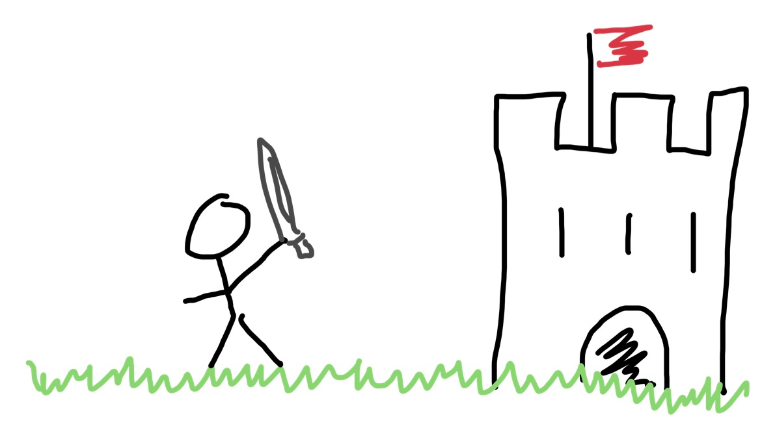
Once Upon A Time
Notes:
Once Upon A Time, NRENs were small. We had a very direct relationship with our users, not so much process and a small portfolio of services
Human skill and ingenuity was what we needed

Slide 3
Autonomy
Mastery
Purpose
Notes:
Pinciple: Build projects around motivated individuals. Give them the environment and support they need, and trust them to get the job done.
Daniel Pink’s book ‘Drive”
This was implicit in the early days of NRENs

Slide 4
Things got complex
Notes:
Network
Identity
Cloud
SaaS
Procurement
Collaboration
education
Legal

Slide 5
Task switching between two tasks at a time = 40% of your productive time for each and 20% lost to context switching
Task switching between three tasks at a time = 20% of your productive time for each and 40% lost to context switching
A team can only really manage 2-3 simple domains or one complex one
Notes:
When measuring cognitive load, what we really care about is the domain complexity
a single team (considering the golden seven-to-nine team size) should be able to accommodate two to three “simple” domains.
team responsible for a complex domain should not have any more domains assigned to them—not even a simple one.

Slide 6
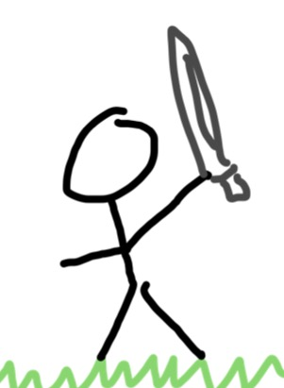
We grew bigger
Notes:
The mythical man month is an old and highly valid insight. Adding more people doesn't help. Why not?
When everyone is still a generalist, they are all context switching, plus now they have a bigger communication network.
A six-person group (the minimum group size fed under the Two Pizza Rule) has 15 links.

Slide 7
5 people can share close relationships and working memory
15 people can share deep trust
50 people can share mutual trust
150 people can roughly remember who does what
Notes:
Limit the size of multi-team groupings within the organization based on Dunbar’s number.
- Dunbar found fifteen to be the limit of the number of people one person can trust deeply.
- By team, we mean a stable grouping of five to nine people who work toward a shared goal as a unit.
- A single team: around five to eight people (based on industry experience) In high-trust organizations: no more than fifteen people
- Families (“tribes”): groupings of teams of no more than fifty people
- Several squads that work on similar areas are collected into a tribe, a sort of affinity grouping of squads. The squads within a tribe are familiar with the work of other squads and coordinate inside the tribe.

Slide 8
There are new risks
Notes:
We change, but the environment we work in also changes.
Cynefin
CLEAR - majority of previous challenges.
COMPLICATED - unclear but knowable
COMPLEX – No single cause and effect path
CHAOTIC
Ref Renato on VUCA

Slide 9
The human toolkit
Fast thinking
Simple
Unconscious
Automatic
Error Prone
Slow thinking
Complex
Conscious
Effort
Reliable
Daniel Kahneman, Thinking Fast and Slow.
Notes:
What does our NREN knight do when confronted with a dragon?
Examples of system 1 thinking:
Adding 2+2
Reading a simple roadsign
Identifying a basic alert
Good for clear challenges - everything else you need system 2
Examples of system 2:
Planing, complex debugging, crisis management.

Slide 10
Autonomy?
Mastery?
Purpose?
Notes:
Time to break out the reinforcements.
Standards to minimize the amount of invention and replication and to provide common vocabs etc.
Standards to help us THINK

Slide 11
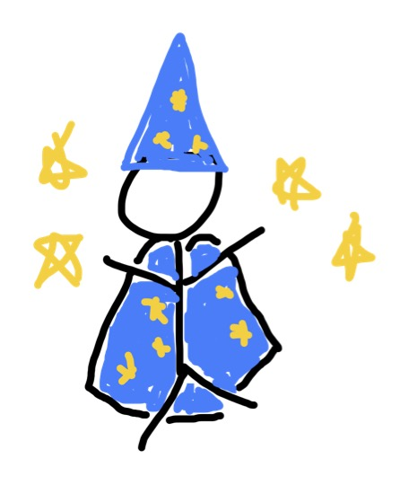
Team Topologies – The Wizard
How to organise for flow and autonomy
Platform teams, enabling teams, stream aligned, specialist.
Interaction modes – as a Service, collaborative, facilitating
Primary ability: Manipulate the structures of reality (the reverse Conway)
Cost to play: Material freely available, consultancy from the originators
Notes:
Limit cognitive load - identify areas of autonomy
How we organise behind individual processes
Conway: Organizations which design systems (in the broad sense used here) are constrained to produce designs which are copies of the communication structures of these organizations.
Reverse: break down your organizational silos to deliver something that can flow. What drives your flow? Your purpose, not your structure.

Slide 12
The Cleric – ISO27002
Magic in the service of a higher power (information security).
Extensive list of spells (ISO controls)
Primary Ability: Wisdom.
Cost to play:
ISO 27001 Certification can run to 100k+
But the controls list ISO27002 is 130chf per person
Notes:
ISO27002 provides controls (what, high level )and guidance – ideas how to do it.
Organisational, people, technological, physical.
Certification based on ISO27001
Can seem a bit obscure/threatening and alienating.
There's a risk of paying only lip service to the rituals.
Certain 'sects' involve a lot of expensive consultancy and rigid obedience
Even if you don’t adopt it there’s merit in using it as a way to ask questions without having to think them all up yourself.
Even if you are not in infosec, as an architect, or scrum/devops person there’s things of value in here.

Slide 13
The Bard – ITIL4
A versatile selection of songs (ITSM practices) for any occasion
A bit lighter than they used to be but generally more crowd pleasing if repetative.
Primary Ability: Charisma
Cost to play: ITIL practice manager courses – c 3 to cover the ITSM practices 3.5k each, then c250 per practice exam
Peoplecert membership 115 a year, access to ‘selected resources’
Notes:
Recently relaunched. ITIL3 much more proscriptive
Charisma. Sounds good.
Works well as an appeal to authority.
Says it providfes ‘practical’ guidance. Not practical IMO, still useful.
ITIL4 has
14 general management practices
17 Service management practices
3 technical management practices

Slide 14
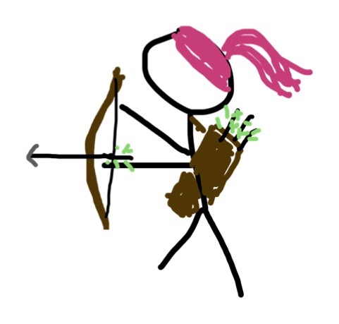
The Rangers – DevOps and SRE
The first and often the last lines of defense.
Primary Ability: Magic and combat in one
Cost to play:
SRE Material is mostly free or attending conferences or book based
DevOps can be highly formal like ITIL (SAFe certification) or also free/effort based
Notes:
DevOps & SRE – Dexterity and Wisdom
Combats threats on the edges of civilisation
Tracker with some spellcasting ability
Individuals and interactions over processes and tools Working software over comprehensive documentation Customer collaboration over contract negotiation Responding to change over following a plan
Material is mostly free or attending conferences or book based (O’Reilly subscription – SLI/SLO book)
For devops, free if you hunt but if you latch on to certification, something like SAFe can cost like ITIL
Even SAFe material is free but annoying copyright c/p artefacts will follow you

Slide 15
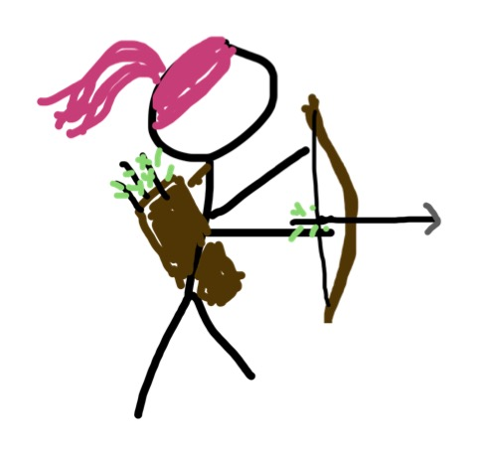
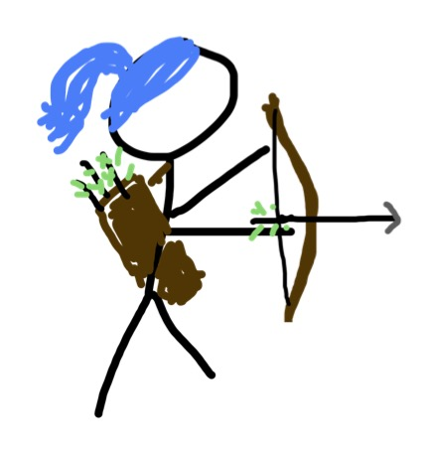
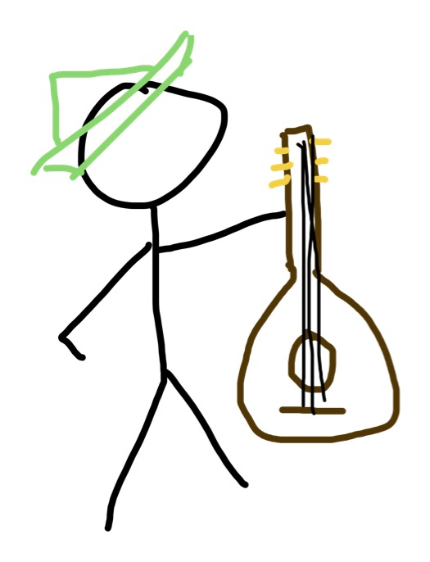
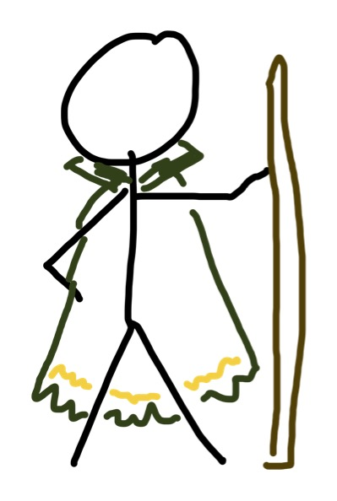
Let’s roll some dice - Incidents
You should have a coms lead and tech response/ops lead too
Automate and scale e.g. SLOs, status pages, runbooks
May be no single root cause
Respond to change over having a plan
Holistic blameless review
Have an incident manager
Swarm to assemble team
Have a comms plan
Workarounds are fine
Keep an eye on technical debt
Establish incident response process with competent staff
Have ways of identifying and assessing incidents
Collect evidence
Do reviews
Notes:
In this example you can combine all the options into a coherant plan
ISO has 5 controls related to incident response
Automate the clear, and respond to change on the rest

Slide 16
Let’s roll some dice - Changes
Empower teams to manage risk
Automate
Concrete deployment strategies
Fast recovery
Know what users want from availability and performance
Change enablement
Not all changes can be handled the same way
Risk and throughput
Change authorities, not change board
High level process structure and roles, choice in method
Plan, assess impact, get authorisation, communicate, record changes.
Test and acceptance, deployment plans, fallback options.
Agreed rules, formal documentation, QA etc.
Notes:
ISO is stricter on authorisartion and segregation of duties.
ITIL4 has moved on from CAB approach as it has not proven safer and is slower
Here, you have to make some decisions on approach
If you are empowering teams, document and commit to this in order to address ISO controls.
SAFe CALMR culture, automation, lean flow, measurement, and recovery.

Slide 17
All Models Are Wrong But Some Are Useful
Notes:
Relationships
Models cannot achieve the complexity of reality.
Humans are especially complex. Nonetheless, they are useful, especially where they are Simple but evocative and cause us to pay attention to constraints and limits
George Box, 1976
There are some challenges to Dunbar's work on the precise numbers.
There are some challenges to reverse Conway as 'hard'
17 ITIL practices have a philisophical background or alignment with 41 ISO controls.
SRE and DevOps principles are generallly repeating and reinforcing and more detailed.
With this much convergence we don't need to reinvent wheels.
We save our valuable slow thinking for answers, not questions.

Slide 18
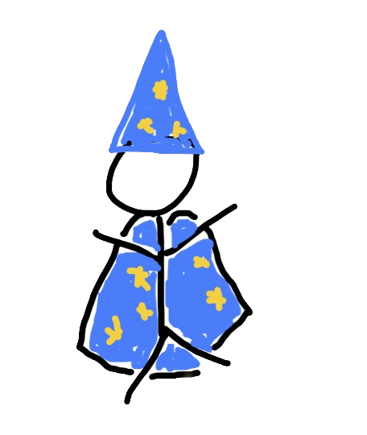
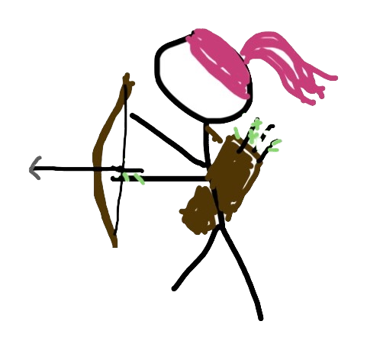
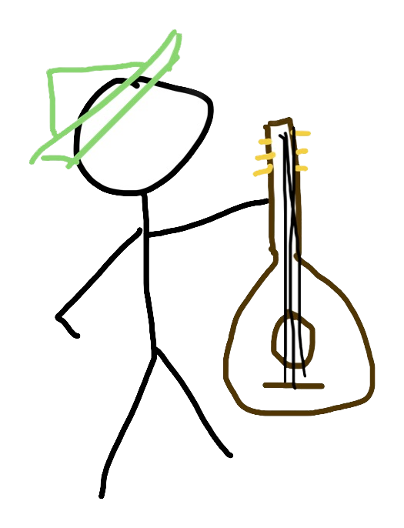
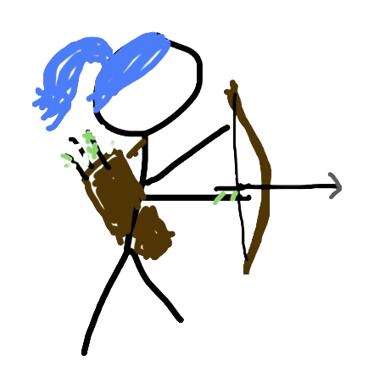
Better together?
Can we get NREN rates for standards/publications access from ISO, Peoplecert and O’Reilly?
SREcon and many conferences already give discounts for non profits.

Slide 19
Autonomy!
In carefully designed scopes
Mastery!
With the help of standards
Purpose!
Where we make a difference

Slide 20
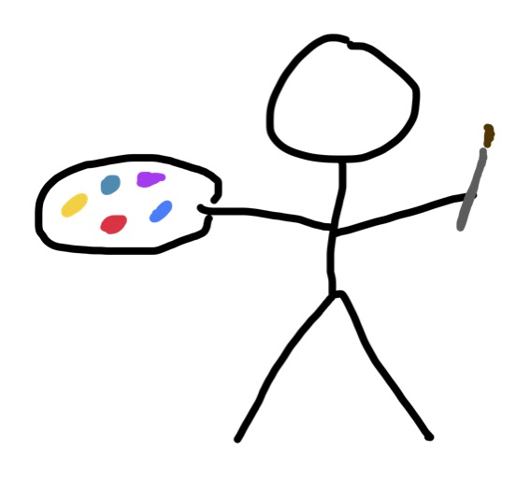
No artists’ livelihoods were harmed in the making of this presentation.
Notes:
all images drawn with my index finger on Freeform on an ipad

