Slide 1

Title slide
The end of
dead ends
Peter Havekes & Marlies Rikken

Slide 2

Intro
Logging in has been solved
in both mesh & hub + spoke federations
Most issues arise with access management to applications

Slide 3
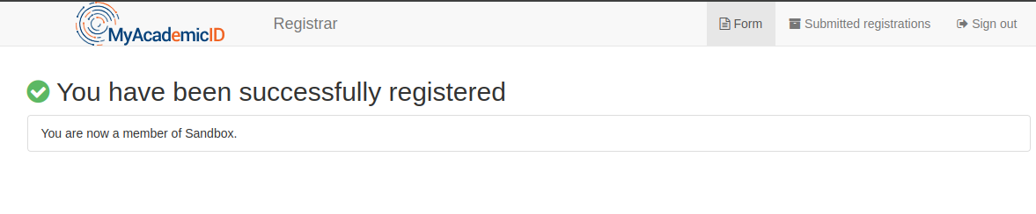
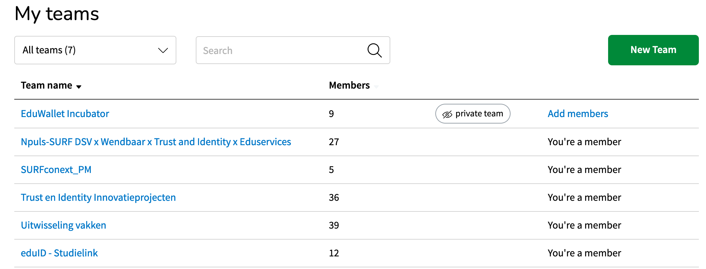
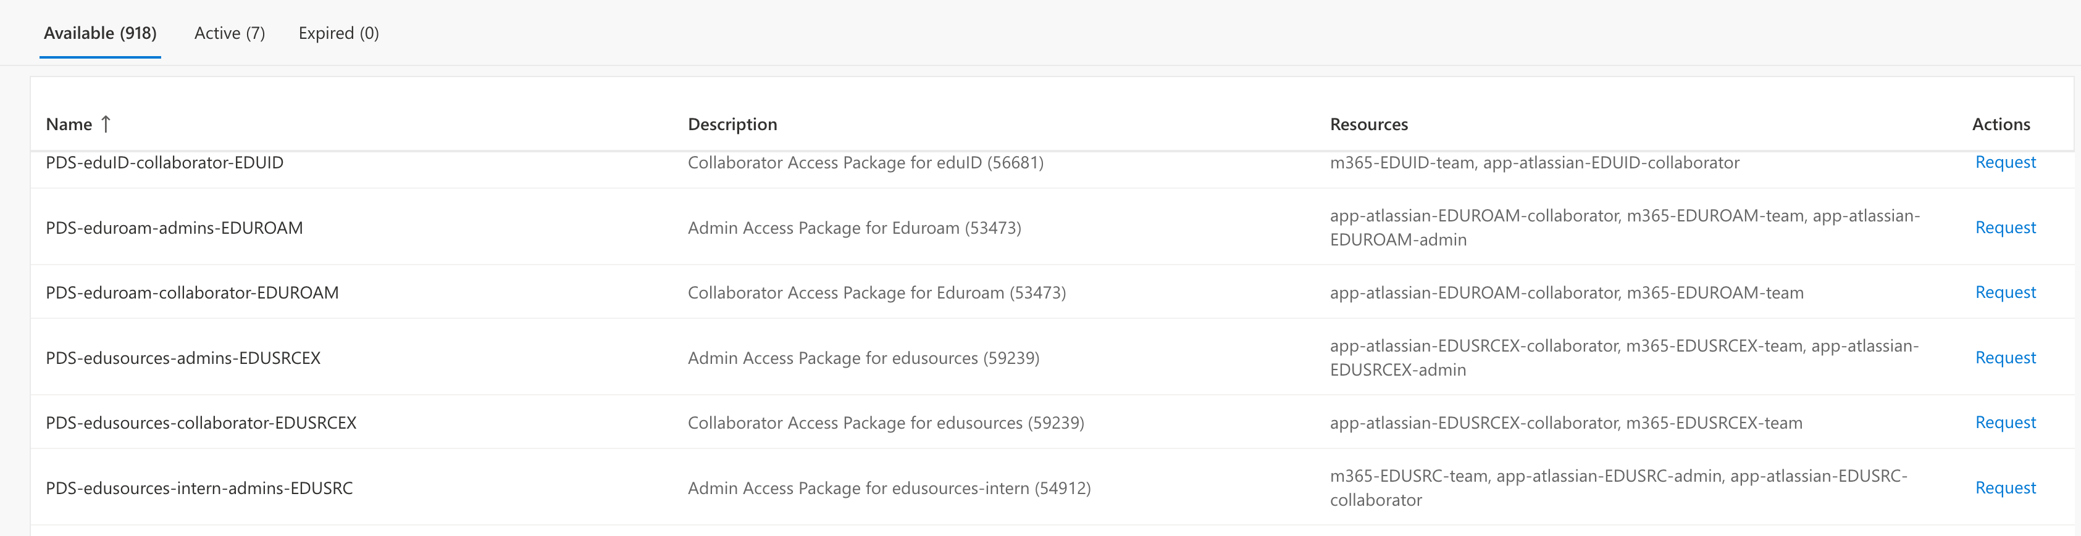
A few examples of the current situation

Slide 4
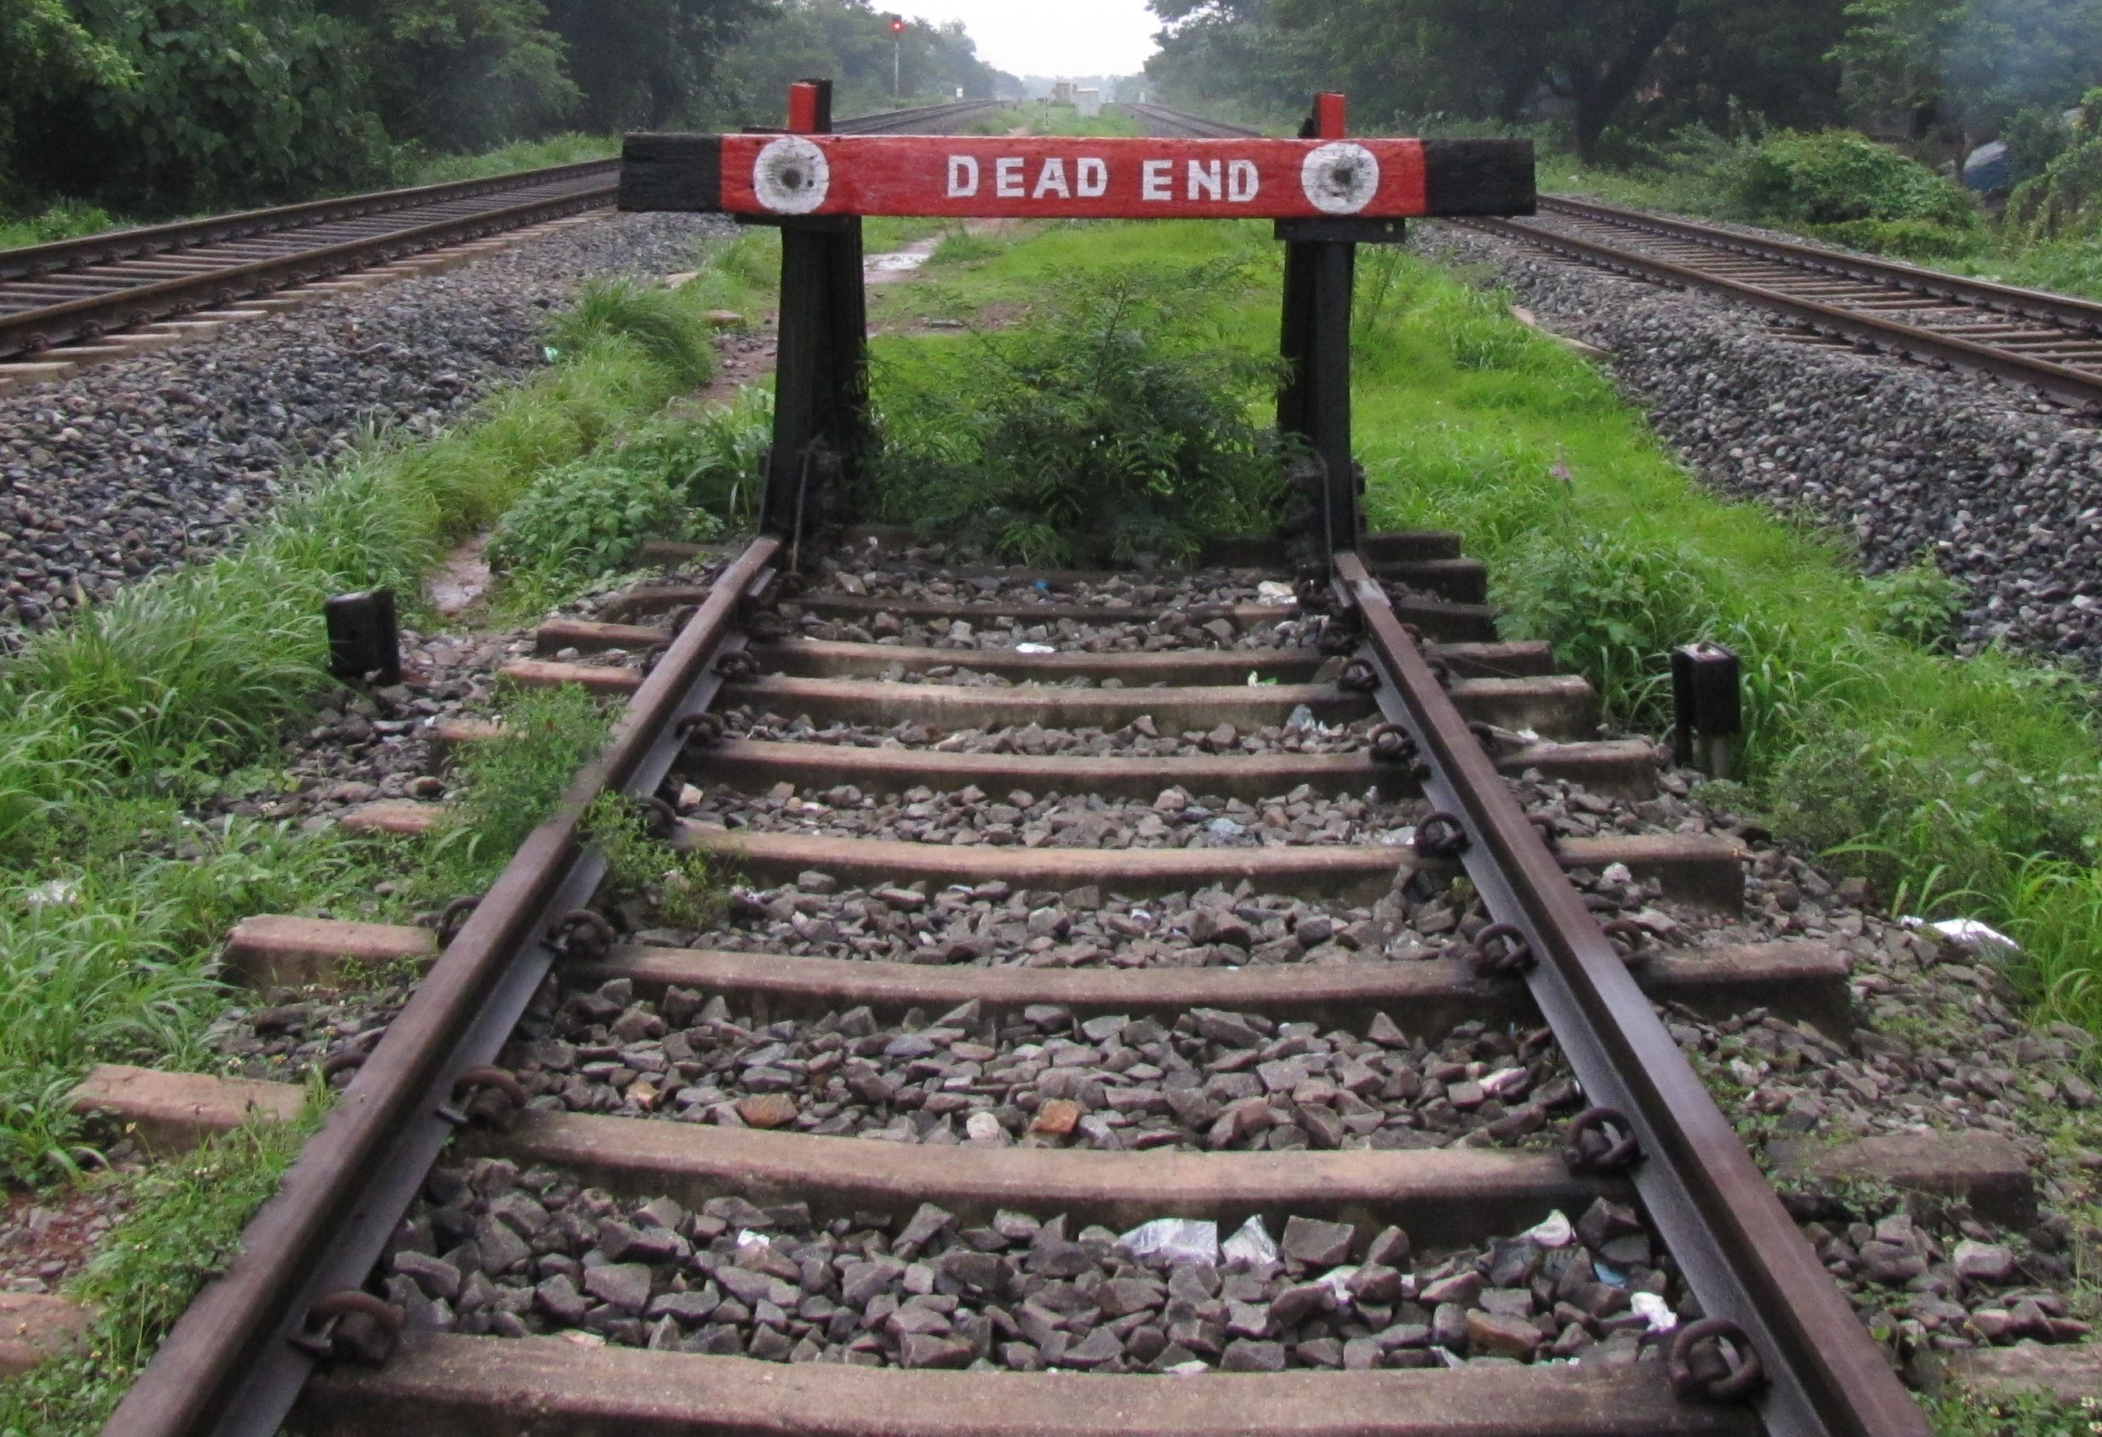
What is going wrong?
  I think someone gave me access but where do I go now?
  No end dates, access exist indefinitely
  Too many places where access rights are managed
  Manual actions lead to mistakes and risks
  Employees leave and access rights lists become unmaintained
  Request account first, request access later

Slide 5

So who’s bothered?
    The institute has security and privacy risks
    The admin is faced with a mess of rights and users
    The users have trouble finding their way

Slide 6
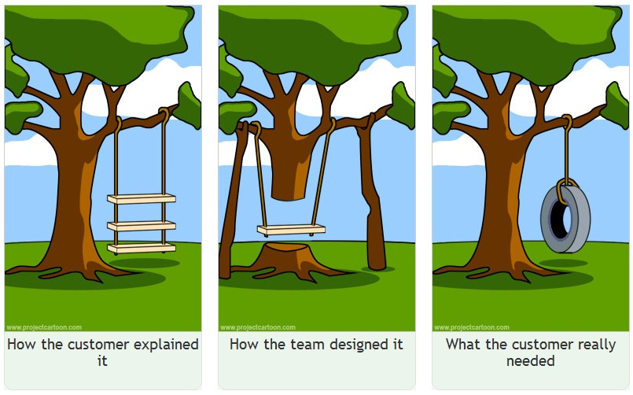
What does the user want?
    I just want to access the application and content I need.
    Yet we confront the user with lists, wait times and dead ends..

Slide 7

How do we fix it?
    Make the life of inviters and users easier!
    Simplify the process of giving users access (inviting)
    Provision real time, after invite is accepted
    Link user log into the application
    Enforce end dates for users
    Use any account in the federation or eduID. BYOIdP!

Slide 8
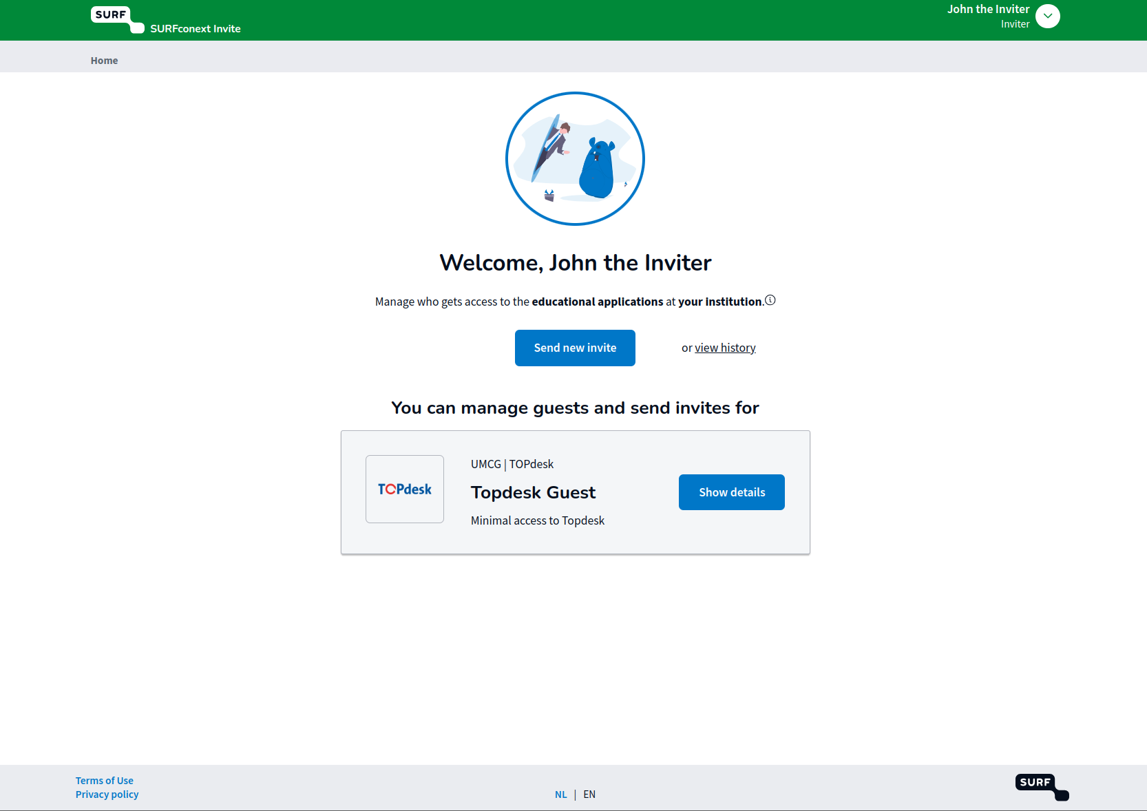
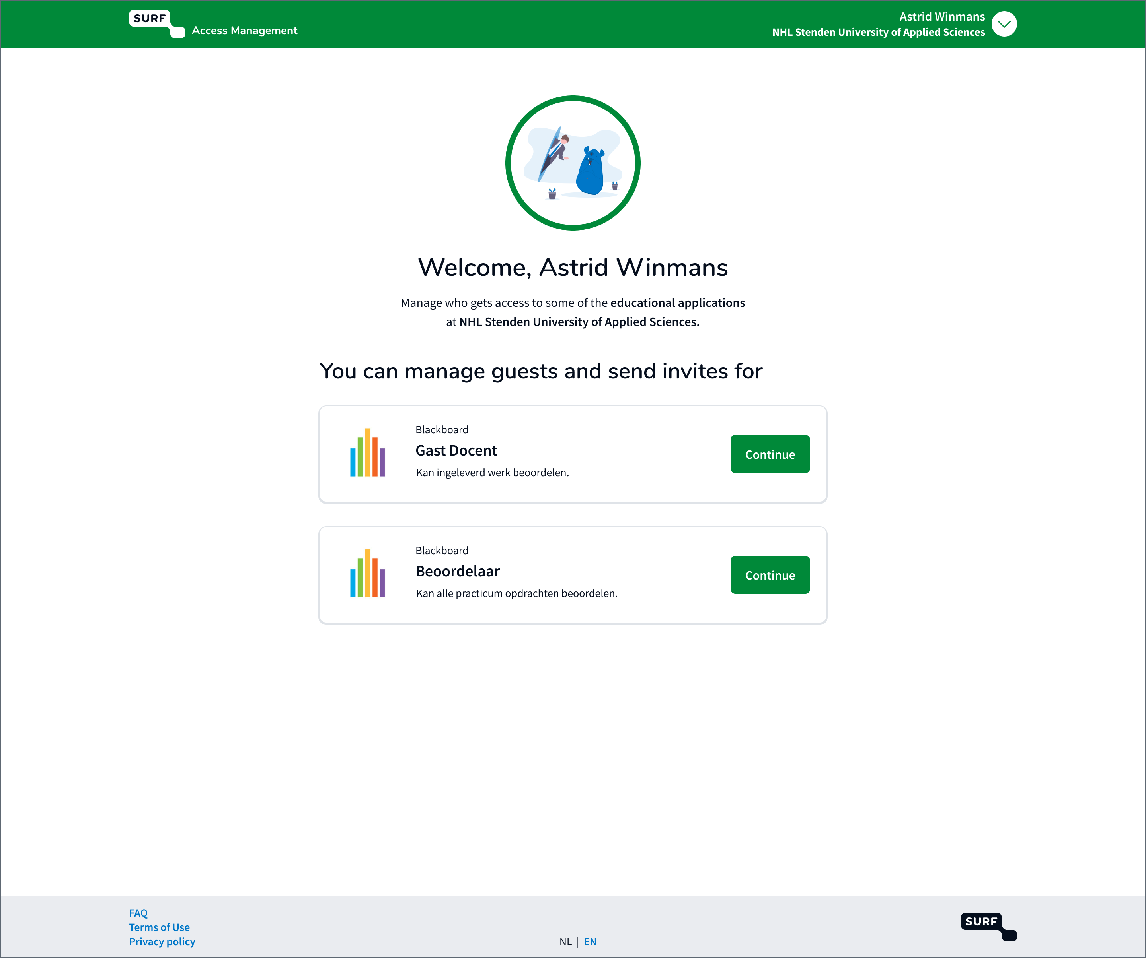

Slide 9
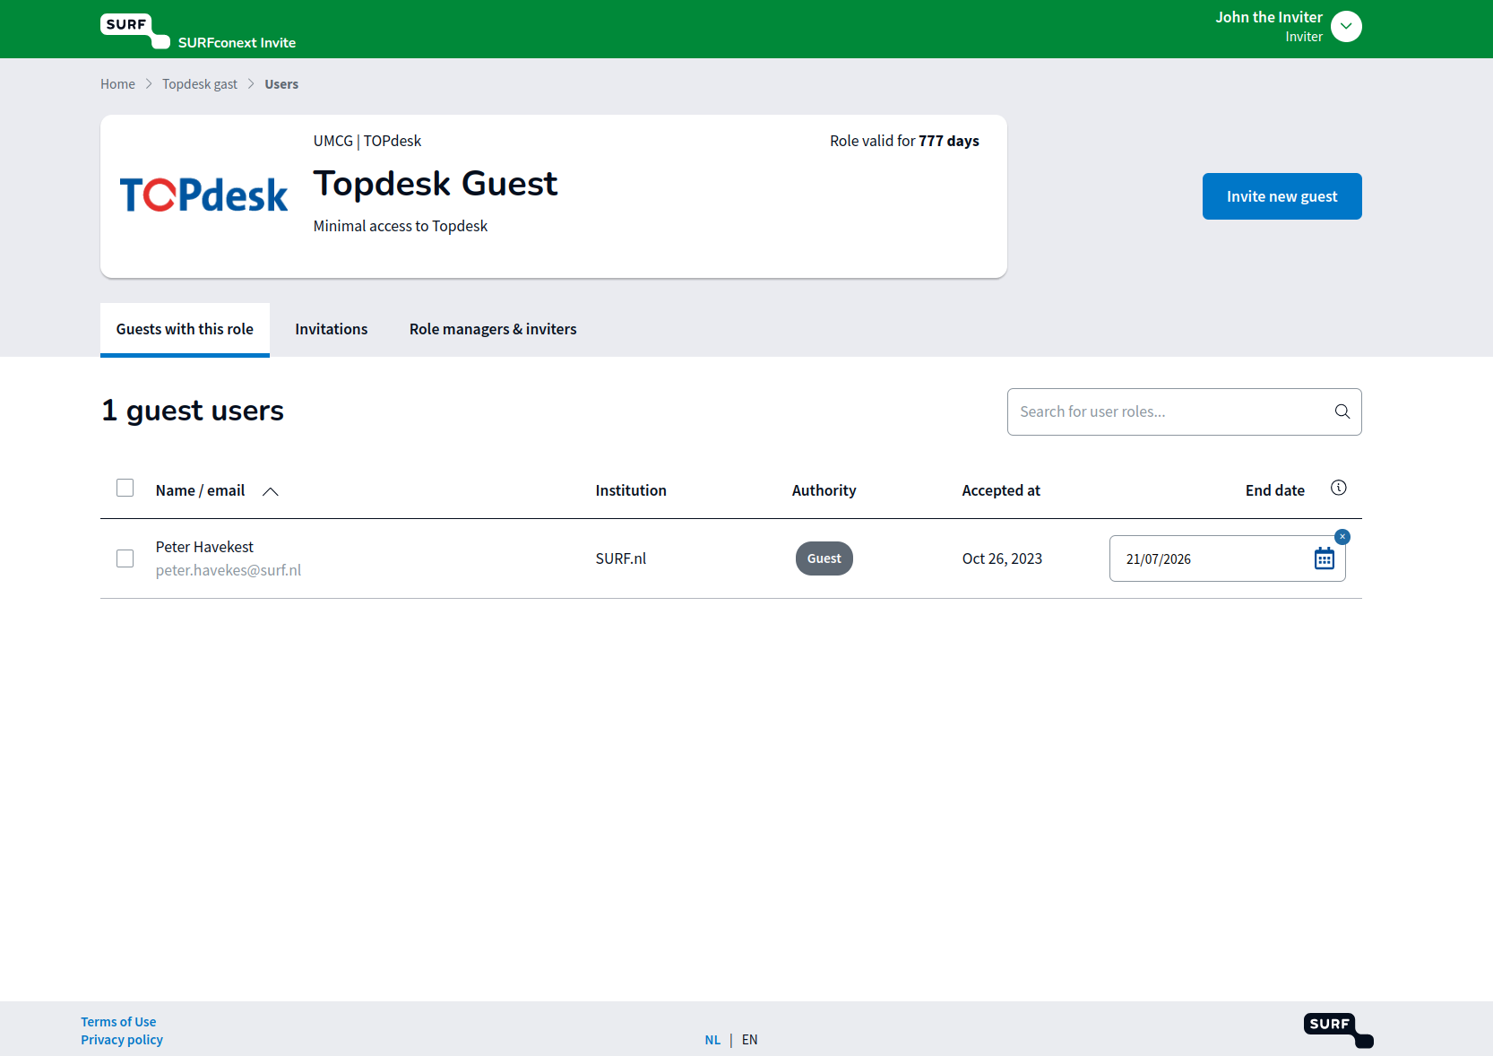
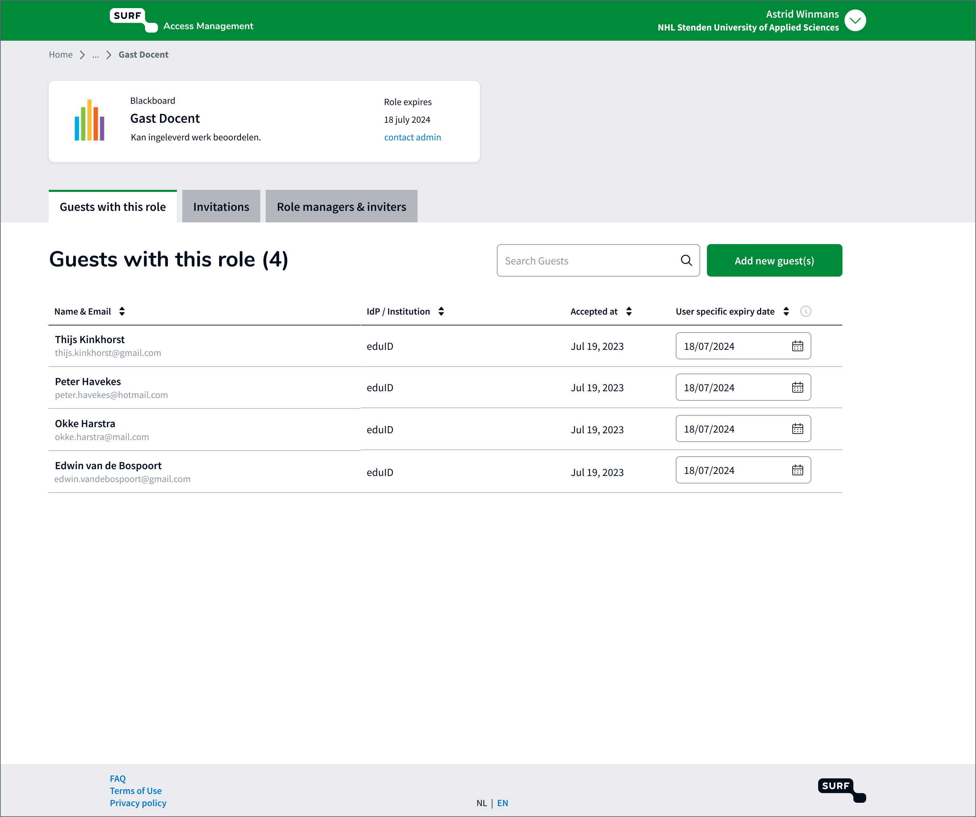

Slide 10
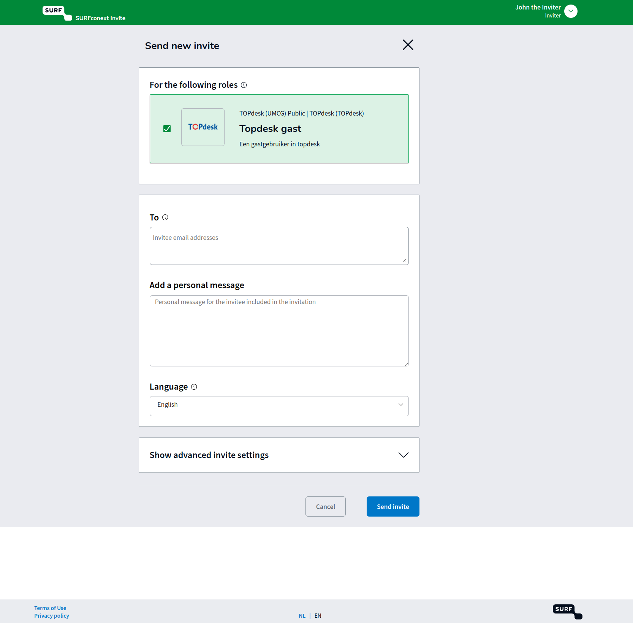

Slide 11
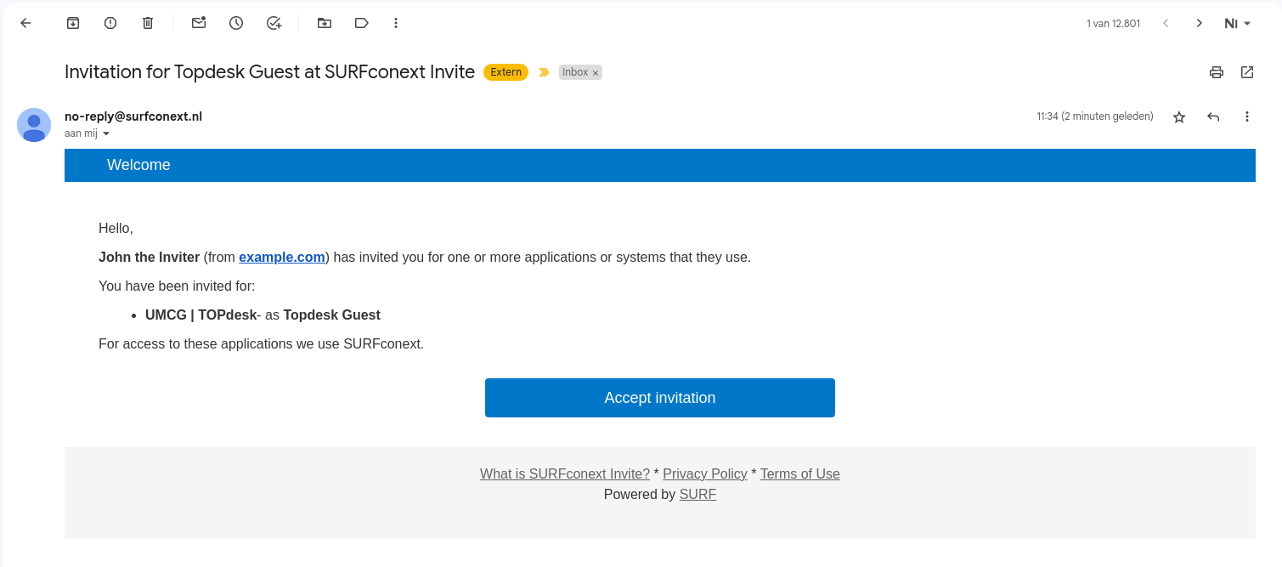

Slide 12
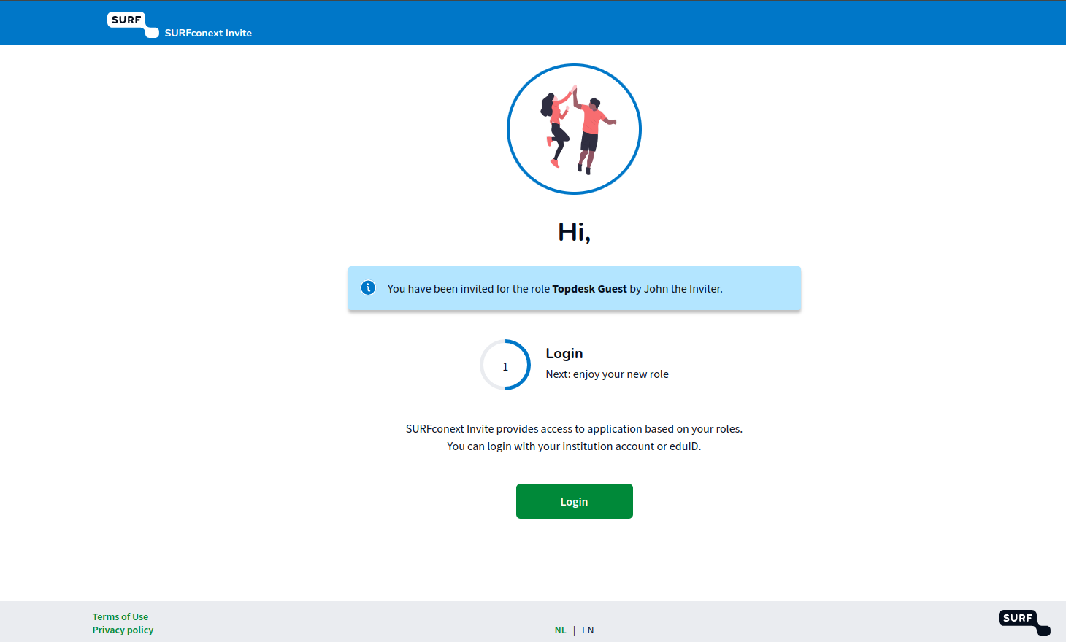
Notes:
Emphasize: flow for user is 'all in one' -> access is granted. If an account has to be made this can be done right away.
No need to have the process split with days in between.

Slide 13
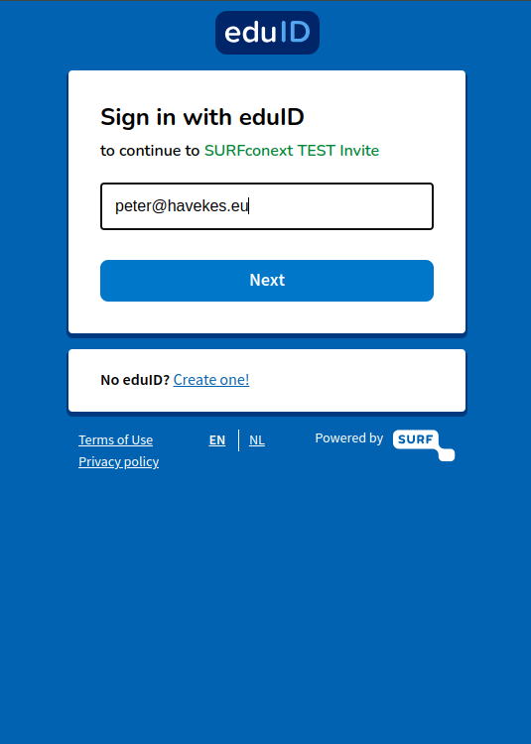
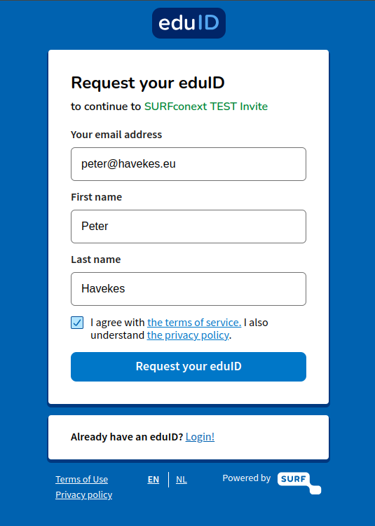

Slide 14
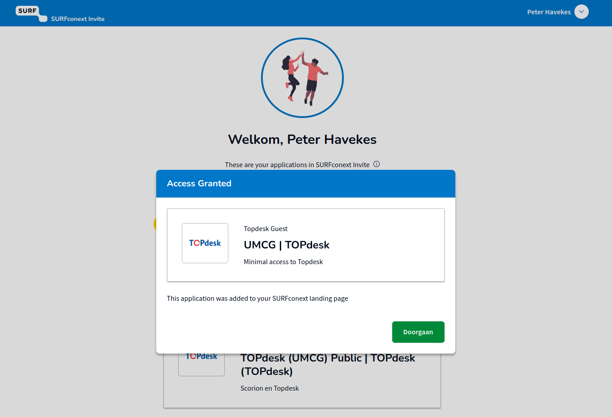

Slide 15
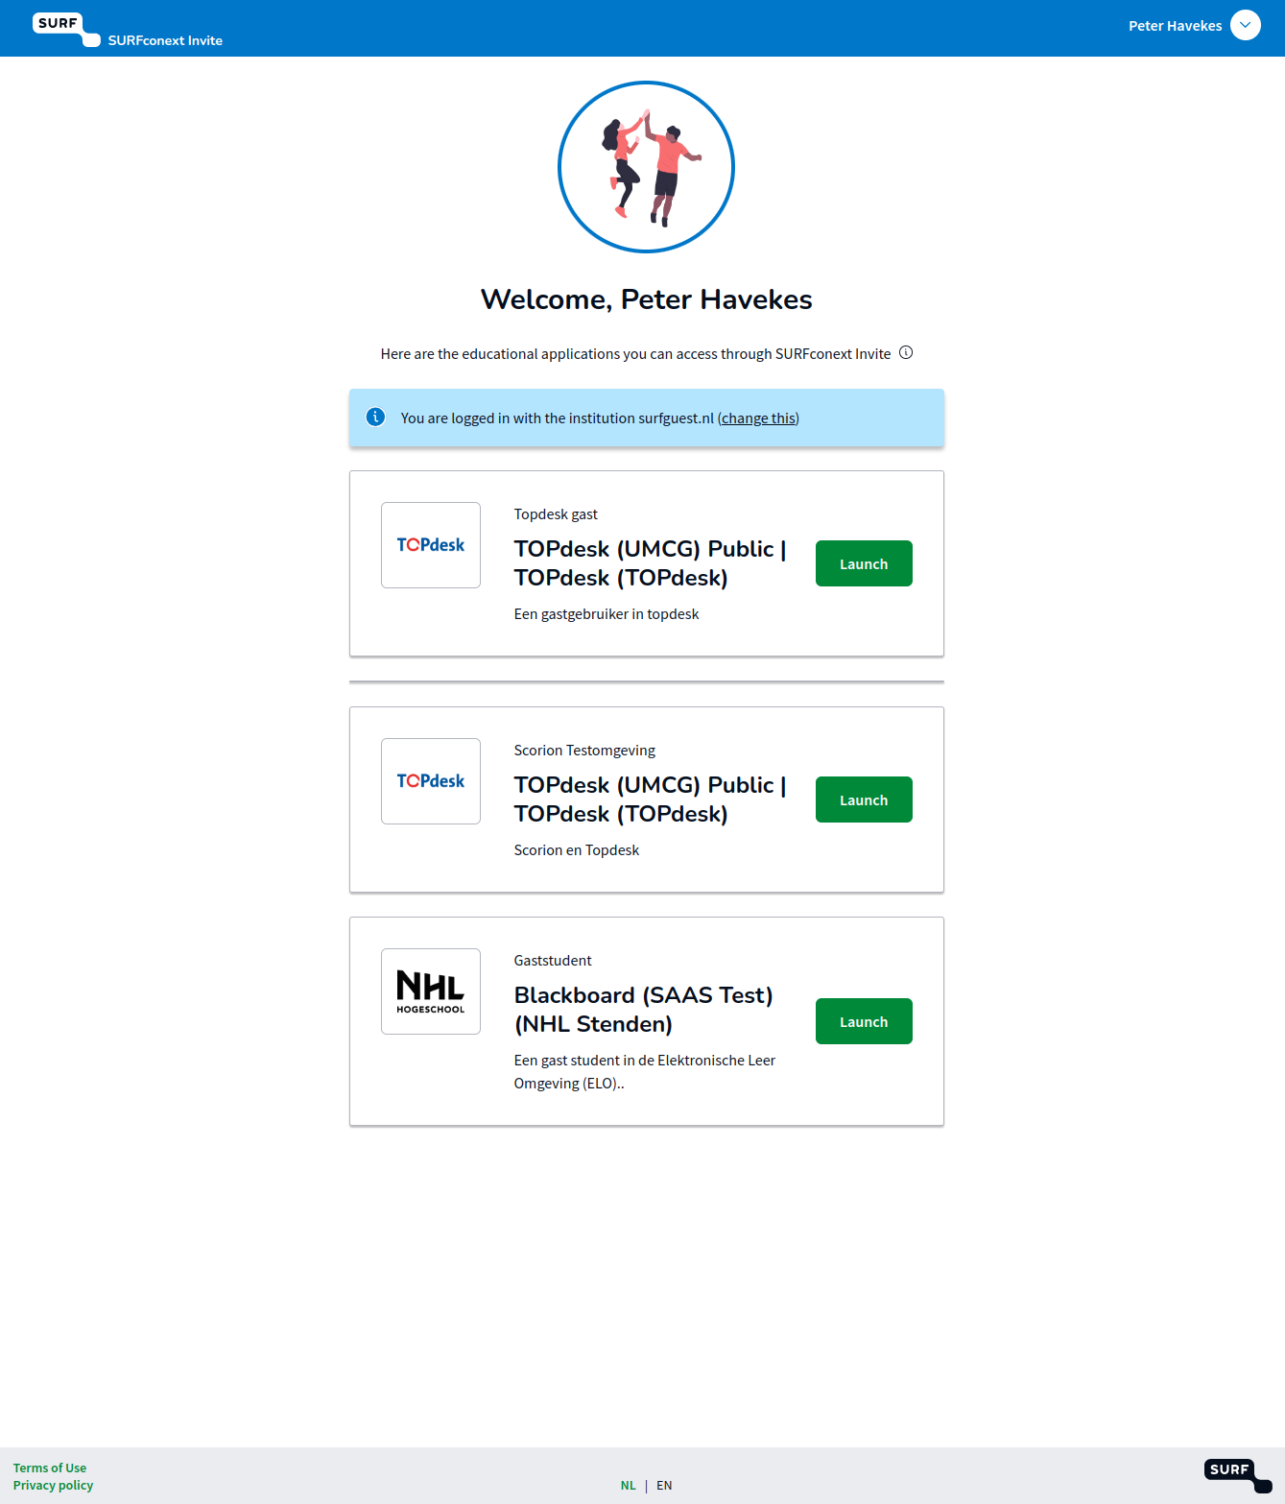

Slide 16
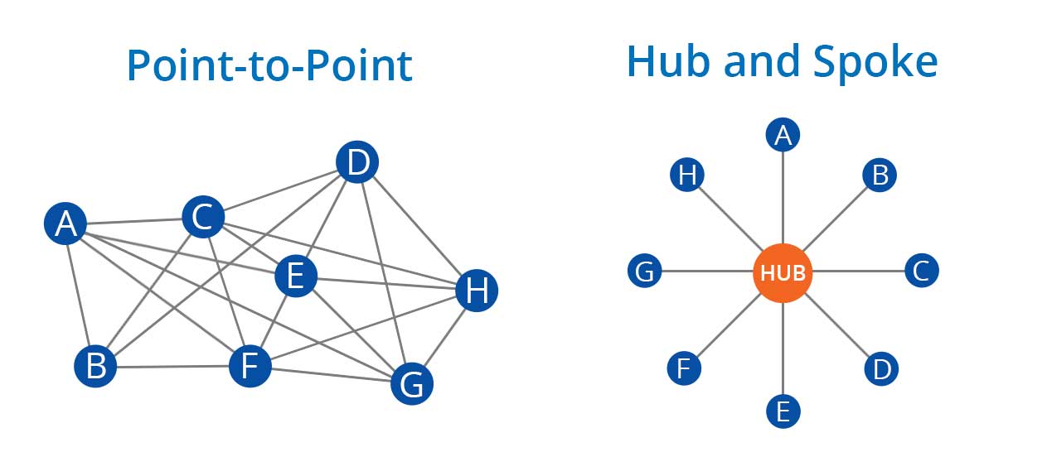



How it works
Institution
SIS
IDM/ESB
Applications
Invite application
Create user
Sets roles that determine access to which application
Federated Login
User logs in with institution ID
or guest account
Notes:
Include that this is possible for both mesh & hub&spoke – mesh requires more connections

Slide 17
Challenges and learnings
Not all applications are able to provision real time.
Microsoft applications…
Hierarchy of role management roles is complex and varies!
Developing together with the institutes leads to a better application and adoption.
Keep it simple where possible. Differing wishes can dilute the simplicity.

Slide 18


Slide 19
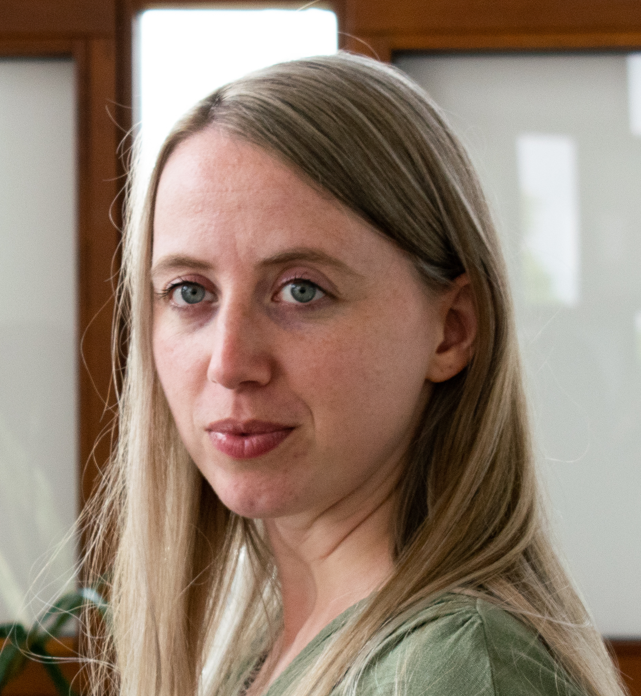
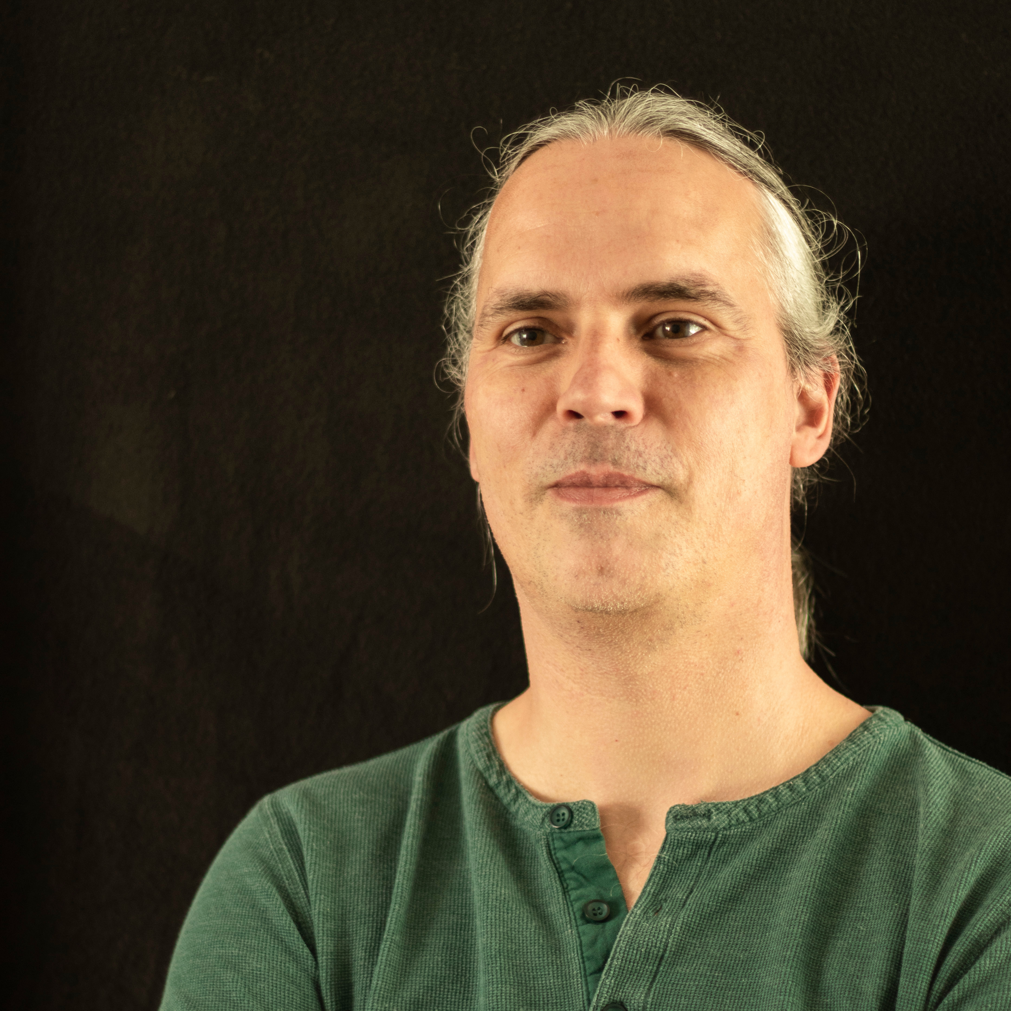
Contact
Marlies Rikken
Peter Havekes
Product Manager
Technical Product Manager
marlies.rikken@surf.nl
peter.havekes@surf.nl

