Slide 1
Scaling up secure network access without passwords
Using FIDO security tokens to access eduroam
Stefan Winter (RESTENA) and Janfred Rieckers (DFN)
T&I on the Fly with Guy - Les Dortoirs
12th June 2024

Slide 2
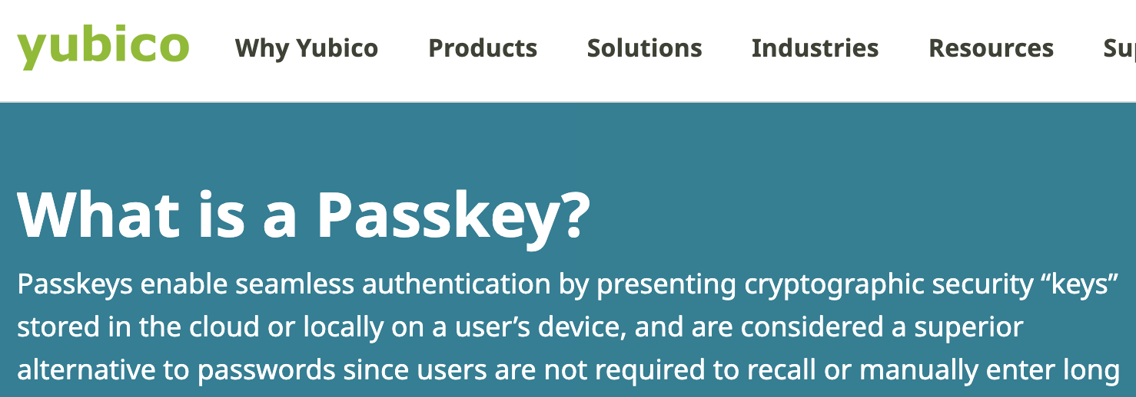
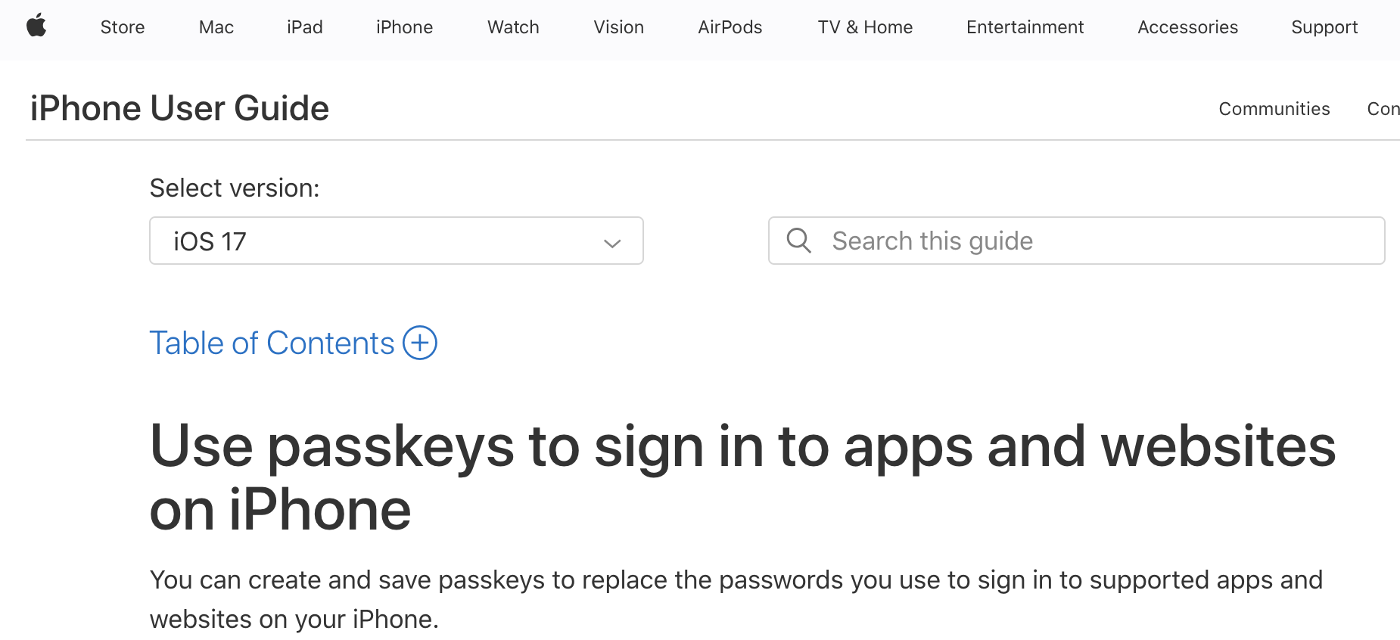
CONTEXT
Recent industry movement: “FIDO Security Tokens”, “Passkeys”
Used for 2FA/MFA in the web context – many big techs are implementing this
IdP: USB tokens; Microsoft Entra ID & Windows Hello; Google; iCloud Keychain; …

Slide 3
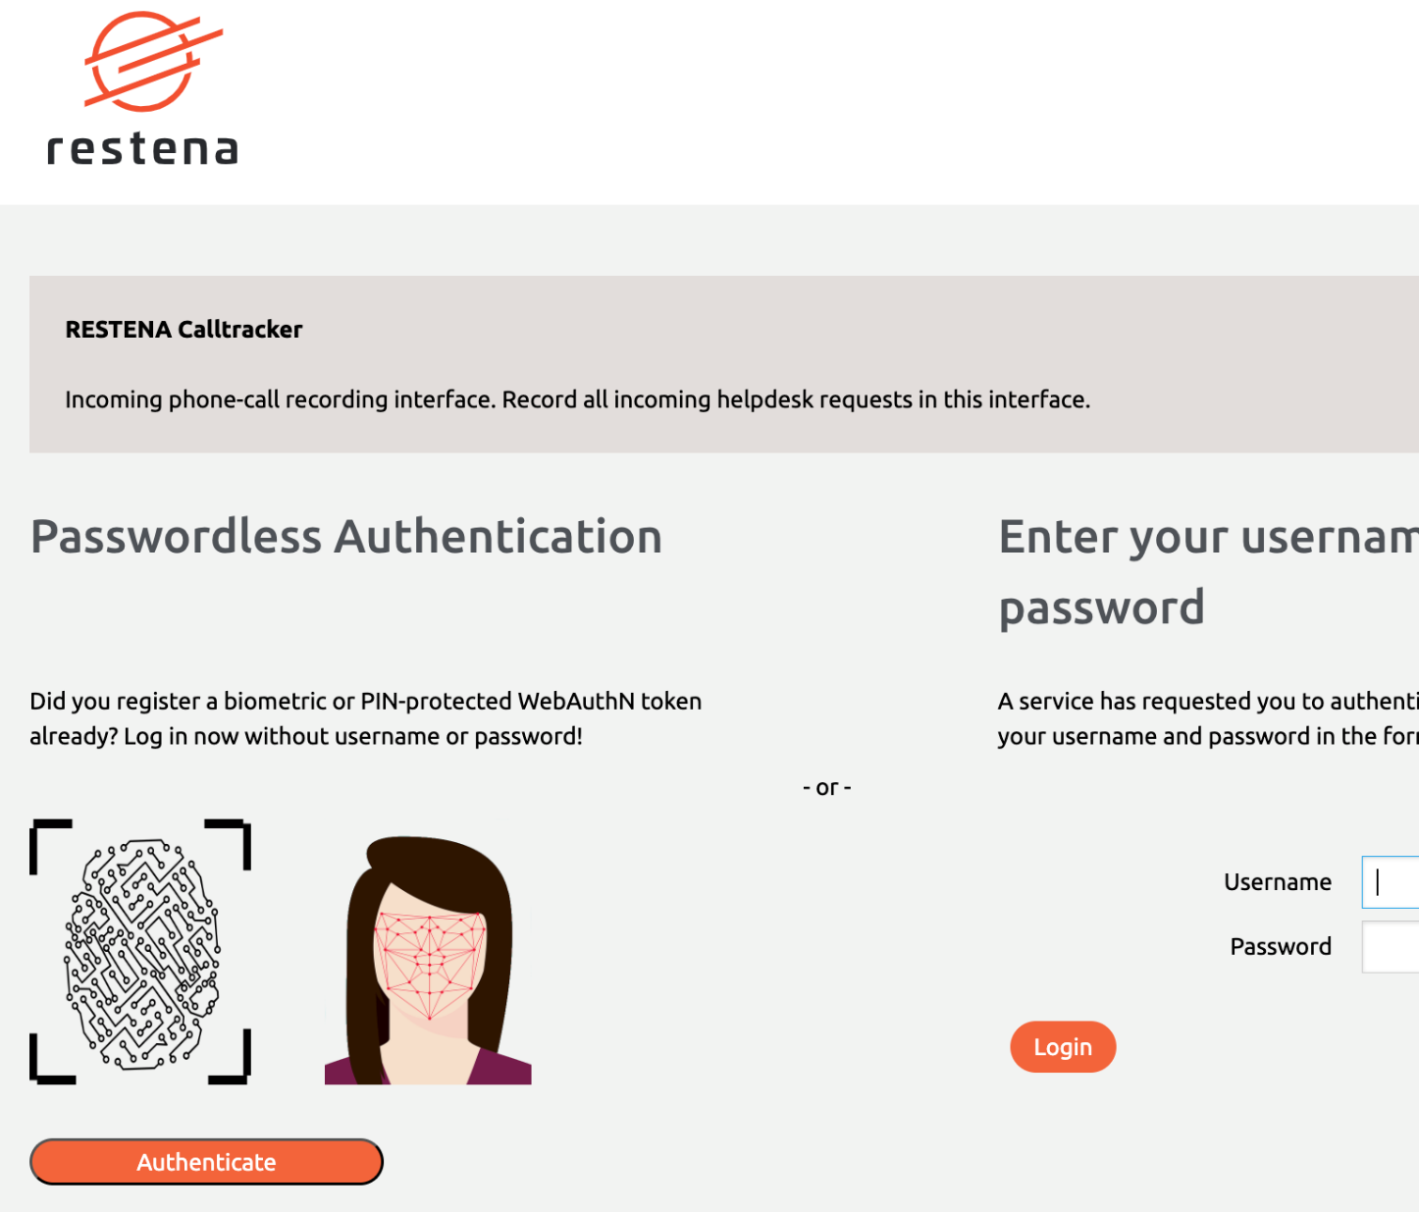
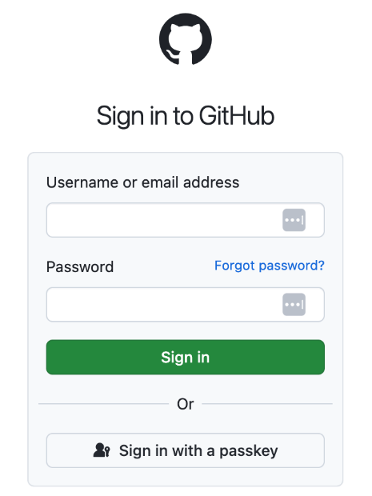
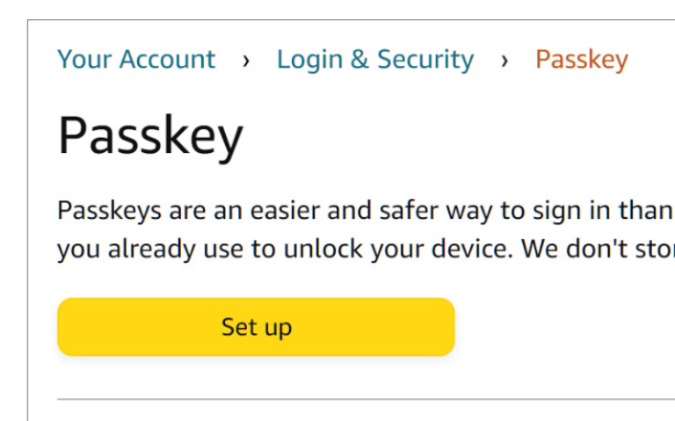
CONTEXT - SPs
Does away with passwords! Proper asymmetric crypto! Intuitive to use! No more PKI or expired client certificates!
Widely available on the web
But eduroam is not a web thing. Why do we care?

Slide 4
UNIFIED SSO
SSH
Web Authn
EAP?
Some non-web uses exist (not so broad support)
Not currently usable on EAP and
Enterprise Wi-Fi. ← You are here.
CTAPv2
(Client To Authenticator Protocol)
a.k.a. „The Holy Grail“
Once it is: unified Single-Sign On: register once (visit student onboarding page …) for web uses
… and you get eduroam for free – no client configuration required
Introducing Janfred for the heavy lifting
Image by Peggy und Marco Lachmann-Anke from Pixabay

Slide 5
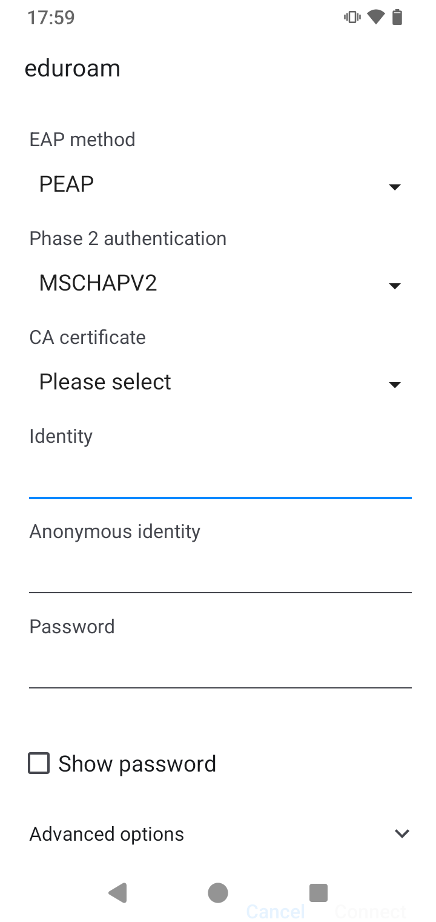
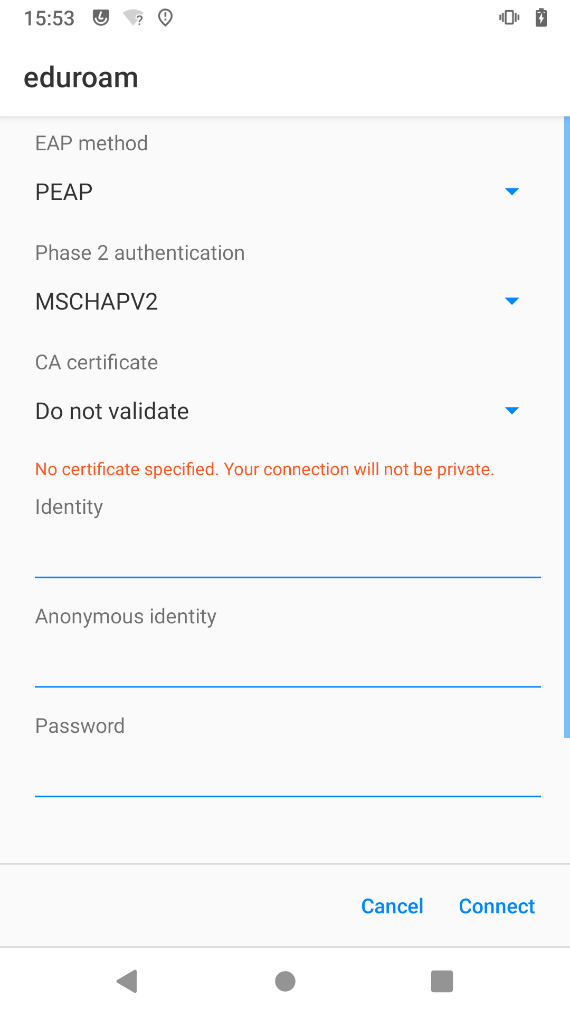
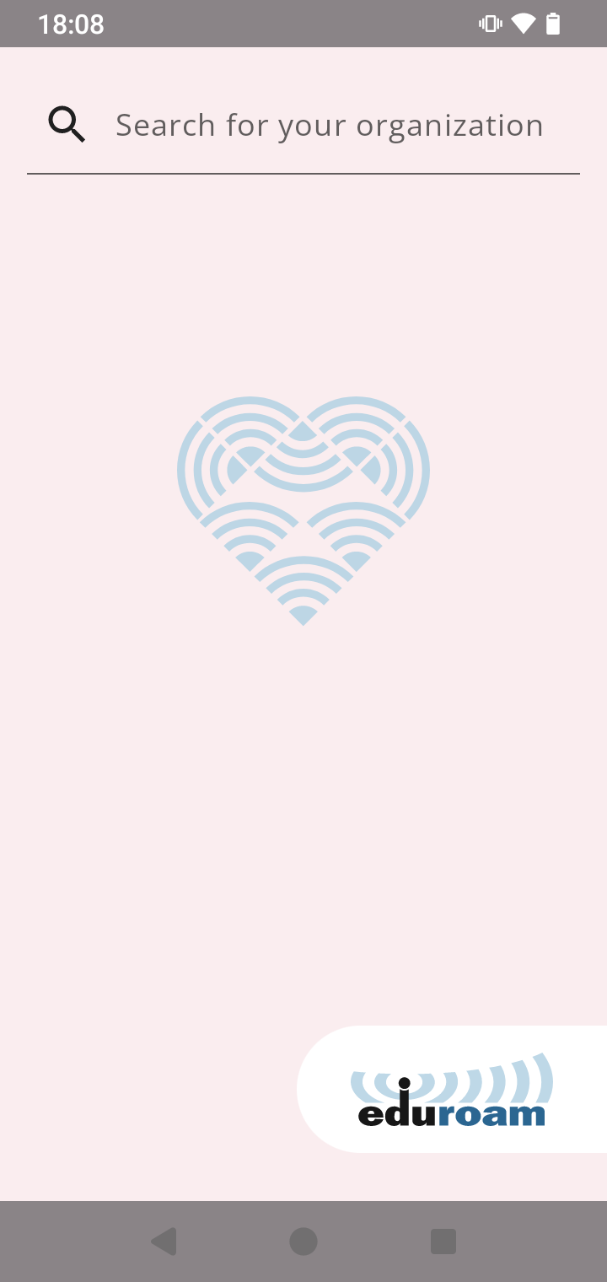
Why change a running system?
Configuration of EAP-TTLS/EAP-PEAP is very complicated
Admins need to communicate the proper configuration
Misconfiguration can lead password compromise
Malicious APs can be set up within minutes
Aid for secure configuration: Use the app!
But: Not every eduroam IdP uses eduroam CAT/geteduroam
Server certificate is usually pinned to a specific (Root-)CA
Changing the Root-CA of the RADIUS server cert can be complicated, every end-user device needs to be touched

Slide 6
And what about client certificates?
Some advantages
(Easier) possibility for device-specific credentials
Does not leak passwords, not compromised even if server cert isn’t checked
If issued certs are tracked: Revoking access for one device (instead of whole account) possible
Possibility to distribute authentication servers. The servers only need the CA (and maybe the CA’s CRL or do OCSP)
Some disadvantages
Provisioning is hard → Again with app, possibly difficult for edge-cases. (i.e. unusual OS’es, devices like SmartTV with limited capabilities)
Certificates expire. Users need to renew them regularly.

Slide 7
What features do we want for a new EAP method?
Easy to provision and configure
No need to download a configuration file
Not much configuration items, only things we can expect the user to know
Secure by default
No “Do not validate” option, that users are compelled to select, because they don’t understand the meaning of “Domain” in that context
Easy to maintain
Simple configuration on the server side, with easy-to-follow setup guidelines
Verbose error handling to identify potential problems

Slide 8
Advantages of FIDO Keys
Easy provisioning via a web portal with WebAuthn
Can be included in an institution-wide deployment of MFA or passwordless login architectures
Platform authenticator already on most current devices
No additional App/config/… needed, if the device has already a Android Passkey / Apple FaceID/TouchID / Microsoft Hello on board
Other use cases (i.e. in networks with high-security requirements) with roaming authenticators (i.e. YubiKey) possible
But: FIDO specification still requires the server to authenticate to the client with a TLS certificate (In case of WebAuthn via HTTPS)

Slide 9
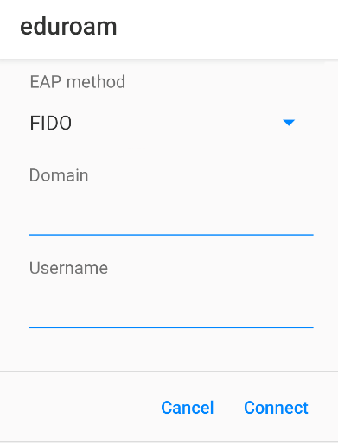
Architecture of the new EAP method
Super easy Configuration: Just type in your institution’s domain
Tunneled EAP method with a TLS tunnel
Server presents a certificate during TLS Handshake
Client checks validity of server cert against its configuration
Expected Server Name derived from Domain, checked against system certificates
(We use these certs for WebAuthn anyway, so we can re-use them for EAP)
Flexible Authentication options within the TLS tunnel
Discoverable credentials without a username or Server-Side credentials with username
Silent authentication possible, or request User Presence / User Verification, for higher security demands

Slide 10
Protocol flow
TLS Handshake
FIDO Authentication Request with Parameters
Request Passkey Signature
No Passkey available
Additional Information Request (with Username)
Request Sig (loop over PKIDs)
Information Response with list of user’s PKIDs
*optional (if not Usernameless)
Data + Signature
Authentication Response
*can be repeated, if first auth was not sufficient
Success or Failure Indication

Slide 11
Current status
Draft Specification is submitted to the IETF for standardization
Still in development
First Proof-of-Concept was presented at Mobility Day at tnc23
Interest from some stake holders at the IETF
We’re still looking for a good name for the EAP method

Slide 12
OUTLOOK (WEATHER: CLOUDY)
We have proven that it works, with security keys that follow the relevant specifications.
Code exists for supplicant and server side.
Guess who doesn’t follow the specifications: the big platform operators!
They do web parts (“WebAuthn”) well; but the underlying interface to the keypair (“CTAP”) not at all.
So, right now: EAP-FIDO works with a USB Security Token; no easy way to get it working with the iCloud TouchIDs and Windows Hello’s of this world.
Web Authn
wibbly-wobbly CTAPey-wimey
… stuff (proprietary)

Slide 13
Interested? Get involved!
Say your opinion about the specification during the IETF process!
Draft is expected to become a WG item soon
Discussion is in the emu Working Group, join the Mailing List and/or the WG sessions
https://datatracker.ietf.org/doc/draft-janfred-eap-fido/

Slide 14
Thank you
Any questions?
For more questions:
rieckers@dfn.de
stefan.winter@restena.lu

Slide 15
X.509 certificates vs. FIDO
An X.509 deployment is a complex system
CA for issuance
real-time revocation checks
client certificates in need of regular re-issuance
Client-side storage has undefined security properties → With enough effort (apps…) one can hide the complexity reasonably well from the end user
With FIDO-CTAP, the operational complexity is very much reduced, and specifications focus on usability
→ there is no complexity one would need to hide

Slide 16
Single-Sign On: Pseudo-credentials vs. FIDO-CTAP
Deriving an EAP-TLS credential from a web identity (SAML …) creates two distinct credentials, loosely linked together with significant semantic differences and friction in usage
WebAuthn + EAP-FIDO = usage of a single, identical credential, which is managed coherently

Slide 17
Basic Architecture of backend servers
Web Server
Central Auth DB
RADIUS Server
Write Credential Pubkey to DB
Retrieve Credential Pubkey from DB
Step 2 : Eduroam Login via EAP-FIDO
Step 1: WebAuthn Registration via Portal

