Slide 2
Direct vs Indirect
Direct
Supplier
Institute
Indirect
NREN

Slide 3
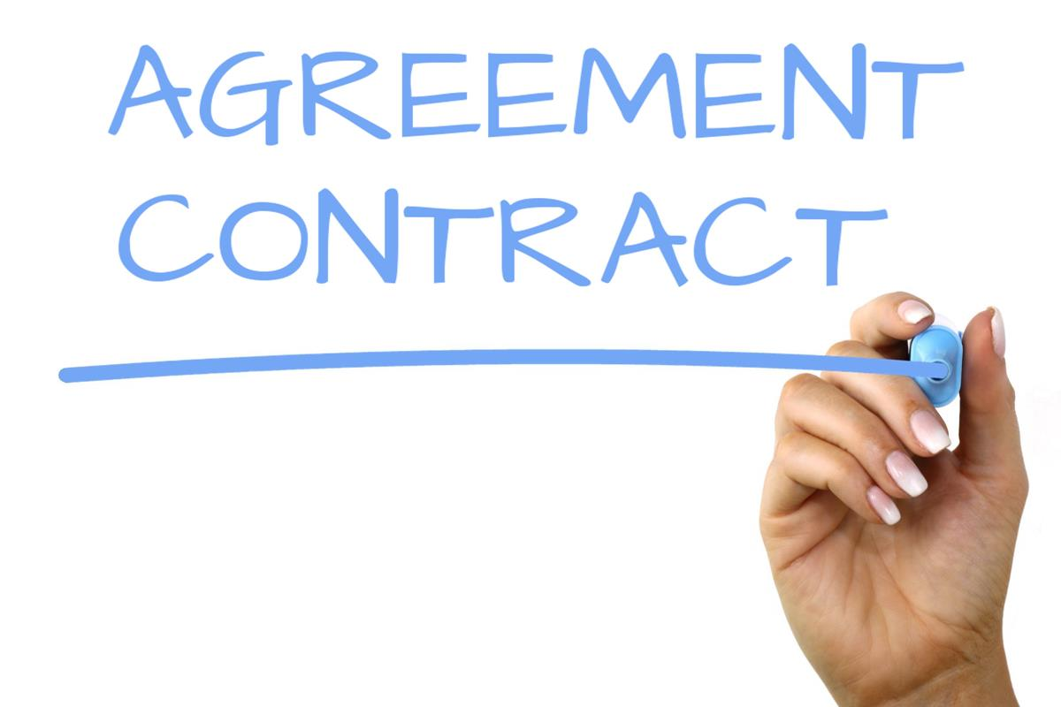
Risks in indirect model
Contractual risks
Legal risks
Privacy and security risks
Financial risks
Institution cannot pay
Institution will not pay

Slide 4
Casus: public cloud services
Why indirect (through SURF)
Additional advantageous conditions
Monitoring usage, technical support
Support security ambitions members
Risk
Institute gets hacked
Consequences
If institute doesn’t pay, SURF might have to
Resulting in SURF members covering

Slide 6
Takeaways
Risks are a reality
Decide on your NREN’s risk appetite
Seek buy-in from members
Share experiences between NRENs
Join SIG-MSP meetings

Slide 7
Chapter yellow
Merci!
Michel.wets@surf.nl

