Slide 1
22 May 2024
Threat Blocking
at the network border
Tackle Cyber
Threats head on

Slide 2
Who are REANNZ?
100Gbps backbone
Capacity on Hawaiki Subsea cable to Australia and US
44 members
  8 Universities
  7 Crown Research Institutes
  9 Polytechnics
  5 Government agencies
  5 independent research, innovation or
  education organisations.

Slide 3

The challenge we faced
Members - asked us to b;ock Cyber threats at a Network level
Cabinet minute -
“Government directs all state sector agencies,
to the extent it is legally possible, to adopt CERT NZ
Phishing Disruption Service within 12 months or
when contracts with ICT providers are renewed.”

Slide 4


We sourced threat feeds from across Government
Indicators of compromise (IOCs)
IP addresses
Fully qualified domain
names (FQDN/DNS)
URLs
Malware Free Networks® (MFN®)
Threat
feeds
Phishing Disruption Service™

Slide 5
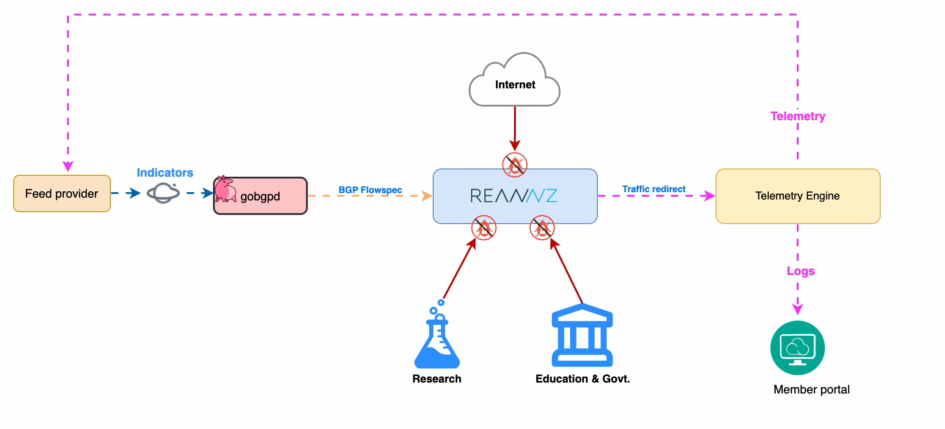
And integrated them into our network

Slide 6
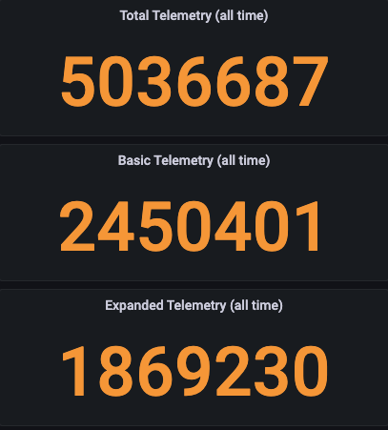
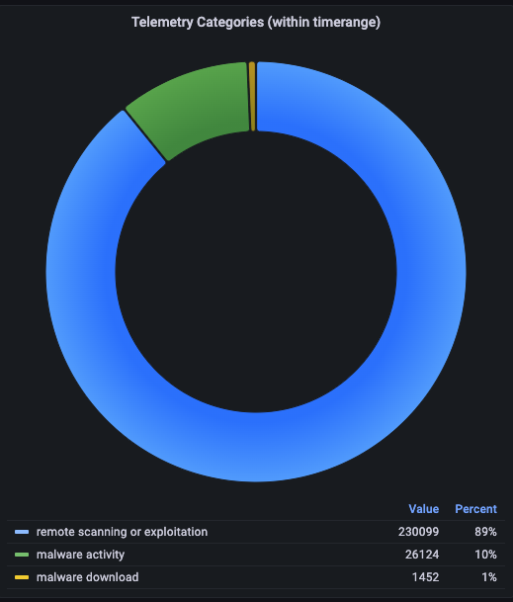
As a result we blocked millions of cyber security threats

Slide 7
What got blocked?
  Emotet: A sophisticated malware delivery service evolving from a banking Trojan.
  IcedID: A banking Trojan targeting financial information and acting as a malware dropper.
  SocGholish: Malware spreading via compromised websites, or masquerading as software updates tricking users into installing it.
  Pikabot: Information theft and botnet activities malware with scarce specifics.
  TrickBot: A versatile malware platform for data theft and delivering other malicious software.
  Cobalt Strike: Legitimate tool often used by attackers for post-exploitation and payload deployment.
  Amadey: Simple malware for loading payloads, stealing information, and remote control.
  FormBook: Steals data like keystrokes and credentials, known for evasion techniques.
  RedLine: Stealer targeting browser credentials and sensitive data, sold in underground forums.

Slide 8
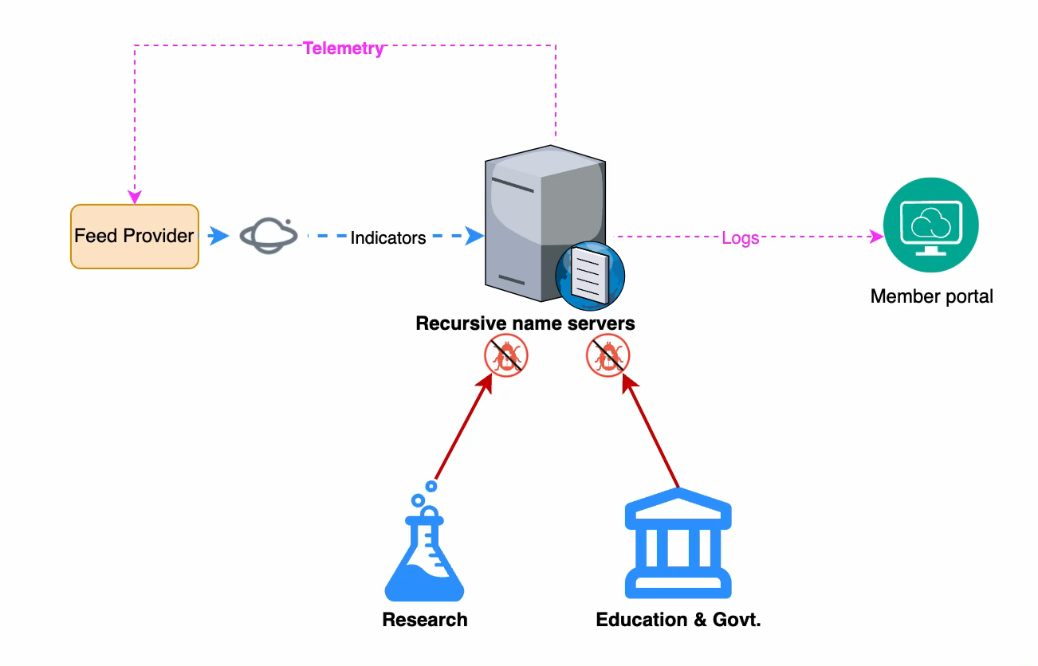
Phase two is to block malicious DNS
Blocking Malicious DNS Names
supplied by NCSC and Cert NZ via Cassini
Creating RPZ Zone files using threat indicators

Slide 9
Lessons learnt
Blocking was easy
  Exclude well known addresses as a safety net
Telemetry was hard
  Consent of member for expanded Telemetry added complexity
  Opt-out is hard, flowspec on routers favours one direction
We still need endpoint security for remote workers, moving around etc
Collaborating with the external parties enabled us to move quickly

Slide 10
22 May 2024
Thank you

