Slide 1
The Cryptographic Keys to a Safer Internet: The RPKI Revolution
Billy Holbrook
GÉANT
TNC24 Lightning Talk
12/06/2024

Slide 2
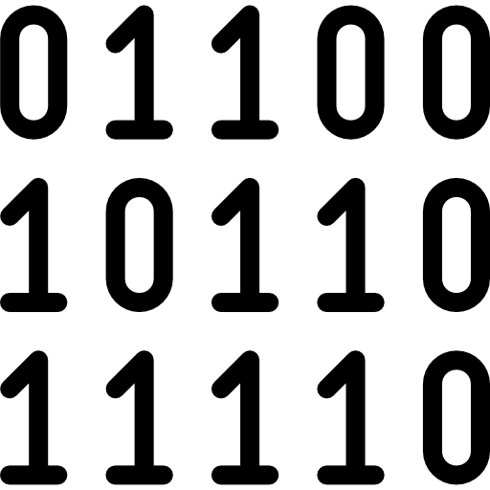
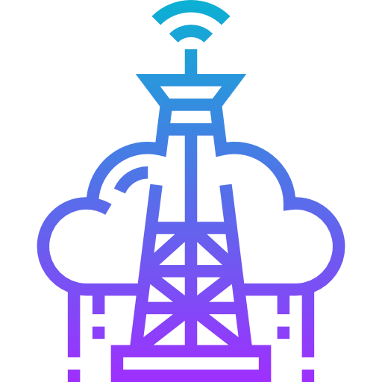
Sam has a secure ISP

Slide 3
Jenny has an Unsecure ISP

Slide 4
Jenny’s ISP is Vulnerable to Mistakes and Attacks

Slide 5
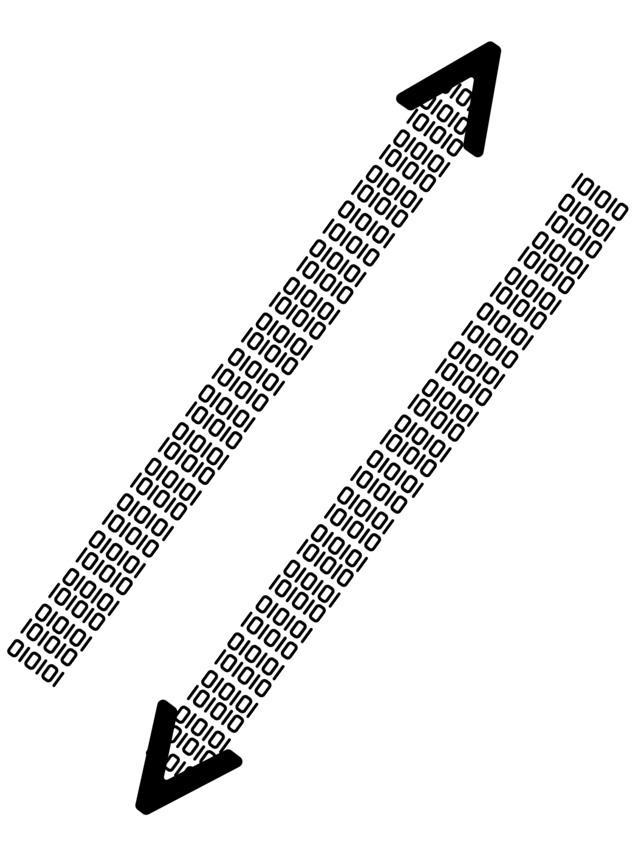
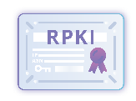
Sam’s Traffic is Protected Because They Use RPKI
Announcement With
Valid RPKI Certificate
Announcement With
No RPKI Certificate
Sam’s ISP
Jenny’s ISP
Genuine announcements being allowed by upstream
False announcements being dropped by upstream

Slide 6
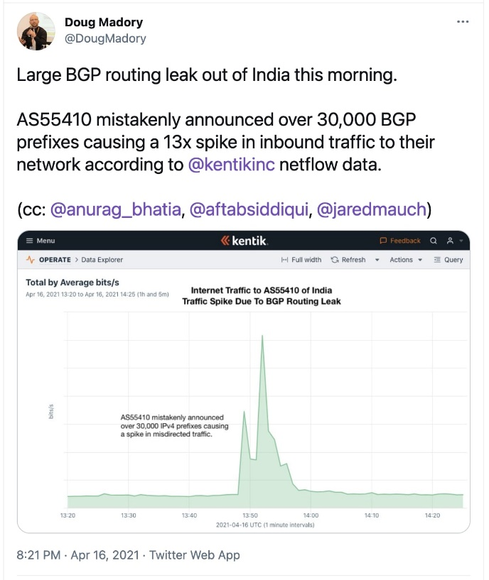
These kind of mistakes happen in real life!
*https://www.catchpoint.com/blog/vodafone-idea-bgp-leak
*https://manrs.org/2021/04/a-major-bgp-hijack-by-as55410-vodafone-idea-ltd/#:~:text=Looking%20at%20the%20data%2C%20the,must%20have%20stopped%20your%20announcements.

Slide 7
Further interest
manrs.org
ripe.net
arin.net
ripe.net/manage-ips-and-asns/resource-management/rpki
arin.net/resources/manage/rpki

Slide 8
Thank you
Billy.Holbrook@geant.org

