Slide 1
As Above – So Below
Who Validates your Organisation?
Cathrin Stöver
CCO, Géant
TNC24, Lightning Talks, Strike 2
Rennes, 13 June 2024

Slide 2
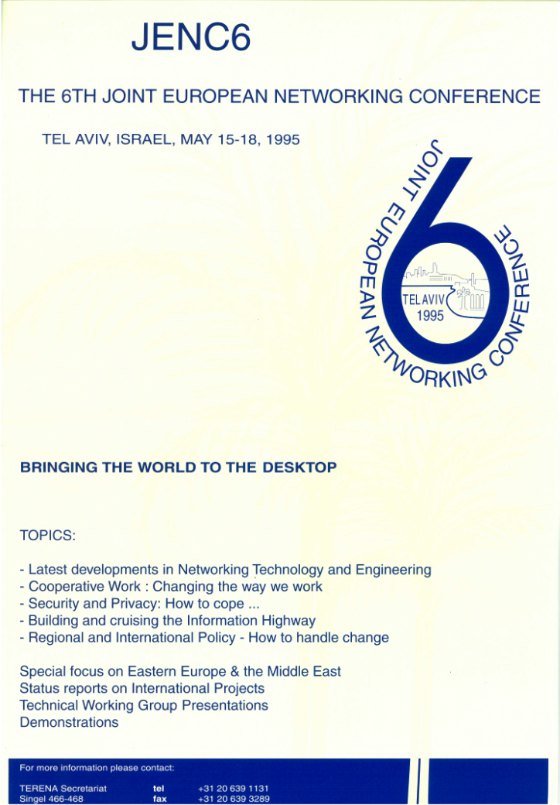
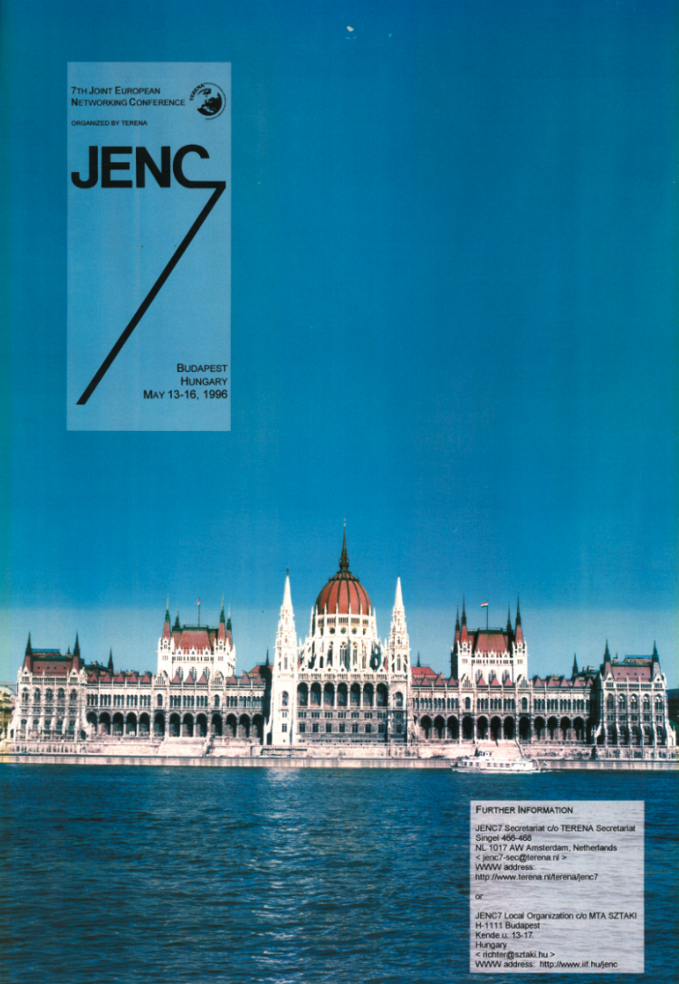
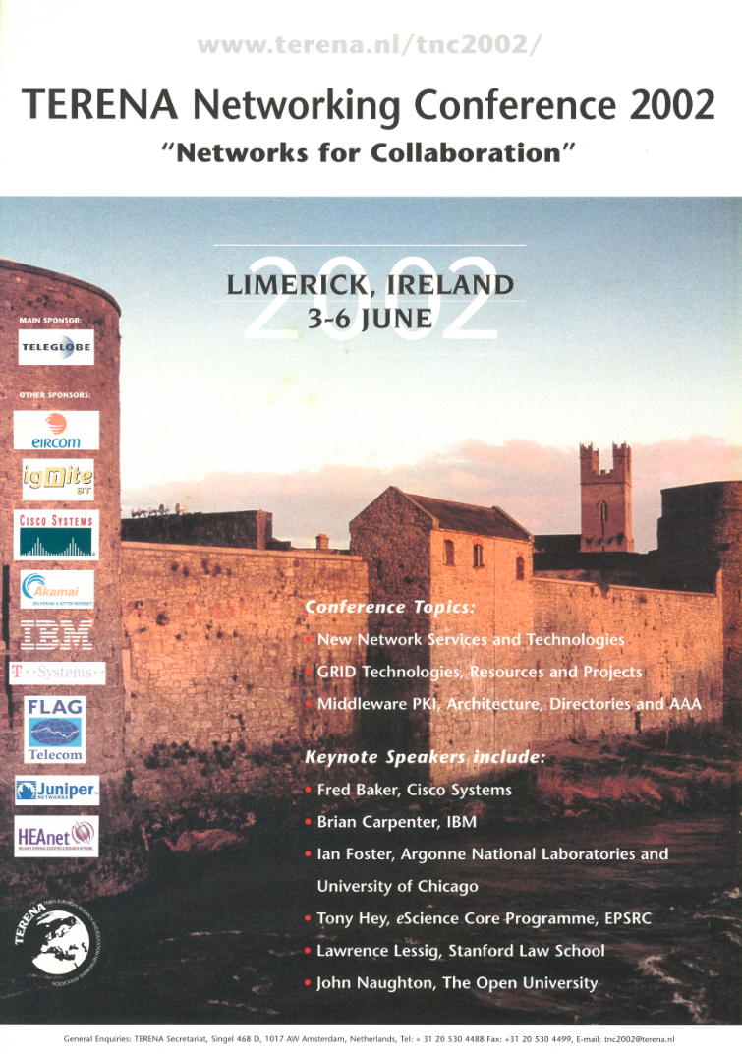
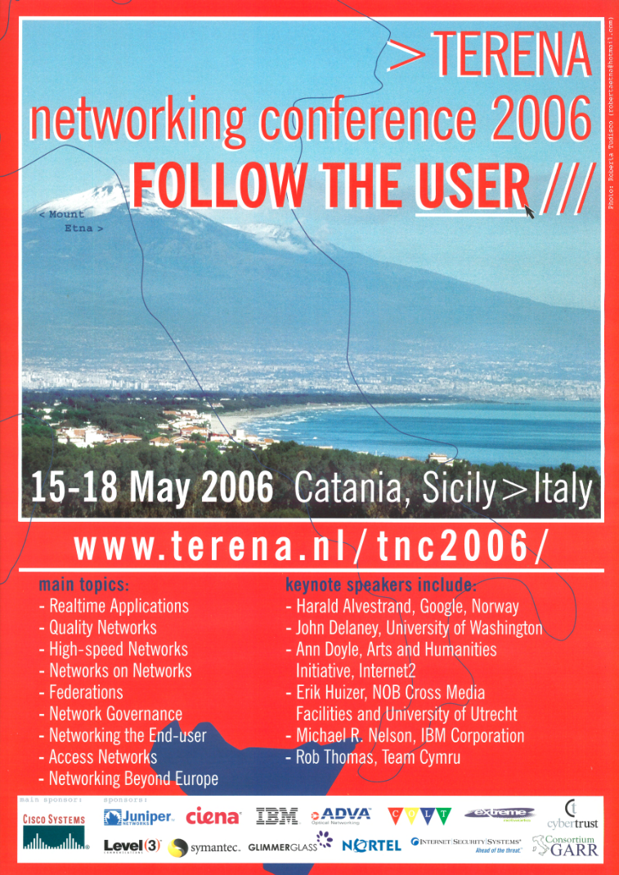
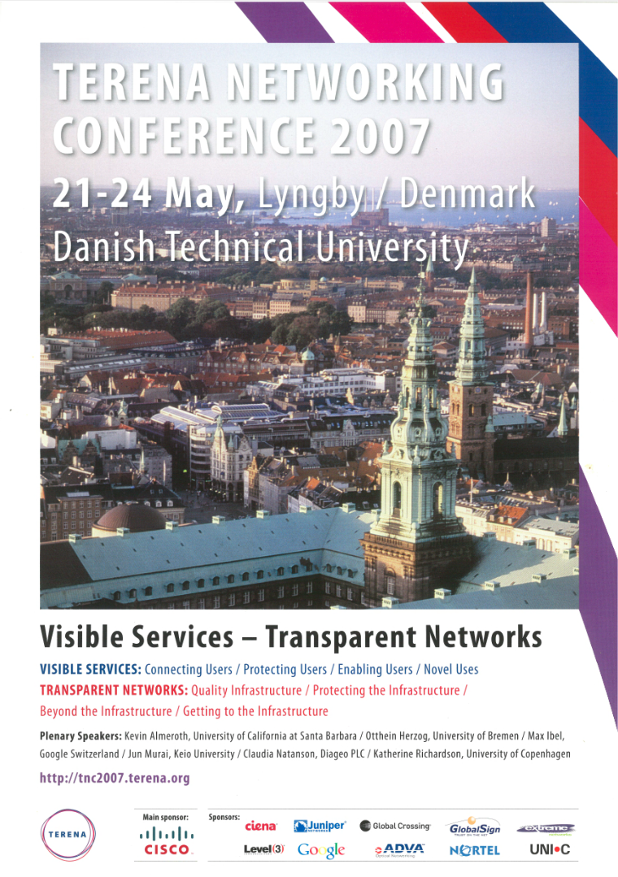
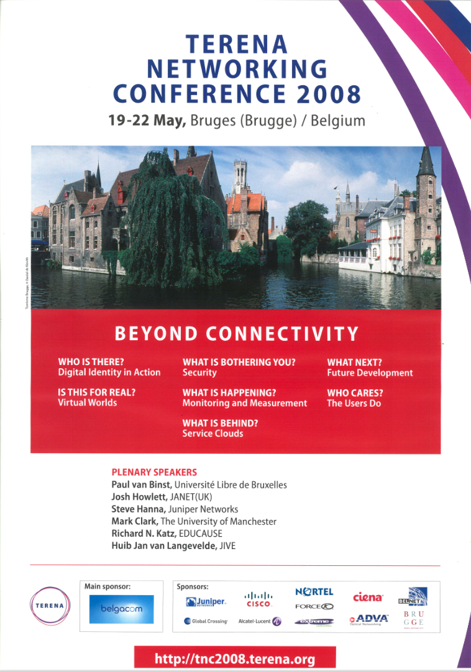
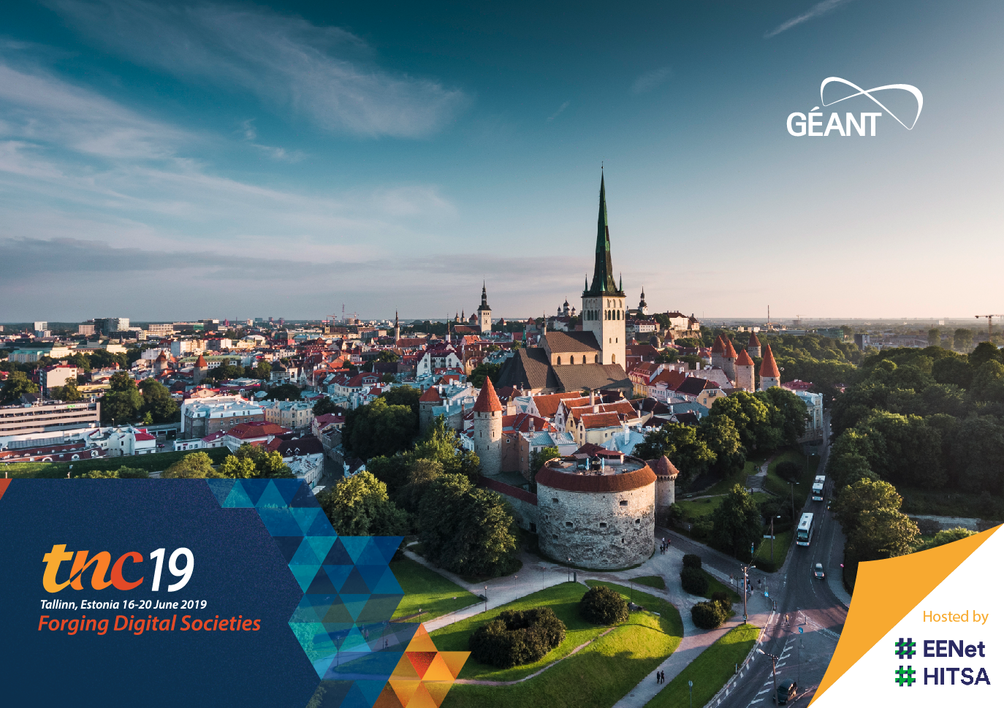
My First!
1995...
2024…

Slide 4
Compliance
Policy
Financial Maturity
NIS-2
Greening
Digital Europe
SDGs
JU
Art 185
Funding
Eligibility
EEC
Control
Security Clause
Diversity
Certification

Slide 6
2015 2016 2017 2018 2019 2020 2021 2022 2023 2024 2025 2026 2027
GN4 FPA – H2020 ~8 Years (~€225 Million)
GN5 FPA (7 Years)
GN5-2 (2.5 Years €80 Million)
GN4-1
(1 Year €25 Million)
GN4-2
(2.5 Years €59 Million)
GN4-3
(4 Years €77.5 Million)
GN5-1
(2 Years €55 Million)
GN4-3N
(5 Years €50.5 Million)
BELLA-S1
(5 Years €10 Million)
GN5-IC1
(3 Years €15 Million)
EuroHPC, Quantum, etc.
Notes:
GN5-2 oversubscribed by nearly 6 million euros

Slide 10
Thank You!

