Slide 1
Data management services for NRENs
Piloting a storage service for active data for Ireland
Mark van de Sanden
EUDAT/SURF

Slide 2
IRLDAT - a NREN use case
Open Science, FAIR RDM gaining momentum in Ireland through NORF
No national service at present in Ireland for storing and sharing active research data
Scarcity of services at institutional level
Researchers “crying out” for well organised storage and RDM services, especially for active data
IRLDAT: a Shared Storage service pilot
Funded: NORF (Irish National Open Research Forum)
Started in October 2022

Slide 3
IRLDAT - a NREN use case
Objectives
Understanding researchers' data storage and sharing requirements
Build a platform for active data management to be tested by researchers
Design an operational and governance model for a national service
develop a formal proposal to set up a national environment covering service design, architecture, resourcing, funding and sustainability
Concept:
Leveraging existing solutions/services
Strong research communities link
Trust
EUDAT ideal partner for technology, services and tools for RDM

Slide 4
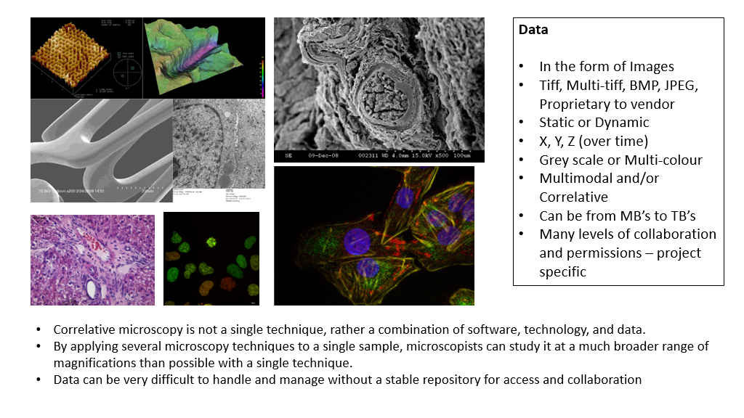
Use cases
Different use cases were involved in the testing and requirements
Multiple institutes in Ireland
11 use cases identified, 5 selected for 1 phase pilots
Different domains:
GeoData​
IoT for smart roads​
Material sciences​
Social Sciences​
Humanities​
Life Sciences
C21 Editions: Scholarly Editing and Publishing in the Digital Age
UCD School of Medicine: utilising X-ray CT
University of Galway: Delivering state of the art microscopy and imaging
TUS: IoT for smart roads
Tyndall: Materials Modelling and Simulation
Insight: Personalised recommendations on biomedical sensors

Slide 5
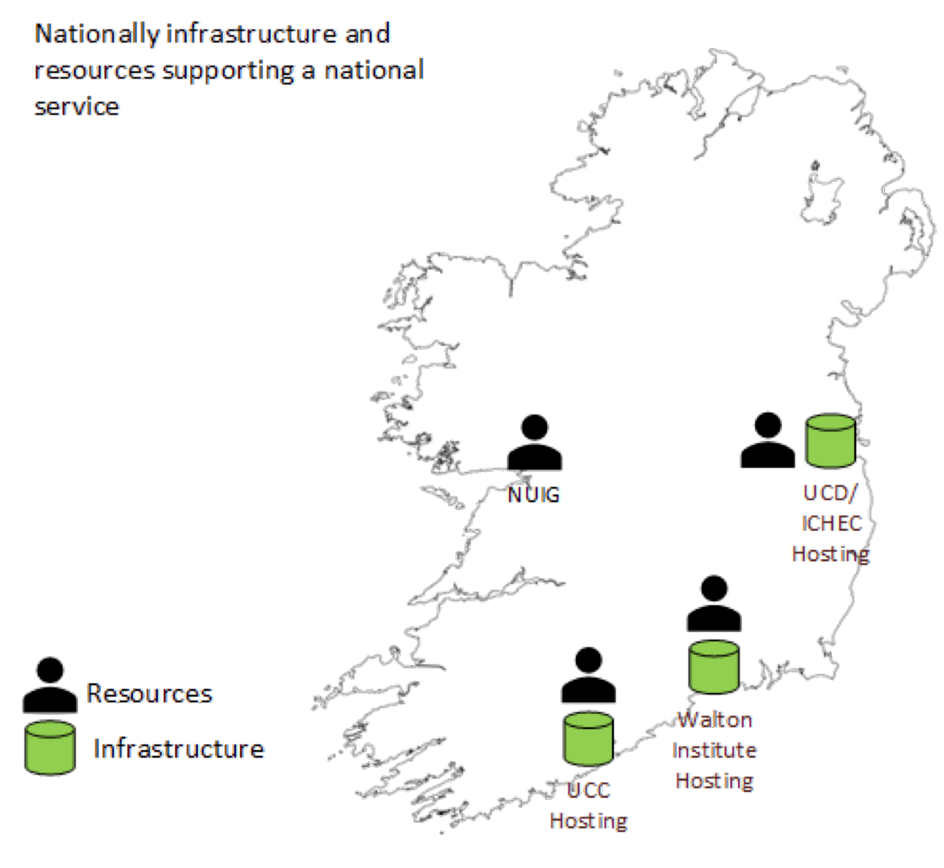
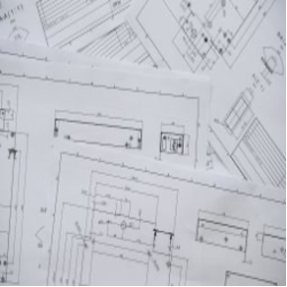
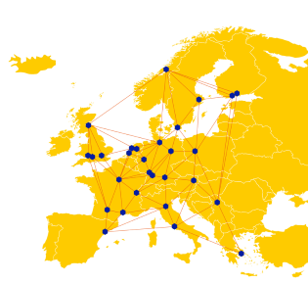
Development in 3 phases
Develop and run a pilot for a national service for active research data. Leverage findings to develop the specification of a national production-quality and sustainable service.
Phase 1
Verify services on EUDAT European infrastructure with 2 use cases.
Phase 2
Phase 3
Develop specification for a national production quality and sustainable service
Design and implement national pilot infrastructure
Onboard pilot users on
national infrastructure

Slide 6
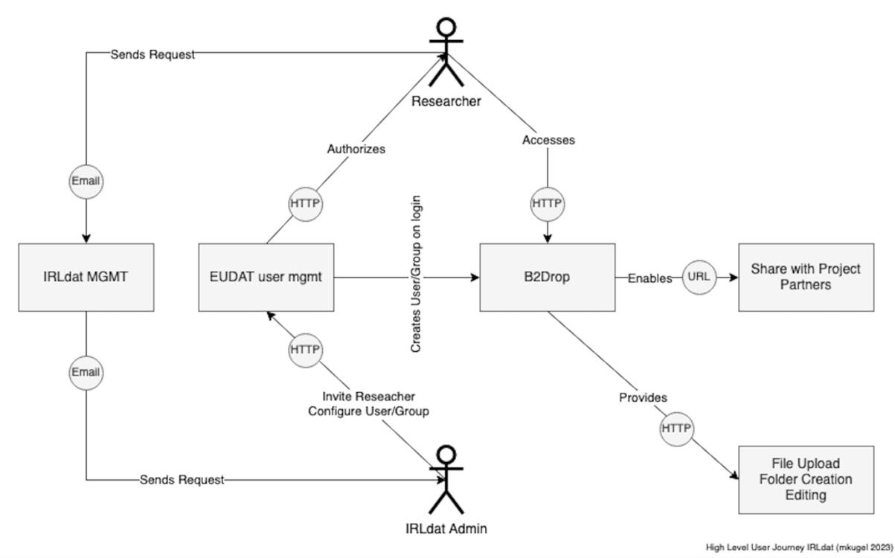
Solution
B2DROP and B2ACCESS deployment at 3 sites in Ireland with different backend technologies

Slide 7
Next steps
Successful deployment of the services
Positive feedbacks from users and communities
Final definition of the production service Oct 2024
“Build” vs “Buy” options are under evaluation
Possible start with “buy” option from EUDAT to reduce initial investment
Future set up of a national B2DROP node

Slide 8
Acknowledgements
IRLDAT
Barry O’Sullivan, Brian Clayton (UCC)
Fred Clarke, Paul Skelton (UCD)
Michael Kugel (Walton Institute)
Niall Wilson, Niall Guerin (ICHEC)
Roberto Sabatino (HEAnet)
EUDAT
Sander Apweiler (FZJ)
Debora Testi (CINECA)
Narges Zarrabi (SURF)

Slide 9
Thank you
Mark van de Sanden
mark.vandesanden@surf.nl

