Slide 1
Presented by Zoë Fischer (GÉANT)
From Climate Confusion to Cyber Clarity
using Evidence-based Message Framing

Slide 2
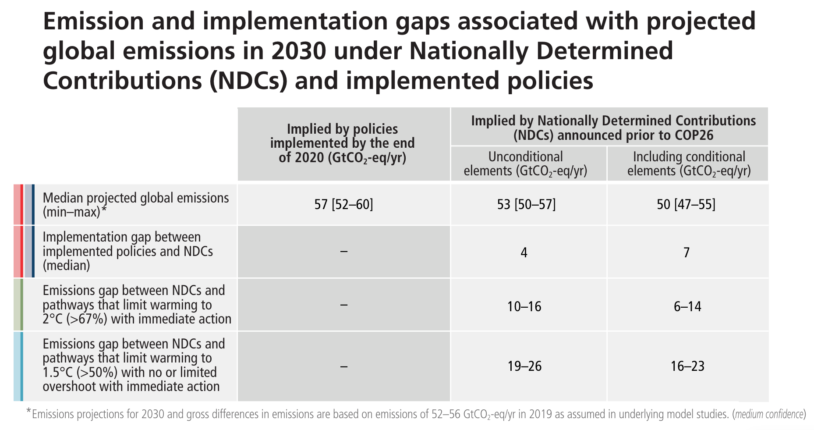
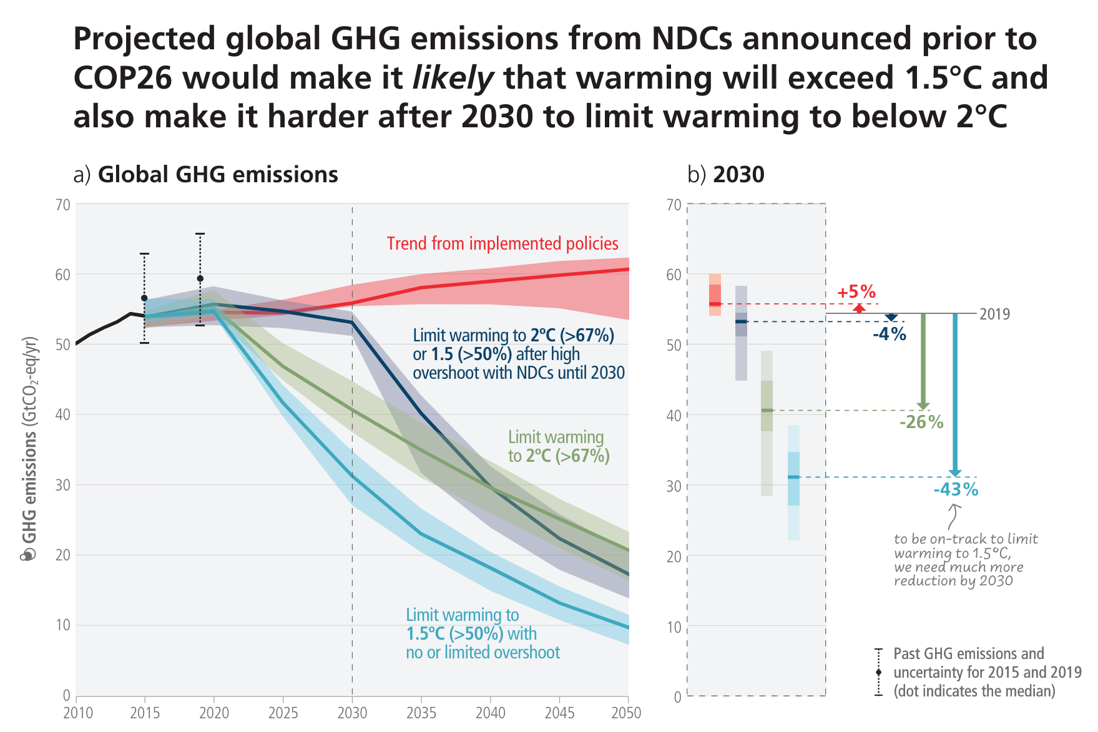
“Global GHG emissions in 2030 associated with the implementation of NDCs announced prior to COP26 would make it likely that warming will exceed 1.5°C during the 21st century and would make it harder to limit warming below 2°C – if no additional commitments are made or actions taken (Figure 2.5, Table 2.2). A substantial ‘emissions gap’ exists as global GHG emissions in 2030 associated with the implementation of NDCs announced prior to COP26 would be similar to or only slightly below 2019 emission levels and higher than those associated with modelled mitigation pathways that limit warming to 1.5°C (>50%) with no or limited overshoot or to 2°C (>67%), assuming immediate action, which implies deep, rapid and sustained global GHG emission reductions this decade (high confidence) (Table 2.2, Table 3.1, 4.1). The magnitude of the emissions gap depends on the global warming level considered and whether only unconditional or also conditional elements of NDCs are considered (high confidence) (Table 2.2). Modelled pathways that are consistent with NDCs announced prior to COP26 until 2030 and assume no increase in ambition thereafter have higher emissions, leading to a median global warming of 2.8 [2.1–3.4]°C by 2100 (medium confidence). If the ‘emission gap’ is not reduced, global GHG emissions in 2030 consistent with NDCs announced prior to COP26 make it likely that warming will exceed 1.5°C during the 21st century, while limiting warming to 2°C (>67%) would imply an unprecedented acceleration of mitigation efforts during 2030–2050 (medium confidence) (see Section 4.1, CSB2). {WGIII SPM B.6, WGIII SPM B.6.1, WGIII SPM B.6.3, WGIII SPM B.6.4, WGIII SPM C.1.1}.” (IPCC, 2023, p.24-25)
Notes:
Greenhousegas Emissions

Slide 3
“Global GHG emissions in 2030 associated with the implementation of NDCs announced prior to COP26 would make it likely that warming will exceed 1.5°C during the 21st century and would make it harder to limit warming below 2°C – if no additional commitments are made or actions taken (Figure 2.5, Table 2.2). A substantial ‘emissions gap’ exists as global GHG emissions in 2030 associated with the implementation of NDCs announced prior to COP26 would be similar to or only slightly below 2019 emission levels and higher than those associated with modelled mitigation pathways that limit warming to 1.5°C (>50%) with no or limited overshoot or to 2°C (>67%), assuming immediate action, which implies deep, rapid and sustained global GHG emission reductions this decade (high confidence) (Table 2.2, Table 3.1, 4.1). The magnitude of the emissions gap depends on the global warming level considered and whether only unconditional or also conditional elements of NDCs are considered (high confidence) (Table 2.2). Modelled pathways that are consistent with NDCs announced prior to COP26 until 2030 and assume no increase in ambition thereafter have higher emissions, leading to a median global warming of 2.8 [2.1–3.4]°C by 2100 (medium confidence). If the ‘emission gap’ is not reduced, global GHG emissions in 2030 consistent with NDCs announced prior to COP26 make it likely that warming will exceed 1.5°C during the 21st century, while limiting warming to 2°C (>67%) would imply an unprecedented acceleration of mitigation efforts during 2030–2050 (medium confidence) (see Section 4.1, CSB2). {WGIII SPM B.6, WGIII SPM B.6.1, WGIII SPM B.6.3, WGIII SPM B.6.4, WGIII SPM C.1.1}.” (IPCC, 2023, p.24-25)

Slide 4
Struggles
Complexity
Intangible effects
Psychological distances
Negative framing
Notes:
Does this sound familiar?
All of these struggles are also aparent when you try to communicate cyber security

Slide 5
Struggles
Complexity
Intangible effects
Psychological distances
Negative framing
Raise awareness
Motivate action

Slide 6
Evidence-based Message Framing
(De Bruijn & Jansen, 2017)
Notes:
De Bruijn and Jansen did research on this and found that evidenced message framing is a good solution of communicating climate change.

Slide 7
Message
FACTS
Notes:
In addition, De Bruijn and Jansen said that as soon as a message is quite complex, you need to base your messages around it on scientific facts.
----
Let's take a closer look at how evidence-based message framing is used in effective climate change communication.

Slide 8
Local and personal impacts
Notes:
Past efforts have strategically emphasized the local and personal impacts of climate change.
For instance, highlighting the increase in heatwaves within specific region, like here an article from 2022 about heatwaves in Rennes.
Or one more personal to me as I’m Swiss, about the impact of climate change on skiing areas.
This is all based on scientific facts.
-> By framing the message to resonate with experience and values from the audience, awareness can be raised more effectively and people get motivated to take action.
-----
So how does it now work for cybersecurity communication.

Slide 9
Technical jargon
Notes:
Instead of bombarding people with technical words and concepts about cyber threats, we can highlight the tangible and personal impacts.
----

Slide 10
Security
measures
Personal impacts
Over- dramatization
Tangible impacts
Notes:
For instance, we might discuss how a recent data breach led to financial losses for an NREN in our community. And based on that we organise a securitry training internally.
This approach isn't just a shot in the dark; it's rooted in facts, showing a real and relatable example for the audience.
Studies demonstrate that when we connect cybersecurity to real-life consequences that people can understand and relate to, we can overcome psychological barriers like distance and helplessness.
Additionally, framing the message in a positive light, such as emphasising the importance of proactive security measures and not overdramatise the impact, can counteract negative framing.
By using evidence-based strategies, we can effectively but in the end very simply communicate the importance of cybersecurity, …….raise awareness and motivate action!

Slide 11
Raise awareness
Motivate action
Notes:
….. raise awareness and motivate action!

Slide 12
Thank you very much!

