Slide 1
Empowering Women in IT:
Bridging the Gender Gap through Program Funding
Brenna Meade, Program Director, Indiana University
Kate Robinson, ESnet

Slide 2
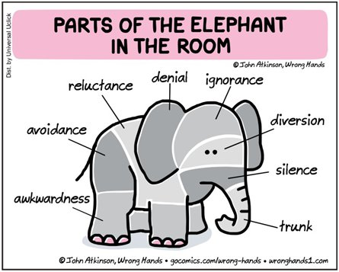
Lets Address the Elephant in the Room!
Gender gap in the technology and engineering

Slide 3
Women in IT Networking at SC (WINS)
The Women in IT Networking at SC (WINS) is a multi-year program initially funded by the National Science Foundation (NSF)
Was developed for addressing the prevalent gender gap that exists in Information Technology (IT), particularly in the fields of networking engineering and high-performance computing (HPC).
Collaborative project managed by:
University Corporation for Atmospheric Research (UCAR)
Energy Sciences Network (ESnet)
Indiana University

Slide 4
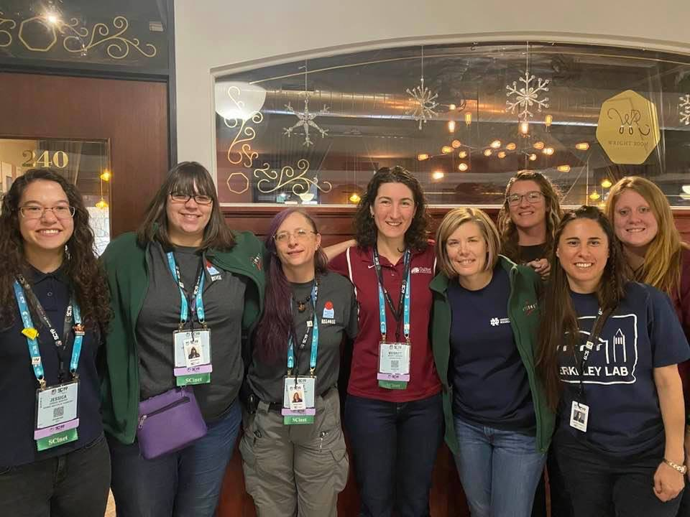
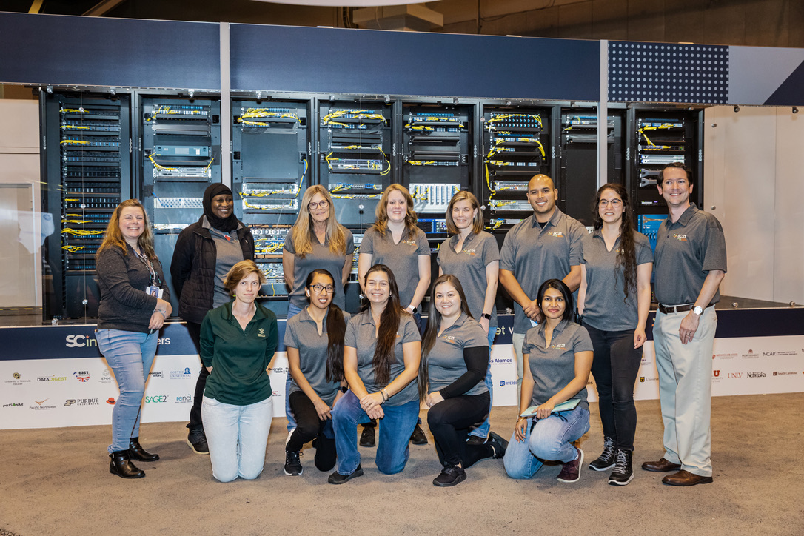
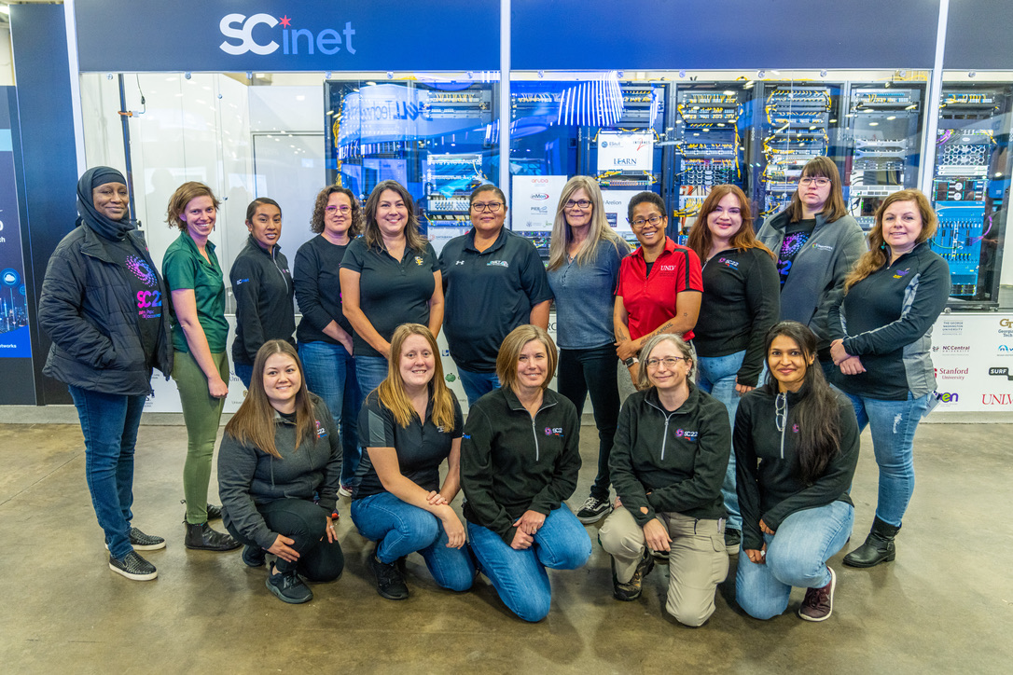
Components of WINS

Slide 5
FINANCIAL ASSISTANCE

Slide 6
Source: American Library Association

Slide 8
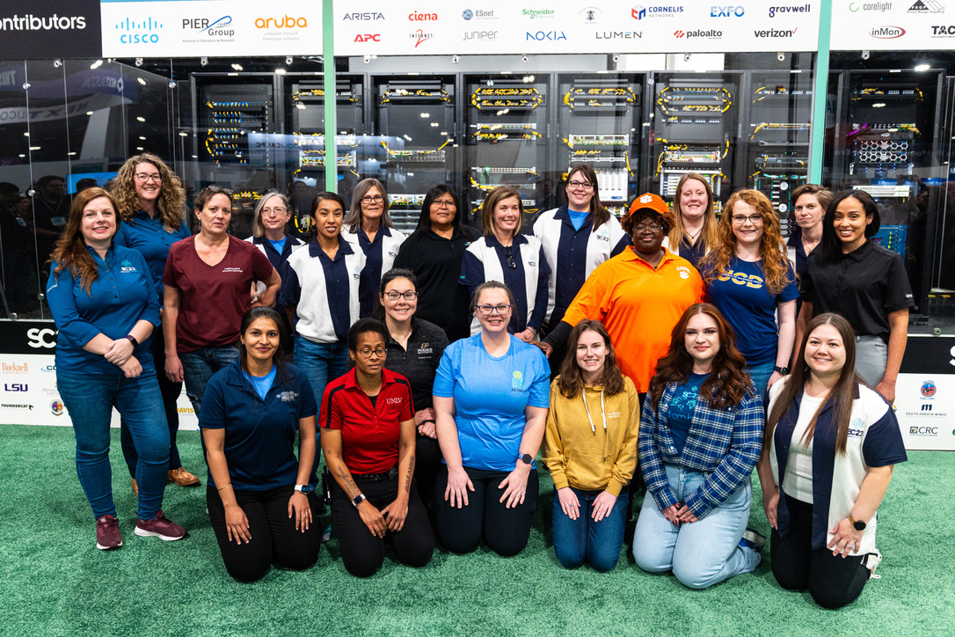
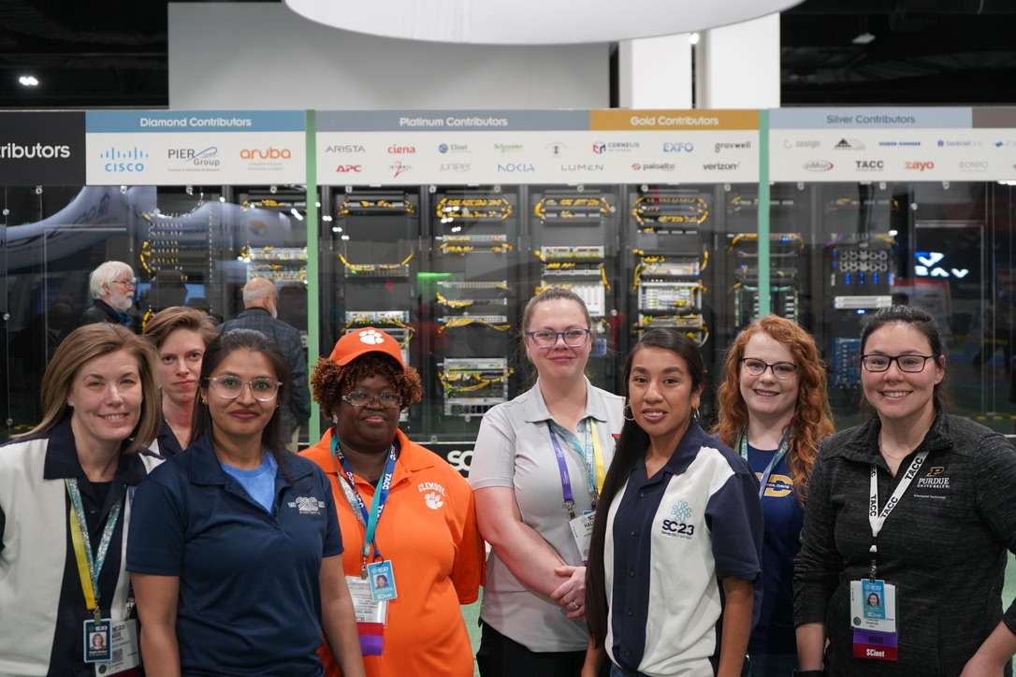
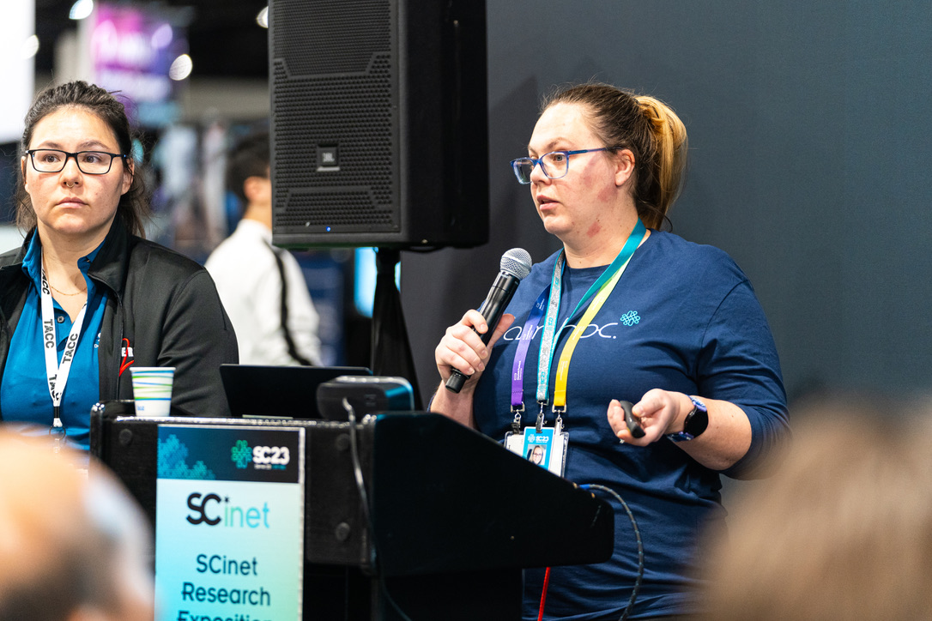
2023 WINS Participants

Slide 9
MORE INFO!
The WINS program is now open to INTERNATIONAL participants !!!
Applications Open : December 2, 2024
Applications Close : January 31, 2025

