Slide 1

BRINg it

Slide 2

IDENTIFYING
THE PUZZLE PIECES
01
OPEN SCIENCE AND FAIR DATA
02
SUPERCOMPUTING / HPC
03
SUSTAINABILITY

Slide 3





TARGETING
OUTREACH
GOVERNMENT BODIES
THE PUBLIC
RESEARCH COMMUNITY
STUDENTS

Slide 4



BRING
it
hackath

Slide 5
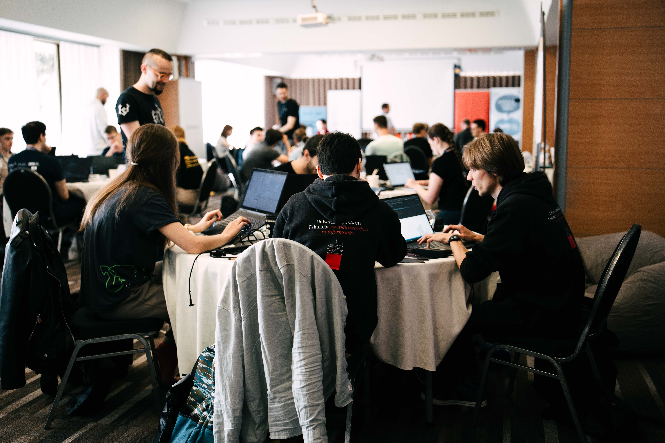
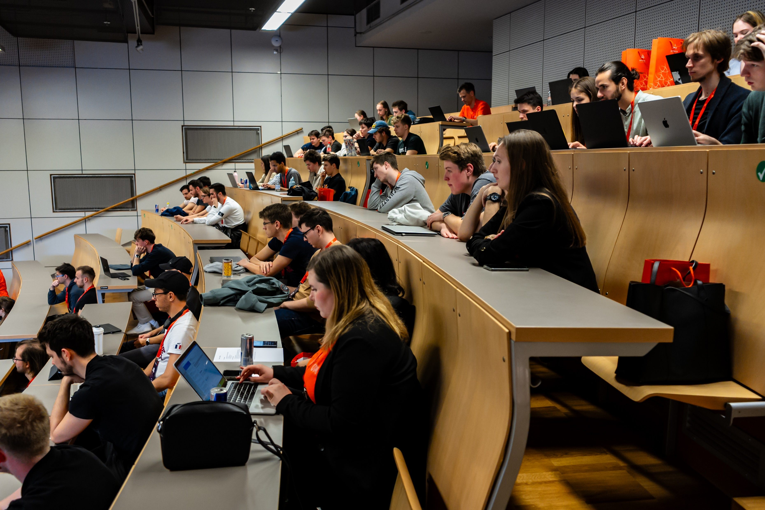

Slide 6


Slide 7


Slide 8


