Slide 1
University 4.0
The Potential of 5G on the University Campus
Lorena Gomez Gaviria

Slide 2
University Foundation and Evolution

Slide 3
University Foundations and Evolution
Tracing the journey from medieval roots to the tech-driven future
Foundation Period
Industrial Age
Digital Age
1
2
3
Medieval Foundations (11th - 14th century)
Renaissance and Expansion
(15th - 17th century)
Industrial Revolution (18th - 19th century)
Modern Era (20th century)
Information Age (late 20th century - present)
Digital Transformation (21st century)
Advanced Tech and Innovation (present - future)
Knowledge-Based on society, industry and technology evolution

Slide 4
University Foundations and Evolution
Tracing the journey from medieval roots to the tech-driven future
Foundation Period
Industrial Age
Digital Age
1
2
3
Medieval Foundations (11th - 14th century)
Renaissance and Expansion
(15th - 17th century)
Industrial Revolution (18th - 19th century)
Modern Era
(20th century)
Information Age (late 20th century - present)
Digital Transformation (21st century)
Advanced Tech and Innovation (present - future)
Knowledge-Based on society, industry and technology evolution

Slide 5
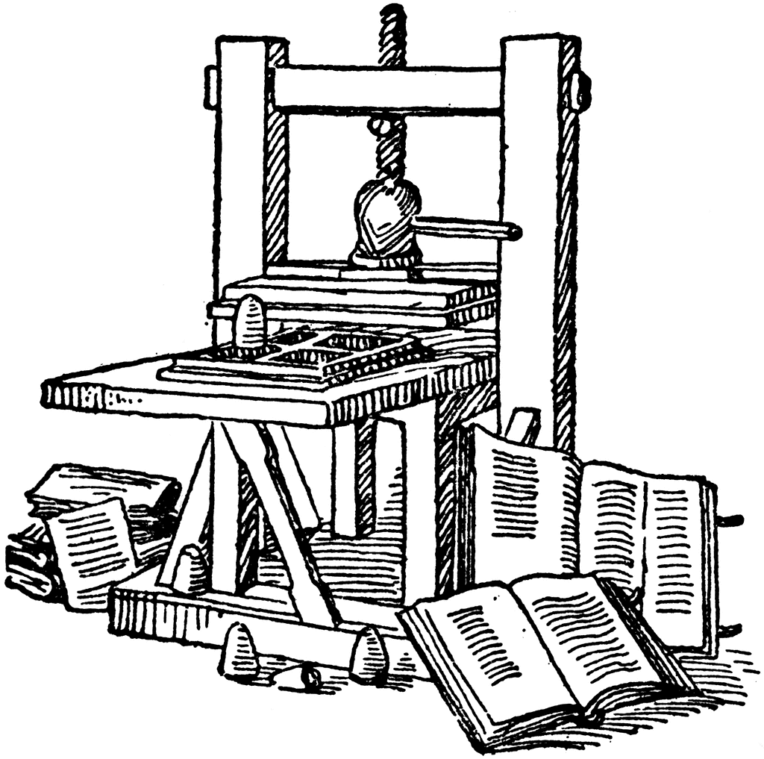
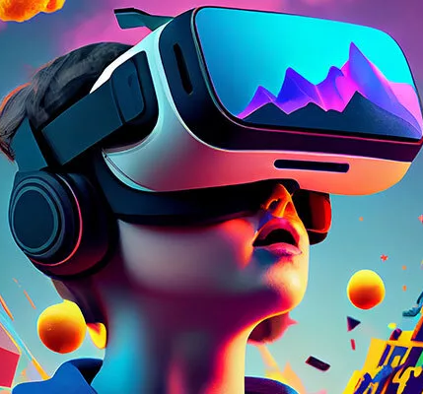
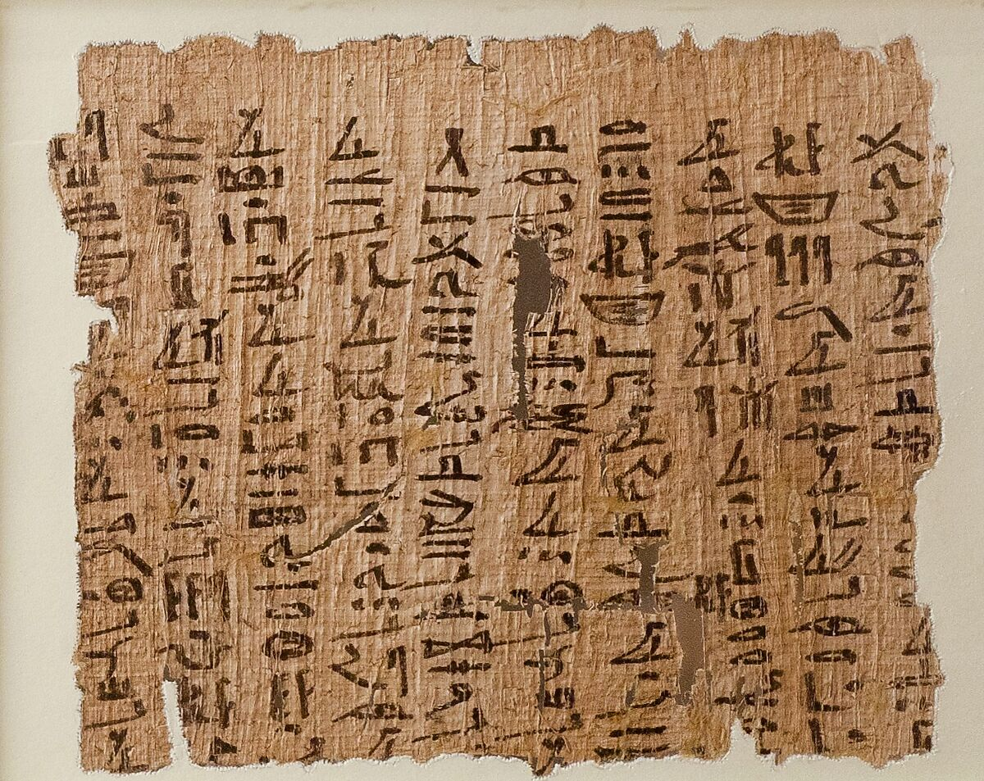
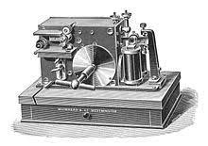
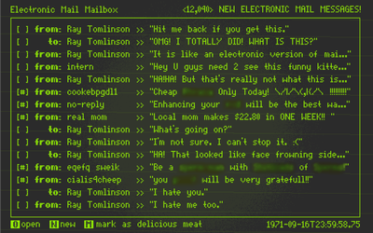
University Foundations and Evolution
Tracing the journey from medieval roots to the tech-driven future
Foundation Period
Industrial Age
Digital Age
1
2
3
5G
Medieval Foundations (11th - 14th century)
Renaissance and Expansion
(15th - 17th century)
Industrial Revolution (18th - 19th century)
Modern Era
(20th century)
Information Age
(20th century - present)
Digital Transformation (21st century)
Advanced Tech and Innovation
(present - future)
Knowledge-Based on society, industry and technology evolution

Slide 6
Evolution of Wireless Communication
From 1G to 5G
5G, AI,
VR, XR
Industry
Impact
Speed
Analogy

Slide 7
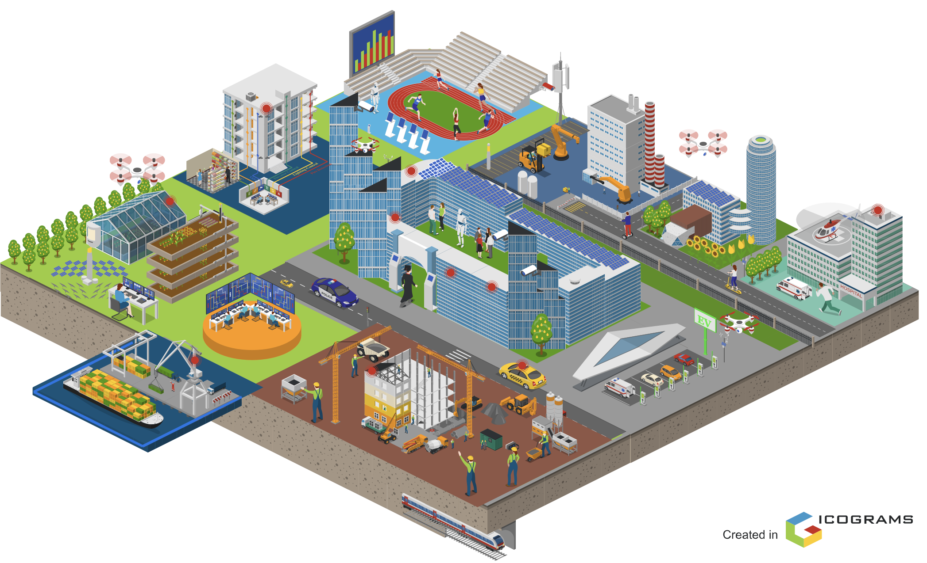
University 4.0 prototype powered by 5G technology
Partnerships with High-Tech Industry
Technology Integration
1
2
Enhanced Connectivity
Improved Learning Experience
Smart University Campus
Efficient Operations
Sustainable Campus Initiatives
Problem-Oriented Approach
Product-Oriented Focus
3
4
Data-Driven decision-making
Enabler for R+D+I+E

Slide 8
University 4.0 use cases: Integrating 5G for next-generation learning campus
Smart Sport Arena
Sustainable Living and Mobility
4
Entrepreneurship hub
3
Smart factory
Smart Hospital
Smart Agriculture
Smart University Campus
Smart Port
Smart construction
Industry 4.0 learning campus
2
1
Smart University Campus

Slide 9
What’s wrong with today’s Wi-Fi networks
Latency
Higher latency impacts real-time. (1-100 ms )
5G: <10ms
Capacity
Limited connections per access point (30).
5G: 800 Connections
Coverage
Limited range and dead zones. (~50-100 meters)
5G: up to 30Km
Mobility
Connection loss up to 15 seconds
5G: Up to 350 km/h
Security
High risk for hacker attacks
5G: Security by design
Performance
Unstable with increasing connected devices, impacting speed and reliability

Slide 11
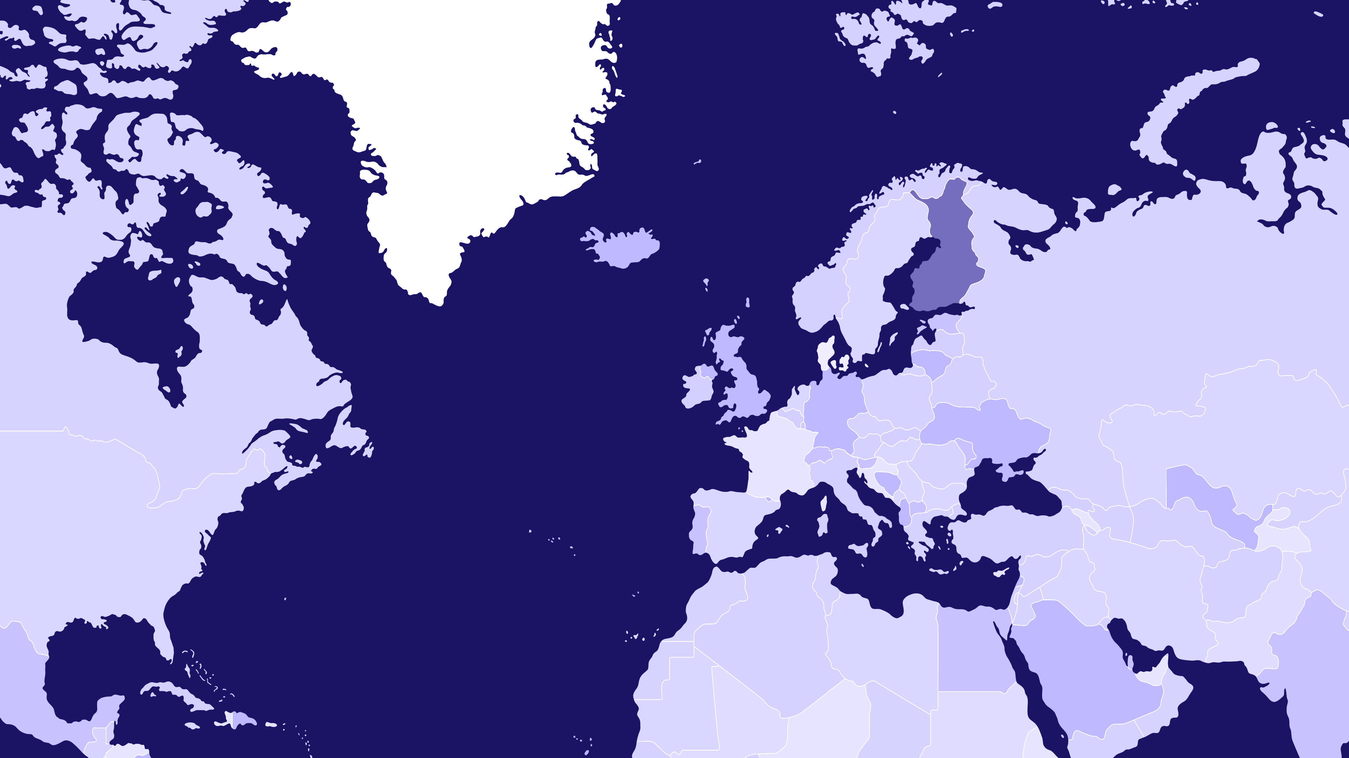
5G University Test Network Finland
Finland

Slide 12
5G University Test Network Finland: A Collaborative Model for Innovation and Impact
Healthcare
Construction
Agriculture
Manufacturing
Sustainability
University
XR (AR, VR,
5G
Government
Industry
Robotics
& mobility
Telecomm
Platform for I.40 R+D+I+E

Slide 13
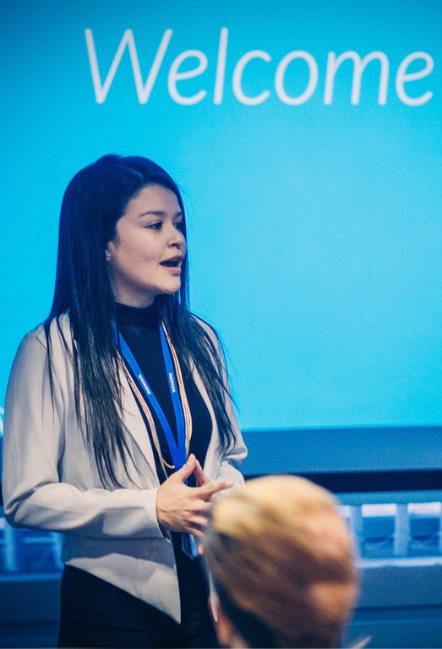
Connecting the dots
Early experiences shaped my vision for 5G in education

Slide 14
Leveraging 5G for the next generation of universities and workforce
5G
University 4.0
5G Technology
Industry 4.0
Labor 4.0
Educational framework aligning with I4.0 a hub for R+I+E
Connectivity that transcend traditional university campus.
Practical learning integrated into real industry use cases
Evolving workforce equipped for the future job market.

Slide 15
Let’s connect!
Lorena Gomez Gaviria
Email: lorenagomezgaviria@gmail.com
LinkedIN: http://www.linkedin.com/in/lorena-gomez-gaviria

