Slide 1
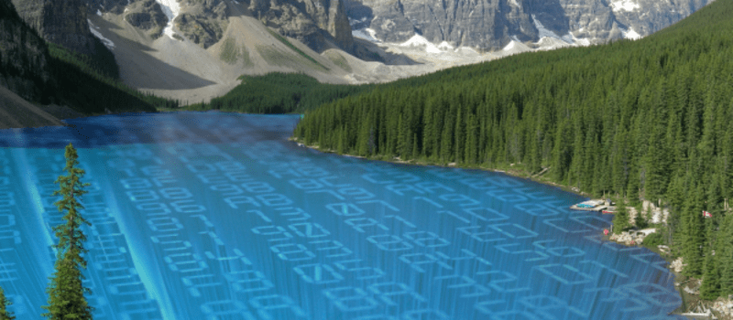
Do you really know what time it is?
Making informed decisions with data lakes
Eliza Gyulgyulyan
ASNET-AM

Slide 2
15 minutes late?

Slide 3
Expectation
ALPHA

Slide 4
Reality

Slide 5
Clean data before analysis?
$600 billion annually

Slide 6
Make decisions?
Null values
Inaccurate
Duplicates
Inconsistent
Wrong source
Information Errors
Invalid for analysis

Slide 7
Be protected?

Slide 9
Alert it!
Your data is
95% accurate
Your analysis result is 2.4 % biased

Slide 10
ALPHA
Your decision is based on
21% inconsistent data

Slide 11
Clean data before analysis?

Slide 12
Quality Model

Slide 13
Quality Model

Slide 14
Quality Model

Slide 15
after the session.
DontBe15MinutesLate@gmail.com

