Slide 1
ePrivo.eu
Ismael.Castell@upc.edu
Notes:
Hello everyone. I’m Ismael Castell and I’m going to explain something that I found very shocking the first time I realize about it. Probably, most of us have a Facebook, or any other social networks account.

Slide 2
Notes:
But I guess that not many people know that your bank can deny you a credit because of the information that you have on your Facebook account. And not only because of your information, but also from your friends information.

Slide 3
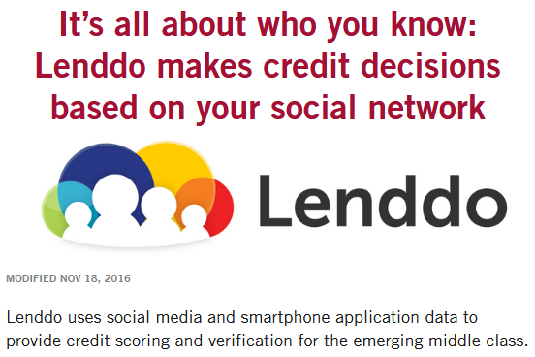
Notes:
Think about it, if some of your friends have problems paying their credits… well, you are in the same circle so you may have more problems than other people to pay it. And your bank can use this kind of information to take their decisions. But it is not only the information of your facebook account. The International Monetary Fund suggested that in the future your credit score may be based on your browsing history.

Slide 4
Notes:
And how do they know our browsing history? In fact, there are many different ways to collect this information directly from the website. They are the so-called web tracking techniques, and they are present in more than 95% of the websites. So, please, at this moment, assume that many companies know everything that you do online. And this information is not only used by your bank, but also for example by your insurance company.

Slide 5
Notes:
If, for instance, you do a risky sport, well, you have more probability of dying than other people so they can use this information to deny you some coverage. But your private data is not only important from you own privacy but also from the cybersecurity point of view. It has been found that cybercrime groups buy this data to find targets for their phishing and hacking campaigns.

Slide 6
Notes:
What is the information that they look for? They are interested in information about the executives of many different companies with credentials that give access to key systems inside their companies. And reports demonstrate that most of them in fact have information listed in those services, with very important information like your family, relatives or even the IP address of your home network, not your office, but your home network. So they can try to hack your router or use your personal emails for their phishing purposes. And now…

Slide 7
ePrivo.eu
Notes:
I’m going to present our solution to this problem. It is called eprivo.eu

Slide 8
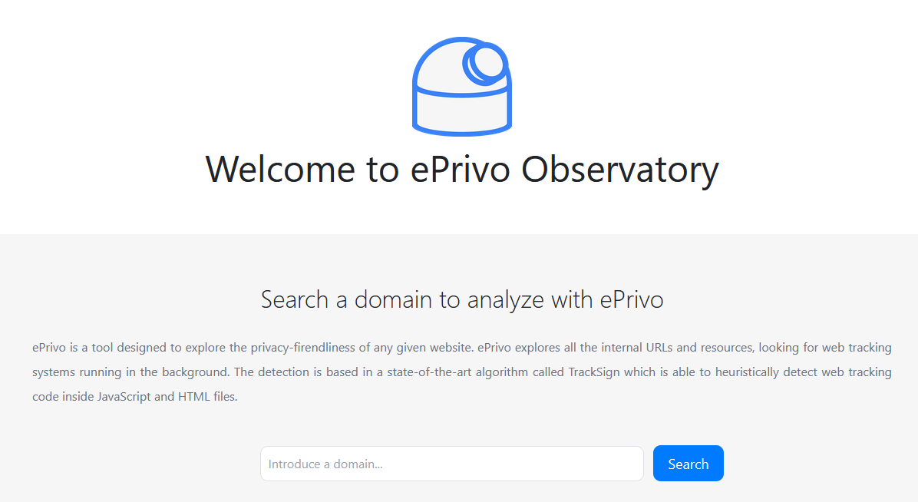
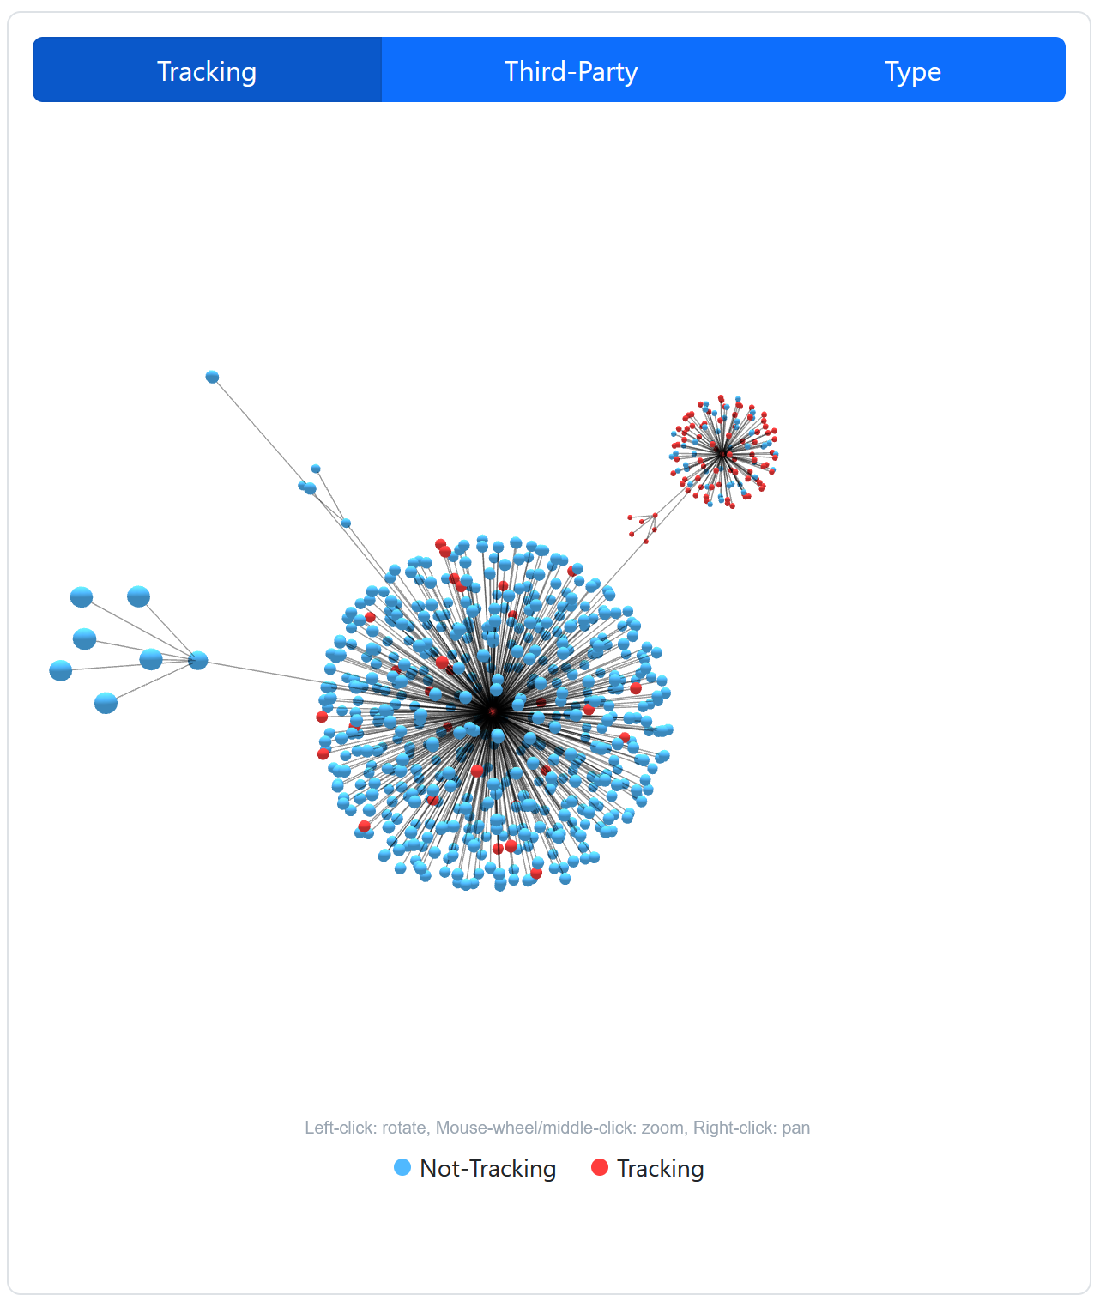
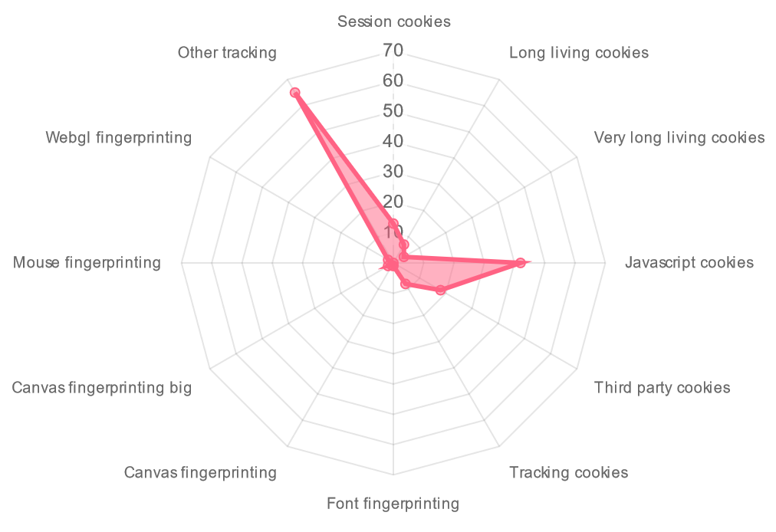
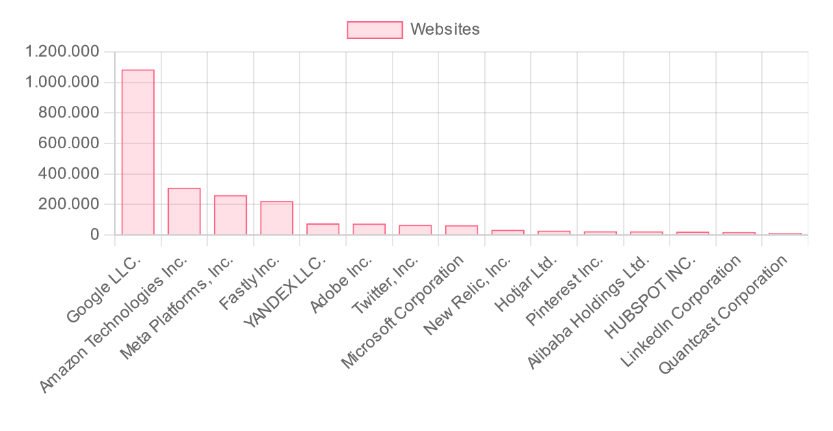
www.eprivo.eu (beta)
Notes:
It is a web service were anyone can search for a web and see its privacy-friendliness. It is still in beta phase, but it will give you a lot of information about the web tracking systems being used in the background or the tracking resources loaded by the website. But let me comment here that blocking web tracking is not so much difficult. In fact, many of you probably use an adblocker that can at some extent block them. The most difficult thing is it find unknown web tracking systems. And our system uses two state-of-the-art detection mechanisms…

Slide 9
Web tracking detection
State-of-the-art web tracking detection: TrackSign / ASTrack
Notes:
…that I’m going to present very, very briefly here. It is more complex tan this, but let’s assume that we have all the website code of all websites partition in different code portions. This is one of those portions. What we do is to look for all the websites that load this specific code portion. And, for instance, we find it present in several websites. But looking in detail to those URLs and files, we notice that for most of them we already know that they are tracking the user. Thus, this code portion is most probably being used for tracking purposes. But then, what happens with those two websites that we don’t have information about it? Well, if they include this code portion then they are also performing tracking. So we can automatically classify them as trackers, and this is the way we find unknown web tracking systems.
Finally, before ending my presentation let me comment that we have tried to get funding for this research in several venues, including GEANT, but it has been completely impossible… zero. But we really believe that our detection system can be included inside a browser, so that it can help to protect everyone’s privacy, so…

Slide 10
www.eprivo.eu
contact@eprivo.eu
Notes:
If anyone knows a call or has contact with some company, or major browser that can be interested in helping us to continue our research, please contact us in this email or talk with me after the session. I hope you find it interesting and thank you very much for your attention.

Slide 11
Acknowledgements
This work was supported by the CHISTERA grant CHIST-ERA-22-SPiDDS-02 corresponding to the GRAPHS4SEC project (reference nº PCI2023-145974-2) funded by the Agencia Estatal de Investigación through the PCI 2023 call
References:
[1] https://d3.harvard.edu/platform-rctom/submission/its-all-about-who-you-know-lenddo-makes-credit-decisions-based-on-your-social-network/
[2] https://money.cnn.com/2016/08/24/technology/lenddo-smartphone-battery-loan/
[3] https://reclaimthenet.org/imf-report-suggests-credit-score-browsing-history
[4] https://www.economist.com/finance-and-economics/2012/06/02/very-personal-finance
[5] https://www.cisecurity.org/insights/blog/the-conti-leaks-a-case-of-cybercrimes-commercialization
[6] https://joindeleteme.com/blog/what-are-data-brokers/#the-impact-of-the-data-brokerage-industry-on-business-cybersecurity
[7] https://www.corporatecomplianceinsights.com/wp-content/uploads/2022/06/Quantifying-the-Business-Need-for-Digital-Executive-Protection-Report.pdf
[8] I. Castell-Uroz, J. Solé-Pareta and P. Barlet-Ros, "TrackSign: Guided Web Tracking Discovery," IEEE INFOCOM 2021, Vancouver, BC, Canada
[9] I. Castell-Uroz, K. Fukuda and P. Barlet-Ros, "ASTrack: Automatic Detection and Removal of Web Tracking Code with Minimal Functionality Loss," IEEE INFOCOM 2023, New York City, NY, USA, 2023

