Slide 1
Continuous Testing at a Global Scale
Richard Freitag

Slide 2
Sunet is the Swedish University Computer Network

Slide 3
You accept a challenge
Wednesday – 10:51 a.m.

Slide 4
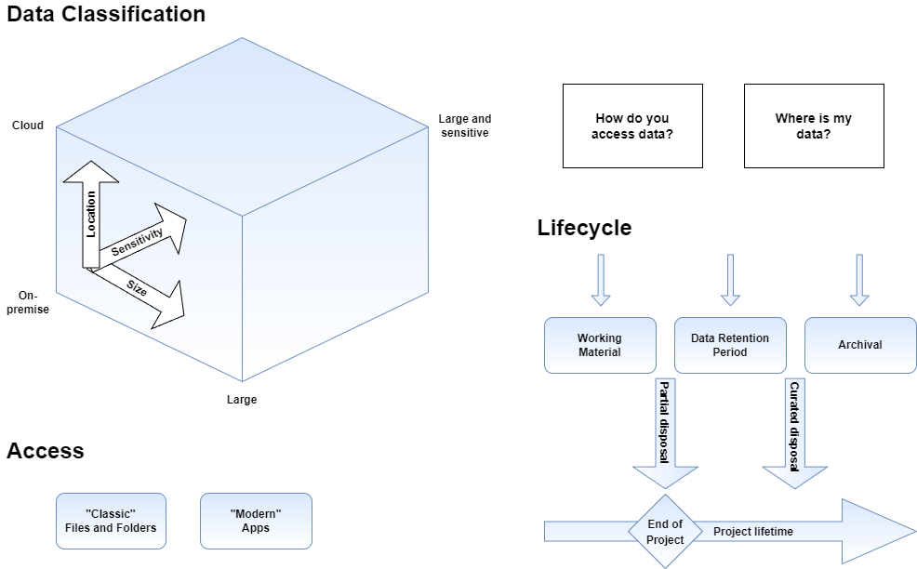
You model your system

Slide 5
You face reality
This is where the money ends!*
*for many projects

Slide 6
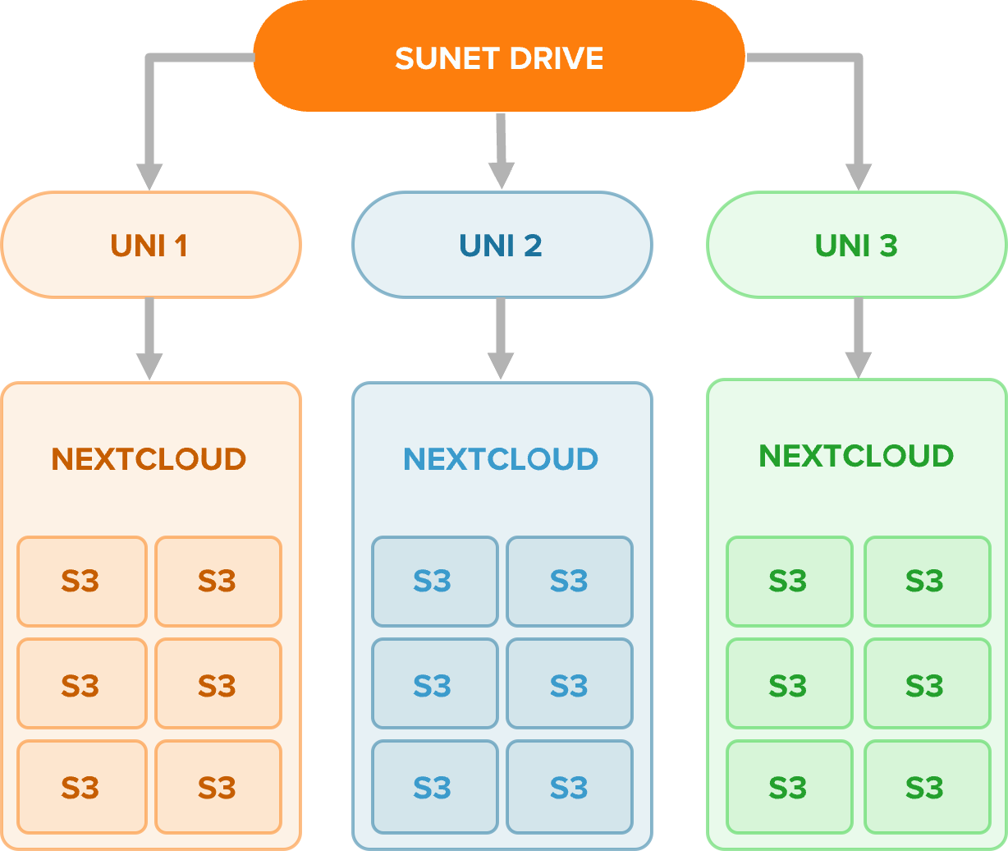
You build at a global scale

Slide 7
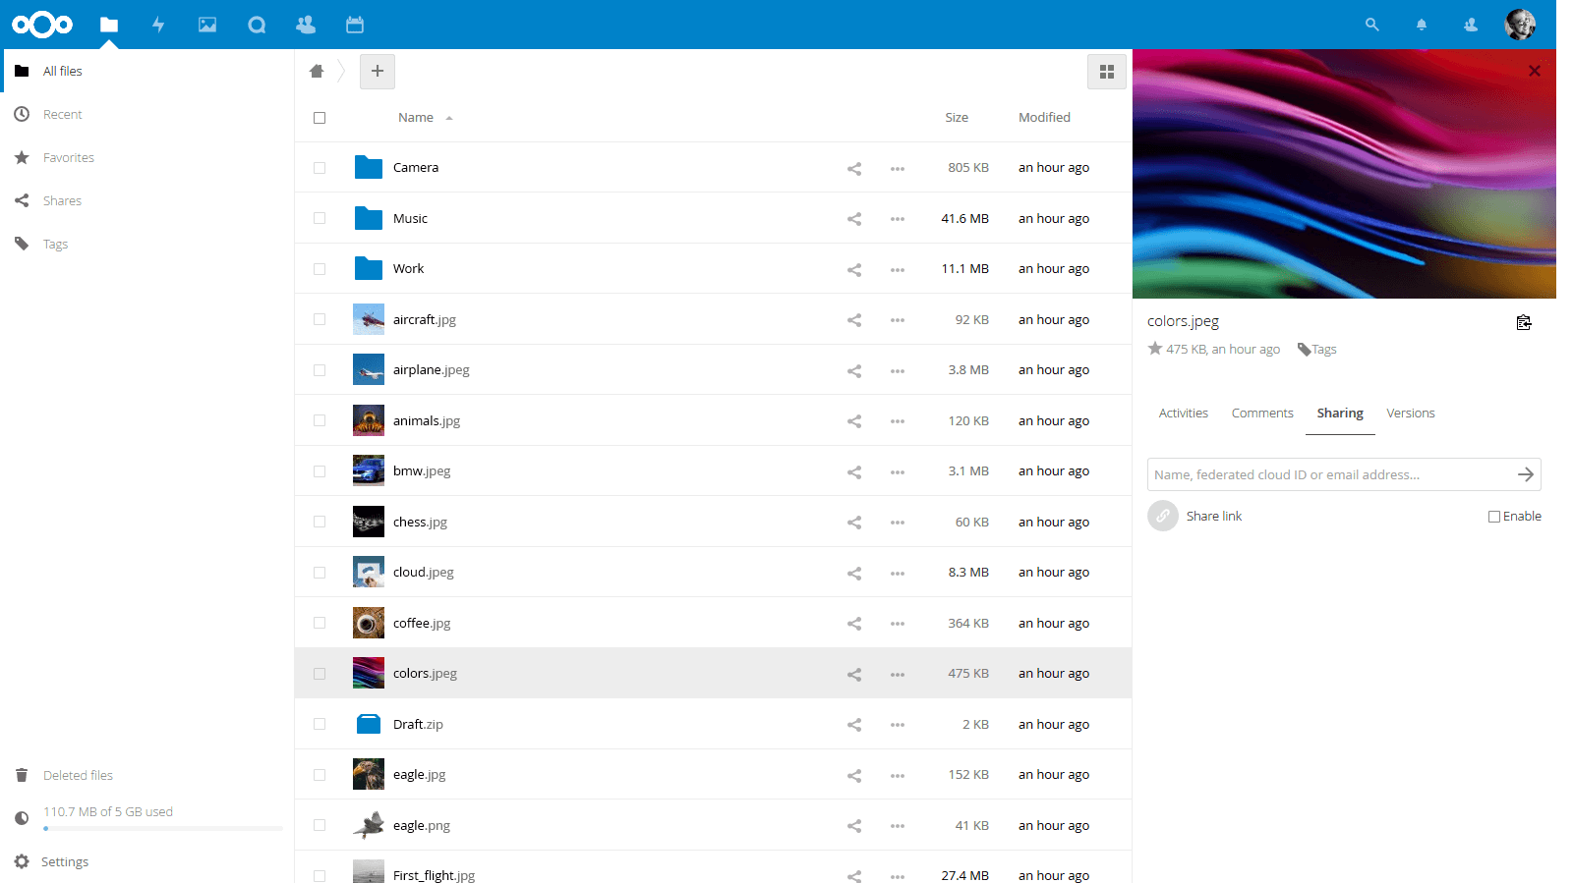
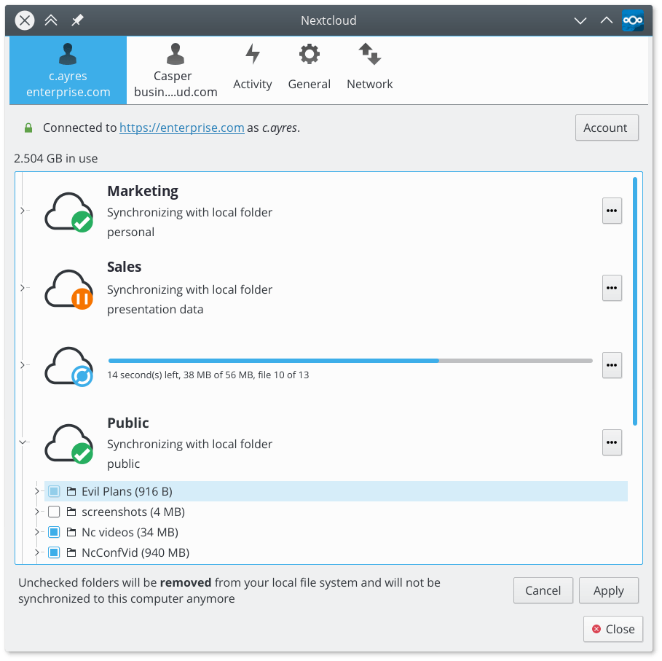
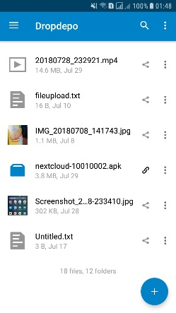
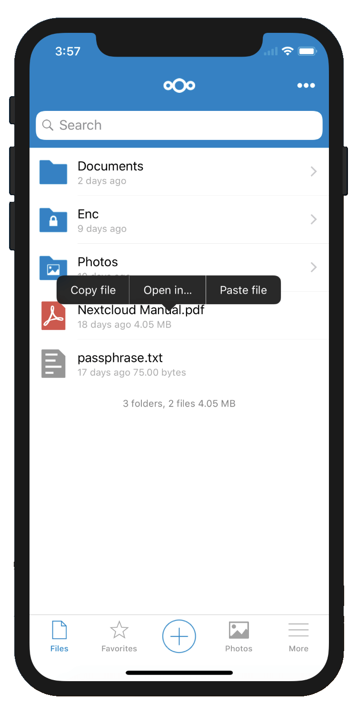
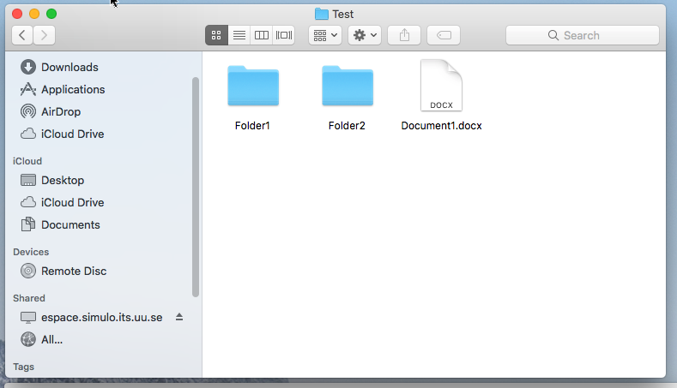
You integrate
Primary data sources
Secure Storage
UV-Vis
IVIUM
Storage (S3)
…
PIA
IPCE

Slide 8
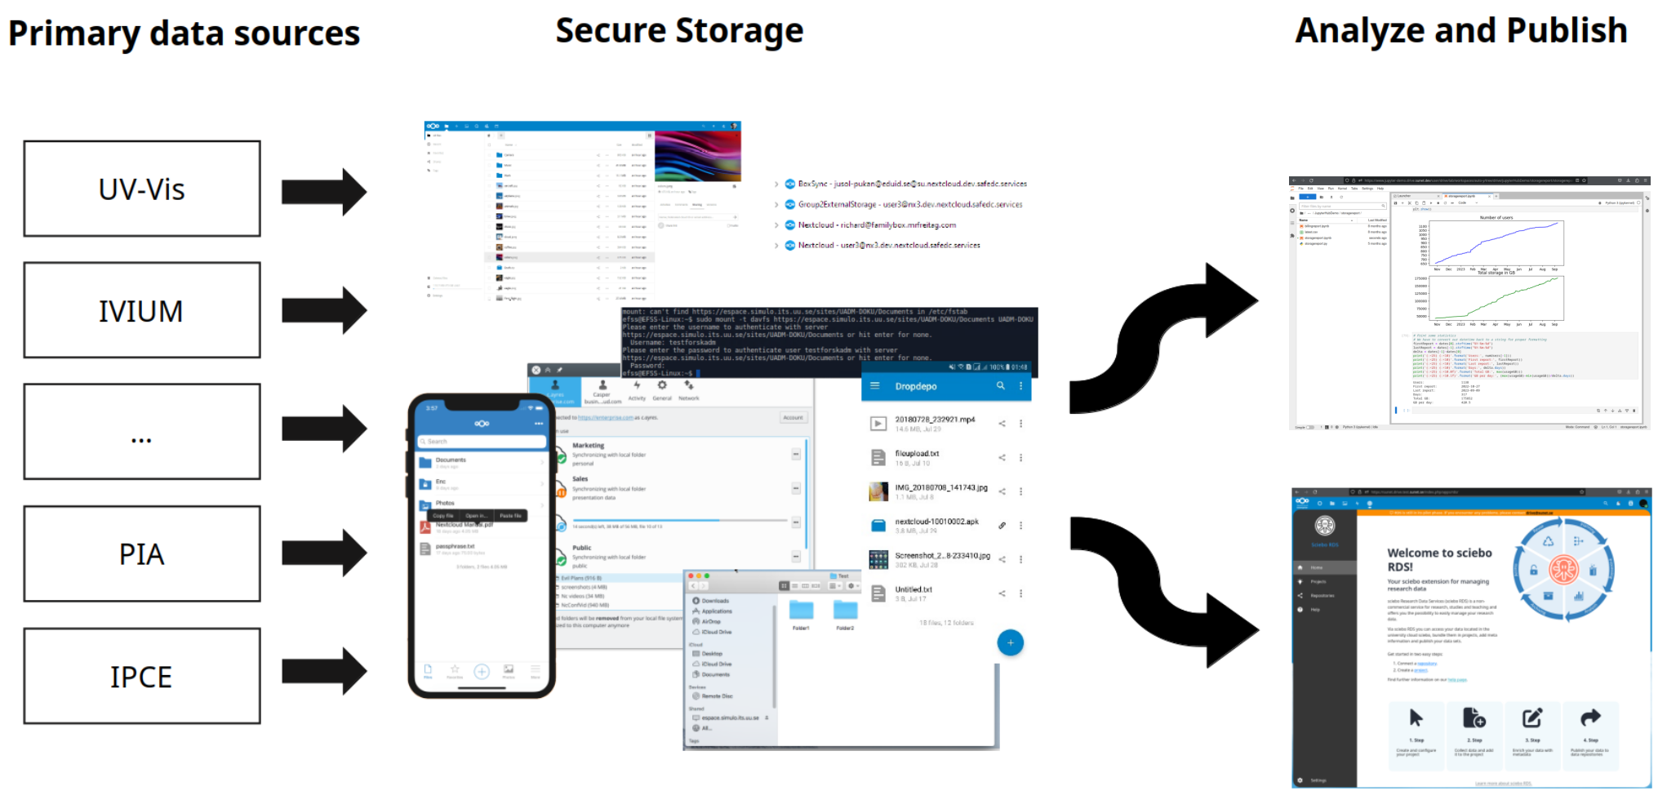
You expand

Slide 9
You ask yourself ’Does it really work all the time?’

Slide 10
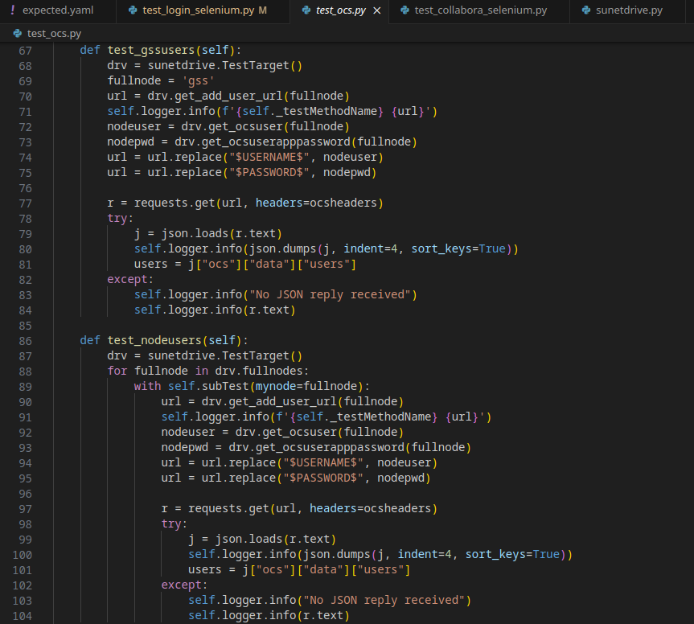
You write tests

Slide 11
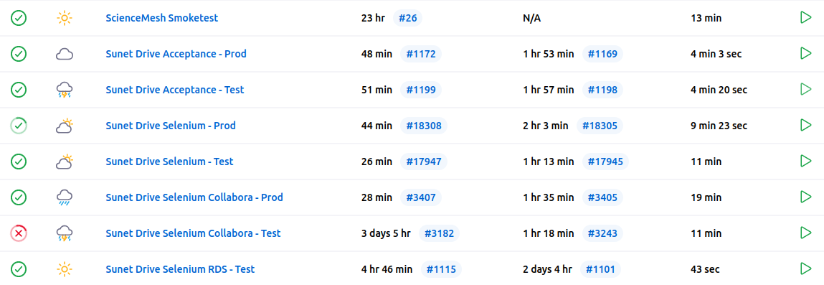
You test systematically
Testing on top of monitoring Manual – Automatic – On-Demand
Acceptance Testing – Capabilities, Status and Versions, User life-cycle, File handling, Apps, ...
Selenium
Node-login
Local and non-MFA SSO accounts
Collabora
Docoument handling and collaboration
Load
20 VMs, 300 users per VM
120-150 full load users
750-1000 resyncs within 5 minutes
6000 resyncs within 40 minutes

Slide 12
You test automatically

Slide 13
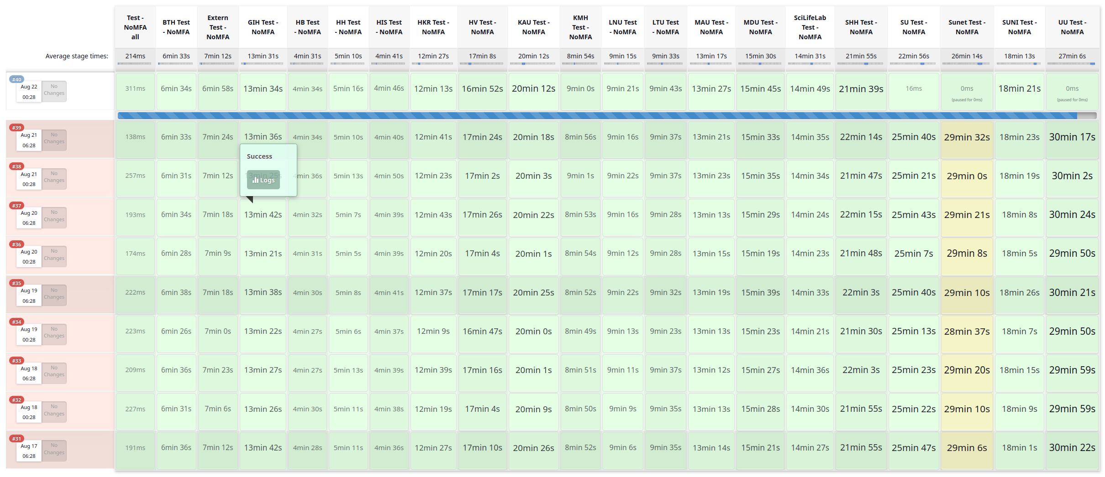
You use pipelines

Slide 14
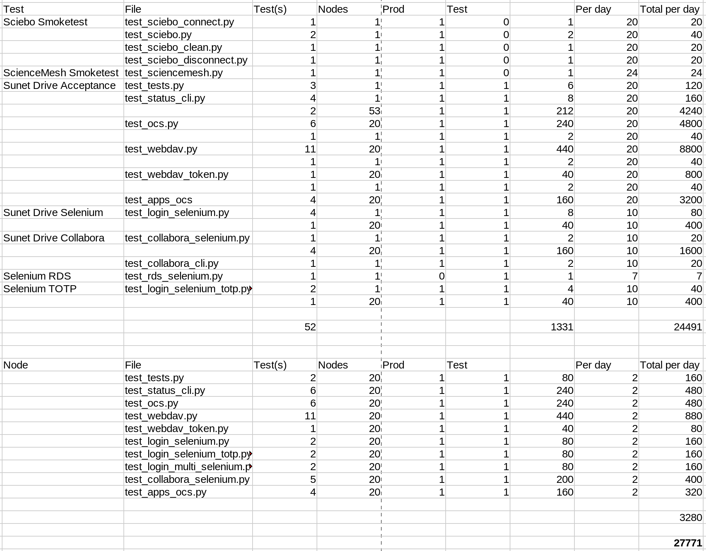
You test a lot – all the time
Test Coverage
52 Tests
Prod & Test
Different views and scenarios
>27k test points per day
ca. 1350 test points per tenant per day

Slide 15
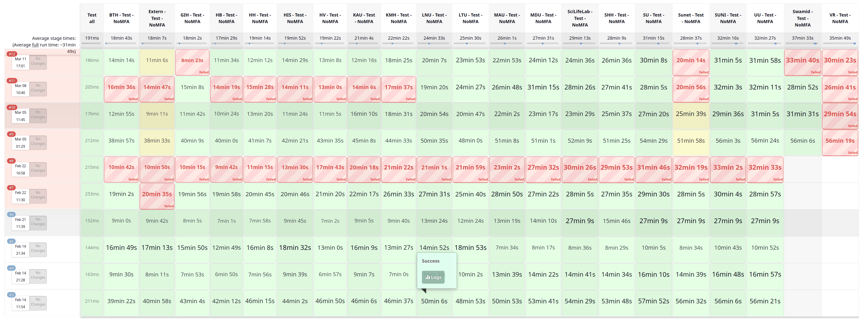
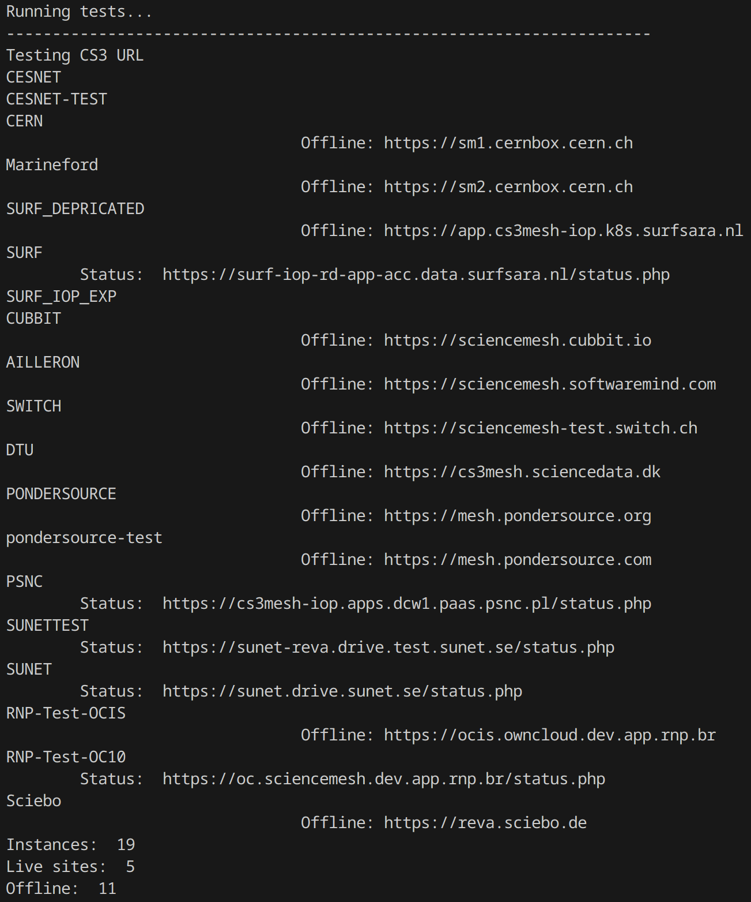
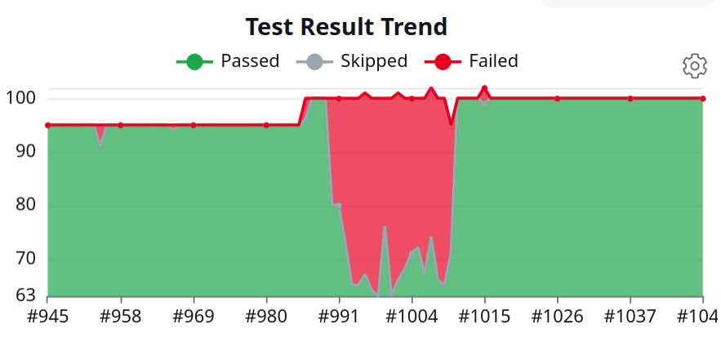
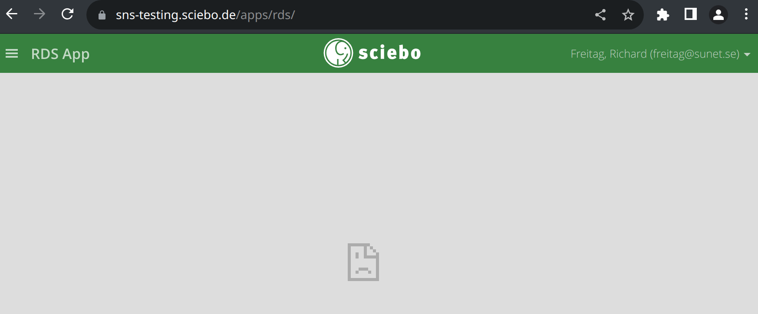
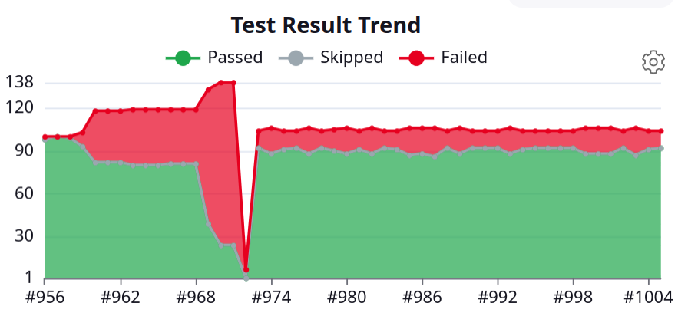
You break it – You fix it

Slide 16
You help building better solutions

Slide 17
Thank you
github.com/sunet/drive-tests

