Slide 1
THEY WILL NOT KNOW WHAT HIT THEM!
Joan Ophelia Ampaire
Le Grand Auditorium
Thursday 13 June 2024.

Slide 2
Roadmap for NREN Growth
Maturity
Birth/
Creation
Growth
Notes:
At Maturity, an NREN may feel like they have made it
Recurring revenue has increased
Increase in non connectivity related services
Operations grow
Operations are now streamlined

Slide 3
Notes:
Why the NREN may not stay afloat;
Complacency
Changing consumer demands. (The market is always changing)
Competition comes into play
Stagnation in innovation.
Poor governance structures.
This could lead to regression.
Regression isn’t the end of the organisation. There’s possibility of a restructure and getting things back to normal.

Slide 4
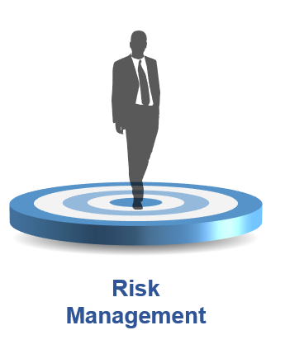
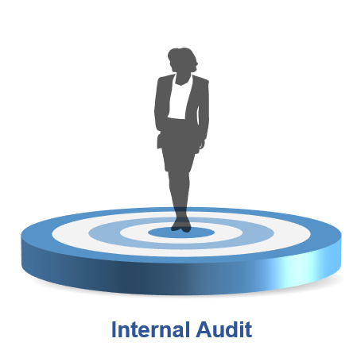
A case for Business Development, Internal Audit and Risk Management for NRENs
Notes:
There are some support functions that bring a lot to the table and can help the NREN regain relevance.

Slide 5
Business Development
Product and Service Innovation
Revenue Growth
Market Expansion
Stakeholder Relationship Management
Notes:
Business Dev’t is that function that looks out for growth opportunities for the organisation, they work with other departments to ensure that revenue grows, we remain innovative and serve the market as per their needs and manage relationships with already existing stakeholders.

Slide 6
Internal Audit
Review & Evaluate
Assurance
Insight & Foresight
Notes:
An independent, objective assurance and consulting activity.
Internal audit on the other hand adds value to an organization by regularly assessing its operations and governance, risk management and control processes, by providing assurance, insight and consulting services. As such, the NREN is able to implement changes and improvements that will help it operate more efficiently and effectively.

Slide 7
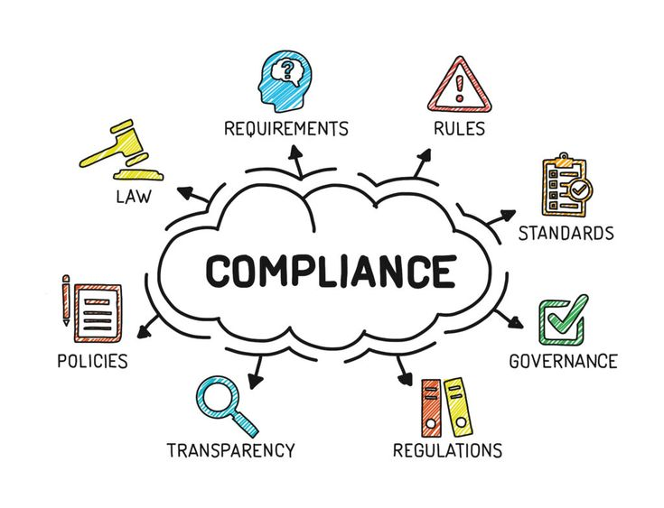
Risk Management
Better decision making
Compliance and Legal obligations
Business Continuity
Notes:
Why Risk Management
It promotes better decision making
Business continuity
Protection of assets
Compliance and legal obligations

Slide 8
Combined assurance [3 Lines of Defense]

Slide 9
Thank you
Any questions?
jampaire@renu.ac.ug
Notes:
References
Images from the public domain on Pinterest
https://www.linkedin.com/pulse/what-assurance-fatakpay/
https://txm.com/overcoming-four-big-barriers-to-a-lean-culture-part-1-breaking-through-complacency/#:~:text=The%20most%20easily%20recognised%20of,is%20no%20need%20to%20improve.

