Slide 1
MFA Evolution in Higher Ed Survey Results
TNC Lightning Talk
Sean O’Brien obo/ Nick Lewis
12 June 2024

Slide 2
Background
Internet2 conducted 2020 and 2023 MFA Surveys
Supported and sponsored by the NET+ Duo Service Advisory Board
The goal was to have it take 10 minutes or less for someone knowledgeable about MFA at an institution to complete the survey
We gave respondents a month to complete the survey
Request to complete the survey sent to NET+ Duo users, EDUCAUSE Security and IDM lists, and REN-ISAC Discuss email lists
A public version of the data will be posted as a blog

Slide 3
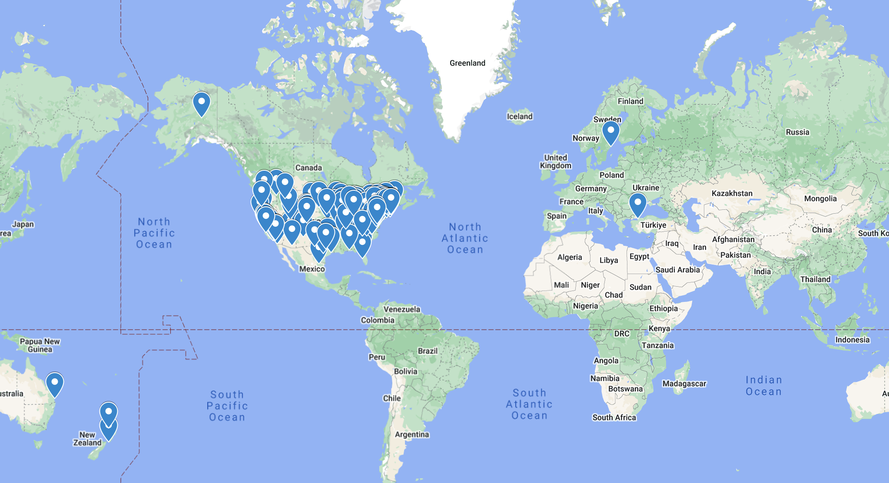
225 unique responses from 10 countries

Slide 4
Institutional Profiles
About
225 unique responses with 2 anonymous from 10 countries
US, India, Mexico, Philippines, Canada, Sweden, New Zealand, UK, Australia, Turkey
Participating institutions span a range of sizes, from sites with no students to those with enrollments approaching 100,000 students - across 20 Carnegie Classifications.
Combined, responding institutions' services protect the learning of over 3 million students.
Common Roles
CIO: 13.06%
CISO: 10.78%
IT Director: 5.38%
Systems Administrator: 4.17%
Director of Information Security: 3.74%
Security Engineer: 3.31%
IAM Architect: 2.45%
Identity and Access Management Specialist: 2.02%
IT Manager: 2.02%
Network Engineer: 1.88%

Slide 5
What We Found: Interesting Data.

Slide 6
Institutions Supporting a Single MFA Solution

Slide 7
Remember Me Duration

Slide 8
Timeline for Implementing Passwordless

Slide 9
What Prevents Implementing Passwordless

Slide 10
Timeline for Implementing REFEDS MFA Profile

Slide 11
What We Found: Five Key Themes.

Slide 12
Increased Adoption of MFA
There is a significant increase in the adoption of Multi-Factor Authentication (MFA) across higher education institutions. In 2023, 86% of institutions support only one MFA solution, up from 68% in 2020.
The number of institutions requiring MFA for all applications has increased from 5% in 2020 to 40% in 2023.

Slide 13
Expansion of User Coverage
The requirement for MFA across different user categories has expanded significantly. In 2023, 79% of institutions required MFA for faculty, staff, and students, compared to 38% in 2020.
MFA availability for students has become more prevalent, with only 15% of sites supporting fewer MFA users than they have students, down from 45% in 2020.

Slide 14
Market Evolution
While Cisco Duo remains a popular MFA solution, its dominance has decreased, with 68% of respondents supporting it in 2023, down from 82% in 2020.
There is a rise in the use of Microsoft Entra MFA (formerly Microsoft Azure MFA), supported by 46% of respondents in 2023, up from 23% in 2020.

Slide 15
Implementation and Support Challenges
Institutions report varied experiences with implementing MFA, including challenges related to user support and training. Nearly 75% of respondents provide MFA support with fewer than 2 full-time employees (FTEs).
The "remember me" feature and its support duration vary, with more institutions allowing longer periods in 2023 compared to 2020.

Slide 16
Future Plans
Institutions plan to expand MFA coverage to more applications and user groups, ensuring that all access points are secure. This includes making MFA mandatory for all remote access and sensitive applications.
Despite widespread MFA deployment, the majority of institutions do not have current plans to shift to passwordless authentication, citing budget constraints, prioritization issues, and the novelty of passwordless technology as main impediments.

Slide 17
What comes next: Acting globally?

Slide 18
Future direction
Including students
Risk based auth
Passwordless
Retire telephony

Slide 19
MFA Evolution in Higher Ed Survey Results
TNC Lightning Talk
Sean O’Brien obo/ Nick Lewis
Sobrien or Nlewis @internet2.edu
12 June 2024

