Slide 1
InCommon’s Cybersecurity Cooperation Exercises
Practicing REFEDS Sirtfi Procedures
Presenter
Matthew Economou
June 2024
Notes:
Bonjour à tous! Good afternoon, everyone!
I’m Matthew Economou, vice president of engineering at Research Data and Communication Technologies.
I’m here on behalf of my colleague, Kyle Lewis, who runs the InCommon Federation’s annual Sirtfi exercises.
We want you to participate in this year’s exercise, which is open to any research and education federation member.
But first, let me explain what Sirtfi is.

Slide 2
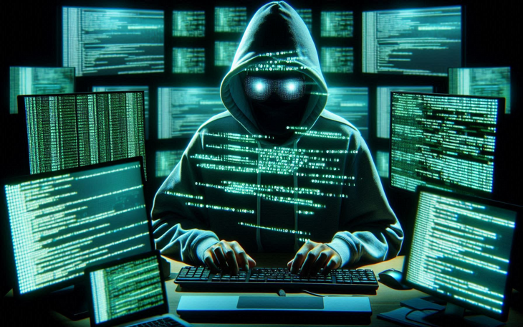
REFEDS Sirtfi – What is it?
Security Incident Response Trust Framework for Federated Identity (Sirtfi)
Enables federation members to coordinate cybersecurity incident response.
Builds information security trust between federation members.
https://refeds.org/sirtfi
TLP:CLEAR
Notes:
Trust federations enable scientific collaboration at global scale.
Your users can access data and services hosted by other institutions.
Conversely, faculty, students, and staff at research and education institutions worldwide can access scientific resources, training materials, and more hosted by you.
This is awesome!
But it also means a cybersecurity incident at one institution can affect its partners.
The Security Incident Response Trust Framework for Federated Identity, or Sirtfi, is a standard created by REFEDS, the Research and Education Federations Group, to provide a means for federation members to link their security teams and cooperate when bad things happen.

Slide 3
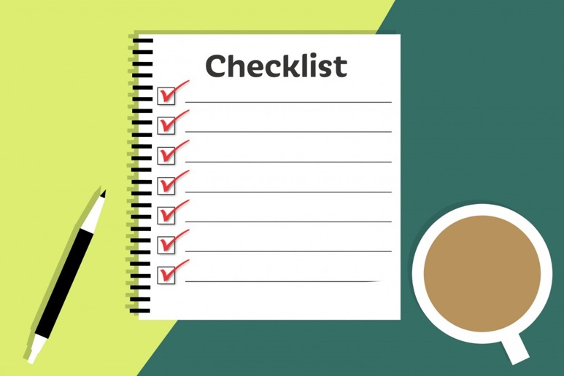
Guide for Federation Participants https://wiki.refeds.org/display/SIRTFI/Guide+for+Federation+Participants
16 Normative Assertions
Publish Security Contact to your Federation
Agree to use Traffic Light Protocol
Assert Sirtfi Compliance to your Federation
TLP:CLEAR
Notes:
To be able to claim Sirtfi compliance, your organization has to be able to say “yes” on a self assessment for 16 ‘normative assertions’ specified by the framework.
You must publish your security incident response team's contact in federation metadata.
You must agree to use—but more importantly, to honor—the traffic light protocol as a means for marking how information shared during a security incident can, or cannot, be shared.
Then you can assert Sirtfi compliance to your Federation.

Slide 4
Sirtfi - Normative Assertions
Self Assess - must say “yes” to all before claiming Sirtfi
Managing access to information resources, maintaining their availability and integrity, and maintaining confidentiality of sensitive information (boundary protection, intrusion detection, scanning, patching, etc)
Incident response interactions with other organizations participating in the Sirtfi trust framework
Able to answer the basic questions "who, what, where, and when" concerning a security incidents. Requires retaining relevant system generated logs, including accurate timestamps and identifiers of system components and actors, for a period of time.
All participants (IdPs and SPs) in the federations rely on each others users practicing knowing what is expected as authorized, appropriate and responsible network behavior
OS - Operational Security
IR - Incident Response
TR - Traceability
UR - User Requirements
16 Assertions across four security families
Notes:
The normative assertions are grouped into four families… from traditional operational security—like having a security boundary, intrusion detection, vulnerability scanning, and remediation—to the ability and (more importantly) the willingness to cooperate with federation partners.
You also need to be able to trace your users activities—determining which services they might have accessed during the time an account was compromised.
Furthermore, your users must be aware of basic cybersecurity practices, of acceptable use policies or terms of service, and how to report suspected security incidents internally.

Slide 5
Traffic Light Protocol (TLP)
Traffic Light Protocol (TLP) is a way of marking information so others know if and how wide they can share it.
TLP:RED = Not for disclosure, restricted to participants only.
TLP:AMBER = Limited disclosure, restricted to participants’ organizations.
TLP:GREEN = Limited disclosure, restricted to the community.
TLP:CLEAR or TLP:WHITE = Disclosure is not limited.
https://www.cisa.gov/tlp
TLP:CLEAR
This Photo by Unknown Author is licensed under CC BY-NC
Notes:
Finally, marking information with TLP colors communicates how you wish, or do not wish, sensitive incident response information to be shared.

Slide 6
InCommon Cybersecurity Cooperation Exercises
2022 – 16 Universities and Govt agencies participated
2023 – 20 participating organizations, including international federations (Australia and New Zealand)
2024 – Planning in progress! Third annual exercise planned 18-22 Nov
Observations
Identified that many IAM teams and Security Teams are not integrated
Some security response teams unaware of IAM, federation, or Sirtfi, despite their organizations asserting Sirtfi compliance to federation.
There exists a need to help federation member organizations increase Sirtfi awareness in their security teams.
TLP:CLEAR
Notes:
In 2021, InCommon made Sirtfi compliance part of the federation's Baseline Expectations.
In 2022, InCommon launched its first cybersecurity cooperation distributed tabletop exercise as a means for institutions to practice using the Sirtfi framework.
Through these events, we’ve observed that sometimes Security Teams may not know about their institution's role within the federation.
These exercises have helped security teams become aware of areas they need to modify their incident response plans and procedures to incorporate Sirtfi and the reality of the federated community.

Slide 7
InCommon Cybersecurity Cooperation Exercises
Participating Security Teams practice:
Scenario involving multi-organization, cross-federation security incident
Security teams interact with players from other organizations
Exposure to TLPs
Goals:
Expose Security Teams to Federation by practicing Sirtfi
Help security teams identify where procedures need updating to include Sirtfi.
NOT a technical exercise! This is about people and procedures.
2024 Exercise Planning under way!
Look for Call for Participation in September 2024 to InCommon and REFEDS distro lists
(or email klewis@researchdata.us to ensure you get the call)
Distributed Tabletop Exercise scheduled 18-22 Nov 2024
No travel required!
https://spaces.at.internet2.edu/display/sepwg/2024+InCommon+Cybersecurity+Exercise+Information
TLP:CLEAR
Notes:
Now in 2024, planning is underway for a November exercise.
There will be a Call for Participation that goes out in the late summer timeframe to InCommon and REFEDS email lists.
If you’re interested in making sure you get the Call, you can also email Kyle directly at klewis@researchdata.us, and he will put you on a list of guaranteed recipients for the signup information.
No travel is required!
We think this is a great opportunity for your security teams to review their plans and raise awareness of federation incident response coordination using the Sirtfi framework.
We hope you'll join us!

