Slide 1
Simplifying complexity with AI
Improving the accessibility of official documents
Antoni Klorek
Rennes
12th June 2024
Notes:
Simplifying complexity with AI. My name is Antoni and I would like to present a tool that improves the accessibility of official documents using Artificial Intelligence.

Slide 2
Long documents
Sophisticated vocabulary
Complex phrases and sentences
Notes:
I believe many of us have received some official documents from authorities, lawyers, or other offices. And probably some of us had a hard time to fully understand them. It may be the use of sophisticated words or long and complex sentences that make a text hard to comprehend. Difficult writings complicate the lives of recipients and can result in misunderstandings. So, why not make these documents simpler and improve their accessibility?

Slide 3
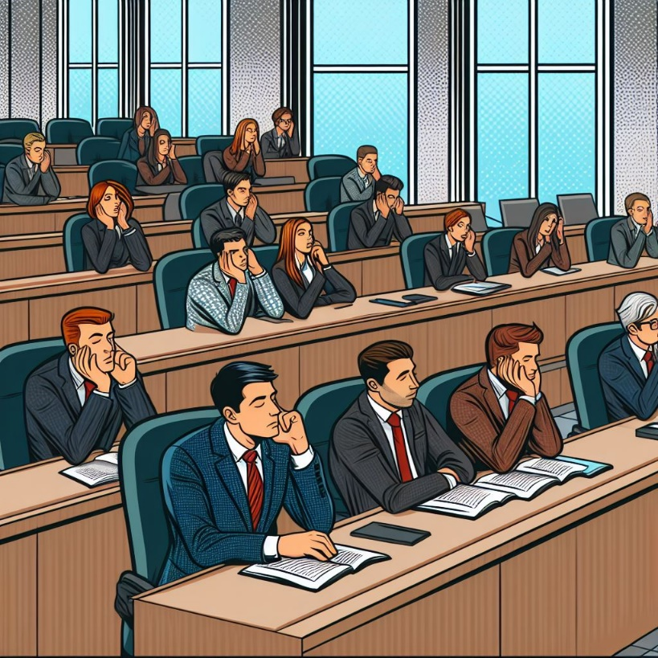
Current solutions are inadequate
Numerous exhaustive trainings
Expensive experts and trainers
Long and uncertain process
Notes:
It seems that the problem comes down to employee training. However, it is hard to change the learned habits of thousands of people across different departments or even professions. This would be a long, complex, and expensive process that requires hiring many domain and language experts to conduct these trainings. And at the end, there is no guarantee that the process will succeed. To sum up, this approach is not what we all want to go through.

Slide 4
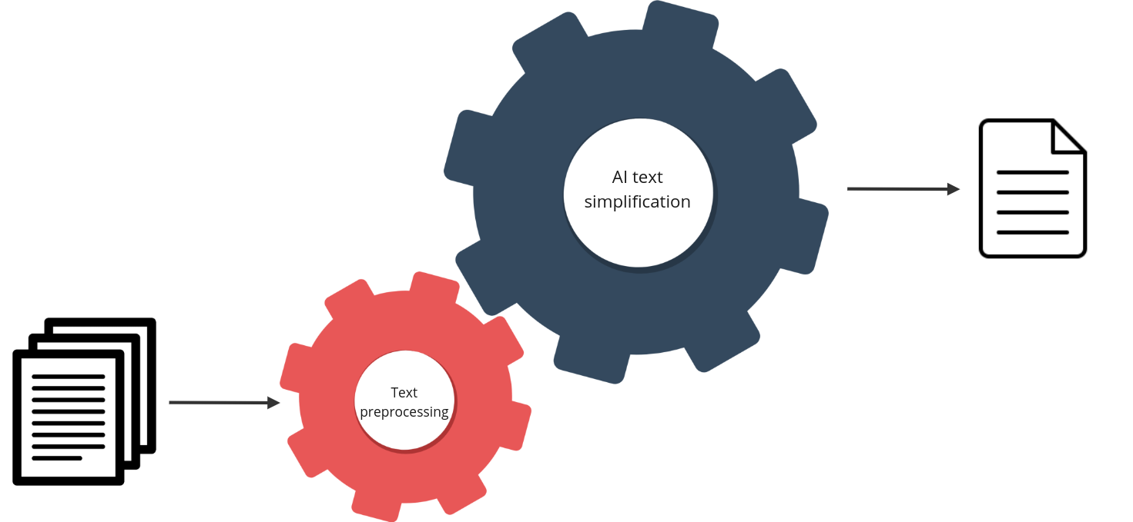
AI advantage in text processing
left-to-right decoder
seq2seq architecture
- Long documents
- Hard to understand
- Sophisticated vocabulary
bidirectional encoder
- Clearer and shorter text
- Important points preserved
- Simpler vocabulary
Notes:
We want to propose an automated process of text simplification. Long, hard-to-understand and sophisticated documents would be translated into their simpler, clearer, shorter versions while preserving all important points. The process is built from two main components - text preprocessing and AI text simplification. Focusing on the latter, it is a text-to-text AI model that converts input text into output text, performing a specific, trained task, here text simplification. With a sequence-to-sequence architecture, a model trained on pairs of phrases could learn which fragments of text to change into simpler versions and which pieces to leave unchanged. The benefit of using an AI model in this task is that it knows the language’s structure and grammar thanks to the pre-trained stage performed on large corpora of text. Also, it can generalize and adapt to previously unseen data.

Slide 5
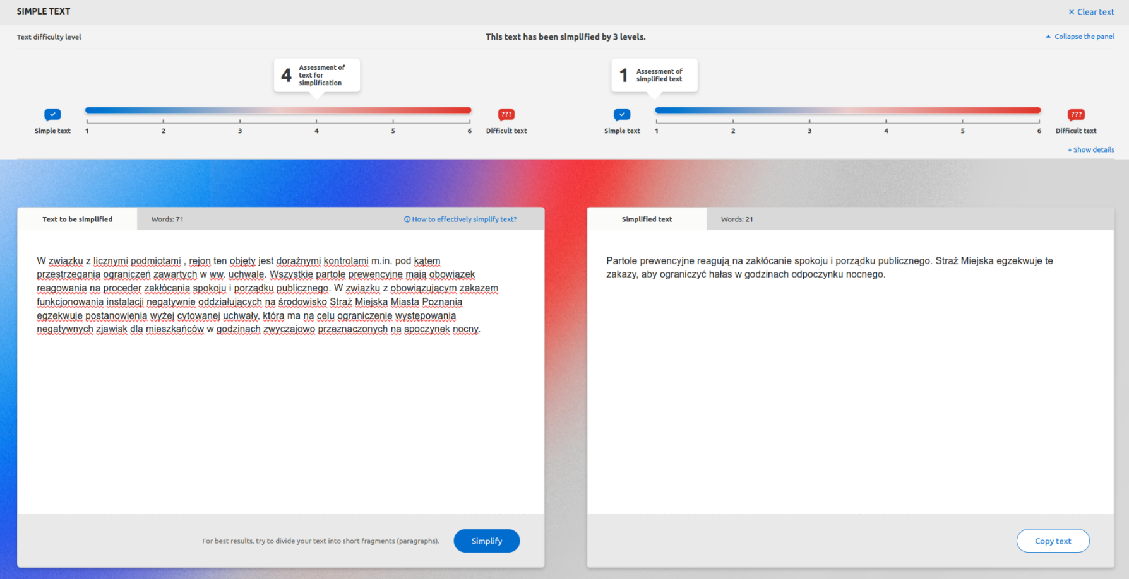
Web-based application view
In connection with numerous subjects, the area is covered by ad hoc inspections for, among other things, compliance with the restrictions contained in the above-mentioned resolution. All the preventive patrols are required to respond to the procedure of disturbing the peace and public order. In connection with the current ban on the operation of installations that have a negative impact on the environment, the Municipal Guard of the City of Poznań enforces the provisions of the above-mentioned resolution, which aims to limit the occurrence of negative phenomena for residents during the hours customarily designated for night rest.
Preventive patrols respond to disturbances of public peace and order. The City Guard enforces these bans to reduce noise during night rest hours.
*Texts translated from Polish
Notes:
We also built a handy user interface in the form of a web application to simplify the utilization of the tool. A simple editor, where a text can be written, pasted or uploaded, is provided. Then, the text is transformed into a simpler version by the use of the AI model. The editable output can be seen on the right. As the AI is not always perfect, the final word belongs to the author. They can edit, copy or delete the text. On the top, the metrics assess the difficultness of both texts indicating how much the output version was simplified.

Slide 6
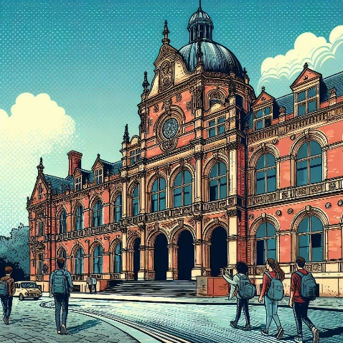
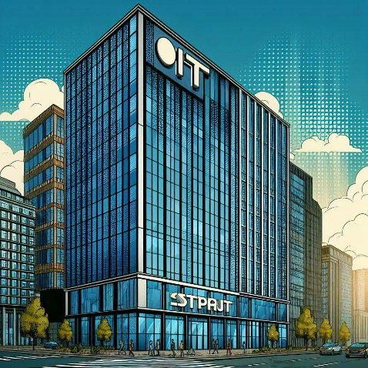
Great for any large organisation that produces complex, and important documents
City halls
Universities
IT companies
Schools
and many more…
Notes:
The solution could be extended beyond the state institutions. Any large organisations, such as schools, universities, IT companies and law firms, can benefit by adapting this intelligent simplification tool to their needs. From simplifying rector’s announcements and writing easy-to-understand documentation and usage instructions to helping lawyers in clear communication with their clients, more accessible language is crucial to mutual understanding. The automated solution, coupled with the newest AI technology, can make the lives of many people easier. To sum up, there are still many places where AI can help people. Let’s utilize the latest technology with responsibility and build even more supportive tools.

Slide 7
Thank you
To learn more, connect with me today!
aklorek@man.poznan.pl
Notes:
If you would like to learn more about the presented solution, please don’t hesitate to connect with me or drop me an email. I would be happy to provide more details. Thank you for listening!

