Slide 1
When Government Looks to an NREN for Help
Ntuthuko Sambo
Network Engineer
TNC 24, Rennes
13 June 2024

Slide 2
Some context…
The Department of Home Affairs’ systems have been inefficient for a long time and suffer high downtime/offline rates
SITA, mandated by law to be responsible for all state organs’ IT and networking affairs
DHA, unhappy with the status quo, citizens have grown despondent but have no other option
January 2023, DHA approaches the SA NREN for help with a diagnostic study
April 2023, after contract negotiations, contract commences

Slide 3
Challenges with the study
Firstly, incorrect or inconsistent information in their databases. E.g. branch GPS coordinates, connection speeds, incorrect or no backup/secondary link captured
NREN had to clean up that information before commencing with any data collection and analysis
Legislation, NREN license does not allow non-research or non-related entity traffic
Also, through the SITA act, SITA governs any, and all IT affairs of state departments. Therefore, any changes to DHA’s network have to be communicated to and subsequently actioned and/or signed-off by them SITA
Study is only for a period of a year from April 2024 – March 2025, after which a detailed report on findings is required

Slide 4
More challenges…the Proof of Concept
As part of the diagnostic study, the NREN and DHA both agreed that a temporary cut-over to the SANReN of some of their branches was imperative to yield authoritative findings about where issues might lie on stack
Procurement Framework of the CSIR (NREN’s host organization) not conducive for “urgent” procurements. Acquisition of networking equipment and links, turnaround times quite long for this exercise
Three-way communication between SA NREN and SITA through DHA proved ineffective at times, had to change to simultaneous comms where necessary
However, we overcame challenges…Fancy footwork of negotiations and hardware loans

Slide 5
Data collection and analysis
Many of the sites still running 2Mb/s links (Diginet)
15 sites selected for monitoring for the study
6 of the 15 sites to be cutover to the SANReN network, the 6 links are currently being delivered, 3 already live
All 15 sites have their link performance monitored by Perfsonar. Capacity, latency, throughput etc
Interesting results found, see me after the talk for more insights ☺

Slide 6
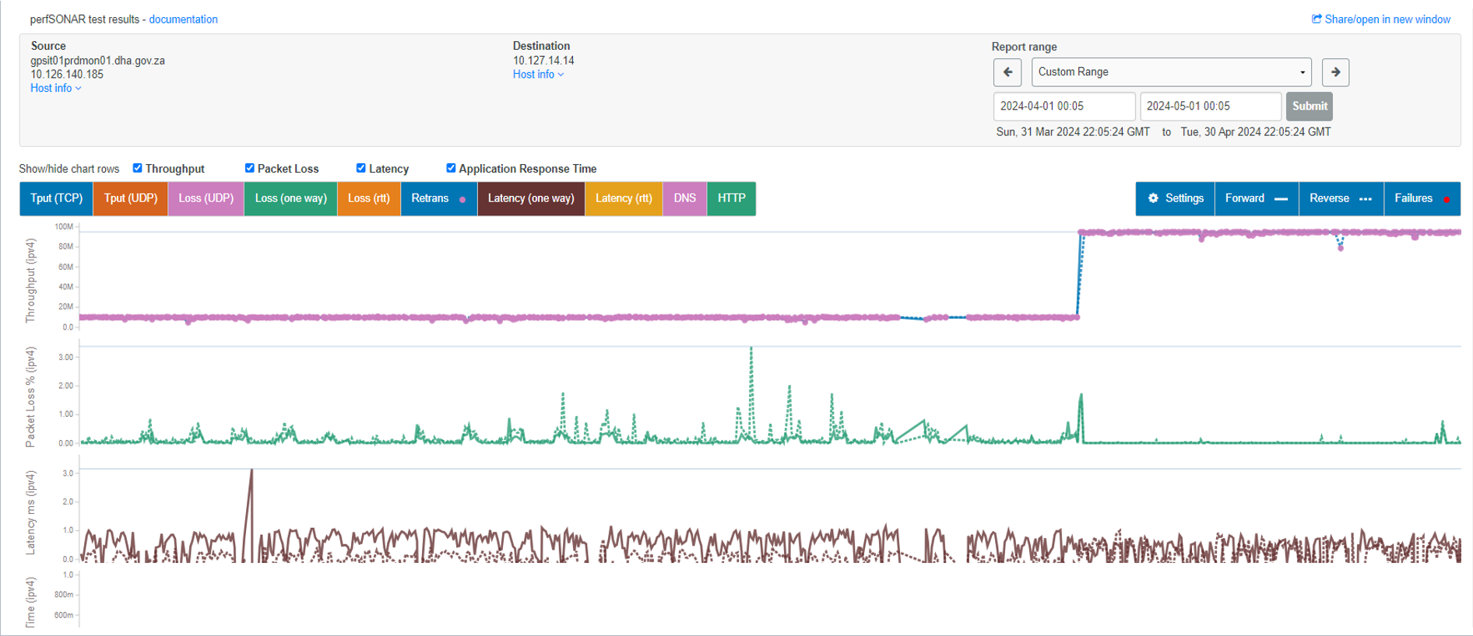
Actual cutover to SANReN

Slide 7
Preliminary findings
Higher bandwidth does not equate better performance in this case
While bandwidth may be a problem, it is not necessarily THEE problem
Increased throughput, decreased packet loss, latency changes ignorable
Applications not properly fine tuned to perform optimally given the bandwidth
Power issues (Eskom’s load shedding)
Layer 8 issues
Findings not concluded at time of submission of this talk
Email me in September 2024 for more insights ☺

Slide 8
Question
Should Governments invest in building strong internal ICT capacity???

Slide 9
Thank You
ntuthuko@sanren.ac.za
https://www.sanren.ac.za/

