Slide 1
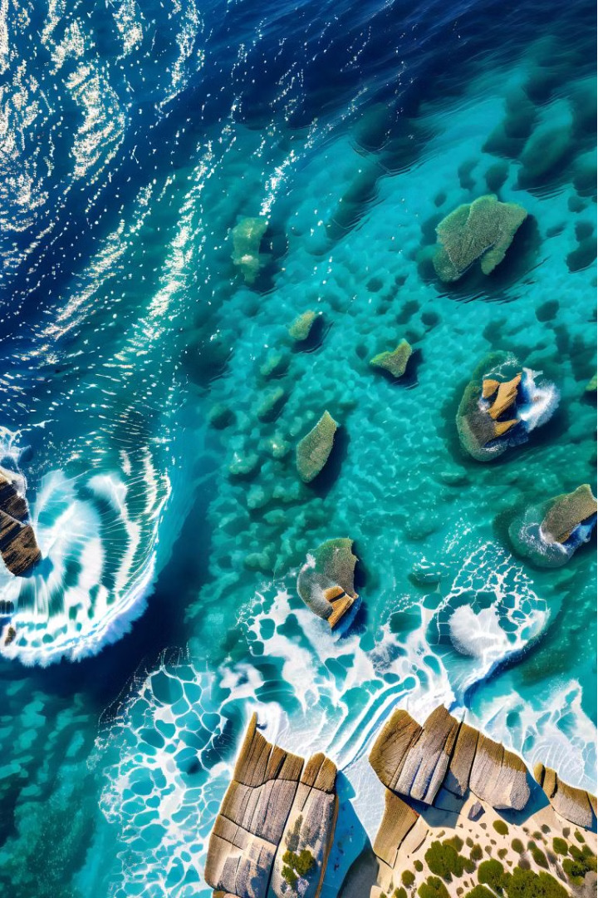
The Data Evaporation Cycle
Enhancing Marine Ecosystem Surveillance
Ricardo Veiga
NOVA LINCS-UAlg & Universidade do Algarve
Notes:
Ladies and gentlemen,

Slide 2
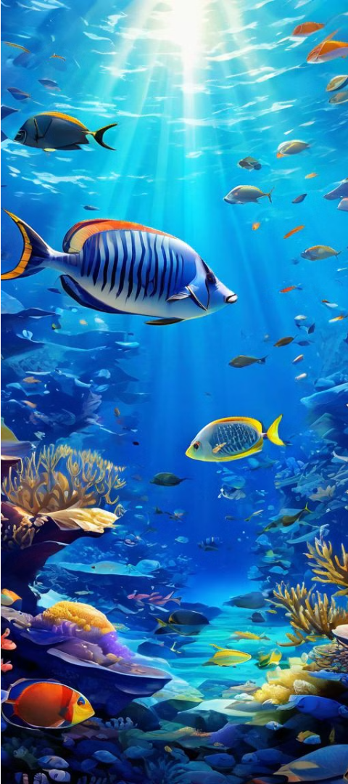
Invasive Species
Infiltration
1
Shifting
Ecosystems
2
Delicate
Balance
Invasive fish outcompeting native species due to climate change.
Disrupting the fragile equilibrium of marine environments.
3
Global Concern
A stark reminder of climate change's far-reaching effects.
Notes:
Imagine yourselves on the Mediterranean’s shores, a region known for its vibrant marine life and rich biodiversity. However, beneath these tranquil waves, a silent battle is unfolding. New, invasive fish species are infiltrating these waters, threatening the native populations that have thrived here for centuries. As sea temperatures rise and currents shift, these invaders outcompete the locals, causing a dramatic shift in this delicate ecosystem. This invasion is not just a local phenomenon; it's a stark reminder of the far-reaching effects of climate change on our oceans.

Slide 3
Edge AI + Cloud AI
Data Evaporation Cycle
Innovative approach to underwater surveillance.
Transforming Marine Conservation
Monitor and track impacts of climate changes in real-time.
Technology Integration
Edge devices with AI capabilities for remote processing.
Cloud AI for precise data analysis.
Notes:
What if I told you we could monitor these underwater battles in real-time, tracking the impacts on our marine life minute by minute? This is the vision behind the Data Evaporation Cycle, an innovative approach to underwater surveillance that promises to transform marine conservation. By combining Edge AI with Cloud AI, we are on the brink of a new era in ecological monitoring.

Slide 4
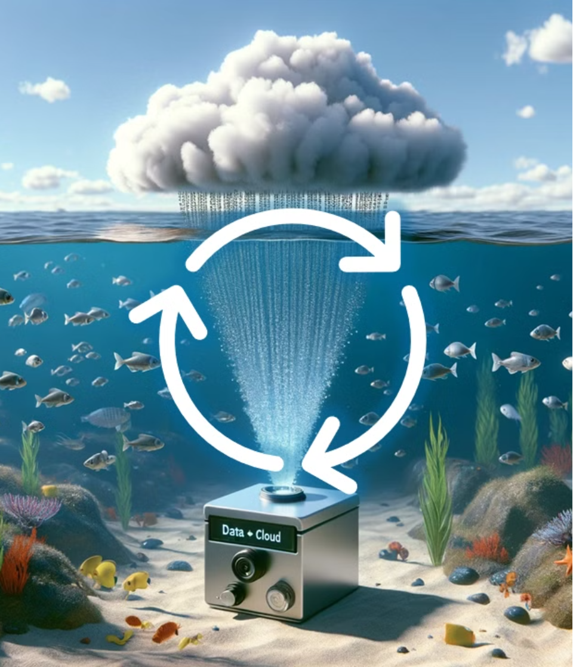
The Data Evaporation Cycle
Streamed data evaporates
Condensed data analyzed by Cloud AI
Model precipitated to Edge device
Notes:
Picture this: cameras equipped with AI-powered edge devices are submerged into the ocean, quietly observing the underwater realms. These devices begin to stream video data to the Cloud, much like water evaporates from the sea into the sky. In the Cloud, a massive AI foundation model meticulously analyzes these videos.
The AI identifies the common species in the specific region and crafts a smaller, specialized model. Once this task is complete, the AI returns to a standby mode, reducing its carbon footprint. This specialized model is then sent back to the edge device, much like precipitation returning to the earth. This allows the edge device to operate remotely, saving energy and resources, while monitoring the frequency and abundance of species.

Slide 5
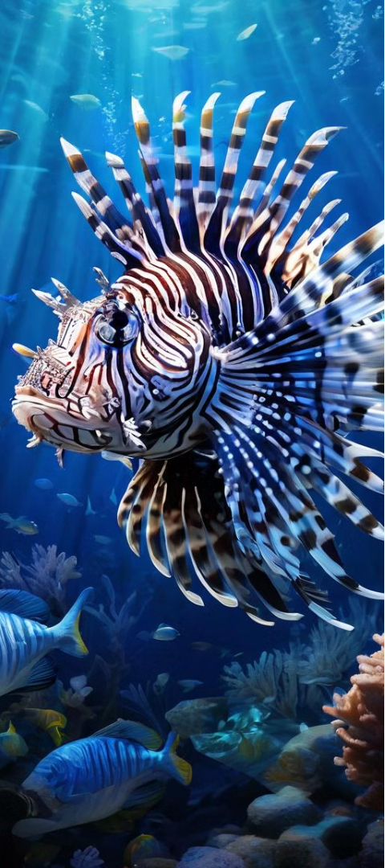
Real-Time Underwater Surveillance
1
2
3
Invasive species detected
Cloud AI identify the new species
An updated model is sent back to Edge
Notes:
But the true magic happens when the remote edge device doesn’t recognize a new species – potentially an invasive species. At this moment, the device "wakes up," reconnects to the Cloud, and sends back this new streaming. The Cloud AI identifies the new species and updates the model accordingly. This refreshed model is then sent back to the edge device, which resumes its remote monitoring with enhanced capabilities.

Slide 6
Cloud hub: Collaborative Conservation
Rapid
Response
Biodiversity Insights
Global
Effort
Open-
Source
Identify and control invasive species.
Monitor changes in marine life.
Share findings to combat climate change.
Anyone can benefit and help.
Notes:
Beyond just identifying species and updating models, the Cloud serves as a central hub where all metadata is sent and analyzed. It delivers open-source data, available to scientists around the globe, contributing to a global effort to understand and mitigate the impacts of climate change.

Slide 7
The Power of Data
Comprehensive Monitoring
Actionable Insights
Widespread deployment
of edge devices.
Guiding conservation
efforts and policy.
Collaborative Approach
Resource-Efficient Design
Sharing data to drive
global change.
Minimizing energy use and
carbon footprint.
Notes:
This energy-saving, adaptable design makes it feasible to deploy these devices widely, giving us a comprehensive picture of how climate change is affecting marine life. By creating a cycle where data "evaporates" to the Cloud and “precipitates” as actionable information, we build a responsive network that conserves resources while growing our ecological knowledge.

Slide 8
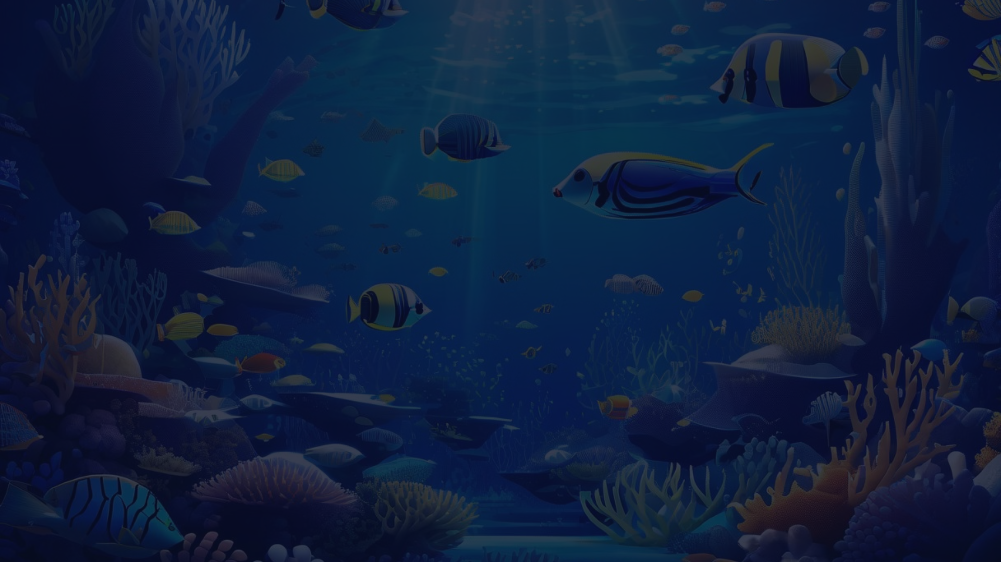
A Vision for the Future
Comprehensive
Surveillance
1
Widespread deployment
of edge devices.
2
Rapid Adaptation
AI-powered models
updated in real-time.
Informed Conservation
3
Guiding targeted efforts
to protect ecosystems.
Notes:
Consider the implications. With this technology, we can respond quickly to the threat of invasive species, safeguarding marine ecosystems and supporting conservation efforts. We can monitor changes in marine biodiversity with unprecedented accuracy, allowing us to better understand, and combat, the effects of climate change. This goes beyond protecting fish, it’s about the health of our oceans and everything that depends on it.

Slide 9
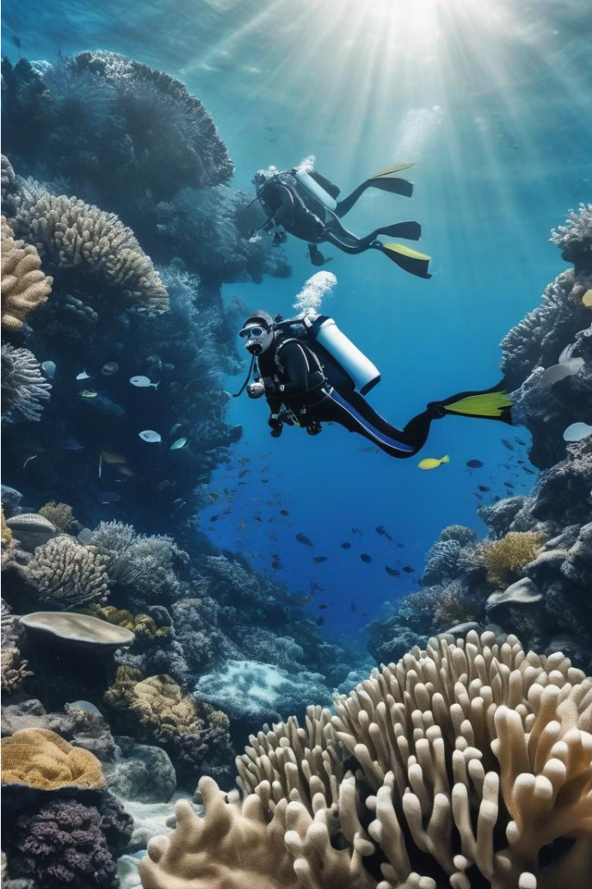
Join the Mission
Collaborate
Partner with us to expand the network.
Contribute
Share your expertise and insights.
Innovate
Help us push the boundaries of technology.
Notes:
Right now, there are teams of marine biologists working tirelessly to protect our sea’s ecosystems. Armed with real-time data from the Data Evaporation Cycle, they could pinpoint the exact locations where invasive species are thriving, deploying targeted measures to control these populations, giving native species a fighting chance.

Slide 10
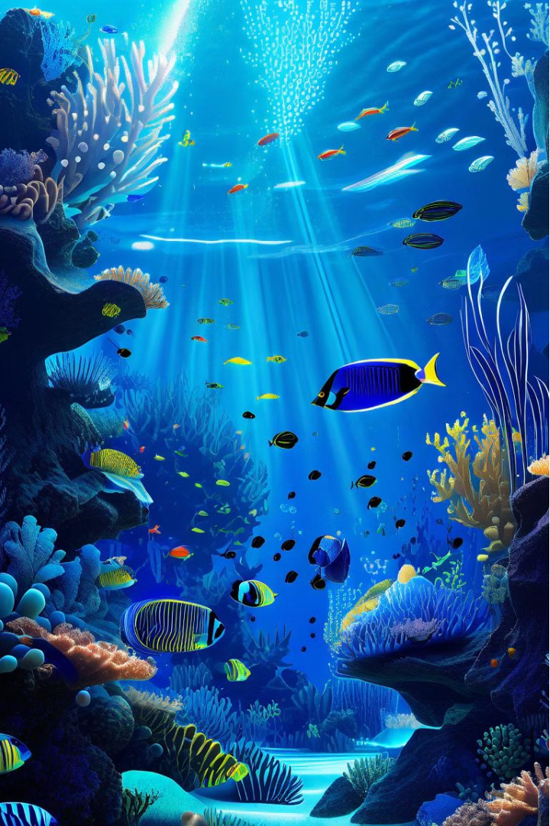
The Future is Underwater
Protecting our oceans, one data point at a time.
Notes:
In this interconnected web of surveillance, every drop of data counts. Each piece of information helps us build a clear picture of our oceans' health, guiding our efforts to preserve these vital ecosystems for future generations. The Data Evaporation Cycle is more than just a technological advancement; it’s a revolutionary perspective on collaborative conservation.

Slide 11
Want to
Contact me at:
rjveiga@ualg.pt
Notes:
My name is Ricardo Veiga, and I am proud to be part of this groundbreaking initiative at the University of Algarve.
Thank you for your attention, and please reach out if you would like to learn more or join us in this crucial mission.

