Slide 1
GREN Map Deployment Demo
Dan Sellars | Manager, Software Development
June 11, 2024
TNC24

Slide 2
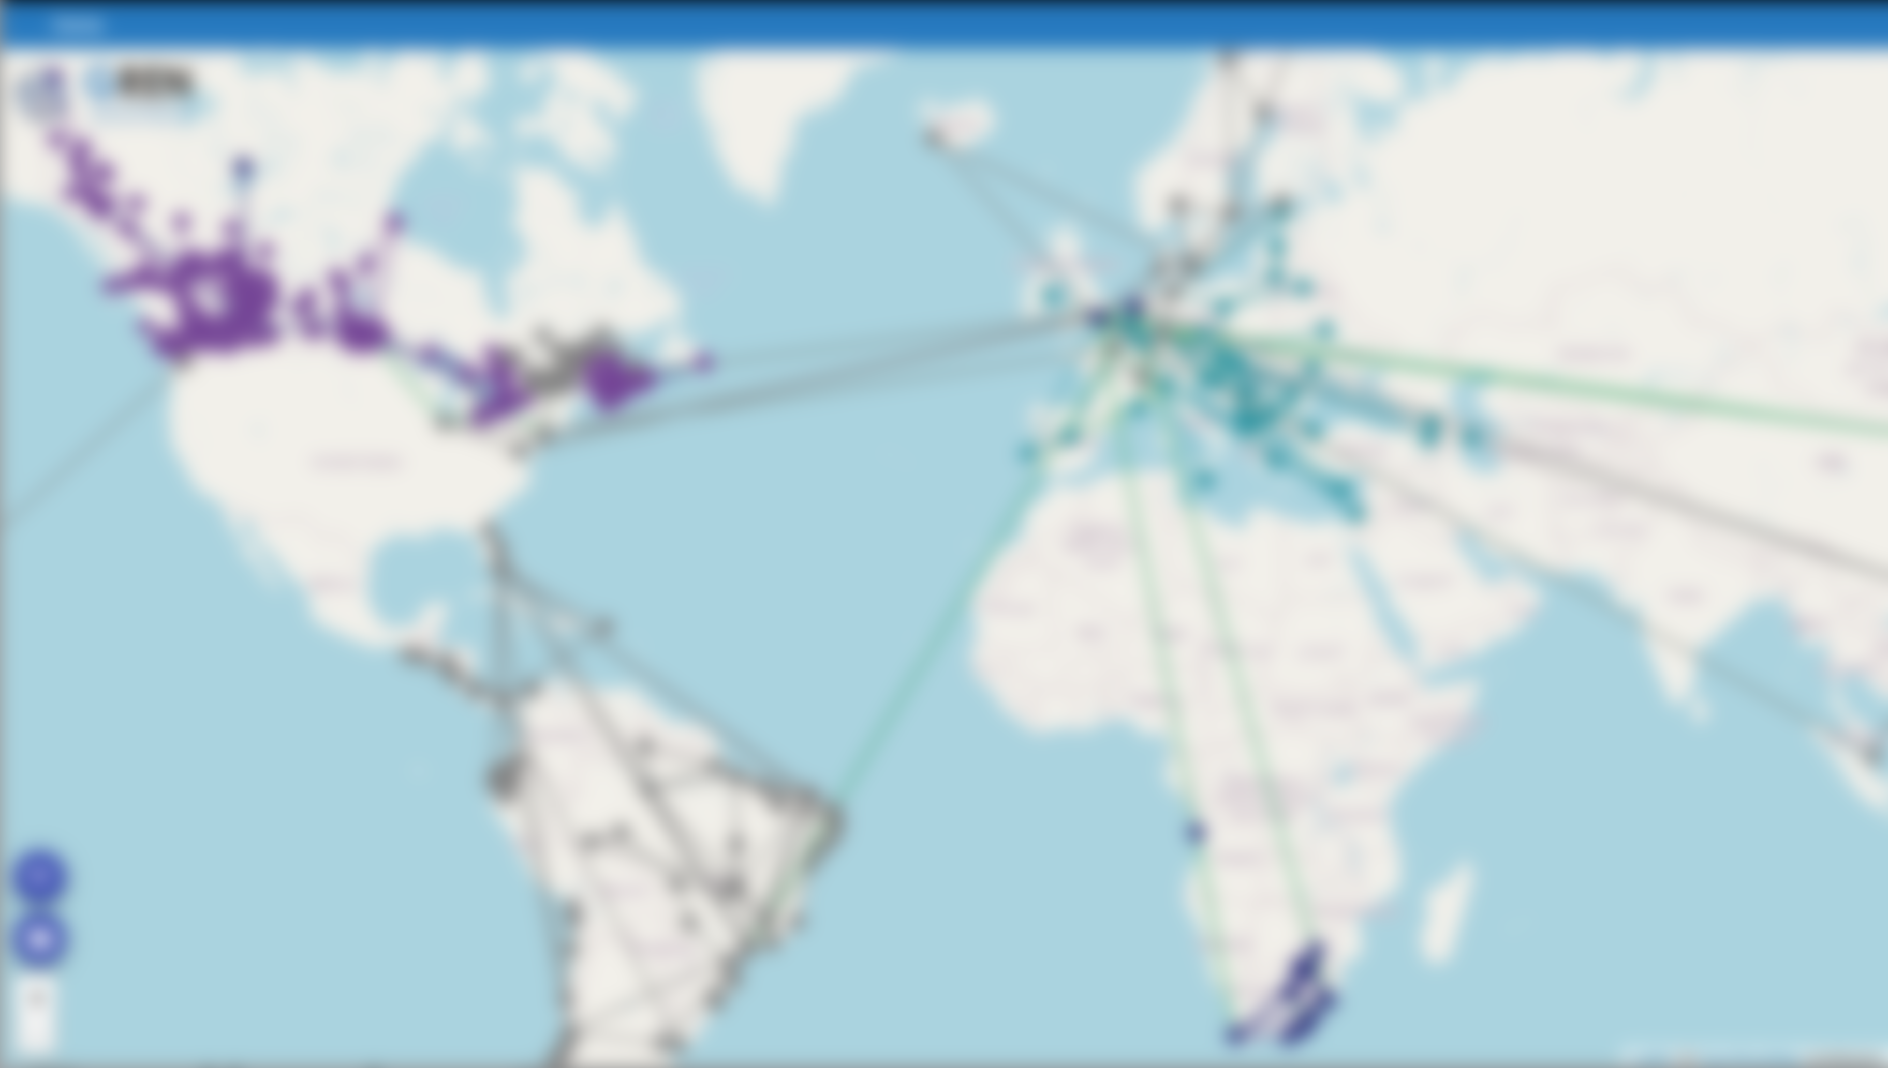
Why have a map of the Global Research & Education Network (GREN)?
To best understand how the GREN connects us all
What is it?
Architecture overview
How CANARIE deployed 14 instances
Demo of running in Helm
Q&A
Notes:
Talking points:
All from different NRENs around the work, all with different funding models and it’s important to convey that when you fund your NREN, what you actually get is THIS, a global connection of dedicated research networking.
This demo is about deploying an instance, not selling the concept, but that ‘why’ is important and powerful.
Give you a quick update on what it is and how it works, happy to discuss later over TNC.
A touch on why and we deployed the way we did.
Then a demo to use as a starting point for your deployment.
Happy to take questions at any time, I may defer as I do have some time at the end too.

Slide 3
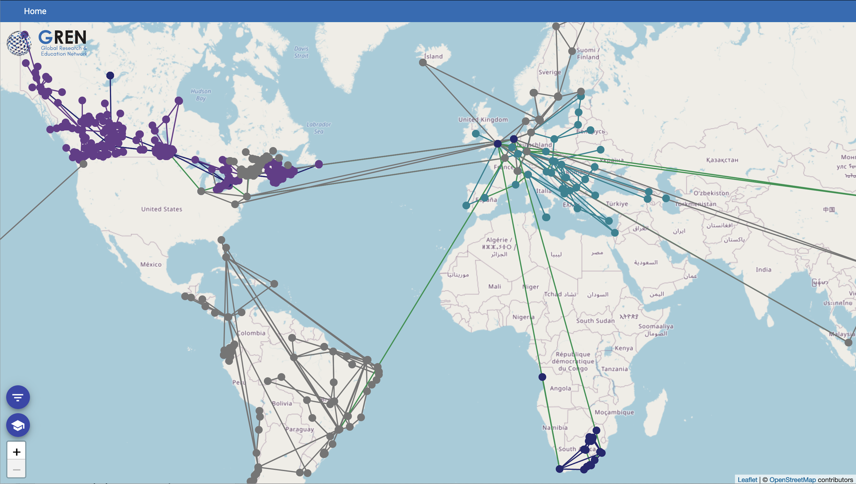
What is a GREN map?
Notes:
Talking points:
This. You might have seen it before at recent TNC’s.
It’s a live up to date map of the GREN. This is an example using sample data we have collected previously
This is what we want, how do we get it?
Well…

Slide 4
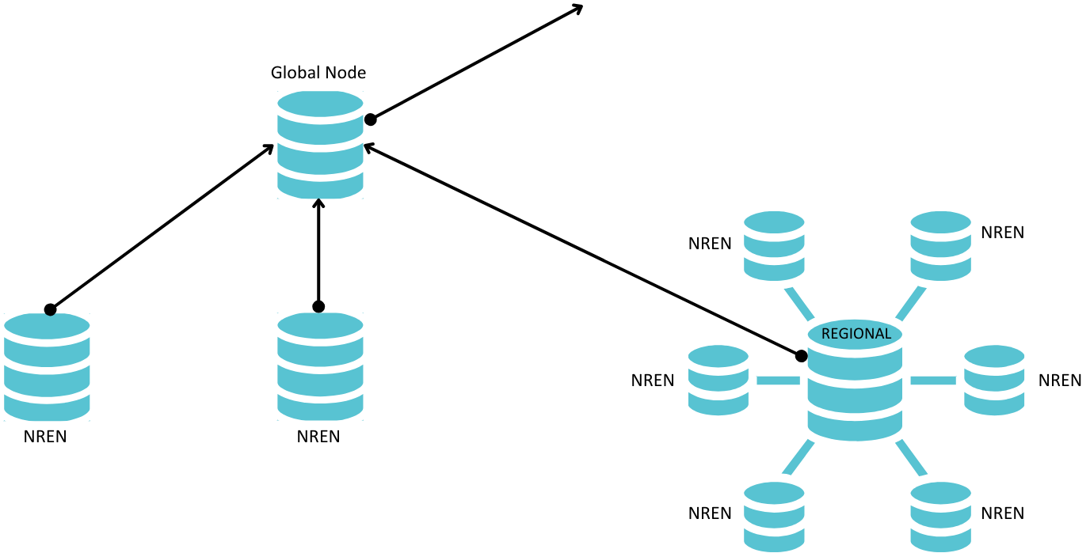
How do you get a global view?
GREN map view
Notes:
Talking points:
The global map is comprised of live data from each NREN.
There is a hierarchy where the NRENs feed into Regionals, like say GÉANT. Some feed directly into a global node.
Network data feeds up the hierarchy to a consolidated view. It’s live and up to date.
So you might be asking where do I fit in?
Well, you are the NREN nodes and what we want to show you today is how to get running a node that your NREN controls so we can build out the network.

Slide 5
What is the GREN Map Application?
Reference Map View
(Leaflet/Angular)
GREN
Map
GRENML
(Python library + XML)
GREN Map Node
(Django server)
Notes:
Talking points:
Three inter-related software components
A python library and XML Schema
Reference Map view
GREN Map DB Node

Slide 6
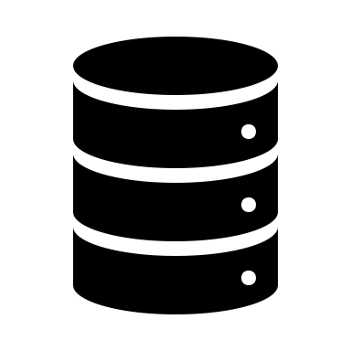
How does it fit together?
Map view
Network data
API
InCommon SP
GRENML
(XML)
Polling API
GREN App
GRENML
(XML)
Manual Entry
PostgreSQL
Notes:
Talking points:
Fit together into a GREN DB Node with some other components.
Admin protected by FIM
Uses the InCommon SP container as a web/shibboleth proxy
Network data can be supplied in multiple ways
Manual Entry
GRENML XML format
via API
Upload in Admin
Excel spreadsheet
Communicates with other nodes via XML format (one format in - one format out)
Can perform data rationalization
The map renders the contents of the database

Slide 7
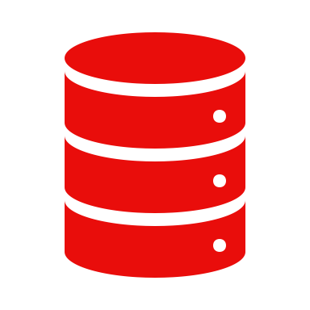
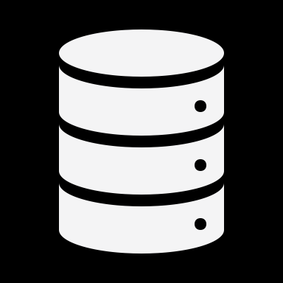
Benefits of Kubernetes
Canada's NREN is comprised of CANARIE and 13 provincial and territorial partners
Each partner controls their own data
Deployed a production instance for each partner
FIM-enabled access to each instance
Manage with as little effort as possible
Notes:
Talking points:
• Running 14 nodes for individual organizations seems like a lot – we need a way to manage them
Act as a proving ground for running the model in production
Worked with each organization to onboard, typically only took an hour or so to show them how it worked
Some went manual
Some went fully automated using the grenml library and API

Slide 8
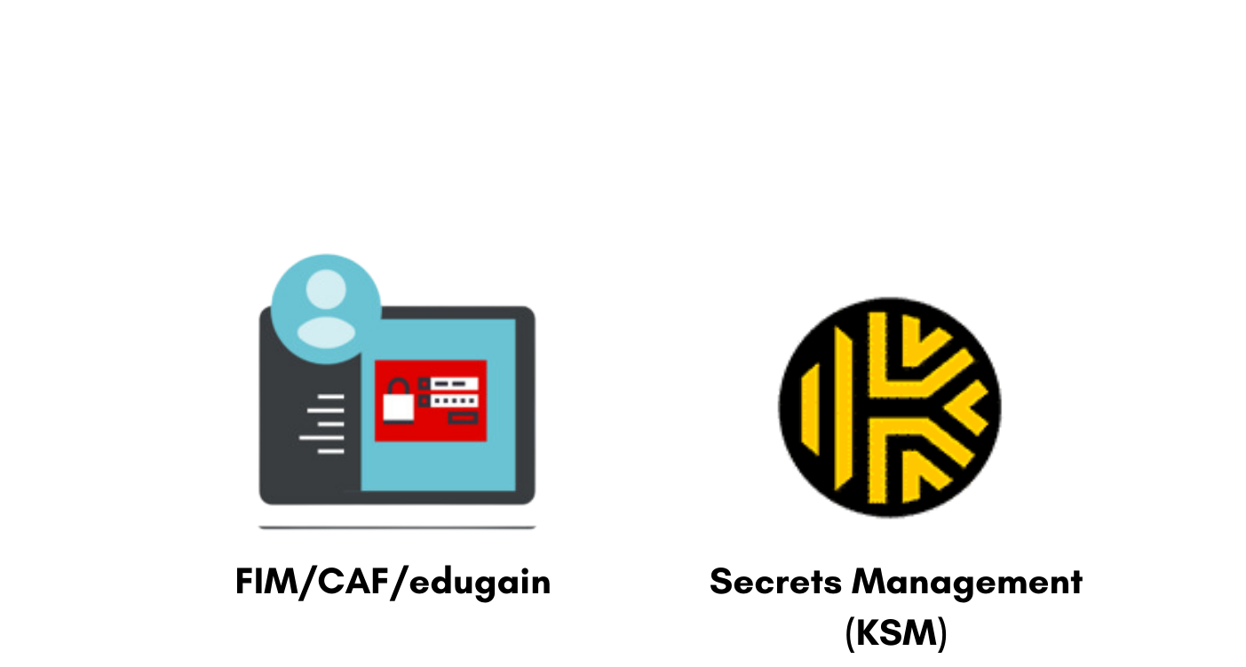
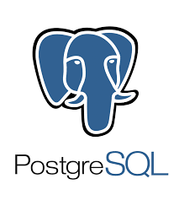
What does the CANARIE GREN Map hosting look like?
eduGAIN
Secrets Management (KSM)
Prod
Pre-prod
…
…
Notes:
Talking points:
Simplified view of CANARIE’s infra for the GREN maps
Not going into details, this is to give an idea of what the supporting technologies look like
These are the technologies in use, we follow a CNCF model
Separate clusters for prod and pre-prod
Standalone DBMS for the persistent databases, again separated for prod and pre-prod
FIM and KSM cloud based
Demo here!

Slide 9
To get started…
Join the Working Group and steer the future
Check out a Helm chart example
*new
Join the GitHub project
Notes:
Talking points:
So what now? How do I get started?
The application and example code is available on GitHub
Recommend pulling and getting it working locally, read the helper scripts to see what they are doing
Read the project documentation to understand how it is working
Think about how your environment matches or not
Can be as simple as Docker compose for a leaf node
The project is container based and fully configurable via the environment so you should be able to adapt to your infra
Please get involved in the working group and GitHub project

Slide 10
How does the demonstration differ from production?
 | DEMO | CANARIE PROD
K8s Platform | Docker Desktop | Rancher cluster (RKE2)
Sign-in | Local bi-lateral IdP | Federated Identity Management
Secret Management | Directly added to K8s | Keeper Secrets Manager
Database | Ephemeral Container-based | External Persistent DB
Container source | Locally built (GREN dev environment) | External Registry (Harbor)
Notes:
Talking points:
In order to come up with a demo example of the Helm chart we needed to make some changes and simplify things
The chart is based off our production chart
This table shows the main changes
These are the areas that would need thinking about to develop your own instance

Slide 11
Contact
Working group: https://www.gna-g.net/join-working-group/gren-mapping/
Dan Sellars: dan.sellars@canarie.ca
GitHub Project: https://github.com/grenmap/
Deployment example used in the demo: https://github.com/grenmap/GREN-Helm-Deployment-Example

Slide 13
dan.sellars@canarie.ca

