Slide 1
Connecting arts: network and advanced technology to bring art communities together
Dr Domenico Vicinanza
TNC24, Rennes, France
13/06/2024

Slide 2
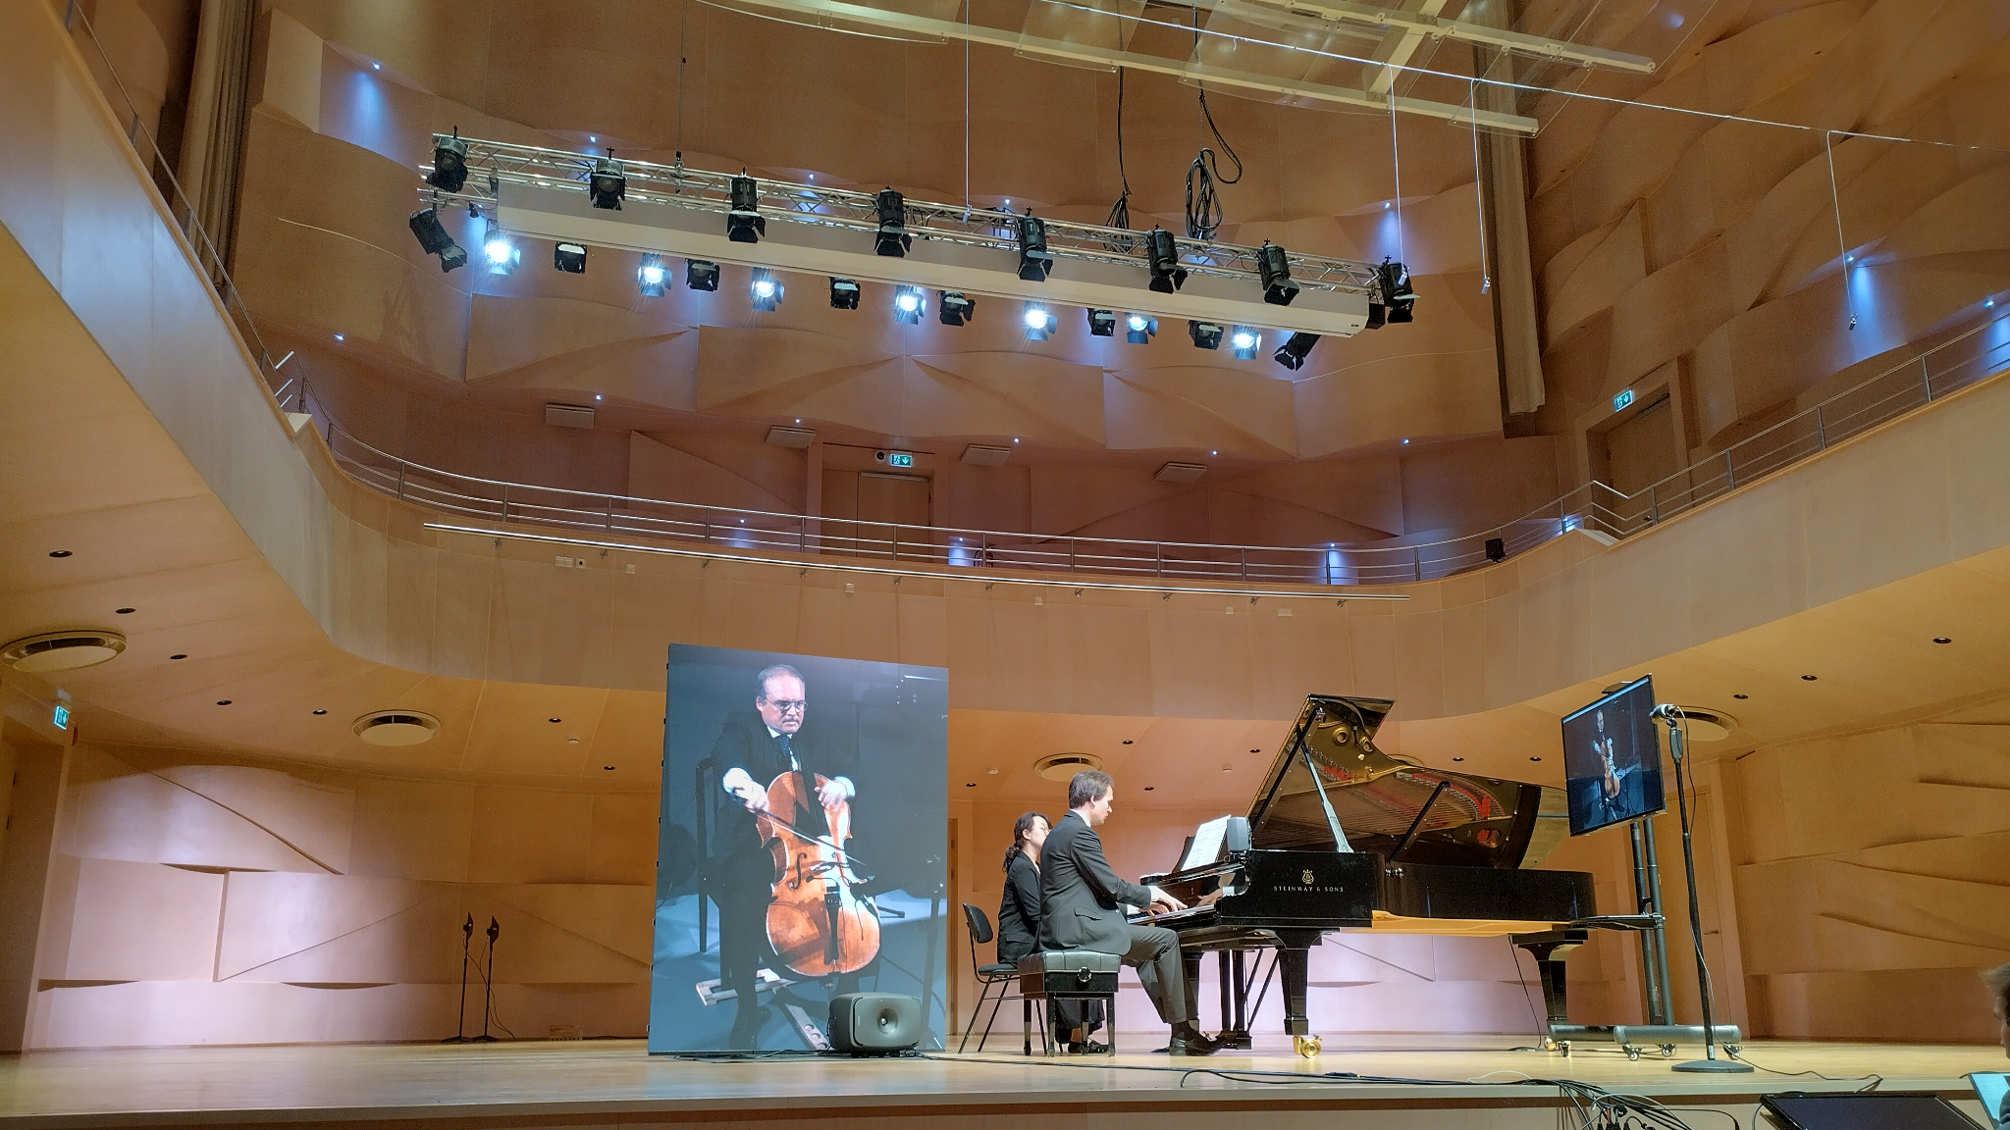
Géant supporting remote teaching and performing arts
Research and education go beyond science and encompass many disciplines, including the arts and humanities, social sciences, and other cultural areas.
Art has always been a driver for technology and science, from the patent of the first music communication and streaming device in 1876 (the Musical Telegraph, by Elisha Gray), to the latest developments in terms of low‐latency audio‐video communication (LoLa, Ultragrid)

Slide 3
NPAPW
Held in Europe and the United States annually since 2009, NPAPWs are a collaborative project of GÉANT, Internet2, New World Symphony, GARR and other European National Research and Education Networks (NRENs) and various cultural institutions around the world.
Three main objectives:
Outreach to new user communities in the arts and humanities by demonstrating the use of R&E networks in supporting real-time musical, dance, and artistic performances.
Collaboration between R&E networks and cultural institutions worldwide.
Expert knowledge exchange on the use of specific tools to support teaching, auditions, and remote performances.

Slide 4
Where it started
Internet2 and GÉANT have been partnering for years on Network Performing Arts Production Workshops (NPAPW), organising and hosting yearly conventions in the US and Europe built around the growing collective of art educators, academics and performers.
NPAPW gathers a quite large distributed community, mostly based in Europe and North America, but with an increasing representation in Asia/Pacific and Latin America.
The COVID-19 emergency created a sudden shift to online teaching, performing, and student support for many schools, theatres, and art academies around the world.
In the spirit of assisting each other in this unprecedented time in our world, the NPAPW community organised a webinar aimed at providing advice and general best practices for teaching performing arts online.

Slide 5
The role of GEANT and R&E Networks
Musicians playing music together online without perceivable delay is among the most demanding challenges of live streaming.
GÉANT and its NREN partners play a crucial role in Europe promoting, advocating, connecting, and enabling remote arts tuition, performances, and knowledge exchange.
The GÉANT community has many artists and technologists with specialist expertise in networking for the arts, supporting schools, music conservatories and art academies in Europe and worldwide.
NPAPW strikes a chord in these unprecedented times in which we are living, as it sees the impact of new technologies extend outside of traditional theatres and established recording studios.

Slide 6
The first GEANT networked art production

Slide 7
GÉANT3 launch event in Stockholm
In December 2009 two continents and two cultures on opposite sides of the globe were joined through a music and dance performance made possible by the high-performance GÉANT and TEIN3 research and education networks.
Showcased at the GÉANT launch event in Stockholm, Sweden, and the TEIN3 gala dinner in Malaysia, Kuala Lumpur, the unique performance was an exciting collaboration of artists and networks.
The GÉANT pan-European network offered the performing arts community the challenging and fascinating ability to create new genres of artistic events, transcending distance and fusing experiences and cultural backgrounds.
The performance was a collaboration between GÉANT and TEIN3, the Asia-Pacific’s research and education network, able to connect researchers in the region with their counterparts in Europe at speeds of up to 2.5 Gbps (in 2009).

Slide 8
Two locations, 9,300km, one virtual stage
The performance took place in two different locations, brought together to form a “virtual stage” linked by the GÉANT and TEIN3 networks and locally by SUNET (the Swedish NREN) and MYREN (the Malyasian NREN).
Kuala Lumpur provided the stage for the dancers, who performed live at the TEIN3 Gala Dinner as part of the ASIA-Europe Meeting workshop.
Their musical background was provided by musicians performing at the GÉANT Launch, held at the Modern Art Museum in the Swedish capital of Stockholm.

Slide 9
A world-first artistic performance
Bi-directional audio-video channel set up using DVTS (Digital Video Transport System) over the TEIN3 and GÉANT links.
Dancers in Malaysia, with musicians at the Modern Art Museum in Stockholm
Record-breaking live music and dance performance across the 9,300 km distance.
DVTS is also used in the Arts and Humanities communities for music master classes and conferences.

Slide 10
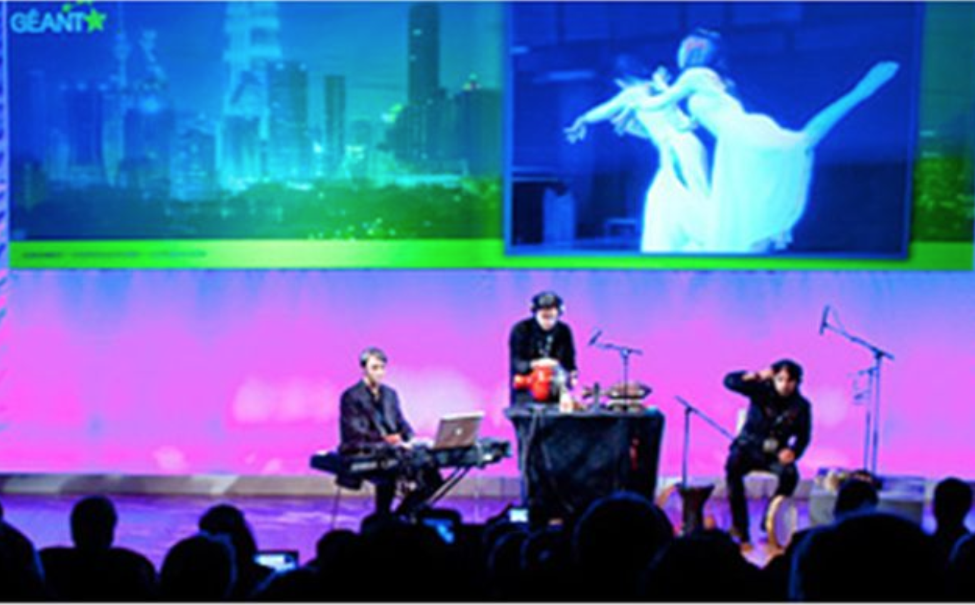
First GEANT networked AV production: 2009 - Kuala Lumpur-Stockholm
Remote: Kuala Lumpur
Stage: Stockholm

Slide 11
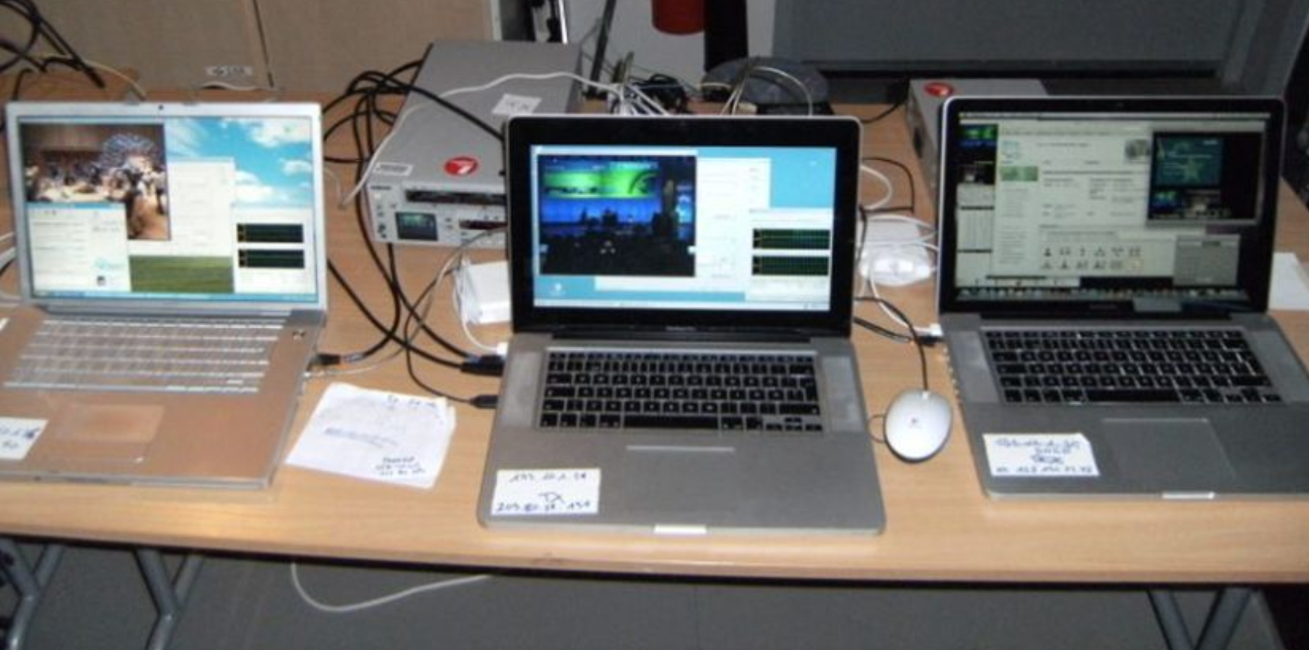
Behind the scenes (DVTS over 2.5Gb/s, 10,000Km)

Slide 12
At the cutting-edge of network technology

Slide 13
GEANT supporting JISC for Olympics 2012 experimental streaming to Japan
In 2012, GEANT Research Engagement worked with JISC, BBC R&D and NHV (Nippon Broadcasting Corporation) on a proof of concept of their Super Hi Vision (8K Video with 22.2 audio channels).
Streaming from London to Tokyo, uncompressed, at 24 Gbit/s over eight wavelengths.

Slide 14
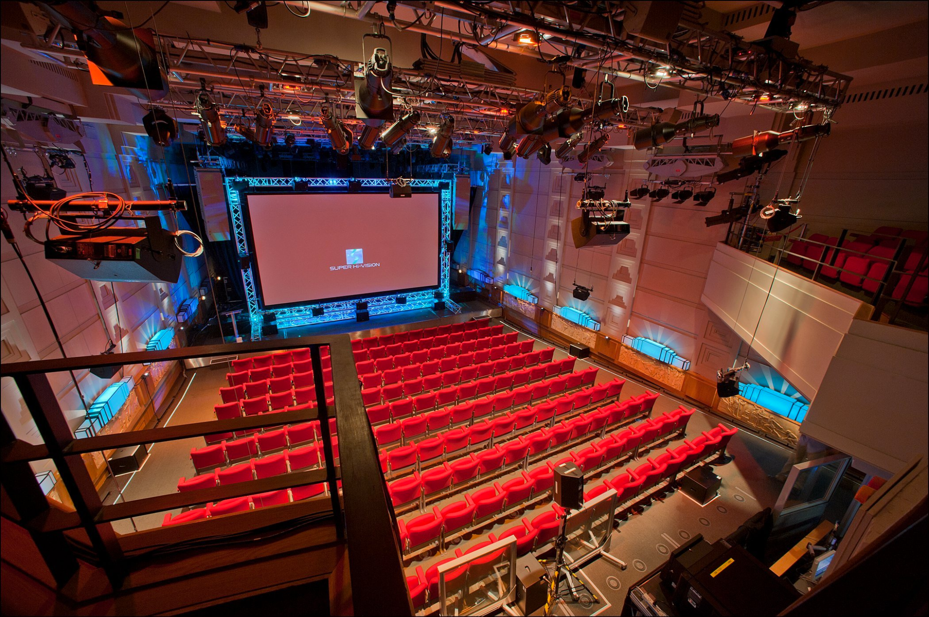
London Olympics 2012 - Super-Hi Vision test to Japan
BBC Broadcasting House Radio Theatre with the Super Hi Vision

Slide 15
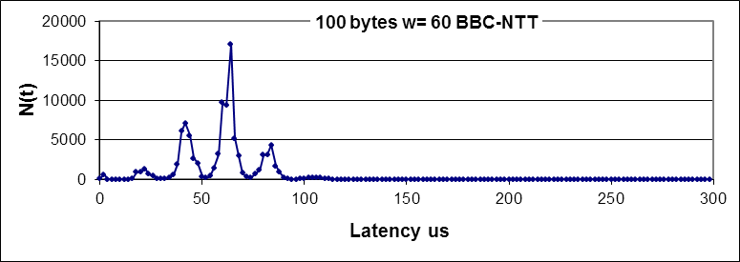
Our role: Engagement + Technical support
Using jitter to discover queuing from Lon to Japan
Histograms of inter-packet arrival times for equally spaced packets
Tool: udpmon
Queuing along the path on a jitter plot shows: Side bands and Multiple peaks
Typical shape of a busy link with cross traffic.

Slide 16
Setting the standards for A/V technology

Slide 17
The world lowest latency at the highest quality
LoLa is an Audio Visual Streaming System developed by “Conservatorio di Musica G. Tartini”, Trieste, Italy, in collaboration with GARR, the Italian Academic and Research Network.
LoLa goal is to provide a tool for real-time audio/video “natural” distance human interaction. It was originally conceived for distance music performances, education and production, but can be used for any other scenario where real-time interaction is required.
A special attention has been paid to the optimization of the signal processing and transmission in order to keep the system latency as low as possible, below the human delay perception threshold.
LOLA offers the world lowest latency at the highest quality
Latest version showcased in Tallinn in Sept 2022

Slide 18
Last AV production (NPAPW2022)
2022 - Tallinn - Vilnius (LOLA)
Cello in Vilnius
Piano in Tallinn

Slide 19
Current GÉANT Role

Slide 20
GEANT current role:
1- Community management
Initiated community on remote and collaborative music creation
50+ audio technology professionals across 23 countries.
Managing Network Performance Art Production Workshops series (www.npapws.org)
Inspiring and driving a distributed community of 40 audio and music professionals, enabling storytelling through art and technology.

Slide 21
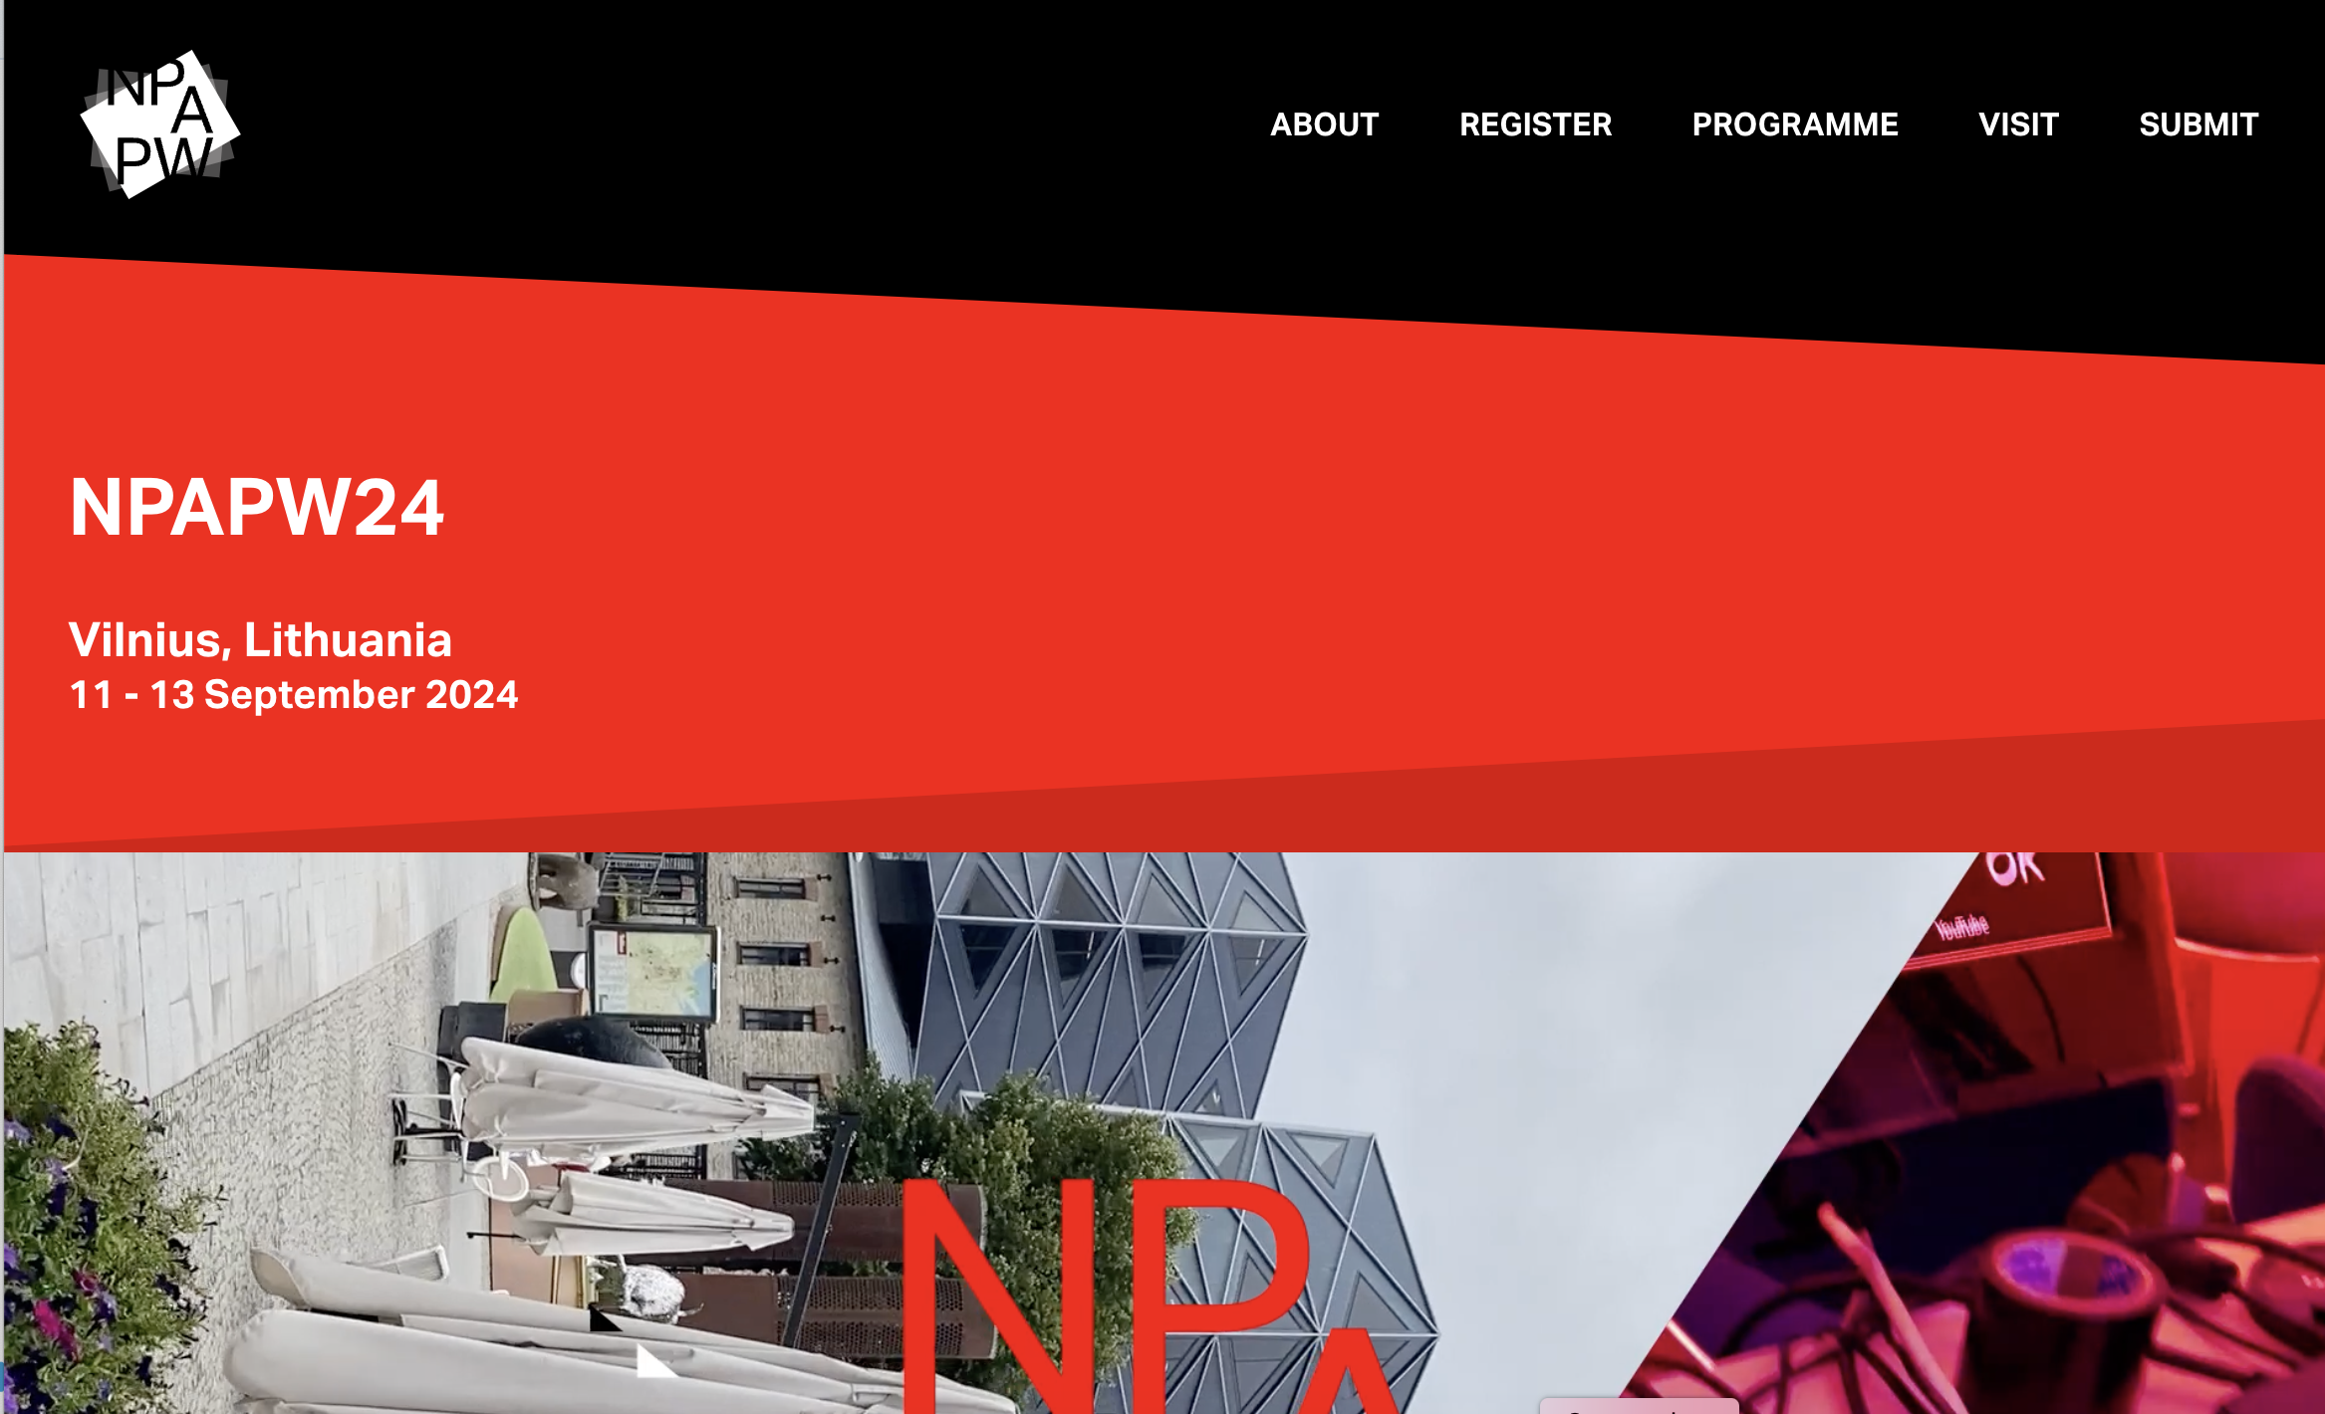
GEANT current role:
2- NPAPW co-organisation and co-hosting
Technology available:
LOLA
MVTP
Ultragrid
eduMEET
LOLA, MVTP, Ultragrid and eduMEET have been developed and maintained by the GEANT community

Slide 22
Demos/Videos

Slide 23
GÉANT current role:
3. International enabler
Providing technical support for international collaborations such as Virtual Conservatoire (UK/Austria via JISC and ACOnet)
Enhancing and championing international best practices, in particular between EU and US with close GÉANT/Internet2 collaboration
Supporting NRENs to help their international academic users, theatres, music departments, conservatories:
Running dedicated workshops (last one in 2021 with 130+ participants)
Managing a shared support function (electronic mailbox)
Providing learning and development material, expertise and resources

Slide 24
Thank you
Any questions?

