Slide 1
GÉANT Community and Gender Equality
Nicole Harris, on behalf of GÉANT Gender Equality Committee

Slide 2
Horizon Europe Gender Equality Plan eligibility criterion
Public document
Dedicated resources
Data collection and monitoring
Training
The GEP must be a formal document published on the institution’s website, signed by the top management and actively communicated within the institution. It should demonstrate a commitment to gender equality, set clear goals and detailed actions and measures to achieve them.
a GEP must have dedicated resources and expertise in gender equality to implement the plan. Organisations should consider what type and volume of resources are required to support an ongoing process of sustainable organisational change.
organisations must collect sex/ gender disaggregated data on personnel (and students, for the establishments concerned) with annual reporting based on indicators. This data should inform the GEP’s objectives and targets, indicators, and ongoing evaluation of progress.
The GEP must also include awareness-raising and training actions on gender equality. These activities should engage the whole organisation and be an evidence-based, ongoing and long-term process. Activities should cover unconscious gender biases training aimed at staff and decision-makers and can also include communication activities and gender equality training that focuses on specific topics or addresses specific groups.

Slide 3
Community Goals
Help meet GEP criteria
Support community diversity
Share resources
Effect Real Change

Slide 4
NREN Principles: Gender Equality
We utilise respective stand-alone gender-inclusive policies that explicitly promote and support Gender Equality in all aspects of our work. If need be, this document can be the first iteration of that process
We promote Gender Equality in all aspects of leadership, governance, and decision-making
We promote Gender Equality in the recruitment and career development opportunities of our respective organisations
We actively support the requirement of gender auditing in our respective organisations
We support a safe and collaborative culture of inclusive Gender Diversity across our respective organisations, including Gender-Aware training
We promote working arrangements within our respective organisations that must include flexible working arrangements and resourcing in order to not just support but encourage the career progression of women
We promote Gender Diversity in the more technical teams of our respective organisations

Slide 5
GÉANT as an example
25% increase in the number of female employees recruited for technical roles (2023 vs. 2022 data)
31% of applicants are female which is a 6% increase in 2023
Specific training actions inc. menopause awareness and unconscious biases
Number of HR-led initiatives with a stronger GE element inc. improving the Careers page, checking all job ads for gender coded words, etc.
Gender data collection (recruitment, community events attendance)
Maternity and paternity leave and pay entitlements revision both in UK and NL offices and the UK entitlement significantly improved
Community Code of Conduct widely communicated

Slide 6
Code of Conduct - Community
https://resources.geant.org/code-of-conduct/
GÉANT Community Code of Conduct
GÉANT is dedicated to providing a positive and collaborative experience for all members of the GÉANT Community. Our aim is for participants to feel safe, supported and valued for their contributions.
The GÉANT Community Code of Conduct applies to all online and in-person meetings and events e.g. GÉANT project meetings, TNC etc., as well as any exchanges that take place within the mailing lists of the Special Interest Groups (SIGs) and Task Forces (TFs). All members of the community, including users of a GÉANT online space or a member of a SIG or TF mailing list, have a responsibility to adhere to the GÉANT Community Code of Conduct.

Slide 7
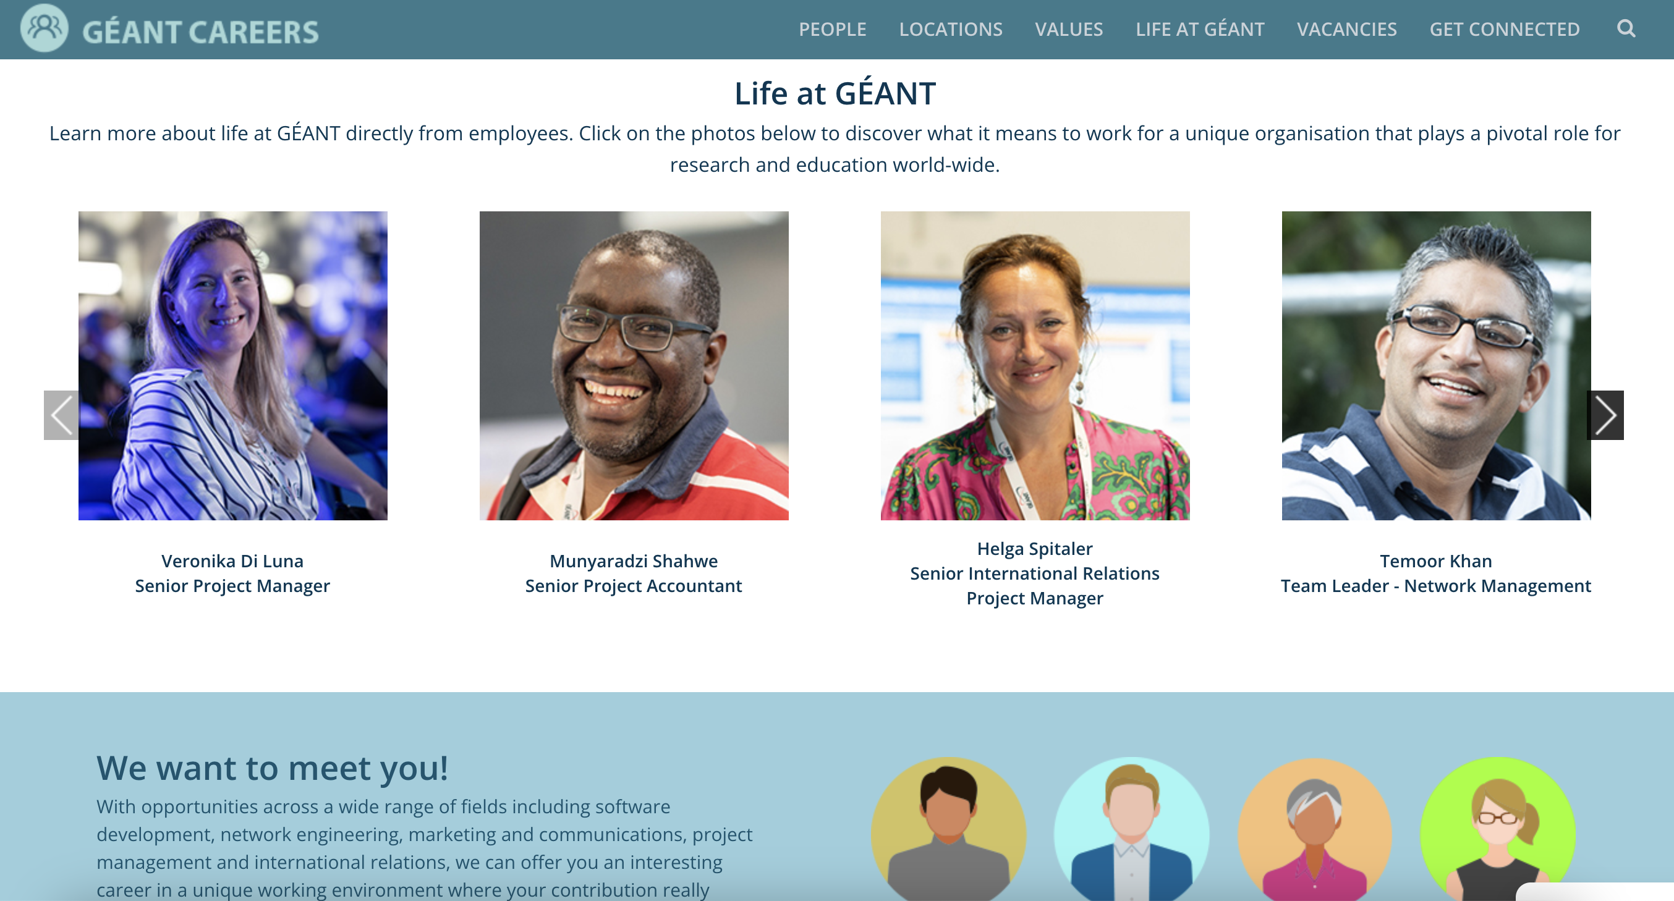

Slide 8
Additional Outreach
Standing Working Group on Gender in Research and Innovation (SWG GRI)
The EU aims to achieve gender equality and equal opportunities in research careers to integrate the gender dimension in R&I content and programmes in the European Research Area
provide support on R&I policy challenges linked to gender equality
exchange knowledge and good practice
facilitate the regular collection of data and indicators
United National Sustainable Development Goals
Goal 5: Achieve gender equality and empower all women and girls
Ensure women’s full and effective participation and equal opportunities for leadership at all levels of decision-making in political, economic and public life
Enhance the use of enabling technology, in particular information and communications technology, to promote the empowerment of women
Adopt and strengthen sound policies and enforceable legislation for the promotion of gender equality and the empowerment of all women and girls at all levels

Slide 9
Community Goals – Proposed Steps
Help meet GEP criteria
Support community diversity
Share resources
Effect Real Change
Implement NREN Principles on Gender Equality and invite NRENs to sign up
Support a programme of work through the principles (e.g. shared training, document repository)
Implement governance proposal
Continue to “walk the talk” – e.g. diversity in our community events (blind marking)
Enforcement of the code of conduct in all aspects of our community

Slide 10
Thank You
Any questions?
www.geant.org

