Slide 1
Redefining Global Connectivity
The Next-Generation Submarine Cable System for Research and Education Networks
Sumithra Velupillai

Slide 2
Abstract
Submarine cable systems are essential to global digital infrastructure, enabling connectivity and international collaboration. Polar Connect is a bold and transformative initiative aimed at establishing vital connectivity between Europe and East Asia, across the central Arctic Ocean. This presentation will examine the pivotal role of Research and Education Networks (RENs) and public funding in the development of complex, critical infrastructure projects. It will also address the growing need for economic security and digital autonomy for Europe and its allies. Additionally, it will highlight how Polar Connect, through cutting-edge technological innovations, will benefit RENs, the global research community, and education worldwide.

Slide 3
Outline
Polar Connect: The Next-Generation Submarine Cable System for Research and Education Networks
The Polar Connect Route & Technical feasibility
Benefits for Science
Summary

Slide 4
Polar Connect
The Next-Generation Submarine Cable System for Research and Education Networks

Slide 5
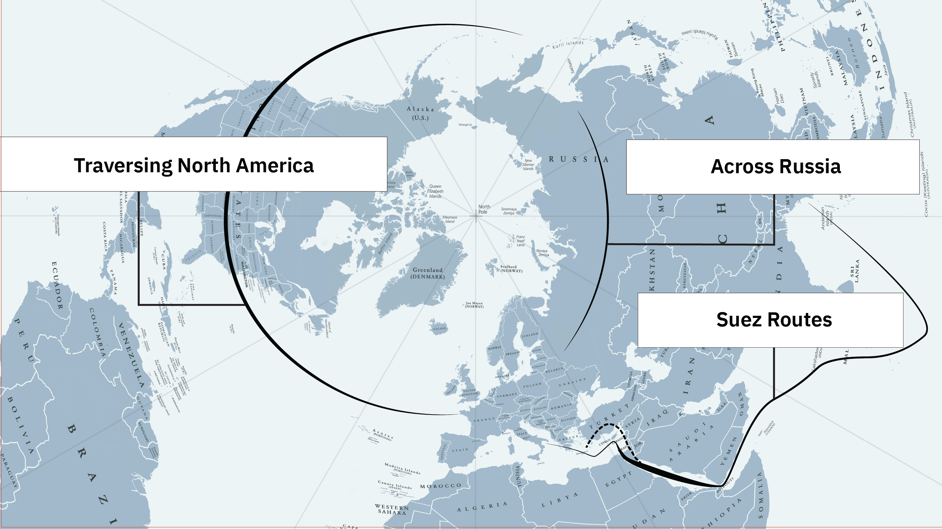
Europe – Asia Connectivity Today
Notes:
If we look at the connectivity today from an European perspective we can dive this into three different areas.
If we would look at the Europe-North America connections there is a lot of connections between Europe and north America, but systems are aging and are there enough vessels and cables to replace the existing cable system in the phase it may require for future needs?
The Europe-Africa and Europe-South America cables goes outside the coast of Africa with limited redundancy.
The terrestrial route across Russia is getting closed and contracts terminated.
Which then leaves us with the Suez routes to the middle East and Asia.

Slide 6
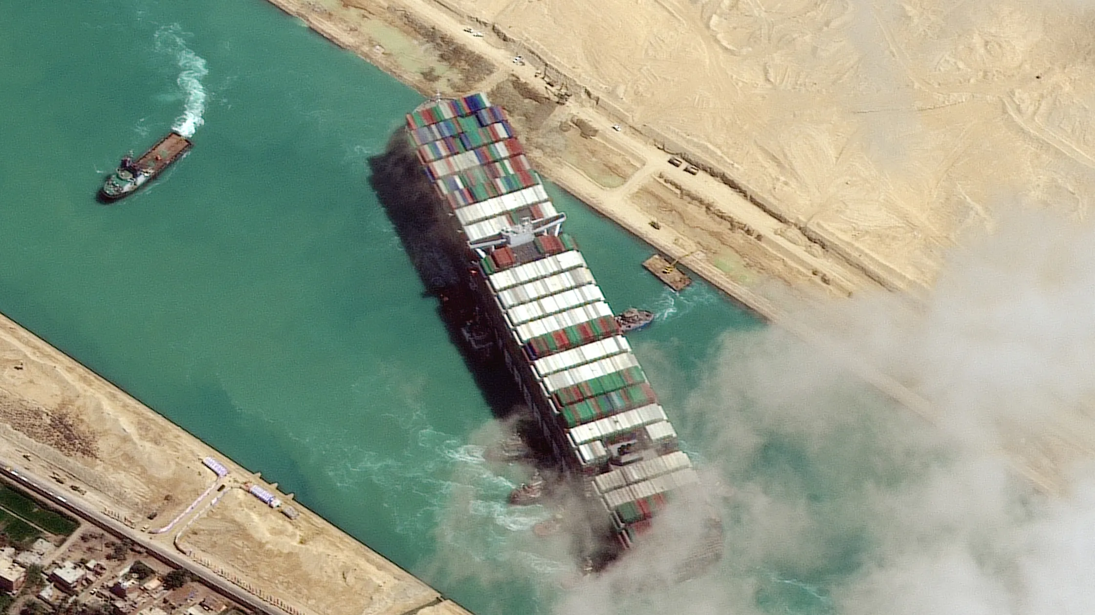
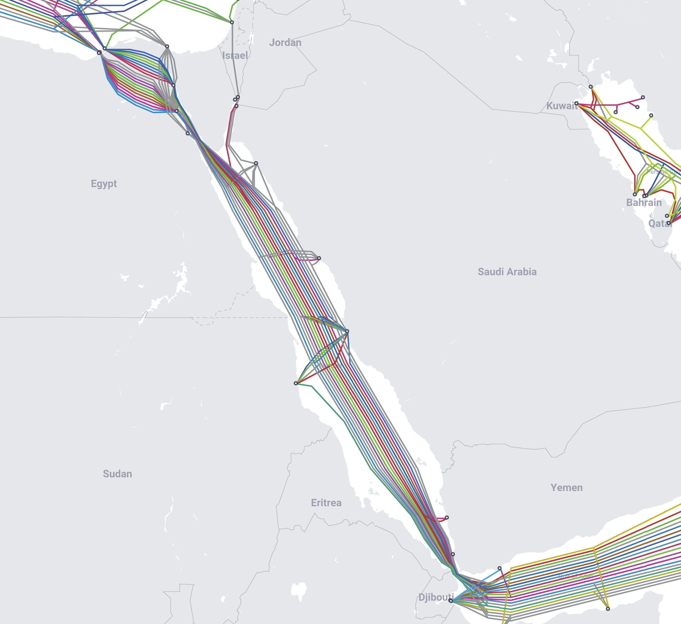

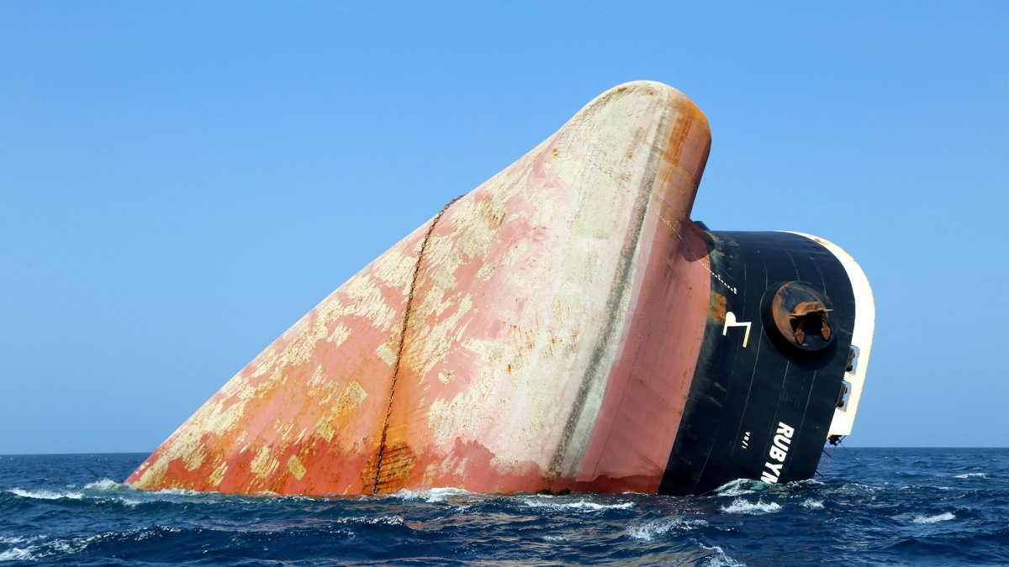
90% of the direct Europe – Asia traffic traverses a very narrow area
Submarine Cable Map
The Submarine Cable Map is a free and regularly updated resource from TeleGeography.
Notes:
If we look a bit closer at the Suez Canal, this is where 90% of the direct traffic between Europe and Asia today traverses a very narrow passage. At its most narrow point the canal is only 200 meters wide, and the waters are highly trafficked: there are 1500 ships passing every month (KLICK KLICK KLICK).
In 2024 there was damage to three submarine cables off the coast of Yemen due to acts of war. Hard to repair cables in a war zone. And new cables are unlikely to use this route in the foreseeable future.

Slide 7
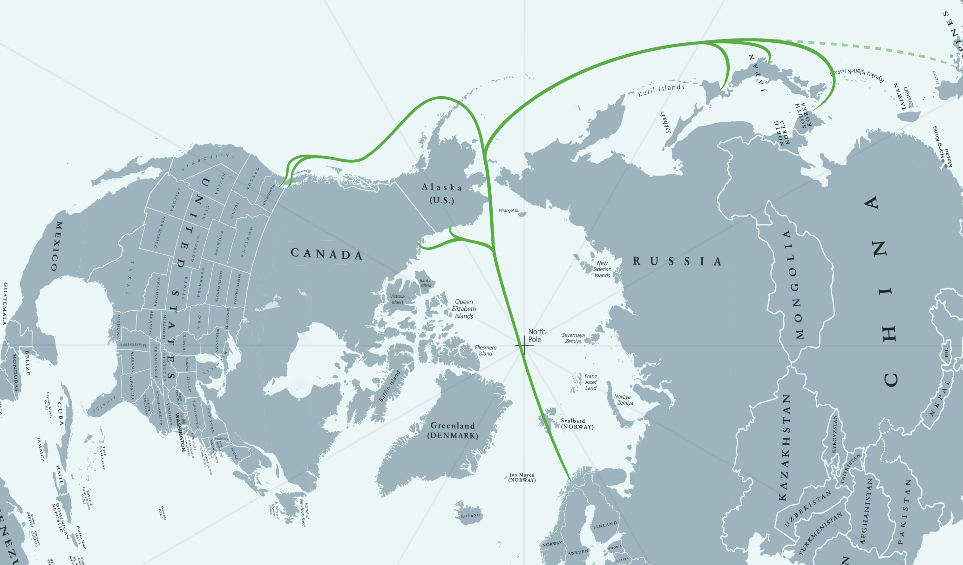
A new route: Polar Connect
Creates a new transport corridor EU – East Asia for the internet at large
Complementary to existing Suez / Red Sea area cables
Digital Resilience
Shortest possible path guarantees reduced latency, improves connectivity

Slide 8
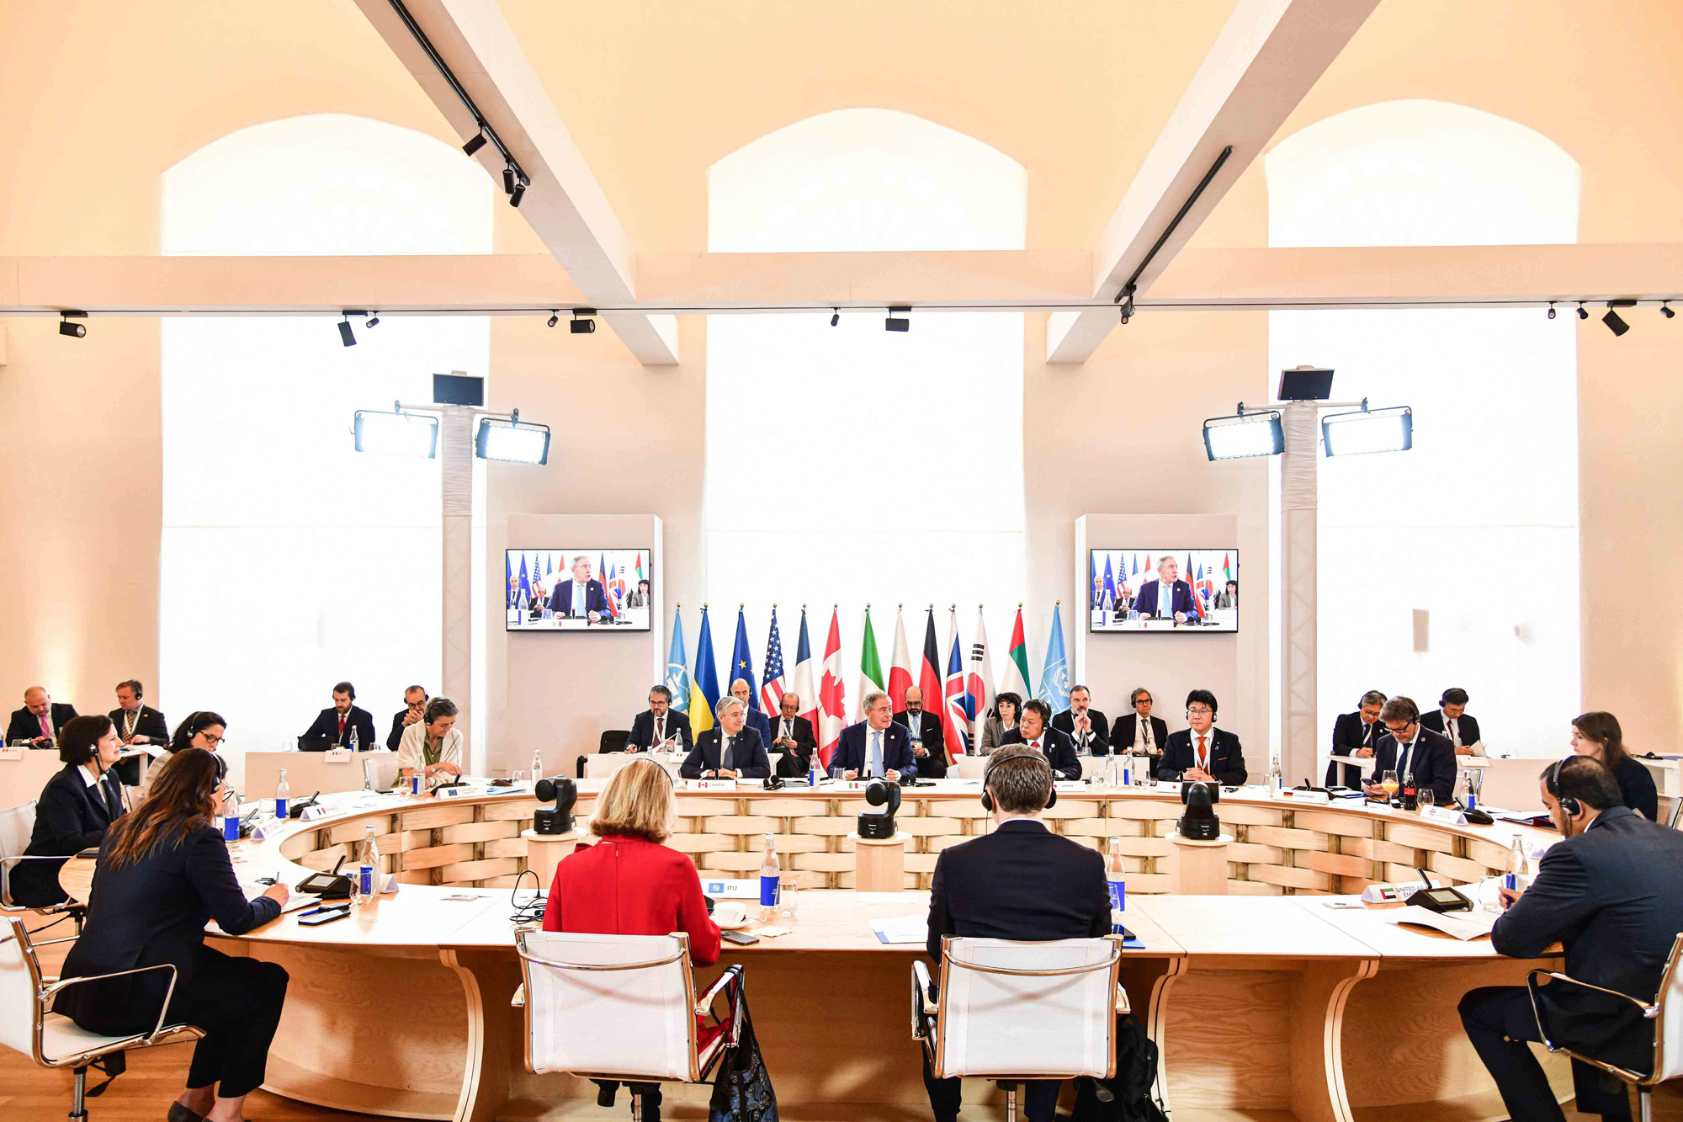
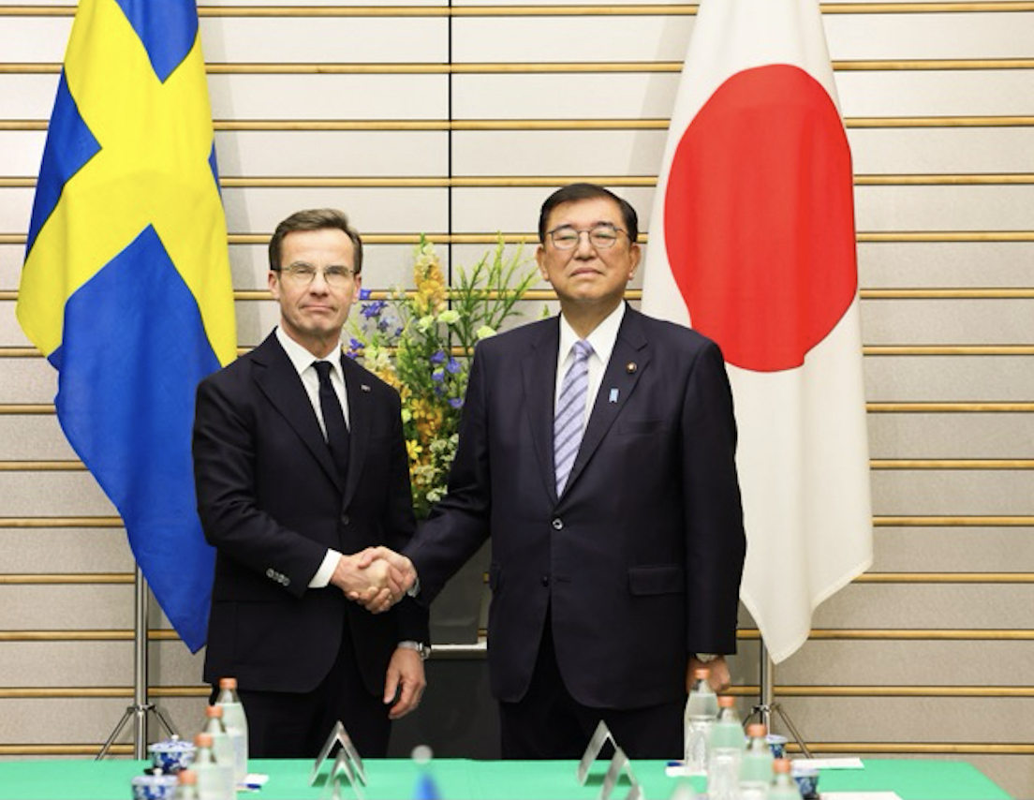
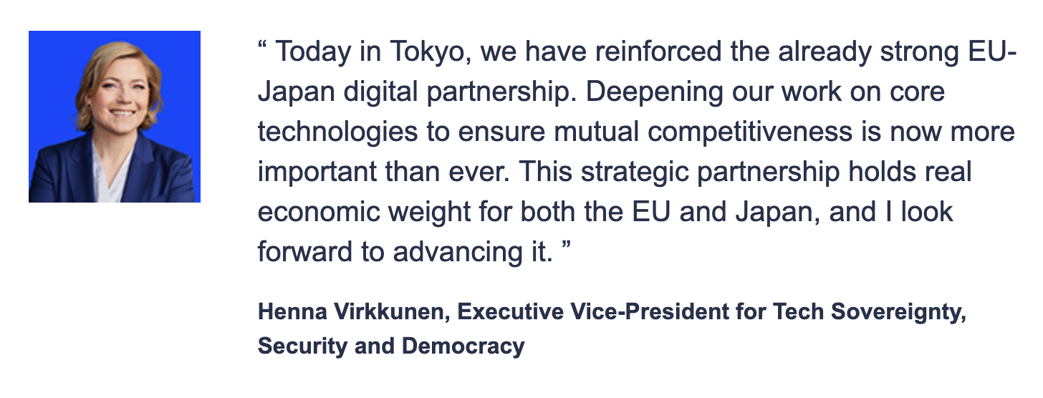
High relevance at political level
G7 meetings in 2023 and 2024
EU – Japan Digital Partnership Councils
Sweden-Japan bilateral meeting
Swedish Government funding
Political govt. support from: SE, FI, DK, DE, LT, EE, LV
Notes:
This initiative is of high relevance at political levels both globally, at EU-level, and in Sweden.
At least two G7 meetings (one in Japan 2023 and the other in Italy 2024) have resulted in statements in support of additional submarine cables to increase resilience, specifically mentioning the Arctic as a possible new route.
Arctic submarine cables are of High relevance to the EU, which is why our project received CEF funding. There have been three European – Japan Digital Partnership Councils, the last earlier this year, where The EU and Japan have reinforced their cooperation on submarine cables, recognising the importance of secure, resilient and sustainable global connectivity. They have also recognised the importance of the development of the pioneering Arctic connectivity route to ensure trusted data flows between Europe and Japan.
In Sweden, this is also a priority at governmental level, where a Sweden-Japan bilateral meeting took place earlier this year, and the government has assigned specific funding for this initiative. We also have politival government support from…

Slide 9
Timeline and relevance for NRENs
Notes:
This initiative is of course complex, involves multiple stakeholders, and requires multiple steps. Three projects have so far been funded through the Connecting Europe Facility (CEF) Digital programme and one more is planned. Broadly, the key elements are: identifying potential routes in the Arctic, identifying potential novel cable technologies that allow for scientific use as well, ensuring that the route is feasible (icebreaker), and ensuring the sustainability also for the use of the cables (including cable landing stations, data management etc),. Many of these elements are relevant for NRENs and could be strategic investments, such as …

Slide 10
The Polar Connect Route & Technical feasibility

Slide 11
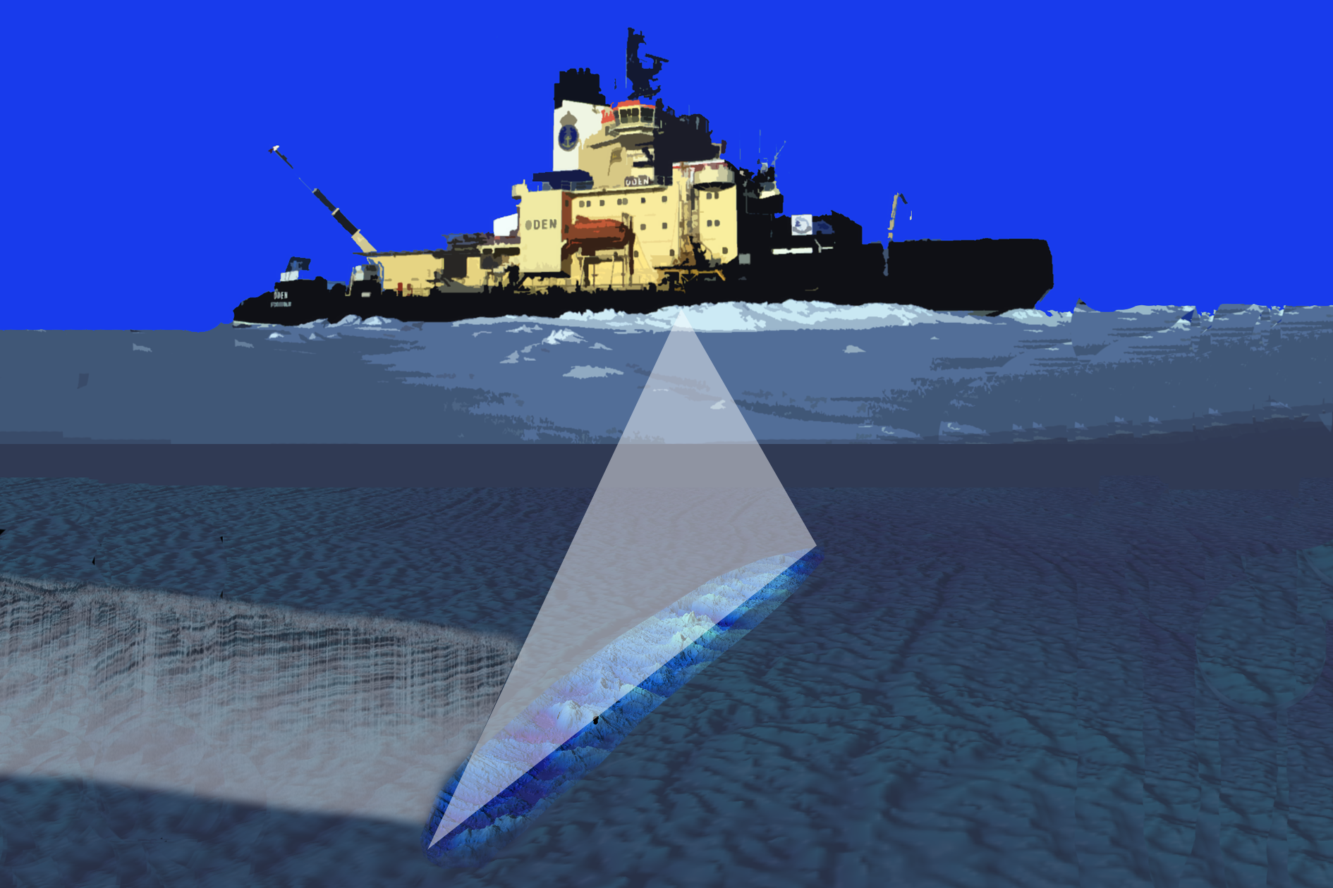
Determining the optimal Route
The cable cost is normally 70-80% of total cost of build
The cable needs to be tailored to the conditions of the seabed to be adequately protected
  More protection, higher cable cost
The route needs to be as short, sound and stable as possible
Requires data collecting through seabed surveys

Slide 12
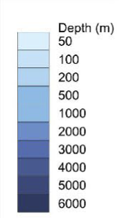
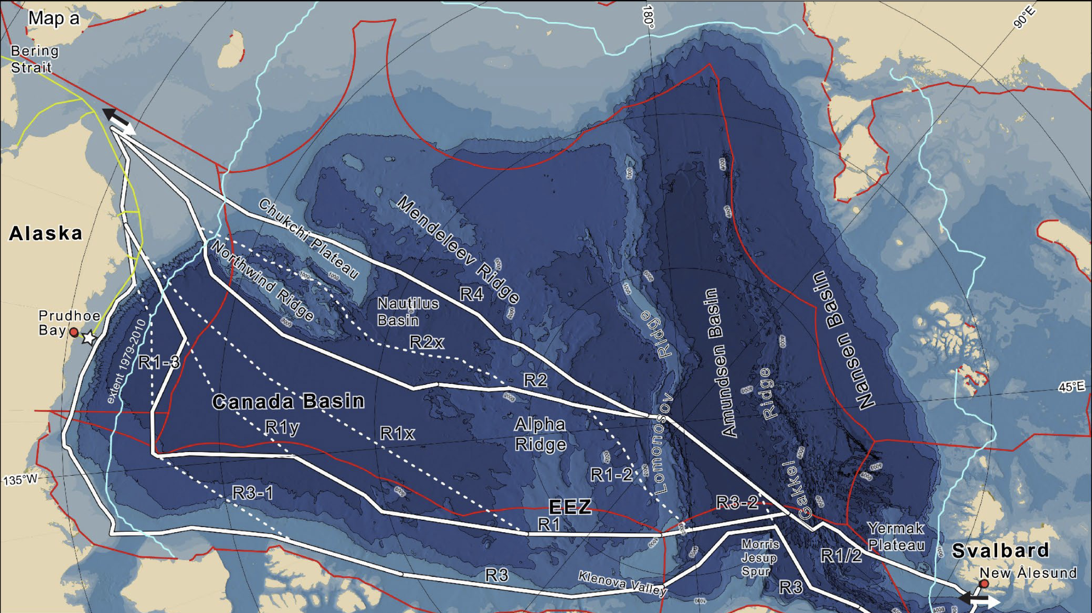
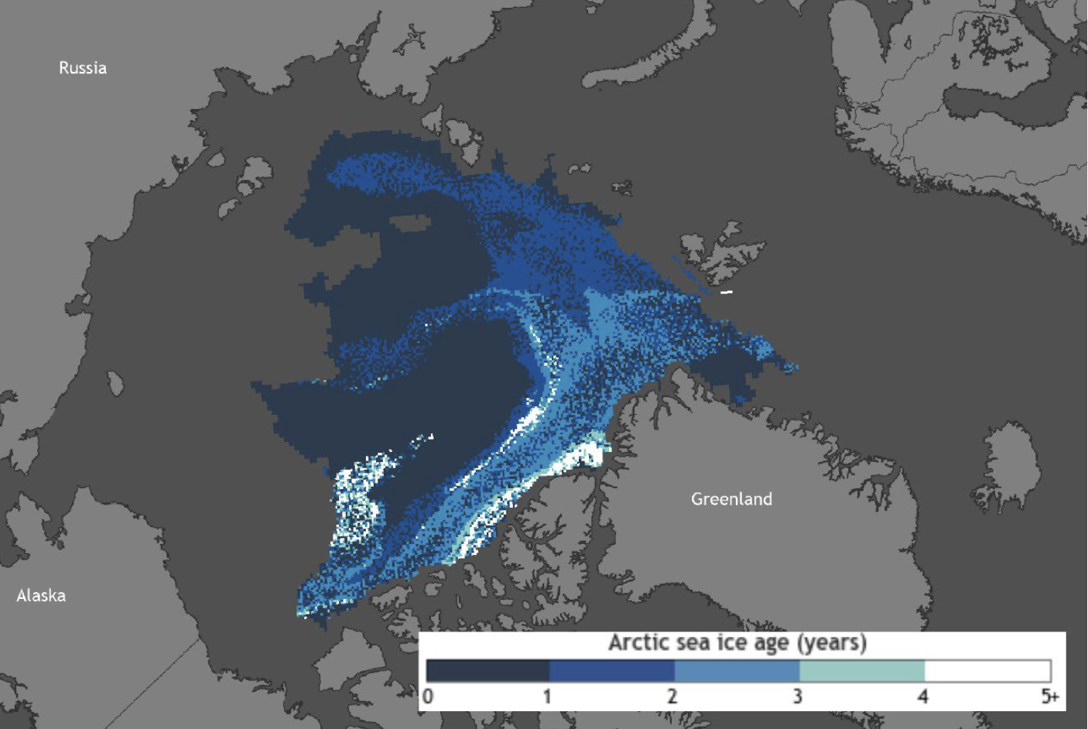
About the Central Arctic Ocean
Largely unexplored
4000 meters deep
Covered by an ice cap
  1-6 m thick
  2000 km edge-to-edge in summer (expands horizontally in winter)
  Different kinds of ice: 1 year vs multi-year ice
Inaccessible in the winter without a heavy icebreaker (of high Polar Class)
09/03 2024
12
Notes:
This is what we know – but there are many gaps here
Ju ljusare ju äldre, djupare – ju mörkare nyare
Vallar kan bli tjockare
1-2 meter enligt vår rutt, men kan finnas tjockare
Largely unexplored – 25% chartered?
The ice cap is 2000 km edge-to-edge in summer. Expands horizontally to XXXX km in winter.

Slide 13
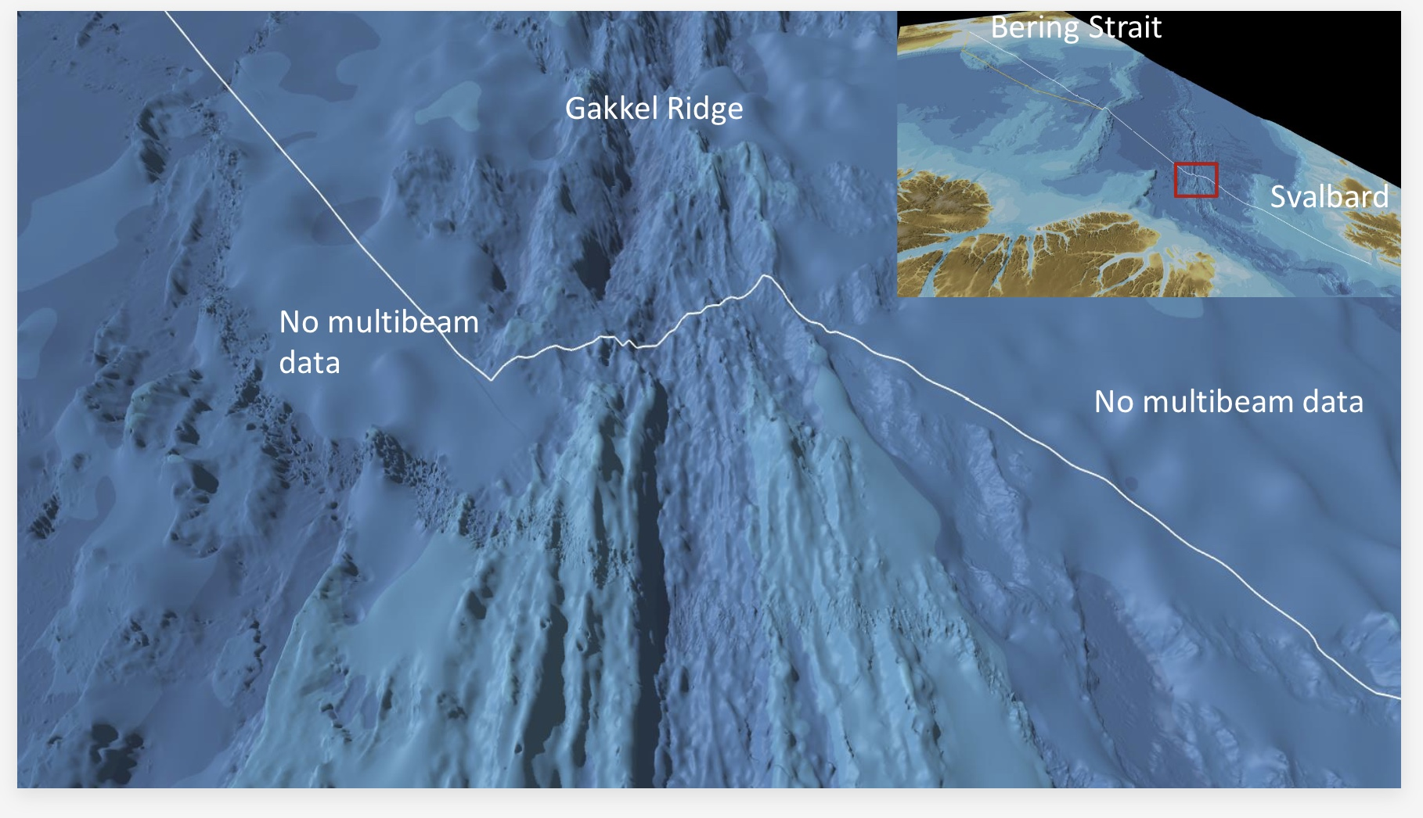
Simulation by Stockholm University*
Simulation to determine the route, estimate the cable cost and identify the best window of operations
Based on existing data:
  seabed conditions
  ice conditions
  cable types (degrees of protection of cable)
  cable types’ costs
To be updated 2025-2027 with data collections from the suggested route, to fill out the unknown gaps
*Martin Jakobsson, Professor of Marine Geology and Geophysics, Stockholm University; Matt O’Regan; Christian Stranne; Vicent Dõnate
Notes:
Simulation helps identify gaps, Areas, but also types of cables, and costs
→ Any submarine cable needs to be tailored to the exact conditions of the seafloor and in the arctic there is also the ice conditions to take into consideration. Therefore, we commissioned the Department of Geological Sciences at Stockholm University to research the best possible routes through the Arctic Ocean for us.
The Arctic Ocean is one of the least mapped parts of our planet. The upper of the white lines in this map, close to the North Pole seems to be the most favourable route, from a geological viewpoint. The routes closer to Greenland have some of the worst ice conditions on the planet.
The next step in Polar Connect, the Polar Connect Step 1 project, is to map the suggested cable route in detail, to be ready for the marine survey phase of Polar Connect, that will lead to the required details of the ocean floor for manufacturing the cable.
The cable cost is normally 70-80% of total cost of build
The cable needs to be tailored to the conditions of the seabed to be adequately protected
More protection, higher cable cost
The route needs to be as short, sound and stable as possible
Requires data collecting through seabed surveys

Slide 14
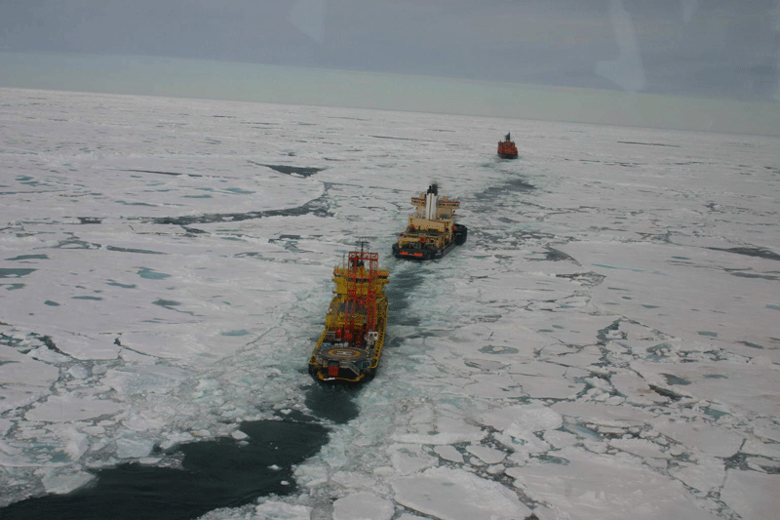
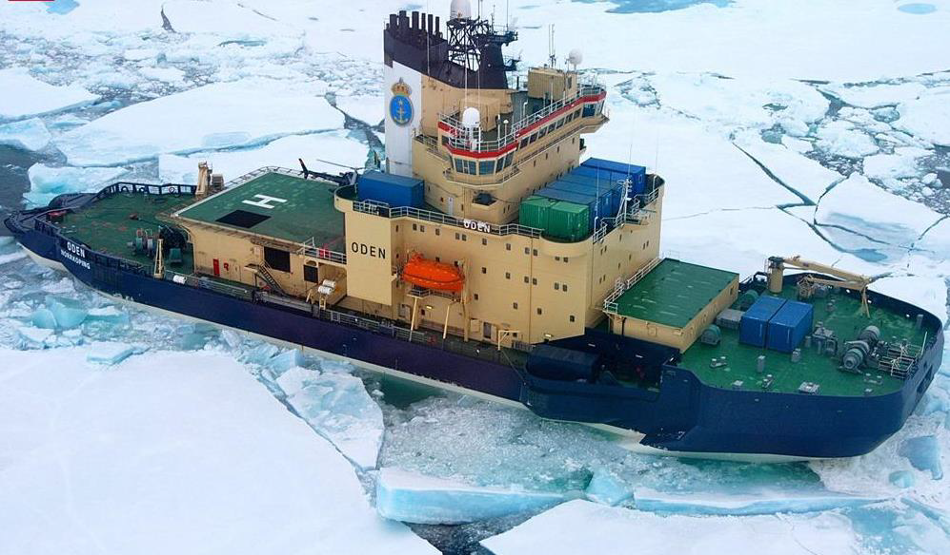




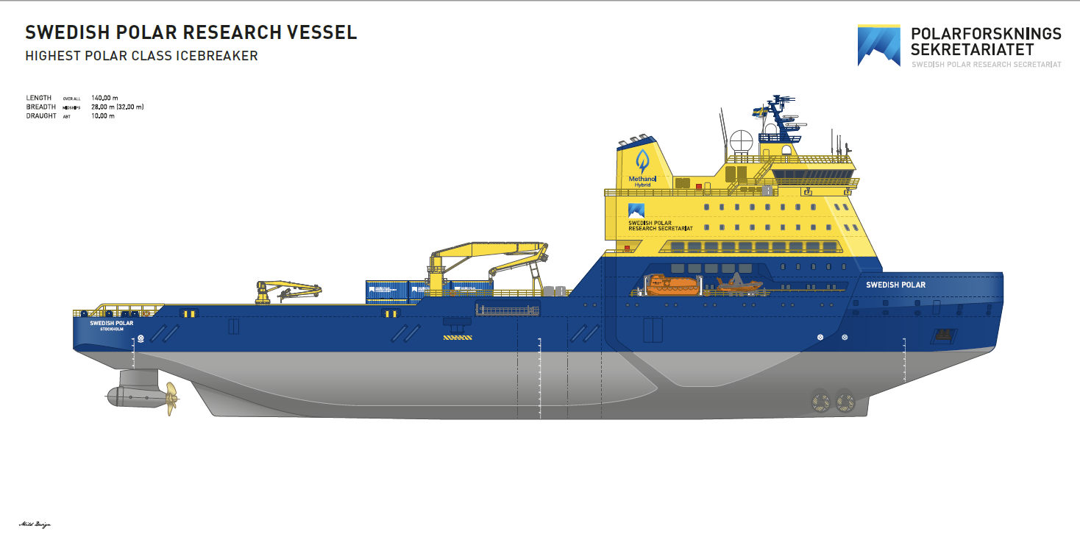
How to deploy a fiber optic cable across the Arctic
Notes:
The Nordic countries are in a unique position to realise connectivity along what would be the shortest possible path across the Arctic Ocean.
The Swedish Polar Research Secretariat is a partner in Polar Connect.
They are highly experienced and have since 1991 carried out 29 polar expeditions with Oden, one of world’s heaviest icebreakers (used for research).
We asked the Swedish Polar Research Secretariat to carry out a feasibility study for the project.
According to their expertise and knowledge, Polar Connect needs two icebreakers (one that breaks ice and a second that mashes it) and a cable laying ship (capable in arctic conditions).
This year, the Swedish Polar Research Secretariat was requested by the Swedish government to write a technical specification of a new icebreaker of the highest polar class - comparable to Russia’s largest ice breakers.
The new ice breaker would be able to operate the Arctic (and Antartic) year-round. And has a modular design, so that it can be adapted and used for different tasks, like cable repair.
The icebreaker is currently being discussed by the Swedis
How can this venture be achieved in practice?
In a previous CEF Digital co-funded project, the Northern EU Gateways project, we carried out several important preparatory studies.
We asked our partner the Swedish Polar Research Secretariat, to perform research on how to navigate the Arctic with Icebreakers and a cable laying ship.
The Swedish Polar Research Secretariat are highly experienced and have since 1991 carried out 29 polar expeditions with Oden, one of world’s heaviest icebreakers. According to their expertise and knowledge, the cable could be laid during one summer.
To do so, we need two icebreakers (one that breaks ice and a second that mashes it) and a cable laying ship (capable in arctic conditions).
Within the Swedish government there is a discussion, about building a new icebreaker of the highest polar class, comparable to Russia’s largest ice breakers. The current timeline for that build is well within the 2030 vision.
h government and the timeline for the build is within the 2030 vision.

Slide 15
Benefits for Science

Slide 16
Input from the scientific community: Polar Connect Webinar on 7 October 2024
https://npf.nordu.net/recordings
Notes:
En annan sak som kom fram: Central Arctic Ocean viktigast
vi behöver veta var, och så djupt som möjligt
The webinar was very well attended, large interest of the scientific community in sensing with Polar Connect
We received a broad range of really good suggestions from the participants. Our Mentimeter survey was completed by 54 participants.
Many scientists see a strong need to monitor and collect data from the central Arctic Ocean
Seismic data monitoring earthquake activity (early warning systems and geophysical models)
Passive hydroacoustic data (soundscape of the Arctic Ocean, human activities, impacts on the biosphere with a particular focus on mammals)
Physical oceanographic data (sea level rise, ocean heat content, global ocean circulation).
The most relevant sensing parameters were given by 45 participants: water temperature, pressure, salinity/conductivity and vibrations/turbulent mixing (Figure 6).

Slide 17
Sensors for Science on Polar Connect
Area of high interest from Arctic research communities to install SMART sensor capabilities
Notes:
In addition to providing connectivity, submarine cables can be equipped with sensing technologies. Sensing is a developing field, that could enable continuous and precise measurements under the arctic ice that were previously impossible and has the potential to revolutionise arctic research, when it comes to fields like earth observation, climate change, marine biology and seismology.
These technologies can also be used to enhance the security of the cable, so that the operator can be alerted if someone approaches the cable, so that they in turn can alert the authorities to take action, and prevent unwanted interference.
In Polar Connect, we have involved Arctic scientists in workshops and work with the sensor and submarine cable industries to define the next steps in sensing.

Slide 18
Science Opportunities
Oceanography (ocean temperature, internal waves, upwelling, current velocities, turbulent mixing, wave height)
Climate (sea level change, ocean heat content, ocean circulation)
Geophysics / Seismology (earthquakes, underwater volcanoes, tsunamis)
Marine Biology (tracking mammals by their sound)
AND: secures digital connectivity between researchers in Europe for all fields of Science!
Notes:
New image here

Slide 19
Summary

Slide 20
Redefining Global Connectivity
Polar Connect brings several benefits:
  Push the frontiers of Connectivity, Build & Cable Security
  Advances Geopolitics & Digital Security for Europe
  Regional Development in the Nordics and in Japan
  Promoting Scientific cooperation with East Asia
  Enabling scientific monitoring of the Arctic Ocean
Notes:
Connectivity:
Improved European connectivity
Creates redundancy and resilience for EU-Asia and the internet at large
Shortest path guarantees reduced latency, improves connectivity
Can replace near end-of-life cable from Norway’s mainland to Svalbard (estimated 2029)
Build & Cable Security:
Feasible deployment according to the Swedish Polar Research Secretariat
30+ years of Arctic expedition experience
a commissioned study under 21-EU-DIG-Northern EU Gateways
Seismologically sound and stable Arctic cable route, according to commissioned study by Stockholm University under 21-EU-DIG-Northern EU Gateways
Once deployed, the the Polar Connect cable is protected by the Arctic ice cap and the depth
No icebergs in the North Pole region, threatening to do damage to the cable
No commercial fishing traffic in the Arctic
Expected less maintenance for 2000 Km
Sensors on cable to monitor and protect the integrity of the cable
Geopolitics & Security:
Creates strategic digital autonomy for EU and other involved regions
The Polar Connect submarine cable system and the Swedish Icebreaker would provide a strong presence in the Arctic and increase security for the EU
Acquiring the data from the Arctic seabed will put EU on the forefront of the Arctic and Climate research
Possibility for countries to control sensing capabilities in their EEZ and territorial waters
Financial:
Shortest path = cheaper build, better business case
Moves digital gravity to the North → likely to boost GDP of Nordic countries
Growing Data Centre industry in the North, strong interest from Japanese companies to build in the Northern Europe
This Data Centre industry can rely on stable power grid and benefit from free natural cooling
Increased connectivity enables local business opportunities, productivity, trade and innovation
Transporting data is cheaper than transporting power
A new Swedish Icebreaker to perform maintenance on submarine cables in the Arctic and bring longterm revenue for Sweden
Shorter = cheaper
Moves digital gravity to the north. Likely to boost GDP from:
(greener) DC industry (with renewable energy and free cooling) supporting japanese customers.
increased connectivity (which enables local business opportunities, productivity, trade and innovation. Transporting power is more expensive than transporting bits.
(+ from a societal point of view, PC also provides remote communities with broader access to services and may help remote areas remain/become populated).
Science:
Arctic Ocean is unchartered – 25-30% is known. Impossible to measure anything continuously with precise position under the Arctic ice today.
Polar Connect will bring:
Arctic bathymetry data (maps of the seafloor)
A long-term Arctic observatory: unique, unprecedented, continuous, near real-time measurements of temperature, pressure, salinity and potentially other parameters from under the Arctic ice.
Connectivity for scientific institutes and instruments that rely on low latency in remote areas:
EISCAT_3D (the world’s most advanced earth and climate observatory), VLBI stations (crucial to services based on GPS), supercomputers in Europe (LUMI, Arrhenius)
Future initiatives
Cost effective capacity for national research and education networks to enable global research cooperation and innovation to solve common challenges (climate, pandemics, AI)

