Slide 1
How to build an Internet sub-marine cable?
Internet’s backbone
Sebastiano Buscaglione & Olaf Verschoor
Brighton - TNC25
Tuesday June 10 2025

Slide 2
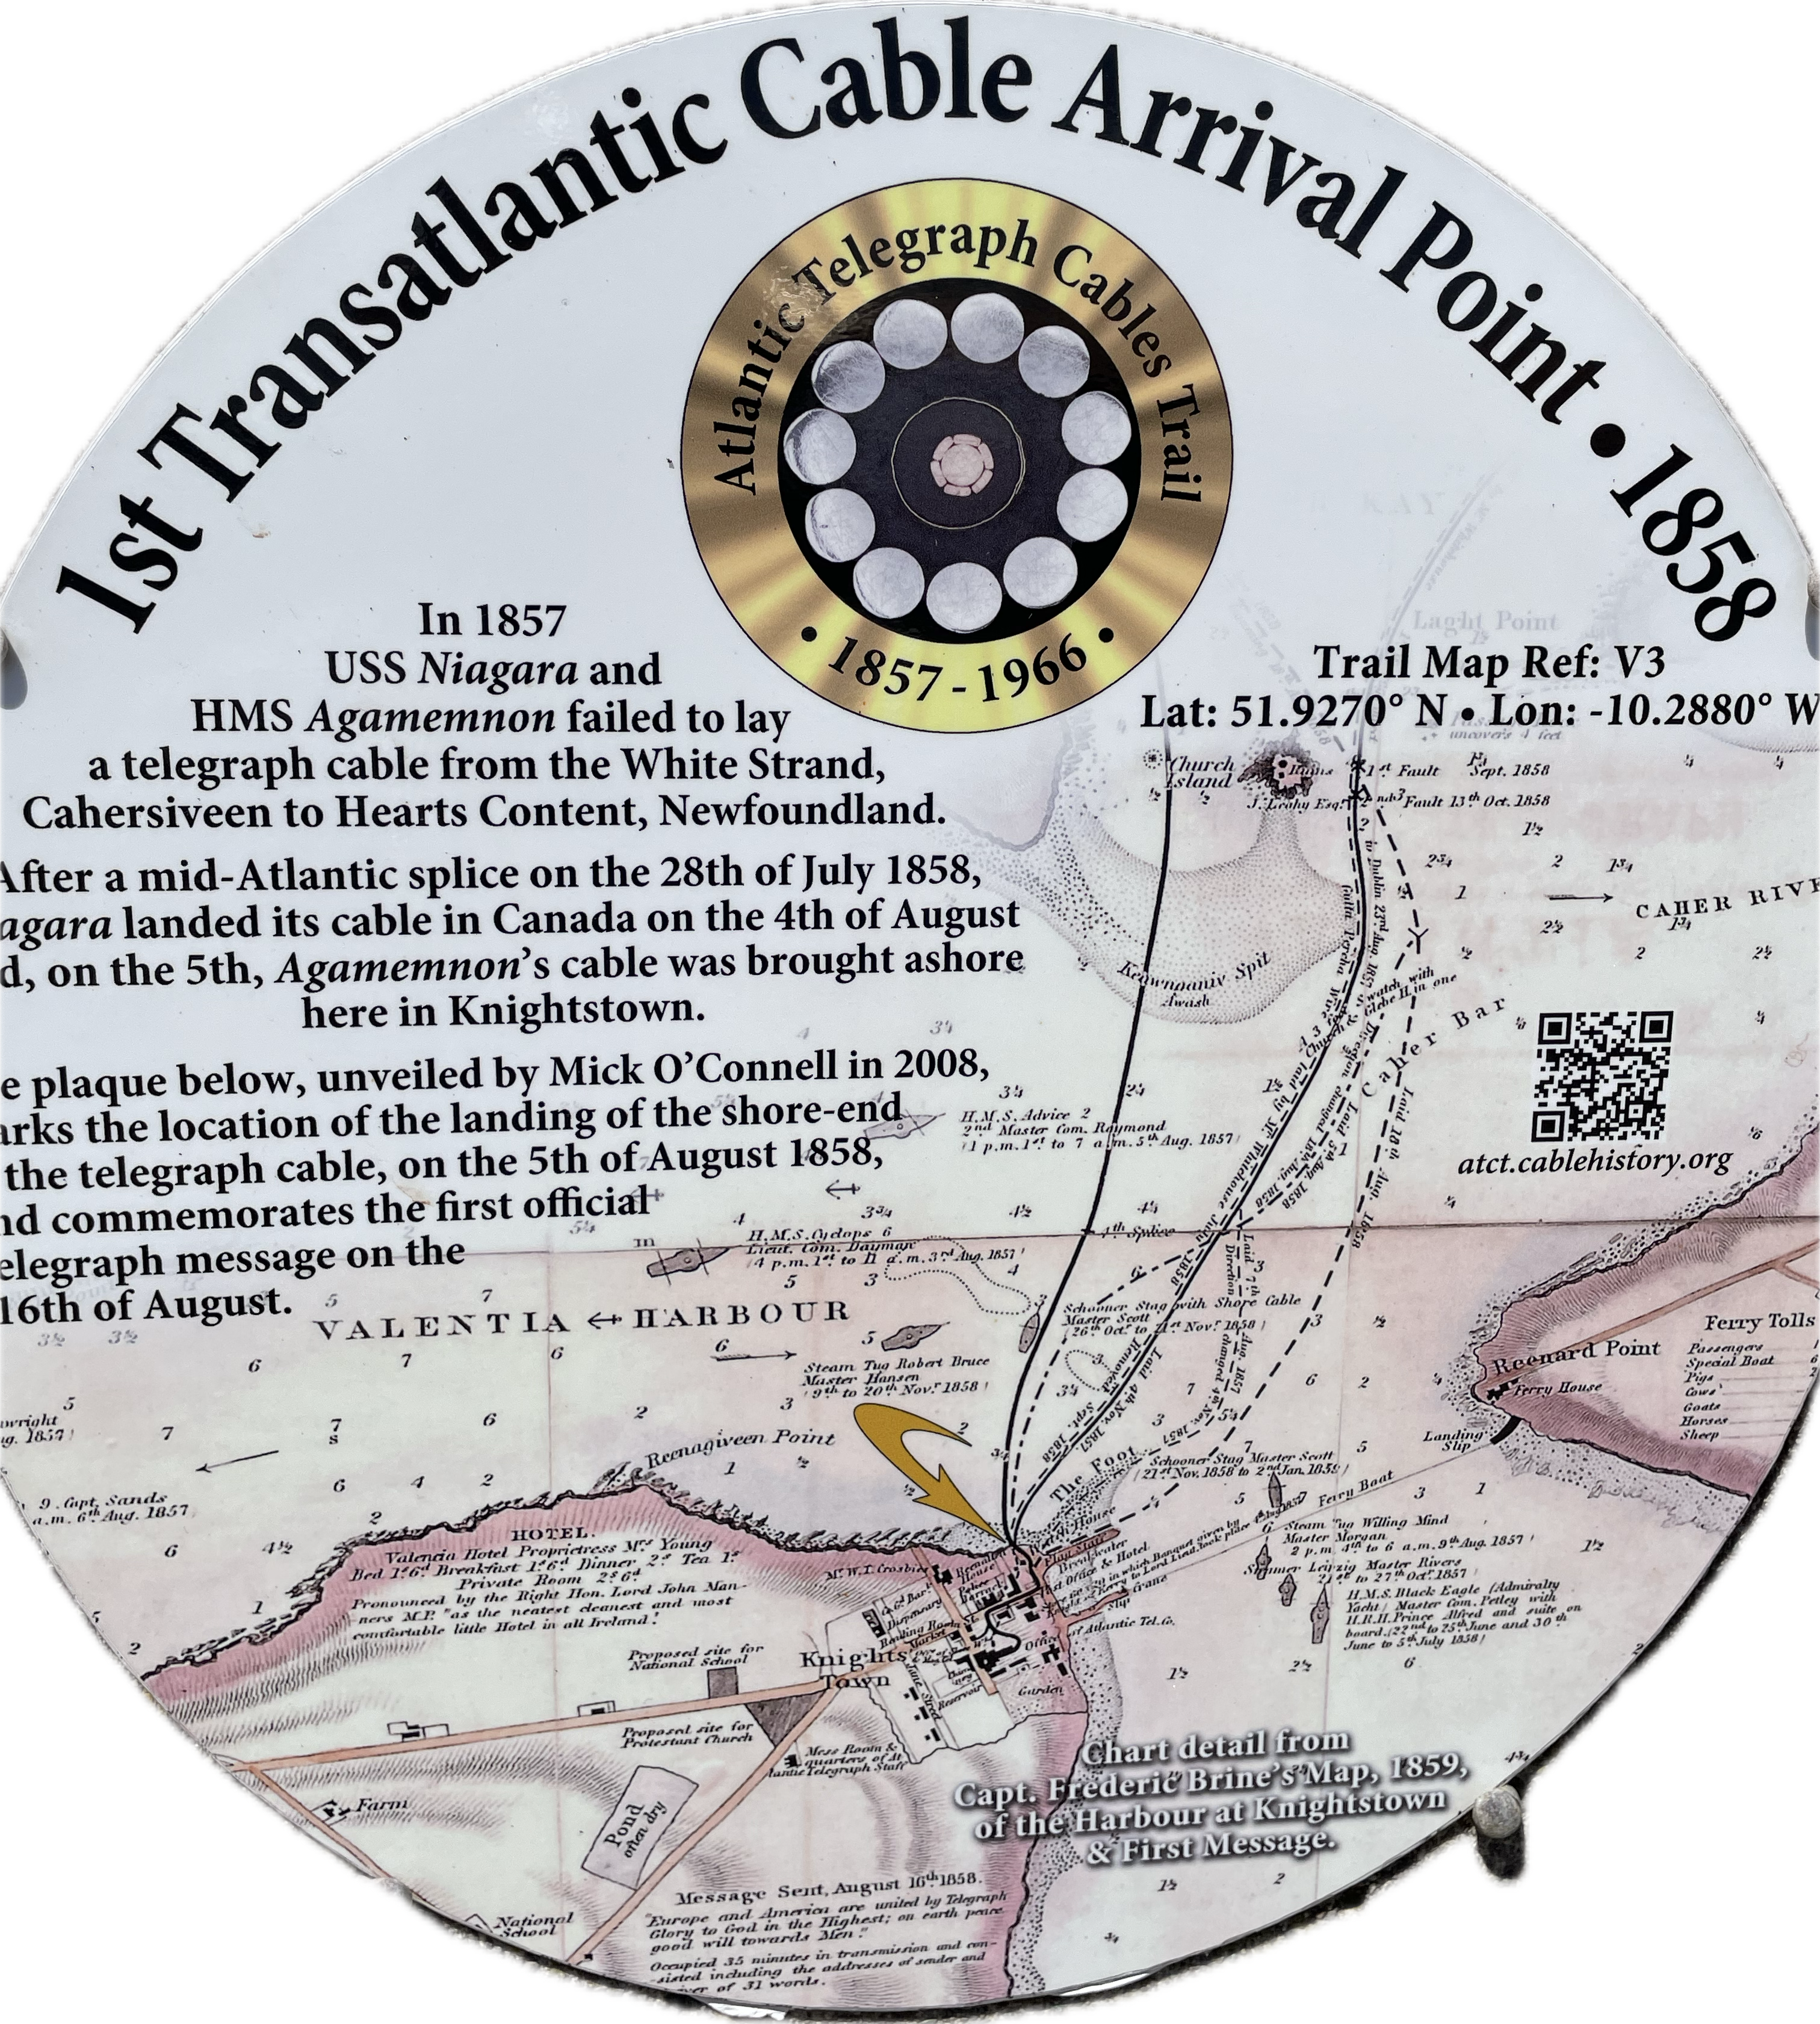
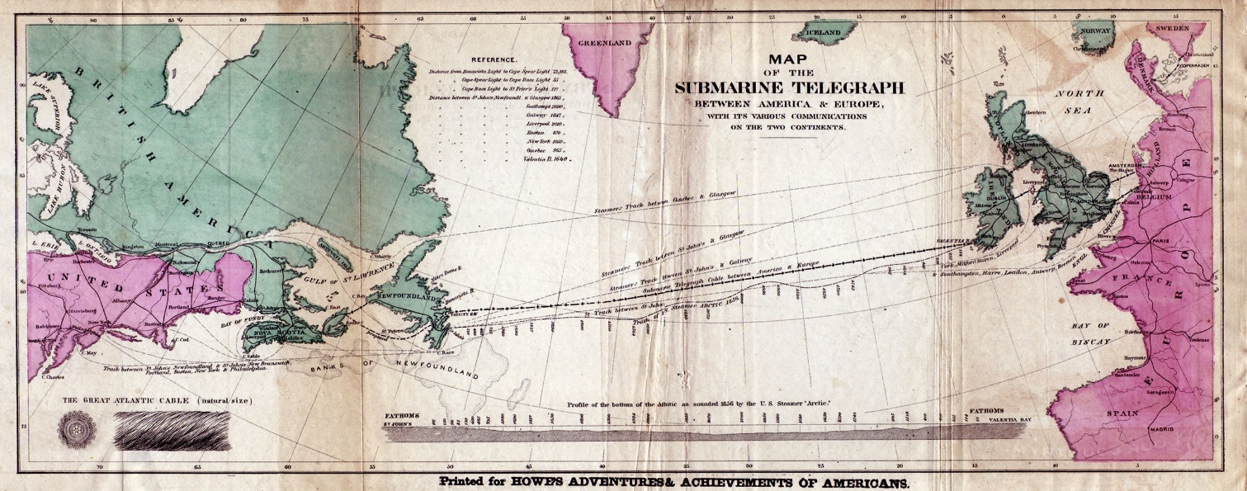
A 170 years old business….
The first Intercontinental Communication Cable was laid in 1858…
…it failed shortly, but successive attempts in 1865/66 produced the first successful cable.

Slide 3
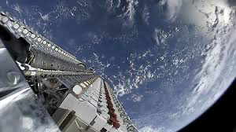
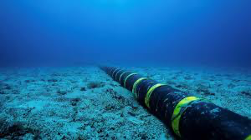
…is it still relevant? Subsea cables, do we really need them?
“Are satellites not the future?”
Feature | 🌊 Submarine Cables | 🛰️ Satellite Internet
Data capacity | Extremely High (Tbps scale) | Lower (Gbps scale)
Latency | Very low / ± 60 ms | High 50 – 500 ms
Reliability | Very stable | Affected by weather / space congestion
Cost per bit | Low | Higher
Use case | Core Internet backbone | Connect underserved / remote locations
Submarine cables account for over 99% of intercontinental data
traffic source: TeleGeography 2023

Slide 4
source: www.submarinecablemap.com

Slide 5
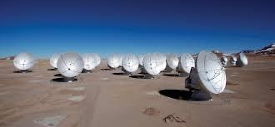
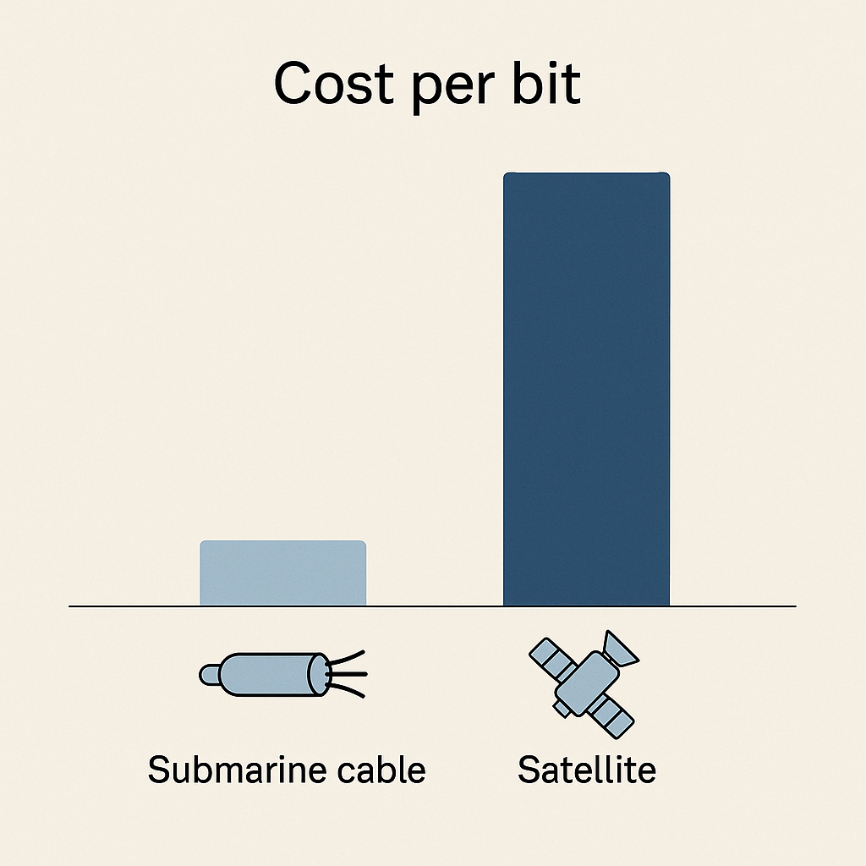
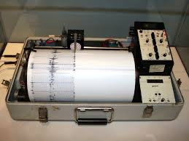
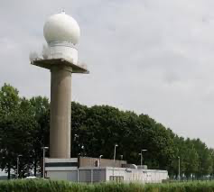
Submarine cables are indispensable for research and education.
Bandwith intensive science
Latency sensitive collaboration
Cost per bit
Uptime & Reliability
Security & Sovereignty

Slide 6
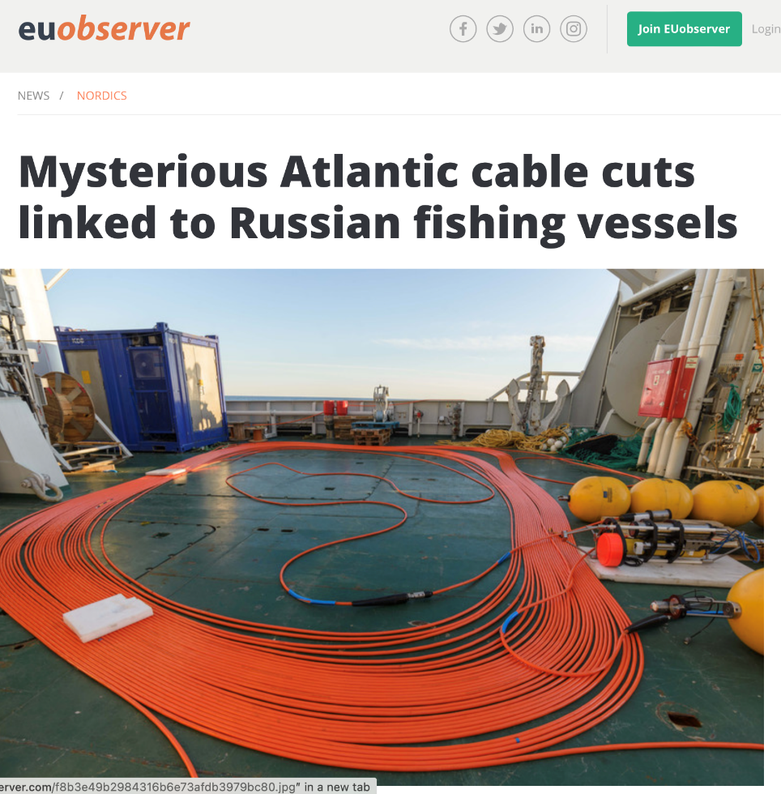
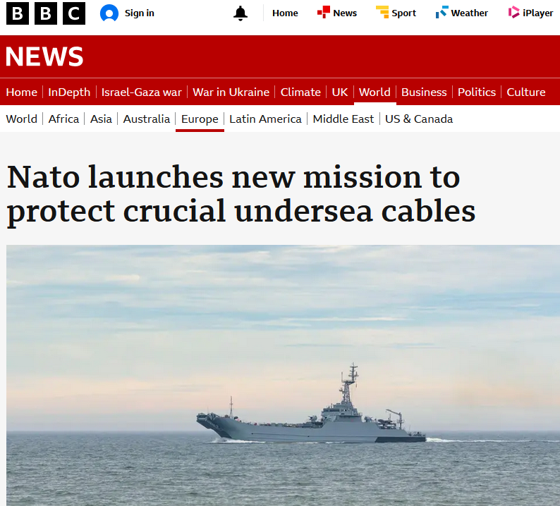
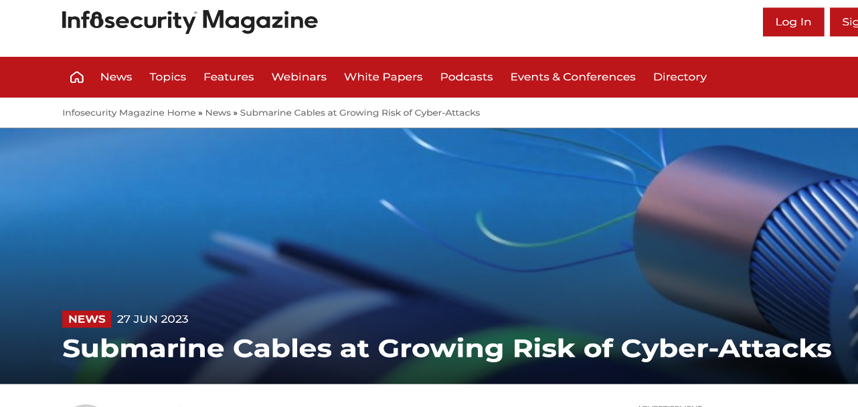
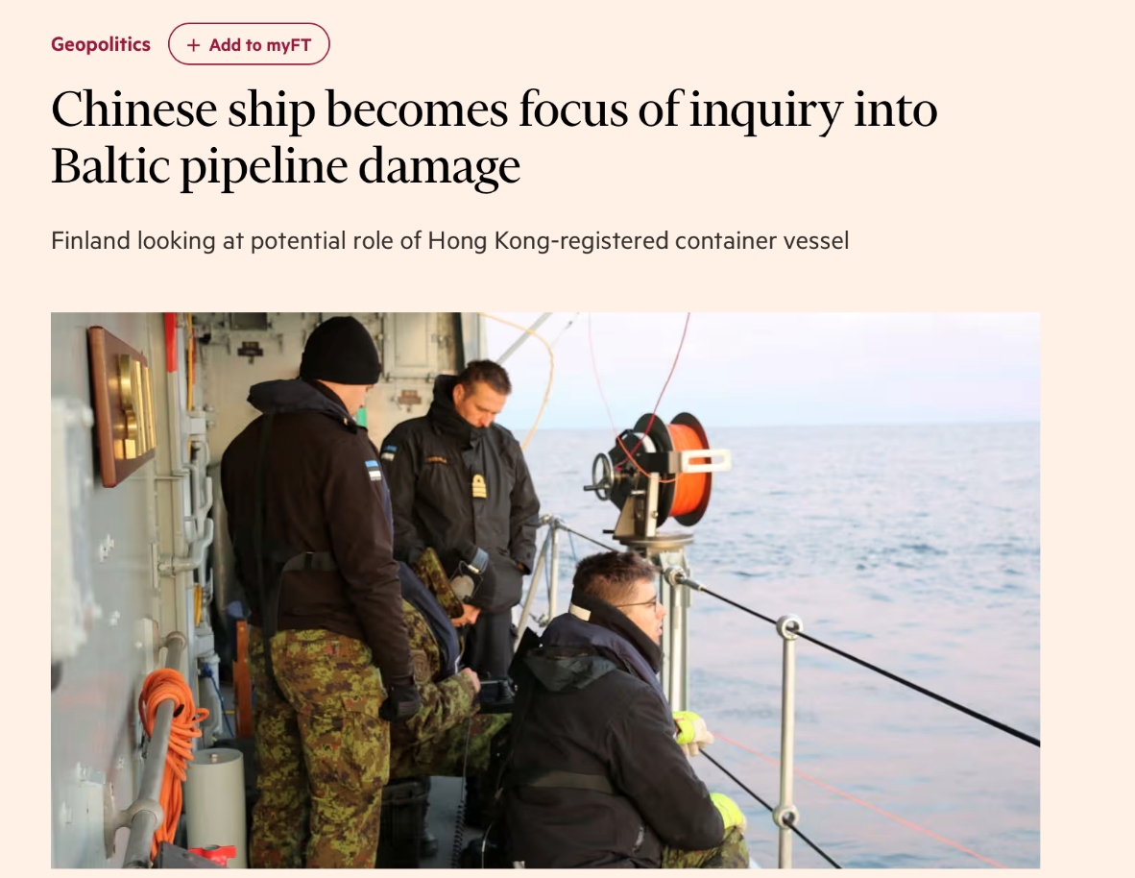
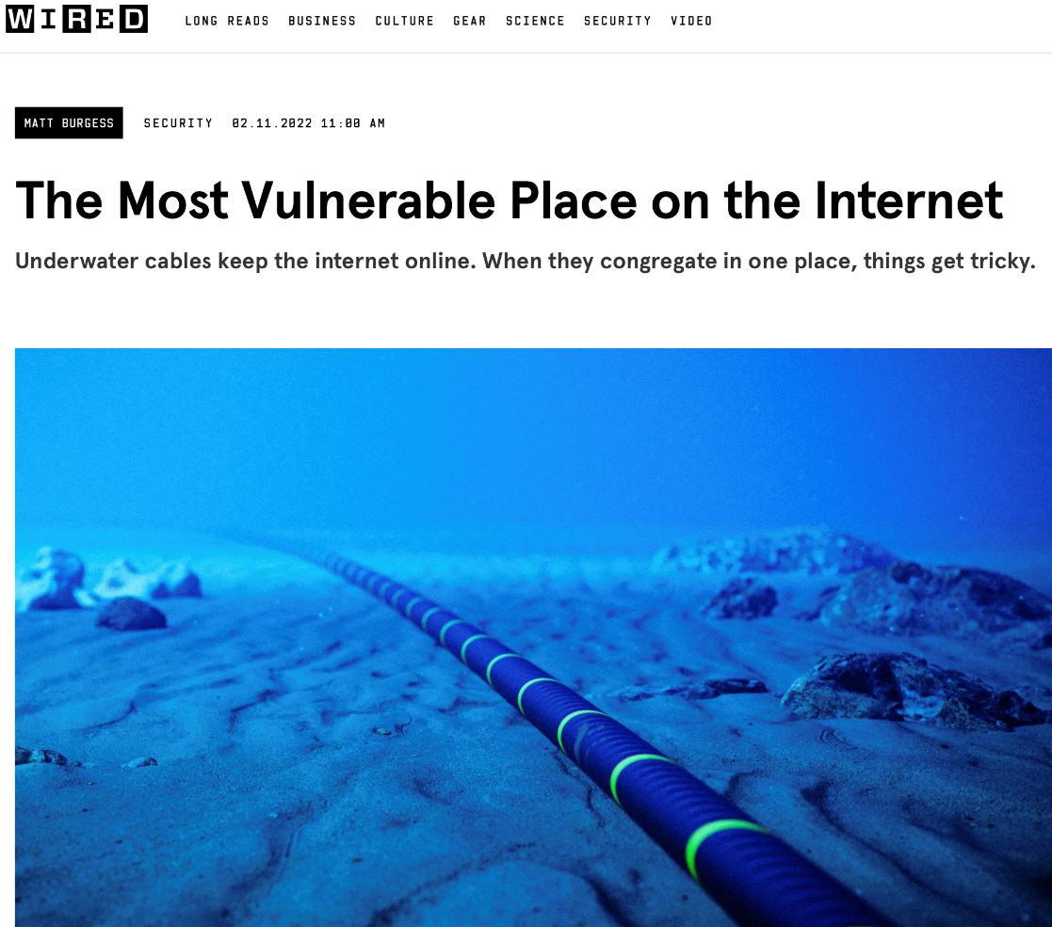

Slide 7
But what do these systems really look like?
Data Centre
Cable Landing Station
Beach Manhole
Backhaul
Fronthaul
Optical Amplifier
Branching Unit

Slide 8
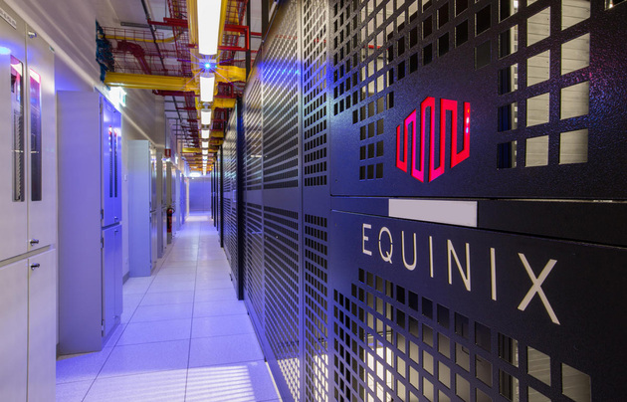
Data Centre
Final termination of the System – here data can be encoded for transmission using DWDM.

Slide 9
Toward the CLS – the backhaul
Backhaul is typically a ring of fibre between the CLS and the Data Centre. Signals are protected optically across this ring.
Data Centre
Cable Landing Station
Beach Manhole
Backhaul
Fronthaul
Optical Amplifier
Branching Unit

Slide 10
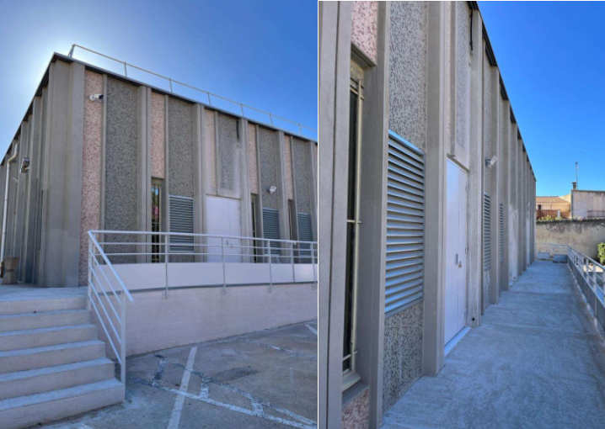
The Cable Landing Station (CLS)
Frequently, and purposefully, an unassuming building – main role is to host the Power Feeding Equipment (PFE) for the system.
What Power?
A subsea cable can only be powered from the edges. Here 1000s V DC current is provided to power all active elements, such as Amplifiers and Branching units equipment (WSS).
Sometimes CLS also host terminating equipment.

Slide 11
Between CLS and Beach Manhole – the fronthaul
The Fronthaul cable carries power therefore the CLS and Beach Manhole should be as close as possible.
Data Centre
Cable Landing Station
Beach Manhole
Backhaul
Fronthaul
Optical Amplifier
Branching Unit

Slide 12
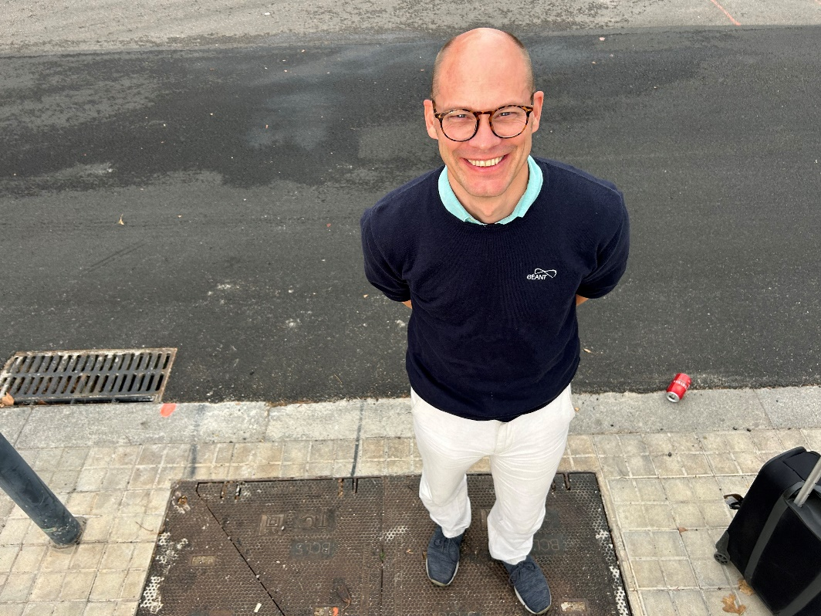
Beach Manhole (BMH)
It is literally – just a manhole, close to the beach.
It physically terminates the “subsea” portion of the cable system, moving from a hardened cable to a much smaller and flexible one.

Slide 13
In the water
Shallow - in reach of human activities, such as Anchors and Fishing Nets. Deep – anything out of reach for that.
Data Centre
Cable Landing Station
Beach Manhole
Shallow
Backhaul
Fronthaul
Deep
Optical Amplifier
Branching Unit

Slide 14
The cable itself
In shallow water and where there is higher risk of Physical damage the cable is “armored” using steel wires.
In shallow water, especially close to the costal area, the cable installation is also more complex, frequently requiring burial or other installation strategies to both protect the cable as well as the environment.
In deep water armoring is not required as the risk of physical damage is low.
Each cable is custom built for a specific project.
Weight and size matters a lot for cost management!

Slide 15
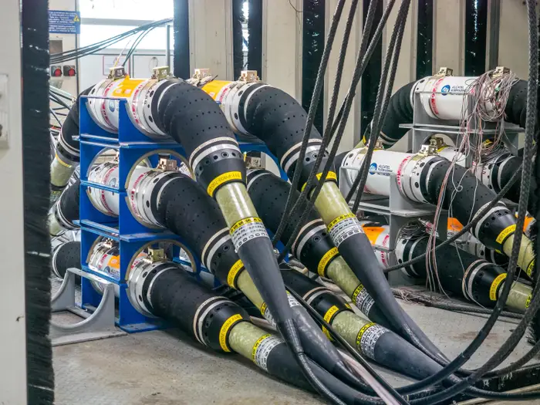
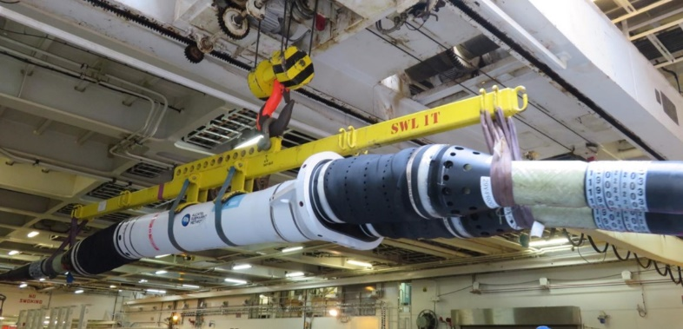
The cable system – repeaters and branching units
Repeaters are installed every ~80Km to “boost” signal strength.
Branching units might also be present to manage system “branches”.
All these elements are hardened and have high level of redundancy to allow for uninterrupted operation for 20+ years.

Slide 16
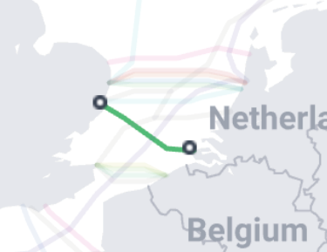
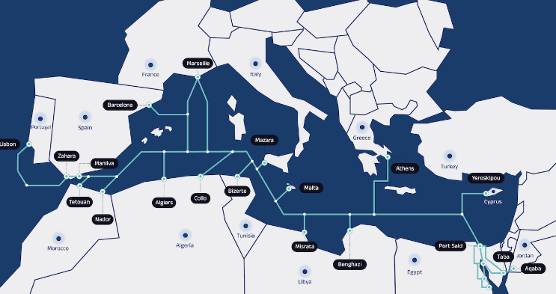
Costs & Financing
Costs determined by many factors
Complexity of cable system
Route / seabed
Telcos
Governments / EC
Banks / loans
Investor
Others
Public investors
Anchor tenants

Slide 17
Building a sub-marine cable system
Time and planning
Time between initial concept/plan and actual install is several years (5-10)
Initiation
6-12 months
Financing
6-12 months
Route design
6-9 months
Maribe Survey
12-18 months
Manufacturing
12-18 months
Installation
6-9 months
Economical lifespan of a cable system is more than 25 years
….and in this time a lot can happen

Slide 18
Building a sub-marine cable system
Investment
Limited number of cable manufacturers
SubCom (USA)
Alcatel Submarine Networks (France)
NEC (Japan
HMW (China)
Contracts
Working capital
Route & Engineering
In sync
Cable laying ships
Permits
Limited capacity
Need to reserve years in advance

Slide 19
Thank you
Any questions?
sebastiano.buscaglione@geant.org
olaf.verschoor@geant.org

