Slide 1
Advancing AI in Libraries, Archives, and Museums through Collaboration with the Geant Community
Ines Vodopivec

Slide 2
AI4LAM: THE Power of CHANGE Individually, we are slow and isolated. Together, we can go faster and farther!
Notes:
AI4LAM should be the driver of change in the digital transformation of cultural heritage. Globally.

Slide 3
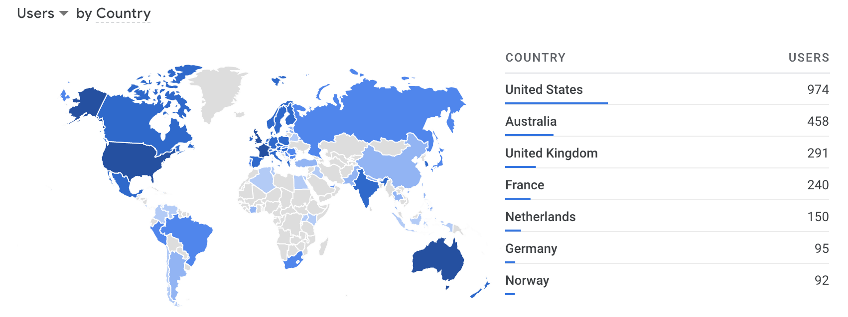
Key facts
Global community and participation
AI4LAM first MoU in 2018
Community of 1.400+ members
Working groups and regional chapters
new MoU Implementation in 2025

Slide 4
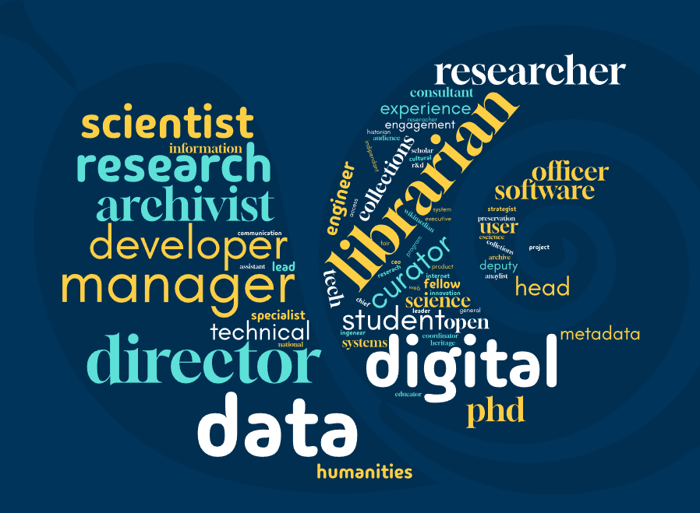
AI4LAM: for whom? By whom? Community driven

Slide 5
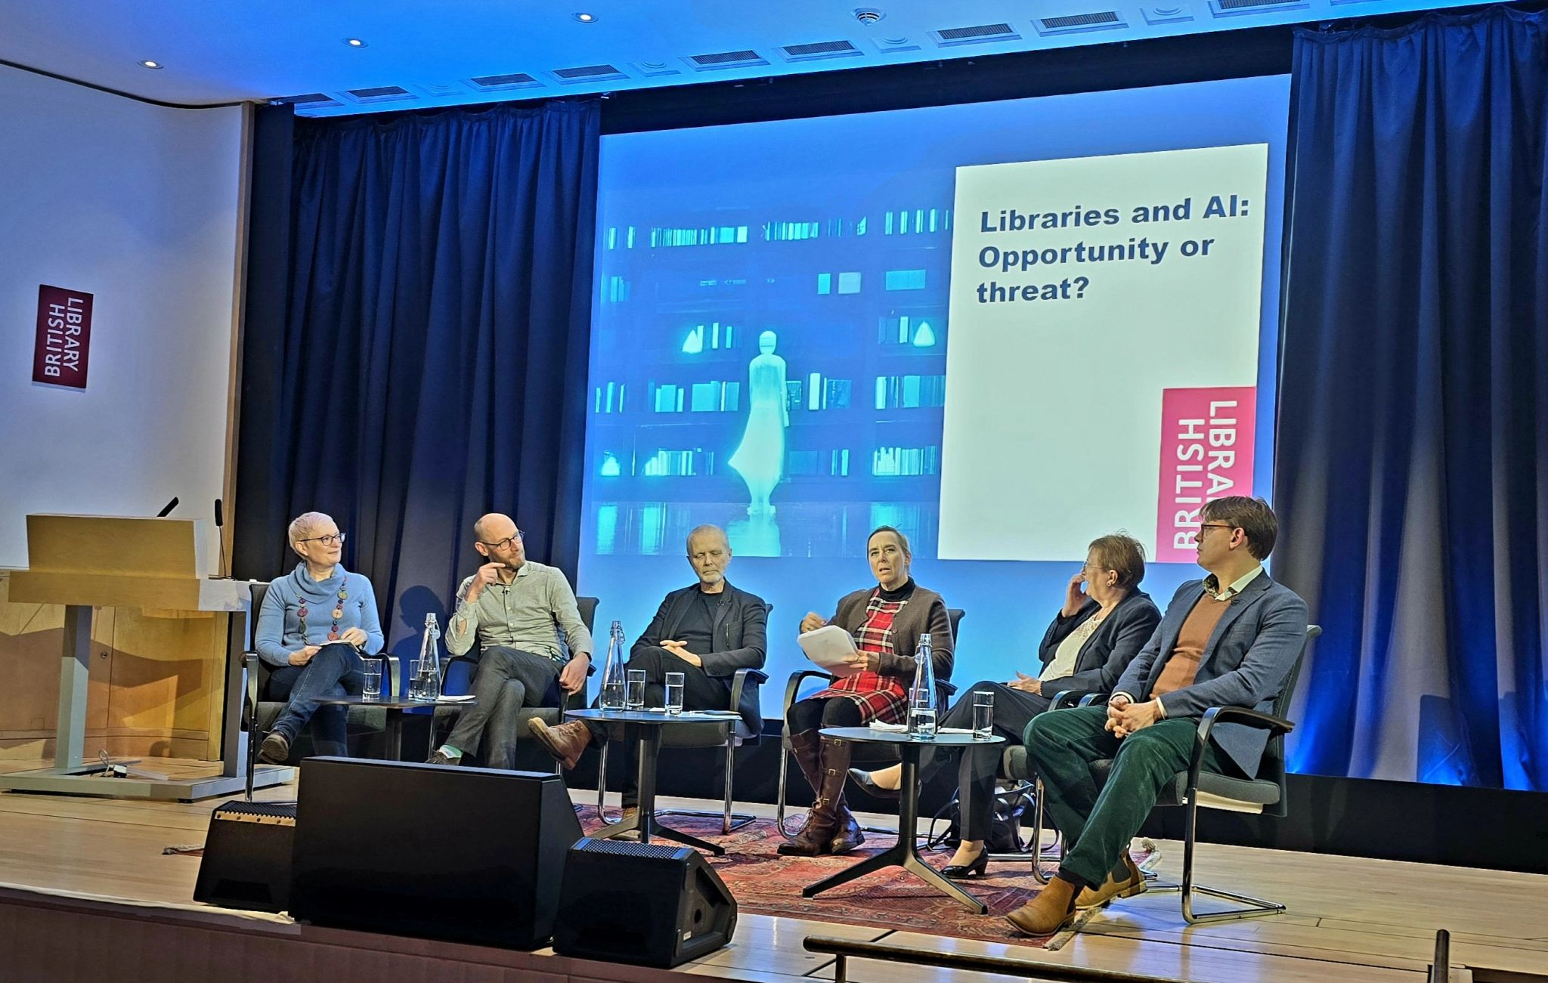
Main areas of work:
Accelerating
- development,
- testing,
- evaluation and
- integration
of AI tools and services into institutional
workflows for innovative solutions and accessibility;
Advancing
- professional skills with
- educational programs
for enhanced efficiency and improved accuracy;
Advocating for change with
- global, regional, and national impact
- reaching out to smaller institutions and
- forming regional branches.
The British Library - series of AI debates
December 3 – 5, London

Slide 6
AI in LAM workflows
Notes:
AI4LAM should be the driver of change in the digital transformation of cultural heritage. Globally.

Slide 7
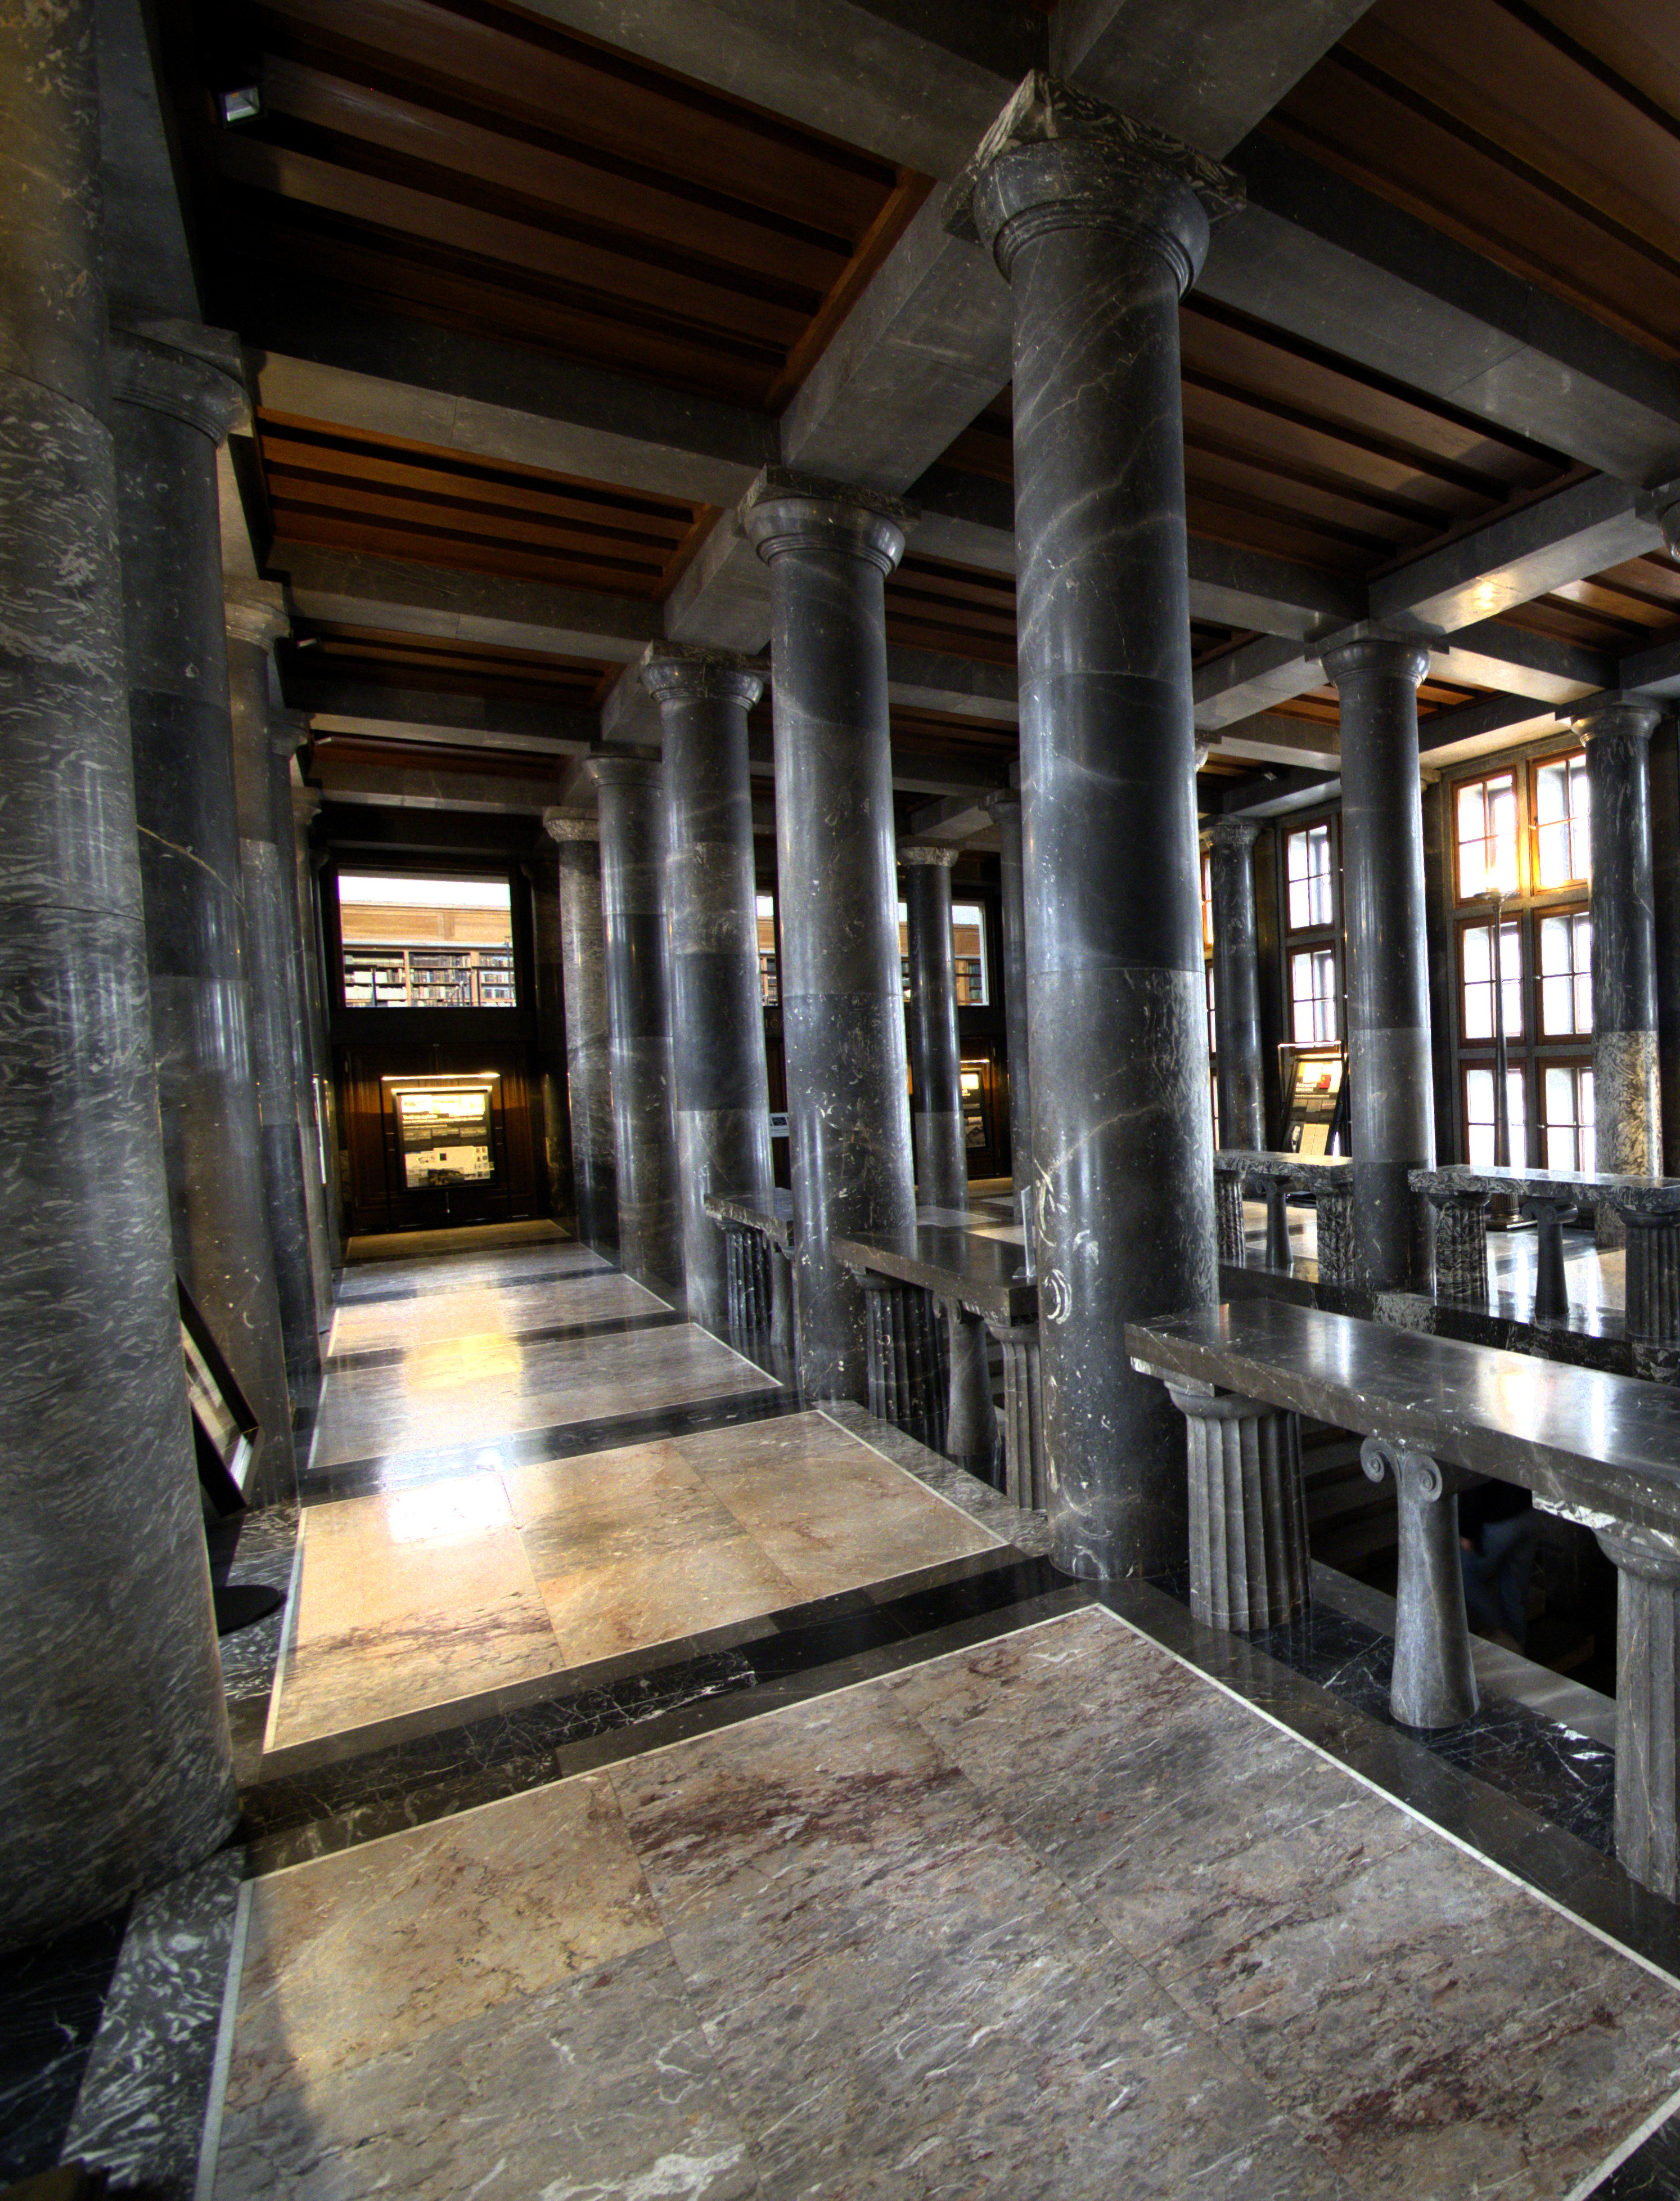
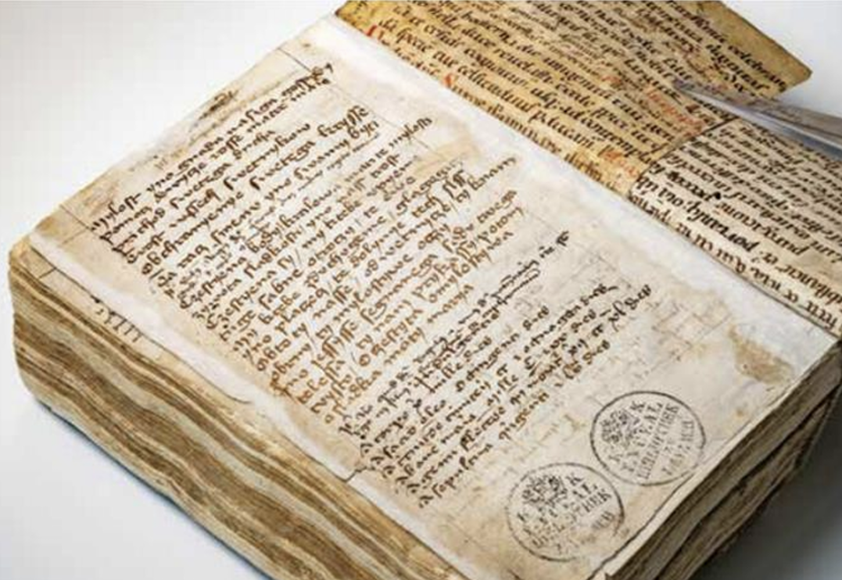
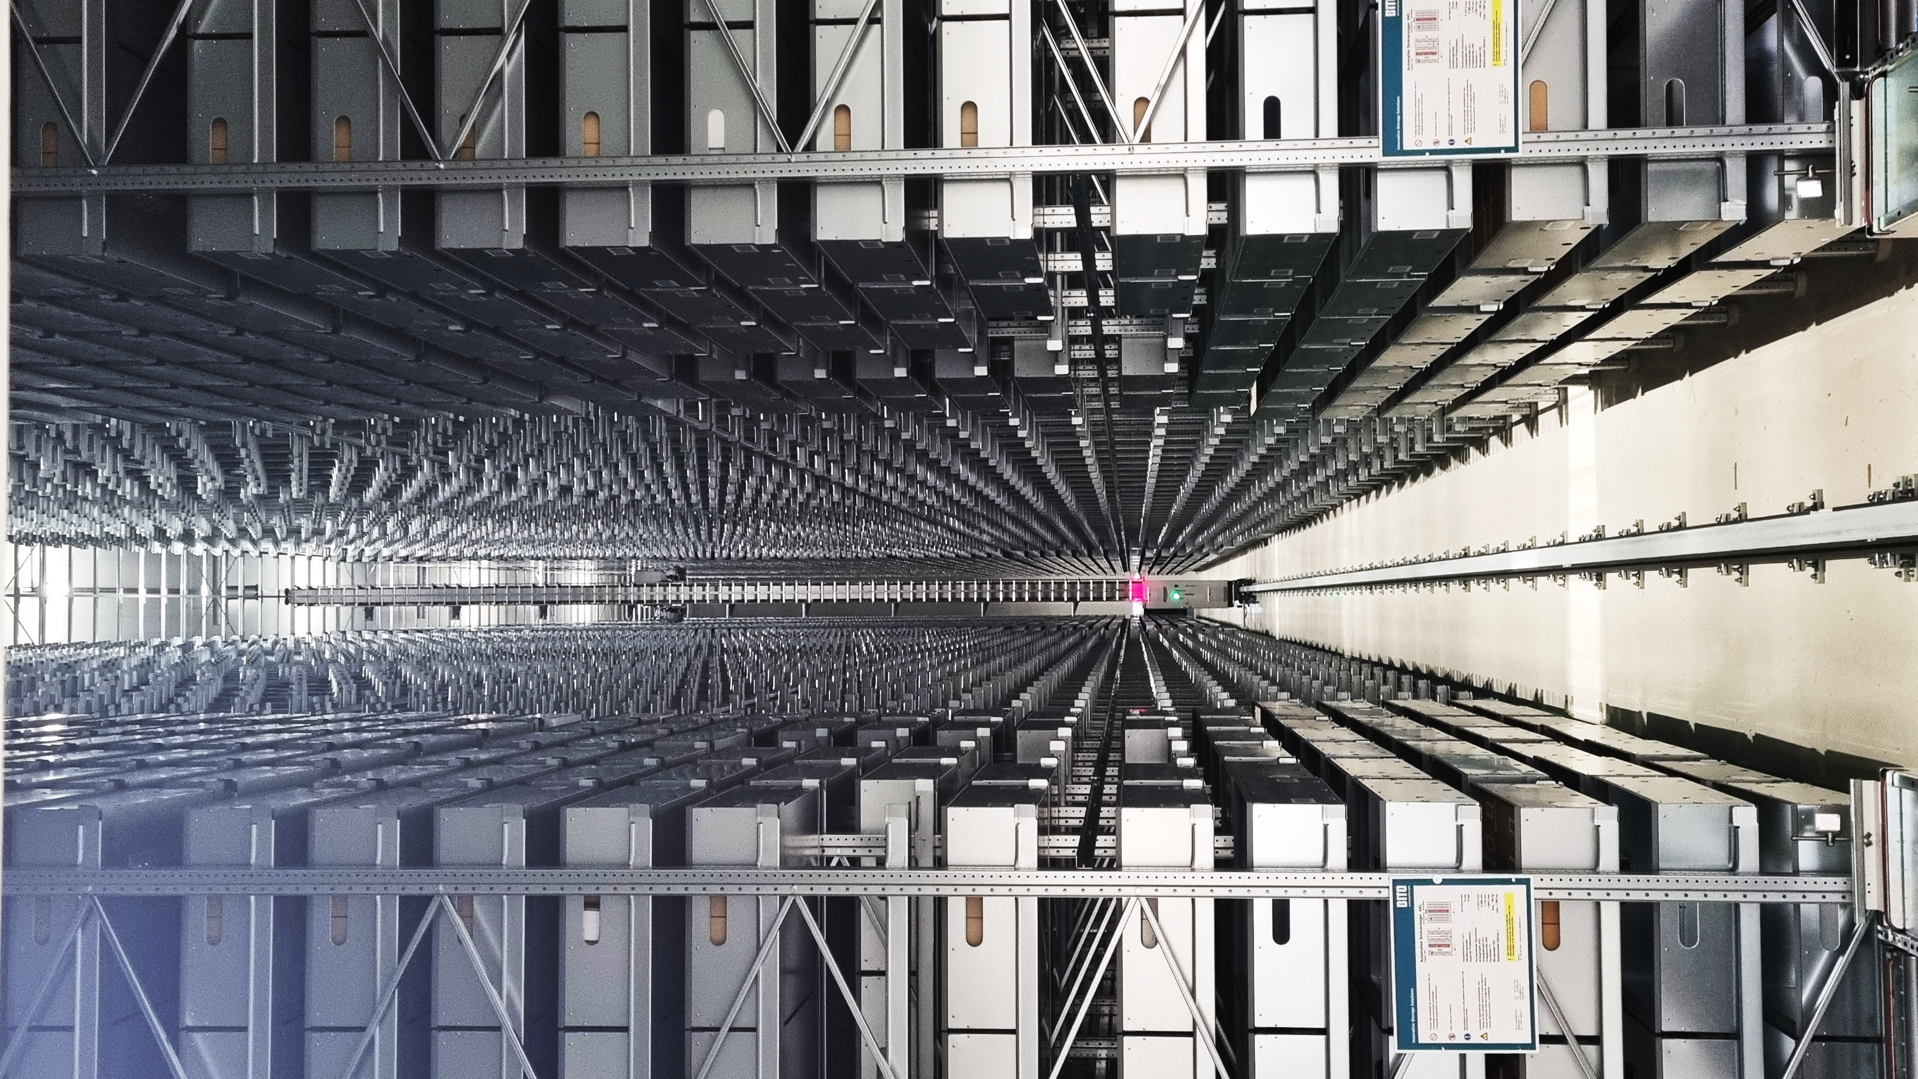
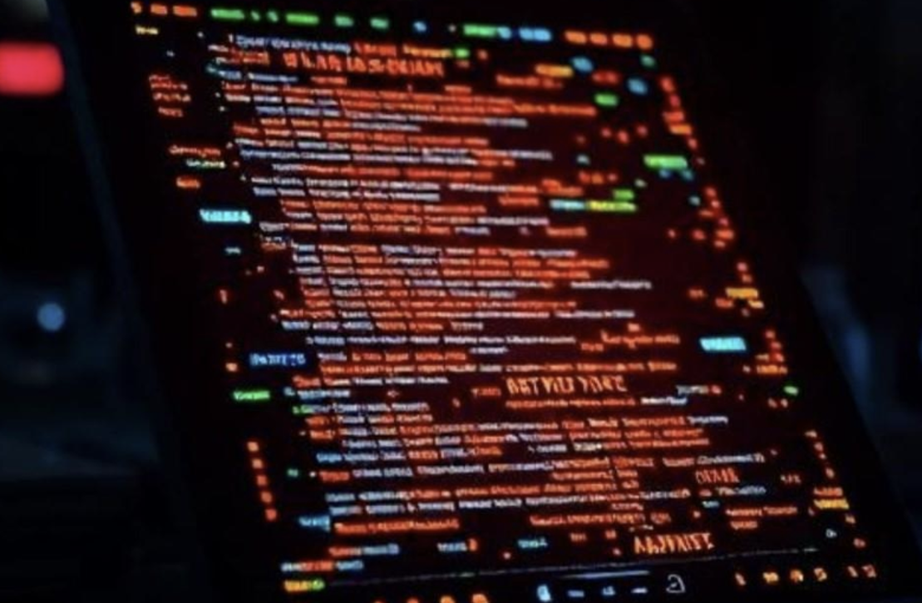

Slide 8
Digitised material
Digitally born material
Harvested web
Databases and repositories
Research data
E-resources

Slide 9
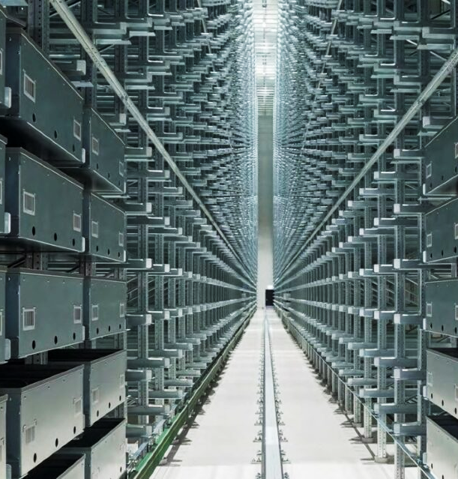
AI4LAM community global impact:
collective power
drives innovation
responsible,
reliable, and
trustworthy AI solutions
development and societal growth.
The Mountain Vault,
Norway National Library,
Mo i Rana, Norway

Slide 10
Why glam data is important?
External Data
(Training!)
(RAG)
Software
-
algorithm
Data
Model
+
=
+
External Data
Llama
Mistral …
=
GLAM DATA!
Digitised / Digitally Born Cultural Heritage
Different Media Types to support user experience (for persons with disabilities etc.)
Natural Language Processing (NLP)
Chatbots
Transcribers
Analytical tools
Recommendation Systems
Virtual Assistants and Onsite Visitor
Translations and exhibition guides
Scientific support (any scientific field)
Industry and tourism
Culture
Education

Slide 11
DATA
Quality data for training, but also external unprocessed data
Dynamic external knowledge retrieval
Research support, automated descriptions …
OPEN DATA!
FAIR DATA!
= integral / = nonintegral part of models
Copyrights: control over data access and use!

Slide 12
GLAM DATA in ai driven digital environment
?
1
4
DATA:
long term storage and preservation
GLAM:
data production,
acquisition, access,
reuse,
source of data
END USERS:
individual, institutions,
industry
6
DATA:
long term storage and preservation
AI FACTORIES:
system infrastructure, development,
training,
deployment of AI models
DATA:
long term storage and preservation
DATA:
long term storage and preservation
DATA STORAGE:
long term preservation
2
EXTERNAL SYSTEMS:
Repositories, digital libraries,
catalogues,
Web,
databases
3
?
Models
7
5
Models
Datasets
?

Slide 13
Why GLAM need safe infrastructure for ai?
AI developed on the market and adopted by GLAM
TESTING, EVALUATION, COMPARISON
FOLLOWING
USERS NEEDS
AND BEHAVIOUR
For internal use:
Like
metadata creation,
enhancing automatization,
support of working processes,
improving accuracy of OCR etc.
For external use:
Like
chatbots and retrieval systems,
research and education,
segmentation of digital data etc.
ADDRESSING
INTERNAL
ISSUES
AI developed by GLAM and used in real-time applications
ADAPTING USER-ORIENTED SERVICES

Slide 14
Examples from practice
AI4LAM institutions:
National Library of Norway
Bibliothèque nationale de France
National Library of Luxembourg

Slide 15
National Library of Norway
TESTING if copyrighted material improves LLM model performance?
NLN AI-lab, Javier de la Rosa et al.

Slide 16
lLM in the health and care services: Norwegian case
The Mímir project and training on copyrighted material
Analysis of the impact of copyrighted material on the linguistic quality of language models.
DATA:
Freely available data
Data with limited access due to rights considerations
Data with limited access due to confidentiality and privacy concerns
Based on presentation of Javier de la Rosa et al., The Impact of Copyrighted Material on Large Language Models: A Norwegian Perspective, IIPC, 2025

Slide 17
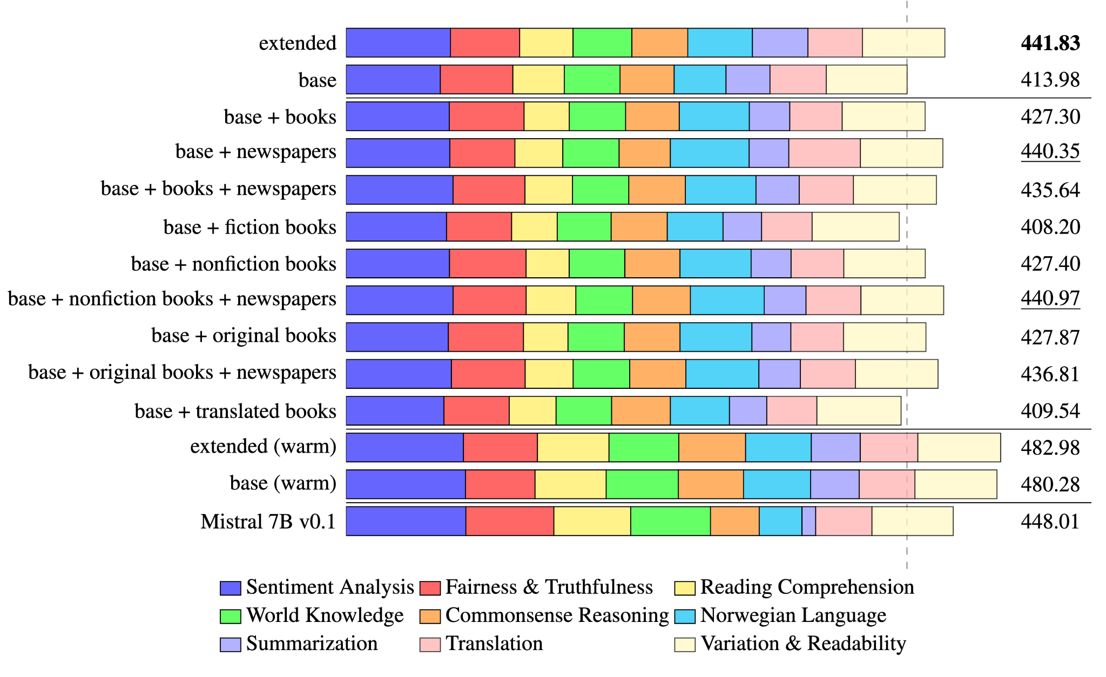
Results
Based on presentation of Javier de la Rosa et al., The Impact of Copyrighted Material on Large Language Models: A Norwegian Perspective, IIPC, 2025

Slide 18
Bibliothèque nationale de France
AI-driven automatic indexing of large-scale iconographic content in Gallica Images
Jean-Philippe Moreux

Slide 19
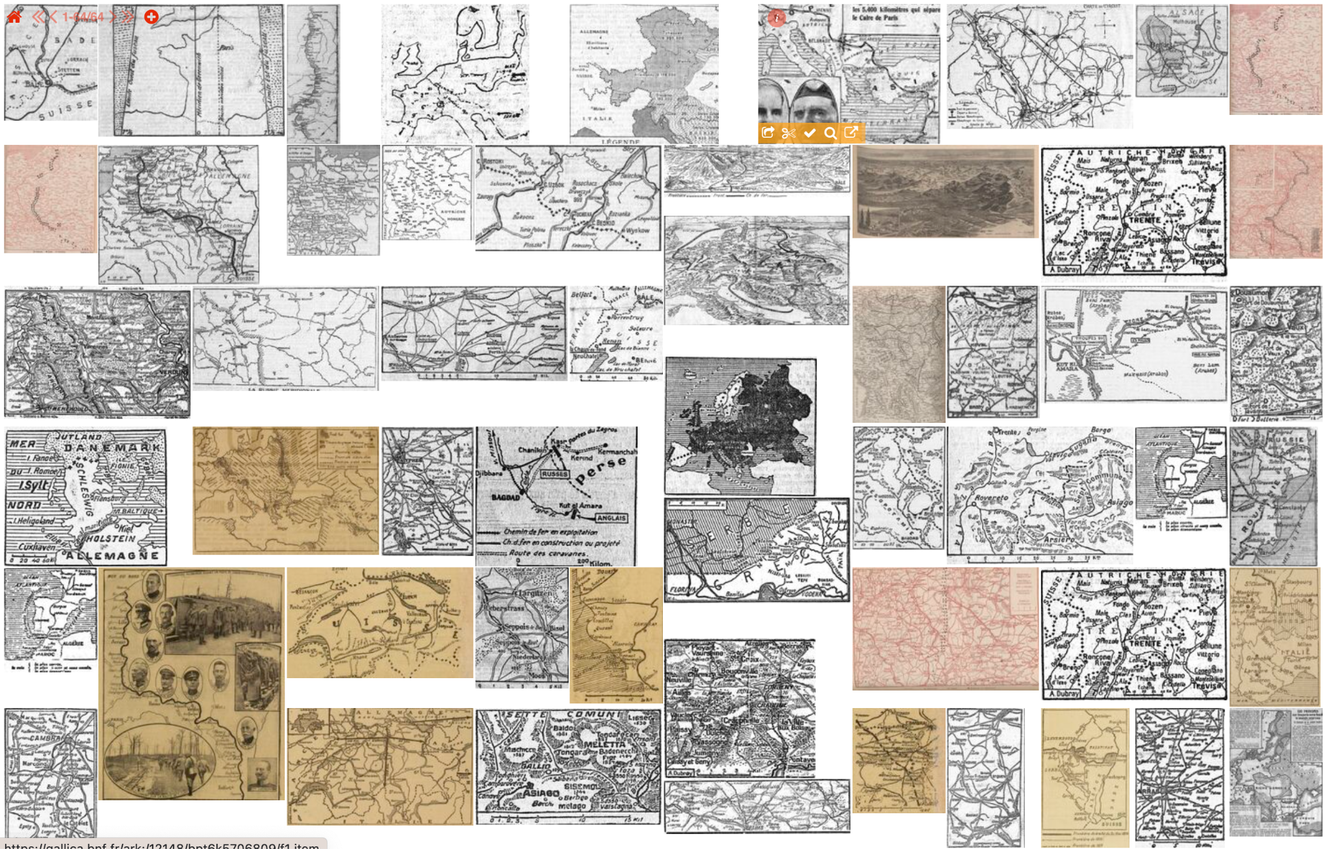
Gallica Images
Gallica Images
Projects
DATA: 50-100M of illustrations
Information retrieval
Classification of heritage images
Visual similarity
Segmentation and rotation
Detection of techniques, functions and genres
Open content: free search and access APIs
Dissemination: IIIF version 3 Gallica APIs
gallicapix.bnf.fr: maps in periodicals (1910-1920)
Based on presentation of Jean-Philippe Moreux, AI@BnF, 2025

Slide 20
National Library of Luxembourg
Chatbot in eLuxemburgensia
Yves Maurer et al.

Slide 22
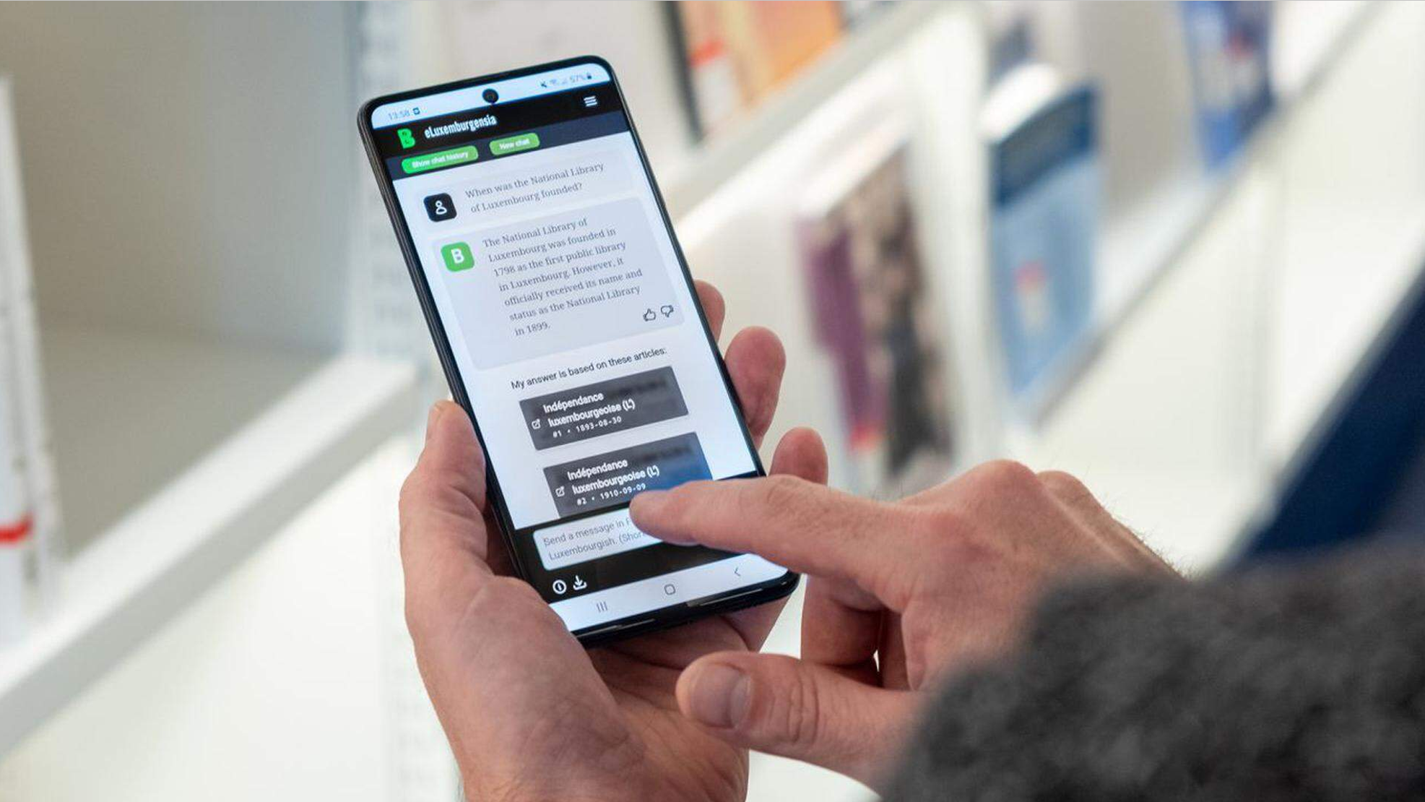

Slide 23
Conclusion
As AI continues to evolve, GLAM institutions have a unique role to:
- shape the digital transformation, and be
- ambassadors of change, fostering a culture of innovation and responsibility.
Cross-sectoral collaboration:
- guiding principle
- collective mindset for the future.
Digital infrastructures support:
- culture & science & education
- efficient workflows, and
- expanded accessibility.
AI4LAM and GÉANT / NRENs collaboration:
Data infrastructure
Knowledge sharing
Building community cooperation
= Innovative future systems

Slide 24
Individually, we are slow and isolated. Together, we can go faster and farther!
Dynamic and Participatory Community
(professional support and openness)
Technology driven AI Organization
(gain solutions)
Cross-Sectoral Open Knowledge Hub
(advance knowledge)
Ethical and Trustworthy Advocacy
(overcome hesitation and opposition )
secretary-general@ai4lam.org

Slide 25
Questions?
Thank you!
Ines Vodopivec
secretary-general@ai4lam.org

