Slide 1
National Technical University of Athens - NTUA
School of Electrical and Computer Engineering
Network Management and Optimal Design Laboratory
Institute of Communication and Computer Systems - ICCS
Explainable AI for DNS Security in Privacy-aware NREN Federations
(FedXAI4DNS)
Dr. Mary Grammatikou, Nikos Bazotis
{mary, nbazotis}@netmode.ntua.gr
TNC25, June 2025 - Brighton, UK

Slide 2
Agenda
Introduction – Contributions
Background
Prototype Baseline
Experimental Assessment
Attention mechanism
Conclusions – Future Work

Slide 3
Introduction
FedXAI4DNS proposes cybersecurity improvements for large-scale networks
Federated Learning (FL)
eXplainable Artificial Intelligence (XAI)
FL and XAI for:
Training Domain Generation Algorithm (DGA) name classifiers in a privacy-aware manner
Interpreting categorizations

Slide 4
Contributions
Binary deep neural networks (Multi-Layer Perceptrons - MLP’s) for benign vs malicious Domain Name System (DNS) traffic classifications
Federated Learning (FL) for collaborative DGA name classifiers without sensitive data exchanges among participants
SHapley Additive exPlanation (SHAP) for interpreting classification decisions in a model-agnostic manner

Slide 5
Background

Slide 6
Domain Generation Algorithms - DGA’s (1/2)
• Bots depend on Command & Control (C&C) servers to
receive orders for attacks
• Bots generate large numbers of DNS requests (most
invalid) based on DGA algorithms with a seeding technique
known to C&C servers
(Image source: Dau Hoang – “An Enhanced Model for DGA Botnet Detection Using Supervised Machine Learning”)

Slide 7
Domain Generation Algorithms - DGA’s (2/2)
Large numbers of requested names (mostly invalid) and frequent DGA seed changes render name blacklists ineffective
DGA names can be detected via Machine Learning (ML) algorithms
(Image source: Dau Hoang – “An Enhanced Model for DGA Botnet Detection Using Supervised Machine Learning”)

Slide 8
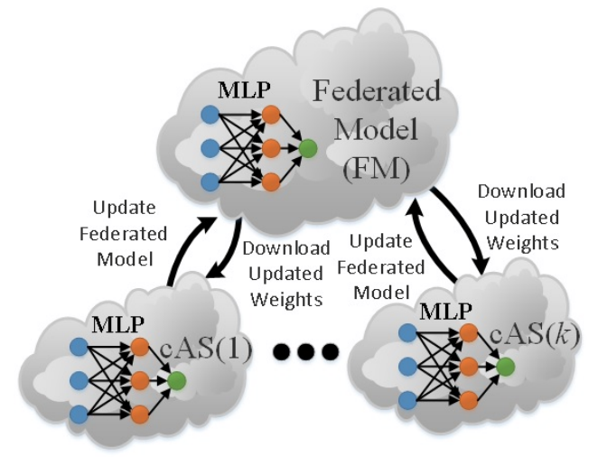
Federated Learning (FL)
Collaborative and privacy-aware ML model development
FL participants (e.g. AS’s) share model weights instead of raw data - No sensitive attack and benign data exchanges - Scalable model development requiring less bandwidth
Federated Averaging: Participant weights are averaged into a global model
- FL rounds: Total times Federated Averaging is performed
- Local epochs: Each participant iteration on the local training dataset
(Image source: Marinos Dimolianis – “DDoS Attack Detection via Privacy-aware Federated Learning and Collaborative Mitigation in Multi-domain Cyber Infrastructures”, IEEE CloudNet 2022)

Slide 9
eXplainable Artificial Intelligence (XAI)
Interpreting decisions of complex (black-box) Machine Learning (ML) models
Our approach relies on model-agnostic, post-hoc XAI methods:
Model-agnostic: Applicable to many ML models (i.e. tree classifiers, neural networks) without modifications
Post-hoc: Applied after model parameter tuning
Model-specific knowledge is not required
Selected model-agnostic method: SHAP

Slide 10
SHapley Additive exPlanation – SHAP
SHAP: Model-agnostic and post-hoc XAI method
SHAP operates on:
eXplainability Background Instances (XBI’s): Used to tune SHAP values (similarly to ML training data)
eXplainability Test Instances (XTI’s): Used to derive interpretations (similarly to ML testing data)
Extending SHAP values to Federated Learning schemas:
Additivity property of SHAP (Interpretable Machine Learning)
SHAP values can be averaged in Federated Learning schemas

Slide 11
Prototype Baseline

Slide 12
Overview
Deployed prototype steps:
Dataset preprocessing
Splitting dataset among FL participants using diverse methods
Training participant models based on their local datasets (i.e. without FL)
Training the global model using FL
Providing SHAP-based XAI interpretations

Slide 13
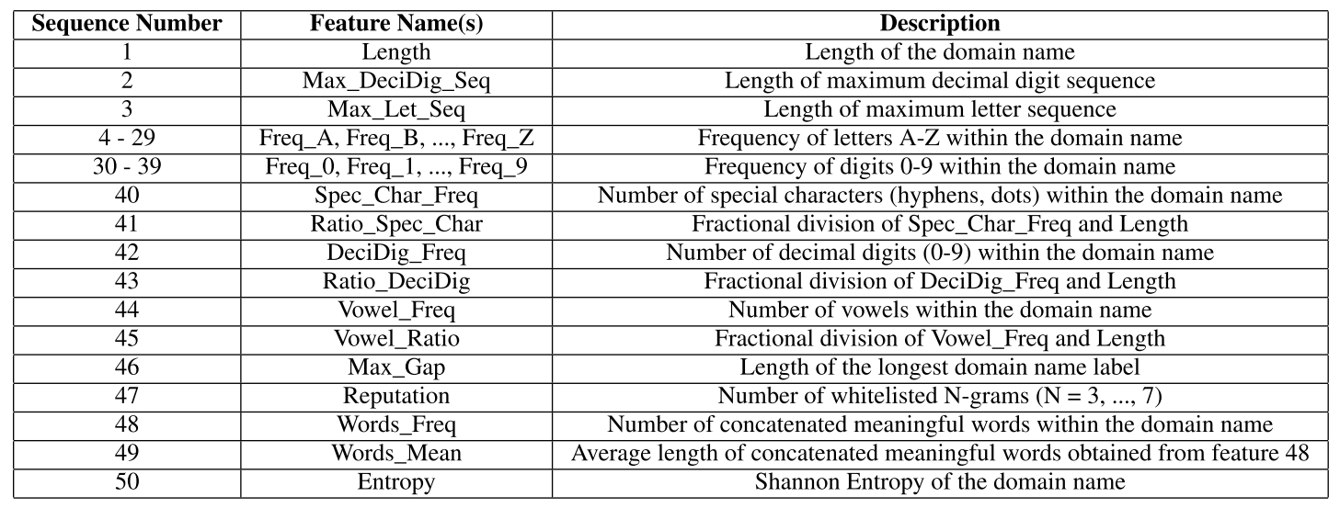
Selected Features
Features are directly extracted from domain name prefixes:
Enabling real-time name classification
Targeting linguistic and statistical name properties
Avoiding time-consuming and privacy-sensitive external repository operations
50 features

Slide 14
Experimental Assessment

Slide 15
Dataset Description
Dataset for training/testing binary MLP classifiers including:
- Malicious (i.e. DGA) names
- Legitimate names
Malicious names → DGArchive Repository
Popular name repository that includes names from over 100 DGA families
675,000 total DGA names and 45 DGA families
Legitimate names → Tranco List
Online service ranking websites based on their popularity
Top 1 million legitimate names were included in the dataset
The combination of these two sources allowed us to build a realistic and diverse dataset, suitable for training robust classifiers

Slide 16
Federated Learning – Dataset Splitting Methods
DGA names:
Three Methods (A, B, C) for distributing DGA names across Federated Learning (FL) participants (e.g. NREN’s)
Legitimate names:
Randomly distributed to participants regardless of methods A, B and C

Slide 17
Dataset Splitting Methods – Method A (1/5)
Method A: DGA names are randomly assigned to FL participants based on a uniform distribution independently of the respective DGA family

Slide 18
Dataset Splitting Methods – Method A (2/5)
Method A: DGA names are randomly assigned to FL participants based on a uniform distribution independently of the respective DGA family
Participant 1
DGA Family 1: Corebot
rauggyguyp.com
zrkdvzjhse.com
DGA Family 2: Simda
gatyfus.com
vowydef.com
Participant 2
...
Participant N

Slide 19
Dataset Splitting Methods – Method A (3/5)
Method A: DGA names are randomly assigned to FL participants based on a uniform distribution independently of the respective DGA family
Participant 1
DGA Family 1: Corebot
rauggyguyp.com
zrkdvzjhse.com
DGA Family 2: Simda
gatyfus.com
vowydef.com
Participant 2
Assigned to Participant 2
with probability 1/N
...
Participant N

Slide 20
Dataset Splitting Methods – Method A (4/5)
Method A: DGA names are randomly assigned to FL participants based on a uniform distribution independently of the respective DGA family
Participant 1
DGA Family 1: Corebot
rauggyguyp.com
zrkdvzjhse.com
DGA Family 2: Simda
gatyfus.com
vowydef.com
Participant 2
...
Participant N

Slide 21
Dataset Splitting Methods – Method A (5/5)
Method A: DGA names are randomly assigned to FL participants based on a uniform distribution independently of the respective DGA family
Participant 1
DGA Family 1: Corebot
rauggyguyp.com
zrkdvzjhse.com
DGA Family 2: Simda
gatyfus.com
vowydef.com
Participant 2
...
Participant N

Slide 22
Dataset Splitting Methods – Method B (1/4)
Method B: A DGA family and all of its respective names are assigned to a single participant (participant selection is based on a uniform distribution)

Slide 23
Dataset Splitting Methods – Method B (2/4)
Method B: A DGA family and all of its respective names are assigned to a single participant (participant selection is based on a uniform distribution)
Participant 1
DGA Family 1: Corebot
rauggyguyp.com
zrkdvzjhse.com
DGA Family 2: Simda
gatyfus.com
vowydef.com
Participant 2
...
Participant N

Slide 24
Dataset Splitting Methods – Method B (3/4)
Method B: A DGA family and all of its respective names are assigned to a single participant (participant selection is based on a uniform distribution)
Participant 1
DGA Family 1: Corebot
rauggyguyp.com
zrkdvzjhse.com
DGA Family 2: Simda
gatyfus.com
vowydef.com
Participant 2
...
All family names assigned to Participant N
Participant N

Slide 25
Dataset Splitting Methods – Method B (4/4)
Method B: A DGA family and all of its respective names are assigned to a single participant (participant selection is based on a uniform distribution)
Participant 1
DGA Family 1: Corebot
rauggyguyp.com
zrkdvzjhse.com
DGA Family 2: Simda
gatyfus.com
vowydef.com
Participant 2
...
Participant N

Slide 26
Dataset Splitting Methods – Method C
Method C: Combination of methods A and B: 50% of DGA families are assigned based on method A and 50% on method B
Participant 1
DGA Family 1: Corebot
rauggyguyp.com
zrkdvzjhse.com
DGA Family 2: Simda
gatyfus.com
vowydef.com
Participant 2
...
Participant N

Slide 27
1. Classification Performance (1/3)
Purpose:
Evaluate Federated Model performance
Assess if FL boosts the performance of individual participants (i.e. models trained without FL)
Performance metric → ML model accuracy on testing dataset
- True Positives: Correctly classified DGA names
- True Negatives: Correctly classified legitimate names
$$Accuracy= \frac{True Positives+True Negatives}{All Testing Dataset Names}$$

Slide 28
1. Classification Performance (2/3)
Purpose:
Evaluate Federated Model performance
Assess if FL boosts the performance of individual participants (i.e. models trained without FL)
ML model specifications
- Deep neural networks: Multi-Layer Perceptron (MLP)
- 3 hidden layers (300, 300, 200 neurons)
- Common architecture for the federated and individual participant models
Best classifier determined based on Grid Search

Slide 29
1. Classification Performance (3/3)
Purpose:
Evaluate Federated Model performance
Assess if FL boosts the performance of individual participants (i.e. models trained without FL)
Number of FL participants
- Experiments including 5 individual participants
- Applicable to NREN collaborations
FL specifications
30 federated rounds
5 local epochs
Non-FL Specifications
Participant models trained in 100 epochs

Slide 30
1. Accuracy Assessment – 5 FL Participants
Charts for methods A, B and C
Federated Model Accuracy:
A: 92.65%
B: 80.32%
C: 90.43%
A
- FL boosts the accuracy of most participants
- Method B: Disjoint learning sets among participants → Less accurate Federated Model than methods A and C
B
C
Black bars: With FL
Grey bars: Without FL

Slide 31
2. Model Interpretations (1/2)
Purpose:
Derive SHAP values for Machine Learning model to assess feature contributions to classification decisions

Slide 32
2. Model Interpretations (2/2)
SHAP values:
- Negative SHAP values point to class 0: Non-DGA names
- Positive SHAP values point to class 1: DGA names
XAI samples:
- 50 eXplainability Background Instances (XBI’s): Cluster centroids from K-Means execution on the training set
- 250 eXplainability Test Instances (XTI’s): Subsampled from the testing set sample
Model interpretations are based on SHAP summary plots

Slide 33
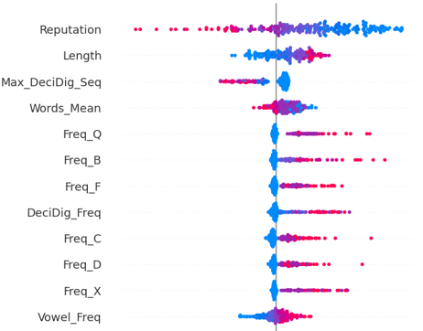
2. MLP Interpretations based on Summary Plots
Summary plots:
Top contributing features ranked in descending order
Plot dots: eXplainability Test Instances (XTI’s) from 45 DGA families
Color shades: Low → High feature values
Indicative interpretation:
- Large Length feature values are indicated by red XTI’s (plot dots)
- Red XTI’s have positive SHAP values → they point to class 1 (class of DGA names)
- Long names favor DGA name classifications as expected

Slide 34
Bringing Focus to MLPs: Enhancing Interpretability with Attention

Slide 35
Integrating MLPs with Attention mechanism
Attention mechanisms: known for their ability to capture meaningful relationships and dependencies among input features
Benefits:
Enhancing the model’s ability to extract valuable insights
Improve overall performance
Attention mechanism: Multi-head Attention

Slide 36
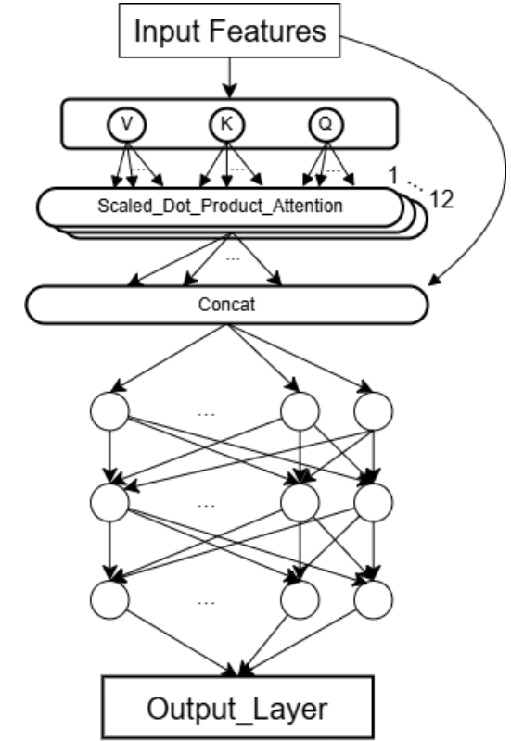
Overview
Dataset preprocessing (same)
MLP architecture: Attention mechanism added →
Training on - DGA names - legitimate names - Single agent approach applied (Non-Federated)
Providing SHAP-based XAI interpretations

Slide 37
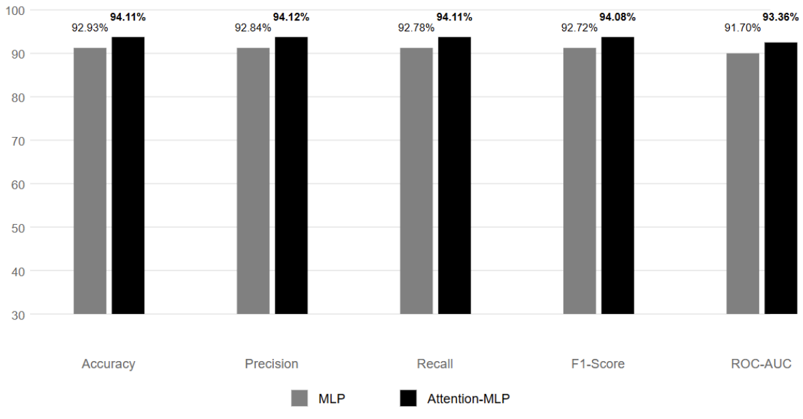
1. Classification Performance
Performance comparison between baseline MLP and Attention-MLP models across multiple metrics
NOTE: Both the MLP and Attention-MLP are trained and evaluated as standalone models, without a federated approach in either case
Accuracy increase (92.93% → 94.11%), demonstrates enhanced ability to detect and classify DGA domains
Attention mechanism improves the performance across all metrics

Slide 38
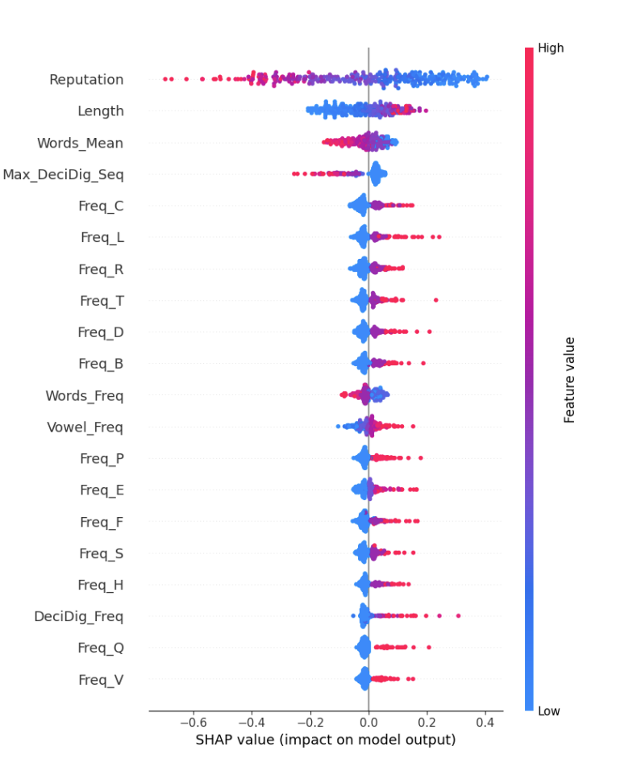
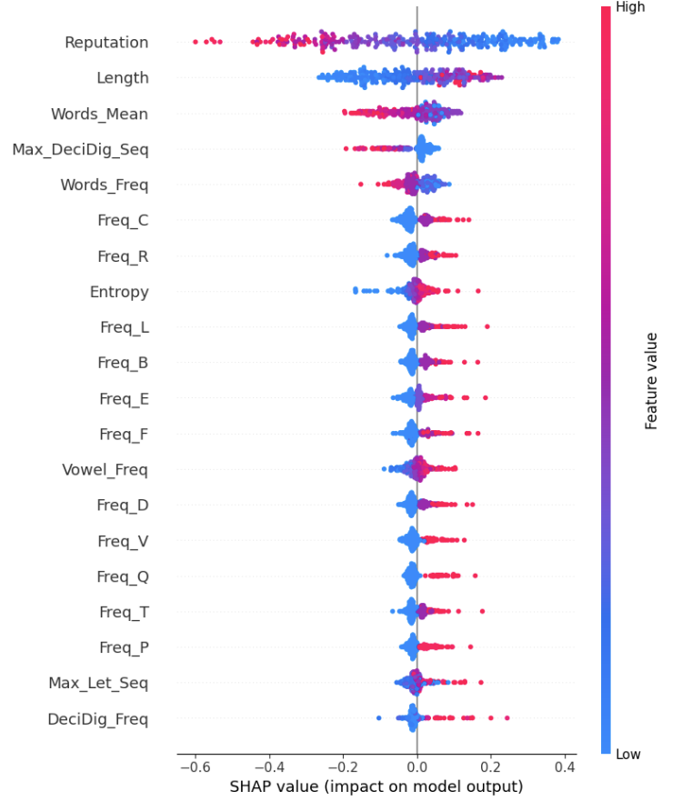
2. Model Interpretations based on Summary Plots
MLP
Attention - MLP
- Similar feature rankings appear in the top tier across both models
- Entropy and Max_Let_Seq do not appear in the MLP’s top 20 features, while they are ranked higher in the Attention-MLP
- Words_Freq is present in both models but is ranked 11th in MLP and 5th in Attention-MLP

Slide 39
Key Takeaways
Federated Learning is promising for collaboratively developing accurate DGA name classifiers without exchanging sensitive attack and benign data
SHAP is a promising technique for interpreting the operation of ML-based security mechanisms that filter malicious DNS messages
Attention mechanisms show potential for enhancing MLPs by improving both performance and the ability to extract meaningful insights from domain name features.
Future Work: Federated Learning methods to be applied in NREN collaborations

Slide 40
THANK YOU!
fedxai4dns@netmode.ntua.gr
Project implementation available from: https://github.com/netmode/FedXAI4DNS

