Slide 1
What’s in the head of a network architect?
Rob Evans

Slide 2
Who am I?
A network architect!
Working on the Janet network since 1999

Slide 3
What the NOC thinks I do

Slide 4
Step 1

Slide 5
Step 2

Slide 6
Step 3
Photo by kazuend on Unsplash

Slide 7
What I think I do

Slide 8
Let’s start from the very beginning…
A very good place to start
Why am I having to work?
Apart from food and shelter
New customer requirement
End of life of existing equipment
Capacity growth
Are the expectations realistic?
Is there a risk they are over-estimating need?
Maybe even under-estimating
One day it might happen

Slide 9
Fibre
Handover document for fibre currently being used on the network
25 years old, 25 splices on the span.
~ when I joined the Janet NOC.
1 GE metro circuits were new.
“Oops, I did it again” top of the charts*
Can the same fibre cope with 16-way QAM and 28Tbps?
Should we be looking at newer G.652, or G.657?
(*) Christmas Nº 1 in the UK was Bob the Builder with “Can We Fix it?”

Slide 10
Do I need to be replacing our fibre entirely?
SDM?
Hollow core fibre?
CC BY 4.0: Optical Switching in Future Fiber-Optic Networks Utilizing Spectral and Spatial Degrees of Freedom - Scientific Figure on ResearchGate. Available from: https://www.researchgate.net/figure/Channel-switching-options-for-an-ingress-SDM-WDM-optical-fiber-of-an-optical-network_fig4_365099707
U. Nasti, H. Sakr, I. Davidson, F. Poletti, and R. Donaldson, "Utilizing broadband wavelength-division multiplexing capabilities of hollow-core fiber for&#x00A0;quantum communications," Appl. Opt. 61, 8959-8966 (2022). CC-BY-4.0

Slide 11
Transmission equipment
Carry on as before…
…or put DWDM into the routers?
Notes:
Transmission considerations.
50GHz, then flexgrid, 100GHz for 400G. 150GHz for 800G.

Slide 12
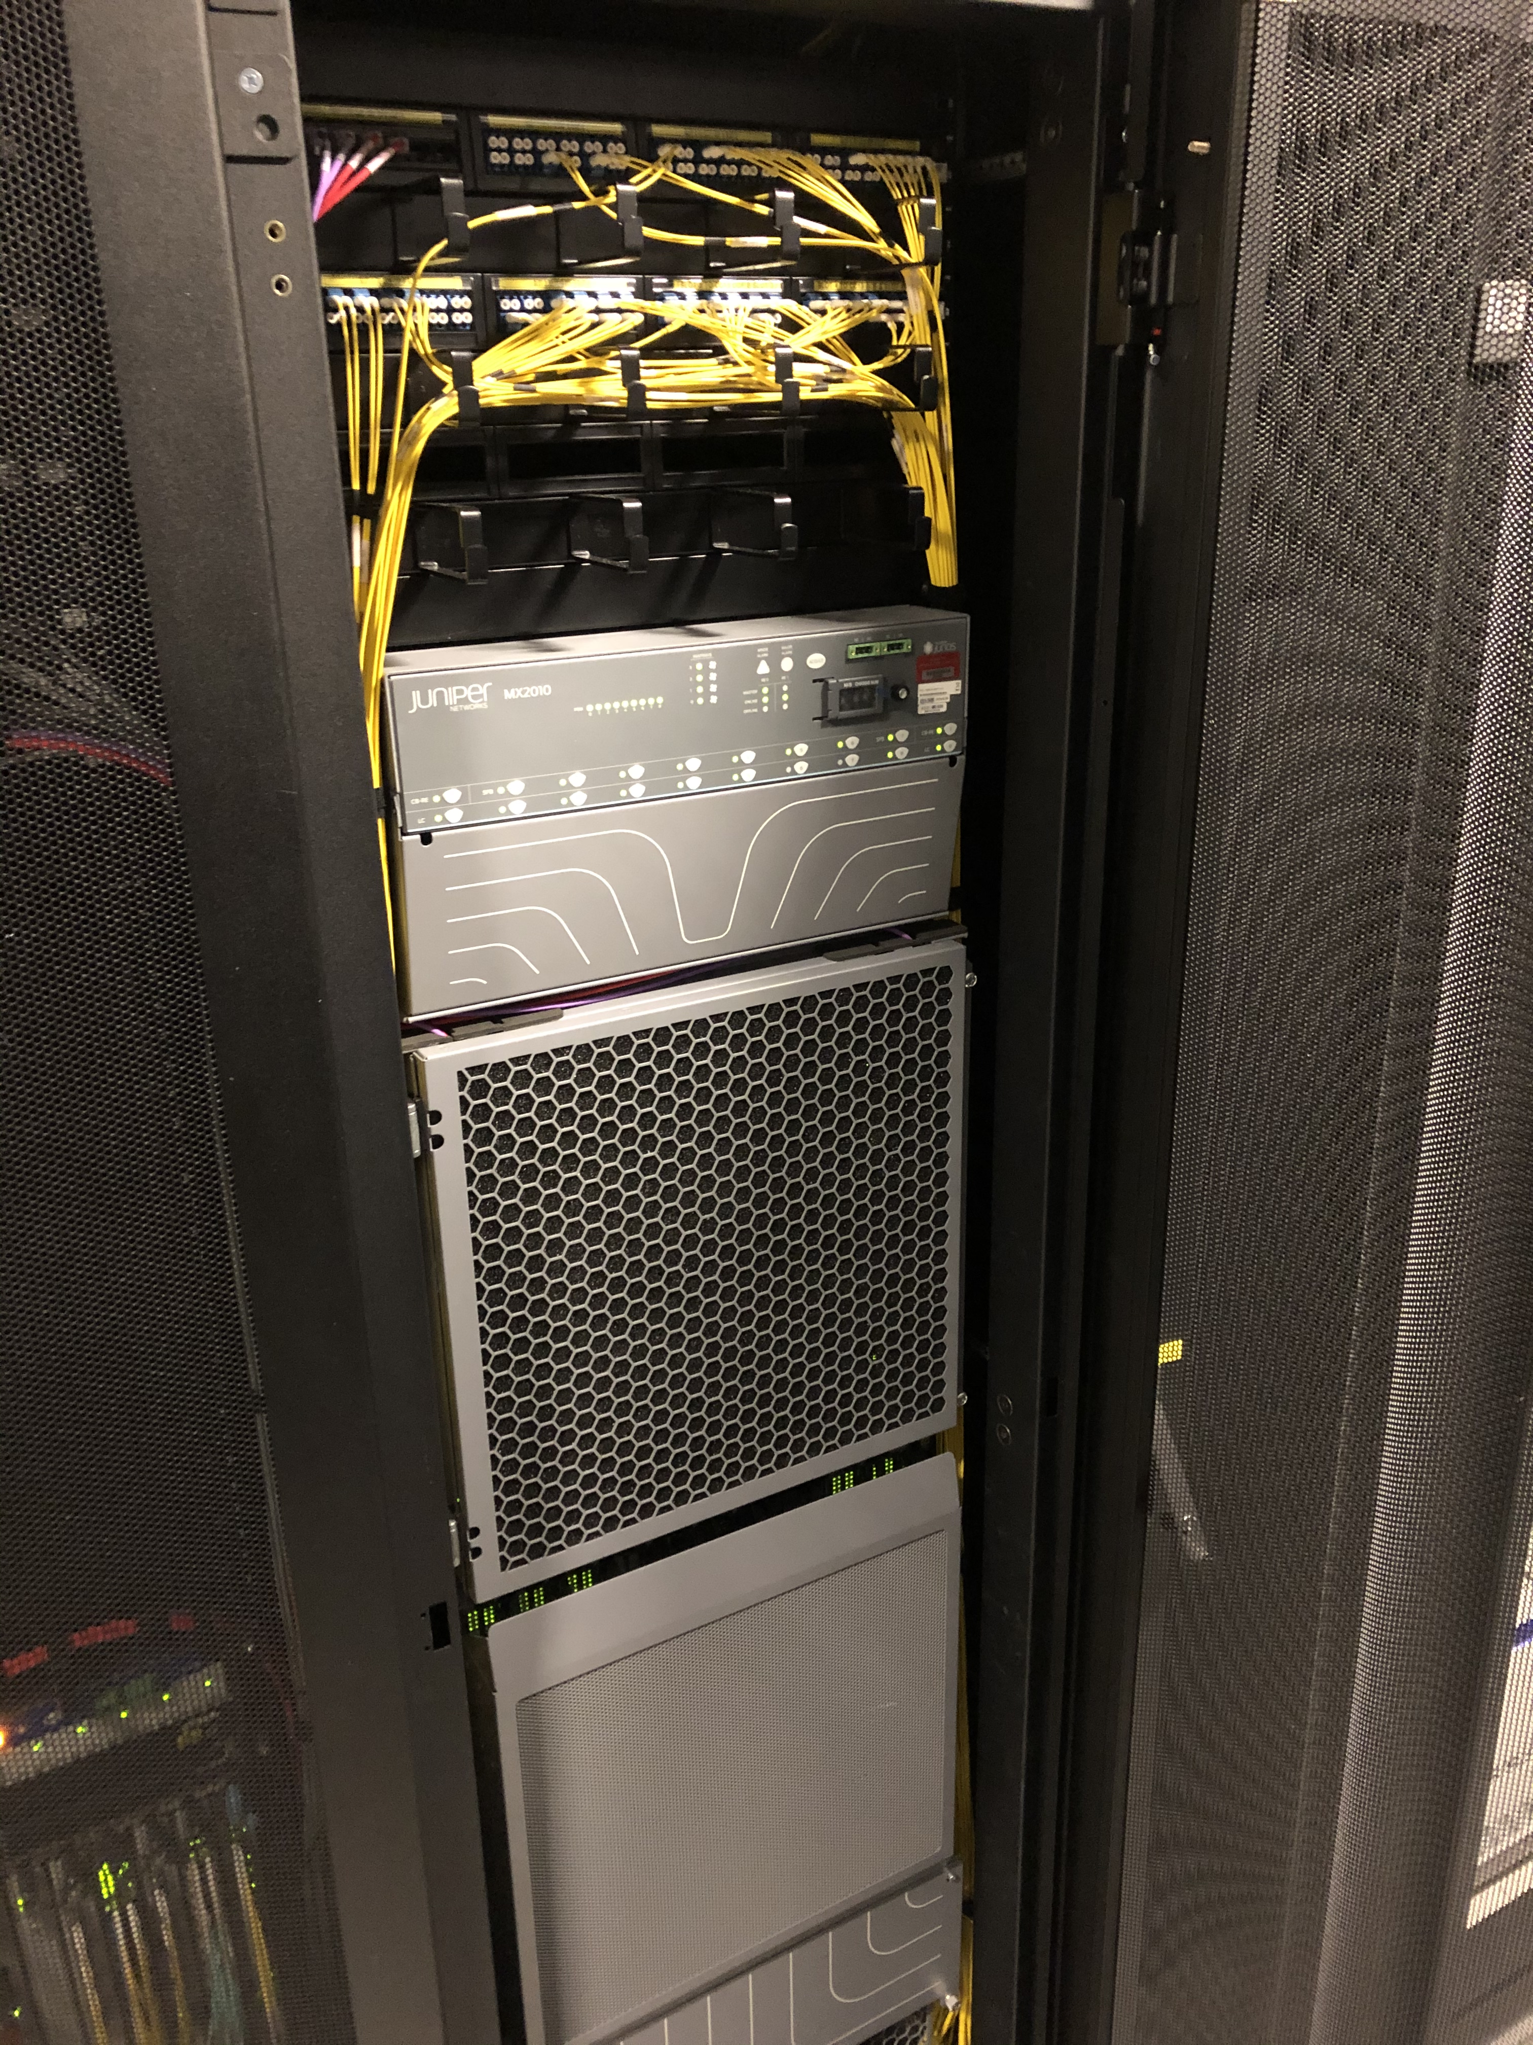
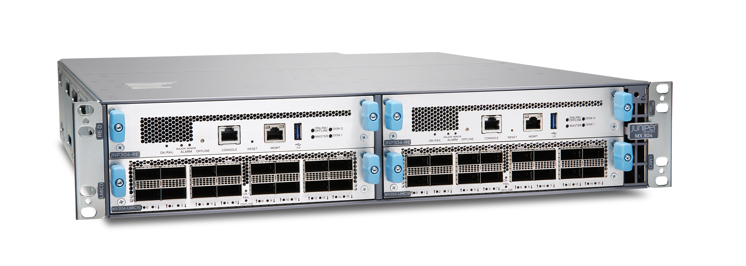
At least routers haven’t changed much…

Slide 13
Oh, the routers
They grow, they shrink, but they do much the same, right?
Merchant silicon or custom silicon?
If we lock into features baked into silicon now, are we locking the services we can offer?
FIB size?
Segment Routing? SRv6?
Netflow?
Have we mentioned security yet?
Queuing? Expandability! Resilience
Licensing.

Slide 14
It’s 2025
What do you mean your service doesn’t support IPv6?
You need an IPv4 address per customer?
Multiple publicly routable IPv4 addresses per customer?
CC BY 2.0 Phil Benchoff https://www.flickr.com/photos/n3pb/8765646099/in/album-72157634324914351
Notes:
Two recent examples of services that require an IPv4 address per customer site connected to it. In both cases the service owners were predicting thousands of customers per service.

Slide 15
Where is the traffic coming from?
What’s that? It’s going to be the largest single source of traffic since the invention of the Internet?
What networks is it connected to?
'Deluge’ by Ivan Aivazovsky. Public Domain.

Slide 16
Regulations and Standards
CC-BY-SA 4.0 Mattia Luigi Nappi https://commons.wikimedia.org/wiki/File:Decreti_originali_per_mese,_1857_-_Grande_Archivio_di_Stato,_Napoli.jpg

Slide 17
Carbon footprint
CC-BY-SA 2.0 Dave Price / Aerial view from Paramotor of Didcot Power Station https://www.geograph.org.uk/photo/305618

Slide 18
Automation
Reproduction of image in the public domain. https://commons.wikimedia.org/wiki/File:Racknitz_-_The_Turk_1.jpg

Slide 19
Legacy
CC BY-SA 2.0 https://flickr.com/photos/37996649474@N01/51333327030
Notes:
Transmission systems
Legacy architectures

Slide 20
Security
We were designing security in from the start, right?
Photo by Stephen Harlan on Unsplash
Notes:
Transmission systems
Legacy architectures

Slide 21
How do we buy it?
That’s the technical stuff out of the way, that was easy.
How much?
What are the procurement means to buy it?
125 days lead-time you say?
Photo by Wonderlane on Unsplash

Slide 22
To sum it all up…
Despite the fact that I’m ‘internetplumber’ wherever I could grab the username…
…it’s more than just plumbing.
…but a plumber would (rightly) say that too.
CC BY-SA 2.0. Andy Beecroft. https://www.geograph.org.uk/photo/4188136

Slide 23
Thank you
Rob Evans
Chief network architect
Rob.Evans@jisc.ac.uk

