Slide 1
Researcher Identity – it’s all about attributes, not authentication
John Scullen – Head, T&I Strategy & Futures, Australian Access Federation
Scott Koranda – Senior Research Scientist (NCSA), University of Illinois

Slide 2
Revelation 2:17
… and I will give him a white stone, with a new name written on the stone that no one knows except the one who receives it.

Slide 3
Agenda
Project overview
Incorrect assumptions
Wins – some ideas you might want to steal
Demos
User interface – stock REMS vs customized
Manage terms and conditions / acceptable use policy agreement
Transparent enrolment
External data sources
Link your ORCiD flow
Custom OIDC claims for training

Slide 4
The Problem
Researchers can spend months of their project finding data relevant to their research question, submitting a data access request, and waiting for a response
Relevance of restricted datasets is unknown until the data is obtained (can be a lot of work for little result)
The request process is largely email-based – little transparency about current state to the requestor or the Data Access Committee (DAC)

Slide 5
The Five Safes
SAFE
Projects
􀈮
SAFE
Data
􀨪
SAFE
People
􀉬
Popular in UK, AU and NZ (especially in government)
A framework, not a technical solution
SAFE
Outputs
􂆏
SAFE
Settings
􀣌
Notes:
Given today’s setting we can refer to these as the “Holy Quinity”
CADRE project mainly addresses the first two (highlight)

Slide 6
The Idea
Can we link enough data points about researchers and the project to have sufficient confidence to streamline the DAC approval process and potentially automate data release?
CADRE: Coordinated Access for Data, Research and Environments
a platform designed to help share sensitive research data.
make data access easier and more consistent
a decision support system employing the Five Safes principles (especially safe projects and safe people)
Notes:
REMS (CSC Finland) became a major building block for CADRE (after initially planning to build their own system)

Slide 7
AAF
Name
Email address
Home organisation
Affiliation
Identity assurance (REFEDS RAF)
Authentication assurance (REFEDS MFA)
ORCiD
ORCiD ID (via OAuth flow to link)
CADRE + external data sources
Training credentials (safe data management, roles & responsibilities)
Research Graph
Public data linked with ORCiD record
Safety Threshold

Slide 8
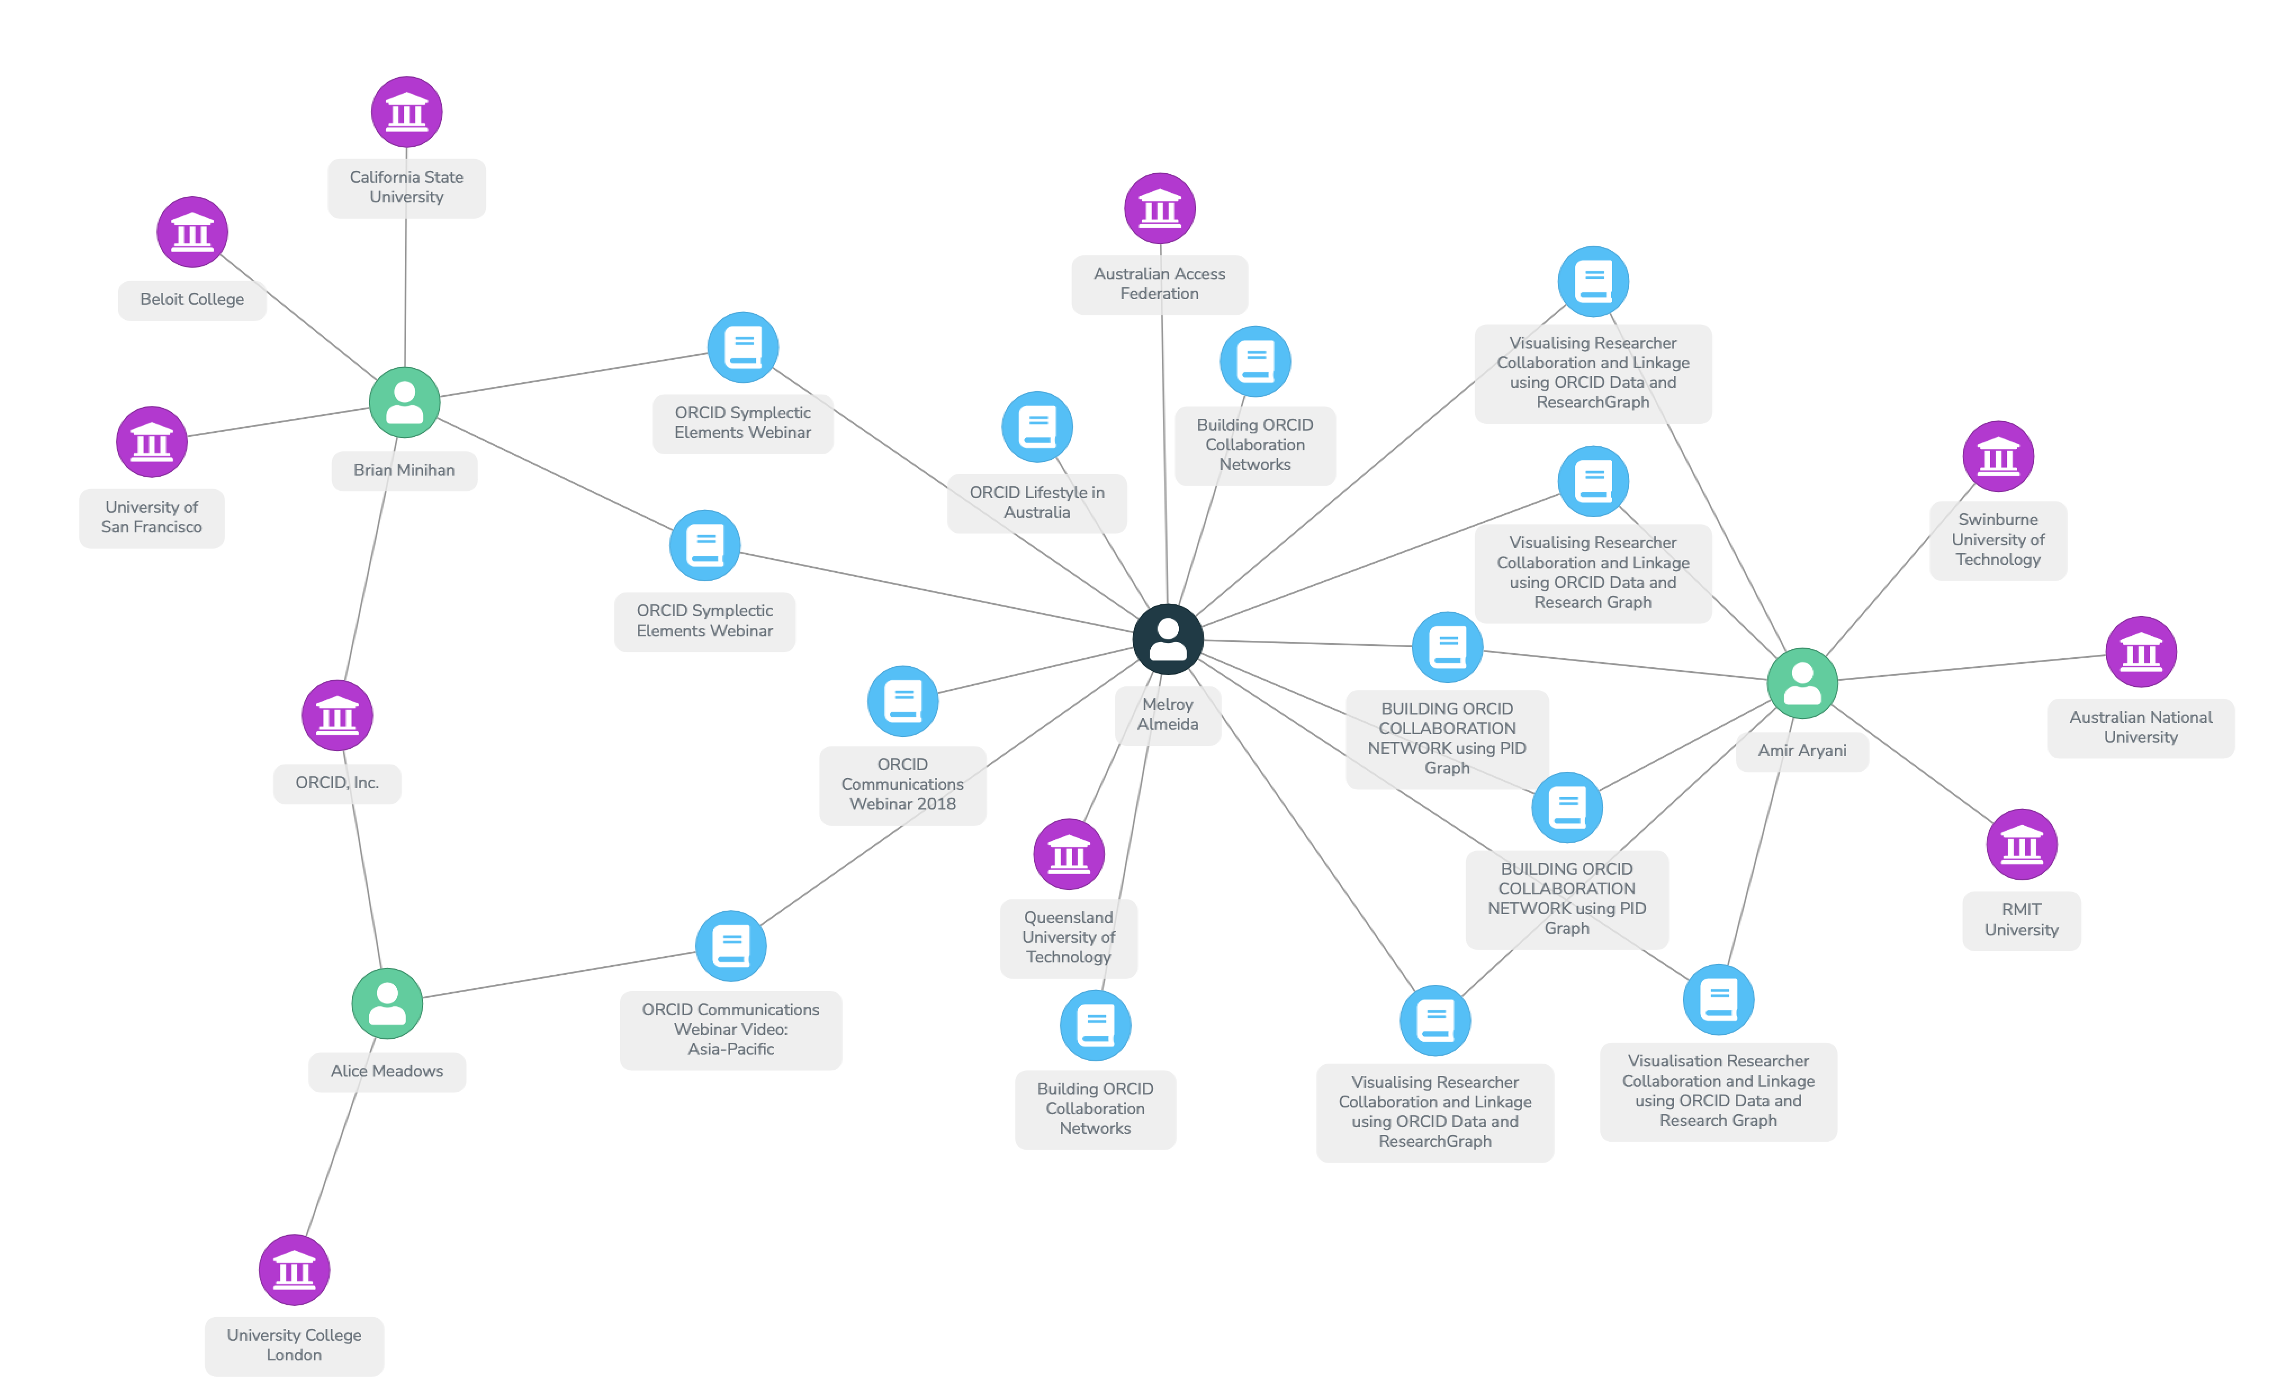
Research Graph
Uses PID Graph by DataCite – connects PID metadata
Similar to OpenAIRE Graph
https://researchgraph.org
Notes:
Relies on PID Graph by DataCite
Also OpenAIRE Graph
Demo: https://researchgraph.team/siri/

Slide 9
Expectations vs Reality
Expectation 􀆮
Reality 􀇟
All users will come through AAF
Many government and other users aren’t connected to AAF. Unsuccessful discussions about connecting government to AAF.
So, we can use Google / GitHub / ORCiD for everyone else, right…?
These IdPs release few attributes. Limited use beyond basic authentication.
OK, so we can add some extra workflow steps to validate these users
No one wants to manage accounts. Communities want users to be validated automagically.
Everyone will bring an identity so we won’t need a community IdP
Some users can’t / won’t use a federated id. We still need to provide an IdPoLR ☹

Slide 10
Discoveries
ORCiD is not a magic bullet
not helpful if the user chooses not release their email address
ORCiD frowns on encouraging users to release their email address
for CADRE, ORCiD is now in the same trust bucket as Google, Microsoft and GitHub
valuable as an attribute authority
Many more non .edu.au users than expected (roughly 50%)
Australian Government not interested in ORCiD since publications are not attributed to individuals
Shift from user registration and approval flow > transparent enrolment
AARC policy work is hard
Notes:
Researchers don’t care a whole lot about policies
The policy kit is complex and something of a tough sell

Slide 12
Transparent Enrolment
Standard flows:
invitation
sign up (with optional approval)
Requires a priori knowledge of who makes up the community
Transparent Enrolment
user is automatically registered to the AAI (with basic information) using attributes supplied by the login provider
stub identity is extended with more detail as required (e.g. when submitting a data access request)
reduces administration by community managers
Notes:
- Users encouraged to link their ORCiD before submitting a data access request. Faster processing of users who supply an ORCiD.

Slide 13
Architecture
CADRE Guest Users
AAF
􀉪
Transparent
Enrolment
External Services
Front End
(React)
Research Graph
Groups
RAiD
Link & Unlink ORCiD
Dataverse provisioner
Moodle
CADRE REMS (Admin and APIs)
MIDL
ANU Dataverse
DOI Service
CADRE Dataverse

Slide 14
Wins
Link your ORCiD OAuth flow
easy to implement
reliable binding of user with ORCiD
others have since adopted this idea
Transparent enrolment
Dataverse provisioner
new CILogon plugin to provision and update user via Dataverse API
specific to CADRE requirements but could be generalised
https://github.com/cilogon/DataverseProvisioner
Recognition of the need for a scalable national IdP of last resort
eduID style service
Makes no sense for every research community to set up and manage their own IdP
Interest in connecting more data holders to the CADRE platform
Notes:
There was skepticism about CADRE but that vanished pretty quickly once people saw it in action. Now others want to join in.
Demonstrable services are (even if limited) get more traction than impressive sounding vapourware.

Slide 15
Demos
UI – stock REMS vs CADRE
transparent enrolment – stub identity and build out as needed
manage terms and conditions / acceptable use policy agreement
Link your ORCiD flow
Data sharing requests
centralised group management
provisioning users and groups to Dataverse
Training records
custom OIDC claims

Slide 16
Stock REMS Application

Slide 18
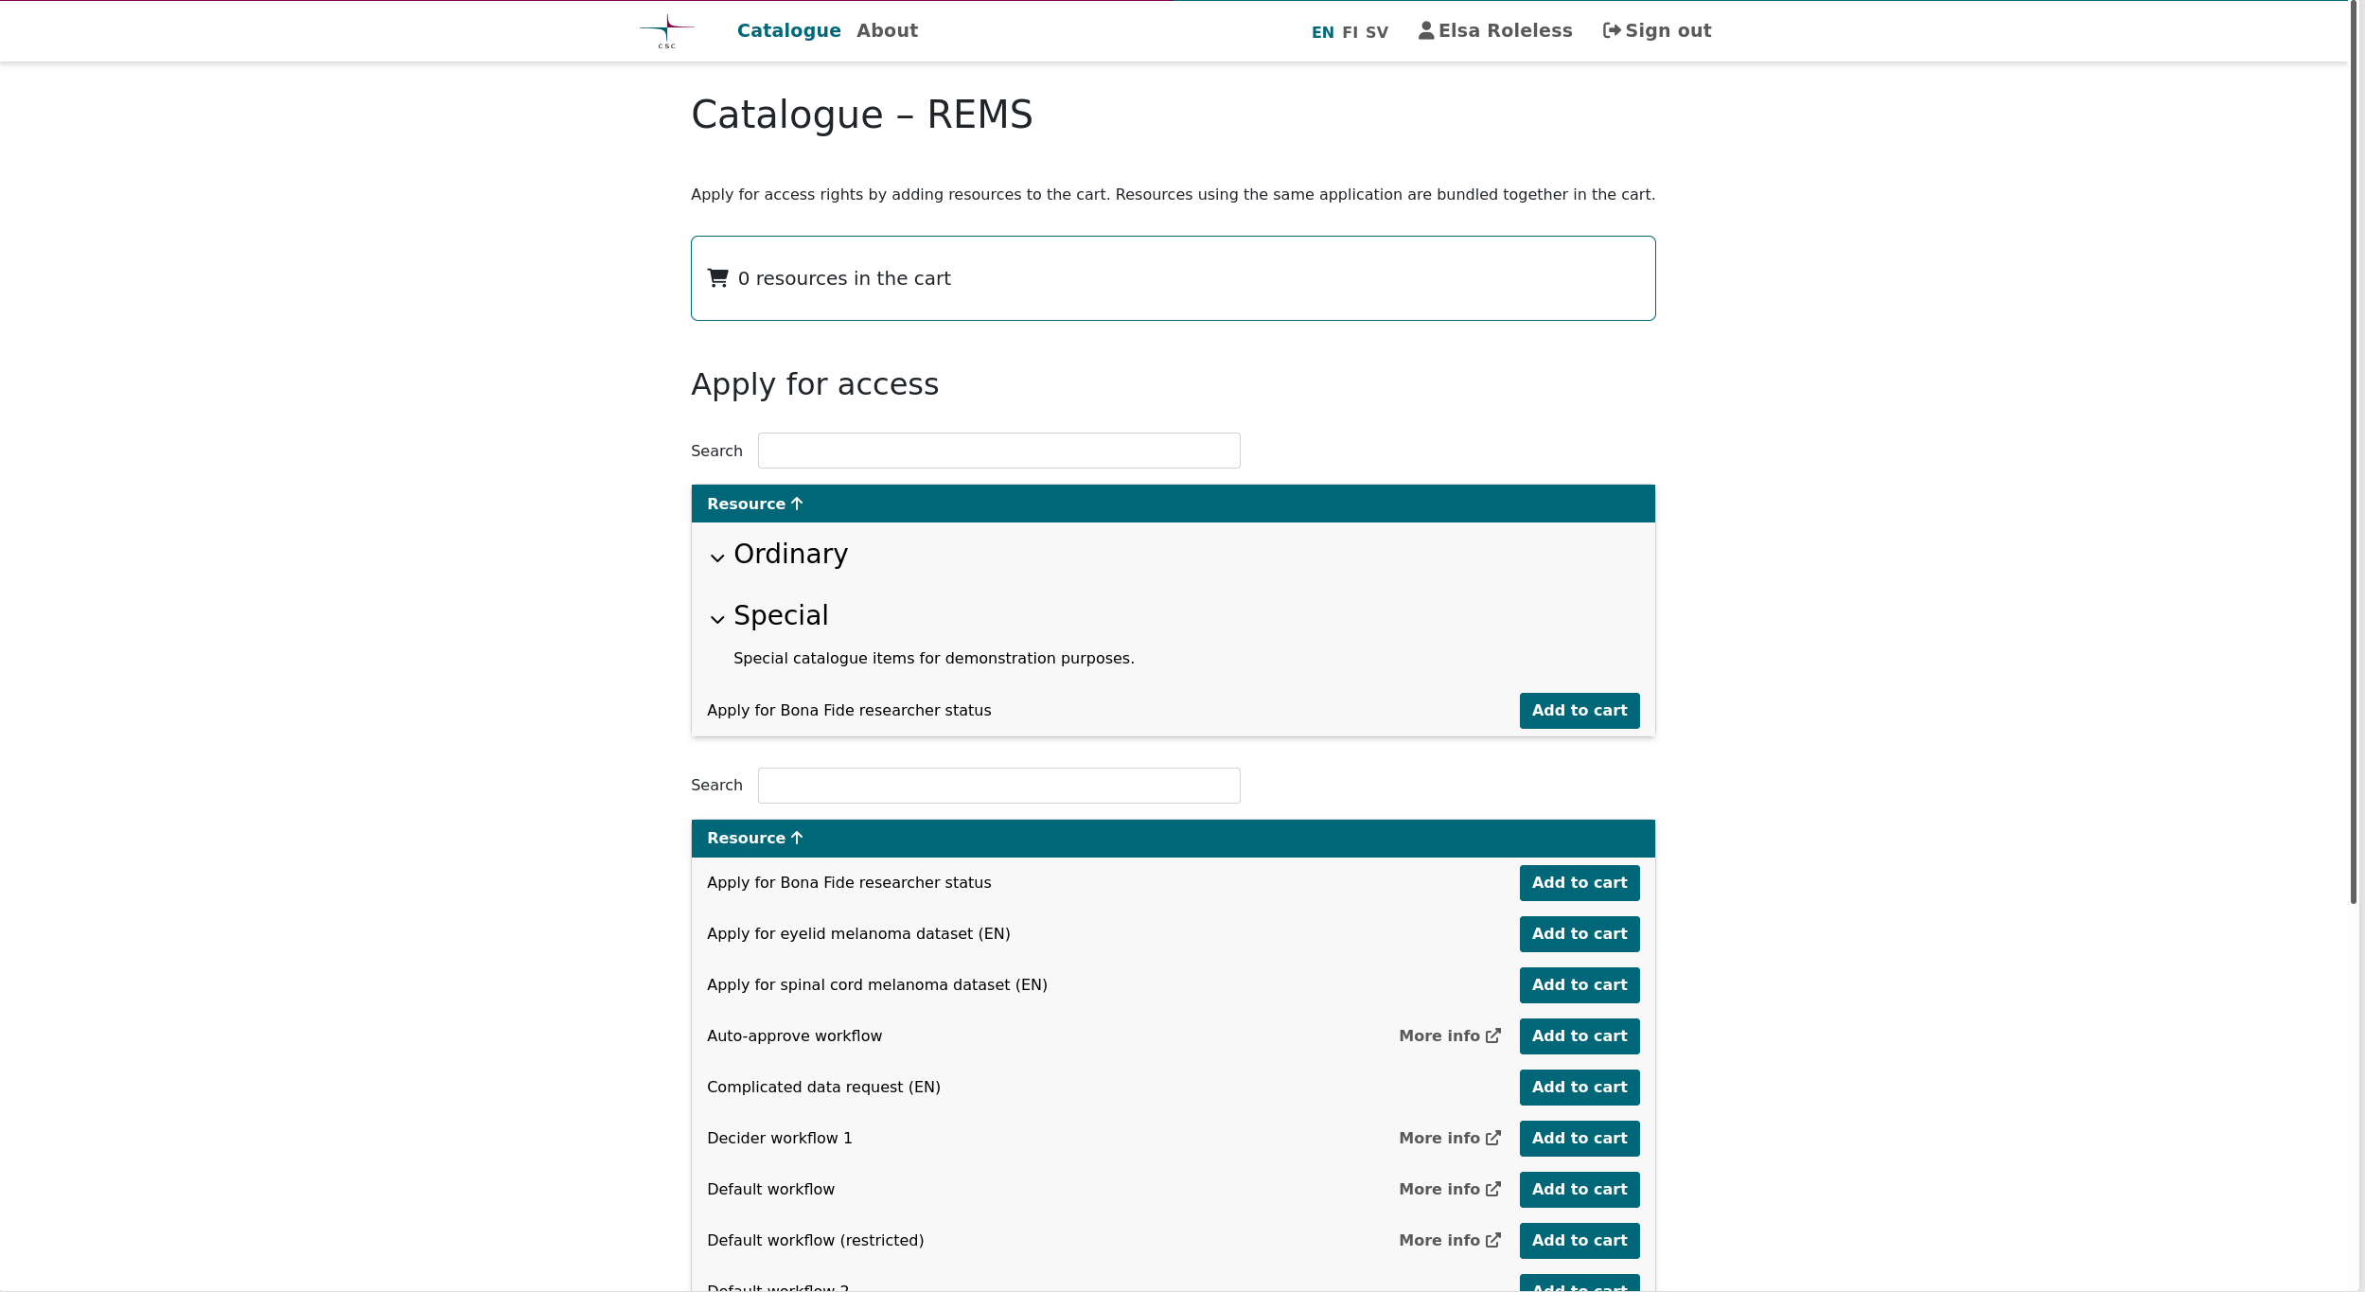

Slide 19
CADRE Custom REMS Front End
Transparent Enrolment
Terms and Conditions/AUP

Slide 21
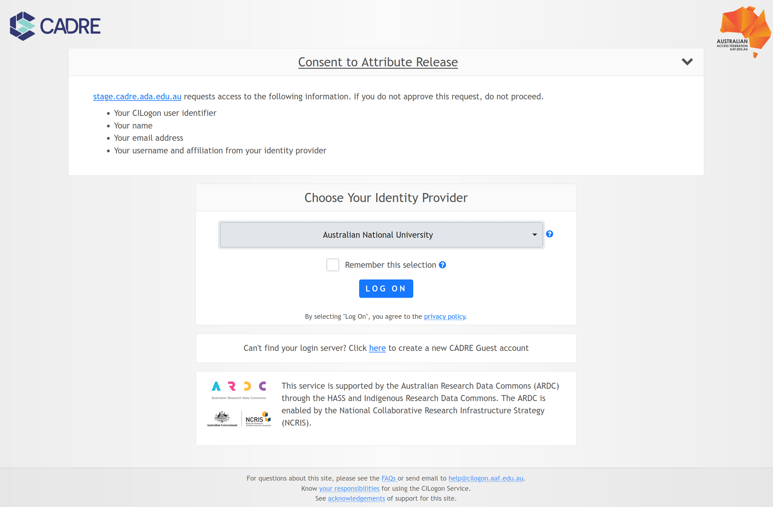

Slide 22
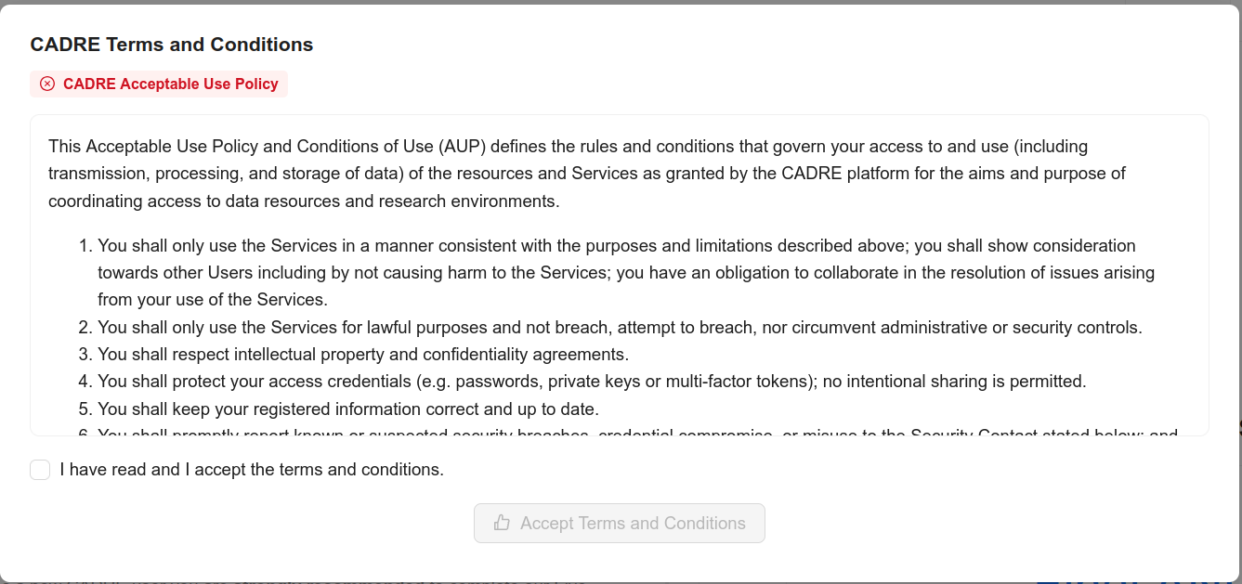

Slide 23
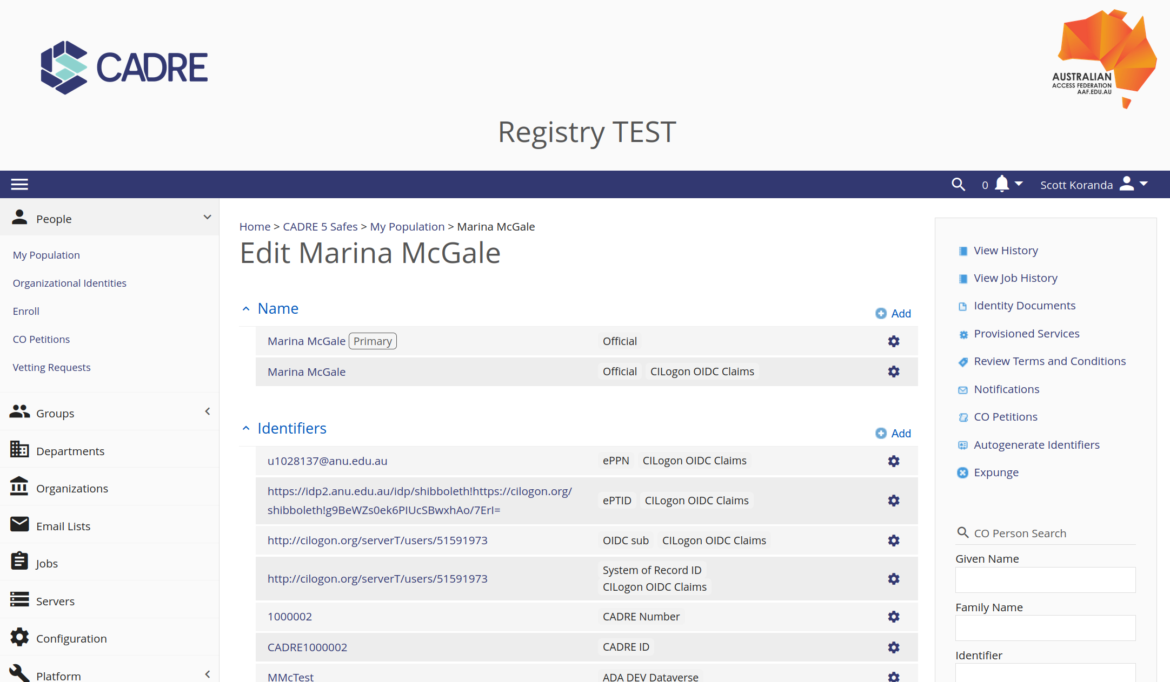

Slide 24
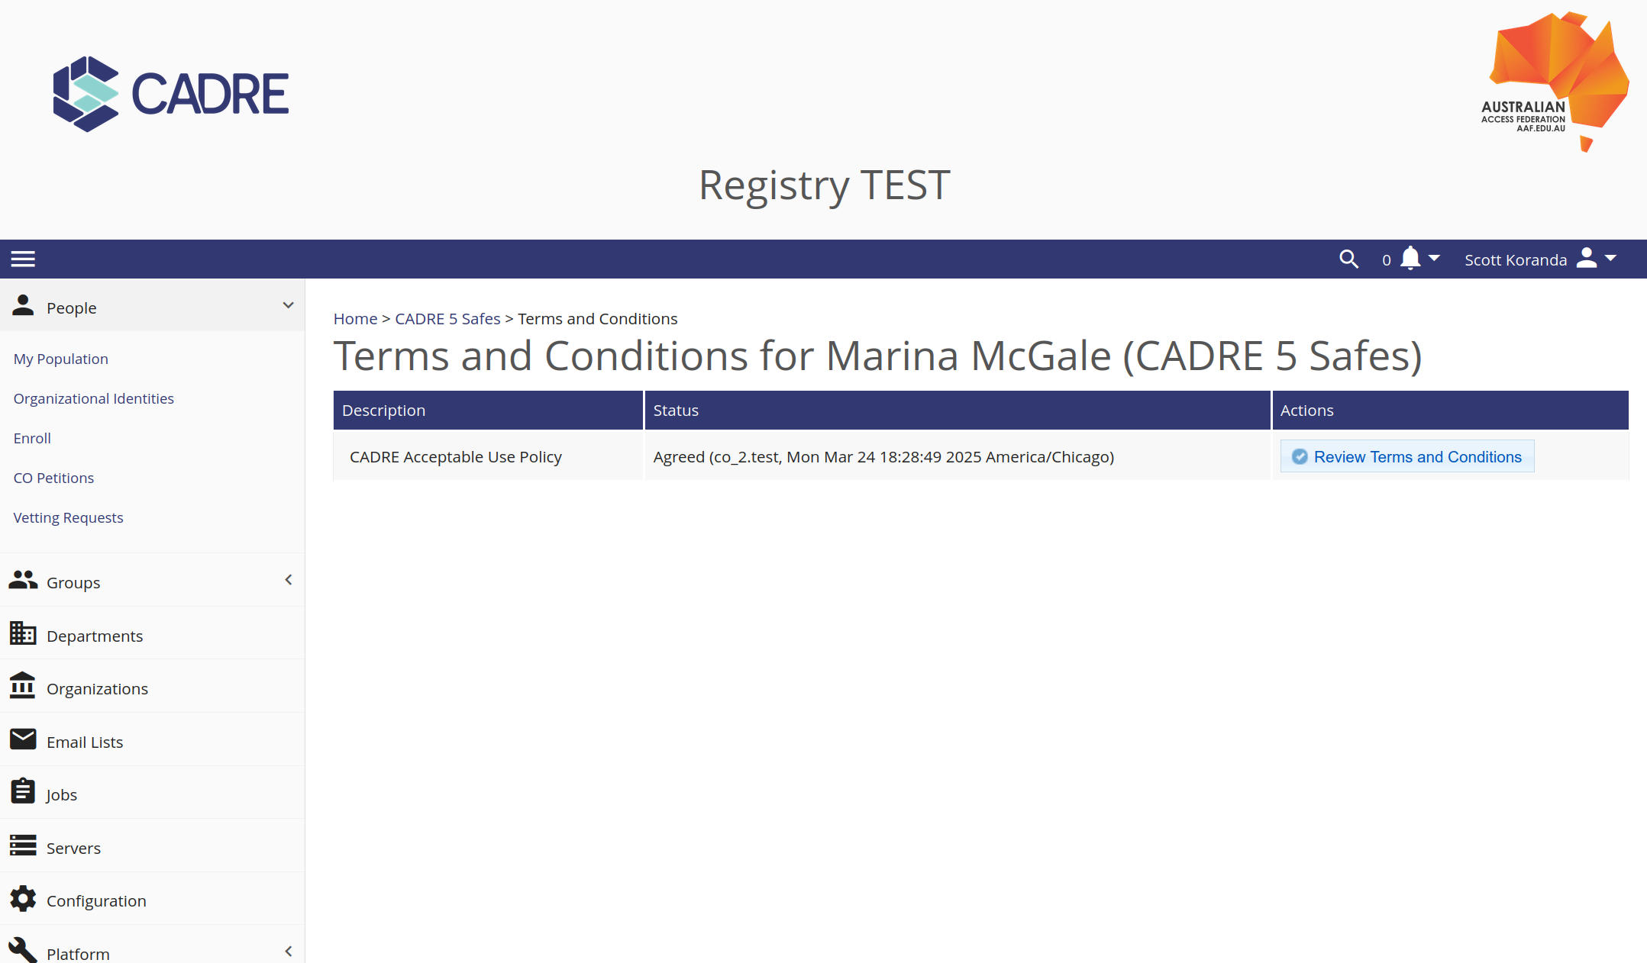

Slide 25
CADRE Custom REMS Front End
ORCiD Linking

Slide 26
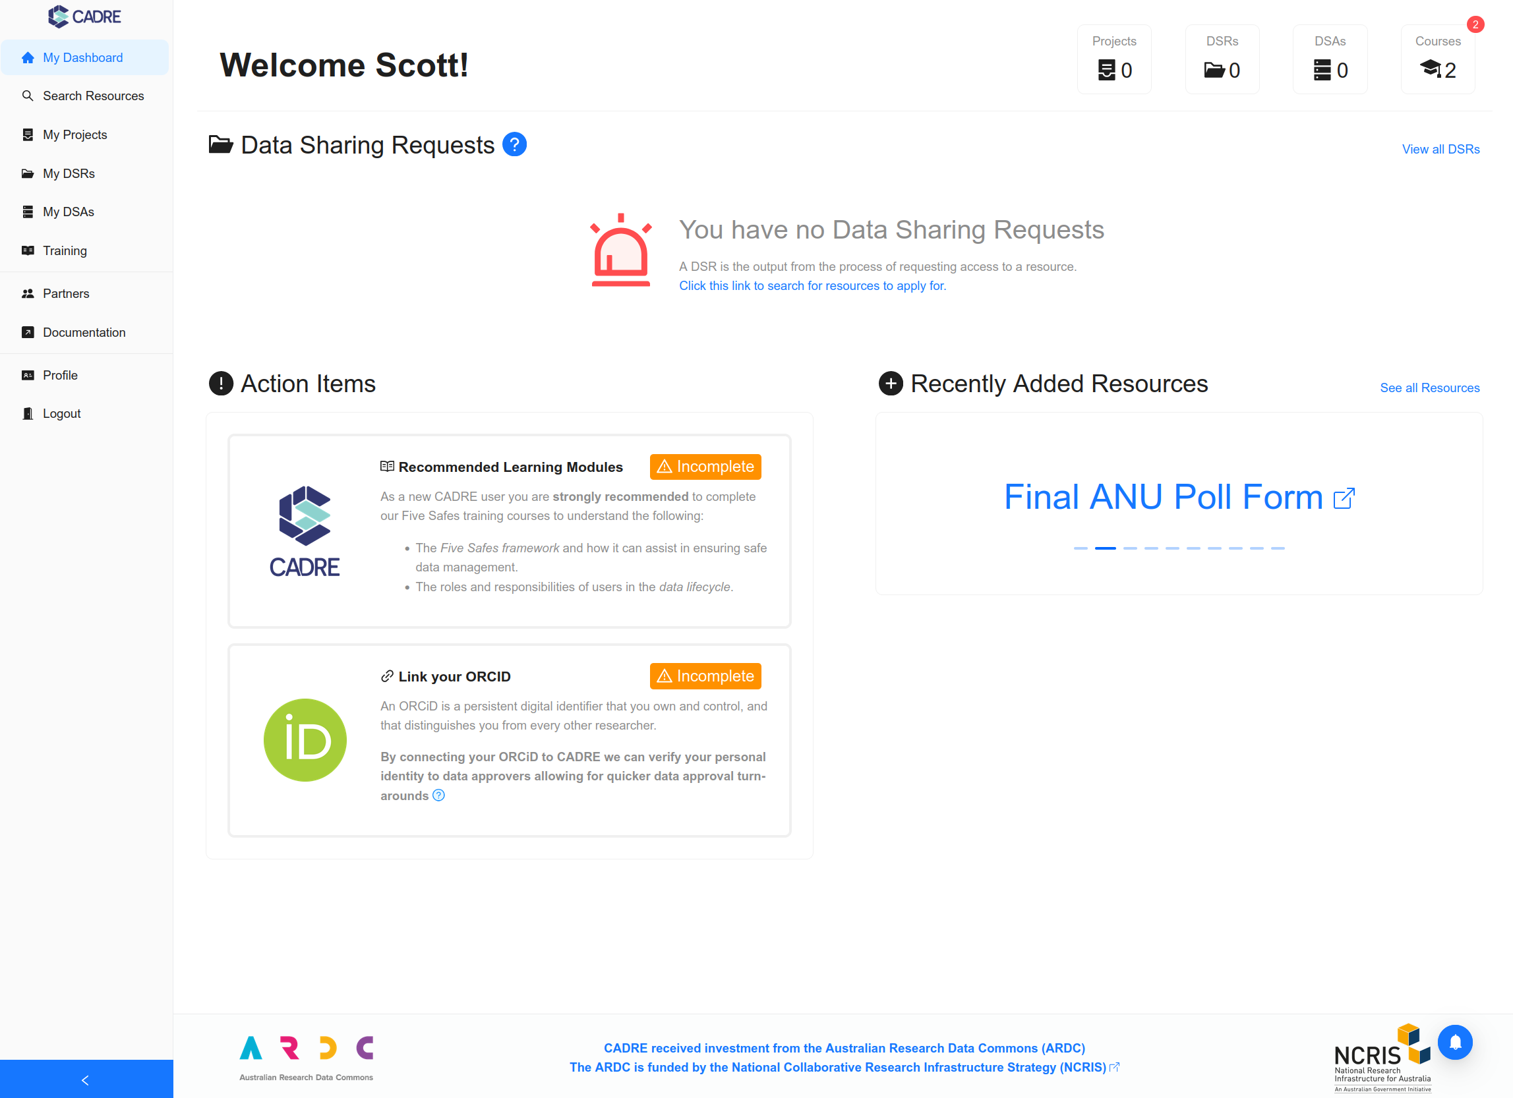

Slide 27
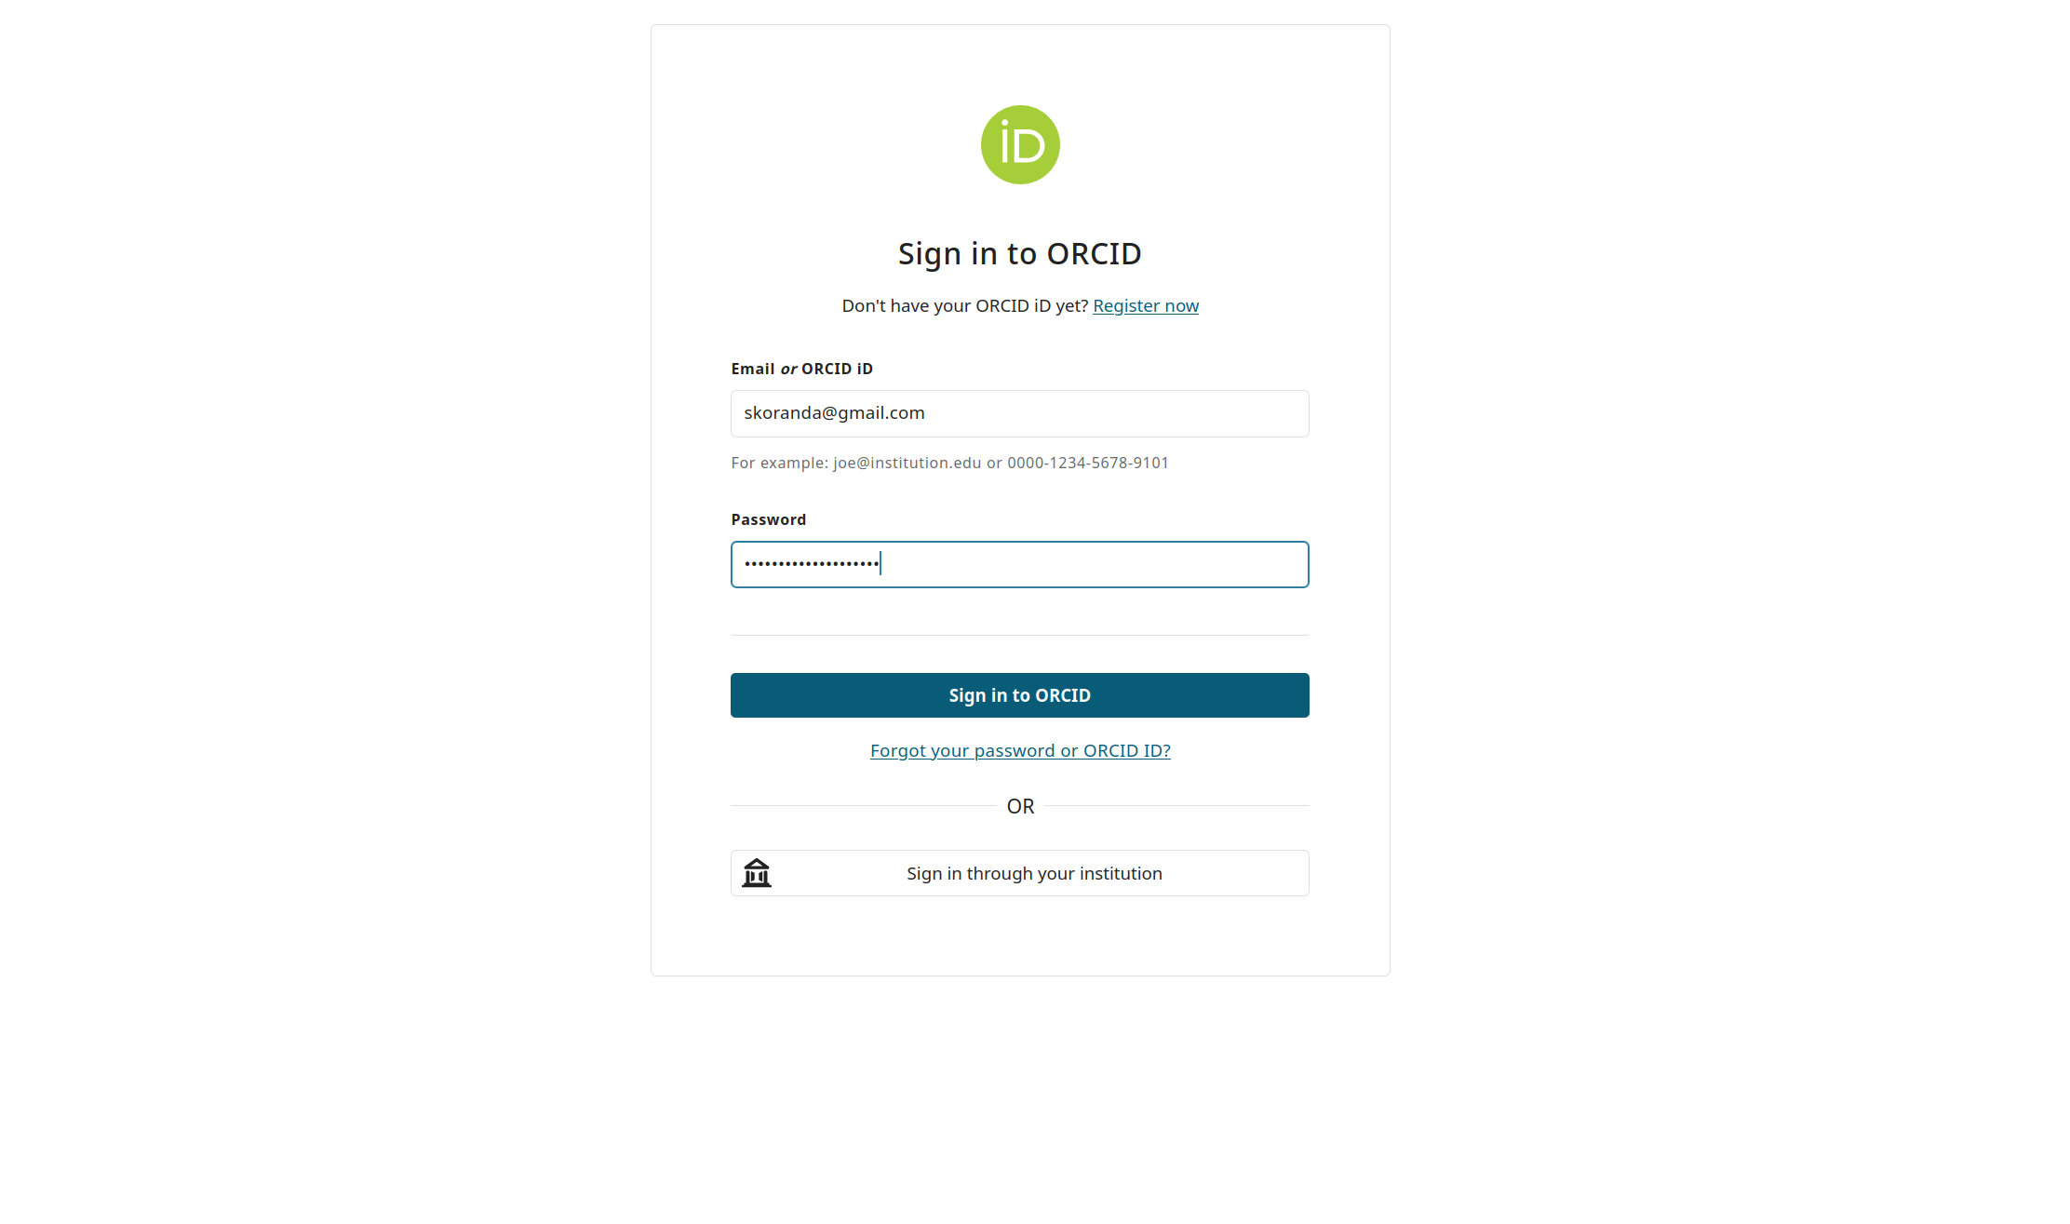

Slide 28
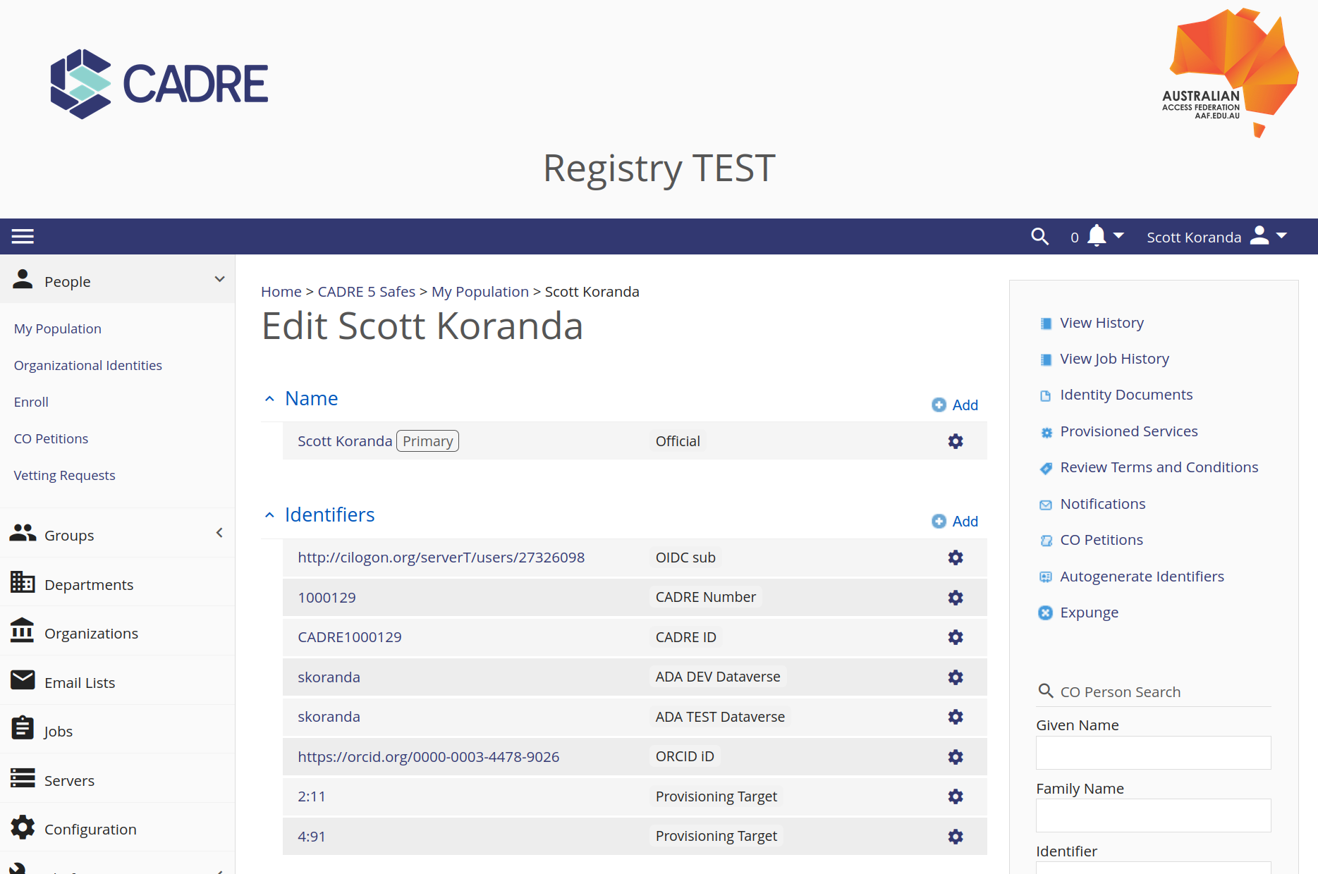

Slide 29
CADRE Custom REMS Front End
Data sharing request (DSR)
Centralised group management
Dataverse provisioner

Slide 30
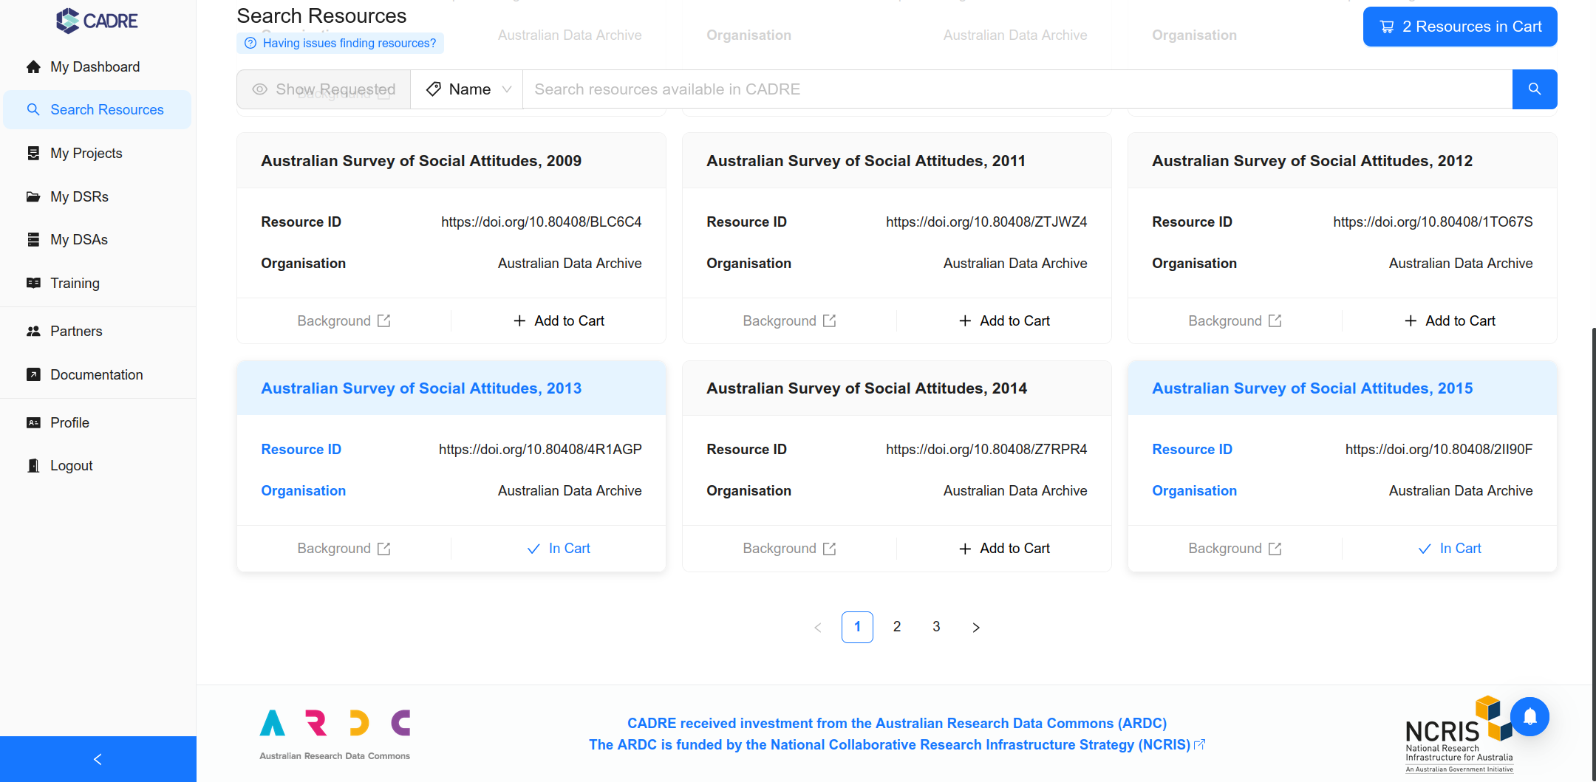

Slide 31
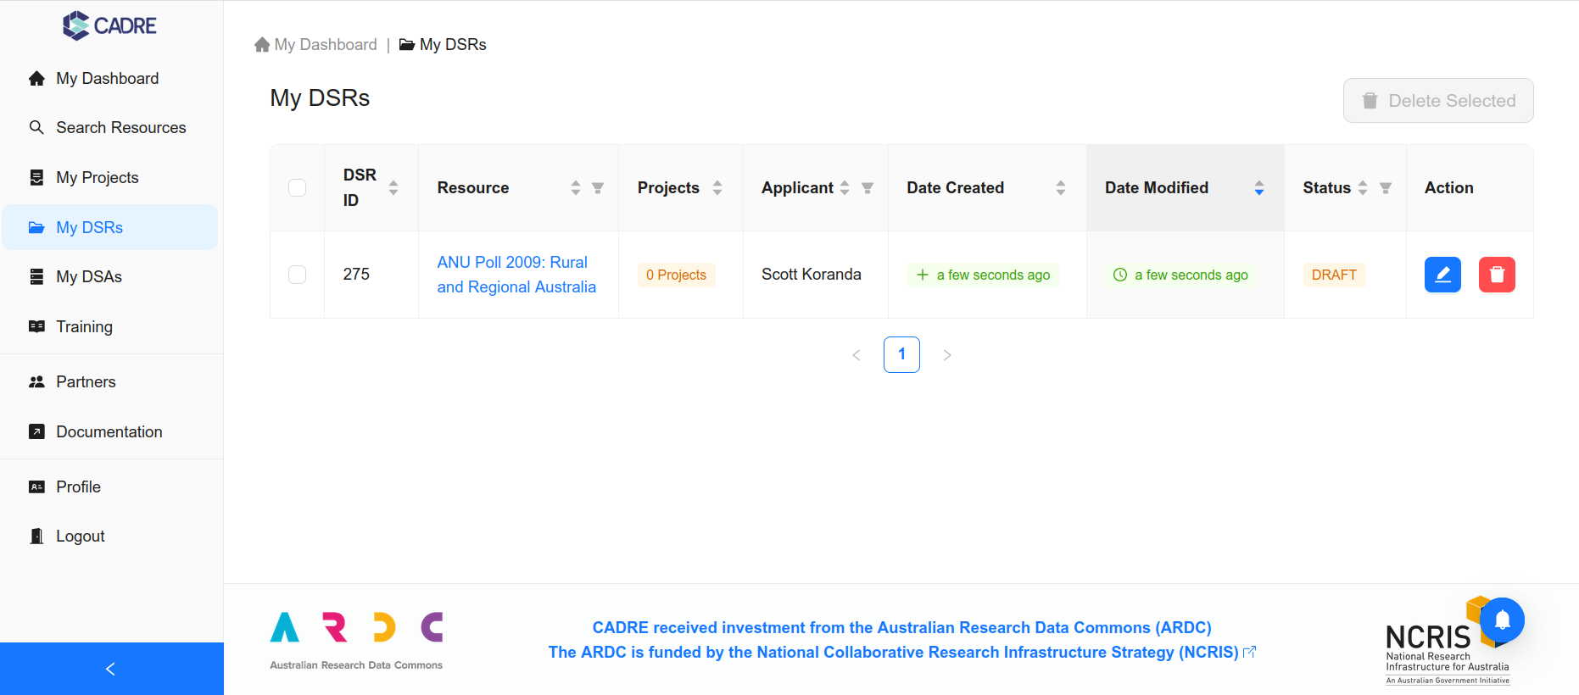

Slide 33
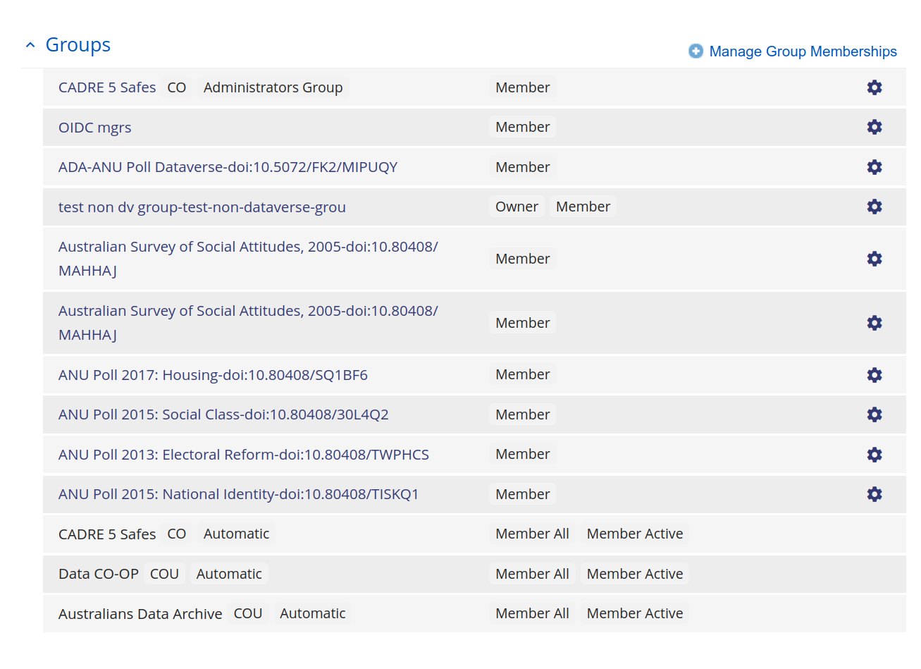

Slide 34
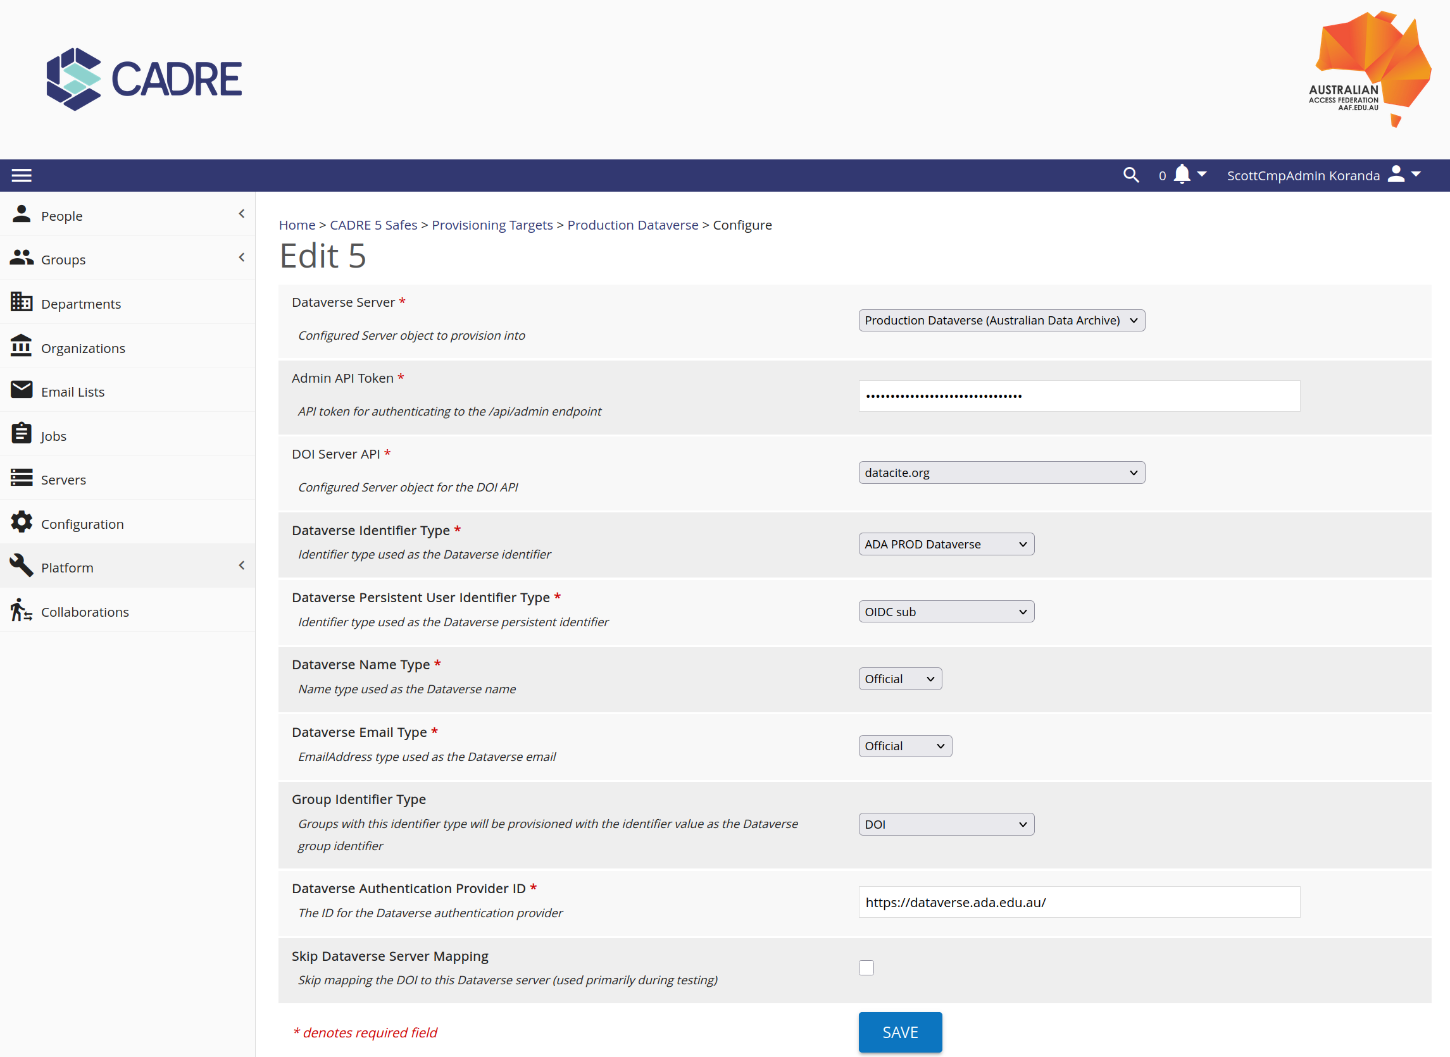

Slide 35
CADRE Custom REMS Front End
Custom OIDC Claims for Training

Slide 36
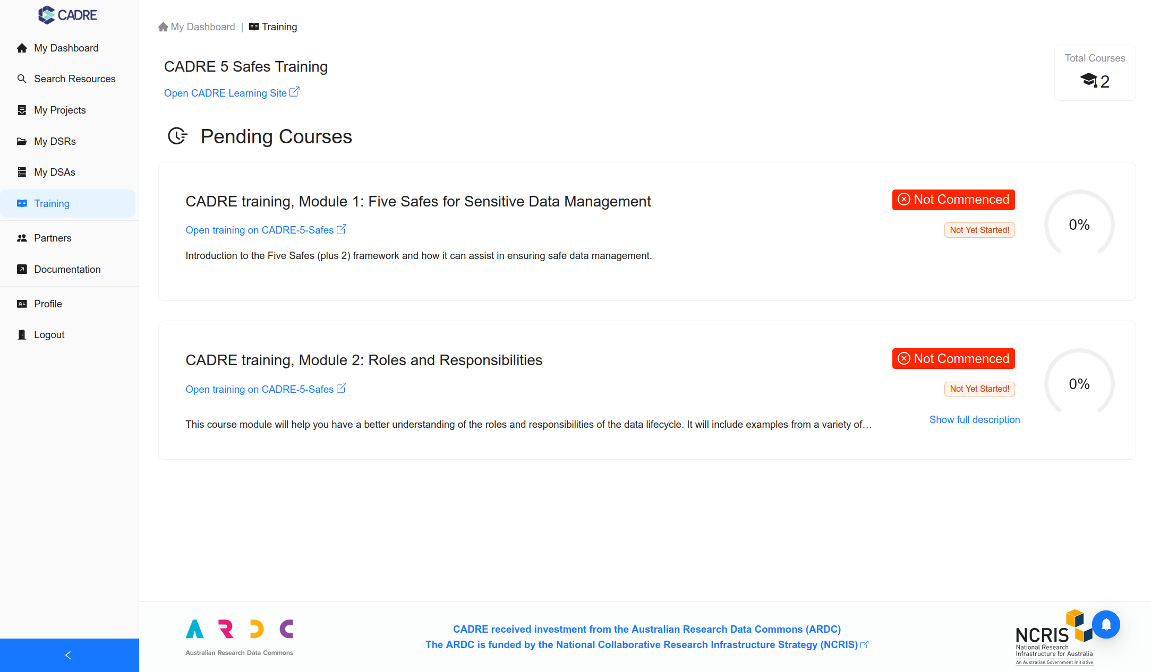

Slide 37
Find out more
CADRE documentation: https://documentation.cadre.ada.edu.au/guides
CADRE platform overview video: https://www.youtube.com/watch?v=MCrpKgHW-is
Using CADRE video demo: https://www.youtube.com/watch?v=HPuYOTvgmZ0
CADRE staging environment: https://stage.cadre.ada.edu.au/login
Dataverse provisioner repo: https://github.com/cilogon/DataverseProvisioner
Research Graph: https://researchgraph.org

Slide 38
Acknowledgements
CADRE
Marina McGale (ANU)
Matej Mitrev (ANU)
Adam Zammit (ACSPRI)
Ryan Perry (ANU)
Steven McEachern (ANU/Essex)
AAF and CILogon
Patrick Carnuccio (AAF)
Jim Basney (Illinois)
Terry Fleury (Illinois)
Jeff Gaynor (Illinois)
Robin Blair (Illinois)
Yan Zhan (Illinois)
CSC (Finland) REMS team

Slide 39
Acknowledgements

Slide 40
Amen
Visit: aaf.edu.au Email: john.scullen@aaf.edu.au

