Slide 1
A long time ago, in an NREN not so far away…
New services were born. Network. Identity. Security. Cloud. Data. Each had it’s own tooling for collaboration and ticketing.
While this structure isn't fundamentally flawed, navigating these organisational divides becomes more challenging as they grow, as COMPLEXITY expands and the need for clearly demonstrated compliance increases.
A small band of ADVENTURERS set out to DE-SILO Switch, no project, no fixed team, only grassroots pragmatism, and the most boring topic in the world for engineers. ITSM.
Notes:
AHa: To be read in a portentous voice.

Slide 2
It’s ITSM Jim, But Not As We Know It
De-siloing an NREN with service management.
TNC 25, Brighton
Ann Harding, Switch Reliability Engineering Coach
Andrey Cunha, Switch External Contractor Architecture
Notes:
Intro Ann
Intro Andrey

Slide 3
But first….ITSM as we know it
Buy
Buy a tool
“Do” ITIL
Declare victory
Make
Explain why all tools are broken and you need to develop a new one
Explain why no processes are correct, design a new sector specific standard
Declare victory
Make a whole enterprise project
Squeeze a task into a funded project
Notes:
Ann: Make or buy, NREN style.

Slide 4
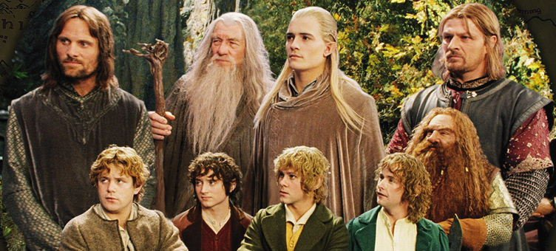
The “Not Exactly A Team”
Architect
Business Owner
Platform Teams
Process Owners
Coordinator
InfoSec Officer
User teams
By New Line Cinema - Screenshot of The Lord of the Rings: The Fellowship of the Ring
Image: New Line Cinema
Notes:
Ann: We are none of us ‘native’ ITSM specialists. None of us have dedicated time for ITSM. Some of us have blinkers on.

Slide 5
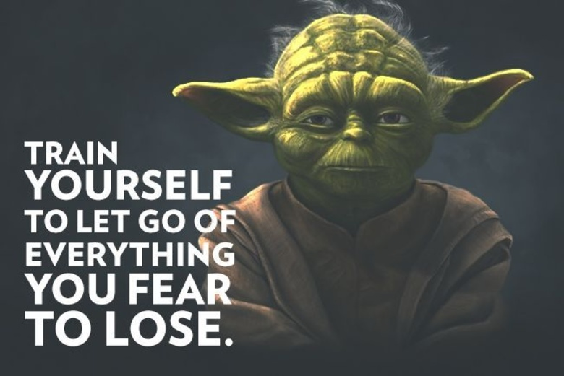
The “Not Exactly A Project”
No central ITSM budget
Teams operating platform tooling have budget
Teams using processes have budget
Central minimal budget for architecture and coordination
Collaboration and “pull” approach for work
Notes:
Ann: Initially a project was propopsed to deploy ITSM. It was big, complicated and undigestable. We made the deliberate choice not to have a project at all and stripped everything back.

Slide 6
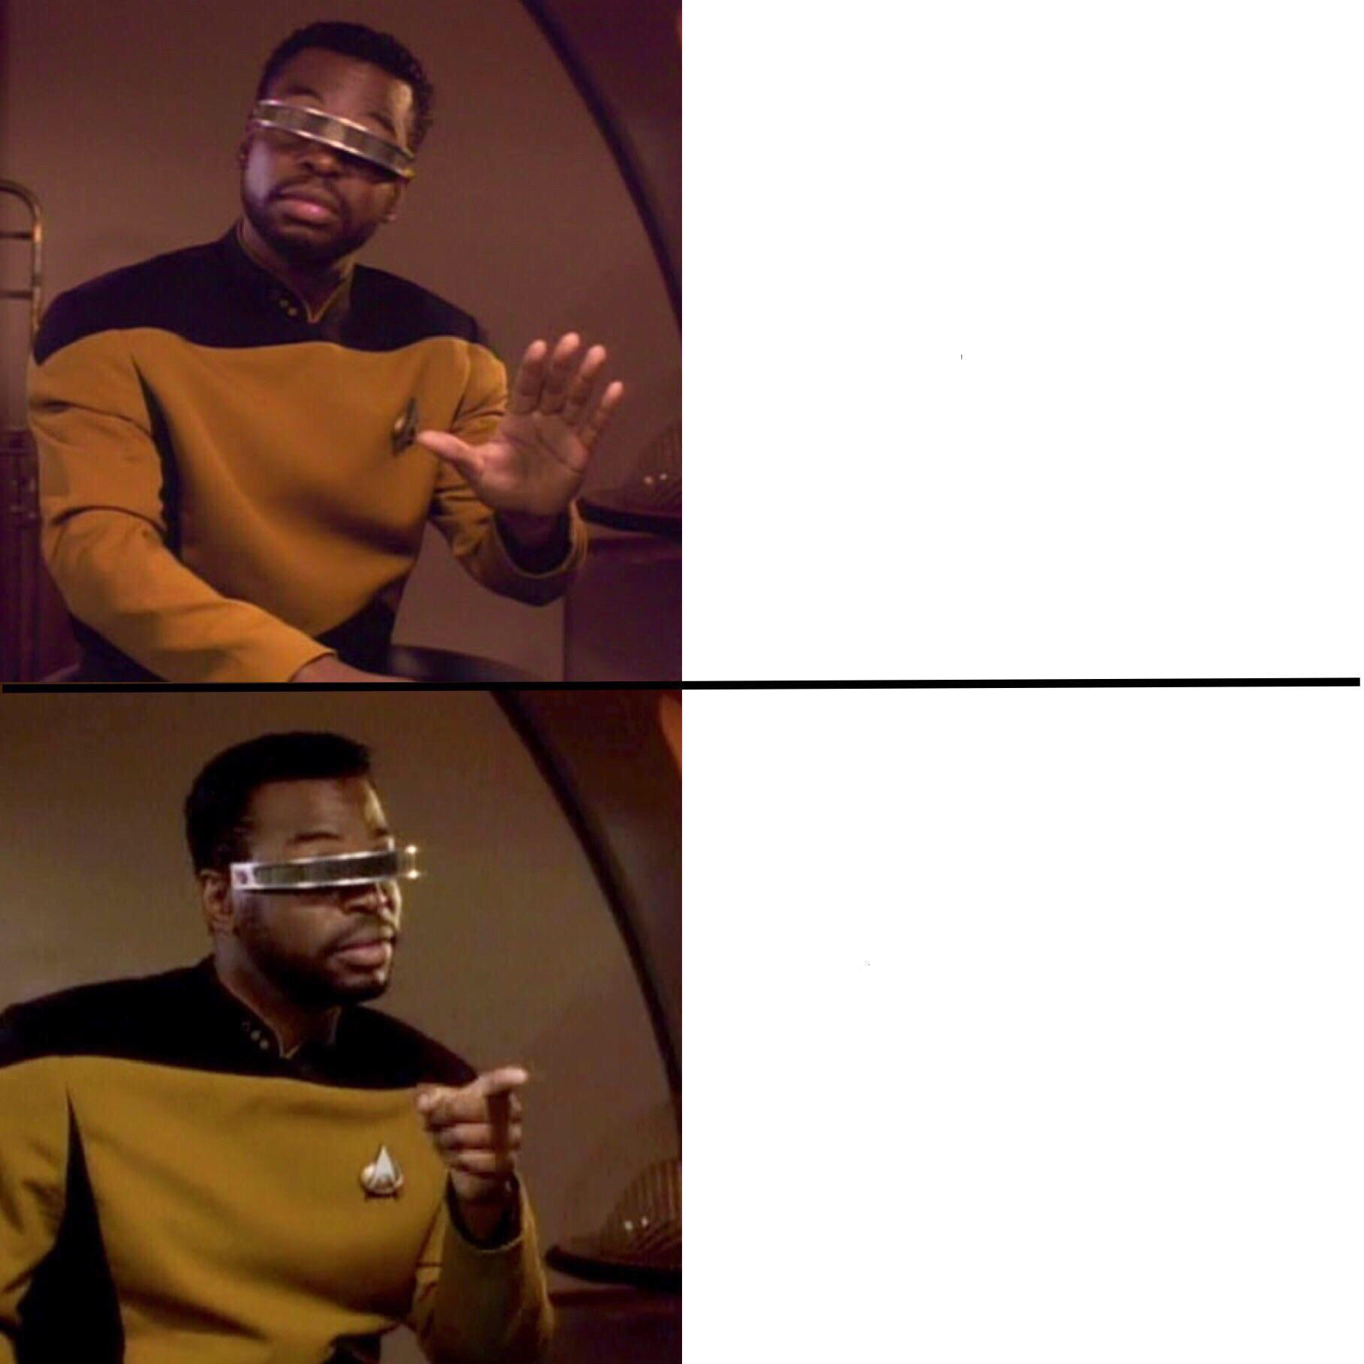
Solve problems, not add to them
Introduce 30+ new processes, yet another tool and a small mountain of paperwork
How do I run incidents better?
How can I improve the flow of change?
How can I work out more quickly what’s impacted?
How can I decrease release time?
How do I cope with remembering so many rules and policies?
Notes:
Ann: Another reason to drop a project approach was the cognitive load of the organisaiton. We had many projects and restructurings simultaneously. This means we can’;t simply write compliance and demand it. Instead, we had to treat ITSM like a product, with adopters as users and solve their problems. Wardley mapping step 1: user needs
Case studies: Incident Management in the intranert project
DevSecOps for cloud certification

Slide 7
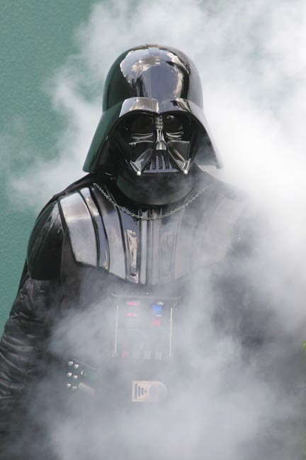
All Tools Turn to the Dark Side
JIRA Service Management,
I am your father
OTRS
Request Tracker
In-House Developed
Star Wars/Ron Riccio - https://www.flickr.com/photos/starwarsblog/793008715/ cc-by-2.0
Notes:
Ann - Tools will not solve your problems.
Everyone hates ther tool they currently have and assumes another is better or if you are trying to remove theirs, that everything else is not suitable and only this tool will solve the issue.
How did we handle this?
Atlassian is the backbone.yes there are better tools but people are familiar with the itnerface and there’s some economy of scale with operations.
If teams wish to maintain interfaces to it to their own preferred systems they can.
e.g. Assets can interoperate with the more detailed network information tooling, Incident, teams can use their original tooling to communicate

Slide 8
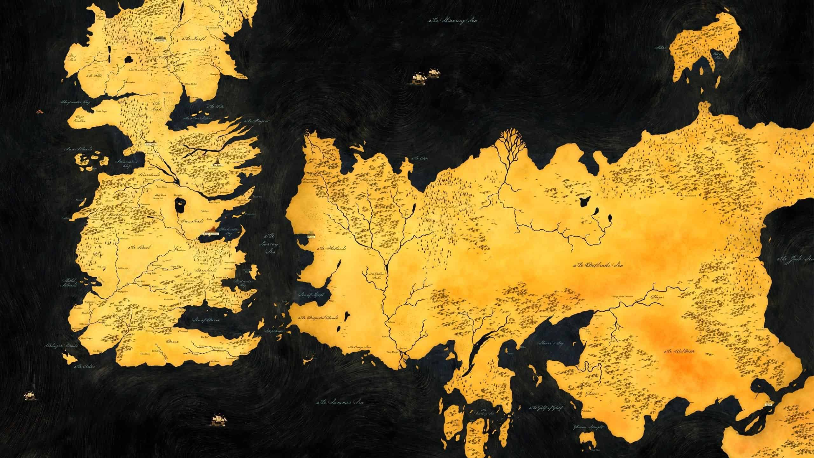
90s’ legacy
fly-by-wire
ITIL
Enterprise
DevOps
but other tools
DevOps
Notes:
Andrey:
Not a tech issue.
Collaboration and langages
Conway’s law?

Slide 9
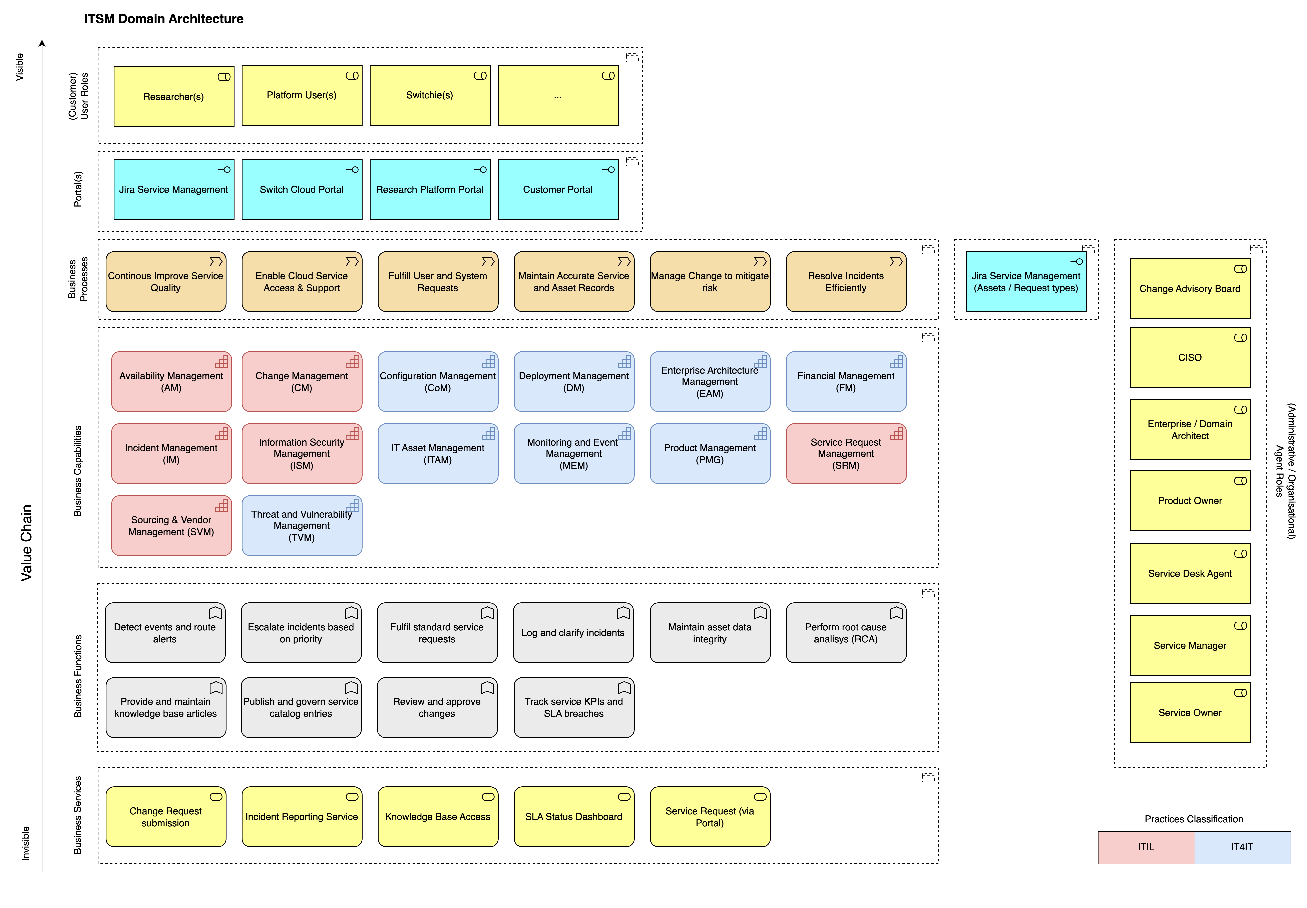
ITSM as a Landscape
Notes:
Andrey
Switch – context
Landing on the Switch planet and going ‘what is this?”
Something about mapping –tooling, people, organisation
Key components, strategic and value interests, ways of working.

Slide 10
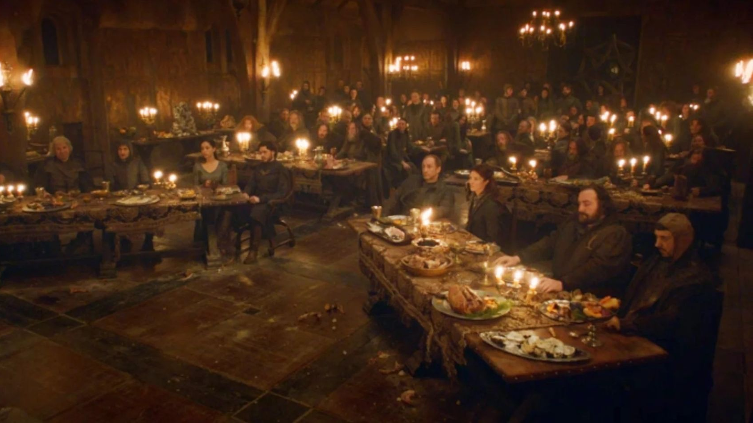
Red Planning
PRODUCT MANAGEMENT
PORTAL
IAM
ARCHITECTS
PLATFORM
CISO
Notes:
Andrey
Not a tech issue.
Collaboration and langages
What can go wrong when you don’t have a central project and everyone has their own axe to grind.
Concrete examples: a team deprioritises this work due to a lack of resources because it will cause them to work differently and lose control over some things.
Product cares about features which have customers attached to them who have names and faces. Compred to this, how doe assets get attention?
Image from: https://screenrant.com/game-of-thrones-red-wedding-richard-madden-response/

Slide 11
ISO IS COMING
Notes:
Not a tech issue.
Collaboration and langages
Key message: a big shared problem gives you an opportunity to harmonise.
We infiltrated other existing projects rather than starting a new one to reduce perceived overload
Cloud
Research platform
Intranet relaunch
ISMS
Source: https://ew.com/article/2015/05/10/winter-coming-live-recaps-game-thrones-kill-boy/
https://ew.com/thmb/XzqguVVg_rT2j4F0Iz6-gPCXV2o=/1500x0/filters:no_upscale():max_bytes(150000):strip_icc():format(webp)/got-jon-snow-1b22313b73324001b5ed1e545573fd74.jpg

Slide 12
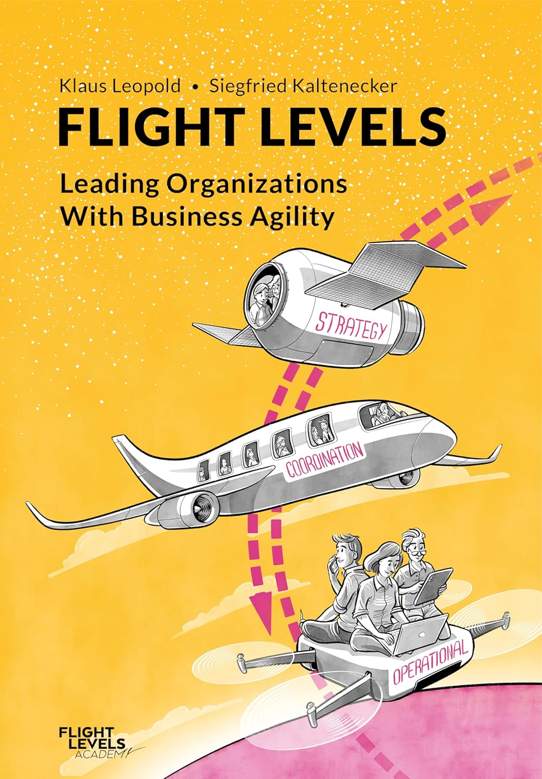
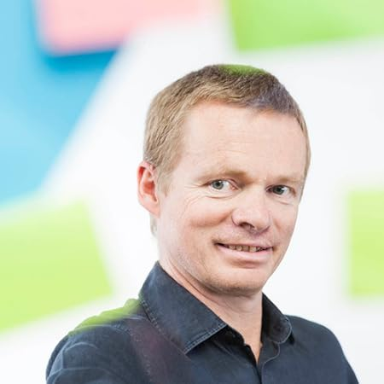
Flight Levels
Notes:
Addressing agility into an agile organisation
“Flight Levels” provides a systemic view of how workflows through the organisation, from strategic priorities to operational execution. It helps connect the dots between teams, departments, and leadership to ensure that decisions made at every level support meaningful progress, taking into account the contextual constraints.

Slide 13
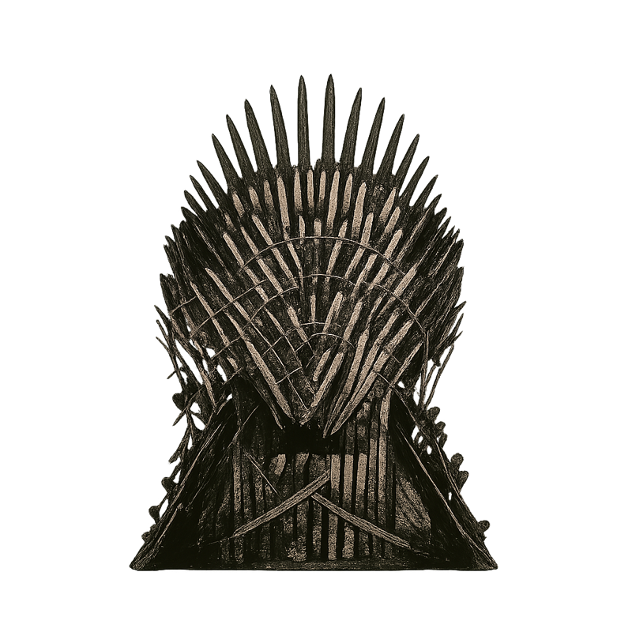
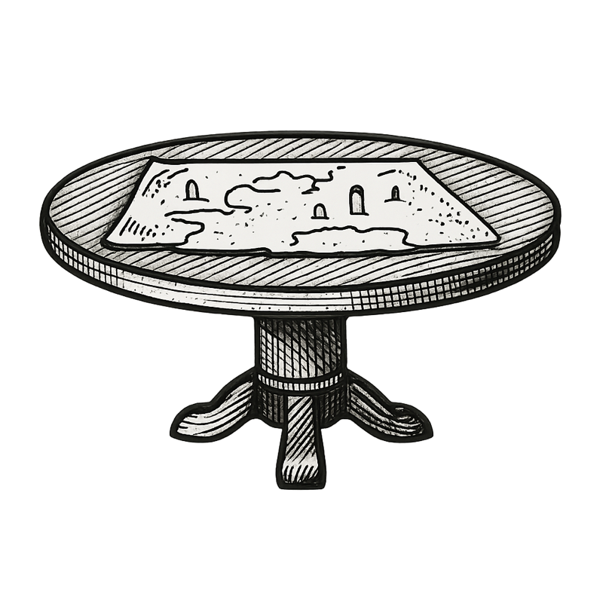
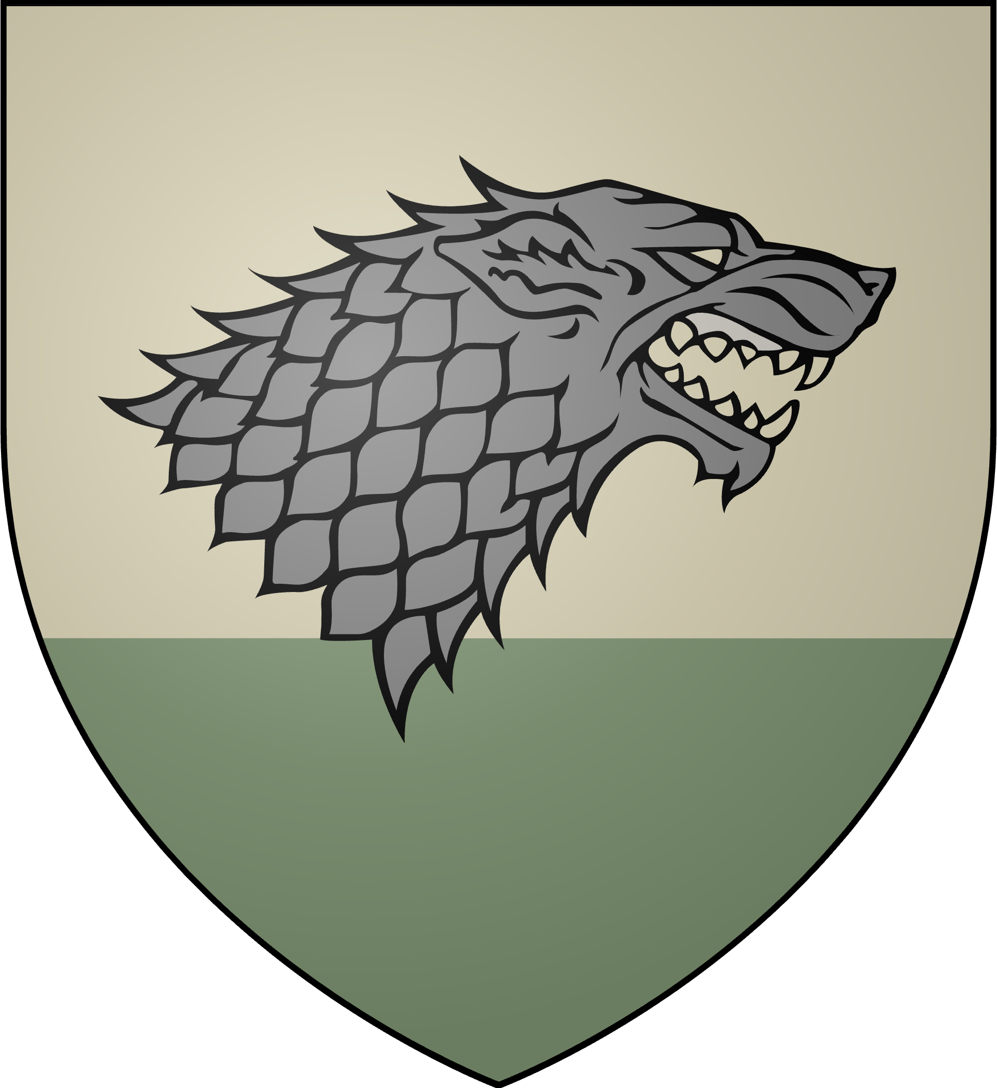
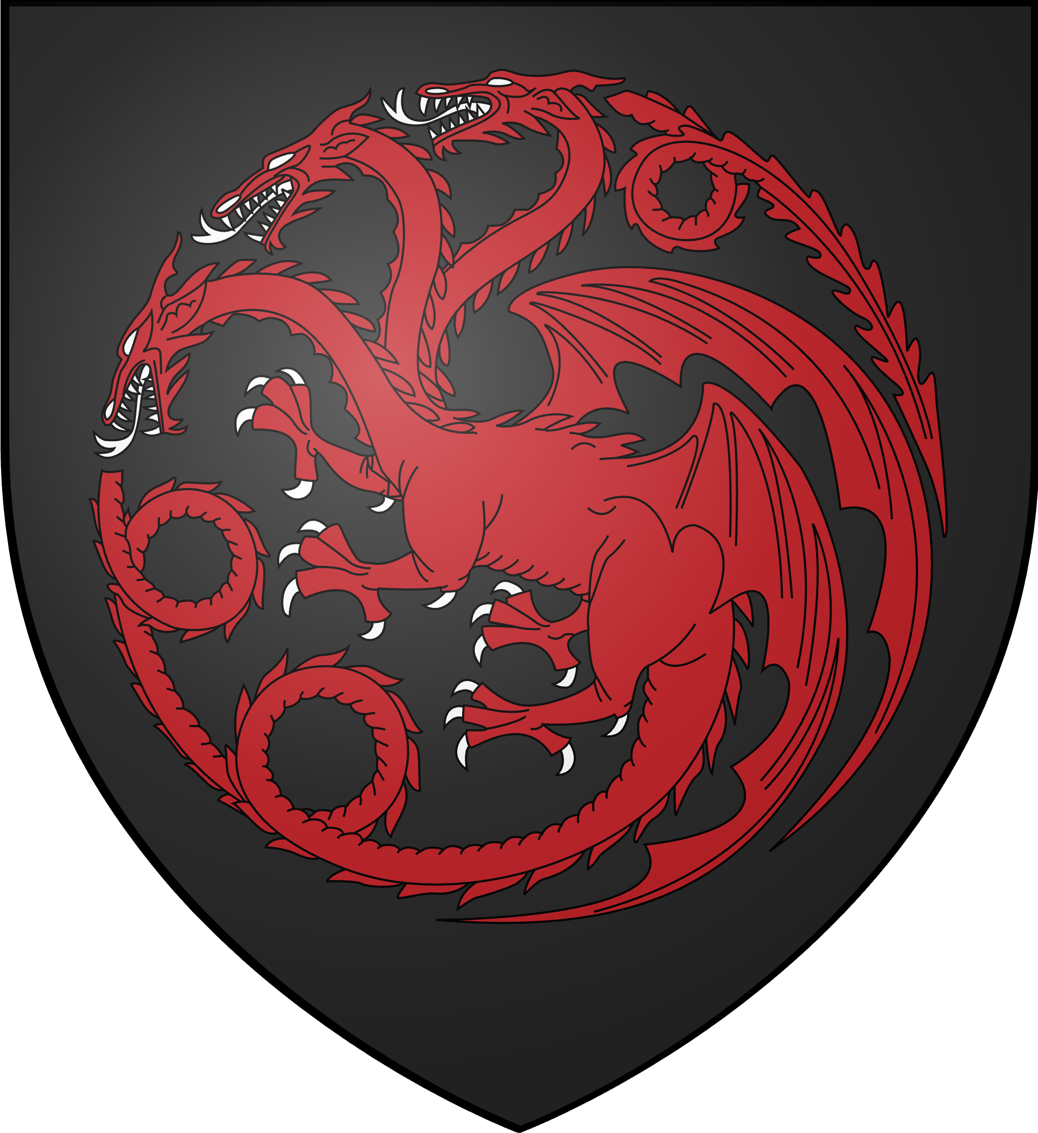
Assembling with Flight Levels
Flight Level 3 Strategic Level
Board
Flight Level 2 Coordination Level
Flow(s)
Flight Level 1 Operational Level
Teams
Notes:
Not a tech issue.
Collaboration and langages
Source: https://gameofthrones.fandom.com/wiki/Wiki_of_Westeros

Slide 14
Interaction with Team Topologies to improve the coordination level
Flow of change
Enabling the teams allows them to operate closer to their services and address the customer needs by implementing the services that can bring higher value
Stream-aligned team (Cloud Platform)
Stream-aligned team (Cloud Portal)
Stream-aligned team (Research Platform)
X-as-a-Service
Stream-aligned team (Organisation)
It allows the team to expand and create stream-aligned teams in the Jira SM Platform.
Jira Service Management Platform
Stream-aligned team (Cloud)
Stream-aligned team (Customer projects)
Enabling
Notes:
Ann: suggest to move this up to after the red wedding as how to get out of that trap?
Not a tech issue.
Collaboration and langages
Source: https://gameofthrones.fandom.com/wiki/Wiki_of_Westeros

Slide 15
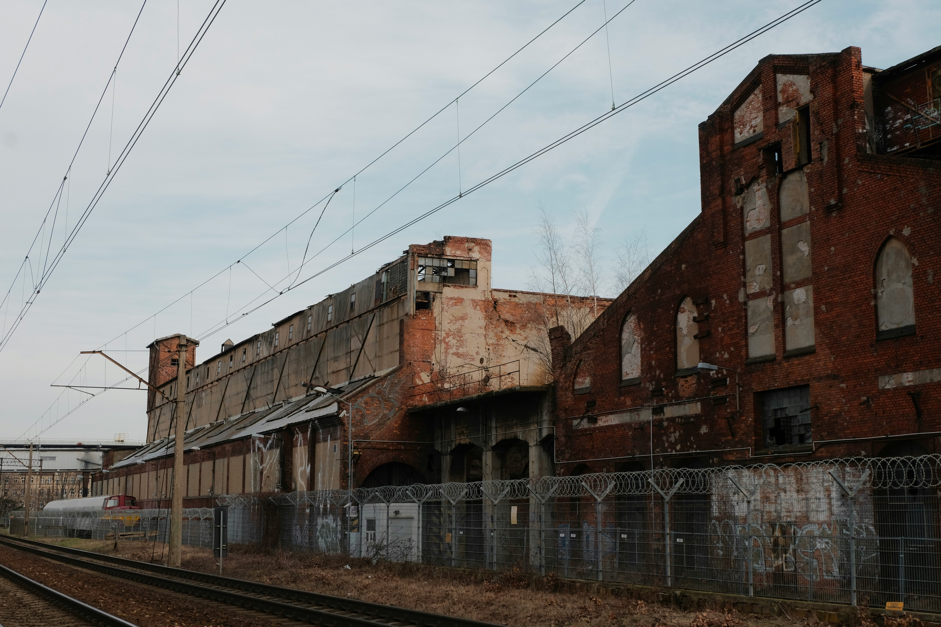
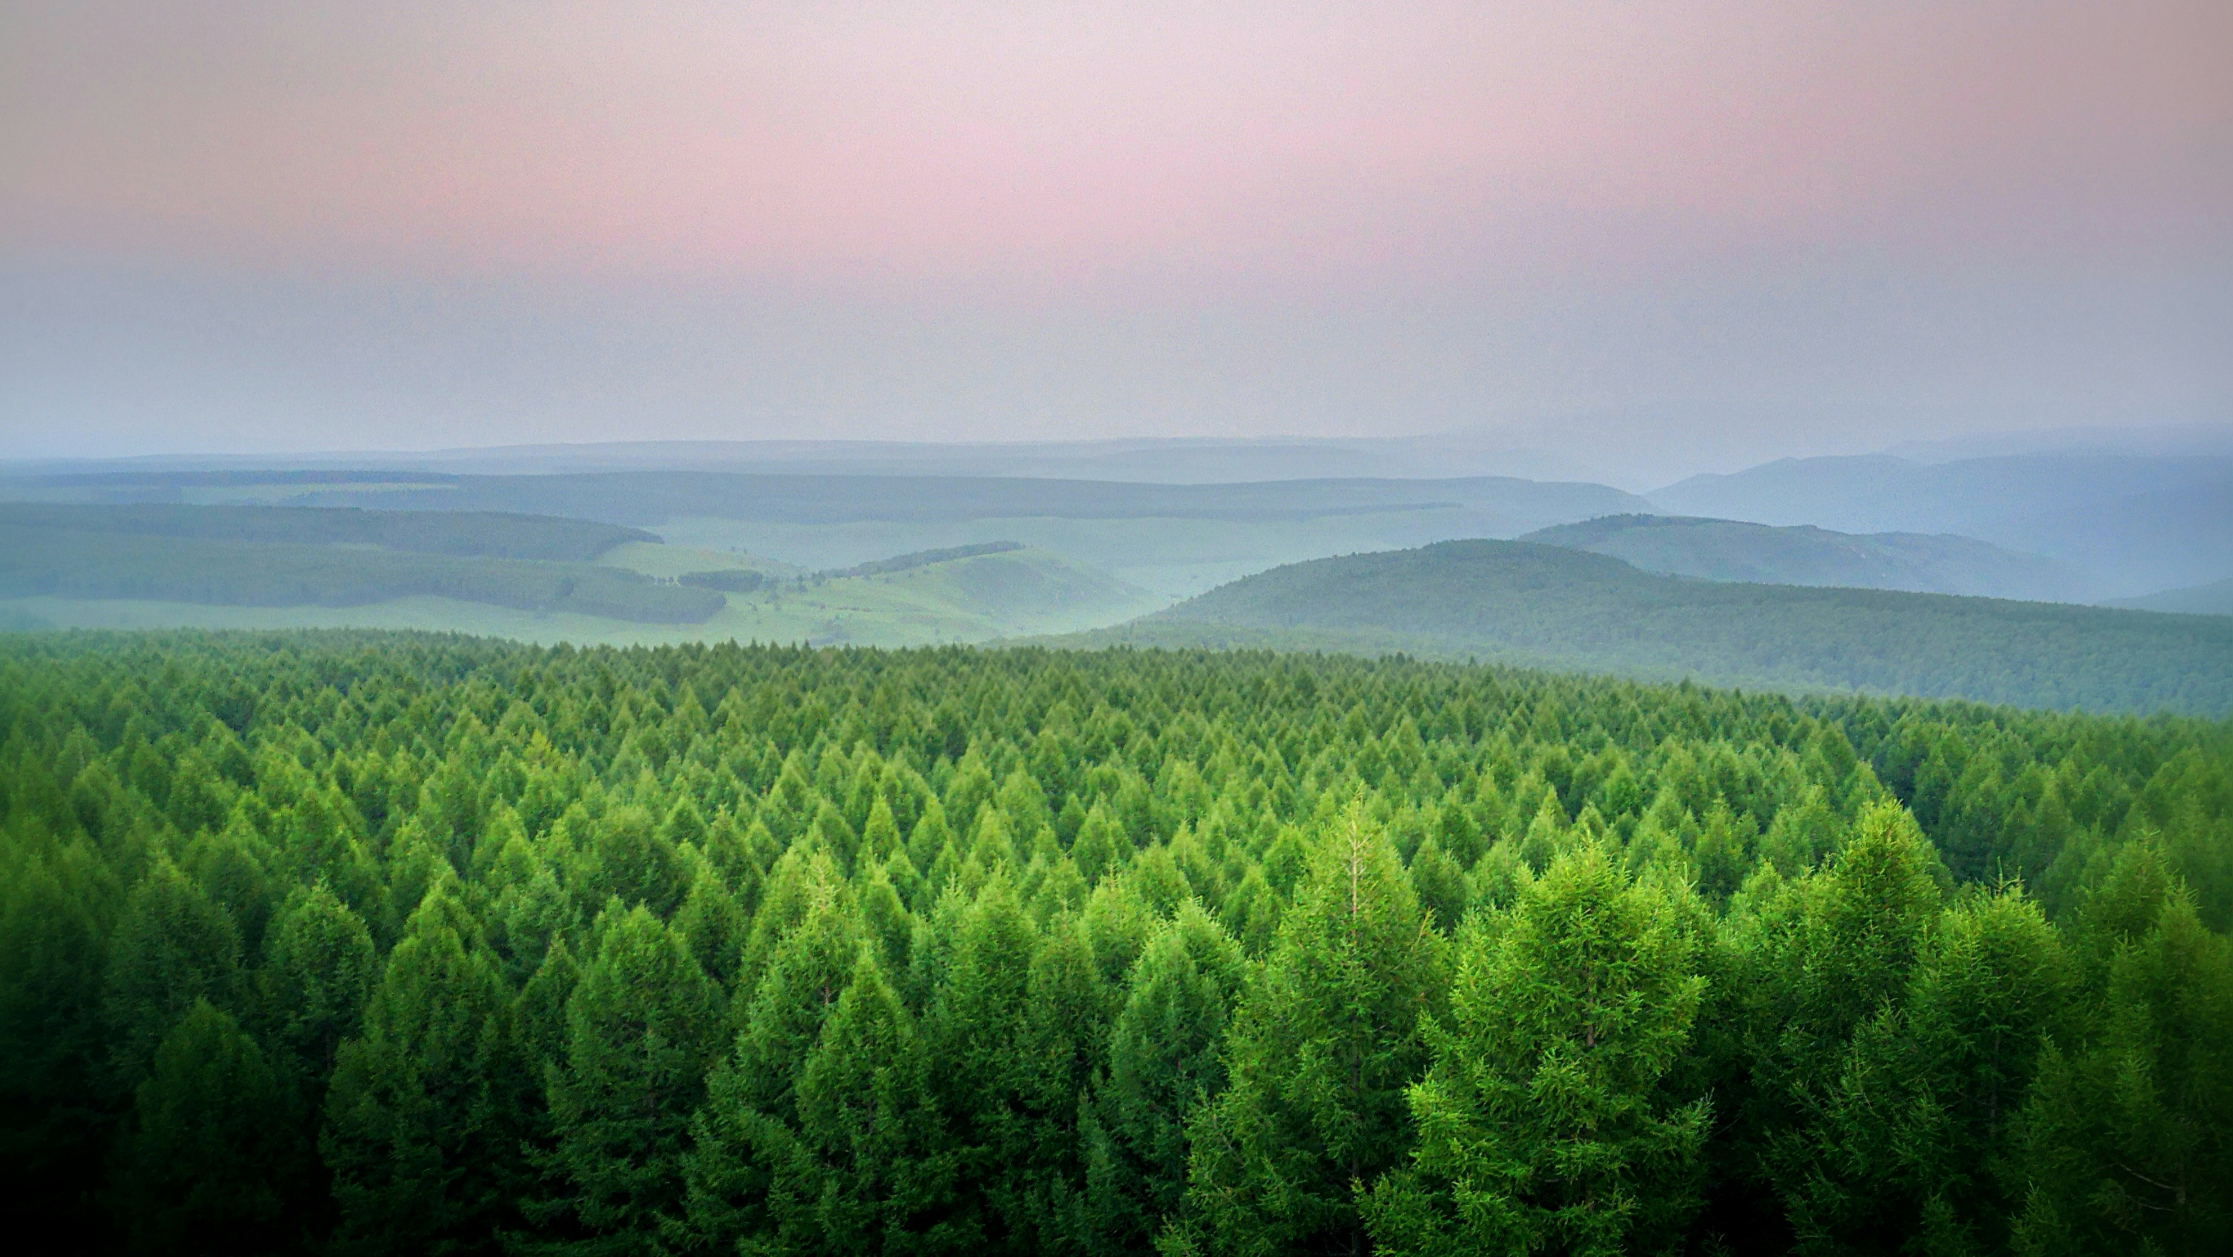
From Friction Generator to Freedom Enabler
We need ITSM to evolve from a control-centric to a freedom-enabling approach by setting up guardrails
Photo by Uladzimir Vasilyeu on Unsplash
Photo by Sicheng Liu on Unsplash
Notes:
Processes are enablers but willingness is harder
We should give a concrete example slide after this Factory - Photo by Uladzimir Vasilyeu on Unsplash Nature - Photo by Sicheng Liu on Unsplash

Slide 16
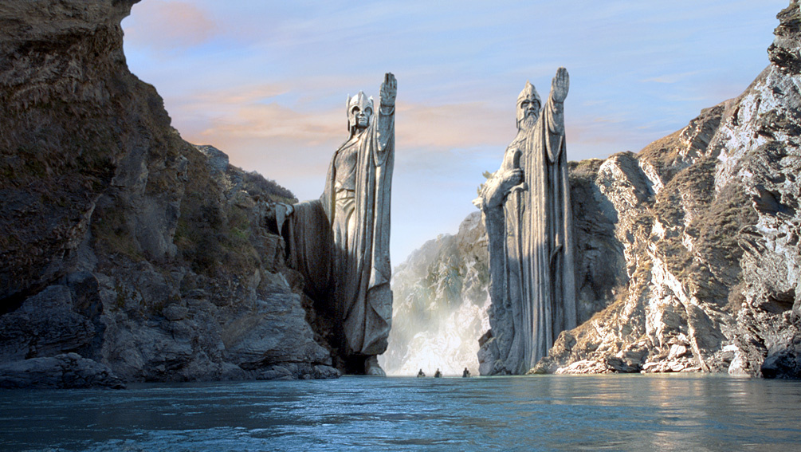
Enabling flow by shared awareness
Processes are not the goal; value delivery is.
Autonomy isn’t about working in isolation – it depends on trust, clarity, and a shared language.
Delivering value requires focus, coordination, and the discipline to say no when necessary.
Notes:
Ann & Andrey
Message:
That only happens when concerns are visible and the organisation's mission is connected to real, tangible goals.
Co-design ITSM with your teams – not for them. Move from friction to flow.

